Slide 1

MODULE 9
RELIGION AND EDUCATION

Slide 2
OBJECTIVEsS
Sociological perspective of religion
Basic tenets of major world religions
Religion in the US
Educational differences around the world
Theoretical perspective of Education
Historical and Contemporary issues in education

Slide 3
What is Religion?
Emile Durkheim
  The Elementary Forms of Religious Life (1912)
Religion is a “unified system of beliefs and practices relative to sacred things.”
Religion’s component parts
  A theology
    Organized set of beliefs and practices—doctrine
  A set of rituals
    Beliefs are translated into behaviors--faith must be observable
  Classification of sacred and profane objects
    Sacred (Elements that are set apart from the everyday world---to be treated with reverence)
    Profane (Elements of the everyday world)

Slide 4
History of religion?
Max Weber believed that religion was a precipitator of social change. Religion could be separated from society.
Protestant Work Ethic – he examined the effectofs of religion on economic activities and noticed that heavily Protestant societiesinfluenced the development of capitalism. (Netherlands, England, Scotland and Ireland).
Karl Marx – believed that religion reflects the social stratification of society. He believed that religion was an extension of Proletariat suffering. “Is the opium of the people“

Slide 5
Secularization/fundamentialism
  Secularization:
  Process in which religion is challenged by the notions of science and the products of modernization
    Megachurch – 2,000+ who attend weekly service
    Lakewood Church in Houston, Texas is the largest:
    Characteristics: lead by charismatic leader, male, evangelism, use of social networking and technology, multiple sites, and predominantly white membership.
    Fundamentalism:
    Literal interpretation of the Bible

Slide 6
Types of Religious Organization
A church
  Inclusive religious body (moral community) engaged in formalized worship
A denomination
  A socially and legally recognized religious body
  Exist within a religion through shared theology but contain differences in interpretation of such theology
A sect
  Smaller but formalized
  Focus on salvation and otherworldly concerns—Hostile to society
A cult
  Smallest but not formalized—Lacking well defined structure
  Typically organized around charismatic leaders

Slide 7
RELIGIOUS CLASSIFICATIONS
Animism
  The belief that non-human beings (animals, plants, natural world) – Example: Shinto
Theism
  The belief in the existence of an independent being not of this earth
    Monotheism - Judasim, Islam
      One all powerful and knowing being (a God)
    Polytheism – Example: Ancient Greeks and Romans
      A hierarchy of powerful and knowing beings (the Gods)
Atheism- believe in no God.
Totermism – Human Natural being connection. Example: Ojibwa (Native American) beliefs

Slide 8
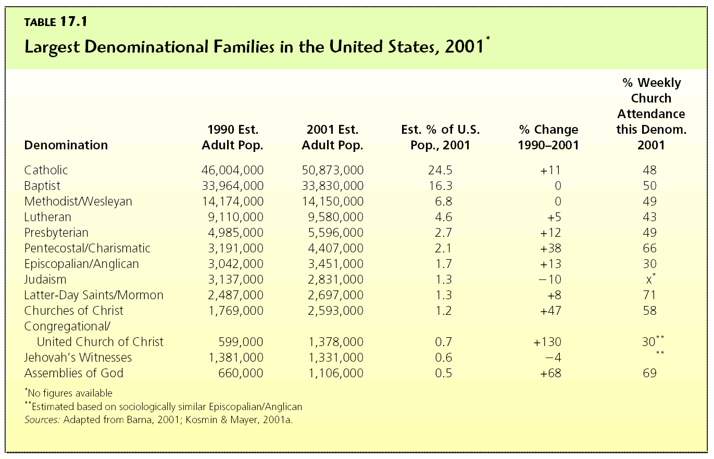
Denominational Membership in the
United States
(p. 462)

Slide 9
RELIGIOUS BELIEFS TODAY
http://www.pbs.org/wnet/religionandethics/week1143/perspectives.html

Slide 10
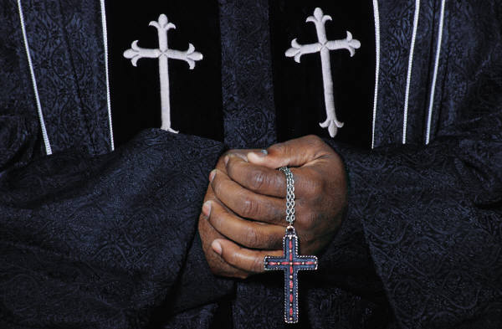
World Religions:
Christianity
The largest of the world religions
Dates back 2,000 years
Roots in Judaism
Begins as a cult led by a Jew in the Middle-East
Contains within it many denominations
History recorded in the New Testament of the Bible—Shares the first five books of the Hebrew Bible with Jews
Engaged in missionary work and military conquest to bolster expansion

Slide 11
Christianity
2.0 BILLION FOLLOWERS
85% OF AMERICANS AND CANADIANS
CHRISTIANITY BEGAN AS A CULT
IT IS MONOTHEISTIC (ONE GOD)
JESUS CHRIST IS CENTRAL FIGURE AS BOTH MAN ON EARTH AND SON OF GOD
PREACHES PERSONAL SALVATION
MANY SPLITS FROM ORIGINAL FORM OF ROMAN CATHOLICISM

Slide 12
World Religions:
Islam
World’s 2nd largest religion
Like Christianity, faith spread through missionary and military work
Founded in the 7th century by the teachings of Muhammad
History recorded in the Qur’ an
Includes references to Jesus, Abraham, and Moses
Two major division
  Shiite (Fundamentalist)
  Sunni (More Secular and larger in representation)

Slide 13
Islam
1.2 BILLION FOLLOWERS
NOT ALL MUSLIMS ARE ARABS
THE MIDDLE-EAST, ASIA, AND PARTS OF AFRICA ARE ISLAMIC-CENTERED
ISLAM IS THE WORD OF GOD AS REVEALED TO THE PROPHET MUHAMMAD, BORN IN MECCA AROUND 570
THE QUR’AN URGES SUBMISSION TO GOD (ALLAH) AS THE PATH TO INNER PEACE
FIVE PILLARS OF ISLAM
  RECOGNIZE ALLAH AS THE TRUE GOD
  RITUAL PRAYER
  GIVING OF ALMS TO THE POOR
  FASTING DURING RAMADAN
  MAKING THE ONCE IN A LIFETIME PILGRIMAGE TO MECCA

Slide 14

World Religions:
Judaism
Provides the theological roots for Christianity and Islam
Small in numbers
  18 million worldwide
History is recorded in the first five books of the Hebrew Bible, Torah
Believe a covenant with God and Abraham makes them the chosen people destined to live out their lives in Israel
Driven out by the Romans over 2,000 years ago and witnessed a return in 1948
  Now fighting with Muslim Palestinians over who is the rightful settlers of Israel

Slide 15
Judaism
15 MILLION ADHERENTS WORLDWIDE
NATIONAL MAJORITY ONLY IN ISRAEL
JEWS BELIEVE THAT A COVENANT EXISTS BETWEEN GOD AND GOD’S CHOSEN PEOPLE
THE TORAH EMPHASIZES MORAL BEHAVIOR IN THE WORLD
DENOMINATIONS:
  ORTHODOX JEWS ARE VERY TRADITIONAL
  REFORM JUDAISM IS MORE CHURCH-LIKE
  CONSERVATIVE JUDAISM ACTS TO BRIDGE THE FIRST TWO BELIEF SYSTEMS
ANTI-SEMITISM
  PREJUDICE AND DISCRIMINATION AGAINST JEWISH PEOPLE

Slide 16

World Religions:
Hinduism
The oldest and third largest religion
Mostly practiced in India
Expansion of followers tied to natural growth
A polytheistic faith lacking a specific sacred text
No one supreme being sitting in judgment
Followers undergo reincarnation in death
On a journey toward nirvana (place of spiritual perfection)

Slide 17
Hinduism
THE OLDEST OF ALL WORLD RELIGIONS
MORE THAN 800 MILLION BELIEVERS
FOUND MOSTLY IN INDIA AND AFRICA
NO SACRED WRITINGS LIKE THE BIBLE
PRINCIPLES:
      DHARMA REFERS TO CORRECT LIVING
      KARMA REFERS TO BELIEF IN SPIRITUAL PROGRESS THROUGH REINCARNATION
NIRVANA REPRESENTS SPIRITUAL PERFECTION AND A RELEASE FROM THE CYCLE OF REBIRTH

Slide 18
World Religions:
Buddhism
Do not accept notion of a divine being
Grew out of Hinduism
Focus is on living in proper manner so as to achieve enlightenment
All humans thought to possess Godliness just unable to tap into it

Slide 19
Buddhism
  350 MILLION PERSONS
    ALMOST ALL ASIANS
  RESEMBLES HINDUISM IN DOCTRINE AND CHRISTIANITY DUE TO ITS TIES TO THE LIFE OF ONE INDIVIDUAL
    SIDDHARTHA GAUTAMA
      ACHIEVED “BODHI” OR ENLIGHTENMENT
      BECAME “BUDDHA”
  NO “GOD OF JUDGMENT,” BUT DAILY ACTION HAS ITS CONSEQUENCES

Slide 20

World Religions:
Confucianism
Quite secular in form
Founded by the Chinese philosopher
Based on a code of self-discipline
Work toward the achievement of earthly reward rather than supernatural reward

Slide 21
Confucianism
  100,000 PERSONS IN NORTH AMERICA
  PRIOR TO THE 1949 REVOLUTION, IT WAS AN ECCLESIA: THE OFFICIAL RELIGION OF CHINA
  PERHAPS IT IS MORE A WAY OF DISCIPLINED LIVING THAN A RELIGION

Slide 22
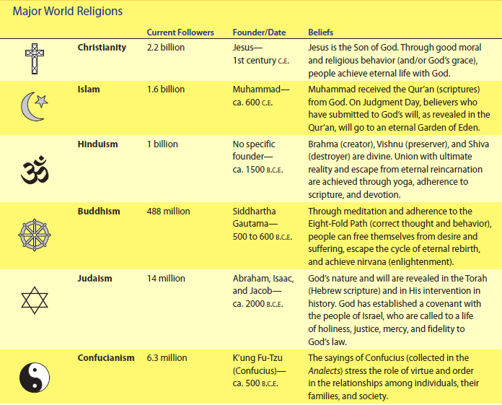
Table 12.1
Major World Religions
Taoism - believes the purpose of life is inner peace and harmony. Founded by Laozil. Emphasize the virtues of compassion and moderation.

Slide 23
Functionalism:
Functions of Religion
  Social Cohesion
    Assists in the building of social ties, further integrating people
  Support System
    Provides strength and comfort—especially in times of crisis
  Emotional Health
    Promotes emotional well-being by addressing important individual questions (Why am I here?)
  Social Service
    Provides much in the way of voluntary services to those less fortunate
  Social Control
    Often legitimizes the efforts of government to engage in social sanctioning and the placement of boundaries on behavior
  Social Change
    Many social movements have had religion as their source of support and inspiration
      Martin Luther King Jr., Liberation Theology, Gay Pride, and Mahatma Gandhi

Slide 24
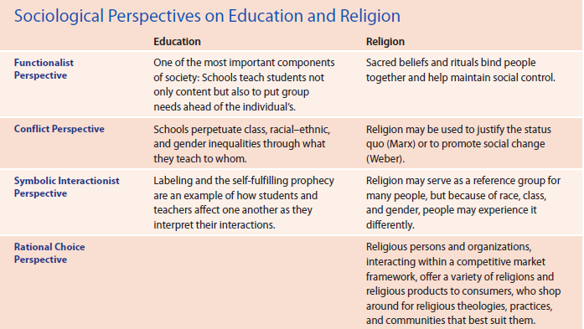
Concept Quick Review

Slide 25
Education
Education is the social institution responsible for the systematic transmission of knowledge, skills, and cultural values within a formally organized structure.

Slide 26
functionalist
Functionalist perspectives on education
  Manifest functions: socialization, transmission of culture, social control, social placement, change innovation
  Latent functions: restricting some activities, matchmaking and production of social networks, creating a generation gap

Slide 27
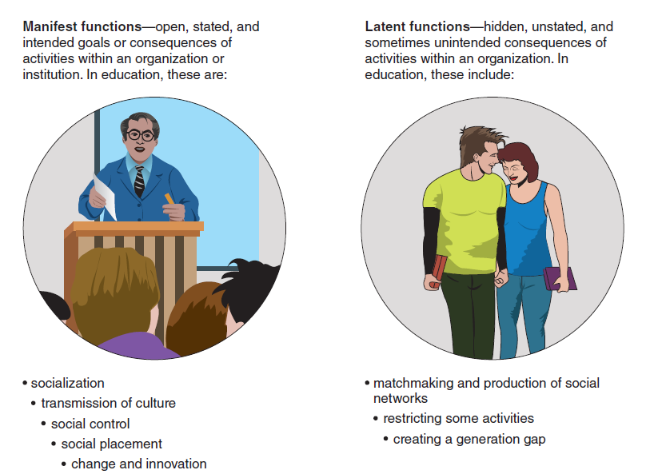
Figure 12.1
Manifest and Latent Functions of Education
<insert Figure 12.1>

Slide 28
CONFLICT
  Cultural capital refers to the social assets that include values, beliefs, attitudes, and competencies in language and culture.
  Tracking refers to the practice of assigning students to specific curriculum groups and courses on the basis of their test scores, previous grades, or other criteria.

Slide 29

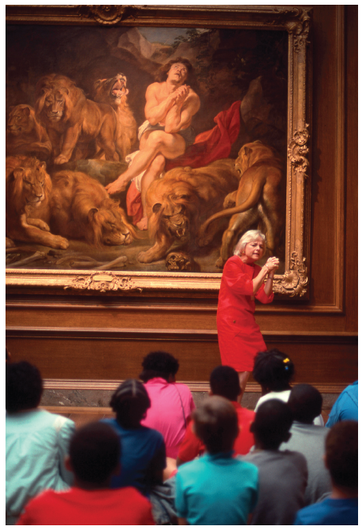
Consider This…
Figure 12.2
Children who are able to visit museums, libraries, and musical events may gain cultural capital that other children do not possess. What is cultural capital? Why is it important in the process of class reproduction?

Slide 30
CONFLICT THEORY
  The hidden curriculum is the transmission of cultural values and attitudes through implied demands found in the rules, routines, and regulations of schools.
  Credentialism is the process of social section in which class advantage and social status are linked to the possession of academic qualifications.

Slide 31
SYMBOLIC INTERACTIONIST
Symbolic interactionist perspectives on education focus on classroom communication patterns and educational practices.

Slide 32
FORMAL AND INFORMAL EDUCATION
Formal Education -
Informal Education

Slide 33
UNIVERSAL ACCESS TO EDUCATION
Access to Education:
Plessy vs Ferguson
Brown vs Tampa, KS Board of Education
Mills vs Board of Education

Slide 34

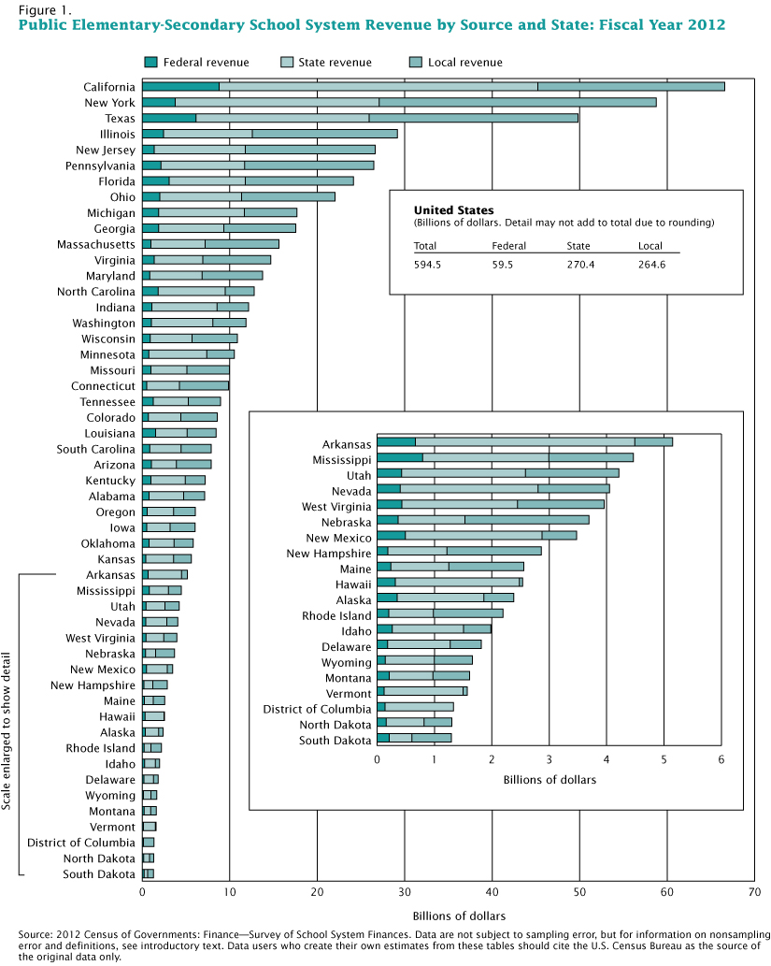
Figure 16.5
How has your state’s revenue affected your educational opportunities? (Graph courtesy of Census of Governments: Survey of School System Finances 2012)

Slide 35
Hot topics in education
.Equal Education
Head Start
Busing
No Child Left Behind
Teaching to the Test
Bilingual Education
Common Care

Slide 36
Charter schools and homeschooling
Charter schools
Home schooling

Slide 37
Issues in education
Teacher Training
Social Promotion
Affirmative Action
Rising Student Loan Debt

