Slide 1

Chapter 2
Methods for Describing Sets of Data

Slide 2
Learning Objectives
Describe data using graphs
Describe data using numerical measures
Describe quantitative data using numerical measures
Describe the relationship between two quantitative variables using graphs
Detecting descriptive methods that distort the truth

Slide 3
2.1
Describing Qualitative Data
Notes:
:1, 1, 3

Slide 4
Data Presentation
Data Presentation
Qualitative
Data
Quantitative
Data
Summary
Table
Dot
Plot
Stem-&-Leaf
Display
Frequency
Distribution
Bar
Graph
Pie
Chart
Pareto
Diagram
Histogram

Slide 5
Data Presentation
Data Presentation
Qualitative
Data
Quantitative
Data
Summary
Table
Dot
Plot
Stem-&-Leaf
Display
Frequency
Distribution
Bar
Graph
Pie
Chart
Pareto
Diagram
Histogram

Slide 6
Summary Table
Lists categories & number of elements in category
Obtained by tallying responses in category
May show frequencies (counts), % or both
Row Is Category
Major | Count
Accounting | 130
Economics | 20
Management | 50
Total | 200
Tally:
|||| ||||
|||| ||||

Slide 7
Data Presentation
Data Presentation
Qualitative
Data
Quantitative
Data
Summary
Table
Dot
Plot
Stem-&-Leaf
Display
Frequency
Distribution
Bar
Graph
Pie
Chart
Pareto
Diagram
Histogram

Slide 8
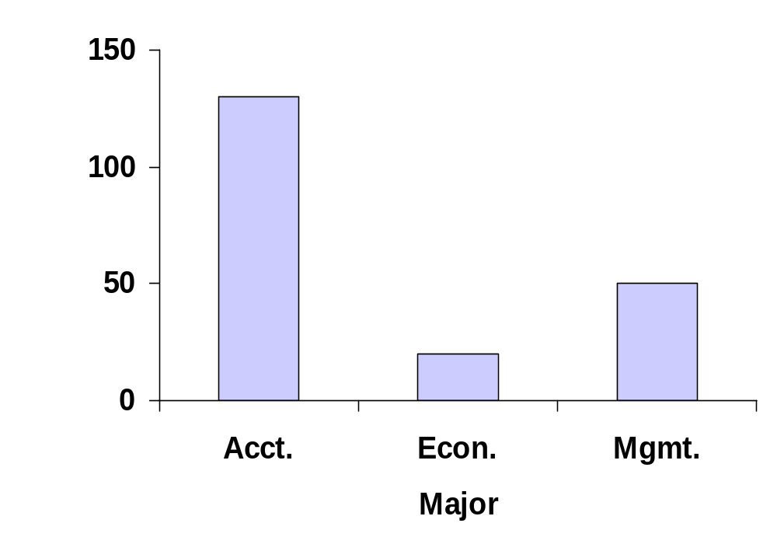
Bar Graph
Equal Bar Widths
Bar Height Shows Frequency or %
Percent Used Also
Frequency
Vertical Bars for Qualitative Variables
Zero Point

Slide 9
Data Presentation
Data Presentation
Qualitative
Data
Quantitative
Data
Summary
Table
Dot
Plot
Stem-&-Leaf
Display
Frequency
Distribution
Bar
Graph
Pie
Chart
Pareto
Diagram
Histogram

Slide 10
Pie Chart
Shows breakdown of total quantity into
categories
Useful for showing
relative differences
Angle size
  (360°)(percent)
Majors
Mgmt.
Econ.
25%
10%
36°
Acct.
65%
(360°) (10%) = 36°

Slide 11
Data Presentation
Data Presentation
Qualitative
Data
Quantitative
Data
Summary
Table
Dot
Plot
Stem-&-Leaf
Display
Frequency
Distribution
Bar
Graph
Pie
Chart
Pareto
Diagram
Histogram

Slide 12
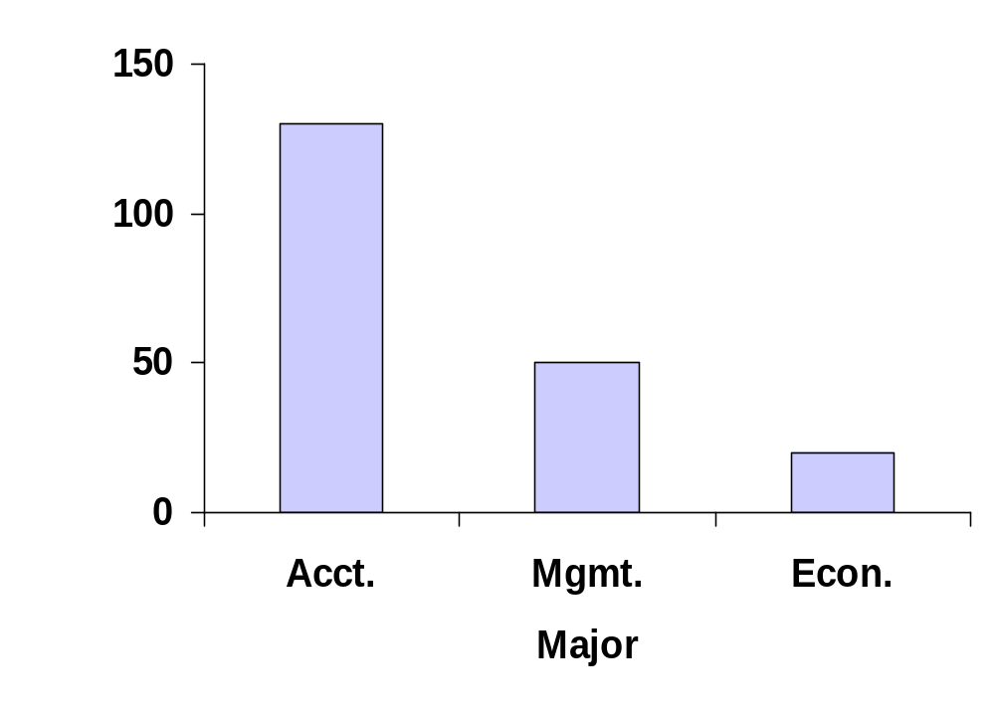
Pareto Diagram
Like a bar graph, but with the categories arranged by height in descending order from left to right.
Equal Bar Widths
Bar Height Shows Frequency or %
Percent Used Also
Frequency
Vertical Bars for Qualitative Variables
Zero Point

Slide 13
Summary
Bar graph: The categories (classes) of the qualitative variable are represented by bars, where the height of each bar is either the class frequency, class relative frequency, or class percentage.
Pie chart: The categories (classes) of the qualitative variable are represented by slices of a pie (circle). The size of each slice is proportional to the class relative frequency.
Pareto diagram: A bar graph with the categories (classes) of the qualitative variable (i.e., the bars) arranged by height in descending order from left to right.

Slide 14

Thinking Challenge
You’re an analyst for IRI. You want to show the market shares held by Web browsers in 2016. Construct a bar graph, pie chart, & Pareto diagram to describe the data.
Browser | Mkt. Share (%)
Firefox | 14
Internet Explorer | 81
Safari | 4
Others | 1
Notes:
Allow students 10-15 minutes to complete this before revealing answers.

Slide 15
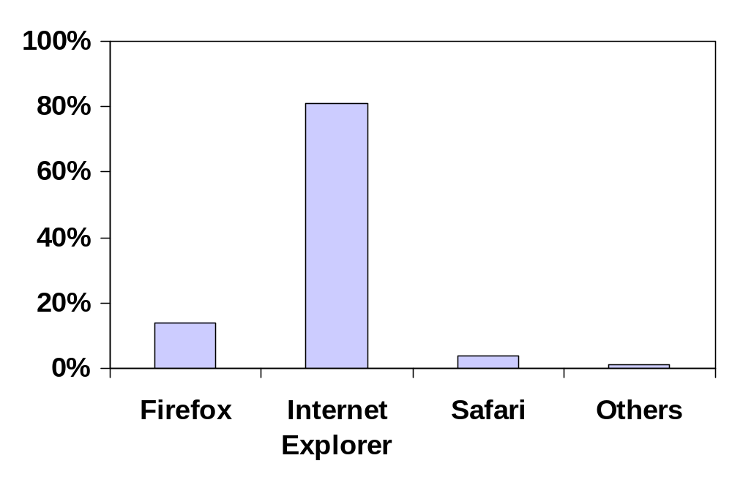
Bar Graph Solution*
Market Share (%)
Browser

Slide 16
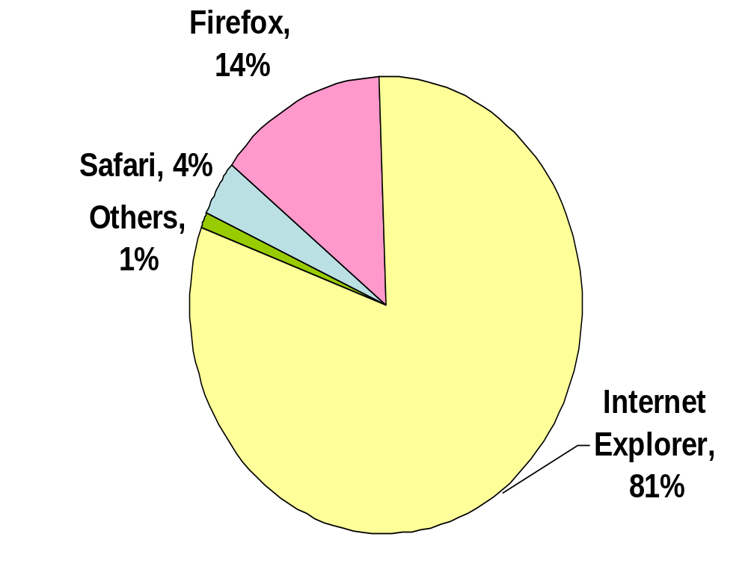
Pie Chart Solution*
Market Share

Slide 17
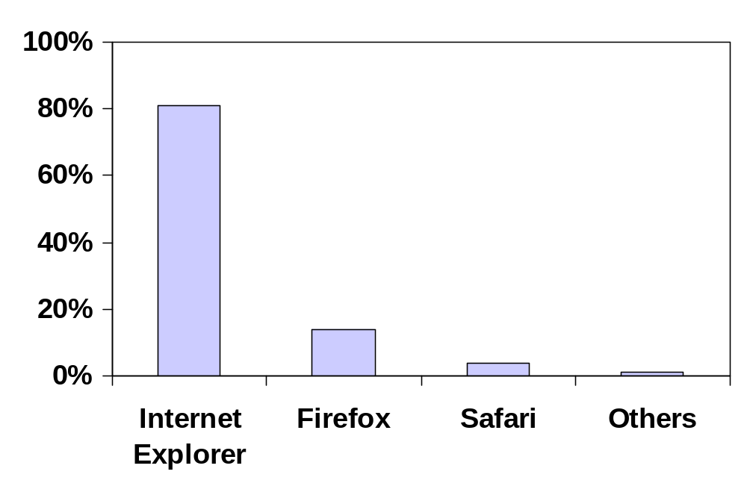
Pareto Diagram Solution*
Market Share (%)
Browser

Slide 18
2.2
Graphical Methods for Describing Quantitative Data

Slide 19
Data Presentation
Data Presentation
Qualitative
Data
Quantitative
Data
Summary
Table
Dot
Plot
Stem-&-Leaf
Display
Histogram
Bar
Graph
Pie
Chart
Pareto
Diagram

Slide 20
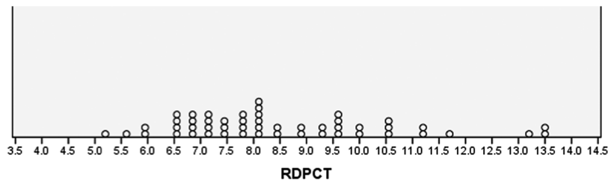
Dot Plot
Horizontal axis is a scale for the quantitative variable, e.g., percent.
The numerical value of each measurement is located on the horizontal scale by a dot.

Slide 21
Data Presentation
Data Presentation
Qualitative
Data
Quantitative
Data
Summary
Table
Dot
Plot
Stem-&-Leaf
Display
Histogram
Bar
Graph
Pie
Chart
Pareto
Diagram

Slide 22
Stem-and-Leaf Display
1. Divide each observation into stem value and leaf value
  Stems are listed in order in a column
  Leaf value is placed in corresponding stem row to right of bar
2
144677
26
3
028
4
1
2. Data: 21, 24, 24, 26, 27, 27, 30, 32, 38, 41

Slide 23
Data Presentation
Data Presentation
Qualitative
Data
Quantitative
Data
Summary
Table
Dot
Plot
Stem-&-Leaf
Display
Histogram
Bar
Graph
Pie
Chart
Pareto
Diagram

Slide 24
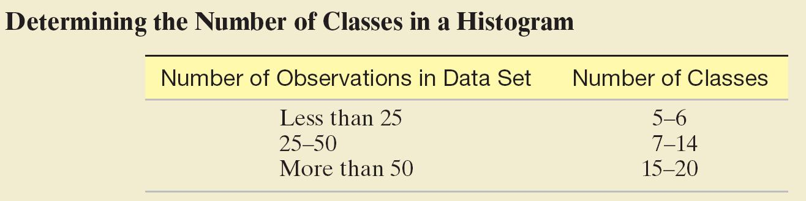

Slide 25
Histogram
Class
Freq.
Count
15.5 – 25.5
3
5
25.5 – 35.5
5
35.5 – 45.5
2
Frequency
Relative Frequency
Percent
4
3
2
Bars Touch
1
0
0 15.5 25.5 35.5 45.5 55.5
Lower Boundary

Slide 26
Summary
Dot plot: The numerical value of each quantitative measurement in the data set is represented by a dot on a horizontal scale. When data values repeat, the dots are placed above one another vertically.
Stem-and-leaf display: The numerical value of the quantitative variable is partitioned into a “stem” and a “leaf.” The possible stems are listed in order in a column. The leaf for each quantitative measurement in the data set is placed in the corresponding stem row. Leaves for observations with the same stem value are listed in increasing order horizontally.

Slide 27
Summary
Histogram: The possible numerical values of the quantitative variable are partitioned into class intervals, where each interval has the same width. These intervals form the scale of the horizontal axis. The frequency or relative frequency of observations in each class interval is determined. A horizontal bar is placed over each class interval, with height equal to either the class frequency or class relative frequency.

Slide 28
2.3
Numerical Measures
of Central Tendency

Slide 29
Two Characteristics
The central tendency of the set of measurements–that is, the tendency of the data to cluster, or center, about certain numerical values.
Central Tendency (Location)

Slide 30
Two Characteristics
The variability of the set of measurements–that is, the spread of the data.
Variation (Dispersion)

Slide 31
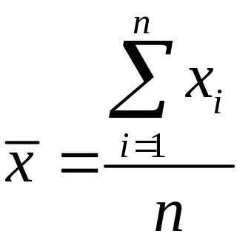
Mean
The mean of a set of quantitative data is the sum of the measurements divided by the number of measurements contained in the data set.

Slide 32
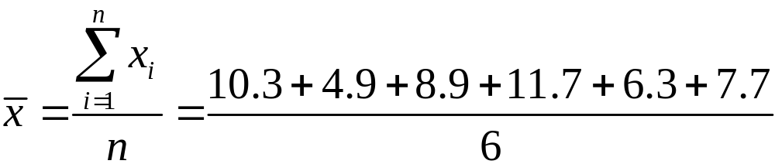
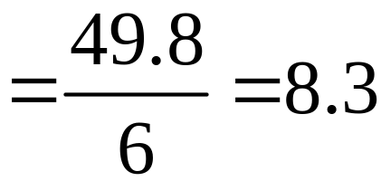
Example
Calculate the mean of the following six sample measurements:
10.3, 4.9, 8.9, 11.7 , 6.3 , 7.7

Slide 33


Symbols for the Sample and Population Mean
In this text, we adopt a general policy of using Greek letters to represent population numerical descriptive measures and Roman letters to represent corresponding descriptive measures for the sample. The symbols for the mean are
Sample mean
Population mean

Slide 34
Median
Measure of central tendency
Middle value in ordered sequence
    If n is odd, middle value of sequence
    If n is even, average of 2 middle values
Position of median in sequence
Not affected by extreme values
n
+
1
Positioning
Point
=
2

Slide 35
Median Example Odd-Sized Sample
Raw Data: 24.1 22.6 21.5 23.7 22.6
Ordered: 21.5 22.6 22.6 23.7 24.1
Position: 1 2 3 4 5
Median = 22.6

Slide 36
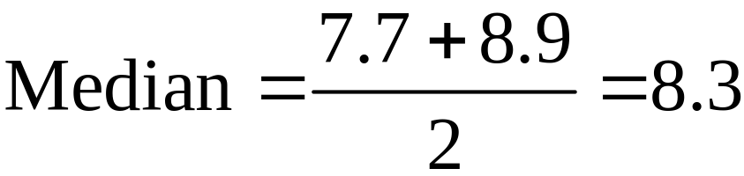
Median Example Even-Sized Sample
Raw Data: 10.3 4.9 8.9 11.7 6.3 7.7
Ordered: 4.9 6.3 7.7 8.9 10.3 11.7
Position: 1 2 3 4 5 6

Slide 37
Skewed
A data set is said to be skewed if one tail of the distribution has more extreme observations than the other tail.

Slide 38
Shape
Describes how data are distributed
Measures of Shape
      Skew = Symmetry
Left-Skewed
Symmetric
Right-Skewed
Mean
Median
Mean
=
Median
Median
Mean

Slide 39
Mode
Measure of central tendency
Value that occurs most often
Not affected by extreme values
May be no mode or several modes
May be used for quantitative or qualitative data

Slide 40
Mode Example
No Mode
Raw Data: 10.3 4.9 8.9 11.7 6.3 7.7
One Mode
Raw Data: 6.3 4.9 8.9 6.3 4.9 4.9
More Than 1 Mode
Raw Data: 21 28 28 41 43 43

Slide 41
Thinking Challenge
You’re a financial analyst for Prudential-Bache Securities. You have collected the following closing stock prices of new stock issues: 17, 16, 21, 18, 13, 16, 12, 11.
Describe the stock prices
in terms of central tendency.

Slide 42
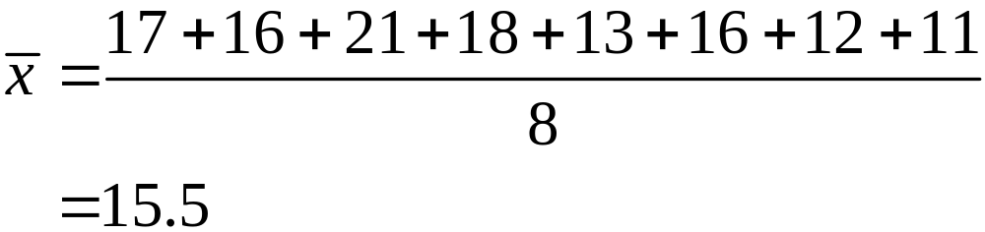
Solution
17, 16, 21, 18, 13, 16, 12, 11
Raw Data: 17 16 21 18 13 16 12 11
Ordered: 11 12 13 16 16 17 18 21
Median = 16

Slide 43
Solution (cont)
Mode
Raw Data: 17 16 21 18 13 16 12 11
Mode = 16

Slide 44
2.4
Numerical Measures
of Variability

Slide 45
Range
Measure of dispersion
Difference between largest & smallest observations
Range = x_{largest} – x_{smallest}
Ignores how data are distributed
7
8
9
10
7
8
9
10
Range = 10 – 7 = 3
Range = 10 – 7 = 3

Slide 46
Variance &
Standard Deviation
Measures of dispersion
Most common measures
Consider how data are distributed
4. Show variation about mean (x or μ)
x
= 8.3
4
6
8
10
12

Slide 47
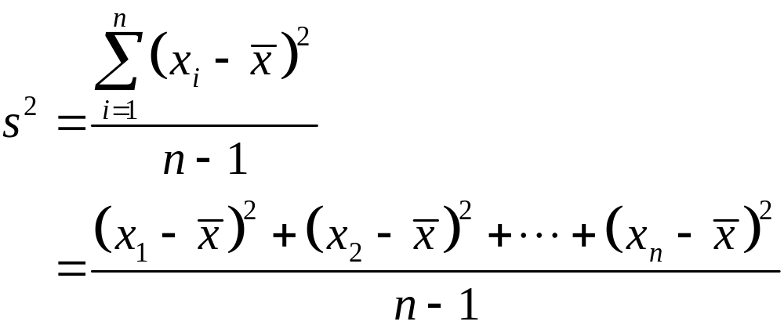
Sample Variance Formula

Slide 48
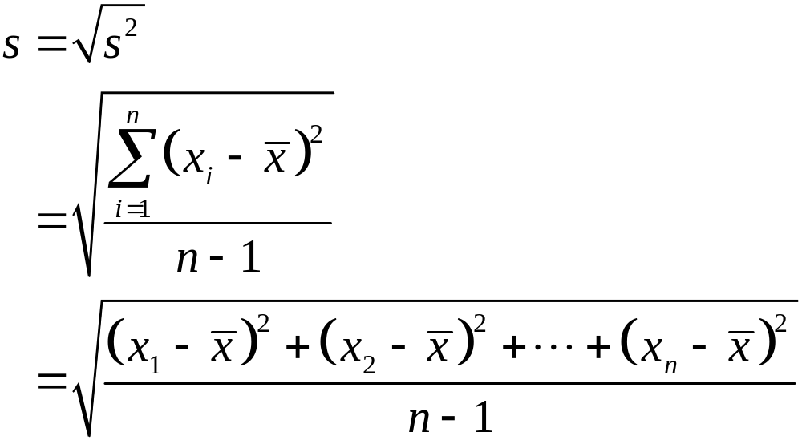
Sample Standard Deviation Formula

Slide 49


Symbols for Variance and Standard Deviation
s² = Sample variance
s = Sample standard deviation
= Population variance
= Population standard deviation

Slide 50
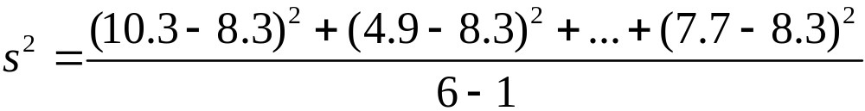

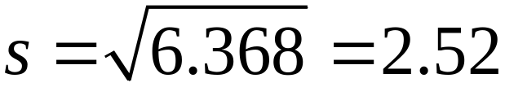
Example
Calculate the variance and standard deviation. 10.3, 4.9, 8.9, 11.7, 6.3, 7.7
Solution
The first step is finding the mean. Which we calculated earlier to be 8.3.

Slide 51
Thinking Challenge
You’re a financial analyst for Prudential-Bache Securities. You have collected the following closing stock prices of new stock issues: 17, 16, 21, 18, 13, 16, 12, 11.
What are the variance and standard deviation of the stock prices?

Slide 52
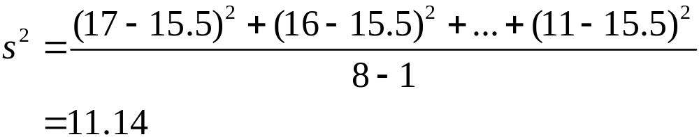
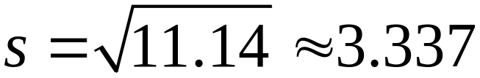
Thinking Challenge Solution
Sample Variance
17 16 21 18 13 16 12 11
The mean = 15.5

Slide 53
2.6
Numerical Measures
of Relative Standing
Notes:
:1, 1, 3

Slide 54
Numerical Measures of Relative Standing: Percentiles
Describes the relative location of a measurement compared to the rest of the data are called measures of relative standing.
The p^{th} percentile is a number such that p% of the data falls below it and (100 – p)% falls above it
Median = 50th percentile

Slide 55
Quartiles
Measure of noncentral tendency
Split ordered data into 4 quarters
25%
25%
25%
25%
Q₁
Q₂
Q₃
Lower quartile Q_{L} is 25th percentile.
Middle quartile m is the median.
Upper quartile Q_{U} is 75th percentile.

Slide 56
Percentile Example
You scored 560 on the GMAT exam. This score puts you in the 58th percentile.
What percentage of test takers scored lower than you did?
58% of test takers scored lower than 560.
What percentage of test takers scored higher than you did?
(100 – 58)% = 42% of test takers scored
higher than 560.

Slide 57
Outlier
An observation (or measurement) that is unusually large or small relative to the other values in a data set is called an outlier. Outliers typically are attributable to one of the following causes:
The measurement is observed, recorded, or entered into the computer incorrectly.
The measurement comes from a different population.
The measurement is correct but represents a rare (chance) event.

Slide 58
Quartiles Review
Measure of noncentral tendency
Split ordered data into 4 quarters
25%
25%
25%
25%
Q₁
Q₂
Q₃
Lower quartile Q_{L} is 25th percentile.
Middle quartile m is the median.
Upper quartile Q_{U} is 75th percentile.
Interquartile range: IQR = Q_{U} – Q_{L}

Slide 59
Quartile (Q₂) Example
Raw Data: 10.3 4.9 8.9 11.7 6.3 7.7
Ordered: 4.9 6.3 7.7 8.9 10.3 11.7
Position: 1 2 3 4 5 6
Q₂ is the median, the average of the two middle scores (7.7 + 8.9)/2 = 8.3

Slide 60
Quartile (Q₁) Example
Raw Data: 10.3 4.9 8.9 11.7 6.3 7.7
Ordered: 4.9 6.3 7.7 8.9 10.3 11.7
Position: 1 2 3 4 5 6
Q_{L} is median of bottom half = 6.3

Slide 61
Quartile (Q₃) Example
Raw Data: 10.3 4.9 8.9 11.7 6.3 7.7
Ordered: 4.9 6.3 7.7 8.9 10.3 11.7
Position: 1 2 3 4 5 6
Q_{U} is median of bottom half = 10.3

Slide 62
Interquartile Range
Measure of dispersion
Also called midspread
Difference between upper and lower quartiles
    Interquartile Range = Q_{U} – Q_{L}
4. Spread in middle 50%
5. Not affected by extreme values

Slide 63
Thinking Challenge
You’re a financial analyst for Prudential-Bache Securities. You have collected the following closing stock prices of new stock issues: 17, 16, 21, 18, 13, 16, 12, 11.
What are the quartiles, Q₁ and Q_{3,} and the interquartile range?

Slide 64
Quartile Solution*
Q₁
Raw Data: 17 16 21 18 13 16 12 11
Ordered: 11 12 13 16 16 17 18 21
Position: 1 2 3 4 5 6 7 8
Q_{L} is the median of the bottom half, the average of the two middle scores
(12 + 13)/2 = 12.5

Slide 65
Quartile Solution*
Q₃
Raw Data: 17 16 21 18 13 16 12 11
Ordered: 11 12 13 16 16 17 18 21
Position: 1 2 3 4 5 6 7 8
Q_{U} is the median of the bottom half, the average of the two middle scores
(17 + 18)/2 = 17.5

Slide 66
Interquartile Range Solution*
Interquartile Range
Raw Data: 17 16 21 18 13 16 12 11
Ordered: 11 12 13 16 16 17 18 21
Position: 1 2 3 4 5 6 7 8
Interquartile Range = Q₃ – Q₁
= 17.5 – 12.5 = 5

Slide 67
Box Plot
1. Graphical display of data using 5-number summary
X
Q
Median
Q
X
smallest
1
3
largest
4
6
8
10
12

Slide 68
Box Plot
Draw a rectangle (box) with the ends (hinges) drawn at the lower and upper quartiles (Q_{L} and Q_{U}). The median data is shown by a line or symbol (such as “+”).
The points at distances 1.5(IQR) from each hinge define the inner fences of the data set. Line (whiskers) are drawn from each hinge to the most extreme measurements inside the inner fence.

Slide 69
Box Plot
3. A second pair of fences, the outer fences, are defined at a distance of 3(IQR) from the hinges. One symbol (*) represents measurements falling between the inner and outer fences, and another (0) represents measurements beyond the outer fences.
4. Symbols that represent the median and extreme data points vary depending on software used. You may use your own symbols if you are constructing a box plot by hand.

Slide 70
Shape & Box Plot
Left-Skewed
Symmetric
Right-Skewed
Q
Median
Q
Q
Median
Q
Q
Median
Q
1
3
1
3
1
3

Slide 71
2.8
Graphing Bivariate Relationships

Slide 72
Graphing Bivariate Relationships
Describes a relationship between two quantitative variables
Plot the data in a scattergram (or scatterplot)
y
y
y
x
x
x
Positive
relationship
Negative
relationship
No relationship

Slide 73
Scattergram Example
You’re a marketing analyst for Hasbro Toys. You gather the following data:
Ad $ (x) Sales (Units) (y)
1 1
2 1
3 2
4 2
5 4
Draw a scattergram of the data

Slide 74
Scattergram Example
Sales
4
3
2
1
0
0
1
2
3
4
5
Advertising

Slide 75
2.9
The Time Series Plot
Notes:
:1, 1, 3

Slide 76
Time Series Plot
Used to graphically display data produced over time
Shows trends and changes in the data over time
Time recorded on the horizontal axis
Measurements recorded on the vertical axis
Points connected by straight lines

Slide 77
Time Series Plot Example
The following data shows the average retail price of regular gasoline for 8 weeks in 2016.
Draw a time series plot for this data.
Date | Average Price
Oct 16, 2006 | $2.219
Oct 23, 2006 | $2.173
Oct 30, 2006 | $2.177
Nov 6, 2006 | $2.158
Nov 13, 2006 | $2.185
Nov 20, 2006 | $2.208
Nov 27, 2006 | $2.236
Dec 4, 2006 | $2.298

Slide 78
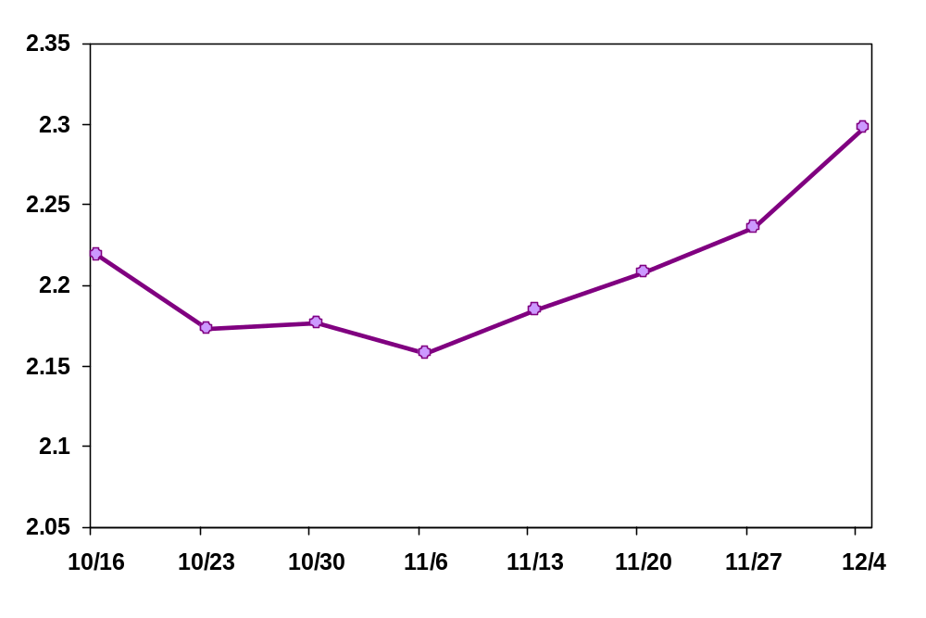
Time Series Plot Example
Price
Date

Slide 79
2.10
Distorting the Truth with Descriptive Statistics
Notes:
:1, 1, 3

Slide 80
Errors in Presenting Data
Use area to equate to value
No relative basis in comparing data batches
Compress the vertical axis
No zero point on the vertical axis
Gap in the vertical axis
Use of misleading wording
Knowing central tendency without knowing variability

Slide 81
Reader Equates Area to Value
Bad Presentation
Good Presentation
Minimum Wage
Minimum Wage
$
1960: $1.00
4
1970: $1.60
2
1980: $3.10
0
1990: $3.80
1960
1970
1980
1990

Slide 82
No Relative Basis
Bad Presentation
Good Presentation
A’s by Class
A’s by Class
Freq.
%
300
30%
200
20%
100
10%
0
0%
FR
SO
JR
SR
FR
SO
JR
SR

Slide 83
Compressing
Vertical Axis
Bad Presentation
Good Presentation
Quarterly Sales
Quarterly Sales
$
$
200
50
100
25
0
0
Q1
Q2
Q3
Q4
Q1
Q2
Q3
Q4

Slide 84
No Zero Point on Vertical Axis
Bad Presentation
Good Presentation
Monthly Sales
Monthly Sales
$
$
45
60
42
40
39
20
36
0
J
M
M
J
S
N
J
M
M
J
S
N

Slide 85
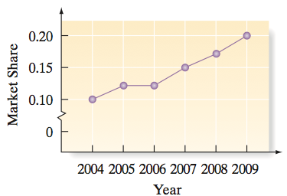
Gap in the Vertical Axis
Bad Presentation

Slide 86
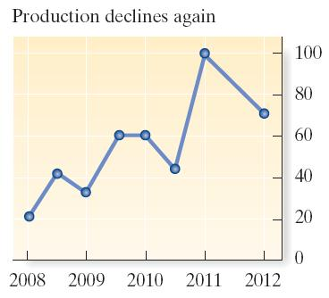
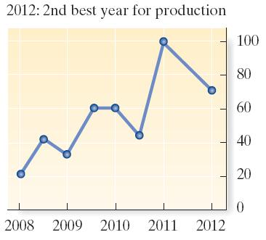
Changing the Wording
Changing the title of the graph can influence the reader.
We’re not doing so well.
Still in prime years!

Slide 87
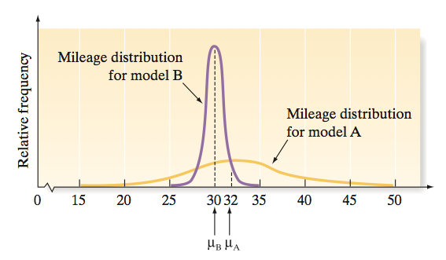
Knowing only central tendency
Knowing ONLY the central tendency might lead one to purchase Model A. Knowing the variability as well may change one’s decision!

