Slide 1
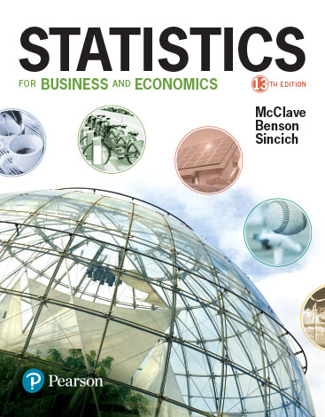
Chapter 3
Probability

Slide 2
Learning Objectives
Develop probability as a measure of uncertainty
Introduce basic rules for finding probabilities
Use probability as a measure of reliability for an inference
Provide an advanced rule for finding probabilities
Notes:
As a result of this class, you will be able to ...

Slide 3

Thinking Challenge
What’s the probability of getting a head on the toss of a single fair coin? Use a scale from 0 (no way) to 1 (sure thing).
So toss a coin twice. Do it! Did you get one head & one tail? What’s it all mean?

Slide 4
Many Repetitions!*
Total Heads
Number of Tosses
1.00
0.75
0.50
0.25
0.00
0
25
50
75
100
125
Number of Tosses

Slide 5
3.1
Events, Sample Spaces,
and Probability
Notes:
:1, 1, 3

Slide 6
Experiments & Sample Spaces
Experiment
  Process of observation that leads to a single outcome that cannot be predicted with certainty
Sample point
  Most basic outcome of an experiment
Sample space (S)
  Collection of all sample points

Slide 7
Visualizing
Sample Space
1. Listing
    S = {Head, Tail}
2. Venn Diagram
T
H
S

Slide 8
Sample Space Examples
Experiment Sample Space
Toss a Coin, Note Face {Head, Tail}
Toss 2 Coins, Note Faces {HH, HT, TH, TT}
Select 1 Card, Note Kind {2♥, 2♠, ..., A♦} (52)
Select 1 Card, Note Color {Red, Black}
Play a Football Game {Win, Lose, Tie}
Inspect a Part, Note Quality {Defective, Good}
Observe Gender {Male, Female}

Slide 9
Events
Specific collection of sample points
Simple Event
    Contains only one sample point
Compound Event
    Contains two or more sample points

Slide 10
Venn Diagram
Experiment: Toss 2 Coins. Note Faces.
Sample Space S = {HH, HT, TH, TT}
Compound Event: At least one Tail
TH
HT
Outcome
HH
TT
S

Slide 11
Event Examples
Experiment: Toss 2 Coins. Note Faces.
Sample Space: HH, HT, TH, TT
Event Outcomes in Event
1 Head & 1 Tail HT, TH
Head on 1st Coin HH, HT
At Least 1 Head HH, HT, TH
Heads on Both HH

Slide 12
Probabilities

Slide 13
What is Probability?
1. Numerical measure of the likelihood that event will occur
    P(Event)
    P(A)
    Prob(A)
2. Lies between 0 & 1
3. Sum of sample points is 1
1
Certain
0.5
0
Impossible

Slide 14
Steps for Calculating Probability
1. Define the experiment; describe the process used to make an observation and the type of observation that will be recorded.
2. List the sample points.
3. Assign probabilities to the sample points.
4. Determine the collection of sample points contained in the event of interest.
5. Sum the sample points probabilities to get the event probability.

Slide 15
3.2
Unions and Intersections.
Notes:
:1, 1, 3

Slide 16
Compound Events
Compound events:
Composition of two or more other events.
Can be formed in two different ways.

Slide 17
Unions & Intersections
1. Union
    Outcomes in either events A or B or both
    ‘OR’ statement
    Denoted by ∪ symbol (i.e., A ∪ B)
2. Intersection
    Outcomes in both events A and B
    ‘AND’ statement
    Denoted by ∩ symbol (i.e., A ∩ B)

Slide 18
Event Union:
Venn Diagram
Experiment: Draw 1 Card. Note Kind, Color & Suit.
Ace
Black
Event Black: 2♣, 2♠, ..., A♠
Sample Space:
2♥, 2♦, 2♣, ..., A♠
S
Event Ace:
A♥, A♦, A♣, A♠
Event Ace ∪ Black:
A♥, ..., A♠, 2♣, ..., K♠

Slide 19
Event Union:
Two–Way Table
Experiment: Draw 1 Card. Note Kind, Color & Suit.
Color
Simple Event Ace:
A♥,
A♦,
A♣,
A♠
Sample Space (S):
2♥, 2♦, 2♣, ..., A♠
Type
Red
Black
Total
Ace
Ace &
Ace &
Ace
Red
Black
Non-Ace
Non &
Non &
Non-
Red
Black
Ace
Total
Red
Black
S
Event
Ace ∪ Black:
A♥,..., A♠,  2♣, ..., K♠
Simple Event Black:
2♣, ..., A♠

Slide 20
Event Intersection:
Venn Diagram
Experiment: Draw 1 Card. Note Kind, Color & Suit.
Ace
Black
Event Black:
2♣,...,A♠
Sample Space:
2♥, 2♦, 2♣, ..., A♠
S
Event Ace:
A♥, A♦, A♣, A♠
Event Ace ∩ Black:
A♣, A♠

Slide 21
Event Intersection:
Two–Way Table
Experiment: Draw 1 Card. Note Kind, Color & Suit.
Color
Simple Event Ace:
A♥, A♦, A♣, A♠
Sample Space (S):
2♥, 2♦, 2♣, ..., A♠
Type
Red
Black
Total
Ace
Ace &
Ace &
Ace
Red
Black
Non-Ace
Non &
Non &
Non-
Red
Black
Ace
Event
Ace ∩ Black:
A♣, A♠
Total
Red
Black
S
Simple Event Black: 2♣, ..., A♠

Slide 22
Compound Event Probability
1. Numerical measure of likelihood that compound event will occur
2. Can often use two–way table
    Two variables only

Slide 23
Event Probability Using
Two–Way Table
Event
Event
B
B
Total
1
2
A
P(A
∩
B
)
P(A
∩
B
)
P(A
)
1
1
1
1
2
1
A
P(A
∩
B
)
P(A
∩
B
)
P(A
)
2
2
1
2
2
2
Total
P(B
)
P(B
)
1
1
2
Joint Probability
Marginal (Simple) Probability

Slide 24
Two–Way Table Example
Experiment: Draw 1 Card. Note Kind & Color.
Color
Type
Red
Black
Total
Ace
2/52
2/52
4/52
Non-Ace
24/52
24/52
48/52
P(Ace)
Total
26/52
26/52
52/52
P(Red)
P(Ace ∩ Red)

Slide 25
Thinking Challenge
P(A) =
P(D) =
P(C ∩ B) =
P(A ∪ D) =
P(B ∩ D) =
What’s the Probability?
Event
Event
C
D
Total
A
4
2
6
B
1
3
4
Total
5
5
10

Slide 26
Solution*
The Probabilities Are:
P(A) = 6/10
P(D) = 5/10
P(C ∩ B) = 1/10
P(A ∪ D) = 9/10
P(B ∩ D) = 3/10
Event
Event
C
D
Total
A
4
2
6
B
1
3
4
Total
5
5
10

Slide 27
3.3
Complementary Events
Notes:
:1, 1, 3

Slide 28
Complementary Events
Complement of Event A
    The event that A does not occur
    All events not in A
    Denote complement of A by A^{C}
A^{C}
A
S

Slide 29
Rule of Complements
The sum of the probabilities of complementary events equals 1:
    P(A) + P(A^{C}) = 1
A^{C}
A
S

Slide 30
Complement of Event Example
Experiment: Draw 1 Card. Note Color.
Black
Sample Space:
2♥, 2♦, 2♣, ..., A♠
S
Event Black:
2♣, 2♠, ..., A♠
Complement of Event Black, Black^{C}: 2♥, 2♦, ..., A♥, A♦

Slide 31
3.4
The Additive Rule and
Mutually Exclusive Events
Notes:
:1, 1, 3

Slide 32
Mutually Exclusive Events
Mutually Exclusive Events
    Events do not occur
    simultaneously
    A ∩ Β does not contain any sample points
♠
♠

Slide 33
Mutually Exclusive Events Example
Experiment: Draw 1 Card. Note Kind & Suit.
♥
Outcomes
in Event Heart:
2♥, 3♥, 4♥ , ..., A♥
Sample Space:
2♥, 2♦,
2♣, ..., A♠
♠
S
Event Spade:
2♠, 3♠, 4♠, ..., A♠
Events ♠ and♥ are Mutually Exclusive
Notes:
Mutually Exclusive
What is the intersection of mutually exclusive events?
The null set.

Slide 34
Additive Rule
Used to get compound probabilities for union of events
P(A OR B) = P(A ∪ B)
= P(A) + P(B) – P(A ∩ B)
For mutually exclusive events:
P(A OR B) = P(A ∪ B) = P(A) + P(B)

Slide 35
Additive Rule Example
Experiment: Draw 1 Card. Note Kind & Color.
Color
Type
Red
Black
Total
Ace
2
2
4
Non-Ace
24
24
48
Total
26
26
52
P(Ace ∪ Black)
=
P(Ace)
+
P(Black)
–
P(Ace
∩
Black)
4 26 2 28
= + – =
52 52 52 52
Notes:
Try other examples using this table.

Slide 36
Thinking Challenge
P(A ∪ D) =
P(B ∪ C) =
Using the additive rule, what is the probability?
Event
Event
C
D
Total
A
4
2
6
B
1
3
4
Total
5
5
10

Slide 37
Solution*
Using the additive rule, the probabilities are:
1.
P(A ∪ D) = P(A) + P(D) – P(A ∩ D)
6 5 2 9
= + – =
10 10 10 10
2.
P(B ∪ C) = P(B) + P(C) – P(B ∩ C)
4 5 1 8
= + – =
10 10 10 10

Slide 38
3.5
Conditional Probability
Notes:
:1, 1, 3

Slide 39
Conditional Probability
1. Event probability given that another event
occurred
2. Revise original sample space to account for
new information
    Eliminates certain outcomes
3. P(A | B) ₌ P(A and B) ₌ P(A ∩ B)
P(B) P(B)

Slide 40
Conditional Probability Using Venn Diagram
Black ‘Happens’: Eliminates All Other Outcomes
Ace
Black
Black
S
(S)
Event (Ace ∩ Black)

Slide 41
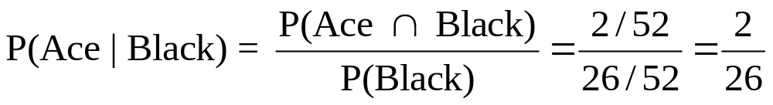
Conditional Probability Using Two–Way Table
Experiment: Draw 1 Card. Note Kind & Color.
Color
Type
Red
Black
Total
Revised Sample Space
Ace
2
2
4
Non-Ace
24
24
48
Total
26
26
52
Notes:
Try other examples using this table.

Slide 42
Thinking Challenge
Using the table then the formula, what’s the probability?
P(A|D) =
P(C|B) =
Event
Event
C
D
Total
A
4
2
6
B
1
3
4
Total
5
5
10
Notes:
Let students solve first. Allow about 20 minutes for this.

Slide 43
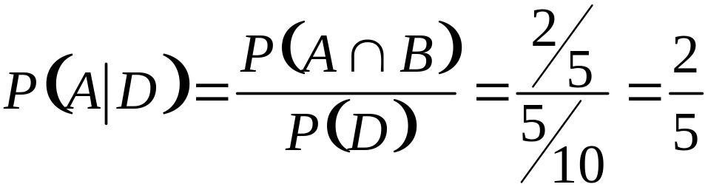
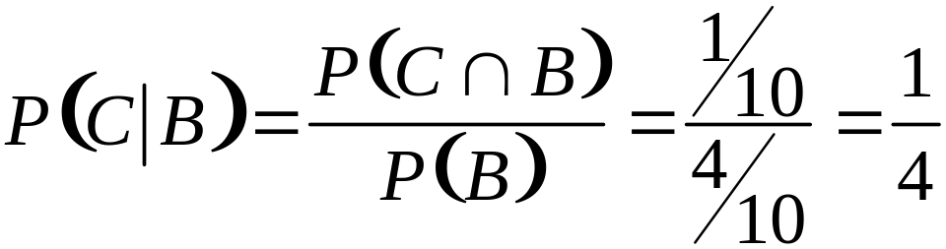
Solution*
Using the formula, the probabilities are:

Slide 44
3.6
The Multiplicative Rule
and Independent Events
Notes:
:1, 1, 3

Slide 45
Multiplicative Rule
1. Used to get compound probabilities for intersection of events
2. P(A and B) = P(A ∩ B)
= P(A) × P(B|A)
= P(B) × P(A|B)
3. For Independent Events:
P(A and B) = P(A ∩ B) = P(A) × P(B)

Slide 46
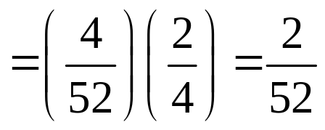
Multiplicative Rule Example
Experiment: Draw 1 Card. Note Kind & Color.
Color
Type
Red
Black
Total
Ace
2
2
4
Non-Ace
24
24
48
Total
26
26
52
P(Ace ∩ Black) = P(Ace)∙P(Black | Ace)
Notes:
Try other examples using this table.

Slide 47
Statistical Independence
1. Event occurrence does not affect probability of another event
    Toss 1 coin twice
2. Causality not implied
3. Tests for independence
    P(A | B) = P(A)
    P(B | A) = P(B)
    P(A ∩ B) = P(A) × P(B)

Slide 48
Thinking Challenge
Using the multiplicative rule, what’s the probability?
Event
P(C ∩ B) =
P(B ∩ D) =
P(A ∩ B) =
Event
C
D
Total
A
4
2
6
B
1
3
4
Total
5
5
10
Notes:
Let students solve first. Allow about 10 minutes for this.

Slide 49
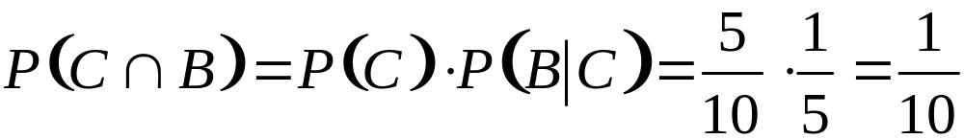
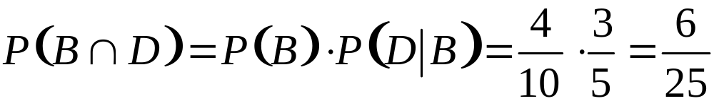
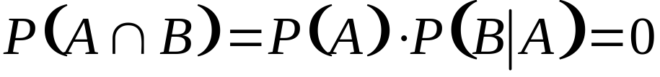
Solution*
Using the multiplicative rule, the probabilities are:

