Slide 1
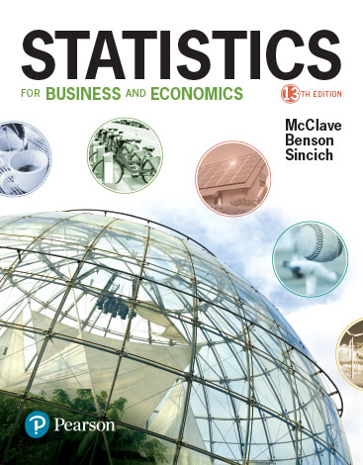
Chapter 4
Random Variables and Probability Distributions

Slide 2
Learning Objectives
Develop the notion of a random variable
Learn that numerical data are observed values of either discrete or continuous random variables
Study two important types of random variables and their probability models: the binomial and normal model
Present some additional discrete and continuous random variables
Notes:
As a result of this class, you will be able to...

Slide 3
Thinking Challenge
You’re taking a 33 question multiple choice test. Each question has 4 choices. Clueless on 1 question, you decide to guess. What’s the chance you’ll get it right?
If you guessed on all 33 questions, what would be your grade? Would you pass?

Slide 4
4.1
Two Types of Random Variables
Notes:
:1, 1, 3

Slide 5
Discrete Random Variable
Random variables that can assume a countable number (finite or infinite) of values are called discrete.

Slide 6
Discrete Random Variable Examples
Random
Variable
Possible
Values
Experiment
Make 100 Sales Calls
# Sales
0, 1, 2, ..., 100
Inspect 70 Radios
# Defective
0, 1, 2, ..., 70
Answer 33 Questions
# Correct
0, 1, 2, ..., 33
Count Cars at Toll
# Cars
0, 1, 2, ..., ∞
Between 11:00 & 1:00
Arriving

Slide 7
Continuous
Random Variable
Random variables that can assume values corresponding to any of the points contained in one or more intervals (i.e., values that are infinite and uncountable) are called continuous.

Slide 8
Continuous Random Variable Examples
Random
Variable
Possible
Values
Experiment
Weigh 100 People
Weight
45.1, 78, ...
Measure Part Life
Hours
900, 875.9, ...
Amount spent on food
$ amount
54.12, 42, ...
Measure Time
Inter-Arrival
0, 1.3, 2.78, ...
Between Arrivals
Time

Slide 9
4.2
Probability Distributions for Discrete Random Variables
Notes:
:1, 1, 3

Slide 10
Discrete
Probability Distribution
The probability distribution of a discrete random variable is a graph, table, or formula that specifies the probability associated with each possible value the random variable can assume.

Slide 11
Requirements for the
Probability Distribution of a Discrete Random Variable x
p(x) ≥ 0 for all values of x
Σ p(x) = 1
where the summation of p(x) is over all possible values of x.

Slide 12
Discrete Probability Distribution Example
Experiment: Toss 2 coins. Count number of tails.
Probability Distribution
Values, x Probabilities, p(x)
0 1/4 = 0.25
1 2/4 = 0.50
2 1/4 = 0.25
© 1984-1994 T/Maker Co.

Slide 13
Visualizing Discrete Probability Distributions
Listing
Table
{ (0, .25), (1, .50), (2, .25) }
f(x)
p(x)
# Tails
Count
0
1
.25
1
2
.50
Graph
2
1
.25
p(x)
.50
.25
Formula
n
.00
x
!
p
(
x
)
=
p^{x}(1 – p)^{n – x}
0
1
2
x!(n – x)!
Notes:
Experiment is tossing 1 coin twice.

Slide 14
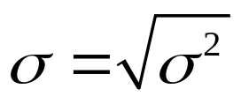
Summary Measures
Expected Value (Mean of probability distribution)
    Weighted average of all possible values
    μ = E(x) = Σx p(x)
Variance
    Weighted average of squared deviation about mean
    σ² = E[(x − μ)²] = Σ (x − μ)² p(x)
3. Standard Deviation
●
Notes:
population notation is used since all values are specified.

Slide 15
Summary Measures Calculation Table
x
p(x)
x p(x)
x – μ
(x – μ)²
(x – μ)²p(x)
Total
Σx p(x)
    Σ(x − μ)² p(x)

Slide 16
Thinking Challenge
You toss 2 coins. You’re interested in the number of tails. What are the expected value, variance, and standard deviation of this random variable, number of tails?
© 1984-1994 T/Maker Co.

Slide 17
Expected Value & Variance Solution*
x
p(x)
x p(x)
x – μ
(x – μ) ²
(x – μ) ²p(x)
0
.25
0
–1.00
1.00
.25
1
.50
.50
0
0
0
2
.25
.50
1.00
1.00
.25
μ
= 1.0
σ² = .50
σ = .71

Slide 18
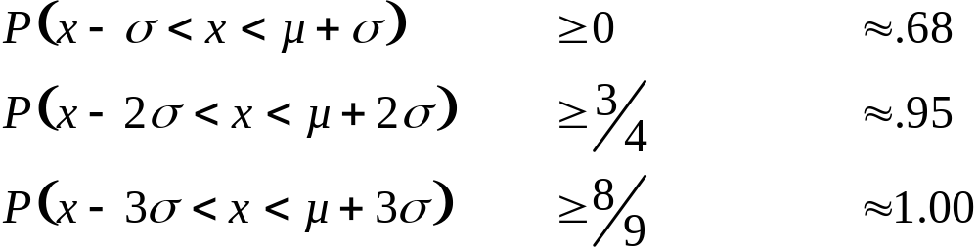
Probability Rules for Discrete Random Variables
Let x be a discrete random variable with probability distribution p(x), mean µ, and standard deviation σ. Then, depending on the shape of p(x), the following probability statements can be made:
Chebyshev’s Rule Empirical Rule

Slide 19
4.3
The Binomial Distribution
Notes:
:1, 1, 3

Slide 20
Binomial Distribution
Number of ‘successes’ in a sample of n observations (trials)
    Number of reds in 15 spins of roulette wheel
    Number of defective items in a batch of 5 items
    Number correct on a 33 question exam
    Number of customers who purchase out of 100 customers who enter store (each customer is equally likely to purchase)

Slide 21
Binomial Probability
Characteristics of a Binomial Experiment
1. The experiment consists of n identical trials.
2. There are only two possible outcomes on each trial. We will denote one outcome by S (for success) and the other by F (for failure).
3. The probability of S remains the same from trial to trial. This probability is denoted by p, and the probability of F is denoted by q. Note that q = 1 – p.
4. The trials are independent.
5. The binomial random variable x is the number of S’s in n trials.

Slide 22
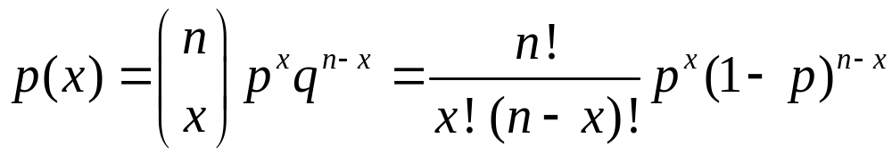
Binomial Probability Distribution
p(x) = Probability of x ‘Successes’
p = Probability of a ‘Success’ on a single trial
q = 1 – p
n = Number of trials
x = Number of ‘Successes’ in n trials
(x = 0, 1, 2, ..., n)
n – x = Number of failures in n trials

Slide 23
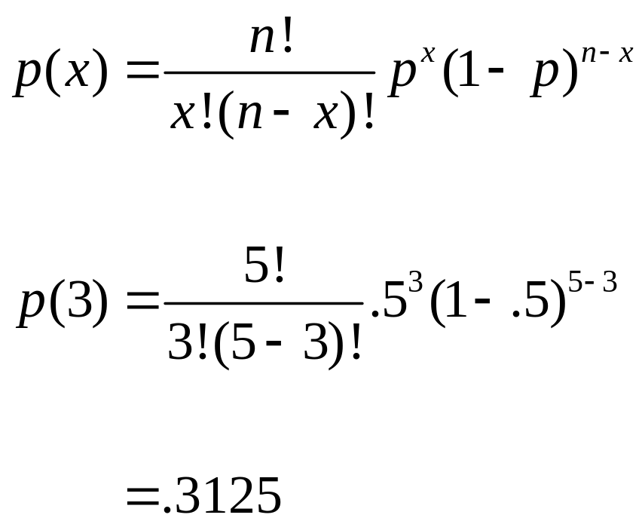
Binomial Probability Distribution Example
Experiment: Toss 1 coin 5 times in a row. Note number of tails. What’s the probability of 3 tails?
© 1984-1994 T/Maker Co.

Slide 24
Binomial Probability Table (Portion)
n = 5
p
k
.01
…
0.50
…
.99
0
.951
…
.031
…
.000
1
.999
…
.188
…
.000
2
1.000
…
.500
…
.000
3
1.000
…
.812
…
.001
4
1.000
…
.969
…
.049
Cumulative Probabilities
p(x ≤ 3) – p(x ≤ 2) = .812 – .500 = .312

Slide 25
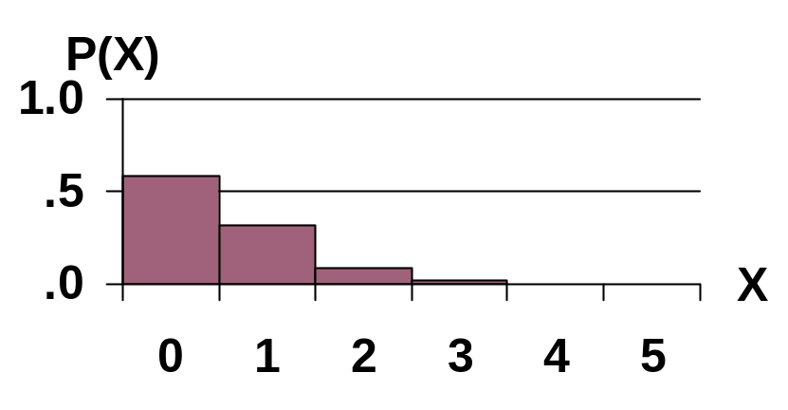

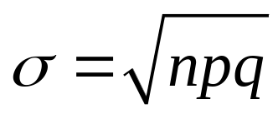
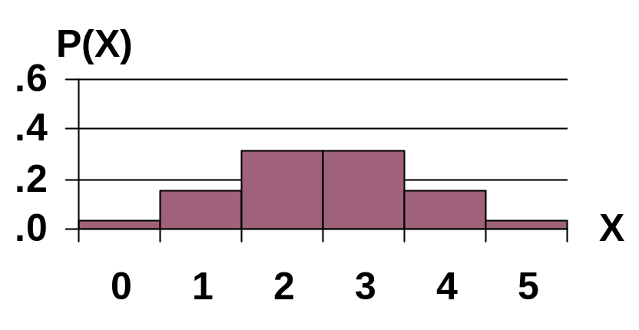
Binomial Distribution Characteristics
n = 5 p = 0.1
Mean
Standard Deviation
n = 5 p = 0.5
Notes:
Distribution has different shapes.
1st Graph:
If inspecting 5 items & the Probability of a defect is 0.1 (10%), the Probability of finding 0 defective item is about 0.6 (60%).
If inspecting 5 items & the Probability of a defect is 0.1 (10%), the Probability of finding 1 defective items is about .35 (35%).
2nd Graph:
If inspecting 5 items & the Probability of a defect is 0.5 (50%), the Probability of finding 1 defective items is about .18 (18%).
Note:
Could use formula or tables at end of text to get Probabilities.

Slide 26
Binomial Distribution Thinking Challenge
You’re a telemarketer selling service contracts for Macy’s. You’ve sold 20 in your last 100 calls (p = .20). If you call 12 people tonight, what’s the probability of
A. No sales?
B. Exactly 2 sales?
C. At most 2 sales?
D. At least 2 sales?

Slide 27
Binomial Distribution Solution*
n = 12, p = .20
A. p(0) = .0687
B. p(2) = .2835
C. p(at most 2) = p(0) + p(1) + p(2)
= .0687 + .2062 + .2835
= .5584
D. p(at least 2) = p(2) + p(3)...+ p(12)
= 1 – [p(0) + p(1)]
= 1 – .0687 – .2062
= .7251
Notes:
From the Binomial Tables:
A. p(0) = .0687
B. p(2) = .2835
C. p(at most 2) = p(0) + p(1) + p(2)
= .0687+ .2062 + .2835
= .5584
D. p(at least 2) = p(2) + p(3)...+ p(12)
= 1 - [p(0) + p(1)]
= 1 - .0687 - .2062
= .7251

Slide 28
4.4
Other Discrete Distributions: Poisson and Hypergeometric
Notes:
:1, 1, 3

Slide 29
Poisson Distribution
Number of events that occur in an interval
  events per unit
      Time, Length, Area, Space
Examples
    Number of customers arriving in 20 minutes
    Number of strikes per year in the U.S.
    Number of defects per lot (group) of DVD’s
Notes:
Other Examples:
Number of machines that break down in a day
Number of units sold in a week
Number of people arriving at a bank teller per hour
Number of telephone calls to customer support per hour

Slide 30
Characteristics of a Poisson Random Variable
Consists of counting number of times an event occurs during a given unit of time or in a given area or volume (any unit of measurement).
The probability that an event occurs in a given unit of time, area, or volume is the same for all units.
The number of events that occur in one unit of time, area, or volume is independent of the number that occur in any other mutually exclusive unit.
The mean number of events in each unit is denoted by the Greek letter lambda, λ.

Slide 31
Poisson Probability Distribution Function
x
–
λ
e
λ
p
(
x
)
=
(x = 0, 1, 2, 3, . . .)
x
!
μ = λ
σ² = λ
p(x) = Probability of x given λ
λ = Mean (expected) number of events in unit
e = 2.71828 . . . (base of natural logarithm)
x = Number of events per unit

Slide 32
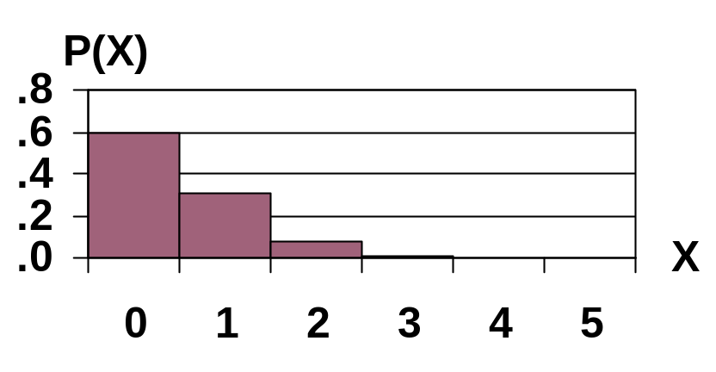

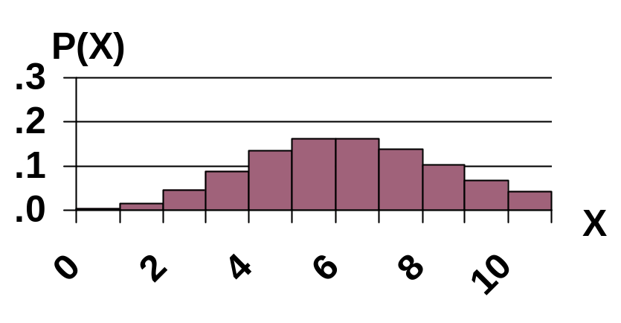
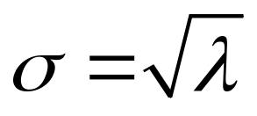
Poisson Probability Distribution Function
λ = 0.5
Mean
λ = 6
Standard Deviation

Slide 33

Poisson Distribution Example
Customers arrive at a rate of 72 per hour. What is the probability of 4 customers arriving in 3 minutes?
© 1995 Corel Corp.

Slide 34
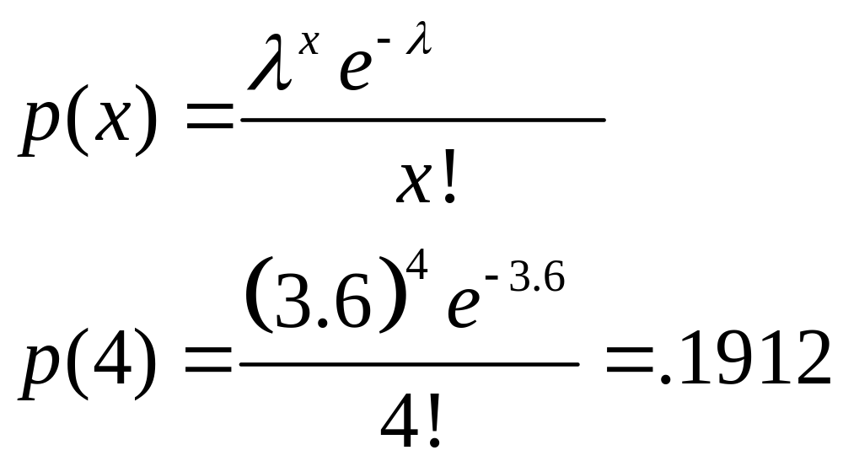
Poisson Distribution Solution
72 Per Hr. = 1.2 Per Min. = 3.6 Per 3 Min. Interval

Slide 35
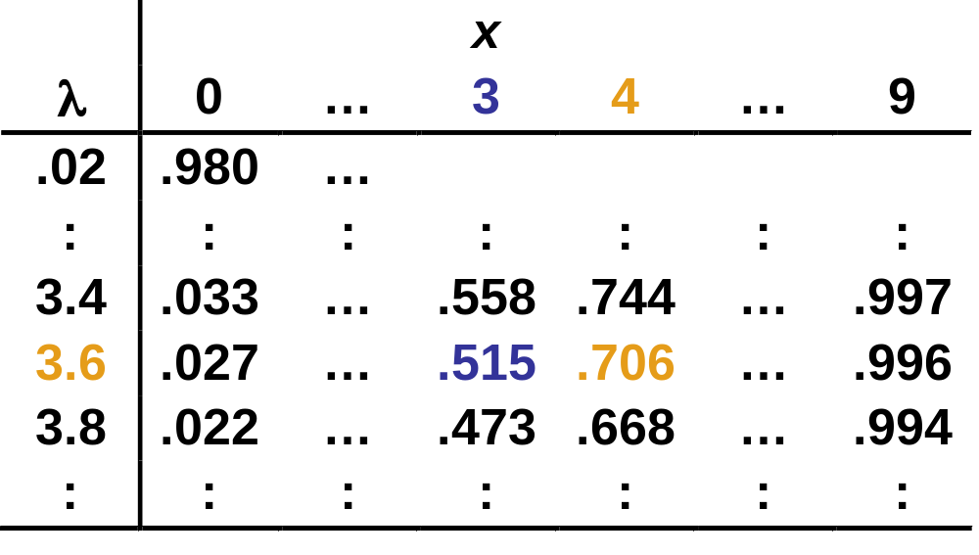
Poisson Probability Table (Portion)
Cumulative Probabilities
p(x ≤ 4) – p(x ≤ 3) = .706 – .515 = .191

Slide 36
Thinking Challenge
You work in Quality Assurance for an investment firm. A clerk enters 75 words per minute with 6 errors per hour. What is the probability of 0 errors in a 255-word bond transaction?
© 1984-1994 T/Maker Co.

Slide 37
Poisson Distribution Solution: Finding λ*
75 words/min = (75 words/min)(60 min/hr)
= 4500 words/hr
6 errors/hr = 6 errors/4500 words
= .00133 errors/word
In a 255-word transaction (interval):
λ = (.00133 errors/word )(255 words)
= .34 errors/255-word transaction

Slide 38
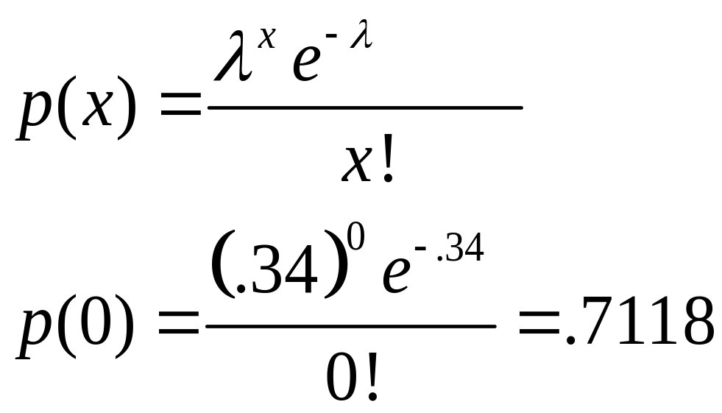
Poisson Distribution Solution: Finding p(0)*

Slide 39
Characteristics of a Hypergeometric
Random Variable
The experiment consists of randomly drawing n elements without replacement from a set of N elements, r of which are S’s (for success) and (N – r) of which are F’s (for failure).
The hypergeometric random variable x is the number of S’s in the draw of n elements.

Slide 40
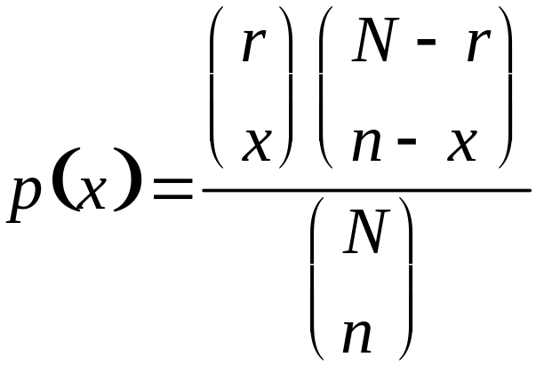
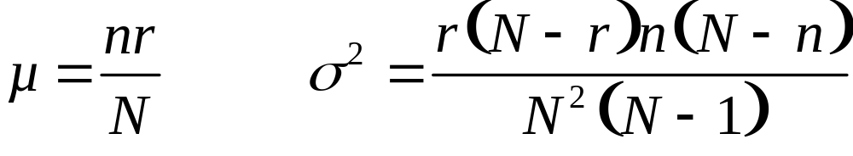
Hypergeometric Probability Distribution Function
[x = Maximum [0, n – (N – r), …,
Minimum (r, n)]
where . . .

Slide 41
Hypergeometric Probability Distribution Function
N = Total number of elements
r = Number of S’s in the N elements
n = Number of elements drawn
x = Number of S’s drawn in the n elements

Slide 42
4.5
Probability Distributions for Continuous Random Variables
Notes:
:1, 1, 3

Slide 43
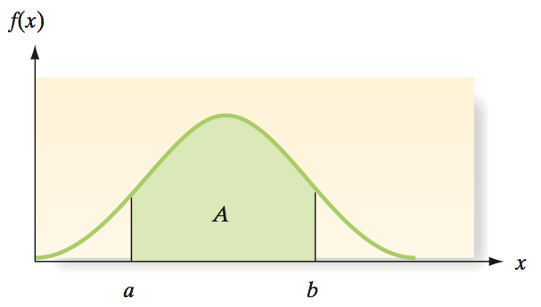
Continuous Probability Density Function
The graphical form of the probability distribution for a continuous random variable x is a smooth curve

Slide 44
Continuous Probability Density Function
This curve, a function of x, is denoted by the symbol f(x) and is variously called a probability density function (pdf), a frequency function, or a probability distribution.
The areas under a probability distribution correspond to probabilities for x. The area A beneath the curve between two points a and b is the probability that x assumes a value between a and b.

Slide 45
4.6
The Normal Distribution
Notes:
:1, 1, 3

Slide 46
Importance of
Normal Distribution
Describes many random processes or continuous phenomena
Can be used to approximate discrete probability distributions
  Example: binomial
Basis for classical statistical inference

Slide 47
Normal Distribution
‘Bell-shaped’ & symmetrical
Mean, median, mode are equal
f
(
x
)
x
Mean Median Mode

Slide 48
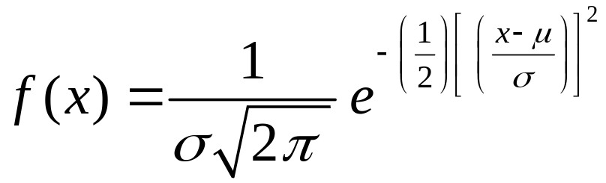
Probability Density Function
where
µ = Mean of the normal random variable x
σ = Standard deviation
π = 3.1415 . . .
e = 2.71828 . . .
P(x < a) is obtained from a table of normal
probabilities

Slide 49
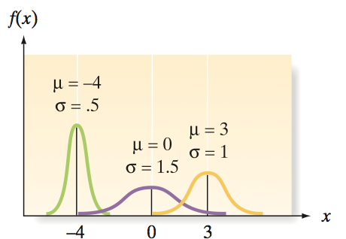
Effect of Varying
Parameters (μ & σ)

Slide 50
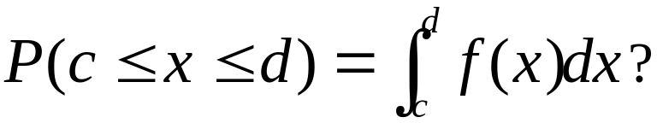

Normal Distribution
Probability
Probability is
area under
curve!
f
(
x
)
x
c
d

Slide 51
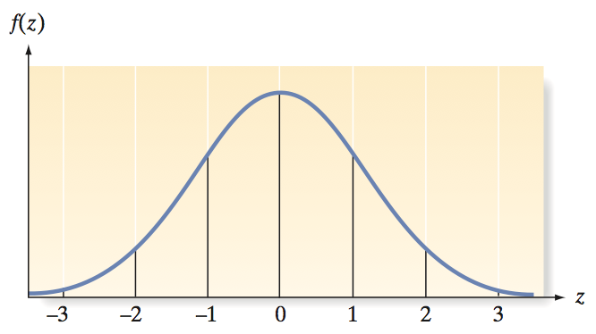
Standard Normal Distribution
The standard normal distribution is a normal distribution with µ = 0 and σ = 1. A random variable with a standard normal distribution, denoted by the symbol z, is called a standard normal random variable.

Slide 52
The Standard Normal Table:
P(0 < z < 1.96)
Standardized Normal Probability Table (Portion)
.06
Z
.04
.05
σ
= 1
1.8
.4671
.4678
.4686
.4750
1.9
.4738
.4744
.4750
2.0
.4793
.4798
.4803
μ
= 0
1.96
z
2.1
.4838
.4842
.4846
Shaded area exaggerated
Probabilities

Slide 53
The Standard Normal Table:
P(–1.26 ≤ z ≤ 1.26)
Standardized Normal Distribution
σ
= 1
P(–1.26 ≤ z ≤ 1.26)
= .3962 + .3962
= .7924
.3962
.3962
–1.26
1.26
z
μ
= 0
Shaded area exaggerated

Slide 54
The Standard Normal Table:
P(z > 1.26)
Standardized Normal Distribution
σ
= 1
P(z > 1.26)
= .5000 – .3962
= .1038
.5000
.3962
1.26
z
μ
= 0

Slide 55
The Standard Normal Table:
P(–2.78 ≤ z ≤ –2.00)
Standardized Normal Distribution
σ
= 1
P(–2.78 ≤ z ≤ –2.00)
= .4973 – .4772
= .0201
.4973
.4772
–2.78
–2.00
z
μ
= 0
Shaded area exaggerated

Slide 56
The Standard Normal Table:
P(z > –2.13)
Standardized Normal Distribution
σ
= 1
.4834
P(z > –2.13)
= .4834 + .5000
= .9834
.5000
–2.13
z
μ
= 0
Shaded area exaggerated

Slide 57
Non-standard Normal Distribution
Normal distributions differ by mean & standard deviation.
Each distribution would require its own table.
f(x)
x
That’s an infinite number of tables!

Slide 58
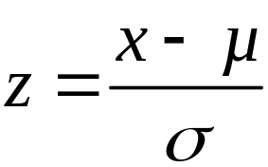
Converting a Normal Distribution to a Standard Normal Distribution
If x is a normal random variable with mean μ and standard deviation σ, then the random variable z, defined by the formula
has a standard normal distribution. The value z describes the number of standard deviations between x and µ.

Slide 59
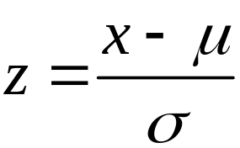
Standardize the
Normal Distribution
Normal
Distribution
Standardized Normal Distribution
σ
σ
= 1
μ
x
μ
= 0
z
One table!

Slide 60
Finding a Probability Corresponding to a Normal Random Variable
1. Sketch normal distribution, indicate mean, and shade the area corresponding to the probability you want.
2. Convert the boundaries of the shaded area from x values to standard normal random variable z
Show the z values under corresponding x values.
3. Use Table II in Appendix D to find the areas corresponding to the z values. Use symmetry when necessary.

Slide 61
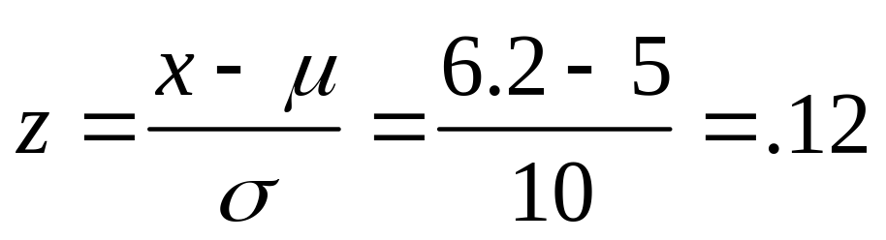
Non-standard Normal μ = 5, σ = 10: P(5 < x < 6.2)
Normal
Distribution
Standardized Normal Distribution
σ
= 10
σ
= 1
.0478
μ
= 5
6.2
x
μ
= 0
.12
z
Shaded area exaggerated

Slide 62
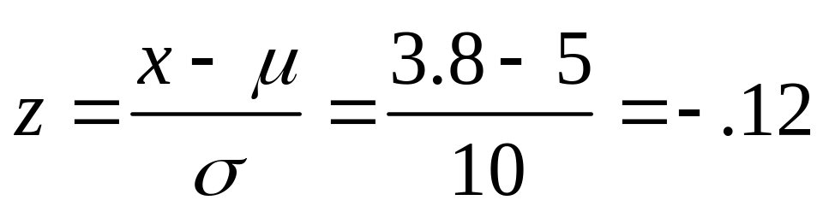
Non-standard Normal μ = 5, σ = 10: P(3.8 ≤ x ≤ 5)
Normal
Distribution
Standardized Normal Distribution
σ
= 10
σ
= 1
.0478
3.8
μ
= 5
x
-.12
μ
= 0
z
Shaded area exaggerated

Slide 63
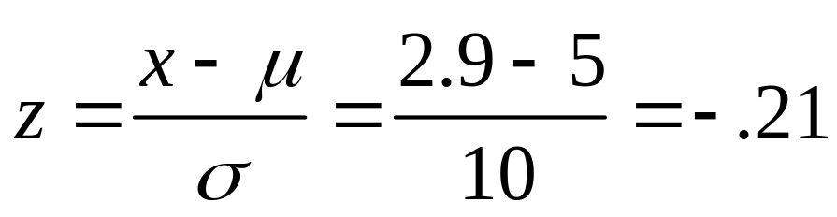
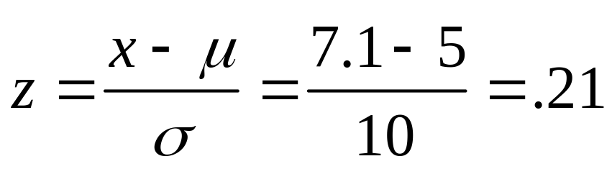
Non-standard Normal μ = 5, σ = 10: P(2.9 ≤ x ≤ 7.1)
Normal
Distribution
Standardized Normal Distribution
σ
= 10
σ
= 1
.1664
.0832
.0832
2.9
5
7.1
x
-.21
0
.21
z
Shaded area exaggerated

Slide 64
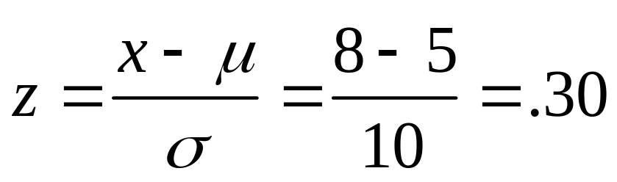
Non-standard Normal μ = 5, σ = 10: P(x ≥ 8)
Normal
Distribution
Standardized Normal Distribution
σ
= 10
σ
= 1
.5000
.3821
.1179
μ
= 5
8
x
μ
= 0
.30
z
Shaded area exaggerated

Slide 65
Non-standard Normal μ = 5, σ = 10: P(7.1 ≤ X ≤ 8)
Normal
Distribution
Standardized Normal Distribution
σ
= 10
σ
= 1
.1179
.0347
.0832
μ
= 5
7.1
8
x
μ
= 0
.21
.30
z
Shaded area exaggerated

Slide 66
Normal Distribution Thinking Challenge
You work in Quality Control for GE. Light bulb life has a normal distribution with
μ = 2000 hours and σ = 200 hours. What’s the probability that a bulb will last
A. between 2000 and 2400
hours?
B. less than 1470 hours?

Slide 67
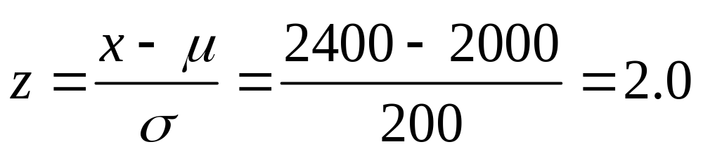
Solution* P(2000 ≤ x ≤ 2400)
Normal
Distribution
Standardized Normal Distribution
σ
= 200
σ
= 1
.4772
μ
= 2000
2400
x
μ
= 0
2.0
z

Slide 68
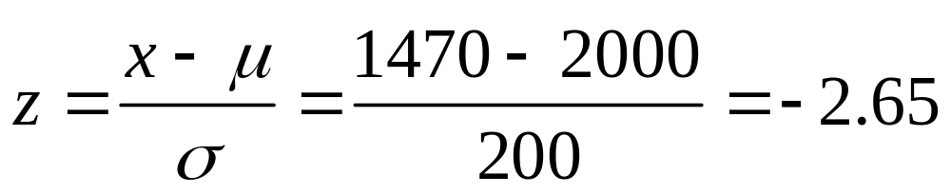
Solution* P(x ≤ 1470)
Normal
Distribution
Standardized Normal Distribution
σ
= 200
σ
= 1
.5000
.0040
.4960
1470
μ
= 2000
x
–2.65
μ
= 0
z

Slide 69
Finding z-Values for Known Probabilities
What is Z, given
P(z) = .1217?
Standardized Normal Probability Table (Portion)
σ
= 1
Z
.00
.01
0.2
.1217
0.0
.0000
.0040
.0080
0.1
.0398
.0438
.0478
μ
= 0
?
0.2
.0793
.0832
.0871
.31
z
0.3
.1179
.1217
Shaded area exaggerated
.1255

Slide 70

Finding x Values for Known Probabilities
Normal Distribution
Standardized Normal Distribution
σ
= 10
σ
= 1
.1217
.1217
μ
?
= 5
8.1
x
μ
= 0
.31
z
Shaded areas exaggerated

Slide 71
Normal Approximation of Binomial Distribution
Useful because not all binomial tables exist
Requires large sample size
Gives approximate probability only
Need correction for continuity
n = 10 p = 0.50
p(x)
.3
.2
.1
.0
x
0
2
4
6
8
10

Slide 72
Why Probability
Is Approximate
Probability Added by Normal Curve
p(x)
.3
.2
Probability Lost by Normal Curve
.1
.0
x
0
2
4
6
8
10
Binomial Probability: Bar Height
Normal Probability: Area Under Curve from 3.5 to 4.5
Notes:
As the number of vertical bars (n) increases, the errors due to approximating with the normal decrease.

Slide 73
Correction for Continuity
A 1/2 unit adjustment to discrete variable
Used when approximating a discrete distribution with a continuous distribution
Improves accuracy
4
3.5
(4 – .5)
4.5
(4 + .5)

Slide 74
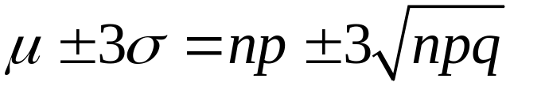
Using a Normal Distribution to Approximate Binomial Probabilities
1. Determine n and p for the binomial distribution, then calculate the interval:
  If interval lies in the range 0 to n, the normal distribution will provide a reasonable approximation to the probabilities of most binomial events.

Slide 75
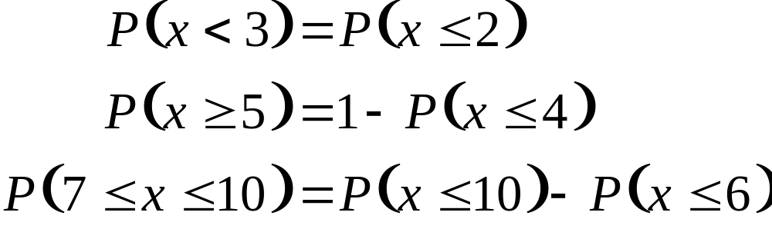
Using a Normal Distribution to Approximate Binomial Probabilities
2. Express the binomial probability to be approximated by the form
For example,

Slide 76
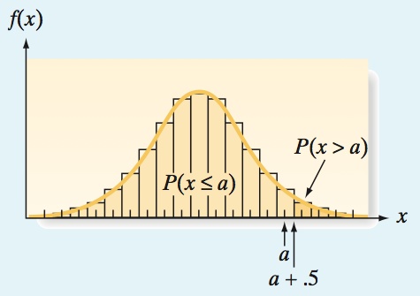
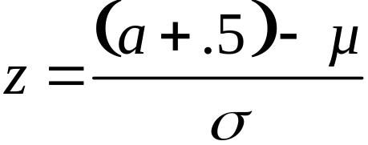
Using a Normal Distribution to Approximate Binomial Probabilities
3. For each value of interest a, the correction for continuity is (a + .5), and the corresponding standard normal z-value is

Slide 77
Using a Normal Distribution to Approximate Binomial Probabilities
4. Sketch the approximating normal distribution and shade the area corresponding to the event of interest. Using Table II and the z-value (step 3),
find the shaded area. This is the approximate probability of the binomial event.

Slide 78
Normal Approximation Example
What is the normal approximation of p(x = 4) given n = 10, and p = 0.5?
P(x)
.3
.2
.1
.0
x
0
2
4
6
8
10
3.5
4.5

Slide 79
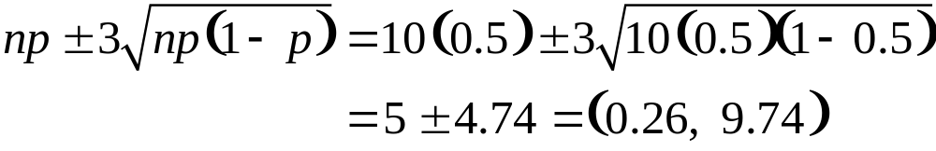

Normal Approximation Solution
1. Calculate the interval:
Interval lies in range 0 to 10, so normal approximation can be used
2. Express binomial probability in form:

Slide 80
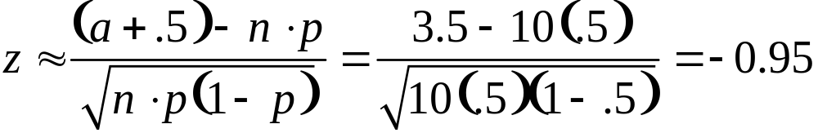
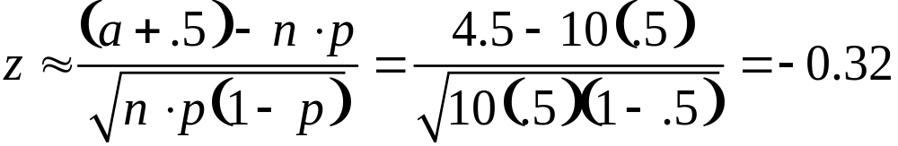
Normal Approximation Solution
3. Compute standard normal z values:

Slide 81
Normal Approximation Solution
4. Sketch the approximate normal distribution:
.3289
- .1255
.2034
μ
= 0
σ
= 1
.1255
.3289
-.95
-.32
z

Slide 82
Normal Approximation Solution
5. The exact probability from the binomial formula is 0.2051 (versus .2034)
p(x)
.3
.2
.1
.0
x
0
2
4
6
8
10

Slide 83
4.7
Descriptive Methods for
Assessing Normality
Notes:
:1, 1, 3

Slide 84
Determining Whether the Data Are from an Approximately Normal Distribution
Construct either a histogram or stem-and-leaf display for the data and note the shape of the graph. If the data are approximately normal, the shape of the histogram or stem-and-leaf display will be similar to the normal curve.

Slide 85

Determining Whether the Data Are from an Approximately Normal Distribution
Compute the intervals and determine the percentage of measurements falling in each. If the data are approximately normal, the percentages will be approximately equal to 68%, 95%, and 100%, respectively; from the Empirical Rule (68%, 95%, 99.7%).

Slide 86
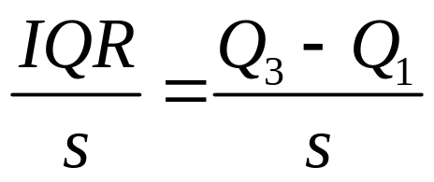
Determining Whether the Data Are from an Approximately Normal Distribution
Find the interquartile range, IQR, and standard deviation, s, for the sample, then calculate the ratio IQR/s. If the data are approximately normal, then IQR/s ≈ 1.3.

Slide 87
Determining Whether the Data Are from an Approximately Normal Distribution
Examine a normal probability plot for the data. If the data are approximately normal, the points will fall (approximately) on a straight line.
Expected z–score
Observed value

Slide 88
Normal Probability Plot
A normal probability plot for a data set is a scatterplot with the ranked data values on one axis and their corresponding expected z-scores from a standard normal distribution on the other axis. [Note: Computation of the expected standard normal z-scores are beyond the scope of this text. Therefore, we will rely on available statistical software packages to generate a normal probability plot.]

Slide 89
4.8
Other Continuous Distributions:
Uniform and Exponential
Notes:
:1, 1, 3

Slide 90
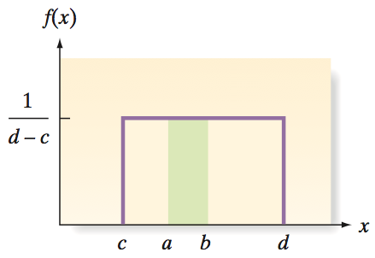
Uniform Distribution
Continuous random variables that appear to have equally likely outcomes over their range of possible values possess a uniform probability distribution.
Suppose the random variable x can assume values only in an interval c ≤ x ≤ d. Then the uniform frequency function has a rectangular shape.

Slide 91
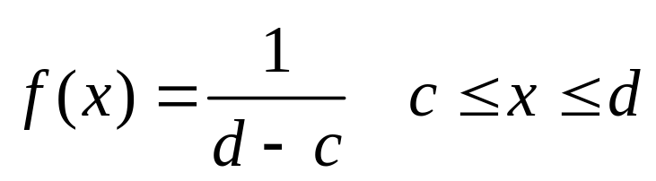
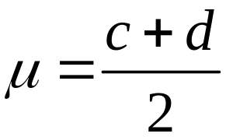
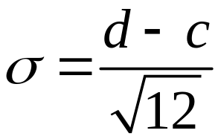
Probability Distribution for a Uniform Random Variable x
Probability density function:
Mean:
Standard Deviation:

Slide 92

Uniform Distribution Example
You’re production manager of a soft drink bottling company. You believe that when a machine is set to dispense 12 oz., it really dispenses between 11.5 and 12.5 oz. inclusive. Suppose the amount dispensed has a uniform distribution. What is the probability that less than 11.8 oz. is dispensed?
SODA

Slide 93
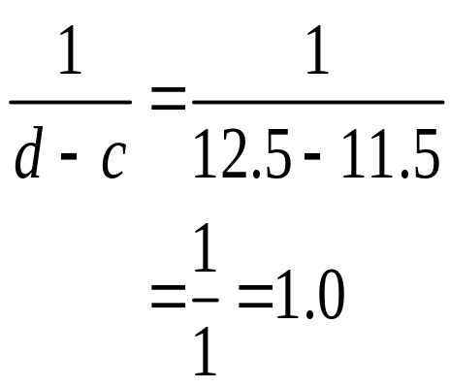
Uniform Distribution Solution
f(x)
1.0
x
11.5
11.8
12.5
P(11.5 ≤ x ≤ 11.8) = (Base)/(Height)
= (11.8 – 11.5)/(1) = .30

Slide 94
Exponential Distribution
The length of time between emergency arrivals at a hospital, the length of time between breakdowns of manufacturing equipment, and the length of time between catastrophic events (e.g., a stock market crash), are all continuous random phenomena that we might want to describe probabilistically.
The length of time or the distance between occurrences of random events like these can often be described by the exponential probability distribution. For this reason, the exponential distribution is sometimes called the waiting-time distribution.

Slide 95
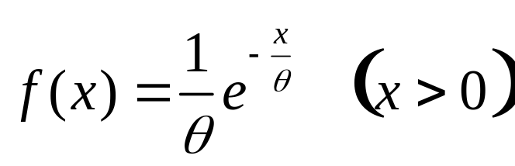


Probability Distribution for an Exponential
Random Variable x
Probability density function:
Mean:
Standard Deviation:

Slide 96
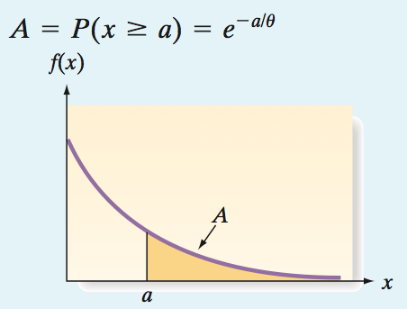
Finding the Area to the Right of a Number a for an Exponential Distribution

Slide 97


Exponential Distribution Example
Suppose the length of time (in hours) between emergency arrivals at a certain hospital is modeled as an exponential distribution with θ = 2. What is the probability that more than 5 hours pass without an emergency arrival?
Mean:
Standard Deviation:

Slide 98
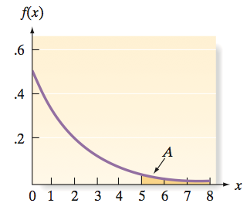
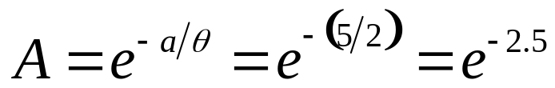
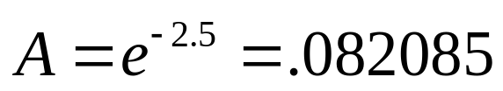
Exponential Distribution Solution
Probability is the area A to the right of a = 5.
Use stat software:
Probability that more than 5 hours pass between emergency arrivals is about .08.

Slide 99
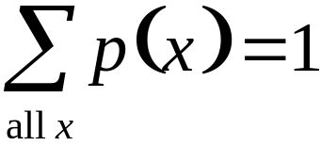
Key Ideas
Properties of Probability Distributions
Discrete Distributions
1. p(x) ≥ 0
2.
Continuous Distributions
1. P(x = a) = 0
2. P(a < x < b) = area under curve between a and b
Notes:
As a result of this class, you will be able to...

Slide 100
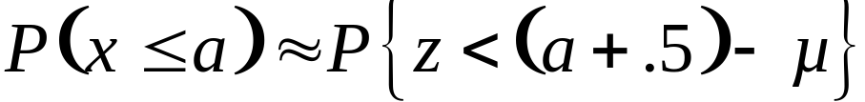
Key Ideas
Normal Approximation to Binomial
x is binomial (n, p)
Notes:
As a result of this class, you will be able to...

Slide 101

Key Ideas
Methods for Assessing Normality
1. Histogram
Notes:
As a result of this class, you will be able to...

Slide 102
Key Ideas
Methods for Assessing Normality
2. Stem-and-leaf display
1 7
2 3389
3 245677
4 19
5 2
Notes:
As a result of this class, you will be able to...

Slide 103

Key Ideas
Methods for Assessing Normality
3. (IQR)/S ≈ 1.3
4. Normal probability plot
Notes:
As a result of this class, you will be able to...

