Slide 1
Professional Development Opportunities

Slide 2
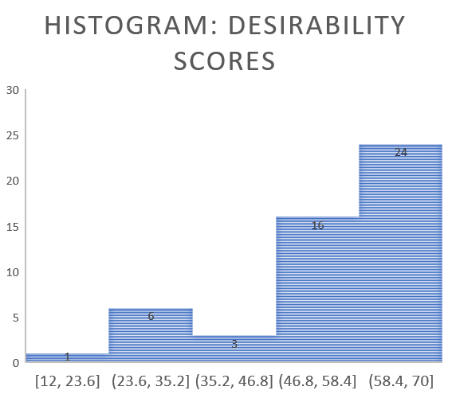
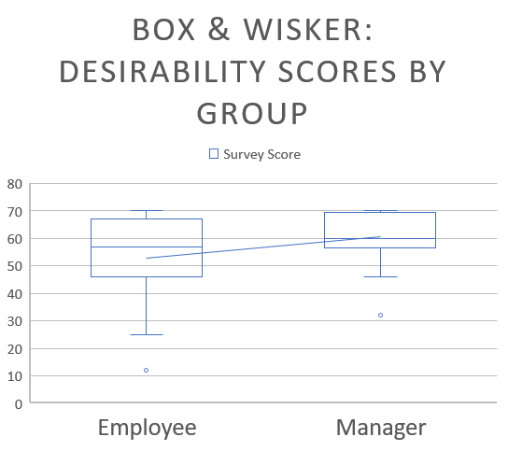
Visual Representation: Desirability Survey

Slide 3
Visual Representation: Cost

Slide 4
Visual Representation: Delivery Preference

