Slide 1
Professional Development Opportunities
Full Report

Slide 2
Purpose
The purpose of this investigation was to understand the opportunities for professional development within the organization.
This report will discuss the following:
Employee desire to obtain professional development
Costs of professional development
Employee professional development delivery preference

Slide 3
Data Sources
Three data sources were considered for this presentation:
Employee Survey to Determine Desirability of Professional Development
Cost of Professional Development per Employee for various lengths
Employee Survey to Determine Professional Development delivery preference

Slide 4
Data: Desirability Survey
Either Ordinal (item level) or Interval Data (total)
Survey deployed to 50 participants
Score determined by totaling 10 item scores on survey
For each item, participants could add between 1 and 7 point to their score total (Ranging from Strongly Disagree to Strongly Agree)
Maximum score: 70, Minimum Score: 10
Higher scores suggest professional development is more desired

Slide 5
Desirability Statistical Analysis: Descriptive
Population (N) | Mean (95% CI) | Median | Mode | Standard Deviation
Managers (21) | 60.52 (4.23) | 60 | 70 | 9.28
Employees (29) | 52.79 (5.90) | 57 | 68 | 15.52

Slide 6
Analysis
Data was represented visually
Statistical analysis completed for Desirability Survey
  Descriptive statistics
  Inferential test (t-test)

Slide 7
Desirability Statistical Analysis: Inferential
Question: Is desirability of professional development different between managers and employees?
  H₀: µ_{M}-µ_{E} = 0
  H₁: µ_{M}-µ_{E} ≠ 0
Non-directional (two tailed), independent samples t-test, ꭤ = 0.05
t = 2.01, df=48, p = 0.048
Reject the null hypothesis.
Employee and Manager Desirability scores are different.
Managers have greater desirability for professional development than Employees.

Slide 8
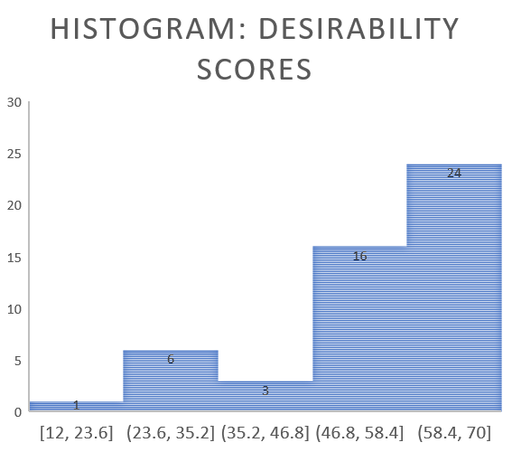
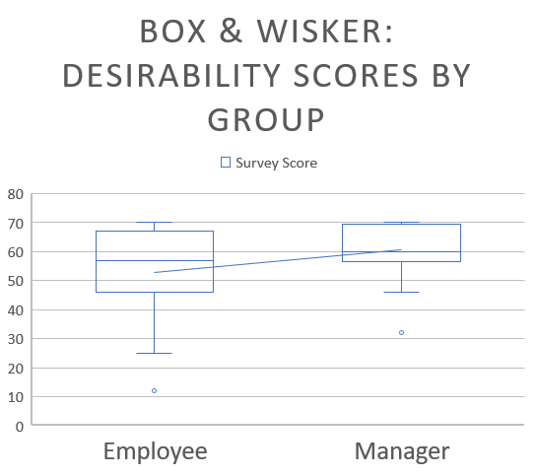
Visual Representation: Desirability Survey

Slide 9
Summary & Discussion
Employees and Managers express desirability for professional development, though Managers express greater levels of desirability.
The hourly cost per person for professional development decreases as hours increase. However, this decrease is not very much and probably should not impact considerations strongly.
The majority of participants prefer in person, synchronous professional development
When planning professional development, Managers should be prioritized

