Slide 1
Professional Development Opportunities
Full Report

Slide 2
Purpose
The objective of this research was to understand the professional development opportunities in the organization.
This report will discuss the following:
The desire of mangers to obtain professional development
Employee professional development delivery preference

Slide 3
Data Sources
Two data sources were considered for this presentation:
Managers Survey to Determine Desirability of Professional Development
Employee Survey to Determine Professional Development delivery preference

Slide 4
Data: Desirability Survey
Ordinal data
Survey deployed to 50 participants
Twenty one managers and twenty nine employees
Maximum score: 70 for managers and 75 for employees
Minimum Score: 12 for both managers and employees
Higher scores indicates a more desire towards professional development

Slide 5
Analysis
Data was presented visually using a histogram and Box plot
Statistical analysis for Desirability Survey
  Descriptive statistics
  Inferential test (t-test)

Slide 6
Descriptive Statistics
 | Total | Mean | Median | Mode | Max | Min | Range | Standard Deviation
Managers | 21 | 41.38 | 47 | 12 | 70 | 12 | 58 | 22.82
Employee | 29 | 50.52 | 56 | 68 | 75 | 12 | 63 | 18.85

Slide 7
Inferential Analysis
Hypothesis: The desirability of professional development is different between managers and employees
  H₀: µ_{M}-µ_{E} = 0
  H₁: µ_{M}-µ_{E} ≠ 0
Two tailed, independent samples t-test assuming equal variances
ꭤ = 0.05
t = 2.01, df=48, p = 0.128
Accept the null hypothesis.
Employee and Manager Desirability scores are different
Employees have greater desirability for professional development than Managers.

Slide 8
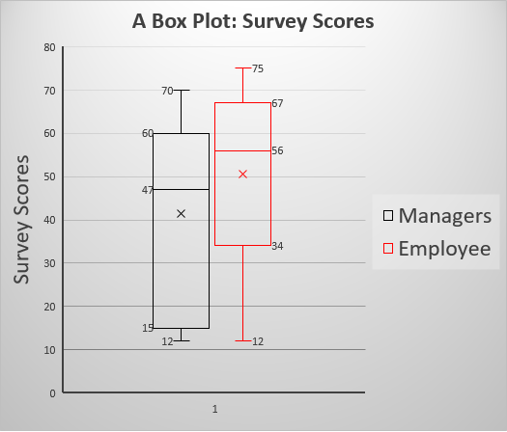
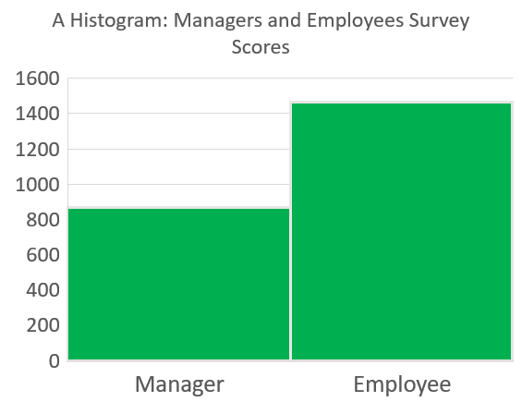
Visual Representation: Desirability Survey

Slide 9
Summary & Discussion
Employees and Managers express desirability for professional development, though Employees express greater levels of desirability.
When planning professional development, Employees should be prioritized
The range for the employees is greater than that of the managers

