Slide 1

Dystopian Novel
Do Androids Dream of Electric Sheep

Slide 2
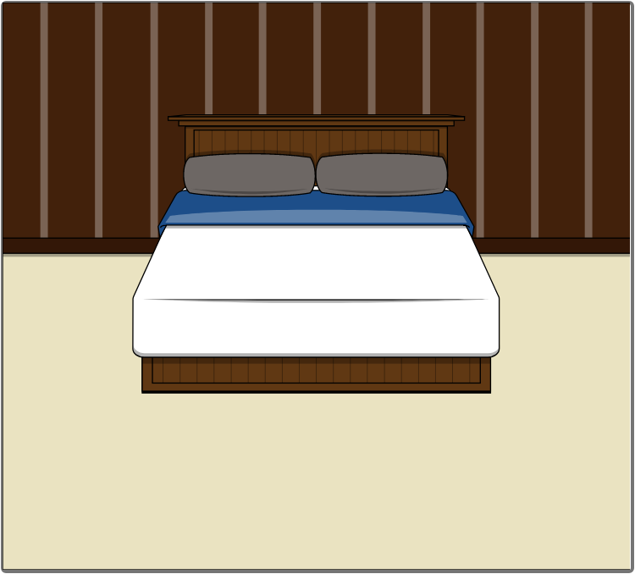
Add Title Here
My schedule for today lists a six-hour self-accusatory depression.

Slide 3
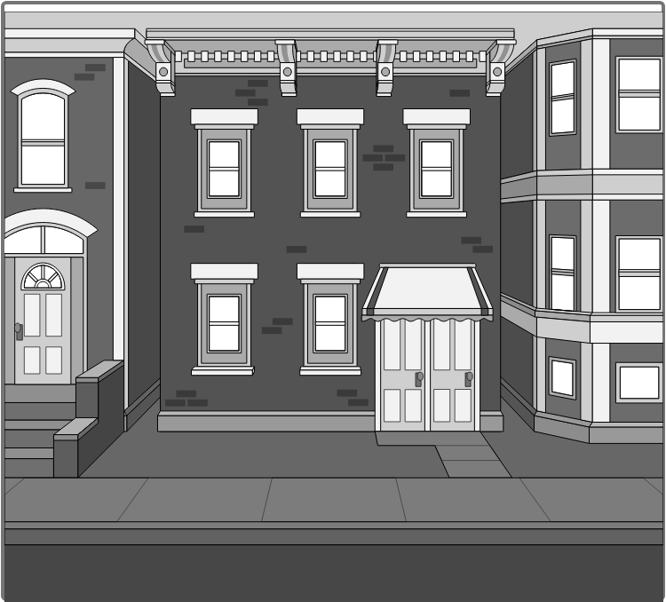
Add Title Here
Emigrate or degenerate! The choice is yours!

Slide 4
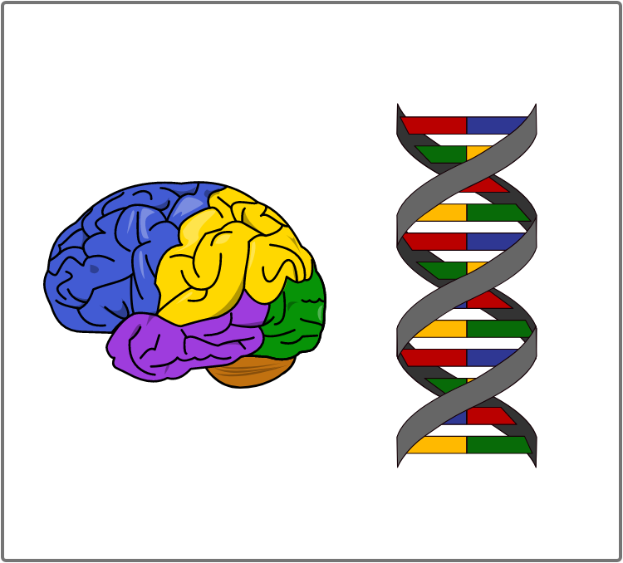
Add Title Here
Marked as biologically unacceptable, a menace to the pristine heredity of the race. Once pegged as special, a citizen, even if accepting sterilization, dropped out of history, in effect, to be part of mankind.

Slide 5
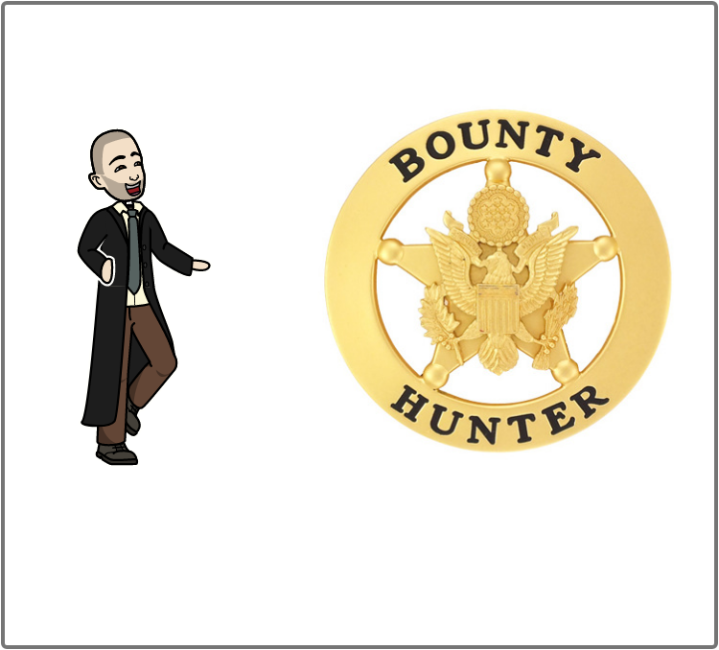
Add Title Here
You will be required to do wrong no matter where you go. It is the basic condition of life, to be required to violate your own identity. At some time every creature which lives must do so.

Slide 6
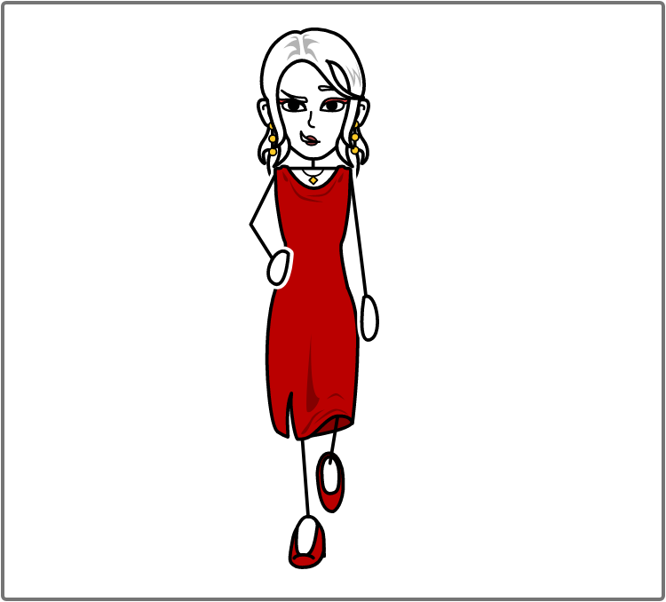
Add Title Here
I love you, ‘Rachael said. ‘if entered a room and found a sofa covered with your hide I’d score very high on the Voigt-Kampff test.

Slide 7
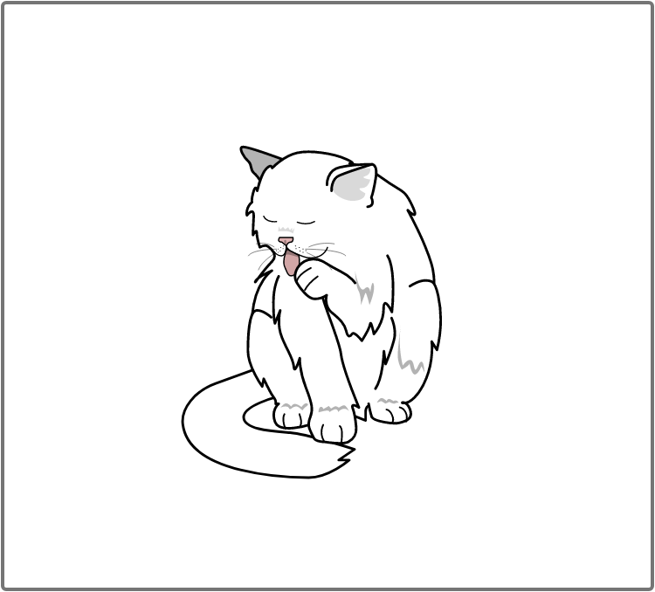
Add Title Here
The electric things have their life too. Paltry as those lives are

Slide 8
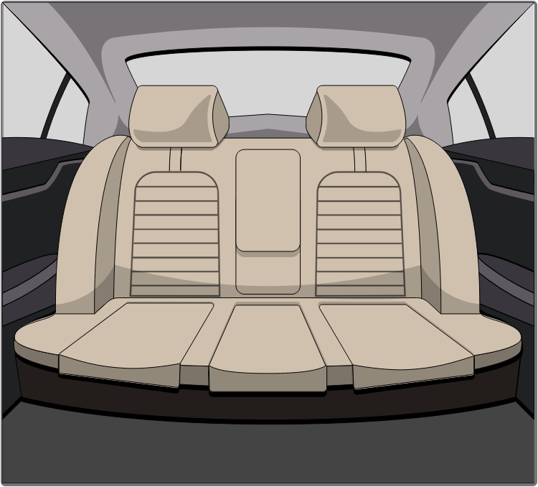
Add Title Here
Maybe there was once a human who looked like you, and somewhere along the line you killed him and took his place. And your superiors don’t know

Slide 9
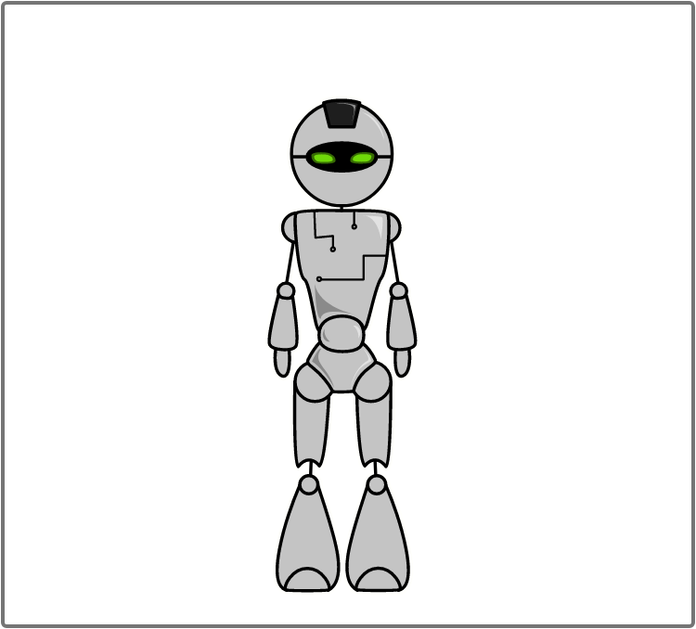
Add Title Here
An android, “he said, “doesn’t care what happens to another android. That’s one of the indications we look for”.
“Then, “Miss Luft said, “you must be an android.

Slide 10
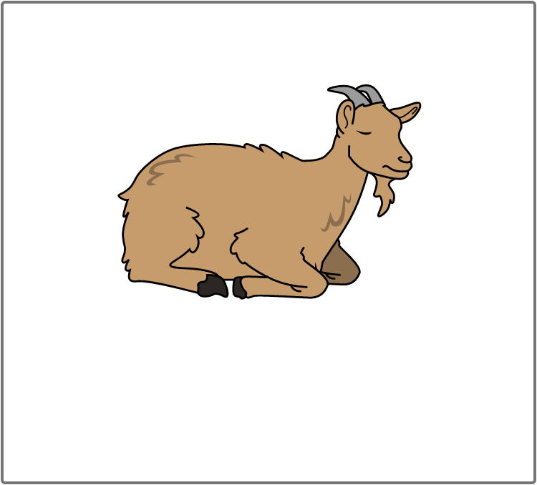
Add Title Here
Frankly you look more like a goat man to me.

