Slide 1

Lecture 5
Order to Cash (OTC)
FIN319

Slide 2
Learning Objectives
Understand the elements involved on the Order to Cash (OTC) process
Understand the goal of Sales and Distribution (SD) and Inventory Management (IM)
Understand the IM elements involved on the OTC process
Understand the SD elements involved on the OTC process
Understand the FI elements involved on the OTC process
Understand the integration points between SD, IMWM and FICO

Slide 3
Introduction
Order to Cash

Slide 4
Order to Cash (OTC)
Business Process
Order to Cash
Covers the process from the contact with the customer and ends with the collection of cash for goods or service
Sales Order
Sourcing
Shipping
Billing
Incoming Payment
Load schedule
Capacity Materials
Manufacturing/
Backflush

Slide 5
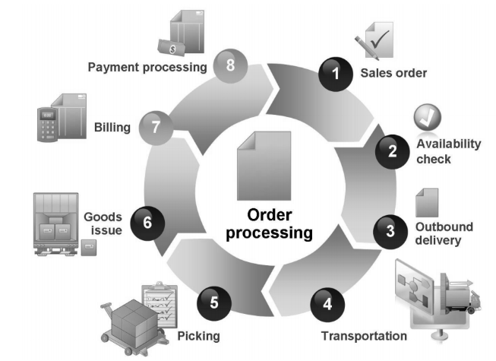
Order to Cash (OTC)
Business Process
Goal
Customer order
  Receive order from the customer (demand)
Order fulfillment/Backflush (financial impact)
  Manufacturing of goods or delivery of services
Shipping (financial impact)
  Delivery of finished goods (transportation, picking and goods issue)
Billing (financial impact)
  Billing to customer
Cash collection (financial impact)

Slide 6
Order to Cash (OTC)
S/4: Sales, Inventory, Finance
Use for the sales order, schedule, manufacturing, shipping, billing and cash collection.
Benefits
  Maximize sales with order and contract management
  Drive and manage sales performance
  Support your sales force and sales managers
Sales Pricing and Performance Management
SD-Sales Order
IM-Inventory control
FI-AR management
Products
Digital Core
S/4 HANA

Slide 7

Order to Cash (OTC)
The case of SAP C/4 HANA
https://www.sap.com/assetdetail/2018/10/f81dbffa-257d-0010-87a3-c30de2ffd8ff.html

Slide 8
Procurement to Pay (PTP)
Organizational Structure
Org
Represents the legal and/or organizational views of an enterprise and it forms a framework that supports the activities of a business in the manner desired by management
Represents an independent legal accounting unit.
Balanced set of books, as required by law, are prepared at this level.
An organizational unit that represents separate areas of operations or locations within
an organization.
  Credit limits
  Monitors credit
  Extend credit
It can include one or more company codes
It can manage credit
  Centralized
  Decentralized
Company code
Credit
Control
The plant represents a production unit and is the central organizational unit in Materials Management and Production Planning.
Manufacturing, distribution, purchasing or maintenance facility
Plant

Slide 9
Procurement to Pay (PTP)
Organizational Structure (Cont)
Org
Is a location in a plant from which outbound deliveries are shipped
They associated to one or more plants and a plant may have more than one.
  .
A unique combination of sales organization, distribution channel and division
Sales organization is the organization unit responsible for the sale and distribution of goods and services in a geographical area.
Distribution channel is the means by which a company code delivers goods and services (e.g. wholesale, retail, online, etc).
Division is a way to consolidate goods and services with similar characteristics.
Sales
Area
Shipping point
Sales
Office
A physical location that has the responsibility to sales goods or services within a geographical area

Slide 10

Order to Cash (OTC)
Global Bike Material Management Structure
Two company codes
Four sales organization
  2 under GBI
  2 under Global Bike Germany
3 Distribution channels
  1 for GBI
  2 for Global Bike Germany
Sales office
  3 under GBI
  2 under Global Bike Germany
Global Bike
Client
Global Bike Inc
Global Bike Germany GmbH
Company code
US West
US East
DE South
DE North
Sales Org
San Diego
Dallas
Miami
Heilderberg
Hamburg
Sales Office

Slide 11



Order to Cash (OTC)
Data Types
Master records
Single source of common business data used across SAP.
Transactional records
Data that represents a financial event.
Material
Sales & Distribution
Orders and Invoices
Purchasing
Sourcing
Customer
Inventory Management
Backflush and Shipping
Price condition
Finance
Invoice and Payment

Slide 12

Order to Cash (OTC)
Reflection
What similitude do you find between plant and sales office?
How would you describe the concept of sales area?
What is the difference between sales organization and sales office?

Slide 13
Inventory Management
Order to Cash

Slide 14
Inventory Management (IM)
Introduction
Inventory
Inventory control
Stock
Demand
GL
Inventory and Warehouse management deals with placing and handling stock that will be shipped to customers in the correct place within the company’s premises and plays a relevant element in the order to cash (OTC) process.

Slide 15
Inventory Management (IM)
Sub-modules
IM
Good Movements
Control the in and outs of inventory.
Sales Pricing and Performance Management
SD-Sales Order
IM-Inventory control
FI-AR management
IM
Material Docs
Control the change, display, reversal of material documents.
Products
IM
Periodic Processing
Controls the period processing of inventory.
Digital Core
S/4 HANA
IM
Subcontracting
Controls the subcontracting of goods and services.

Slide 16
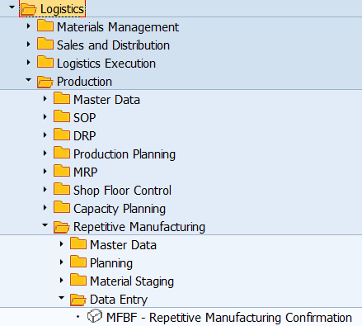
Inventory Management (IM)
Transactions
Invetnory
Tcode | Description | Type
MFBF | Backflush | Transaction
MB03 | Material document | Transaction

Slide 17
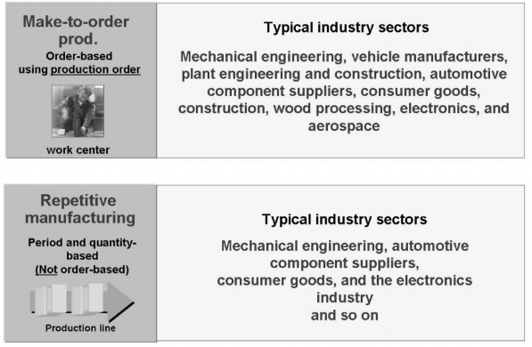


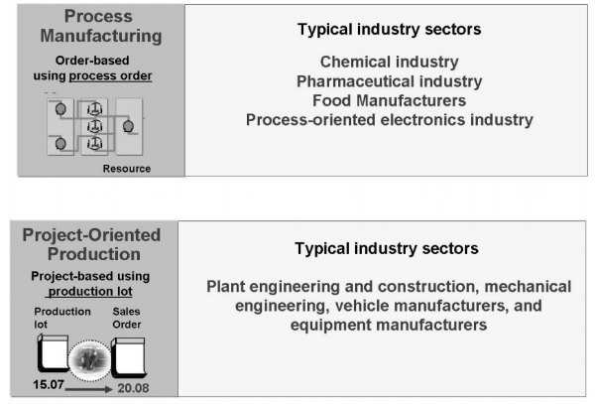
Inventory Management (IM)
Production Strategy
Inventory
01
Production strategy
Repetitive
Discreate
02

Slide 18

Inventory Management (IM)
Backflush
Inventory
Sales order
Customer notification
Customer Demand
Manufacturing finished goods
Procure raw material
Raw
Material
Finish
Goods
Backflush is a goods movement in which we accept the manufactured finished goods after the transformation from components.
Material is placed on stock (finished goods) ready for shipment

Slide 19
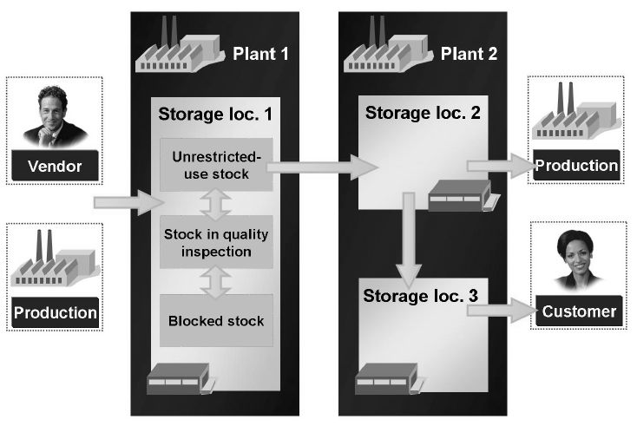
Inventory Management (IM)
Material Movements Types
Inventory
It is a three digit key that represents a movement of goods
Examples of movement types
  101, goods receipt into warehouse
  103, good receipt into blocked stock
  122, return goods to vendor
  231, consumption for a sales order

Slide 20
Inventory Management (IM)
Backflush
Inventory
Event series during a backflush
Material document
Stock quantities and values are updated
Accounting document
  Raw material inventory updates from price on material master from components
  Finished foods inventory updates from price on material from finished foods and BOM
  Any variance goes Backflush variance
Material document
Raw material Inventory valuation
Accounting document
Finished goods Inventory valuation
Controlling document

Slide 21
Inventory Management (IM)
Backflush: Financial impact
Inventory
Company code
Plant
Raw Material ($,550)
Finish Goods
  Bill of Material ($1,550)
Posting & Document date
Transaction date
Currency
Line items
  Finish goods inventory (debit)
  Raw material inventory (credit)
  Amounts
Document date:
09/30/2018
Company code:
US00
Posting date:
09/30/2018
Currency:
USD
Document Number
1XXXXXXX
Transaction date:
09/30/2018
Item in document currency
Line
PK
Account
Amount
001
40
200900 Raw Material Inv
$1,555.00-
002
50
200910 Finished goods Inv
$1,555.00

Slide 22
Order to Cash (OTC)
Reflection
Where do you connect the PTP with the OTC processes?
What do you think is the financial impact of backflush?
What could the reason of any backflush variance?

Slide 23
Sales and Distribution
Order to Cash

Slide 24
Sales and Distribution
Introduction
Sales
Sales and Distribution contains the most relevant elements of the order to cash process gathering the data from the customer order to the delivery of goods.
Sales
Demand
Fulfillment
Quote

Slide 25
Sales and Distribution (SD)
Sub-modules
Sales
SD
Master Data
Controls the SD master data
Sales Pricing and Performance Management
SD-Sales Order
IM-Inventory control
FI-AR management
SD
Sales
Control the creation and change to sales orders
Products
SD
Shipping & Transportation
Controls the shipping and transportation instructions
Digital Core
S/4 HANA
SD
Billing
Controls the invoicing process.

Slide 26
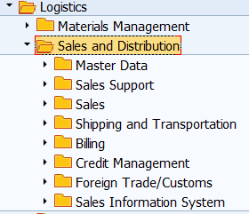
Sales and Distribution
Transactions
Sales
Tcode | Description | Type
XD01 | Customer Master | Master Data
VK31 | Create pricing conditions | Master Data
VA21 | Create quotes | Transaction
VA01 | Crate sales orders | Transaction

Slide 27

Sales and Distribution
Customer master
Sales
Customer Master Account is data needed to conduct business with customers and execute transactions related with fulfillment process.
General (Client)
Sales area
Account
Name
Address
Bank information
Currency
Delivering plant
Delivery priorities
Shipping conditions
Partner functions

Slide 28
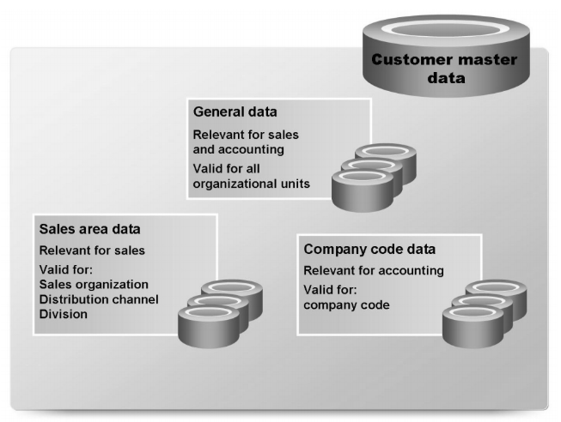
Sales and Distribution
Master Data: Customer Master organization level
Sales
Client level (General)
  For the enterprise
Company level (Accounting)
  For the company code
Sales area level
  For the sales organization

Slide 29

Sales and Distribution
Master Data: Material Master
Sales
Contains all of the key information a company needs to manage a material within its organization.
The material master defines, among other things, how a product is sold, manufactured, purchased, inventoried and costed.
Information is grouped into views that are organized by business function.
The majority of views of master data are stored at the plant level.
Basic Data
Material
Sales
Unit of measure
Material group
Description
Sales org data 1
Sales org data 2
Delivery plant
Tax data
Conditions
Sales general
Availability
Transportation

Slide 30
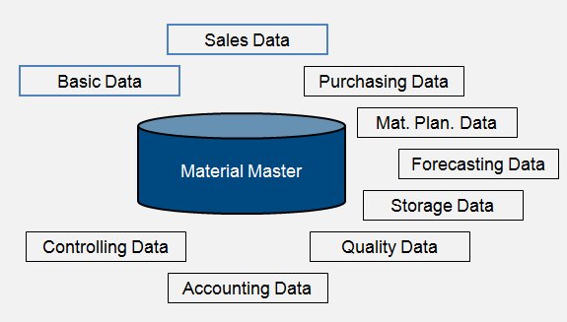
Sales and Distribution
Material Master Views
Sales
Basic
Sales (SD)
Purchasing
Plant
Forecast
Storage
Quality
Accounting
Controlling

Slide 31

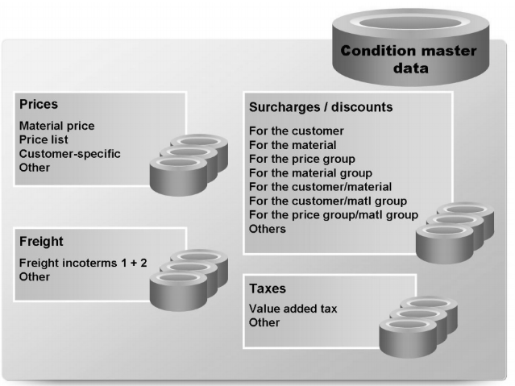
Sales and Distribution
Master Data: Conditions
Sales
Contains the selling prices of finished goods.
You can define the condition master to be dependent on various data:
  Material specific
  Customer specific
Conditions can be dependent on any document field

Slide 32
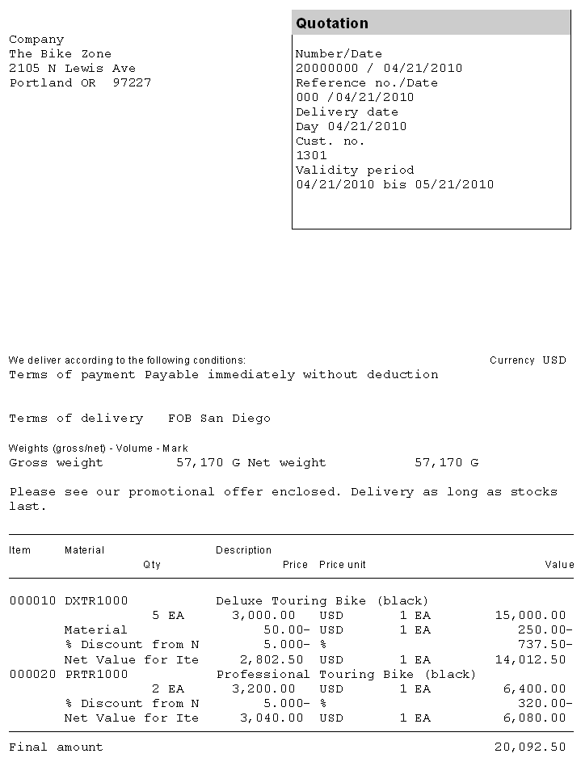
Sales and Distribution (SD)
Quote
Sales
The quotation presents the customer with a legally binding offer to deliver specific products or a selection of a certain amount of products in a specified timeframe at a pre-defined price.

Slide 33
Sales and Distribution (SD)
Sales Order
Sales
Origins
Sales Orders Items
Sales order processing can originate from a variety of documents and activities
Customer contacts us for order: phone, internet, email
Existing Contract
Quotations
The sales order contains all the information needed to process your customers request; the following information is determined for each sales order:
Delivering Schedule
Shipping point and route determination
Availability Check
Transfer of requirements to MRP
Pricing
Credit limit check
Elements
Customer Information
Material/service and quantity
Pricing (conditions)
Specific delivery dates and quantities
Shipping and billing information

Slide 34


Sales and Distribution (SD)
Sales Order Delivery Scheduling
Sales
Delivery date
Delivery timeline
Scheduling types
When an order is created you must enter a requested delivery date for the order or each line item.
The system will then determine a delivery timeline, this will be used when determining our material availability, or ATP (Availability to Promise) date.
The system will determine this date using forward and backward scheduling rules you have defined.
Backward
Forward

Slide 35
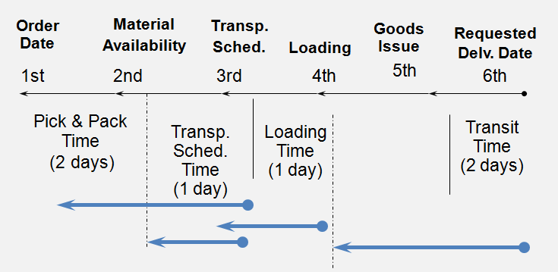
Sales and Distribution (SD)
Backward Delivery
Sales
The time needed to complete all the necessary steps from order to delivery beginning with the required delivery and then works in reverse order.

Slide 36
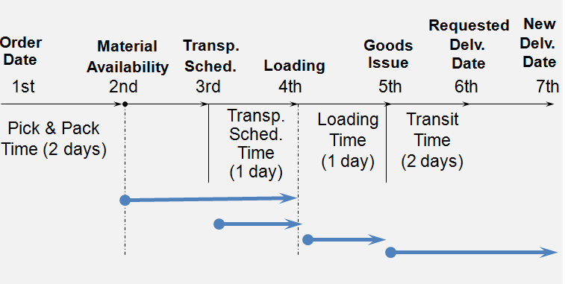
Sales and Distribution (SD)
Forward Delivery
Sales
The time needed to complete all the necessary steps from order to delivery from the customer beginning with order, make sure material will be available and the delivery date

Slide 37
Sales and Distribution (SD)
Introduction to Shipping
Sales
The shipping process begins when you create the delivery document for the sales order. This document controls, supports, and monitors numerous sub-processes for shipping processing:
Integrated with the Material Management (MM) and Finance (FI) modules
Picking
Packaging
Loading
Post Goods issue

Slide 38
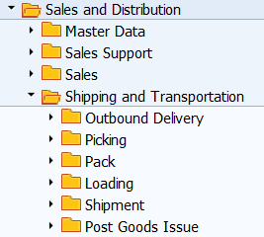
Sales and Distribution
Shipping (Transactions)
Sales
Tcode | Description | Type
VL01N | Outbound delivery | Transaction
VL35 | Picking | Transaction
VL02N | Packaging | Transaction
VL02N | Post Goods Issue | Transaction

Slide 39

Sales and Distribution (SD)
Delivery
Sales
Checks order and materials to determine if a delivery is possible — delivery block (hold), completeness
Checks scheduling
Considers partial deliveries
Confirms availability
Updates route assignment
Confirms export/foreign trade requirements
Assigns picking location
Determines total weight & volume
Updates sales order
Generates packing proposal
Quality check (if needed)

Slide 40
Sales and Distribution (SD)
Post Goods Issue
Sales
Post Goods Issue triggers the official change of ownership of finished goods
Stock overview
Post Goods issue
Finish goods
Delivery

Slide 41
Sales and Distribution (SD)
Post Goods Issue
Sales
Event series during a goods issue
Material document
Stock quantities and values are updated
Accounting and Controlling document
  Inventory updates from price on material master (finished goods)
  COGS updates from price on material master (finished goods)
Billing due list is updated
Output generated
Material document
COGS
Accounting document
Billing due list
Transaction output
Controlling document

Slide 42
Sales and Distribution (SD)
Post Goods Issue: Financial impact
Sales
Company code
Plant
Document and Posting date
Inventory: FG Material ($1000)
Qty: 1
Line items
  GL accounts
  Posting key (debits and credits)
  Amounts
Document date:
09/10/2018
Company code:
US00
Posting date:
09/11/2018
Currency:
USD
Document Number
1XXXXXXX
Transaction date:
09/20/2018
Item in document currency
Line
PK
Account
Amount
001
50
200910 FG Inv
$1,000.00 -
002
40
780000 COGS
$1,000.00

Slide 43
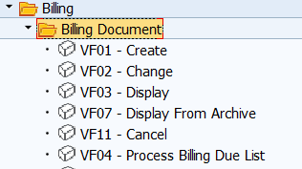
Sales and Distribution (SD)
Billing
Sales
Tcode | Description | Type
VF04 | Billing Due List | Transaction

Slide 44
Sales and Distribution (SD)
Billing
Sales
The billing document is created by coping data from the sales order and/or delivery document.
  Order-based billing
  Delivery-based billing
The billing process is used to generate the customer invoice.
It will update the customer’s credit status.
Reference
Order
Delivery
Billing document
Update credit status

Slide 45
Sales and Distribution (SD)
Billing
Sales
Event series during a Billing
Material document
Sales order is updated
Accounting and Controlling document
  Sales updates from billing document
  AR updates from billing document
Material document
Sales Order History
Accounting document
Controlling document

Slide 46
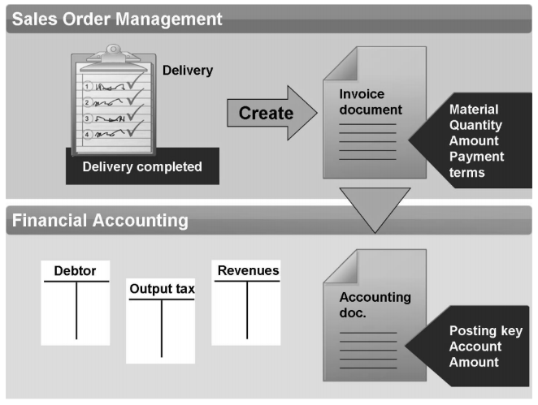
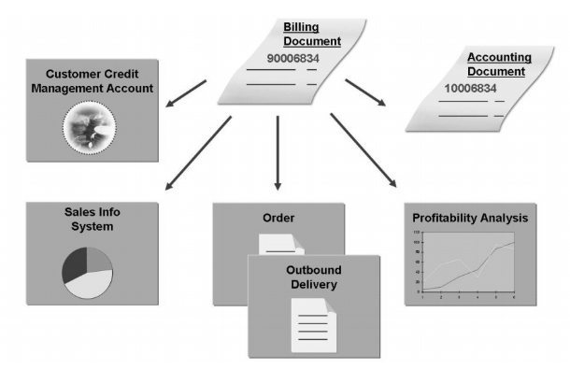
Sales and Distribution (SD)
Material and Accounting Docs
Sales
Material doc track quantities while Accounting doc track financial values.

Slide 47
Sales and Distribution (SD)
Billing: Financial impact
Sales
Company code
Plant
Document and Posting date
Sales ($1,500)
Qty: 1
Line items
  GL accounts
  Posting key (debits and credits)
  Amounts
Document date:
09/10/2018
Company code:
US00
Posting date:
09/11/2018
Currency:
USD
Document Number
1XXXXXXX
Transaction date:
09/20/2018
Item in document currency
Line
PK
Account
Amount
001
40
Customer 123
$1,500.00
002
50
600000 Sales
$1,500.00 -

Slide 48
Sales and Distribution, Billing (SD)
Reflection
What is the purpose of the delivery document on SAP?
What do you think is the financial impact of the post goods issue?
What do you think is the financial impact of processing the billing due list?

Slide 49
Accounts Receivable
Order to Cash

Slide 50


Accounts Receivable
Introduction
AR
OTC
PTP
PRD
RTR
HTR
Billing
GL
Customer
Records and manages accounting data of all customers.
Postings made to accounts receivable are also recorded directly in the G/L.
Integral part of Order to Cash business process.
AR is integrated with SD and Treasury (order to cash process)

Slide 51
Accounts Receivable (FI-AR)
Incoming Payment
AR
Can be done automatically or manually
  Post incoming (F-28)
Payments elements
  Payment method
  Bank from which we collect
  Billing
  Collection amounts
Event series during a cash collection
Accounting document
  Customer references invoice
  Bank reference payment
SD document is updated

Slide 52
Accounts Receivable (FI-AR)
Incoming Payments: Financial impact
AR
Company code
Document and Posting date
Cash collection ($1,500)
Line items
  GL accounts
  Posting key (debits and credits)
  Amounts
Document date:
09/10/2018
Company code:
US00
Posting date:
09/11/2018
Currency:
USD
Document Number
1XXXXXXX
Transaction date:
09/20/2018
Item in document currency
Line
PK
Account
Amount
001
50
Customer 123
$1,500.00 -
002
40
10XXXX Bank
$1,500.00

Slide 53
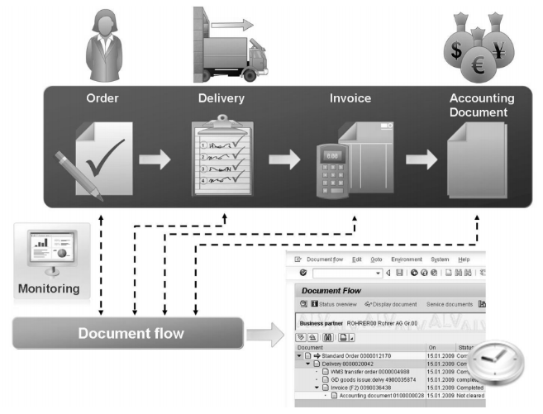
Sales and Distribution
Document Flow
Sales
The document flow and order status feature allows you to find the status of an order at any point in time. The SAP updates the order status every time a change is made to any document created in the customer order management cycle (Order-to-Cash).

Slide 54
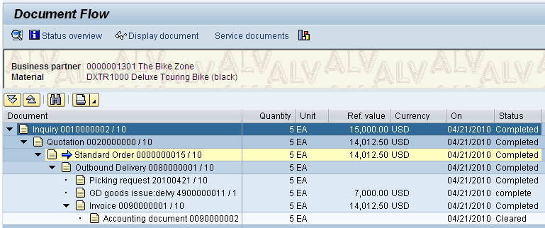
Sales and Distribution
Document Flow
Sales
The document flow and order status feature allows you to find the status of an order at any point in time. The SAP updates the order status every time a change is made to any document created in the customer order management cycle (Order-to-Cash).

Slide 55
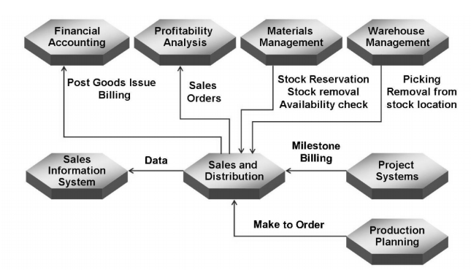
Order to Cash(OTC)
Integration IM, SD and FI
Integration
Sales
  Sales data. Sales orders
  Delivery and Post goods issue
  Billing
Inventory
  Inventory control
  Backflush
Finance and Controlling
  Invoice posting and Payment collection
  Profitability Analysis

Slide 56
Order to Cash(OTC)
Integration IM, SD and FI
Integration
Quote
Sales Order
Backflush
Shipping/
Delivery
Billing
Incoming payment
Backflush
  Dr Finished goods inventory current standard and BOM
  Cr Raw material inventory current standard
Post goods issue
  Dr COGS current standard finished goods
  Cr Finished goods inventory current standard cost
Billing
  Dr AR based on billing (invoice)
  Cr Sales based on billing
Cash Collection
  Dr Bank based on cash
  Cr AR based on invoice
Raw Material Inv
Finish Good Inv
COGS
$1,000
$1,000
$1,000
$1,000
Sales
Accounts Receivable
Bank
$1,200
$1,200
$1,200
$1,200

Slide 57
Summary of Lecture
Elements of Order to Cash (OTC) process
SAP OTC Org Structure
Goal of Sales and Distribution (SD) and Inventory Management (IM)
OTC Master and Transactional data
SAP IM (Backflush)
SAP SD (Quote, Sales Order, Delivery, Shipping and Billing)
SAP FI (Cash collection)
Integration points between SD, IMWM and FICO

Slide 58
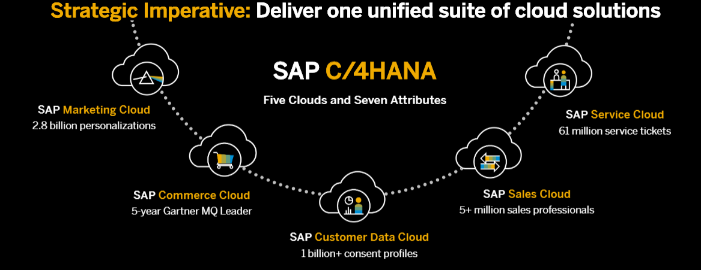
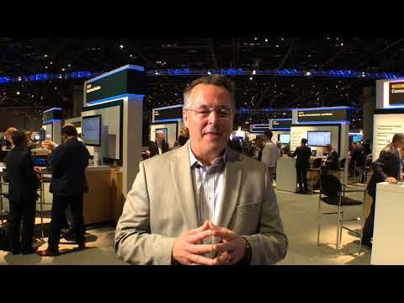
Order to Cash (OTC)
The case of SAP C/4 HANA
OTC end to end integration in the Cloud
Leverage of data on S/4 HANA (ERP)
Elements
  Marketing
  eCommerce
  Customer master data
  Sales
  Service

Slide 59
Order to Cash (OTC)
SAP Practice
Create customer
Cerate sales order from quote
Delivery
Create an inquiry
Billing
Cash collection
Create a quotation
Post goods issue

Slide 60
Order to Cash (OTC)
Practice: Data relationship
Customer
Customer inquiry
Material
Customer Quote
Create SO
Post Goods issue
Review Document Flow
AR Collection
Billing
Delivery
Master data
Transactional data
Display

Slide 61
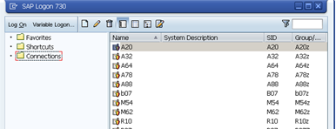

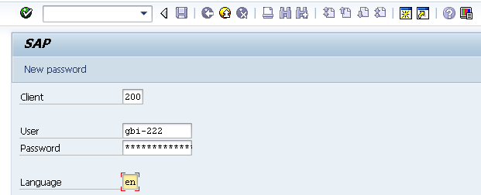
Order to Cash (OTC)
User Logon Screen
Click on the icon in your desktop.
Enter the following information:
System ID: Eagle
Client: 118
User ID: LEARN-XXX
Enter your password
Notes:
Enter Client, Server and Password
Client is a numeric field and this number represents a whole business entity.
Users are client specific which means that having a user identification in one client will only allow access to that particular client.
The system settings are stored in a file on your machine called the saplogin.ini file. This file is normally preconfigured centrally and then made available to all the users. Once you have been provided with the SAP Logon, you need a username and password to logon to the SAP system. The username and password is unique for each user and you do have the option to change your password using the New password button available on the screen.

