Slide 1
Mental Health Disorders
Chapter 13

Slide 2

Mental Health Disorders
What is Abnormal Behavior?
The D S M Model for Classifying Abnormal Behavior
Anxiety, Obsessive-Compulsive, and Trauma-Related Disorders: It’s Not Just “Nerves”
Dissociative and Somatic Symptom Disorders: Other Forms of Anxiety?
Mood Disorders: Beyond the Blues
Psychology Applies to Your World: Suicide Facts and Misconceptions
Schizophrenia: Disintegration
Personality Disorders: Maladaptive Patterns of Behavior
Integrating Psychology: The Big Picture
Notes:
From the beginning of recorded history, there have been people who suffer from unusual or abnormal psychological functioning. We now refer to those situations as mental health disorders, but throughout history they have been called many other things. Today the term is often used interchangeably with others, including psychological disorders, psychological illness, and mental illness (those some object to the use of the term illness due to its necessary association with a medical model).
The modern field of psychopathology is the scientific study of mental health disorders.

Slide 3

Distinguishing Abnormal from Normal
Notes:
Psychological disorders are far from rare; it is likely that you know someone who has suffered or is suffering from such a condition. But defining them can be tricky.
Psychology typically uses several criteria to define abnormality.
Behaviors that are not typical or culturally expected—a statistically infrequent event; behaviors or situations that are uncommon or rare, or inconsistent with the context in which they occur
Distress—personal suffering, or a sense of emotional discomfort with a given situation or set of symptoms.
Dysfunction—when a person’s symptoms interfere with their ability to fulfill the expected roles or responsibilities of their life.
Bear in mind that none of these criteria are, on their own, adequate for a mental health disorder diagnosis. Can you think of examples of how each might exist without being indicative of a psychological disorder?

Slide 4
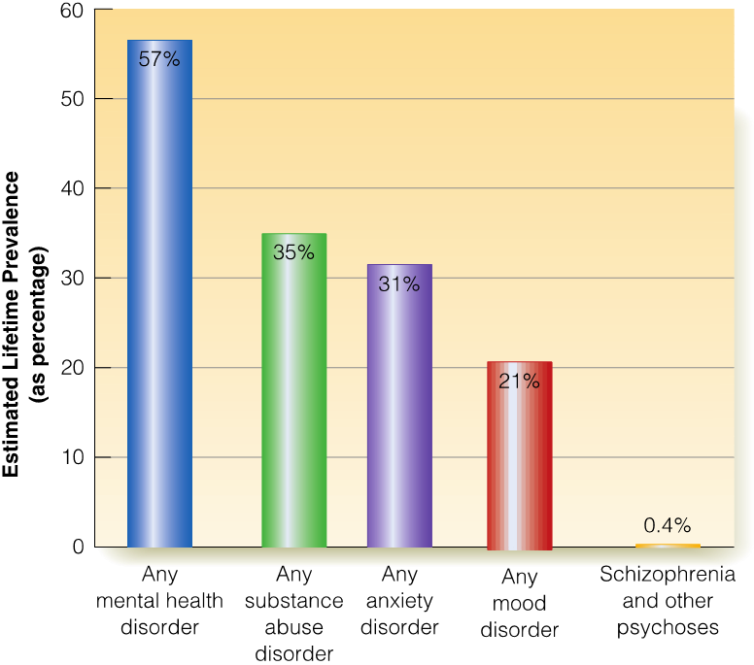
Lifetime Prevalence of Mental Health Disorders
Notes:
Though some believe that mental health disorders are rare, this is far from true. In any given year, approximately one in five adults will face such a challenge, while lifetime prevalence rates are quite a bit higher.
How does age, gender, and racial or cultural background affect prevalence rates, as well as the types of diagnoses that are more likely to be seen?

Slide 5

Explaining Abnormal Behavior: Perspectives Revisited
Notes:
A number of different models in psychology have been reviewed this semester, and they each have an opinion on the causes of mental health disorders.
Biological theories examine genetic influences and physical changes, operating from a medical (or illness) model
Psychological models include the psychoanalytic, social learning, cognitive, and humanistic perspectives. Based on what you already know about these paradigms, how would you expect each one to explain mental health disorders?
Sociocultural models focus on the contextual situations and conditions that can lead people down the road of unhealthy psychological functioning. As one example, this approach might consider the influence of poverty on mental well-being.
An integrative model called the biopsychosocial model integrates all of these, looking at mental health disorders through a wider lens that considers the simultaneous effect of many influences.

Slide 6
The Structure of the D S M (1 of 4)
TABLE 13.1 D S M-5 Major Categories of Disorders
Major Category | Some Included Disorders
Neurodevelopmental Disorders | Intellectual Disabilities Communication Disorders Autism Spectrum Disorders Attention-Deficit/Hyperactivity Disorder Specific Learning Disorder Motor Disorders
Schizophrenia Spectrum and Other Psychotic Disorders | Delusional Disorder Brief Psychotic Disorder Schizophrenia Schizoaffective Disorder
Bipolar and Related Disorders | Bipolar I Disorder Bipolar II Disorder Cyclothymic Disorder
Depressive Disorders | Major Depressive Disorder Persistent Depressive Disorder (Dysthymia) Premenstrual Dysphoric Disorder
Notes:
Released in its latest edition in 2013, the Diagnostic and Statistical Manual of Mental Disorder, fifth edition (DSM-5) is a book that catalogues over 300 diagnosable mental health disorders and their symptoms divided into 20 major categories. It also includes conditions to be researched for future editions.
Bear in mind that DSM-5 is not a treatment guide and offers no information about how to treat these conditions. It also does not give information about the cause of these disorders; that is, it is atheoretical in nature.

Slide 7
The Structure of the D S M (2 of 4)
Major Category | Some Included Disorders
Anxiety Disorders (see You Review, p. 561) | Separation Anxiety Disorder Social Anxiety Disorder (Social Phobia) Panic Disorder Generalized Anxiety Disorder Specific Phobia
Obsessive-Compulsive and Related Disorders (see You Review, p. 561) | Obsessive-Compulsive Disorder Body Dysmorphic Disorder Hoarding Disorder
Trauma- and Stressor-Related Disorders (see You Review, p. 561) | Reactive Attachment Disorder Posttraumatic Stress Disorder Acute Stress Disorder
Dissociative Disorders (see Table 13.2, p. 564) | Dissociative Identity Disorder Dissociative Amnesia Depersonalization/Derealization Disorder
Somatic Symptom and Related Disorders (see Table 13.3, p. 566) | Somatic Symptom Disorder Conversion Disorder Illness Anxiety Disorder
Feeding and Eating Disorders (see Chapter 5) | Rumination Disorder Anorexia Nervosa Bulimia Nervosa

Slide 8
The Structure of the D S M (3 of 4)
Major Category | Some Included Disorders
Elimination Disorders | Enuresis Encopresis
Sleep-Wake Disorders (see Chapter 4) | Insomnia Disorder Central Sleep Apnea Restless Legs Syndrome
Sexual Dysfunctions | Erectile Disorder Female Orgasmic Disorder Genito-Pelvic Pain/Penetration Disorder
Gender Dysphoria | Gender Dysphoria
Disruptive, Impulse-Control, and Conduct Disorders | Oppositional Defiant Disorder Conduct Disorder Kleptomania
Substance-Related and Addictive Disorders (see Chapter 4) | Alcohol-Related Disorders Opioid-Related Disorders Stimulant-Related Disorders Gambling Disorder

Slide 9
The Structure of the D S M (4 of 4)
Major Category | Some Included Disorders
Neurocognitive Disorders | Delirium Major and Mild Neurocognitive Disorders
Personality Disorders (see Table 13.4, p. 583) | Paranoid Personality Disorder Antisocial Personality Disorder Borderline Personality Disorder Unspecified Personality Disorder
Paraphilic Disorders | Voyeuristic Disorder Fetishistic Disorder Sexual Sadism Disorder
Other Mental Disorders | Unspecified Mental Disorder
Source: Reprinted with permission from the Diagnostic and Statistical Manual of Mental Disorders, Fifth Edition, Copyright 2013. American Psychiatric Association.

Slide 10

How Good is the D S M Model?
Notes:
Reliability refers to the consistency of a given finding, while the validity asks whether or not a measure accurately assesses what it is supposed to assess. While DSM-5 is superior to its predecessors in many ways, there are still diagnostic families where these metrics have not been improved upon.
DSM-5 has also been criticized for the fact that labeling people with a mental health disorder can stigmatize them and, in turn, lead to a self-fulfilling prophecy where people “become” the disorder they are told that they have.

Slide 11

Components of Excessive Anxiety
Notes:
Anxiety disorders include conditions that involve chronic disruptive worry, fear, or apprehension that would be considered culturally unexpected.
They typically involve three different areas of symptoms—cognitive, emotional, and behavioral. Refer to your text to see what each type of symptom category might include.

Slide 12
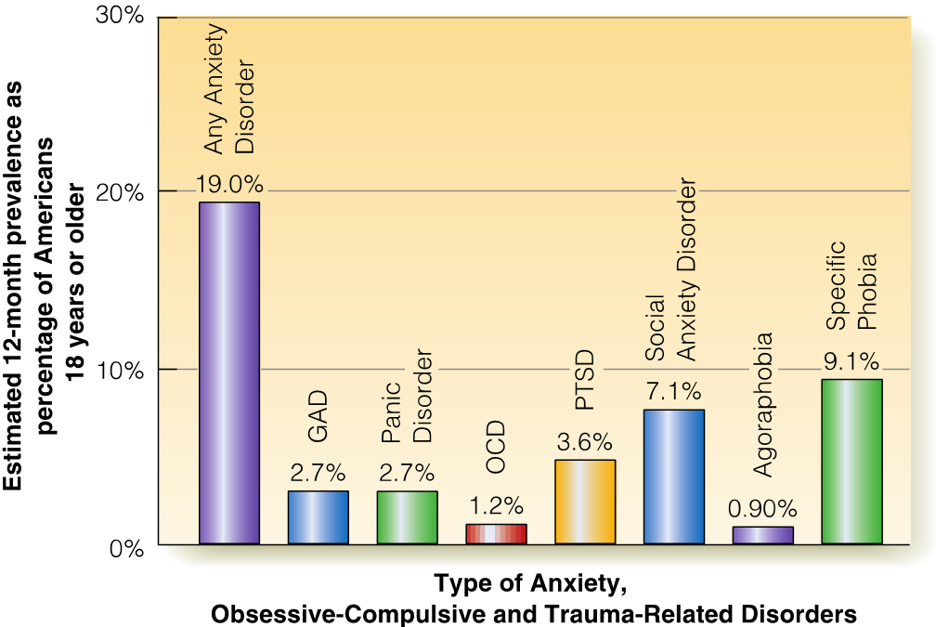
Types of Excessive Anxiety Disorders (1 of 2)
Prevalence of Anxiety, Obsessive-Compulsive, and Trauma-Related Disorders in a Given Year
Notes:
Anxiety disorders identified in the DSM include phobias, generalized anxiety disorder, and panic disorder:
Generalized anxiety disorder includes an extended period of free-floating anxiety that is not tied to any one particular trigger. They seem to worry about everything, but cannot place their finger on what it is that has them upset or concerned.
Panic disorder is marked by sudden and overwhelming attacks (panic attacks) of dread and worry that are accompanied by physical symptoms that mirror a heart attack. They can lead to a vicious cycle of worrying about the next attack which, in turn, actually can trigger an attack.
Phobias (or phobic disorders) are intense and irrational fears that center around a specific trigger (specific phobia). The dysfunctional nature of phobias often lies in the fact that they lead to pathological avoidance of the trigger, which in many cases can be very disruptive. Phobias can also involve social anxiety disorder (social phobia) and agoraphobia (which may be attacked to panic attacks as well).

Slide 13

Types of Excessive Anxiety Disorders (2 of 2)
Notes:
Obsessive-compulsive disorder (OCD) includes repeating, intrusive thoughts that increase anxiety (obsessions) which are often followed by repetitive ritualistic behaviors (compulsions) that feel like they are venting that anxiety.
A related condition is hoarding disorder, which is when a person focuses “obsessively” on acquiring and keeping possessions, even those with very little value. They find disposing of objects psychological painful, if not impossible, and often collect so much that their living space becomes untenable.
Trauma-related disorders typically focus on post-traumatic stress disorder (PTSD). This occurs in some people after exposure to a particularly frightening or dangerous event, often one in which death or serious injury was possible. PTSD is a major problem for those who have been victimized and is also often seen in soldiers who return from combat.

Slide 14

Research Explaining Anxiety, Obsessive-Compulsive, and Trauma-Related Disorders
Notes:
The causes of these disorders have been the topic of intense research and study, with several different avenues of explanation emerging:
Biological factors—neurotransmitters and genetic factors have been identified in many anxiety, obsessive-compulsive, and trauma-related disorders. In addition, specific brain areas have also been identified as showing abnormal structure or activity.
Psychological factors—the primary emphasis in this set of symptoms has looked at cognitive processes (how we think about given situations) and learning (the behaviors that we acquire through typical learning processes, most notably classical and operant conditioning and modeling).
Sociocultural factors—What do you think is the influence of poverty, sex and gender, race and ethnicity, and other cultural factors on anxiety? As an example, if people in low SES communities have a hard time making ends meet and taking care of their basic needs, might they be more included to experience chronic worry that could develop into one of these diagnoses?

Slide 15
Dissociative Disorders: Multiple Personalities
TABLE 13.2 Types of Dissociative Disorders
Disorder | Major Features
Depersonalization disorder | Frequent episodes in which the person feels detached from his or her own mental state or body that causes significant distress or impairs functioning
Dissociative amnesia | Memory loss of important personal information, not due to substance use or brain injury that causes significant distress or impairs functioning. May occur with or without dissociative fugue, in which person unexpectedly travels away from home with memory loss of identity or other personal information.
Dissociative identity disorder | Two or more separate personalities in the same individual that cause significant distress or impaired functioning
Notes:
Disruptions in memory, consciousness, or identity typify dissociative disorders, which take their name from the separation (or “dissociation”) that they involve.
Dissociative identity disorder (formerly called multiple personality disorder) includes the development of two or more identities in the same individual. It is a highly controversial diagnosis, both in terms of how it develops and whether it even truly exists. It is often seen alongside other diagnoses (called comorbidity) including depression, PTSD, borderline personality disorder, and schizophrenia, among others.
Abusive histories have been offered as an explanation for dissociative disorders, as many with such symptoms have a history that includes physical or sexual abuse, typically during their early years.

Slide 16
Somatic Symptom Disorders: “Doctor, I’m Sure I’m Sick” (1 of 2)
TABLE 13.3 Types of Somatic Symptom Disorders
Disorder | Major Features
Conversion disorder | One or more symptoms affecting voluntary motor or sensory functioning, but no physical cause can be found; causes significant distress or impaired functioning
Somatic Symptom disorder | Six months of persistent physical complaints with excessive thoughts, feelings, or behaviors related to the symptoms that cause distress or disrupt one’s life. The person has sought medical attention, but no physical cause can be found.
Illness Anxiety disorder | Persistent worry over having a serious illness for at least 6 months. The person may frequently seek or rarely use medical care.
Notes:
Somatic symptom disorders (and their related diagnoses) occur when physical symptoms appear that have no identifiable physical cause.
Illness anxiety disorder involves ongoing worry and fear about having or developing a physical illness. It was previously referred to as hypochondriasis. Some people with this condition constantly visit physicians, while others believe they are ill but refuse to do so.
Clearly diagnosing these problems is complicated, as it is important that we do not assess true physical problems as psychological in nature. They also do not reflect a person “faking” symptoms but rather truly believing that their physical complaints are real, even if they are not.

Slide 17

Somatic Symptom Disorders: “Doctor, I’m Sure I’m Sick” (2 of 2)
Notes:
Somatic symptom disorders (and their related diagnoses) occur when physical symptoms appear that have no identifiable physical cause.
Illness anxiety disorder involves ongoing worry and fear about having or developing a physical illness. It was previously referred to as hypochondriasis. Some people with this condition constantly visit physicians, while others believe they are ill but refuse to do so.
Clearly diagnosing these problems is complicated, as it is important that we do not assess true physical problems as psychological in nature. They also do not reflect a person “faking” symptoms but rather truly believing that their physical complaints are real, even if they are not.

Slide 18

Depressive Disorders: A Change to Sadness
Notes:
Depressive disorders, including major depressive disorder, involve extended periods of intense sadness, hopelessness, and a lack of ability to take pleasure in previously enjoyed activities. Physical and cognitive symptoms also accompany this disorder. They can emerge in response to external events or show up for no discernable reason whatsoever.
When the disorder is less severe but much longer lasting, it is called persistent depressive disorder (formerly called dysthymic disorder).
Depressive disorders are among the most commonly diagnosed of all psychological conditions and are typically severe enough to warrant significant therapeutic intervention, although many who suffer never receive the help that they need.
Examine how different factors, including age and sex, relate to the likelihood of a diagnosis of a depressive disorder.

Slide 19

Bipolar-Related Disorders: The Presence of Mania
Notes:
Those with bipolar disorder experience both periods of depression as well as mania. Mania, sometimes thought of as the opposite of depression, is an elevated, active emotional state. When the depression and manic states occur with longer duration but lower severity, a diagnosis if cyclothymia might be made. You might think of cyclothymia as being related to bipolar disorder in the same way that persistent depressive disorder is related to major depressive disorder.

Slide 20

Research Explaining Mood Disorders
Notes:
Few psychological disorders have received more research into their causes than the affective disorders.
Biological factors—both depression and bipolar disorders (especially bipolar diagnoses) seem to run in families, suggesting a genetic contribution. Specific genes have been identified that may be related to these conditions. Researchers have also focused on specific brain structures, as well as changes in neurochemical functioning and stress hormone. This information has allowed experts to craft medications that may alter (or restore normal) functioning in these areas.
Psychological and social factors—Even if genetic factors are not relevant, these diagnoses may still be seen in family members because of shared environmental influences. Exposure to problematic early life experiences as well as a cognitive style of learned helplessness contributes to mood disorder symptoms,
A number of sociocultural contributors have been suggested, including social isolation, anxiety, and negative thinking processes, as well as ethnicity, sex, sexual orientation, and socioeconomic status. Different cognitive factors have also been examined, including learned helplessness, specific attributional styles, and ruminative thought processes.

Slide 21
Gender and Depression
Notes:
We know that depression is diagnosed more frequently in women than in men, and this raises a number of questions. Are the symptoms truly more common among women, or are there other reasons why they are simply seen and identified more in women?
If the symptoms truly are more common among women, what might contribute to this effect? Biological, cultural, psychological, and social factors may all be at play here.

Slide 22
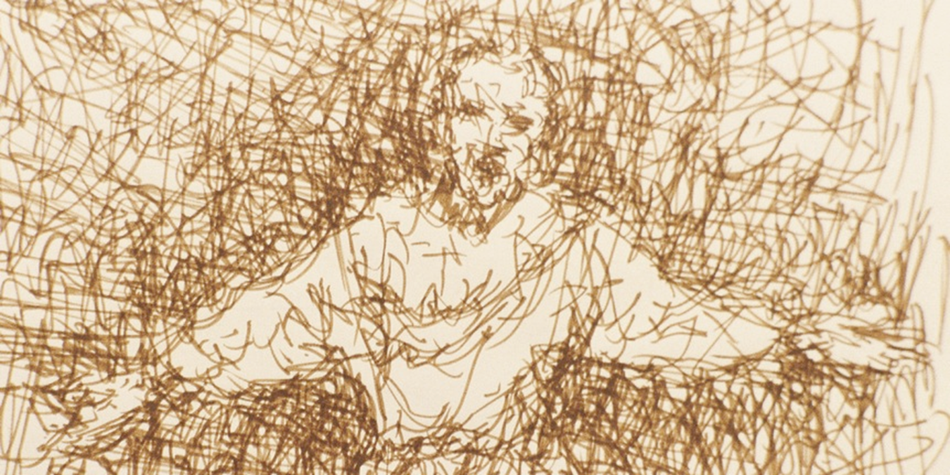
Individual Variations: Onset, Gender, Ethnicity, and Prognosis
Notes:
Schizophrenia typically appears in the late teens or early adult years and is rather uncommon in childhood or later adulthood. The onset is typically somewhat later in women than in men. It is diagnosed more in African American and Asian American individuals, but as with the discussion of depression and gender we have to wonder if this reflects true incidence differences or cultural factors.
A prevailing myth about schizophrenia is that it is untreatable, but that is highly inaccurate. Most with this condition can receive effective treatments that significantly reduce symptoms and improve overall functioning.

Slide 23

Symptoms of Schizophrenia
Notes:
Symptoms of schizophrenia are divided into pathological excesses (positive symptoms) and deficits (negative symptoms).
Positive symptoms include delusions, hallucinations, disorganized speech, and disordered behaviors.
Negative symptoms include blunted, inappropriate, or flat affect, alogia (poverty of speech), and avolition.
See how your authors describe each of these symptoms, along with the varieties of each.

Slide 24
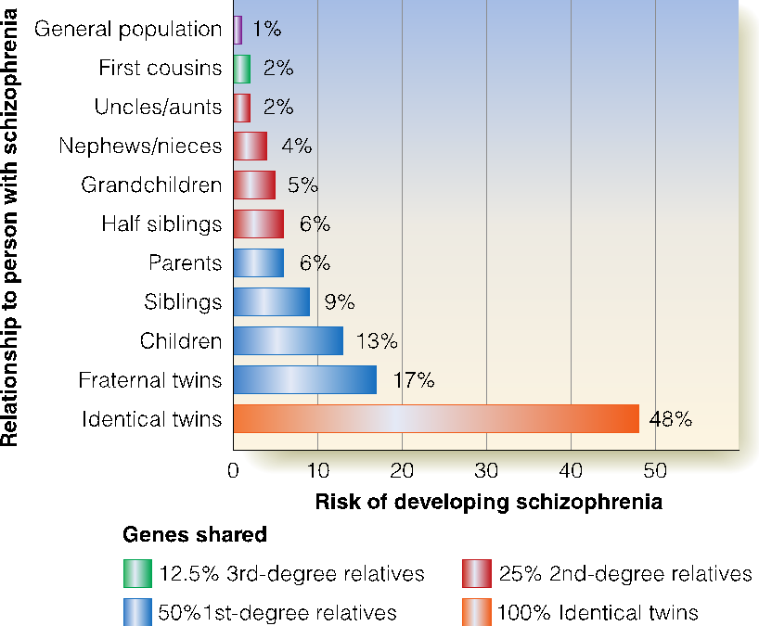
Research Explaining Schizophrenia: Genetics, the Brain, and the Environment
Risk of Schizophrenia and Genetic Relatedness
Notes:
Once again a great deal of research has looked at schizophrenia and its causes:
Biological factors: The concordance rate among relatives with higher genetic similarity rises, providing evidence of a genetic component to psychotic disorders. Certain areas of the brain have been found to be different in those with schizophrenia when compared to those without, and abnormal functioning in the dopamine system has also been offered as an explanation.
Prenatal and developmental factors—Several early life factors (including some during pregnancy and childbirth) have been found to be related to schizophrenia. They include birth complications, maternal diabetes, low birthweight, prenatal stress, and others. Do these factors cause a vulnerability to schizophrenia, or is the relationship complex and reliant on interaction with environmental stressors?
Psychological and sociocultural factors—Living situations and stigmatization have been explored, as well as the influence of higher levels of conflict and critical and harsh interactions in the family and home life of those with these diagnoses.

Slide 25
Clustering by Similarities
TABLE 13.4 Types of Personality Disorders
Disorder | Major Features
Cluster A: Odd or Eccentric Disorders
Paranoid personality disorder | Excessive suspicion and mistrust of others
Schizoid personality disorder | Lack of desire to form close relationships with others; emotional detachment and coldness toward others
Schizotypal personality disorder | Considered a mild version of schizophrenia. The person shows inappropriate social and emotional behavior, and unusual thoughts and speech.
Cluster B: Dramatic, Emotional, or Erratic Disorders
Antisocial personality disorder | Chronic pattern of impulsive behavior; violates rights of others and does not show remorse or guilt for actions
Borderline personality disorder | Instability in mood, self-concept, and interpersonal relationships
Histrionic personality disorder | Intense need for attention; always wants to be the center of attention; excessively dramatic behavior; rapidly changing moods
Narcissistic personality disorder | Preoccupation with own sense of importance and view of self as above others; typically ignores the needs and wants of others
Cluster C: Anxious or Fearful Disorders
Avoidant personality disorder | Intense and chronic anxiety over being negatively evaluated by others, so avoids social interactions
Dependent personality disorder | Excessive need to be cared for by others; denies own thoughts and feelings and clings to others
Obsessive-compulsive personality disorder | Pattern of rigid and perfectionist behavior; preoccupied with details, rules, order, and routine; experiences upset when routine is disrupted. (This is not the same as the disorder O C D.)
Notes:
Personality disorders are maladaptive behaviors that have been stable over a long period of time and across many situations.
They are grouped into three diagnostic clusters:
Cluster A: Odd or Eccentric Disorders—paranoid, schizoid, and schizotypal personality disorders
Cluster B: Dramatic, Emotional, or Erratic Disorders—borderline, narcissistic, antisocial, and histrionic personality disorders
Cluster C: Anxious or Fearful Disorders—dependent, obsessive-compulsive, and avoidant personality disorders

Slide 26

Antisocial Personality Disorder: Impulsive and Dangerous
Notes:
Antisocial personality disorder is marked by impulsive behaviors that violate the basic rights of others and the norms and rules of society. Many believe that “antisocial” equates to wanting to be separated from others, but that is inaccurate.
People with this disorder manipulate and use others for their own benefit, lack empathy for the harm that they cause others, and focus almost entirely on their own needs and desires. There is typically a history of harmful or aggressive behaviors going back to childhood.

Slide 27

Borderline Personality Disorder: Living on Your Fault Line
Notes:
Those with borderline personality disorder show patterns of unstable moods, relationships, self-image, and behaviors.
Their instability often results impulsivity and seeing situations in terms of extremes (“all-or-nothing thinking”). Their relationships tend to be very intense, though often short lived. This diagnosis is seen more in women than in men.

Slide 28

Caution
Notes:
The diagnoses you’ve studied in this chapter are but a few of those contained in the DSM, but as you read you have found that some of these conditions sound familiar. You may have even thought, “I have that!” at one point or another. This is called “Psychology Student Syndrome” and is very common. Remember that psychopathology represents a large continuum of behaviors, and just because you may demonstrate a symptom or two does not mean that you have a mental health disorder. At the same time, if you truly believe that you are suffering from one of these conditions, you are encouraged to see diagnosis and, if needed, treatment from a qualified and trained professional.

