Slide 1
Memory
Chapter 7

Slide 2

Memory
The Functions of Memory: Encoding, Storing, and Retrieving
The Development of New Memories
Long-Term Memory: Permanent Storage
Retrieval and Forgetting in Long-Term Memory
Psychology Applies to Your World: Tips for Improving Your Memory
The Accuracy of Memory
The Biology of Memory
Integrating Psychology: The Big Picture
Notes:
Without a functioning memory—the ability to retain and recall information over time—can you imagine any important functions of being alive that would be possible? You’d be unable to communicate, be aware of your own identity, know friends or family members, recall your own experiences, or even engage in the most basic activities. Memory is something that we may take for granted, but maybe we shouldn’t!

Slide 3

Explicit and Implicit Memory
Notes:
When we are exposed to stimuli from our surroundings, we engage in the encoding of memory traces that allow us to use our storage processes to retain that information over time. While computers can essentially do the same thing, they are not self-aware; that is to say, they do not have consciousness as we do. Where does memory begin? With the focusing of attention on specific stimuli.
As you study for an exam or try to remember a shopping list for the grocery store, you are engaging explicit memory. This refers to conscious, or intentional, remembering. At the same time, you may have memories of facts or events that you never intended to remember. When information “sneaks” into memory without active intent or effort, this is called implicit memory.
What are some examples of explicit and implicit memory?

Slide 4
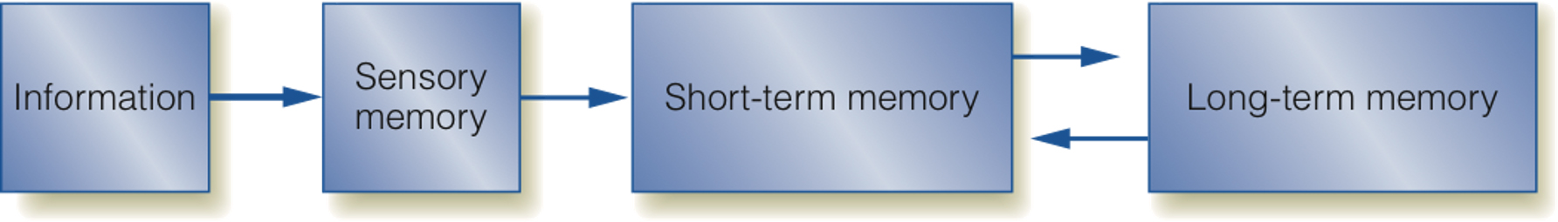
The Traditional Three-Stages Model of Memory
Notes:
The traditional three-stage model, first proposed by Atkinson and Shiffrin, suggested that we have three different types of memory storage: sensory memory, short-term memory, and long-term memory. Information must process through these stages in order if we are to have long-lasting retention and availability of those memories at a later time.
Sensory memory exists for all of our senses, though the majority of attention has focused on iconic (visual) and echoic (auditory) memories. Sensory memory has a rather large capacity but a very short duration and allows us just enough time to either (a) move the information to a slightly longer storage facility or (b) delete it and move on. The process of moving that information from sensory to short-term memory merely requires that we attend to the data. Otherwise it is lost forever.
Don’t worry; it’s not quite as dramatic as it sounds. The vast majority of sensory input is almost instantaneously deleted from our awareness.
Think of your short-term memory (STM) as a “staging area” where information can just hang out for a little while longer, giving us a bit more time to decide if it is or is not important. If we judge it to be unimportant, we delete it (off to the trash can!). If it is important, we will then focus on moving it to long-term memory. If, however, we need more time, we can use various processes to get more time (more about that soon).

Slide 5
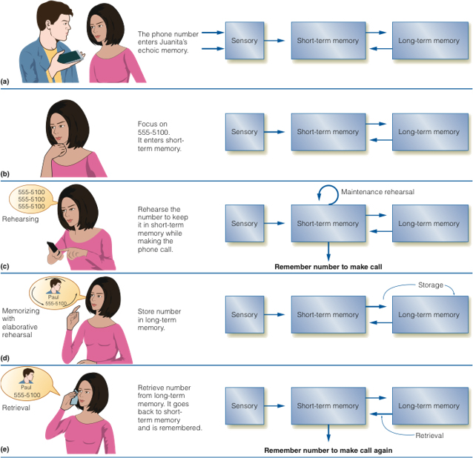
The Capacity of Short-Term Memory: Seven (Plus or Minus Two)
The Three-Stages Model of Memory
Notes:
Noted cognitive psychologist George Miller identified that the capacity of STM is about 7 +2 units (individual bits of information or chunks of related data). If we want to store more information, we can increase the efficiency of STM by using a process called chunking. This allows us to bunch individual units of data together and store them as meaningful groups. This does not increase the size, or capacity, of STM but rather allows us to use Miller’s Magic 7+2 more effectively.
How many stimuli from your surroundings do you chunk in an automatic fashion? How many are “prechunked” for you? Think about your telephone number as an example. Do you remember the area code as three units of information or one grouped, or chunked, unit?

Slide 6
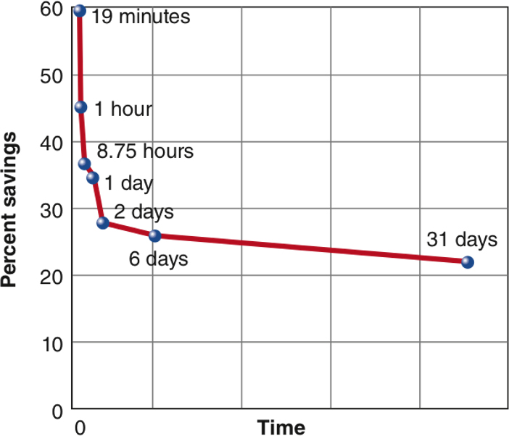
The Duration of Short-Term Memory and Elaborative Rehearsal
Retention After Maintenance Rehearsal
Notes:
STM typically lasts for up to about 30 seconds, and in that time, we have to decide what to do with the information. If we need an extension, however, we can use maintenance rehearsal to reset the 30-second clock. In theory, we could keep information active in STM indefinitely as long as we rehearse it before it fades away.
Is the strength of STM memory declining in recent years? Are we able to store less information for a shorter duration? What do you think might be the relationship between technology usage and weakening memory skills? Thankfully, if such an effect is happening, it is most likely very reversible. Although memory is not a muscle, think of it as if it is. The more you use it, the stronger and more effective it gets.
If you study the work of Hermann Ebbinghaus, who gave us the curve of forgetting, you might be surprised to find out that much of the information you will learn in class today is likely to be forgotten within the first hour after class is over, and even more will be forgotten in the next 24 hours. How did Ebbinghaus study this? What do you think you can do to interrupt this sequence and retain information more effectively?
While maintenance rehearsal keeps information active in STM, you would use elaborative rehearsal to help move that same information into long-term memory (LTM). This occurs when you create connections or links between new information (stored in STM) and older, more familiar information (already existing in LTM). These connections help to transfer the new information into the longer-term storage facility so that you’ll have it over time.

Slide 7
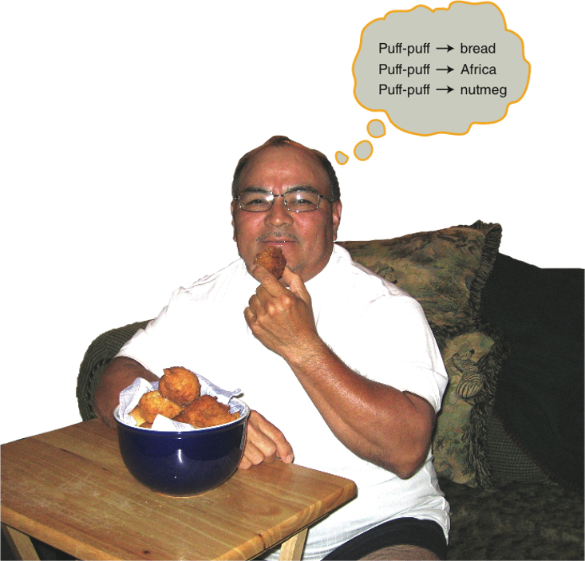
Levels of Processing
Notes:
Levels of Processing—When we encode and process information at a deeper, more thorough level, we will have stronger memory codes for later usage. Distinguishes between maintenance and elaborative rehearsal processes. The first process does not let us move information to LTM but instead gives us more time to deal with the information in STM. The second, as noted earlier, allows us to create links that help to pull the information to LTM.

Slide 8
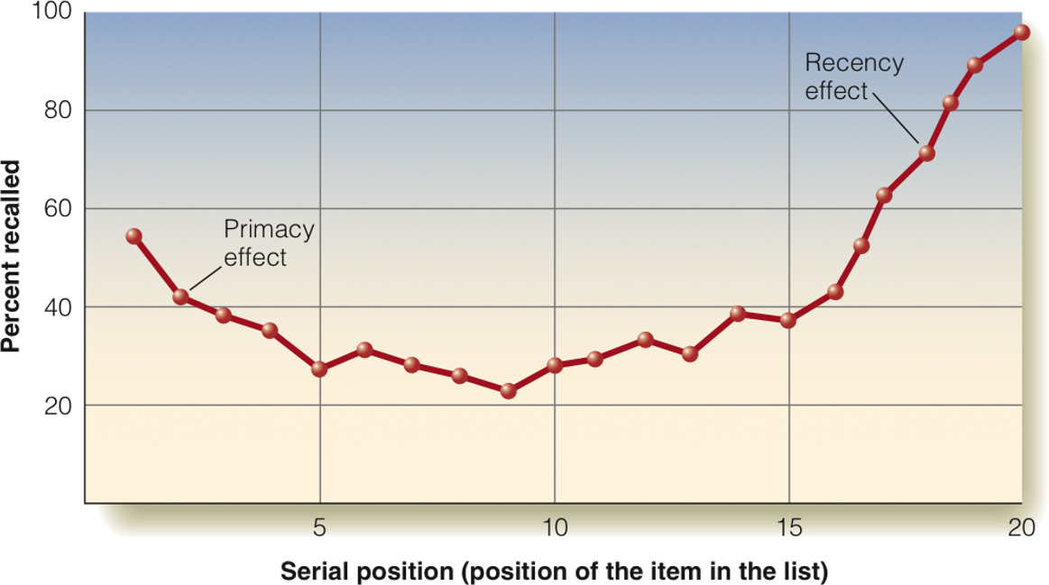
The Serial-Position Curve and Age-related Changes in Memory
Serial-Position Curve
Notes:
The serial position effect reminds us that when we’re given a list of data to remember, we’ll have the best memory of items at the start of the list (the primacy effect) and at the end of the list (the recency effect). We’ll have the poorest memory of those items in the middle of the list.
The primacy effect is believed to occur because it gives us more time to push information into LTM. The recency effect, on the other hand, occurs because the information is still active in STM and has not had time to fade away.
But how are these processes affected by aging? Research finds that STM is most affected by normal aging, as older adults suffer more profound declines in STM functioning than LTM retrieval. At the same time, older adults may develop strategies to compensate for declining STM skills that allow them to continue without these declines impairing their ability to function.
What is the evidence in favor of or in opposite to the three-stage model proposed by Atkinson and Shiffrin? Refer to the textbook to see some of these points.

Slide 9

The Working Memory Model: Parallel Memory
Baddeley’s Central Executive Model of Working Memory
Notes:
For years STM was regarded as a relatively passive storage facility, but an adjustment of this model called working memory suggested that quite a few active processes take place there. These processes take place at the same time, or in a parallel process, so that the memory system can work as efficiently as possible.
Review carefully how the three processes proposed to exist in working memory operate independently of and interdependently with each other.
The central executive is the attention-controlling part of working memory. It coordinates the functions of the system and determines where we focus our consciousness.
The phonological loop is like an MP3 player in our memory that processes and stores verbal/auditory information.
The visuospatial sketchpad processes visual and spatial information, much like an Etch-A-Sketch creates visual codes of data.
The episodic buffer is the bridge between STM and LTM and can allow information to flow in both directions.
What happens if one or more of these systems fails to operate correctly? Is working memory truly an extension of the STM model, or is it really better thought of as being a set of processes that occur in LTM? Perhaps it exists simultaneously in both systems! Cognitive researchers continue to try to identify the exact nature of how these systems operate.

Slide 10

The Capacity of Long-Term Memory
Notes:
Think of your long-term memory as being similar to the hard drive on a computer. A staggering amount of data sits dormant, waiting for the moment when it gets activated. And like a hard drive, over time data can be “corrupted” so that it becomes unavailable.
There is no known limit to the capacity of long-term memory. It may be an overstatement to say that it is truly “unlimited” but the likelihood that any human being could ever fill their LTM is essentially zero. So practically speaking, LTM is unlimited.

Slide 11
Encoding and Organization in Long-Term Memory
Puff-Puff
Is a: | bread
Contains: | flour, sugar, shortening, nutmeg, eggs. etc.
Method of preparation: | fried
Uses: | energy source; eaten with kidney beans
Appearance: | small, donut hole-sized
Origin: | West Africa
Notes:
By the time information has moved from sensory memory to STM and on to LTM, it has had plenty of time for you to connect the stimulus to its meaning. As such, we tend to use semantic encoding when storing information in LTM. That does not mean that we don’t store things in terms of their sensory features, but we connect those features to our understanding of their meanings.
From a levels-of-processing model, this explains why LTM can be a more thorough form of storage. Semantic encoding is a deeper level of information processing.
One way that information is organized in LTM is in terms of schemas, which are organized, general knowledge structures. Schemas organize information in a way that can connect similar concepts to each other and allow us to make connections that are appropriate and necessary.

Slide 12

Declarative and Procedural Long-Term Memories
Gender and Autobiographical Memory
Notes:
LTM is divided into different kinds of memories based on what it is we are trying to remember.
Declarative memories are those that are easily verbalized and include semantic and episodic memories.
Think of semantic memories as the remembering of factual, conceptual information that is not unique to any one person, while episodic memory is our own personal memory diary. It is your recall of your own experiences and is unique to you.
Episodic memory is related to autobiographical memory, which gives you a sense of your own personal history (where you’ve been, what you’ve done, and how this relates to who you are) Refer to your text to see how these memory systems exist in different areas of the brain.
Procedural memory, as the name suggests, is when we remember processes for how to engage in specific actions. They are the “how-to’s” of our memory system and are often retrieved without any conscious effort or awareness. For example, do you continually remember “how to” walk when you are strolling down the hall? Probably not.
What are some other conceptual differences between declarative and procedural memory?

Slide 13
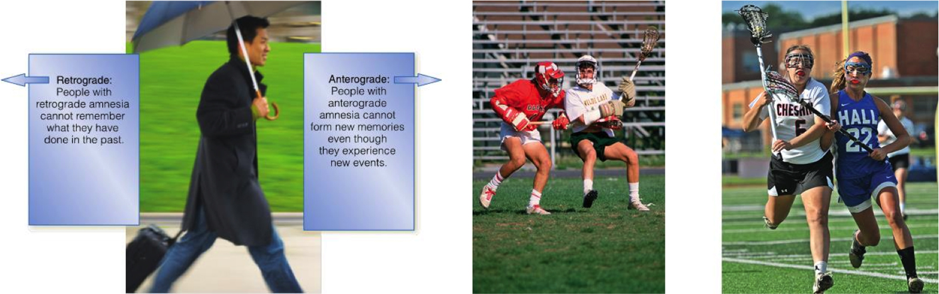
Amnesia: What Forgetting Can Teach Us About Memory
Amnesia Affects a Person’s Memory in Dramatic Ways
Notes:
When one suffers an illness or head injury that severely impairs memory, he or she may be diagnosed with one of two conditions:
Anterograde amnesia refers to a loss of ability to remember events that occur after a head injury, while retrograde amnesia involves the loss of information that occurred prior to the injury. Retrograde amnesia is often what you see depicted (rather inaccurately) in movies, television shows, or novels.
The complete loss of memory for one’s identity often shown in such situations is exceptionally rare.
Of recent concern is how head injuries in recreational and professional athletic activities affect one’s health, including his or her memory abilities. Do the reports of an increasing incidence of such situation affect your willingness to play in organized sports? Would you be more or less willing to let your own children participate in such activities? Perhaps modern sports technology will find a way to reduce or even eliminate these risks, but it is clear that some athletics still pose a serious risk to one’s well-being.

Slide 14

Recognition and Recall
Notes:
What is the use of storing information if we are unable to bring it out of storage when we need it at a later time? This process is called retrieval, and there are two types of retrieval tasks we may encounter:
Recognition tasks require us to take the stimulus we are encountering and filter through the large amount of information it provides, seeing if it matches something previously stored. A multiple choice question on an exam is an example of a recognition task.
Recall tasks are more difficult, because they tend to provide less information and require us to produce a memory in its whole form, with less help from external hints or cues. An essay question would demonstrate a recall task.

Slide 15

Forgetting: Why Can’t I Remember That? (1 of 2)
Notes:
One common theory of forgetting that you may recognize even without a psychology class is the decay theory. The summary of this concept is “use it or lose it,” and it suggests that memory traces in LTM that are not occasionally activated will fade away and disappear over time. There is, however, a problem with this theory, and it is rather obvious; that is, why do some memories that are not routinely activated fail to decay? As such we might note that decay explains some, but not all, instances of forgetting.
Interference theory is another way of explaining how people forget information. It suggests that sometimes information in memory can obstruct the retrieval of other information. When recently encoded, information obstructs the recall of older information that is called retroactive interference. When the opposite occurs, it is proactive interference.
Interference explains the tip of the tongue phenomenon (TOTP), which most people have experienced at one point or another. When you are sure that you know something but can’t remember it at a given moment, this is the TOTP taking place.

Slide 16
Forgetting: Why Can’t I Remember That? (2 of 2)
Theory | Definition | Example
Decay | Memory traces that are not routinely activated erode and disappear over time. | You haven’t thought of your best friend from kindergarten in 15 years. When you meet him/her, you cannot recall his/her name.
Proactive interference | Older memory traces inhibit the retrieval of newer memory traces. | You can’t seem to remember your friend’s new, married name, but you can recall her maiden name.
Retroactive interference | Newer memory traces inhibit the retrieval of older memory traces. | You can’t recall your old phone number, but you can recall your new phone number.
Cue-dependent forgetting | Memories are not as easily retrieved when the retrieval cues do not match the cues that were present during encoding. | You run into a classmate at the grocery store, and you can’t recall her name. But you do recall her name when you see her at school.
Repression | Threatening memories are pushed into the inaccessible unconscious part of the mind. | You are in a horrible car accident in which other people are seriously injured. Although you are uninjured, you later cannot recall details of the accident.
Motivated forgetting | Unwanted memories are temporarily blocked from being retrieved into working memory. | Every time you start to remember the embarrassing things you did at the party last week, you push the thoughts from working memory and concentrate on something else.
Notes:
Cue-dependent forgetting notes that we need specific memory cues, or external retrieval cues, to help us access memories in LTM. If those cues are missing or are not directly tied to the information we’re trying to retrieve, retrieval may fail.
Related to this is the encoding specificity effect, which discusses how consistency between encoding and retrieval states or contexts can aid or hinder retrieval. Refer to your text for a discussion of this concept and examples.
Arguably the most controversial idea of forgetting is Freud’s concept of repression, which suggests that we are unconsciously motivated to block certain memories from our awareness. We may not actually forget the information in question but might block ourselves from accessing it because it is in some way upsetting or threatening.

Slide 17
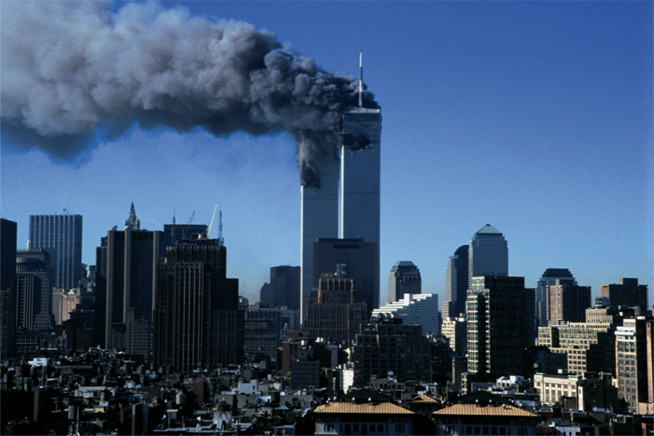
Memory is Not Like a Video Camera
Notes:
Despite the fact that people tend to be very confident in the accuracy of their memories, that confidence may not be well founded. Our memories are not like a video camera that makes a perfect replica of what we experience. Instead, our memories are subject to change and distortion over time. Psychologists note the constructive and reconstructive nature of memory, which explains that what we remember may be a combination of recalling the actual event itself as well as our last memory of the event. Over time, the combined effect of this remembering process can lead to very innocent but important distortions.

Slide 18

Eyewitness Memory
Notes:
Arguably the world’s leading expert on eyewitness memories, Elizabeth Loftus, has done some very intriguing research on how it can be distorted or even manipulated rather easily. Information presented after an event occurs can alter our memory of that original event, a phenomenon called the misinformation effect. People who are affected in this way are not lying about what they remembered; in fact, they are quite innocent victims of their own malleable memories.

Slide 19
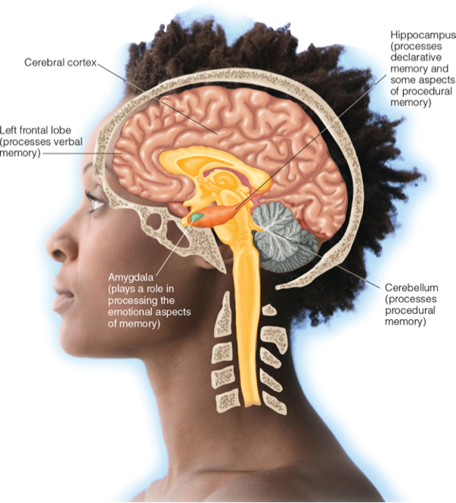
Where Does Memory Lie in the Brain?
Some Brain Structures That Are Important to Memory
Notes:
The biological underpinnings of memory are very complex, and efforts to identify a single place in the brain where memory exists have routinely found that one such “memory center” simply does not exist.
Read carefully about the biology of memory, focusing on memory consolidation, brain structures, and the interdependent functions of brain structures with regard to different types of memory. Of particular interest in this area of research is the workings of the hippocampus and the frontal lobe of the cerebral cortex.

