Slide 1
Assignment:
1. Use Game Theory and the case to explain why the industry participants opted for a standardized delivery medium (i.e. CD)
2. The case provides two payoff matrices. I think that there is a better way to structure this using sequential game theory. Redo the author’s using sequential (i.e. trees) methods.
3. Discuss the role of chapter 7 concepts in these choices. Consider,
  “Micro-dynamics” (i.e. Strategic commitments, substitutes, complements, etc)
  Pricing choices
  Impediments to coordination

Slide 2
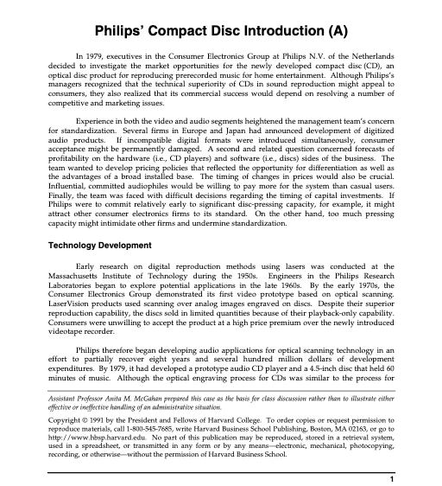

Slide 3
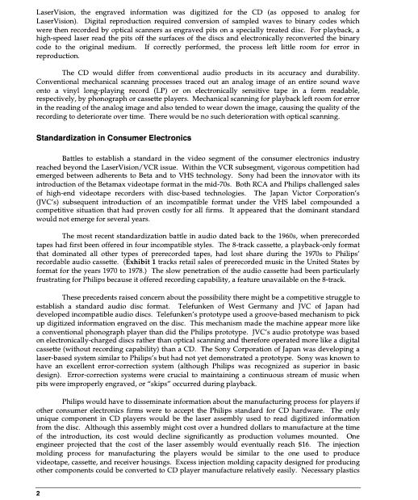

Slide 4
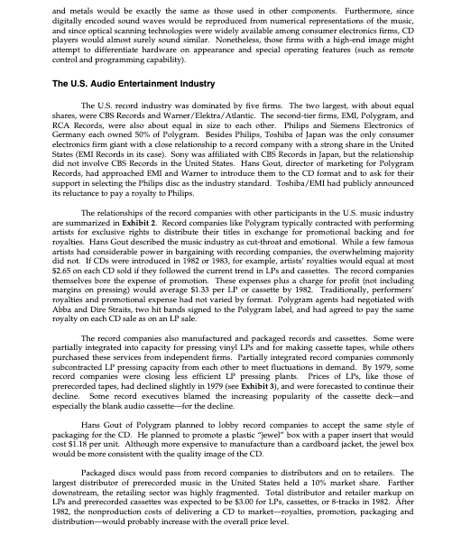

Slide 5
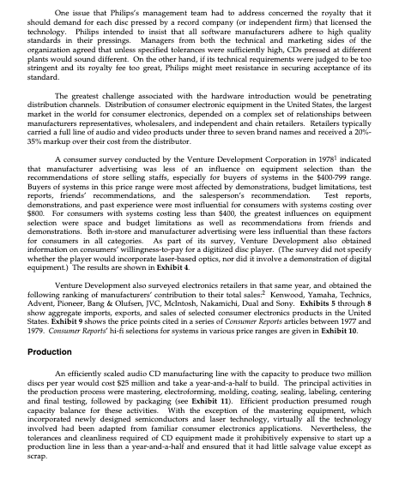

Slide 6
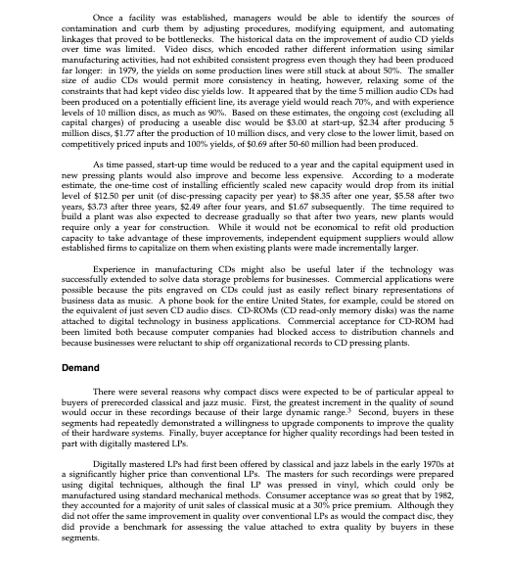

Slide 7
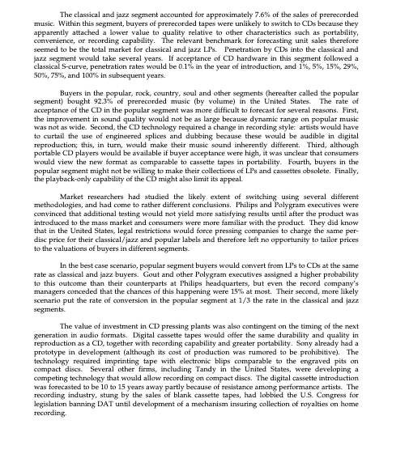

Slide 8
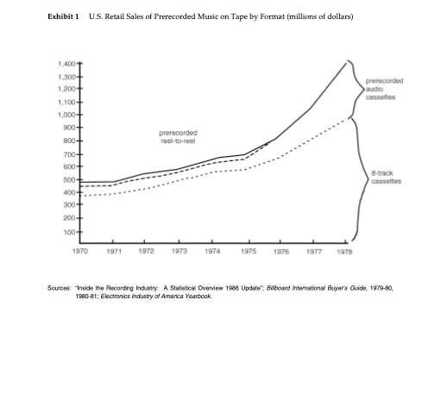

Slide 9
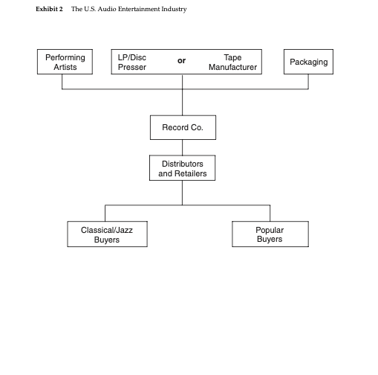

Slide 10
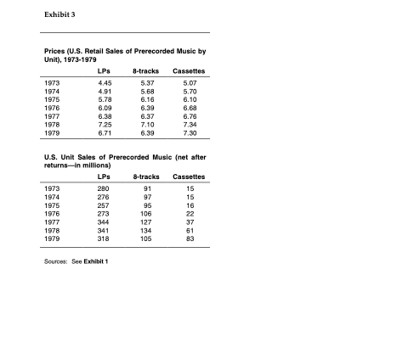

Slide 11
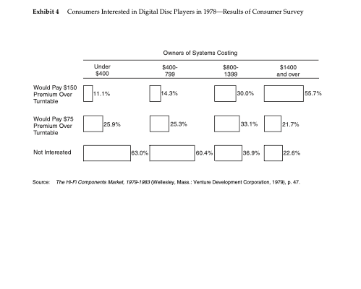

Slide 12
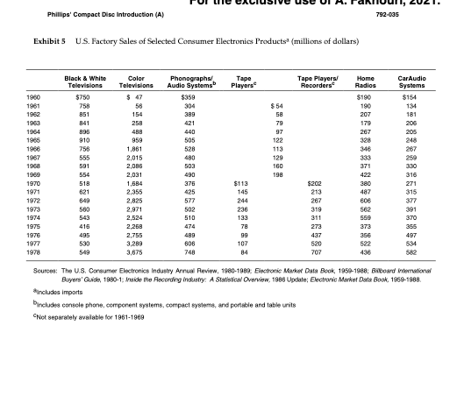

Slide 13
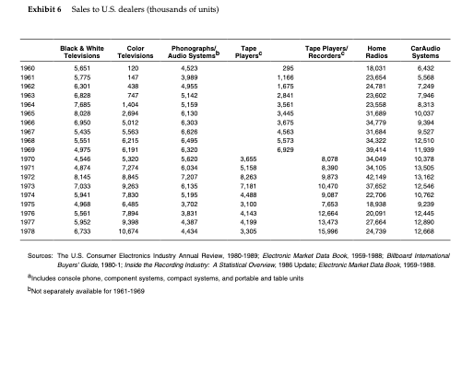

Slide 14
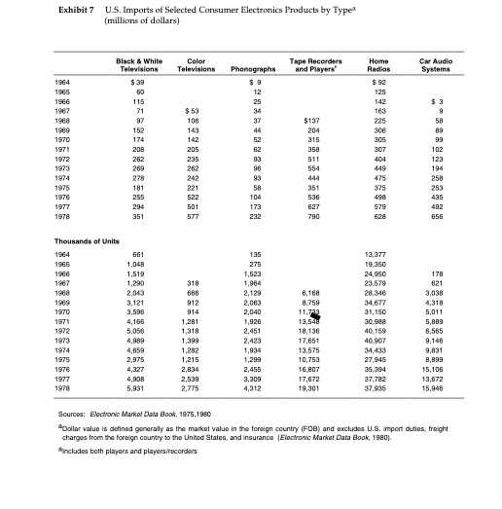

Slide 15
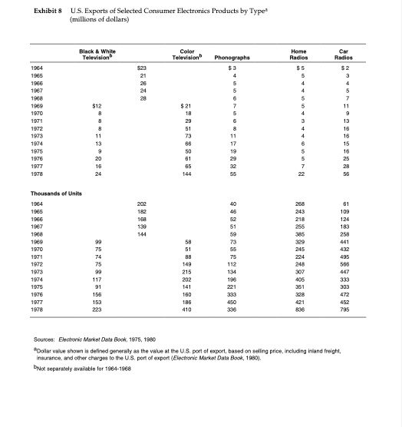

Slide 16
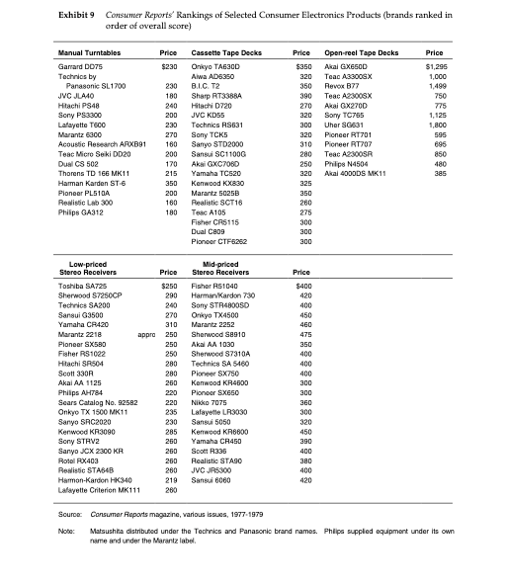

Slide 17
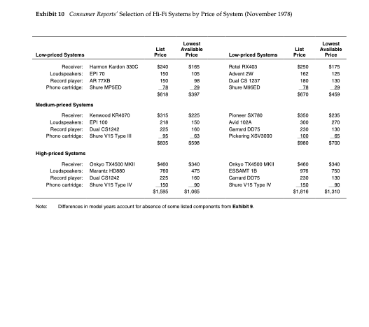

Slide 18
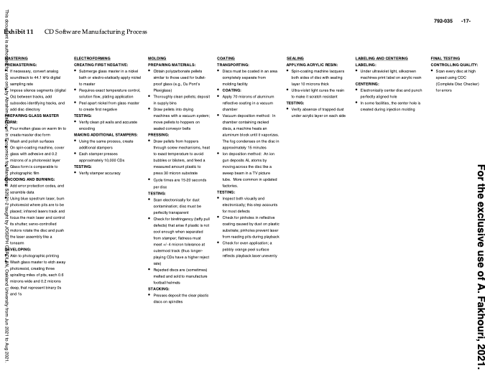

Slide 19
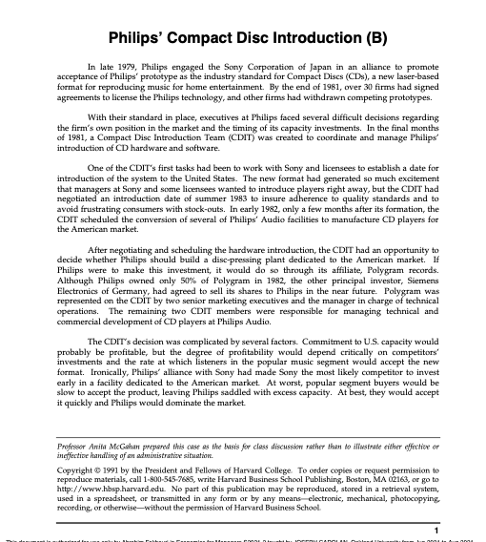

Slide 20
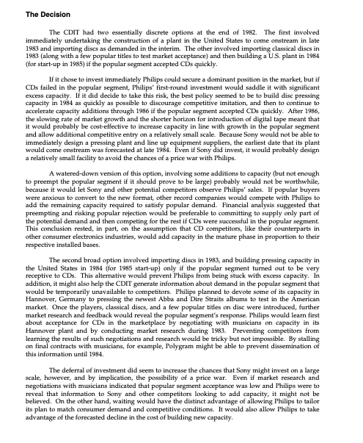

Slide 21
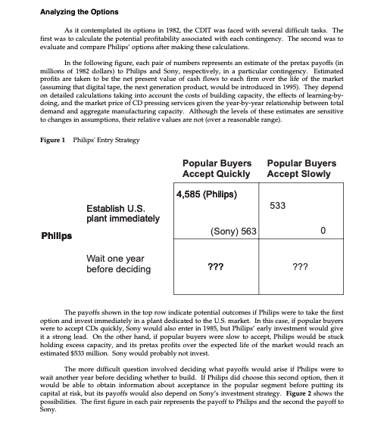

Slide 22
