Slide 1
Presentation
Landfills and Plastic Waste

Slide 2
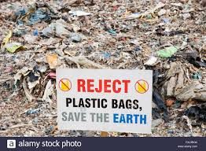
Introduction
Plastics are materials made of any of wide synthetics, or semi-synthetic organic compounds that are malleable hence can be molded into solid objects.
The origin of plastics can be traced back in 1862 by Alexander Parkes. Plastics are currently used in our daily lives in making pipes, in covering electronic substances like computers and cell phones, and packaging food.
The plastics are non-biodegradable, and they have caused landfills and pollution on both the sea and the land.
Notes:
Plastics are materials made of any wide synthetics or semi-synthetics organic compounds that are malleable and thus can be molded into different solid objects. The chemistry of plastics can be associated with inorganics compounds that constitute polymers that are interconnected to make various compounds. The products made of plastics include; making long-lasting designs and constructions in homes and buildings and infrastructure. Plastics are also used in the packaging of goods, which significantly reduced the weight of transportation. The outer covers of computers, televisions, and cell phones are made from plastics. Plastics were discovered in 1862 by Alexander Parkes, who publicly the usability of polymer to form solid materials. Since then, the plastics have been widely accepted and used in day to day lives. However, the effects of plastics on the environment came up due to the non-biodegradability of its product and thus causes landfills and affects marine life adversely.

Slide 3
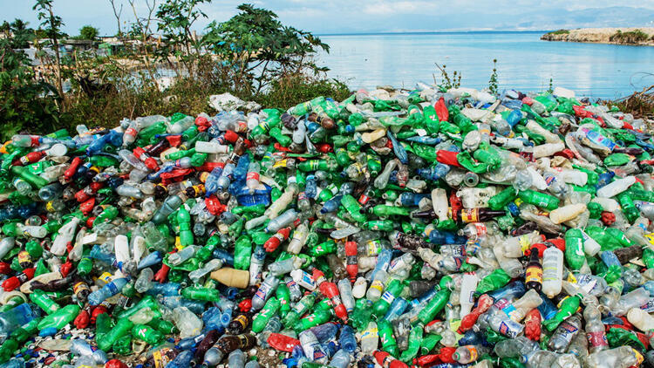
The Difference between Dumps, Tips, Landfills, and Sanitary Landfills;
Dump: an excavated piece of land used as storage for waste materials. It does not possess a liner at the bottom and thus cannot catch the liquid produced.
Landfill: an excavated piece of land that is used in the storage of waste materials and has a liner at the bottom to catch liquid produced by the solid waste (Jani, 2018).
Tips: these are the places in which the waste materials are dumped, the rubbish tips.
Sanitary landfills: Pits with protected bottom in which trash is buried in layers and compressed to make it more solid. It is used to ensure that the harm caused by the environment due to degradation is minimized.
Notes:
The world has reached a point where there is a need to keep the environment in good condition, and this means all the solid wastes need to be managed and controlled. In this regard, some basics should consider ad their differences noted. The dumps are excavated piece of land used as storage for waste materials (Jani, 2018). The landfills refer to an excavated portion of land that is used in the room of waste materials and has a liner at the bottom to catch liquid produced by the solid waste. The difference between a landfill and dumps is seen in the capability of the landfill to holding the liquid in the bottom by the liner, which is missing in the dump. Additionally, tips are the places in which the waste materials are dumped, the rubbish tips. The sanitary landfills are specialized tips with a protected bottom where the trash is buried in layers as well as the compressed to make it more solid.

Slide 4
How Leachate and Gas are Generated an a Landfill
The generation of leachate is principally caused by precipitation through waste deposited in a landfill.
When it comes to contact with the decomposing solid waste, the percolating water becomes contaminated.
If the water flows out of the waste material, then it is referred to as leachate, which is extremely toxic or relatively harmless to the environment (Jani, 2018).
The biochemical oxygen demand (BOD) leads to the organization of the wats into layers.
    The first layer in the linear system
    The second layer with a drainage system
    The third layer which is the gas collection
    The trash containing layer.
Notes:
The leachate and gas production can occur in two ways; the natural process in which the rainwater that gets into the landfill and then decomposition of the waste production occurs with the production of gases. Alternatively, the landfill may be precipitated through waste deposition in a landfill. The solid waste becomes contaminated, although this depends on the substances contained in the solid waste (Rudolph, Kiesel, & Aumnate, 2017). Either the leachate will be relatively harmless or extremely harmful. The gas production in a landfill follows specific procedures in which there is the first layer, in contact with the impervious clay. The second layer is the drainage system, which takes care of the leachate due to its toxicity, and there are perforated pipes at the bottom of the landfill to remove the leachate from leaching through the liner layer. The third layer is associated with the production of greenhouse gases like methane, which is harmful to environmental health. There are extraction pipes that trap the methane gas and channel it to treatment and can be used to produce electricity. Lastly, there is the trash containing layer, which is the topmost and consists of pure solids awaiting the other steps of leachate and gas production.

Slide 5
Municipal Solid Waste (MSW) in Developed Versus Undeveloped Countries
Developed countries
High levels of municipal solid waste production.
Municipalities ensure the total collection of solid waste.
At least 50% of the total solid waste is being recycled by composting (Verma et al., 2016).
Competent human resources, improved technology, and effective policies favor solid waste collection.
Developing countries
There is a high level of uncontrolled dumping of solid waste.
The rate of decomposing solid waste is low, and most of the solid waste remains uncollected, not even treated.
Low levels of municipal solid waste production
Inferior technology, poor government policies, and low human resource affect solid waste collection.
Notes:
We must appreciate the fact that every country in the world recognized the negatives brought by solid waste on the environment. In this regard, there are organized treatment ad waste recycling plans. However, the developed countries have a well-organized MSW that leads to the collection of almost all the solid waste (Verma et al., 2016). On the other hand, the developing countries are subjected to weaker policies, inferior technology, and low human recourses to make the waste collection and recycling process more effective. As the developed countries recycle haft of their MSW, the developing countries have most of its solid wastes uncollected. It should be noted the developed countries have high levels of solid waste production as compared to the developing countries, and this is associated with high levels of industrial output.

Slide 6
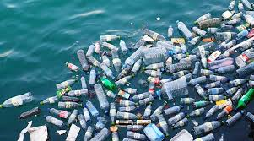
The Quantity and Transport of Plastic Waste
More than 8.3 billion metric tons of plastic have been produced globally in the last 70 years (Rudolph, Kiesel, & Aumnate, 2017).
Coca-Cola is the leading world plastic polluter.
Only nine percent of the plastics waste has been collected and recycled in the world.
The percentage of uncollected and unrecycled plastic waste in the entire world is about 91%, and it was as a result of the slow reaction of the world towards plastics pollution.
Notes:
The world has always known that plastics are non-biodegradable, but the reaction towards implementing policies that reduce the usage of plastic material was delayed. This has led to the accumulation of over 8.3 billion metric tons of plastic that has been produced globally in the last 70 years. Since the policies have been effectively implemented, only nine percent of the total solid waste has been collected and recycled (Rudolph, Kiesel, & Aumnate, 2017). This leaves a greater work to be done on environmental pollution. The leading producer of plastic waste in the world is the Coca-Cola company, and their residues are found in all parts of the universe due to international coverage in their market.

Slide 7
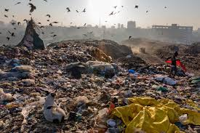
The Sources, Effects, and Characteristics of Micro-plastics in the Environment
The sources of micro-plastics include tires, synthetic textiles, marine coatings, road markings, and plastic pallets.
The effects of micro-plastics in the environment include;
  Interrupting with the food chains (Rudolph, Kiesel, & Aumnate, 2017).
  Land pollution
  Cause infections
  Air pollution
  Affecting crops and other agricultural products
Notes:
The micro-plastics are fragments of large plastic materials like tires, synthetic textiles, marine coatings, road markings, and plastic pallets. The significant characteristics of the micro-plastics are that they are non-biodegradable. This implies that they cause pollution and have adverse effects on the environment. This includes interfering with the food chains, causing air pollution, especially when the combusted (Horodytska, Cabanes, & Fullana, 2019). The gases released to the atmosphere lead to greenhouse effects and, thus, global warming. Additionally, the plastic bottles hold water that can act as breeding sites for mosquitoes which cause malaria. During the combustion of the plastics, the toxins can leach in the soils and thus affecting the animal and plants' life. Toxins will later be transmitted to humans through food chains and thus leading to infections.

Slide 8
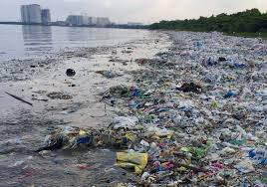
The Sources and Impacts of Plastic Pollution in the Ocean
In the oceans, the coon sources of plastics pollution include tires, marine coating, plastic bottles, plastics papers, and fragments of plastics pipes.
The effects plastics on the oceans are;
  Harming the marine life.
  Pollution of water.
  Affecting the habitats for marine animals.
  Toxify marine life and thus causing sudden death.
Notes:
The oceans are holding a lot of plastic products that are adversely affecting marine life. The fishes are getting out-of-place due to high amounts of the plastics on their habitats. Additionally, the leaking of plastic substances in the water during combustion causes toxify water and thus killing the marine life (Horodytska, Cabanes, & Fullana, 2019). most of the plastics used on the earth's surface are channeled to the ocean by the other water sources like the rivers.

Slide 9
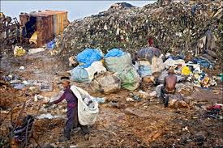
Conclusion
There is a difference between the dumps and landfills in terms of plastics recycling.
Plastics are non-biodegradable and thus cause pollution (Horodytska, Cabanes, & Fullana, 2019).
The developed nations are working better towards reducing the effects of plastics pollution, which the developing countries are fighting with a lack of resources for the same.
Public education on the effects of plastic waste on the environment can help in making the world a better place.
The existing policies on plastics pollution need to be effected.
Notes:
The world recognizes the negatives associated with plastic wastes. Therefore, it is essential to take action toward curbing these effects. Public education will be of great help since the public will be notified of the kind of environmentally friendly products. Moreover, international organizations need to finance the developing nations in managing plastic wats pollution because the efforts to solve these issues are centralized in the developed countries. Lastly, the existing policies on the necessity of protecting the environment should be enforced.

Slide 10
References
Horodytska, O., Cabanes, A., & Fullana, A. (2019). Plastic Waste Management: Current Status and Weaknesses.
Jani, Y. (2018). Landfills and glass dumpsites as future bank accounts of resources–waste characterization and trace elements extraction (Doctoral dissertation, Linnaeus University Press).
Rudolph, N., Kiesel, R., & Aumnate, C. (2017). Understanding plastics recycling: Economic, ecological, and technical aspects of plastic waste handling. Carl Hanser Verlag GmbH Co KG.
Verma, R., Vinoda, K. S., Papireddy, M., & Gowda, A. N. S. (2016). Toxic pollutants from plastic waste-a review. Procedia Environmental Sciences, 35, 701-708.

