Slide 1
Poetry Project

Slide 2
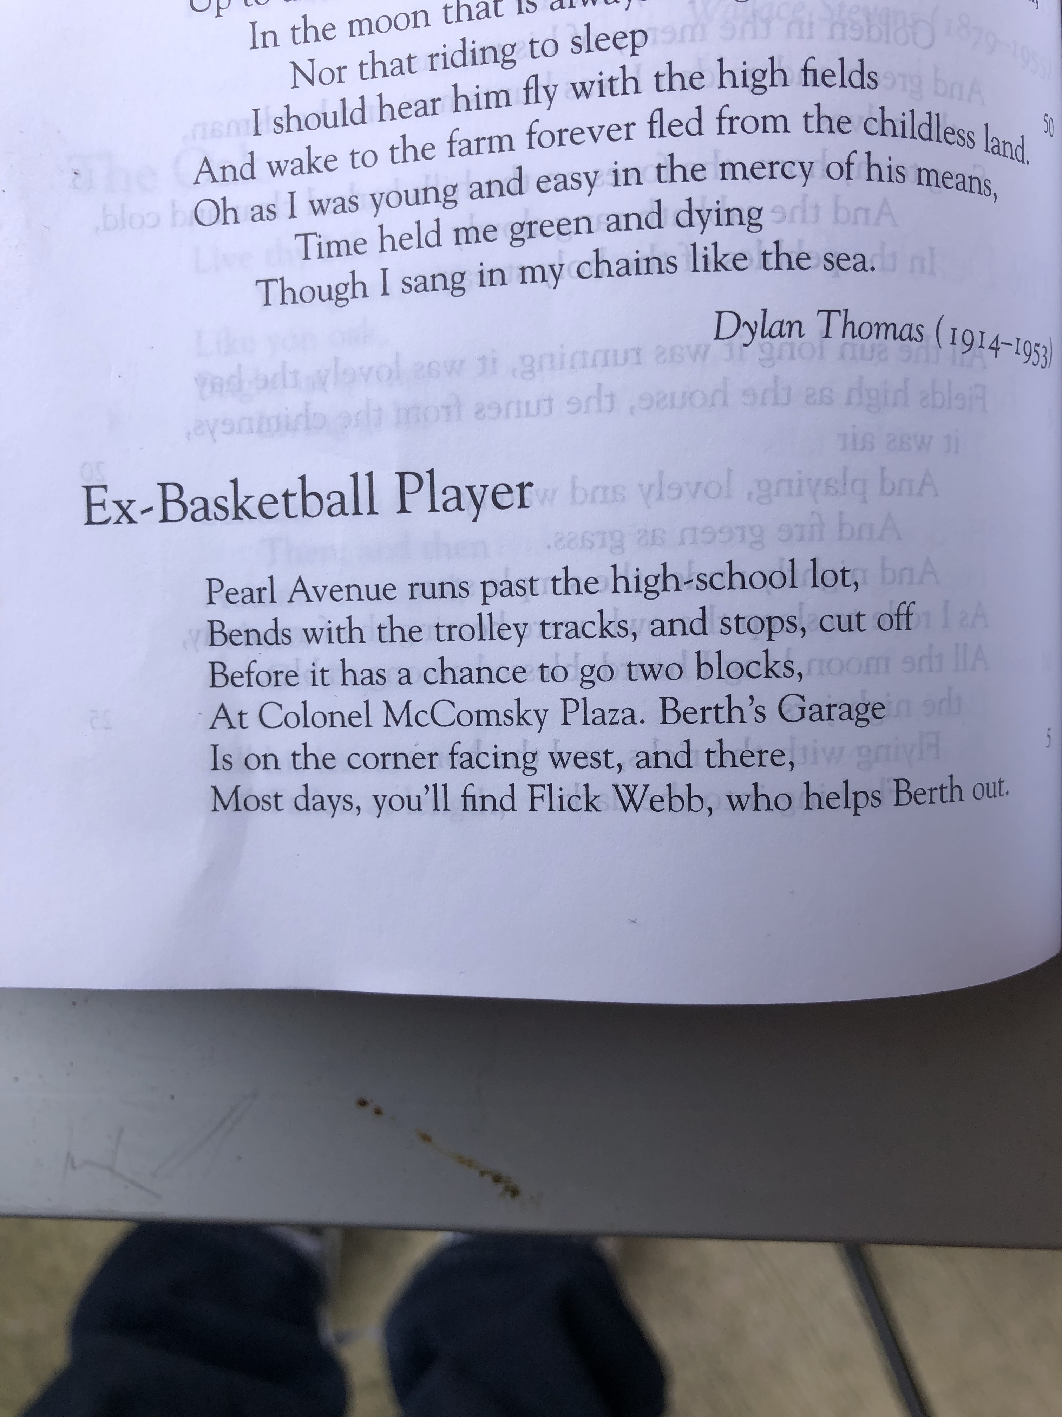
Ex-Basketball player
In this poem done by Updike, the Ex-Basketball player is currently working in a gas station. The purpose of the scope of this poem is to show how fleeting fame can turn out to be.
In this poem, Flick seems to be living in the past. For example;
Once in a while,
As a gag, he dribbles an inner tube,
This imagery created in these two lines shows how Flick is living a n imaginative life.

Slide 3
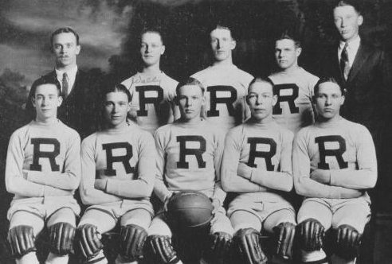
The blank verse
The poem contains five stanzas which each has six lines. The high school basket baller is seemingly living a sub glorious life which is not what he expected. Working in a gas station seems to be hitting a dead.
The second stanza is a snapshot of the manner in which events unfold for Flick. The third and the fourth stanzas give the audience a wider view of the different aspects of live that seem to be a mystery to Flick.

Slide 4
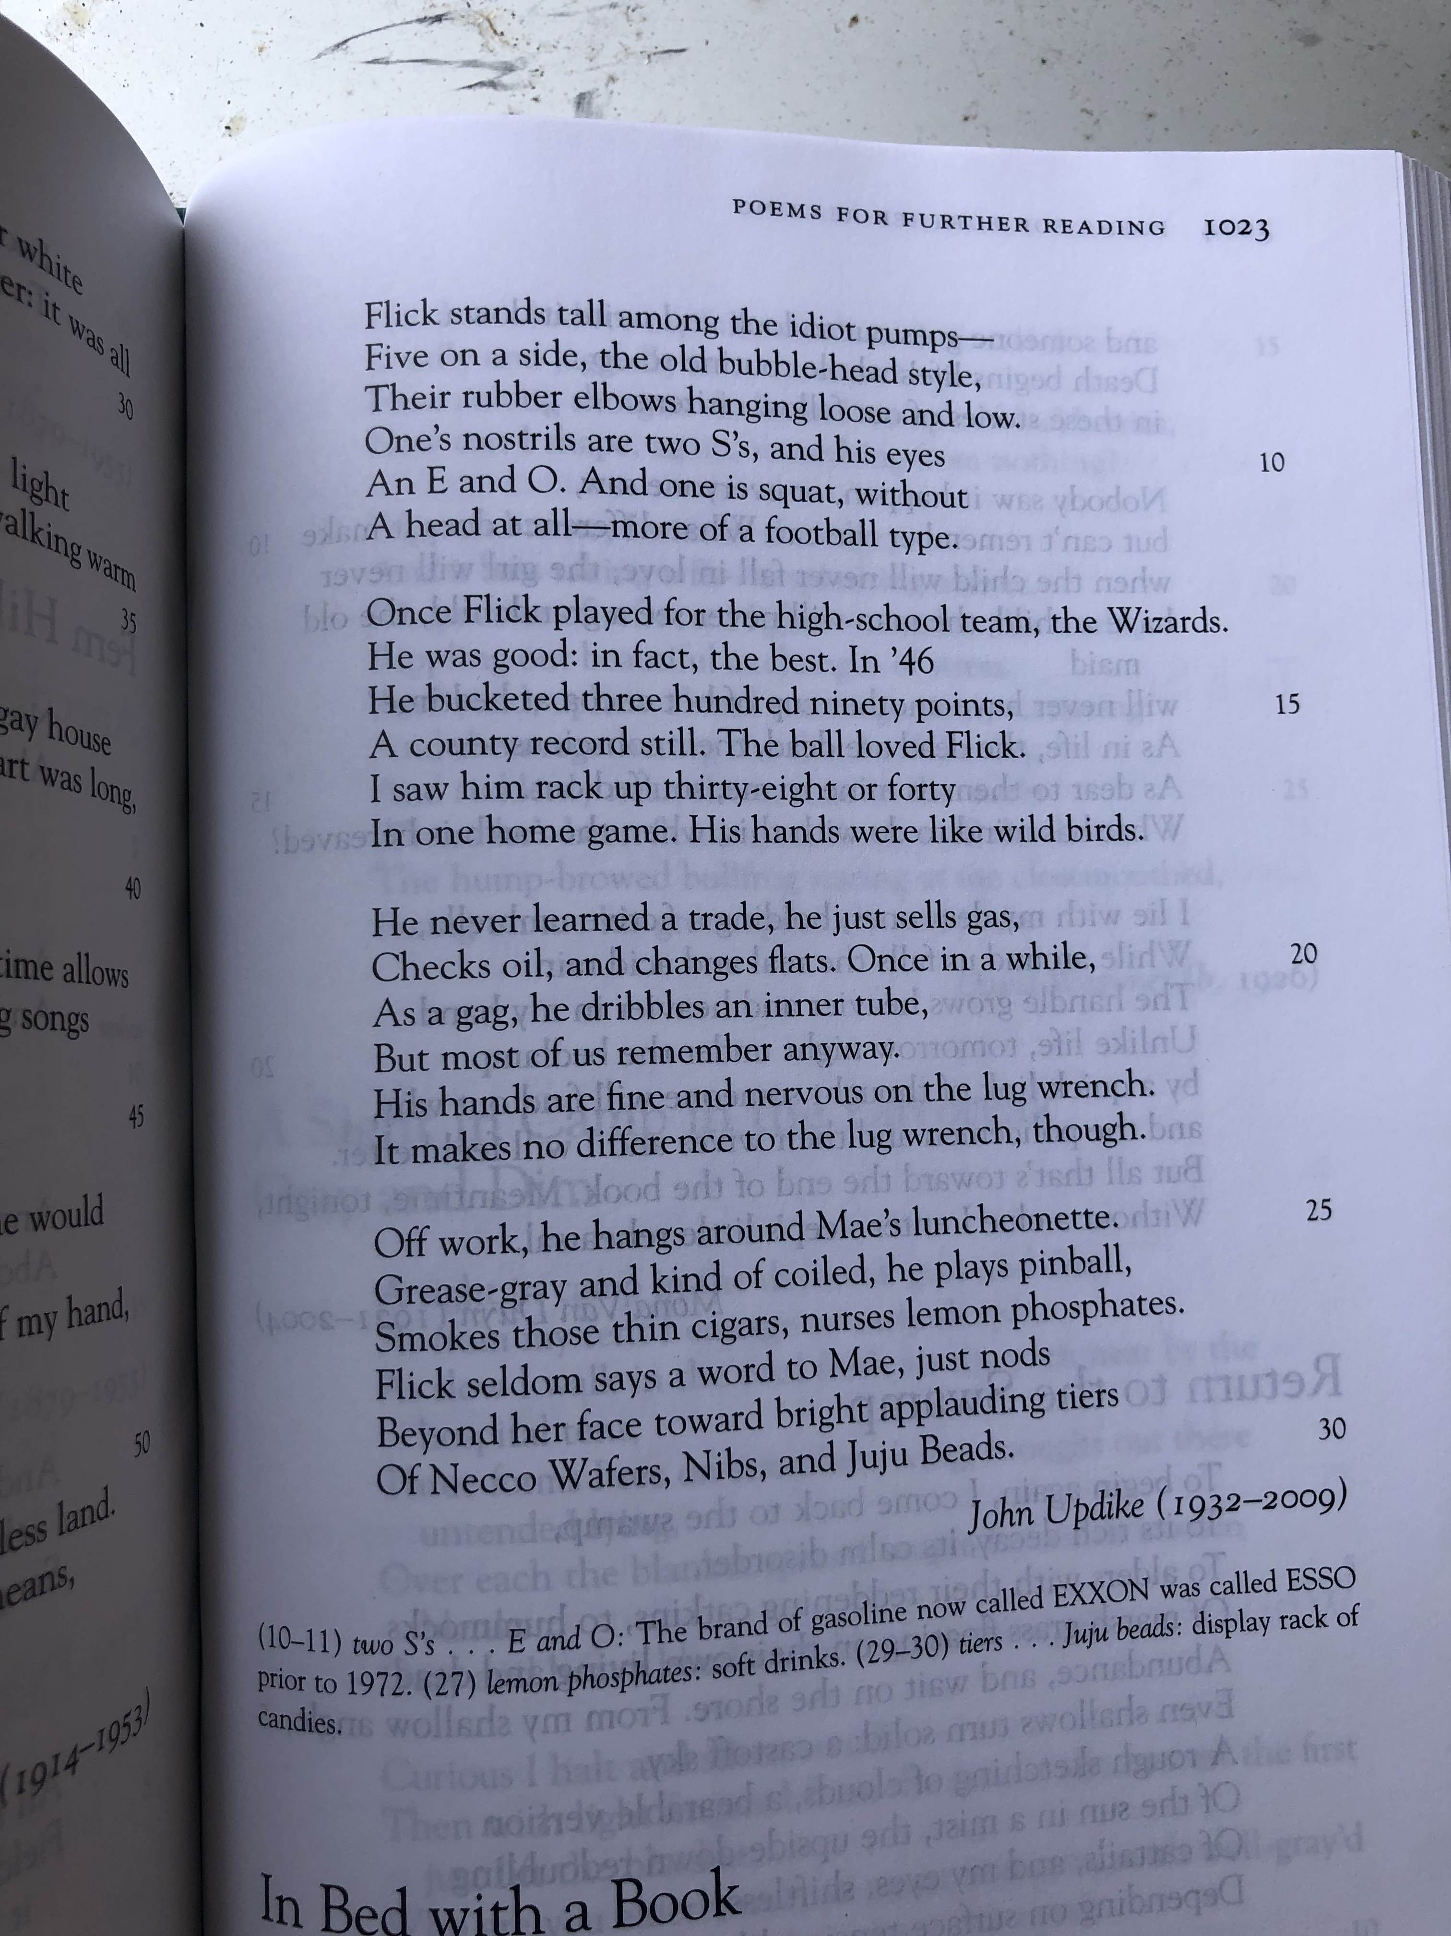
The message
The consequences of failure to get the most valuable skills in life and knowledge can be seen in this poem. The poems seems to persuade the audience that ballin’ without education might not be of great importance,

Slide 5
Relatability
This seems to be a sad story which seem sto be reccuring to many atheletes today. The mental image created in this poem dates back the emotions as well as memories which are powerful and play a critical role in teh poem.
This poem is a powerful one and gives a story of a man who lacked the vision despite being worshiped and followed greately.

Slide 6
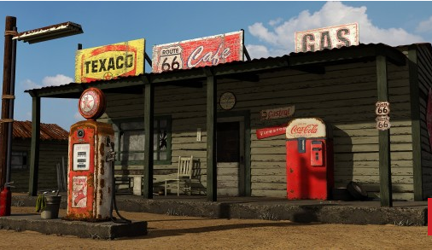
Meaning of the poem
Updike uses a number of literature styles to make the poem an eye-catching one. The poet uses allusions, figurative language and good diction. These styles bring a great effect to the meaning of the poem.
The poem also creates a nolstagic feeling to the audience of imagining life in teh 40’s and this helps in connecting the poem.

Slide 7
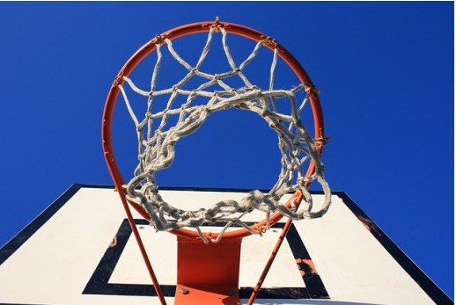
Conclusion
This poem describes how dreams can be sidetracked by reality as well as teh lack of education. Teh literally meaning of the poem is that life is too short to ignore somethings. We all need to make maximum use of our time and do what we ought to do.
Time is limited and when it slips, it cannot be recovered. Instead of swimming in fame and suffere in the future, it is key to make maximum use of teh goodies that come in handy with fame.

Slide 8
Thank You!
Time for questions, welcome!!

