Slide 1
Polish Food and Culture
Name
Institutional Affiliation

Slide 2
Introduction
Poland is a country located in Eastern Europe.
The country is among the favorite tourist destinations in Europe due to its unique geography and culture.
It has a robust food and culture, which combines traditional and exotic cuisines.

Slide 3
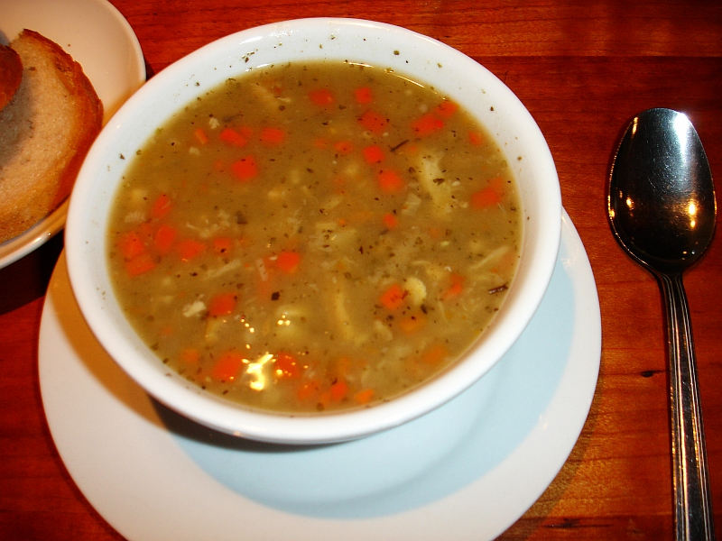
Significant Flavors and Foods
Polish cuisine has a rich history, dating back to A.D. 900.
The country’s current cuisine reflects the cultural and political influence Poland has undergone over decades (Smith, J., & Jehlička, P. 2007)
Cereals like wheat, barley, and rye form part of the country’s staple foods.
Deserts like cheesecake, babbka(pound cake), and poppy ssed cake.
The Polish also love their rye distilled vodka. It is their national drink.
Flaki (tripe soup)

Slide 4
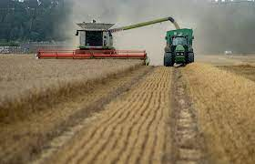
Food Security
Food in Poland is one the most affordable compared to other countries in Europe.
Farmers in Poland have invested in modern technology to improve efficiency in their farms (Filomena, V., Matute, J., Kubal-Czerwińska, M., Krzesiwo, K., & Mika, M. 2020).
Currently, the country produce enough food to meet most of its domestic needs.
Poland has favorite climate to support agriculture without irrigation. Most parts of the country receive rainfall throughout the year.

Slide 5
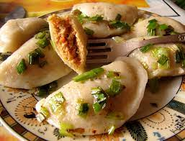
Eating Habits
Polish people have four meals per day; Sniadanie, second breakfast, obiad(main meal) and wieczerza.
Polish people love taking eggs or meat as first meal of the day (Filomena, V., Matute, J., Kubal-Czerwińska, M., Krzesiwo, K., & Mika, M. 2020).
Dining etiquette in Poland includes; not starting eating before everyone is served, wait for the host to invite (smaczengo), and knife on right and fork on left hands (Filomena, V., Matute, J., Kubal-Czerwińska, M., Krzesiwo, K., & Mika, M. 2020).
Food is served as part of any celebration.

Slide 6
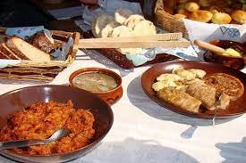
Traditions and Food Culture
Food is part and parcel of any celebration in Poland.
The Christmas celebrations are marked by sharing home-cooked meals with each other.
Wigilia (Christmas Eve dinner) involves sharing home-made but meatless foods with friends and families.
The tradition of sharing influenced the food culture by encouraging family and friends communion during holidays.

Slide 7
Reference
Wiśniewska, M., Czernyszewicz, E., & Kałuża, A. (2019). The assessment of food safety culture in small franchise restaurant in Poland. British Food Journal.
Smith, J., & Jehlička, P. (2007). Stories around food, politics and change in Poland and the Czech Republic. Transactions of the institute of British Geographers, 32(3), 395-410.
Filomena, V., Matute, J., Kubal-Czerwińska, M., Krzesiwo, K., & Mika, M. (2020). The determinants of consumer engagement in restaurant food waste mitigation in Poland: An exploratory study. Journal of Cleaner Production, 247, 119105.

