Slide 1
PHOTO JOURNAL
Student Name
Institution Affiliations
Date

Slide 2
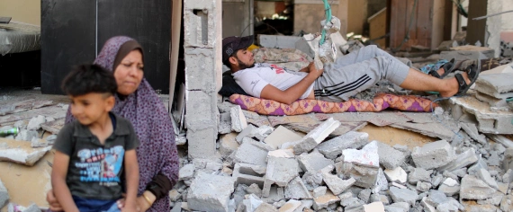
STORY 1
Caption: The Palestinian death toll stood at 248, including 66 children, with more than 1,900 people wounded from Israeli air and artillery attacks [Mohammed Salem/Reuters
Rabah, Sulaiman. Saying goodbye: Gaza civilians describe Israel’s deadly attacks. May 23rd 2021. https://www.aljazeera.com/news/2021/5/22/gaza-attacks-fear-finality-and-farewells-as-bombs-rained-down

Slide 3
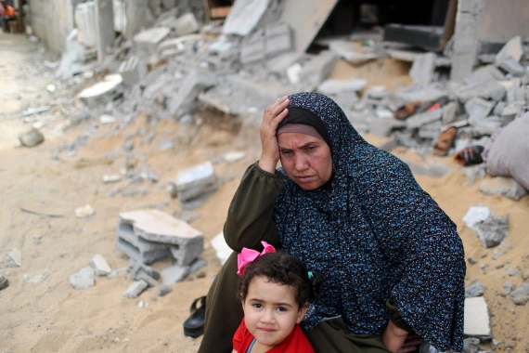
Caption: UN warns health facilities in danger of being overwhelmed and urges immediate access to Gaza for supplies and personnel.
Gaza: Daunting rebuilding task after 11 days of Israeli bombing. https://www.aljazeera.com/news/2021/5/21/thousands-of-gazans-return-to-destroyed-homes-after-israel-truce

Slide 4
SUMMARY
Gaza City holds stories of fear, resignation and survival which occurred from the overwhelmed territory. Most citizens looked frightened and began saying their goodbyes to their families, relatives and friends during the eleventh day attack, fearing they will not make it in one of the densest Israeli onslaughts on the Palestinian territory. A seventeen year old boy who lived in Mughazi camp in Gaza strip was among the individuals who sent a final goodbye to his extended family and friends using Facebook account. The boy talked of how the warplanes bombed many different places without dispensing prior warnings as they did in the past three wars. They were scared of the sounds of bombs as it looked terrifying.
After 11 days of the harsh Israeli bombing, many of displaced Palestine's returned to their homes to see the damages that were caused. It will cost around $150m to rebuild the damages of industries, electricity and power, and agriculture said the Palestinian officials. The UN approximated 900,000 individuals in Gaza lacked accessibility to clean piped water as around 55% of the water network was damaged during the bombing.

Slide 5

STORY 2
Caption: Dozens of these nursing homes facing wrongful death lawsuits, which often tally millions of dollars, are urging judges to move the litigation from state courts to federal courts, where they can invoke the new federal liability protections and potentially avoid massive payouts. | AP Photo/John Minchillo
Luthi, et al. “Nursing homes invoke Trump-era protections to fight lawsuits over Covid deaths.” may 22nd 2021. Nursing homes invoke Trump-era protections to fight lawsuits over Covid deaths – POLITICO

Slide 6

Caption: In this April 15, 2021, file photo, parent Rosa Vargas and her son, 9th grade student Victor Loredo, 14, walk home after getting tested at a Los Angeles Unified School District Covid-19 testing and vaccination site in East Los Angeles. | Damian Dovarganes, File/AP Photo
David, Lim. Vaccines success could undercut Biden’s multibillion-dollar school testing plans. May 23rd 2021. https://www.politico.com/news/2021/05/23/covid-vaccine-testing-schools-490213

Slide 7
SUMMARY
Nurses and nursing homes are seeking protection against the wrongful death law suits from families of Covis-19 victims. A number of law suits have already been filed against nursing homes following the death of several patients in their nursing homes. The law suits limit care providers the from conducting their duties well. The trump administration had placed guidelines to protect nursing homes from such law suits but the Biden administration has failed to strengthen them. With the struggles to launch the US$ 550 million program, nursing homes have found themselves in dramatic positions of high infection rates within the shelter homes.

Slide 8
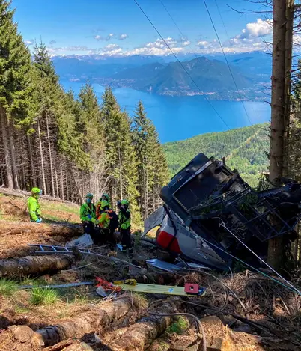
STORY 3
Italy Cable car fall: 14 dead after accident near lake Maggiore.
Fourteen people, including at least one child, have been killed and another child is seriously injured after a cable car fell on a mountain near Lake Maggiore in northern Italy on Sunday. https://ichef.bbci.co.uk/news/800/cpsprodpb/17FB8/production/_118623289_e2eifjmxeaqy2lp.jpg

Slide 9
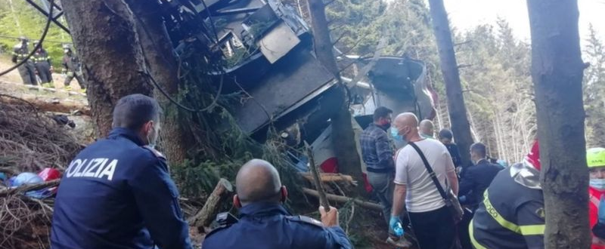
Italy Cable car fall: 14 dead after accident near lake Maggiore.
Fourteen people, including at least one child, have been killed and another child is seriously injured after a cable car fell on a mountain near Lake Maggiore in northern Italy on Sunday. https://ichef.bbci.co.uk/news/800/cpsprodpb/E760/production/_118623295_067552943.jpg

Slide 10
Summary
The service transportation system ferrying passengers from the resort town of Stresa crashed in the Mottarone mountain Sunday morning of 24/5/2021, leaving several people injured a number of fatalities. Among the dead were five Israeli citizens. The accident happened at 10:30 GMT, and the cause of the accident is still unknown. Major speculations have it that the cable failed at 984ft below mountain top and resulted to the fell of the cabin 20m to the ground. Reports by the town mayor indicate that the trees facilitated the stop of the cabin from rolling over. The number of fatalities rose due to steep and difficult mountainous terrain which lead to overturning of one of the fire service vehicle.

Slide 11
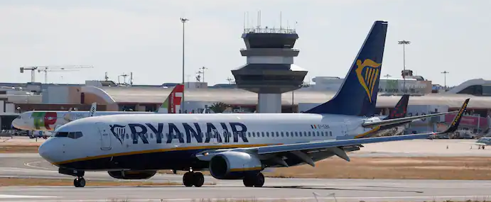
STORY 4
Caption: A Ryanair flight from Manchester arrives at Faro Airport in Portugal on May 17. (Pedro Nunes/Reuters)
Khurshudyan & Birnbaum. (May 24, 2021). Belarus forces down commercial airliner, arrests dissident journalist on board. https://www.washingtonpost.com/wp-apps/imrs.php?src=https://arc-anglerfish-washpost-prod-washpost.s3.amazonaws.com/public/VW2PG5F3YMI6XA7DBSTQLKLLUQ.jpg&w=691

Slide 12
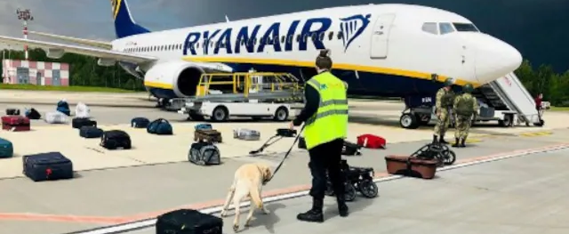
STORY 4
A Belarusian dog handler checks luggages off a Ryanair Boeing 737-8AS (flight number FR4978) parked on Minsk International Airport's apron in Minsk, on May 23, 2021. AFP

Slide 13
Summary
Authorities in Belarus forced a private airliner to land in Minsk to arrest an opposition journalist on board. The seizer of the flight traveling to Lithuania from Athens is considered a hijacking by many European leaders. Mere minutes before the Ryanair flight was to exit Belarusian airspace and cross into Lithuania, its crew received an order from Belarus’s air traffic control to turn around because of possible explosives on board. A Belarusian MiG-29 fighter jet scrambled to escort the Boeing 737-8AS to Minsk, although the aircraft was at that point much closer to Vilnius. Following orders of the President of Belarus, the Ryanair flight was escorted by fighter jets to the airports few minutes after it was out of the Belarusian airspace
The Belarusian opposition said the supposed bomb scare was a pretext for the real reason strongman President Alexander Lukashenko ordered the plane carrying 123 passengers to land: the arrest of Roman Protasevich, an opposition journalist on board. Lukashenko, who has been in power since 1994, has cracked down on dissent since claiming a sweeping victory in last year’s elections. The claim, which has been rejected both domestically and internationally, fueled months of popular protests; most of the opposition is now exiled or jailed

Slide 14
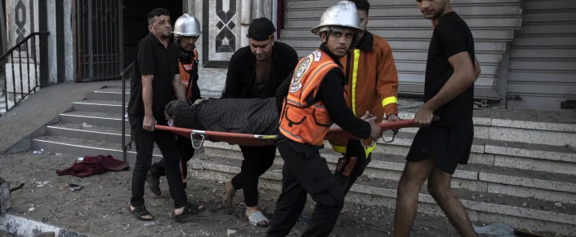
STORY 5
Caption: the latest; Netanyahu
The Latest: Netanyahu raps 'anarchy' of Jewish-Arab fighting (yahoo.com)

Slide 15
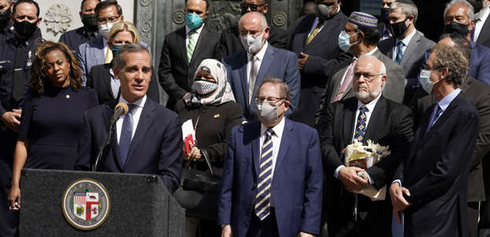
Caption: Los Angeles Mayor Eric Garcetti joins with civic and faith leaders to call for peace in the city. On May 18, a group of people shouting anti-Israel comments attacked diners outside a local sushi restaurant.
‘Who’s out protecting us?’: Spate of anti-Jewish attacks in the U.S. draws calls for more forceful response (msn.com)

Slide 16
Summary
Confrontations between the Israelis and Palestinians indicate increasing conflicts. The anarchy of the Jewish Arab violence in the city of Jerusalem is increasing day after day following unrests. Large police mobilizations and the declaration of the sate of emergency and night curfews have been put in place to reduce the tension and battles between the Jews and Arabs. In the United States, the same anti-Jewish attacks have been witnessed. A series of attacks on Jews have been ongoing in the United States and the attacks are linked to the conflicts in Israel. At least 26 instances of antisemitism have been reported in the US with the cases ranging from protests to physical abuse and attacks.

