Slide 1

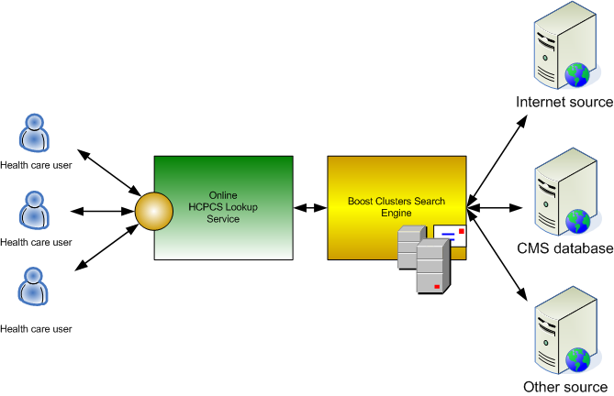
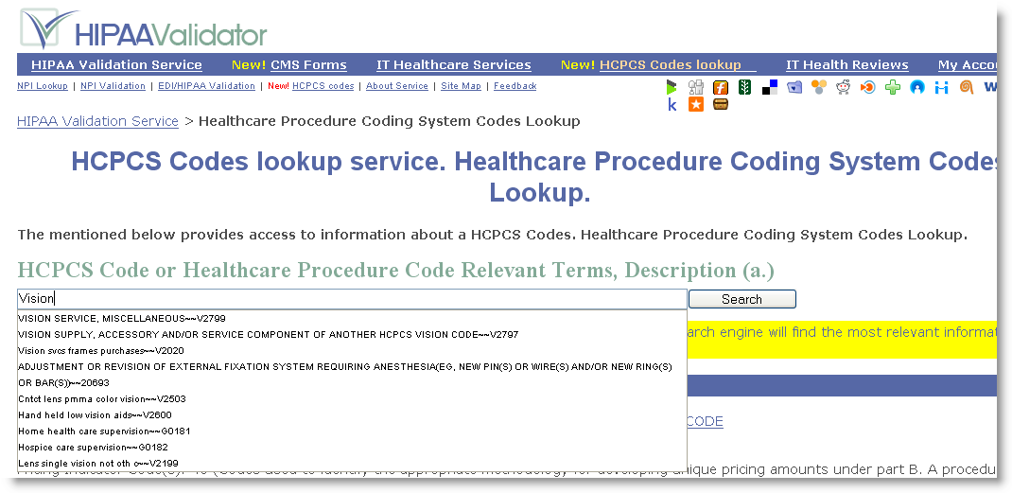
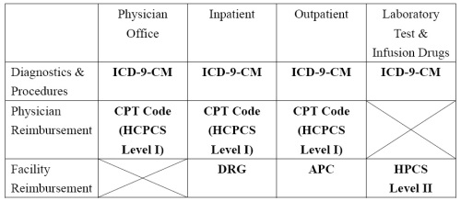
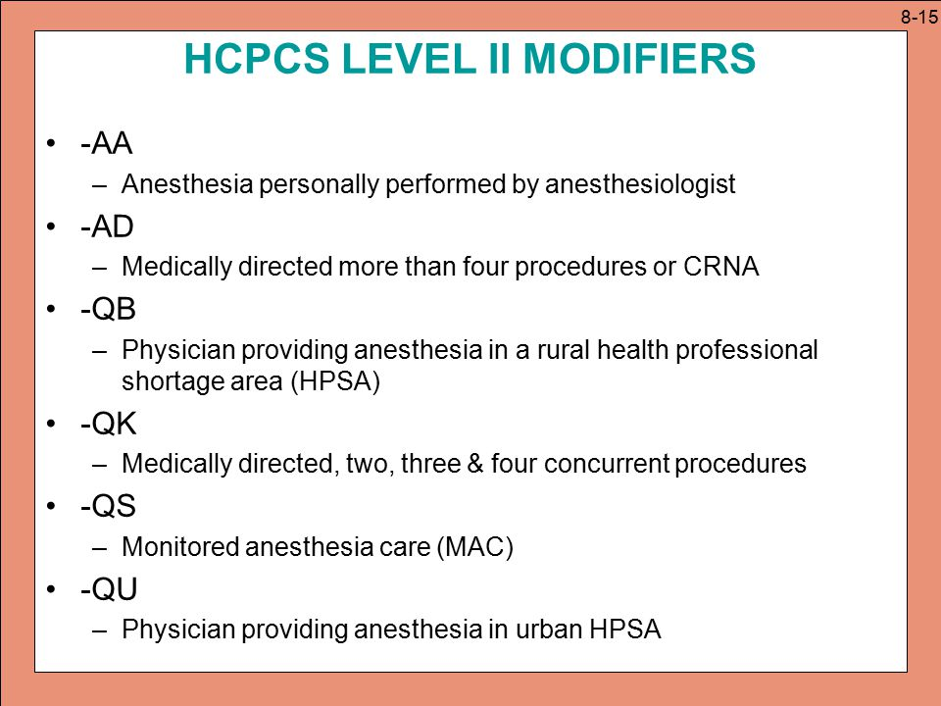
Healthcare Common Procedure Coding System
(HCPCS)
Susan Hull, MPH, RHIA, CCS, CCS-P
Introduction
Methods
Conclusion
HCPCS (pronounced "Hick Picks") is a collection of codes and descriptors used to represent healthcare procedures, supplies, products, and services
HCPCS was originally called the HCFA Common Procedure Coding System
The name of the system was changed in 2001, when the Health Care Financing Administration (the agency that administered the Medicare and Medicaid programs) changed its name to the Centers for Medicare and Medicaid Services (CMS)
In 1983, Medicare introduced HCPCS to promote uniform reporting and statistical data collection of medical procedures, supplies, products, and services.
Most state Medicaid programs and other insurance companies recognize portions of the HCPCS coding system
HCPCS (Healthcare Common Procedure Coding System) is a standardized coding system created to ensure healthcare claims are processed in a consistent and orderly manner.
CPT (Current Procedural Terminology) is a coding system used primarily to identify medical services and procedures furnished by physicians and other health care professionals.
These codes are used to bill private or public health insurance plans. Most professional claims are billed utilizing the CPT code set.
While CPT code sets describe medical, surgical ,and diagnostic services, HCPCS codes are based on the CPT to provide standardized coding when healthcare is delivered.
Also, CPT is largely private, as the AMA has copyright ownership and does not wish to give the codes freely. Meanwhile, according the Health Insurance Portability and Accountability Act of 1996, everyone must have access to HCPCS codes.
Overview
HCPCS is divided into two code levels or groups: Level I and II codes
HCPCS Level I codes are the AMA's CPT codes
It consists of five-digit codes and two-digit modifiers
It primarily cover physicians' services but are used for hospital outpatient coding as well
It is updated annually, effective January 1
HCPCS Level II codes also called National Codes, are maintained by CMS
With the exception of temporary codes (updated throughout the year), level II codes are updated annually on January 1
HCPCS Level II temporary codes begin with the letters G, K, or Q
Level II also contains modifiers in the form of letters and alphanumeric characters
Background
Results
References
Level II codes were developed to code medical services, equipment, and supplies that are not included in CPT
Today, when people refer to HCPCS codes, they are often referring to level II codes
HCPCS codes are alphanumeric and start with an alphabetic character from A to V
The alphabetic character is followed by four numeric characters
The alphabetic character identifies the code section and type of service or supply coded
Level II codes were designed to reflect code assignment based on Medicare payment regulations.
Physicians and providers use HCPCS codes to report the services and procedures they deliver.
Level II also contains modifiers that can be used with all levels of HCPCS codes which permit greater reporting specificity in reference to the main code
1.Healthcare code sets. Susan Hull. HCPCS. American Health Information Management Association
2.Center for Medicaid and Medicare Services. HCPCS Retrieved from https://www.cms.gov/Medicare/Coding/HCPCSReleaseCodeSets/index.html
3. HCPCS Code lookup. Retrieved from https://hcpcs.codes/

