Slide 1
Tuberculosis

Slide 2
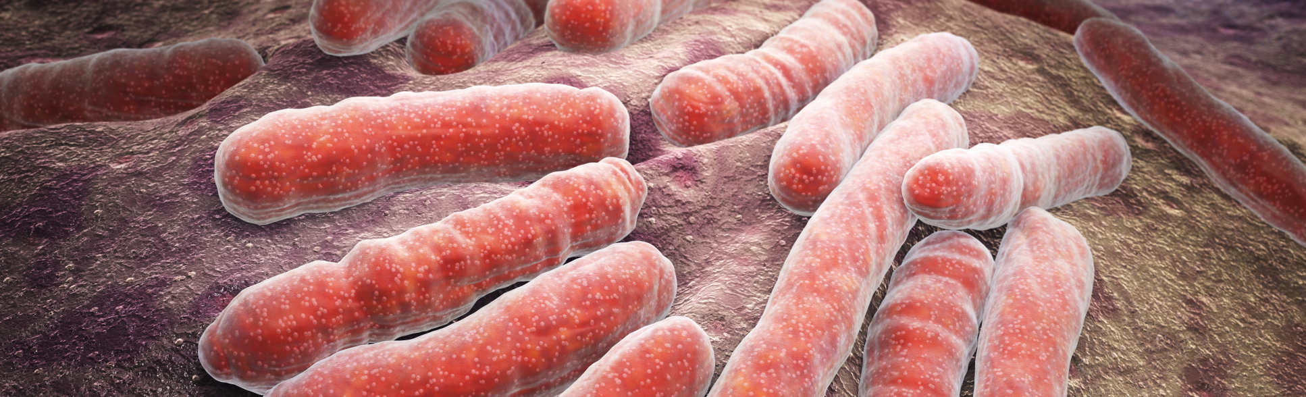
Introduction
Tuberculosis is a major leading cause of mortality(Kirk et al., 2015).
There are a range of factors that increase the risk of this infectious disease:
Toxic pollutants emitted by cooking fuels.
Poor ventilation (Tripathy & Tripathy, 2015)
Notes:
This infectious disease largely affects the poor since the conditions that they live in allow for the bacteria related to the disease to thrive. For instance, the dumpy state of their homes as well as toxic pollutants that are in plenty there largely contribute to the rate of infection.
Since most of these people live in crowded slams, there is little or no ventilation, which means that there is little circulation of air. This translates to the likelihood of an increased rate of infection.

Slide 3
Statistics
95% of the worlds poor people still rely on traditional sources of energy for cooking thus increasing the likelihood of being infected.
A third of the worlds population is infected with Tuberculosis
India is plagued with 20% of the infections in the entire world
Research has shown that biomass fuels produce fifty times more potent pollutants
The disease causes an increased mortality among people aged between 15 and 45 years
Indoor pollution largely contributes to the infection rate in India as well as in other countries
Symptoms of the disease were largely reported among women using the biomass fuels.

Slide 4
Indian Women
This case study found out that women who used biofuels were at a higher risk of tuberculosis than women who used cleaner sources of energy.
The burning of biofuels emitted toxic pollutants that caused most of the infections.
The fuels are largely characterized by a low combustion which translates to many suspended particles
Additionally, women in the low income groups were most affected and at the highest risk (Lakshmi Singh & Jamal, 2012).
The low income women would not afford proper housing in decent places and thus live in slums where the rate of infection is triggered by the living conditions.
Ventilation was found to be critical in determining the risks to tuberculosis.
Building material was also found to be associated with the risk to tuberculosis.

Slide 5
References
Kirk, M. D., Pires, S. M., Black, R. E., Caipo, M., Crump, J. A., Devleesschauwer, B., … Angulo, F. J. (2015). World Health Organization Estimates of the Global and Regional Disease Burden of 22 Foodborne Bacterial, Protozoal, and Viral Diseases, 2010: A Data Synthesis. PLOS Medicine, 12(12), e1001921. doi:10.1371/journal.pmed.1001921
Lakshmi Singh, A., & Jamal, S. (2012). Unhealthy Cooking and Prevalence of Tuberculosis in Indian Women: A Case Study. Journal of Environmental Protection, 03(07), 648-656. doi:10.4236/jep.2012.37078
Tripathy, S., & Tripathy, (. (2015). Chapter-13 Genital Tuberculosis: Epidemiology, Signs and Symptoms. Tuberculosis Manual for Obstetricians & Gynecologists, 155-170. doi:10.5005/jp/books/12514_14

