Slide 1
CleanMyRide Company
By: Amar Hasan

Slide 2
What is CleanMyRide
Mobile car wash based in Bahrain
Customers can wash their cars at home

Slide 3
The Social Mission of the Company
The company donates to organizations
Donates part of the profits
Help the breast cancer organization in Bahrain

Slide 4
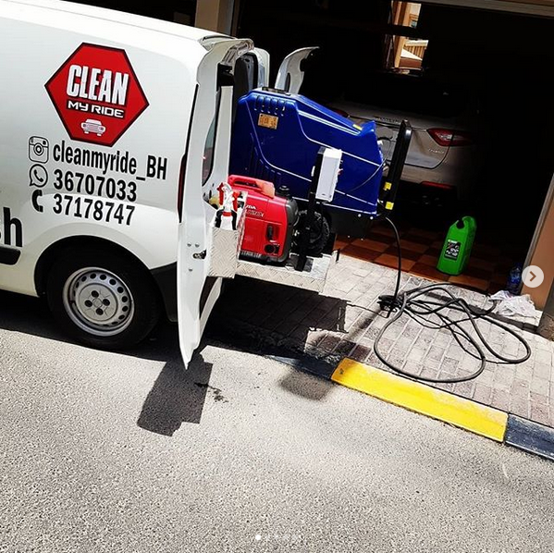
Why and When did The company Start
It was established in March, 2018
A need for mobile car wash
Not many car wash companies in Bahrain
Easy to maintain and operate

Slide 5
The Vision of The Company
A lead mobile car wash in Bahrain
Deliver a quality service to customers
Affordable

Slide 6
How Does The Company Acquire Customers
Using social media ( Instagram, snapchat )
Participating in car wash events
Online advertising
Word of mouth marketing strategy

Slide 7
What Makes CleanMyRide Special
The company uses steam instead of water
High quality products
Can handle any type of vehicle
Able to wash boats and motorcycles
Able to wash many cars per day
Customers can choose from different packages
The company operates 12 hours/day

Slide 8
Profits of The Company Over The Years

Slide 9
Expectations of sales
The company has a positive growth
Profits are estimated to be $30,000 in 2020
Projections are based on the current situation
The company is more profitable during COVID19

Slide 10
The company employees
The company has 20 cars
40 employees

Slide 11
CleanMyRide 2025
The company will expand different countries
By 2025 it will be in 5 countries

Slide 12
Thank you for listening

Slide 13
Any questions?

