Slide 1
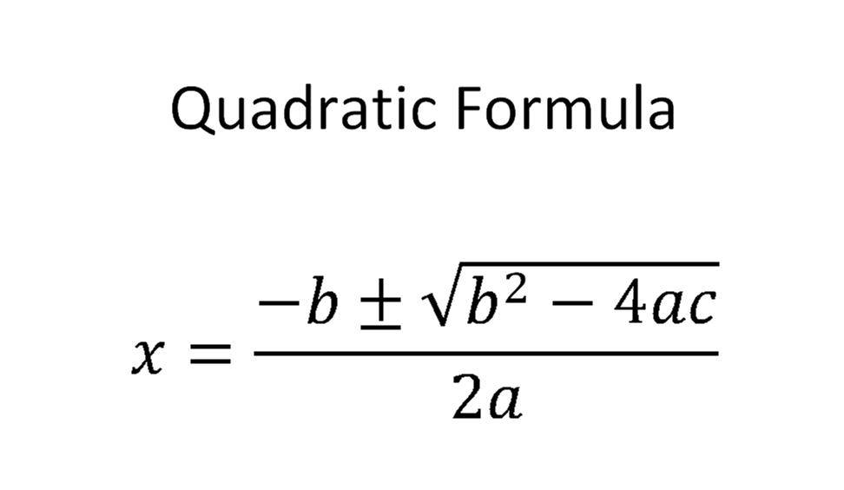
Summer School Algebra 2 A
Quadratics Portfolio
(make a copy to edit)
Unit 2
Video instructions

Slide 2
Solving quadratic equations
Write 2-3 sentences describing how you can use the form of a quadratic equation to decide how it can most efficiently be solved. What are you looking for when you decide which method to use?
We can rearrange the function to take the form ax^2+bx+c=0 . Then we can pick the values of a, b and c and plug them into the quadratic formula if it has all the coefficients a b and c. otherwise we use other formula if the function cannot be explicitly made of that form.

Slide 3
CHOOSE FROM LIST OF EQUATIONS OR CREATE YOUR OWN TO ANSWER QUESTIONS
y = -x²+4
y = 2x²+7x+3
y = (x-10)(x+1)
y = 2x²-8x-1
y = 2(x-5)²-2
y = (x+1)²-9
y = x²-25
x²+4x = 12
y= x²+3x-2
y = x²+3x+7

Slide 4
Solving by Factoring
Example of an equation (you can use your lesson or online examples or make it up yourself)
x²+4x = 12 => x^2+4x-12=0
(x+6)(x-2)=0
Solution
x=-6,x=2
Explain why Factoring is the best method for that equation (explain like you would to a friend detail-wise). Why would other methods not be the best options? Getting numbers that relate a*c as their product and b as their sum was convenient than going the quadratic formula way.

Slide 5
Square Root
Example of an equation
x²-25=0
X^2=25
X=(+/-) √25
Solution
x=5,x=-5
Explain why this method is the best method for that equation (explain like you would to a friend detail-wise). Why would other methods not be the best options?. It would be inconvenient to use other formulas

Slide 6
Completing the Square
Example of an equation
y = (x+1)²-9=0
(x+1)^2=9
x+1=+/-√9
Solution
X=2, x=-4
Explain why this method is the best method for that equation (explain like you would to a friend detail-wise). Why would other methods not be the best options? This function takes the form (x+(b/2)^2)^2+c-(b/2)^2=0

Slide 7
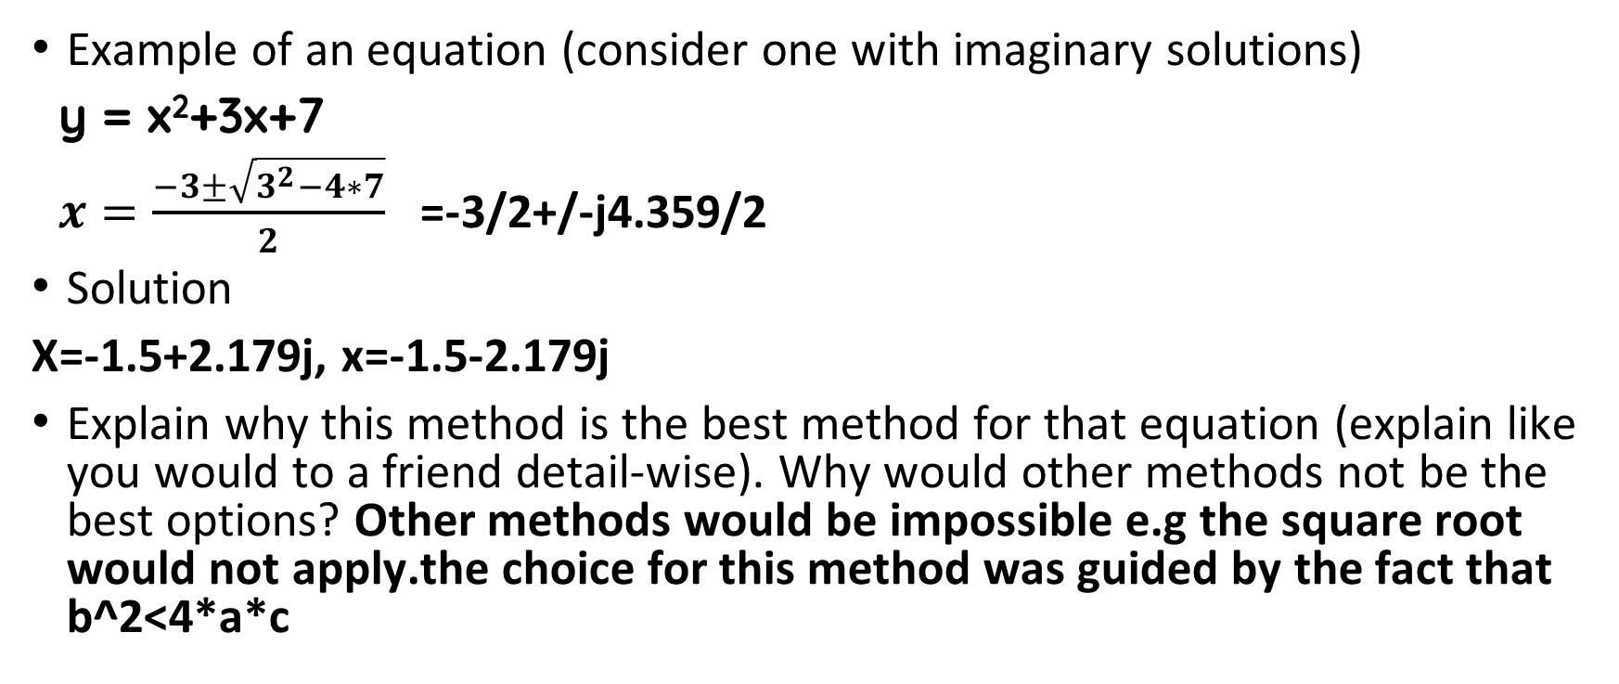
Quadratic Formula
Example of an equation (consider one with imaginary solutions)
y = x²+3x+7
$x=\frac{−3±\sqrt{3^{2}−4∗7}}{2}$ =-3/2+/-j4.359/2
Solution
X=-1.5+2.179j, x=-1.5-2.179j
Explain why this method is the best method for that equation (explain like you would to a friend detail-wise). Why would other methods not be the best options? Other methods would be impossible e.g the square root would not apply.the choice for this method was guided by the fact that b^2<4*a*c

