Slide 1
Three dollar café presentation

Slide 2
Introduction
This presentation will list a number of reasons on why employees should be persuaded a good livable pay.

Slide 3
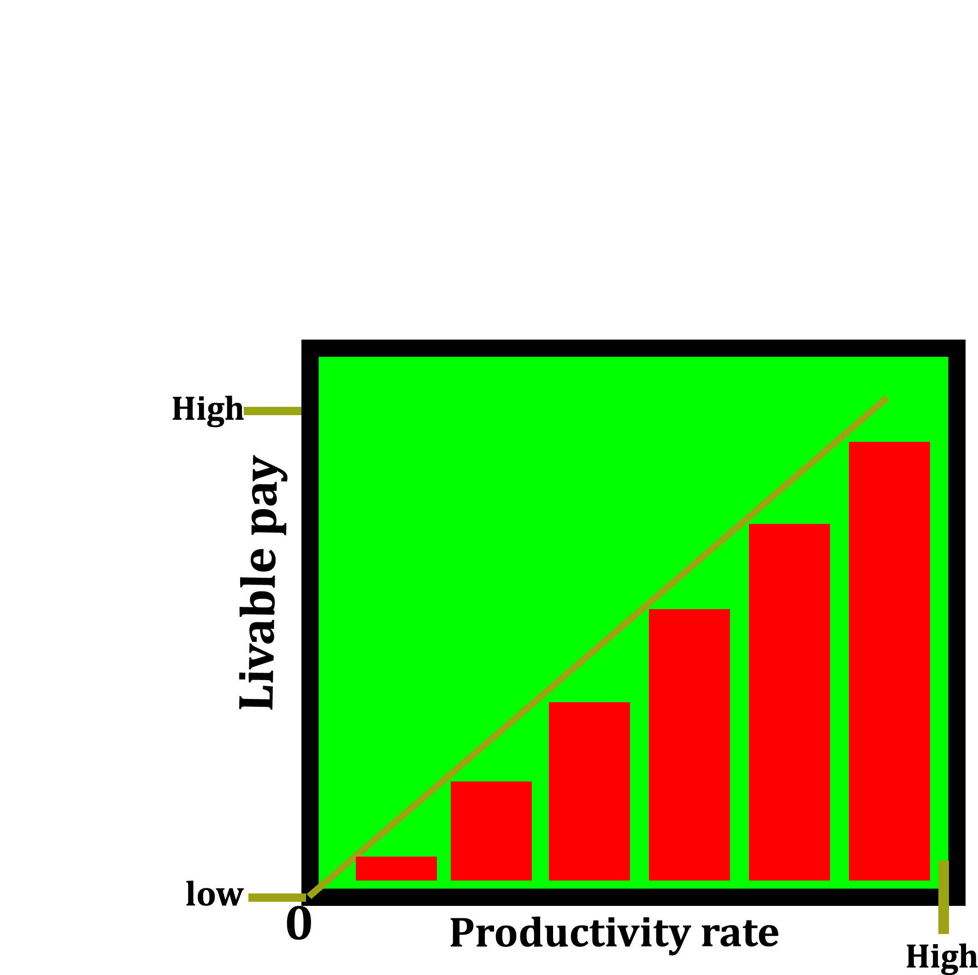
To motivate the workers for high productivity
By paying workers a livable pay, they become more motivated to work hard. And this increases the café’s productivity.
(ETI, 2016.)

Slide 4
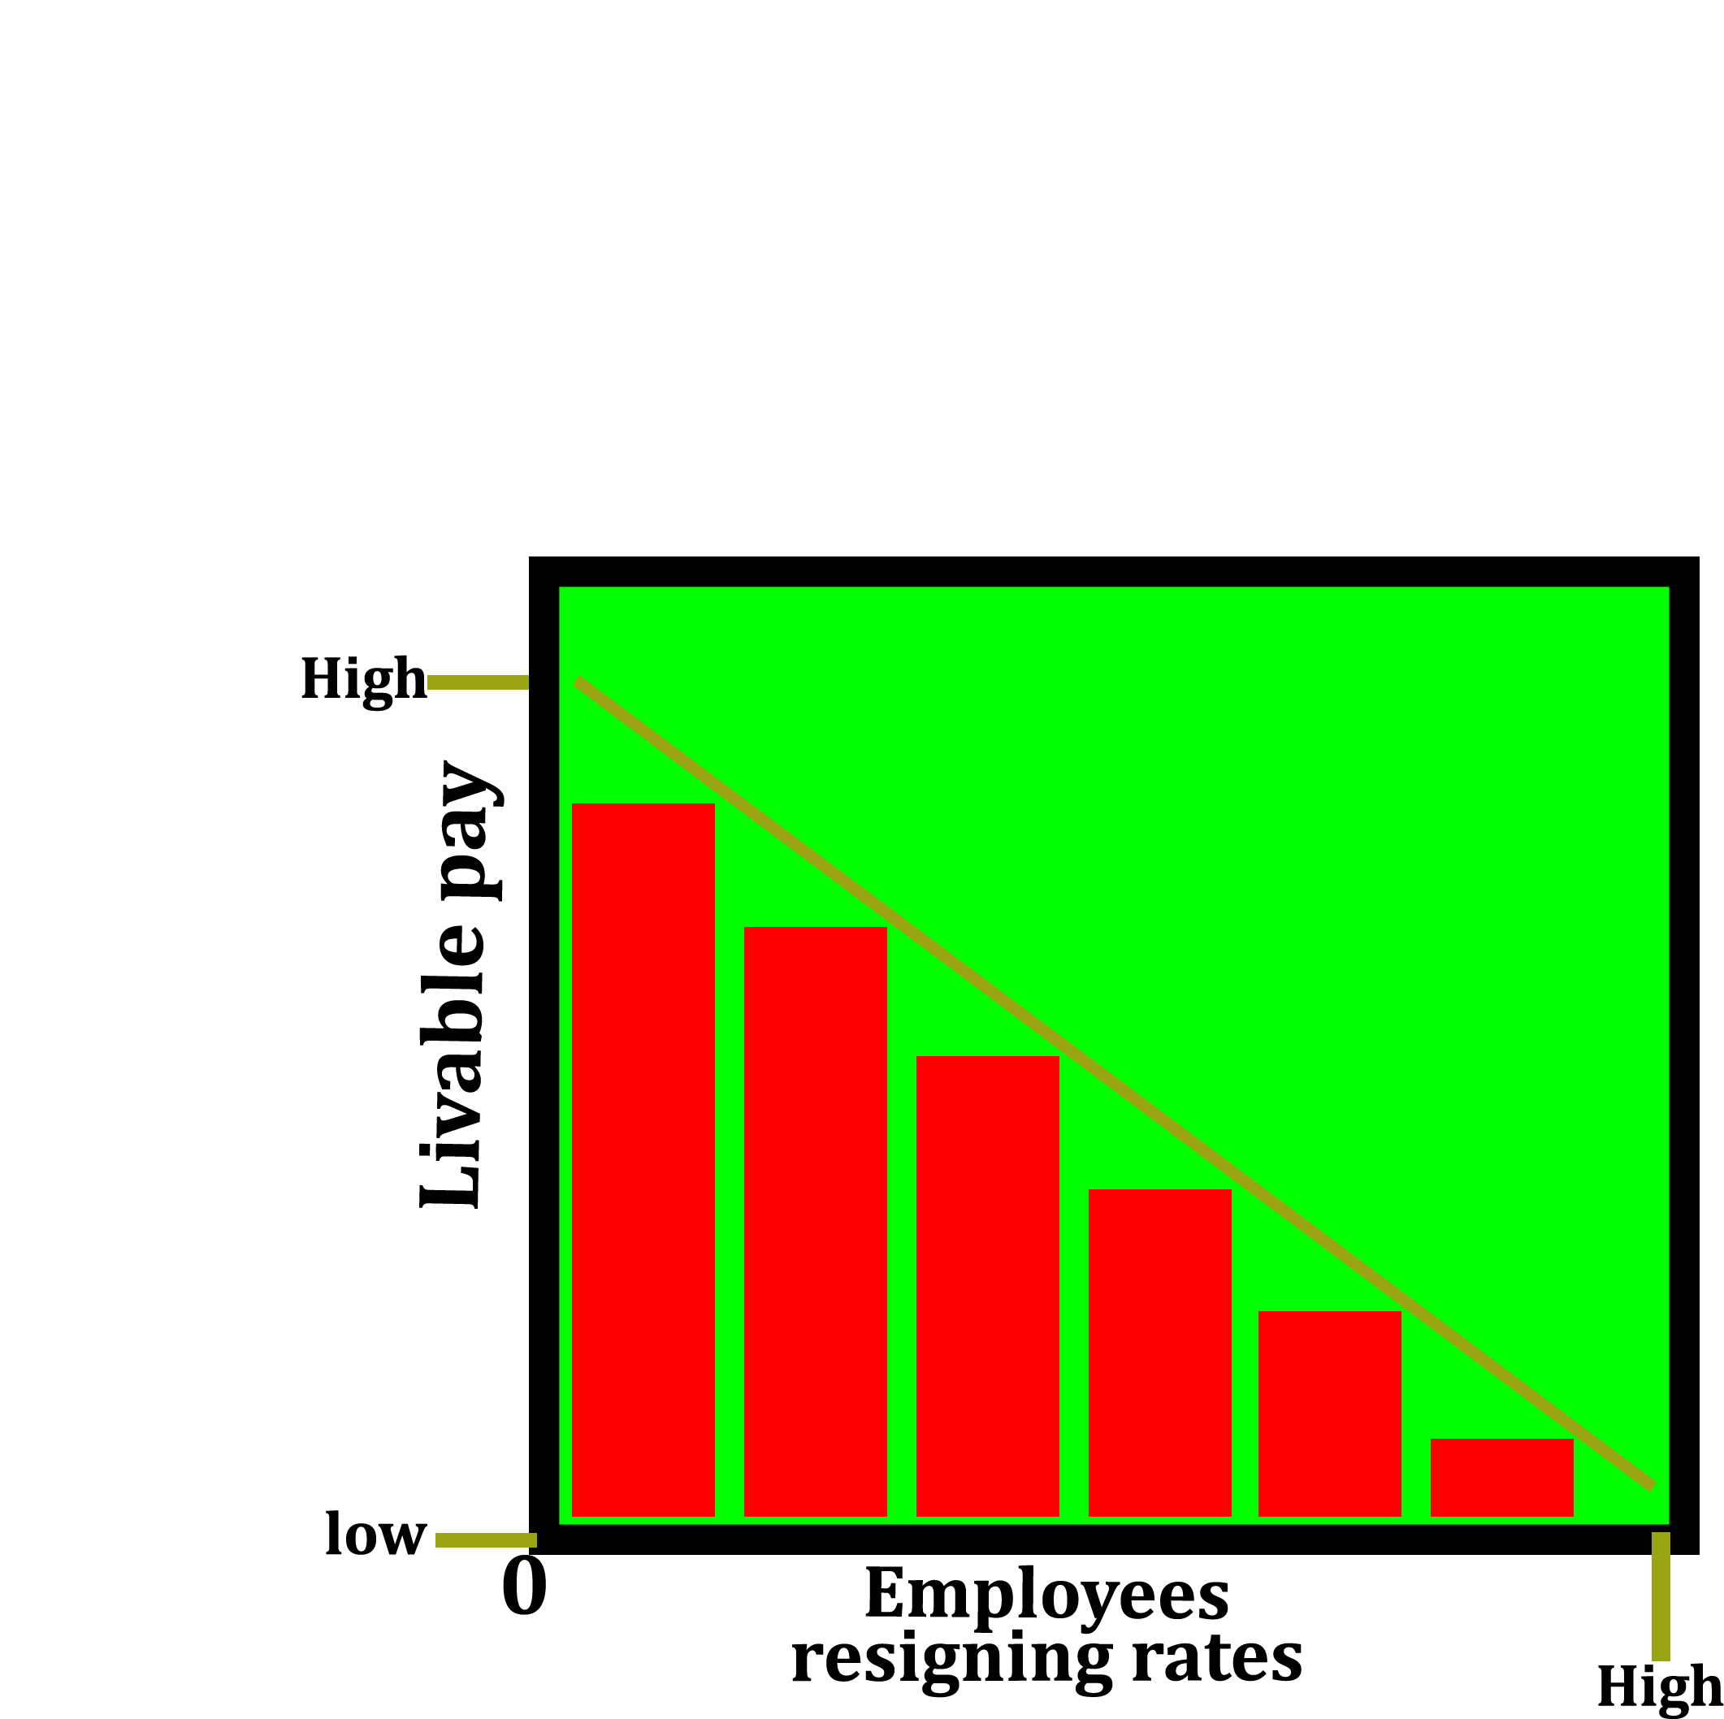
To reduce the resign rates
There is a guarantee that workers will stay and work for long.
Also, incase a worker decides to leave, it will be easier to find another one .
(EPI, nd.)

Slide 5
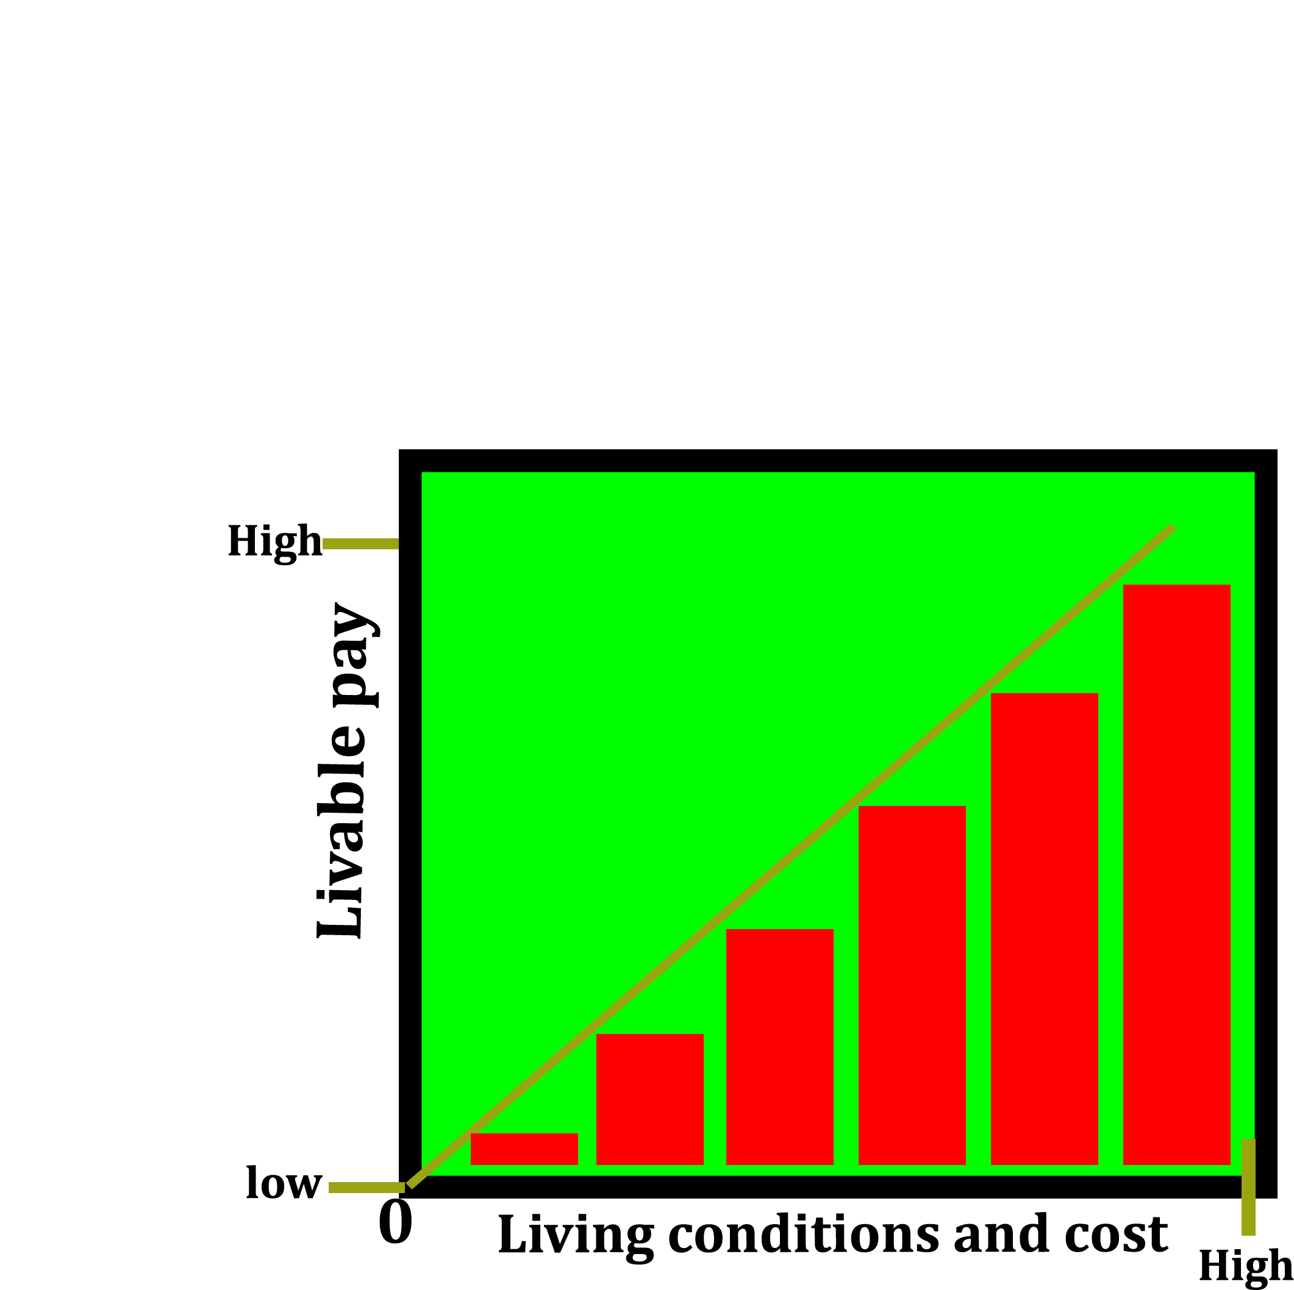
To improve living conditions and cost
By giving them livable pay, they will be able to meet and improve their basic needs without working overtime or relying on tips.
(America Magazine, 2020)

Slide 6
References
America Magazine. (2020). The living wage movement: There are 20 campaigns underway in cities and counties nationwide. https://www.americamagazine.org/politics-society/2000/08/26/living-wage-movement-there-are-20-campaigns-underway-cities-and
EPI. (n.d.). The economic impact of local living wages. Economic Policy Institute. https://www.epi.org/publication/bp170/
ETI. (n.d.). A living wage for workers. Ethical Trading Initiative. https://www.ethicaltrade.org/issues/living-wage-workers

