Slide 1
France
Student Name
Institution Affiliation

Slide 2
Introduction
France is a nation located in the northern western Europe.
France has played a highly significant role in international affairs with former colonies in every corner of the world.
During exploration age, France was much interest in Trade
During age of modern imperialism, France wanted to increase productivity of all newly acquired territories.
During the age of decolonization in France Communist and socialist parties pushed for decolonization.
Industrialization in France was much contributed by railroads.
Notes:
History precisely indicates that France played a very significant role in international affairs, especially in the trade since it colonized by nations around the globe. Focusing on the age of exploration, France much participated in trade during this period. Additionally, productivity in all acquired territories was the greatest aim of France during the age of modern Imperialism. Further, decolonization in France was facilitated by the push from socialist and communist parties. Lastly, industrialization advanced more greatly in France due to the availability of railroads.

Slide 3
Age of Exploration and Encounter (1400-1800)
In 1664, France precisely entered the Asia trade with its Own East India company.
French company established an outpost in India's in the 1720s.
French wanted to gain much profits from all its colonies.
French never lost focus as they encountered more and more individuals from different continents
Notes:
French main focus during this age of exploration was trade. In 166, French entered Asia with a great aim of gaining more from trade. Their company established an outpost in the 1720s as they proceeded to explore new continents to gain something for trade. French altitude of exploration remained as they encountered more people from different continents (Abbattista, 2011).

Slide 4
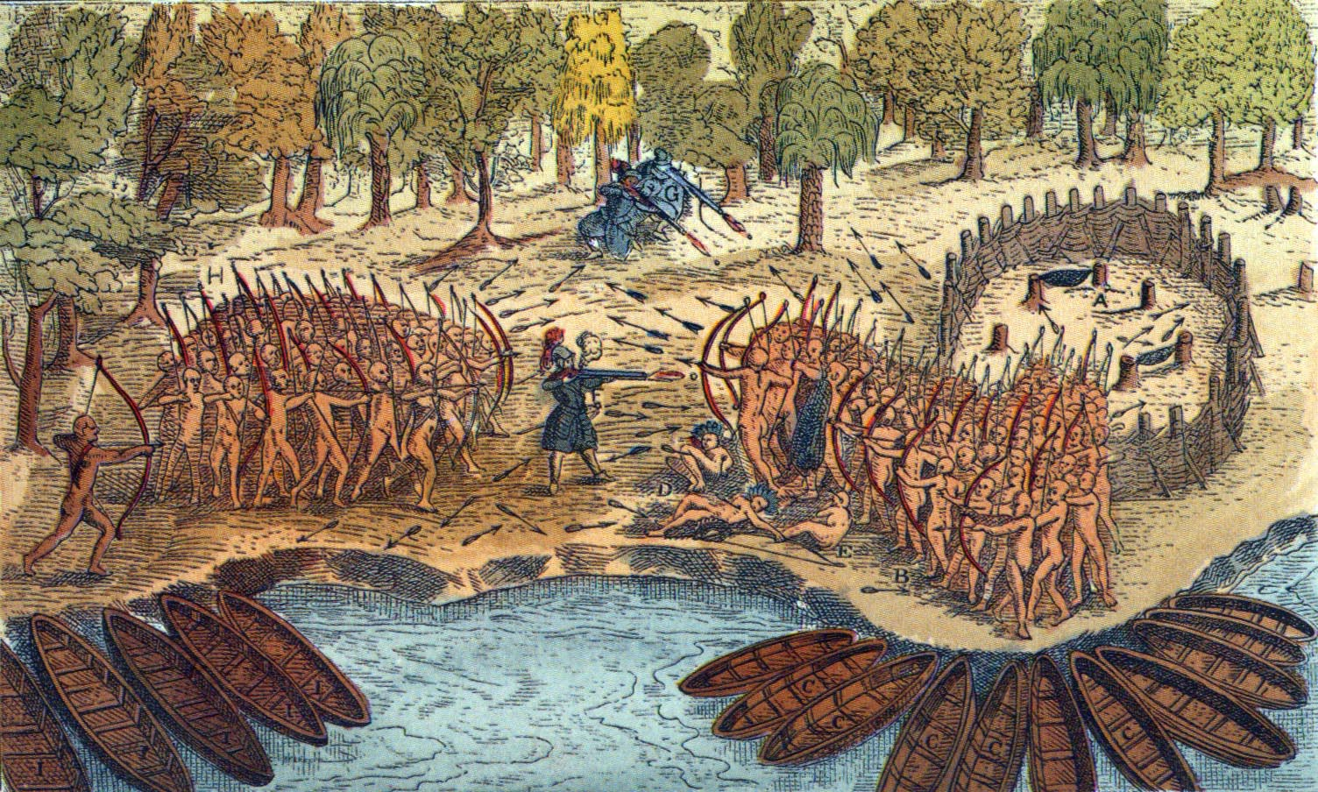
Age of Exploration and Encounter (1400-1800) Cont’d
Samuel de Champlain much facilitated French exploration.
In 1601, he explored the Caribbean
In 1603, he explored the cost of New England.
He new the secret of successful trade was becoming friendly to native people.
French was only interested in establishing commercially viable colonial outposts.
Notes:
French had a leader known as Samuel de Champlain was helped them much during their entire exploration period. The leader leads them to explore different regions, including the Caribbean and New England. Champlain found it easy to successfully trade with these new colonies since he believed that becoming friendly to the native people could much help make trade more successful. However, as French explored further, they were only interested in establishing commercially viable colonial outposts, which made them creative extensive trading networks (Abbattista, 2011).

Slide 5
Age of Modern Imperialism (1800-1945)
French had colonized a big portion of Africa.
French used their colonial official to mark and govern new territories.
In 1845, French military in Algeria made killed 1500 people who had taken refuge in a cave.
French Army in Algeria prevented any killings news from reaching Paris.
Notes:
French colonized three and half million square miles in Africa. Half of which contained the Sahara Desert. By 1830, France had precisely conquered Algeria where different events took place. France had deployed its military to take control of everything in Algeria. Secretly without allowing the news to reach Paris, the French military killed 1500 people in 1845 who had taken refuge in a cave (Johnson, 1985).

Slide 6
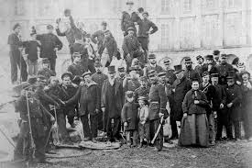
Age of Modern Imperialism (1800-1945) cont’d
During the age of modern Imperialism, the French ruling lass was murderous.
The ruling class ordered French troops in 1871 to crush working class revolt known as Paris commune where 30,000 French workers were shot down.
Notes:
Apart from the French military in different colonies such as Algeria being murderous, the French ruling class was also murderous. This ruling class in 1871 sent the French troops to go and crash down the working class revolt, commonly known as Paris commune, where thousands of French workers were killed (Johnson, 1985).

Slide 7
Age of Decolonization (post-1945)
In 1950s, France contained the communist insurgency in Vietnam with the help of America.
French military failures in Vietnam precisely reflected the tension that decolonization had provoked within the heart of NATO alliance.
French military weaknesses provoked major crises
Notes:
French was able to contain communist insurgency in Vietnam via the help of America, which implicated a way of the French commitment to the precise containment of the Soviet Union in Europe. Additionally, French decolonization was also catalyzed by French failure in Vietnam as well as Algeria. Additionally, the French army weakness also contributed to French decolonization in various countries (Fraser, 2013).

Slide 8
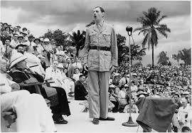
Age of Decolonization (post-1945) Cont’d
Much more France conflictual decolonization process was faced in Algeria between 1954 and 1962 which was marked by prolonged wars.
The transition process gave pride to both France and African political leaders.
French decolonization in west Africa was a contingent process.
Notes:
French decolonization process in Africa was successful though was faced by prolonged wars in Algeria. The independence transition process in most of the France colonies gave pride to most France governing elites and African political leaders since they were portrayed as having successfully transitioned to independence. Generally, French decolonization in West Africa could be termed as a contingent process since it was shaped by different events on the ground (Fraser, 2013).

Slide 9
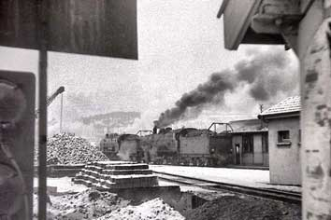
industrialization
In the start of 1840s, all sectors of French economy were powerfully transformed by the railroad construction.
Railroads spearheaded an economic boom period that lasted until 1860s.
The railroads allowed goods to reach to all areas virtually by world war I.
Demand for mental to produce rails and rolling stock was stimulated by railroads construction.
Notes:
The construction of railroads much facilitated France industrialization. These railroads transformed the economy of France, much making it reach to an economic boom. The constructed railroads precisely allowed good to reach all France areas before World war I. Additionally, these railroads construction also much stimulated the demand for mental to produce the rails and the rolling stock (Dunham, 1930).

Slide 10
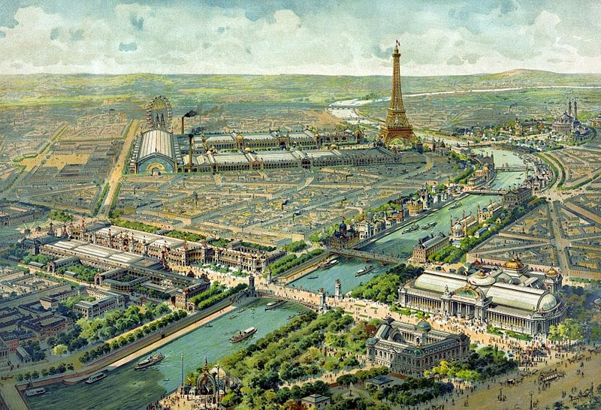
Industrialization Cont’d
In 1950s under the leadership of Gorge Eugene, French government undertook a massive program of urban reconstruction.
However, industrialization was not smooth since Paris faced traffic and health problems.
Industrialization in France led to the formation of a French working class. From 1803 to 1913, Industrial labor expanded from 1.9 million to 6.7 million.
The boom of 19590s raise the living standards of French workers.
Notes:
Industrialization in France was also facilitated by the Government, which in 18950s took a massive program of urban reconstruction. However, this process of industrialization was not smooth as different challenges were faced, including Paris being faced with health and traffic problems since it was large and grew more rapidly. A working class was created by industrialization in France. Industrialization saw the labor force in France expand more quickly. Also, the economic boom experienced in the 1950s leads to an increase of the French workers' standards of living (Dunham, 1930).

Slide 11
References
Abbattista, G. (2011). European encounters in the Age of Expansion. Accessed on, 22(08), 2015
Johnson, m G. W. (Ed.). (1985). Double Impact: France and Africa in the age of imperialis (Vol. 16). Praeger Pub Text.
Fraser, C. (2013). Decolonization and the Cold War. The Oxford Handbook of the Cold War, 745-746.
Dunham, A. L. (1930). The Anglo-French Treaty of Commerce of 1860 and the Progress of the Industrial Revolution in France (Vol. 9). Ann Arbor: University of Michigan Press.

