Slide 1

THERAPY
Student Name
Institution Affiliations
Date

Slide 2

CHOSING YOUR PSYCHOTHERAPIST
Chapter 6 of the book talks about therapy for psychological disorders
In this chapter, the presentation will focus on how to choose a psychotherapist and the best method for therapy.
Smith and Glass (1977) used a Meta-analysis research study to determine the most effective way of dealing with mental illness.
Psychotherapy is the treatment of mental illnesses such as anxiety, mood disorders, personality disorders, and schizophrenia (APA, 2016)
Mental problems can be treated through Systematic Desensitization, Humanistic therapy, Cognitive therapy, Cognitive-behavioral therapy, and Psychodynamic therapy
Notes:
Psychotherapy refers to the treatment of psychological problems through the creation of a close and caring relationship between the therapist and the patient. There are various techniques to treating mental problems such as systematic desensitization, humanistic therapy, and cognitive-behavioral therapy.
Smith and Glass (1977) present a study about how one can choose a psychotherapist. In the research study, they used a meta-analysis of psychotherapy outcomes of patients both with and without mental problems to determine the best way of treating mental problems.

Slide 3
BACKGROUND INFORMATION
Everyone encounters problems in life. These problems may lead to mental illness
The mentally ill require psychotherapy treatment to recover.
It is good to seek psychotherapy before things escalate to mental illnesses
Therefore, psychotherapy is not only for the sick but for anyone experiencing life problems.
Since it is difficult to choose the right therapy for mental illness, Smith and Glass (1977) conducted a meta-analysis on the effects of counseling and psychotherapy to determine the effectiveness of the different forms of therapy.
Notes:
Psychologists believe that every person needs psychiatric help when the need arises. Psychotherapy is not only for the mentally ill but for anyone who has life problems such as being unable to solve problems. When one is unable to solve problems despite the help of friends, family members, and workmates, then it is time to seek psychiatric help. Since it is difficult to choose the right therapy for mental illness, Smith and Glass conducted a meta-analysis on the effects of counseling and psychotherapy to determine the effectiveness of the different forms of therapy

Slide 4
METHODOLOGY
The study involved 375 studies from 1000 different sources including magazines, journals, and books. Different research methods with variations in counselling and psychotherapy effects
Each study examined at least one method of psychotherapy withing a group who received therapy and a controlled group who did not receive treatment.
The meta-analysis was as follows
833 sample size
25000 combined participants
Participants average age of 22 years
Daily therapy session for 17 hours
Notes:
From the 375 studies, 833 samples were obtained and combined. The average age of each participant was 22 years. According to Smith and Glass, the participates received approximately 17 hours of therapy.

Slide 5
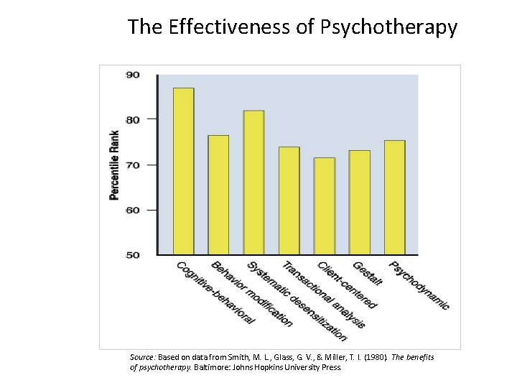
RESULTS
Glass and Smith compared the experimental results between the treated and untreated patients for all the types of therapy. The outcome indicated that participants who received therapy performed better (75%) in dealing with life problems than those who did not receive therapy.
Smith and Glass compared the various psychotherapy methods found in all the studies they analyzed using similar statistical procedures. The results are as shown in the graph
Notes:
First, Smith and Glass compared all the treated participants with all the untreated participants for all types of therapy and all measures of outcome. They found that “the average client receiving therapy was better off than 75% of the untreated controls
Second, various measures of psychotherapy effectiveness were compared across all the studies. The results demonstrate that therapy, in general, was found to be significantly more effective than no treatment
Third, Smith and Glass compared the various psychotherapy methods found in all the studies they analyzed using similar statistical procedures.

Slide 6
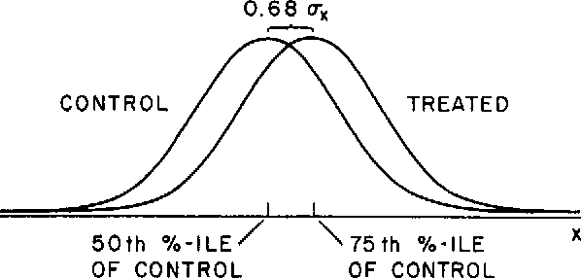
DISCUSSION OF RESULTS
Psychotherapy has proved to be successful in dealing with different forms of mental problems
The differences in psychological problems and the treatment forms are insignificant. Psychotherapy is quite more confusing to therapists as compared to patients.
Treatment of different unique mental illnesses depends on the period of psychiatric practice
(Landman et al, 1982).
Notes:
The research finding by Smith and Glass indicated that there is not much difference in the psychotherapy treatment forms. Another outcome of the research was in line with the research conducted by (Landman et al 1982) which indicated that the willingness of a therapist to carry out psychiatric treatments depends on the uniqueness of the mental problems they encounter.

Slide 7
CONCLUSION
Behavioral therapy and mainly systematic desensitization is a milestone in treating psychological problems.
The meta-analysis approach asserts that people who seek psychotherapy deal better with mental problems than those who do not.
Notes:
Smith and Glass combined all the various methods into two “superclasses” of therapy: a behavioral superclass, consisting of systematic desensitization, behavior modification, and implosion therapy, and a nonbehavioral superclass made up of the remaining types of therapy.

Slide 8
REFERENCES
Smith, M. L., & Glass, G. V. (1977). Meta-analysis of psychotherapy outcome studies. American Psychologist, 32, 752–760.
Landman, J., & Dawes, R. (1982). Psychotherapy outcome: Smith and Glass’s conclusions stand up under scrutiny. American Psychologist, 37, 504–516.
American Psychological Association. Understanding psychotherapy and how it works. 2016. http://www.apa.org/helpcenter/understanding-psychotherapy.aspx

