Slide 1
Richard Misrach
Student’s Name
Institutional Affiliation

Slide 2
INTRODUCTION
Richard Miscrach is one of the most renown and influential photographer of his generation in the United States.
He is an environmental photographer.
His images draws attention as a result of their color, light and time taken ("Richard Misrach | Fraenkel Gallery", n.d.).
Notes:
As an environmental photographer, he has specialized in taking large scale color photographs concerning human intervention on the landscape affects the environment.

Slide 3
WORKS
His best-known series is “Desert Cantos”.
“Border Cantos” is one of its latest chapter illustrating unseen realities in the US-Mexican border
Other works include aftermaths of Katrina and theatrical weather systems surrounding the San Francisco Golden Gate bridge ("Richard Misrach - 155 Artworks, Bio & Shows on Artsy", 2018).
Notes:
One of his best works include “Desert Cantos” captures disastrous human effects in desert.
“Desert Cantos” elaborates the complex relationship between man and a landscape he has worked for over 40 years.

Slide 4
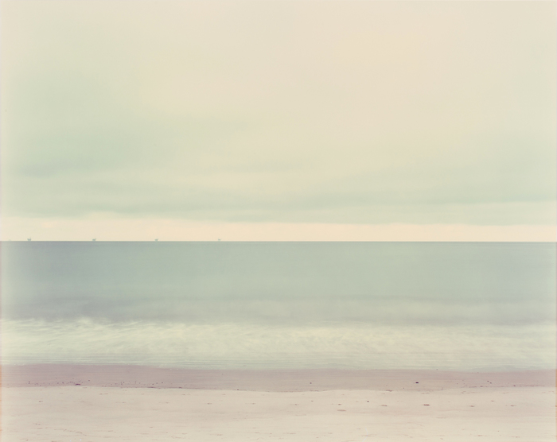
Oil derricks with sand
Notes:
This image was captured in Santa Barbara California in the United States. At the horizon you can see the floating oil derricks and at the front part of the image is the sand deposit on shores of the ocean.

Slide 5
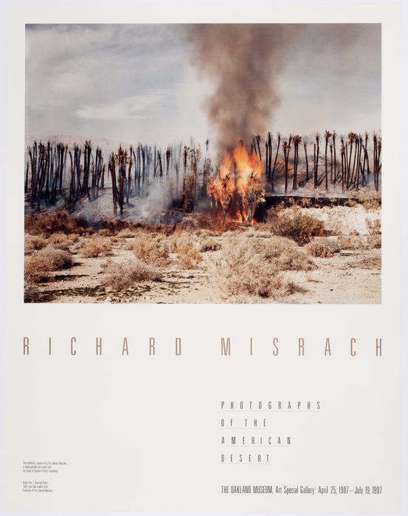
American desert
Notes:
The image illustrates the effects of human relationship with nature in the American desert. Awful and disastrous are the best names that can be given to this kind of an activity.

Slide 6
Major Exhibitions
He once exhibited at National Gallery of Art, the Chicago Art institution.
He exhibited also at Los Angels Country Museum of Art.
Centre Pompidou in Paris ("Richard Misrach", 2018).
Notes:
For all of the above places, he had a one-person exhibition among other places. This has made a major boost in marketing and show casing his works.

Slide 7
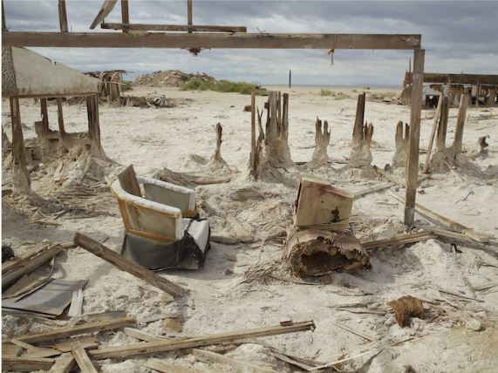
Computer and Chair
Notes:
This image was captured in Bombay beach in California in the year 2011. There is an abandoned chair and a computer at the beach. The photo portrays an image of an abandoned beach hotel.

Slide 8
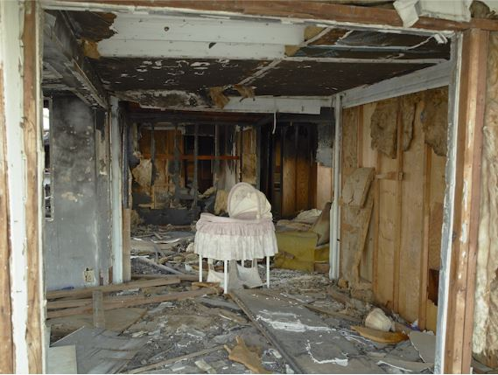
Basinet, Salton sea
Notes:
The picture was captured in Basinet, Salton sea in Californian in the year 2009. This is an abandoned house in Basinet, it shows that there used to be an activity not long time ago before the structure was abandoned.

Slide 9
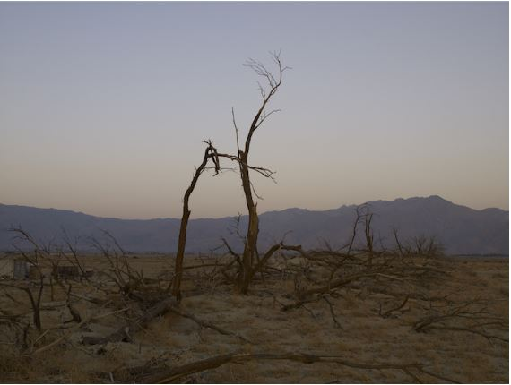
Dead Trees
Notes:
The above image shows how the environment has been affected as a result of man’s activities. It was captured at Anza Borrego desert, California in 2008. The trees have been cut down and the land left bare and left venerable to agents of erosion.

Slide 10
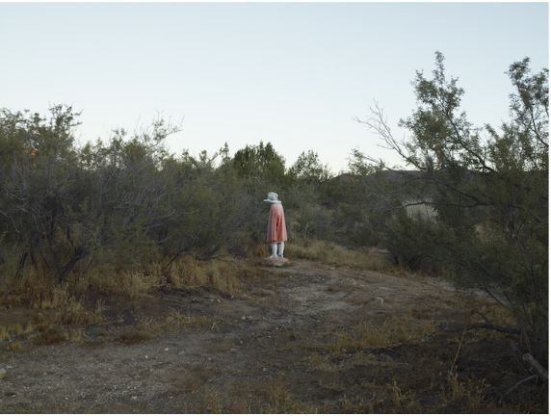
Plaster man
Notes:
This Plaster man photo was captured near Boulevard, California in 2009. It represents environmental condition of that place in 2009. This is a natural envirnment with no much human activities in the area. It shows that the place is also dry and in need of rainfall.

Slide 11
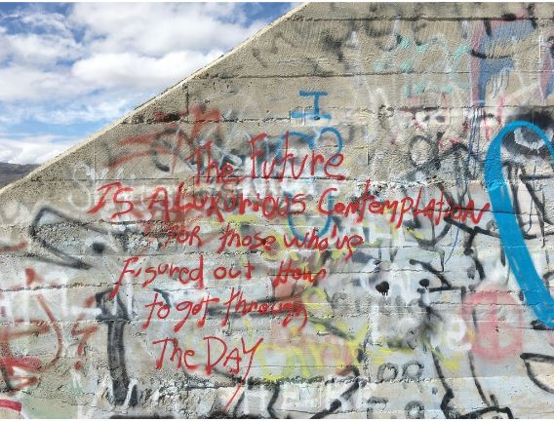
Tonopah junction, Nevada
Notes:
“The future is a luxurious contemplation for those who’ve figured out how to go through the day”. This photo was done in 2017. It shows the artistic nature the artistic nature of those who made the art and the wordings.

Slide 12
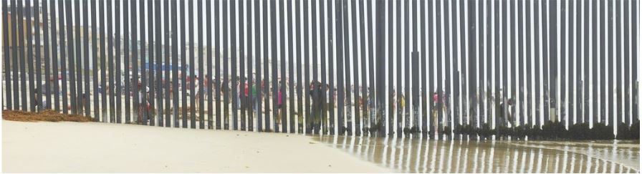
Playas DeTijuana, San Diego, California
Notes:
This image was captured in 2013 at Playas DeTijuana, San Diego, California. Across the veils, you can see people relaxing on a beach. The beach is full to capacity and so much activity happening there.

Slide 13
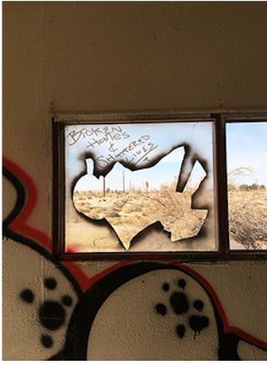
Broken homes and shattered lives. Hinkley, California
Notes:
Right through the window you can see what man has done to environment. This image was captured at Hinkley California January 2018. The land is bare and no live can be spotted outside there.

Slide 14
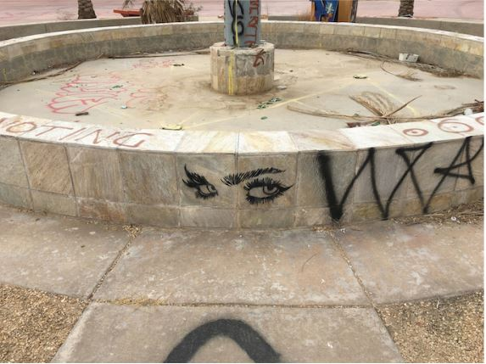
EYES
Notes:
The image was captured at Newberry Springs, California , November 2017. This is a stunning image of artistic eyes.

Slide 15
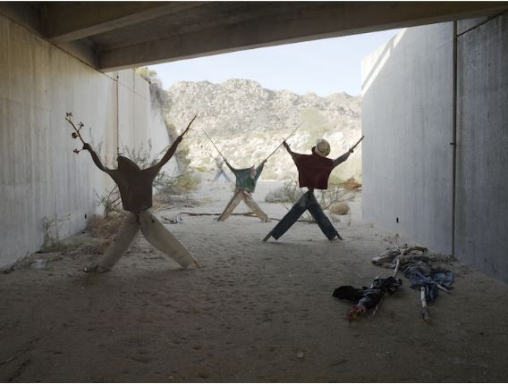
Effigy
Notes:
This effigy photo was captured near Jacumba, California, 2009. Maybe they have been used to ridicule someone for reasons best known to the erectus of the effigy.

Slide 16
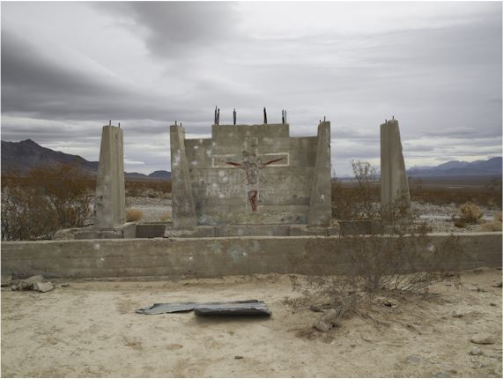
Shotgun Practice, “He will return”
Notes:
The pictures shows holes on concrete of a shotgun practice. It was labeled “He will return” and captured at Nevada in 2009. From a close look of things, an army or a group of people may have been training in this area on the targeting using shotguns.

Slide 17
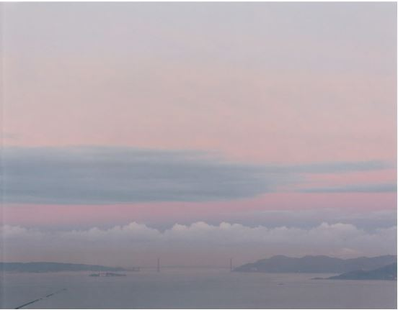
My Front Porch
Notes:
This image was captured by Richard Miscrach at 6.50 am in 2000 from his front porch. The location is however undisclosed. On the photo we can see what looks like an ocean and amazing clouds just above it. The scene is just breadth taking.

Slide 18
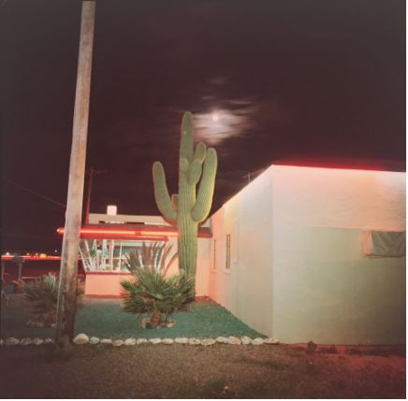
Night Scene
Notes:
This image depicting a night scene was captured in 1976 by Richard Misrach . The night see as captured on the image is just wonderful.

Slide 19
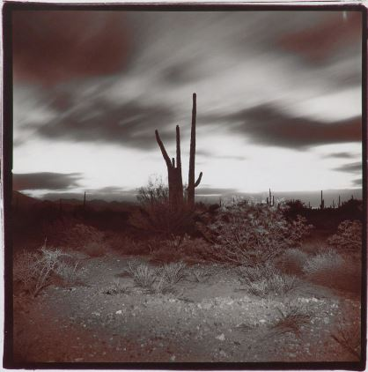
Night Desert
Notes:
This is an image showing how night falls in the desert. He captured it in 1975. The scene seems to be windy as it can be seen from the nature of clouds and vegetation below it.

Slide 20
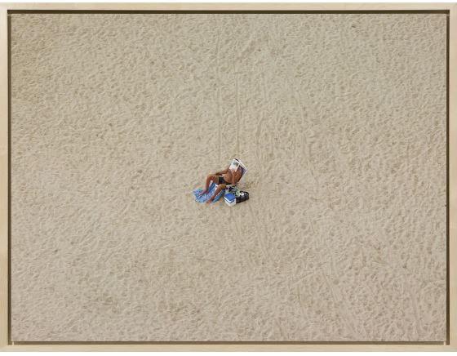
Pigment Print
Notes:
The marvelous image was captured at undisclosed beach on February 12th, 2012 at 12:56 pm. You can see a man relaxing on the shores of a spectaculars beach.

Slide 21
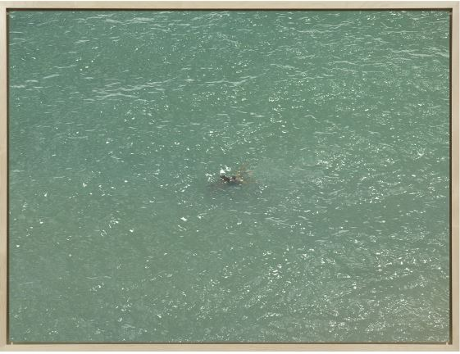
Diver
Notes:
The image was captured on July 24th, 2013 1t 4:57 pm. The location of the capture is however undisclosed. The is a guy swimming in deep waters in the sea even though the waters seems to be tidal.

Slide 22
REFRENCES:
Richard Misrach. (2018). International Center of Photography. Retrieved 16 April 2018, from https://www.icp.org/browse/archive/constituents/richard-misrach?all/all/all/all/0
Richard Misrach - 155 Artworks, Bio & Shows on Artsy. (2018). Artsy.net. Retrieved 16 April 2018, from https://www.artsy.net/artist/richard-misrach
Richard Misrach | Fraenkel Gallery. Retrieved from https://fraenkelgallery.com/artists/richard-misrach

