Slide 1
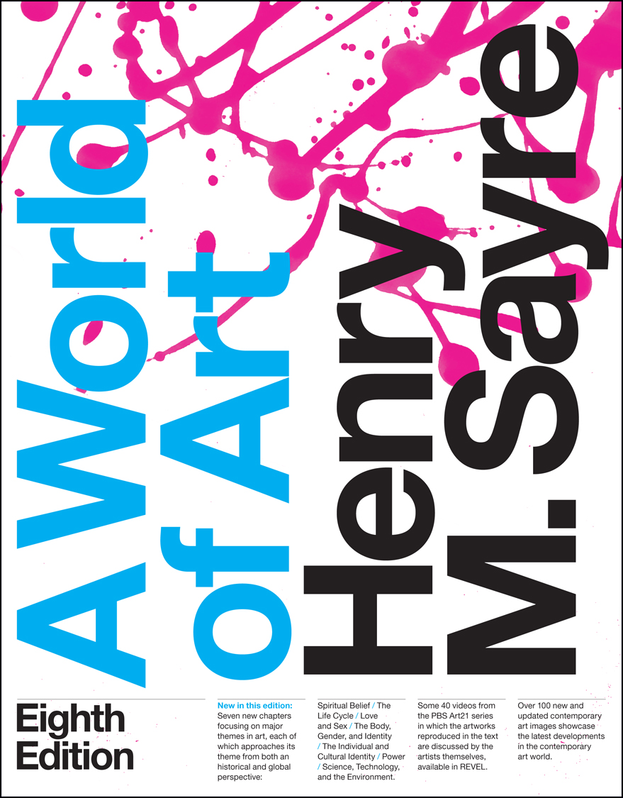
A World of Art
Eighth Edition
Chapter 3
Line
Copyright © 2016, 2013, 2010 Pearson Education, Inc. All Rights Reserved
Notes:
If this PowerPoint presentation contains mathematical equations, you may need to check that your computer has the following installed:
1) MathType Plugin
2) Math Player (free versions available)
3) NVDA Reader (free versions available)

Slide 2
Learning Objectives
3.1 Distinguish among outline, contour, and implied line.
3.2 Describe the different qualities that lines might possess.

Slide 3
Introduction
Line is a fundamental element of nature.
In Matthew Ritchie’s painting No Sign of the World, straight lines represent a direction and curved lines join things in a linking gesture.
  It symbolizes a universe at the dawn of creation.

Slide 4
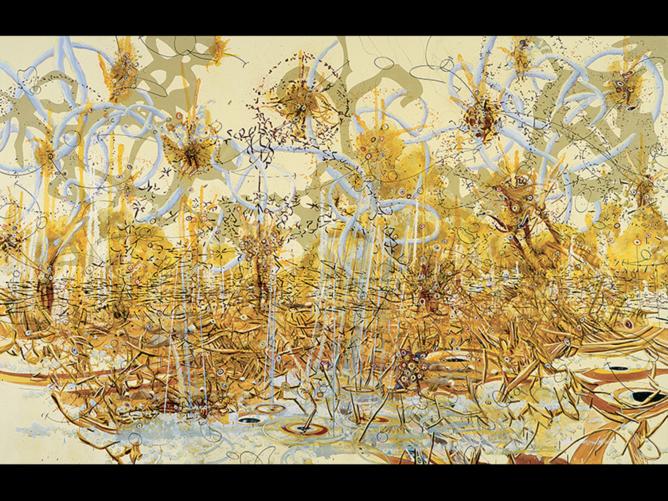

Figure 3-1 Matthew Ritchie, No Sign of the World, 2004
Oil and marker on canvas
© Matthew Ritchie, Image Courtesy
Andrea Rosen Gallery, New York.

Slide 5
Varieties of Line
Lines possess qualities of direction, division, thickness, and patterns of movement.
Water flows in lines along the landscape.
Lines also define the limits of land, such as national borders.

Slide 6
Outline and Contour Line
Outline indicates the shape of a two- or three-dimensional form and emphasize its flatness, as seen in Yoshitomo Nara’s Dead Flower.
Contour lines, however, form the edge of a three-dimensional shape and suggest volume, recession, or projection in space.
  Brier creates the illusion of leaves.

Slide 7
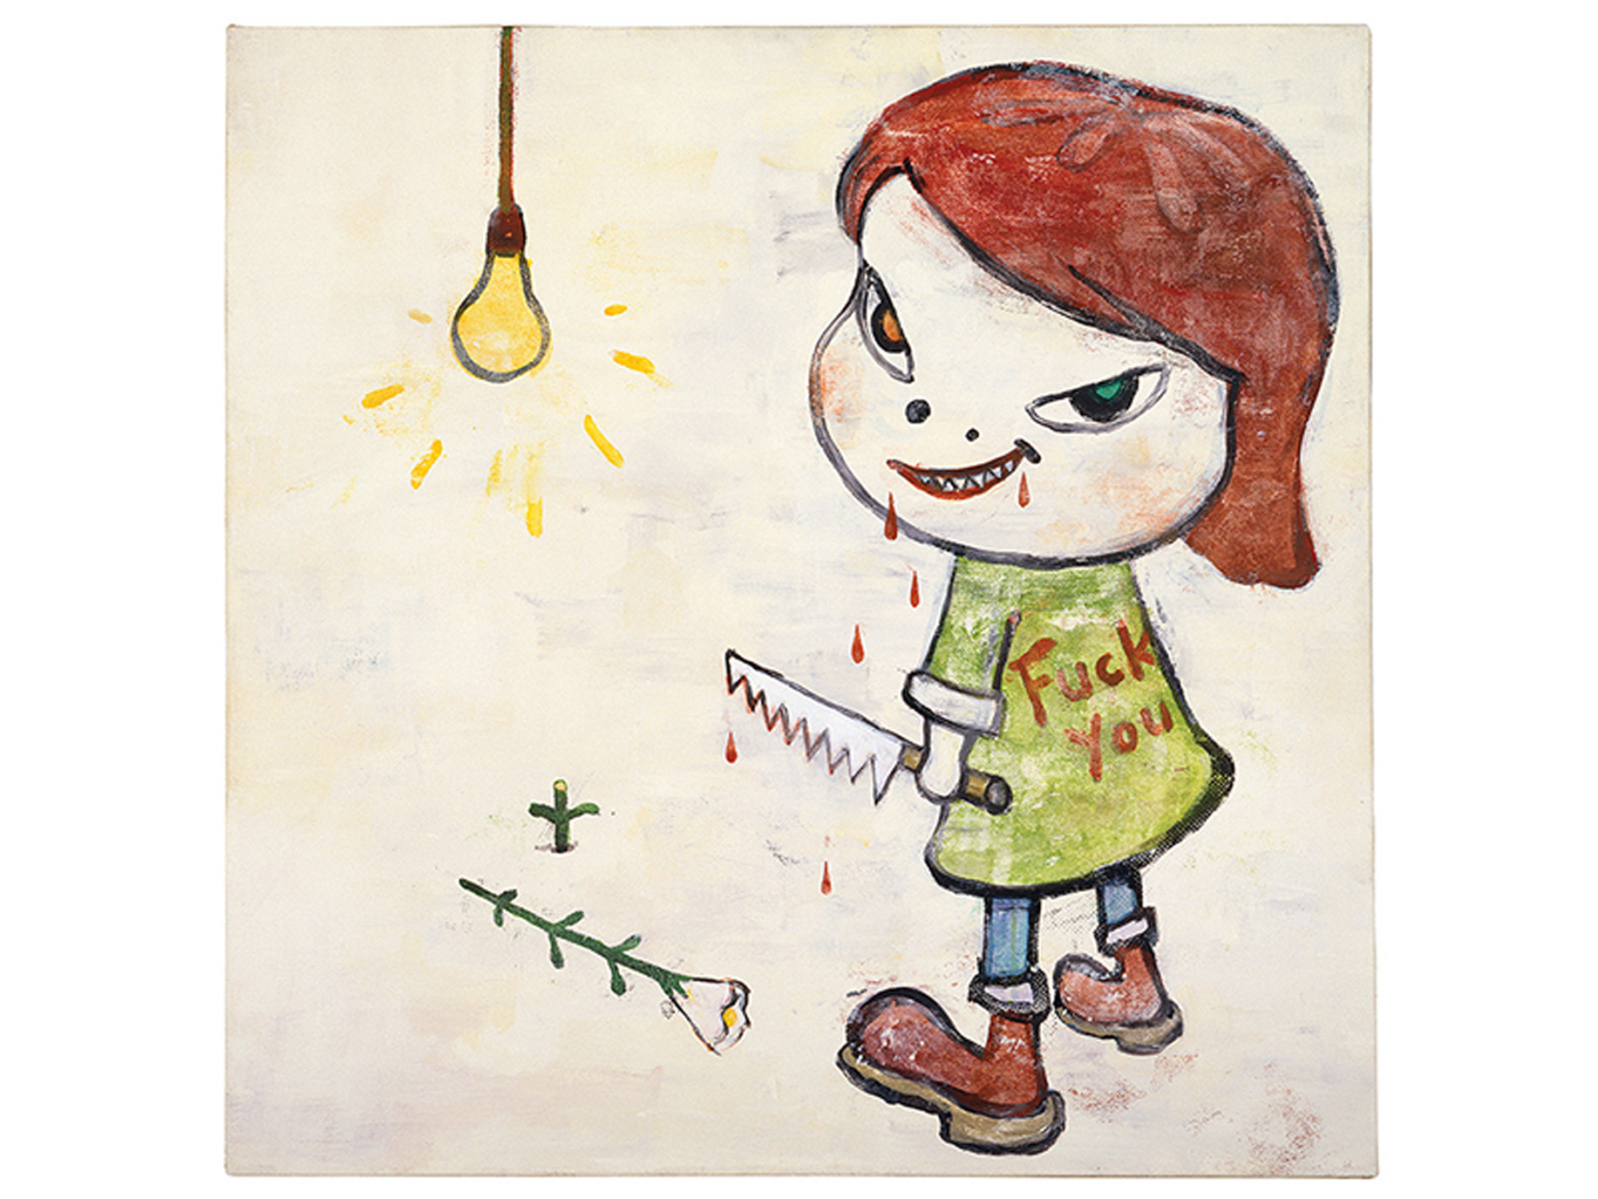

Figure 3-2 Yoshitomo Nara, Dead Flower, 1994
Acrylic on cotton
© Yoshitomo Nara, courtesy of Pace
Gallery. Photograph courtesy of the artist.

Slide 8
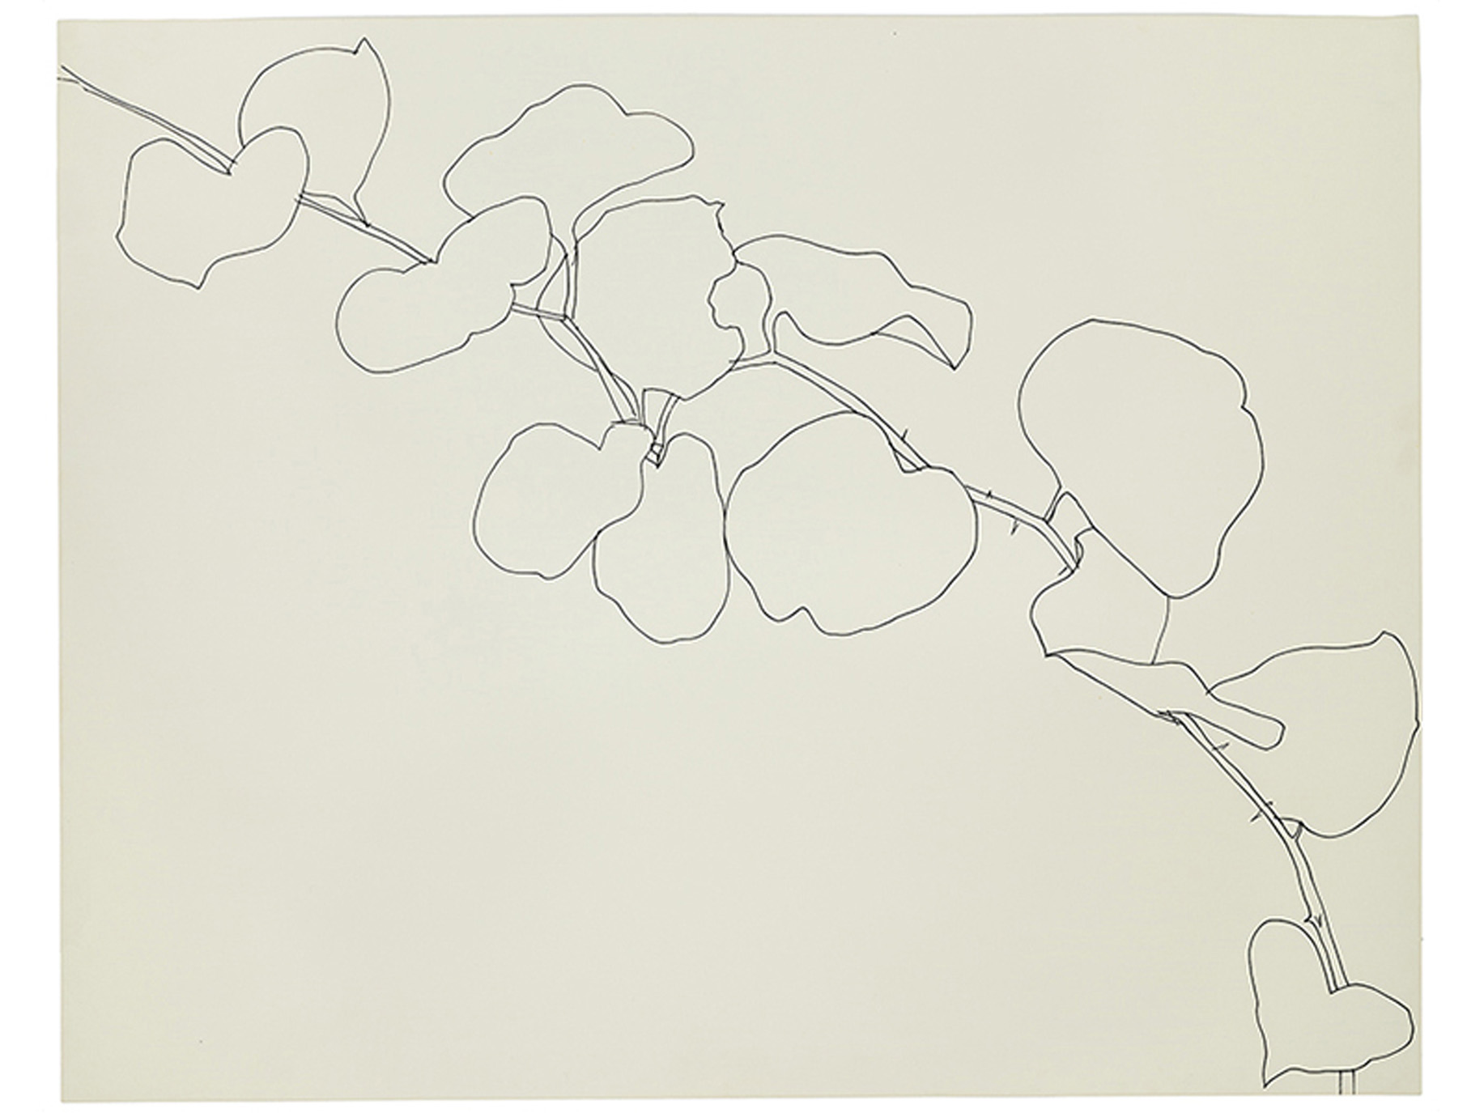

Figure 3-3 Ellsworth Kelly, Brier, 1961
Black ink on wove paper,
Wadsworth Atheneum Museum
of Art, C T Gift of Mr. Samuel Wagstaff in memory of Elva McCormick, 1980.7. © Ellsworth Kelly, all rights reserved

Slide 9
Implied Line (1 of 2)
A line is implied when no continuous mark connects one point to another, but the connection is visually suggested.
Line of sight, the direction in which figures are looking, serves an important compositional function.

Slide 10
Implied Line (2 of 2)
Assumption and Consecration of the Virgin by Titian features three horizontal areas tied together with interlocking, symmetrical implied triangles.
Chéri Samba’s Cavalry casts the subject of the artist in the role of a martyr; soldiers’ whips are winding up for an impending strike.

Slide 11
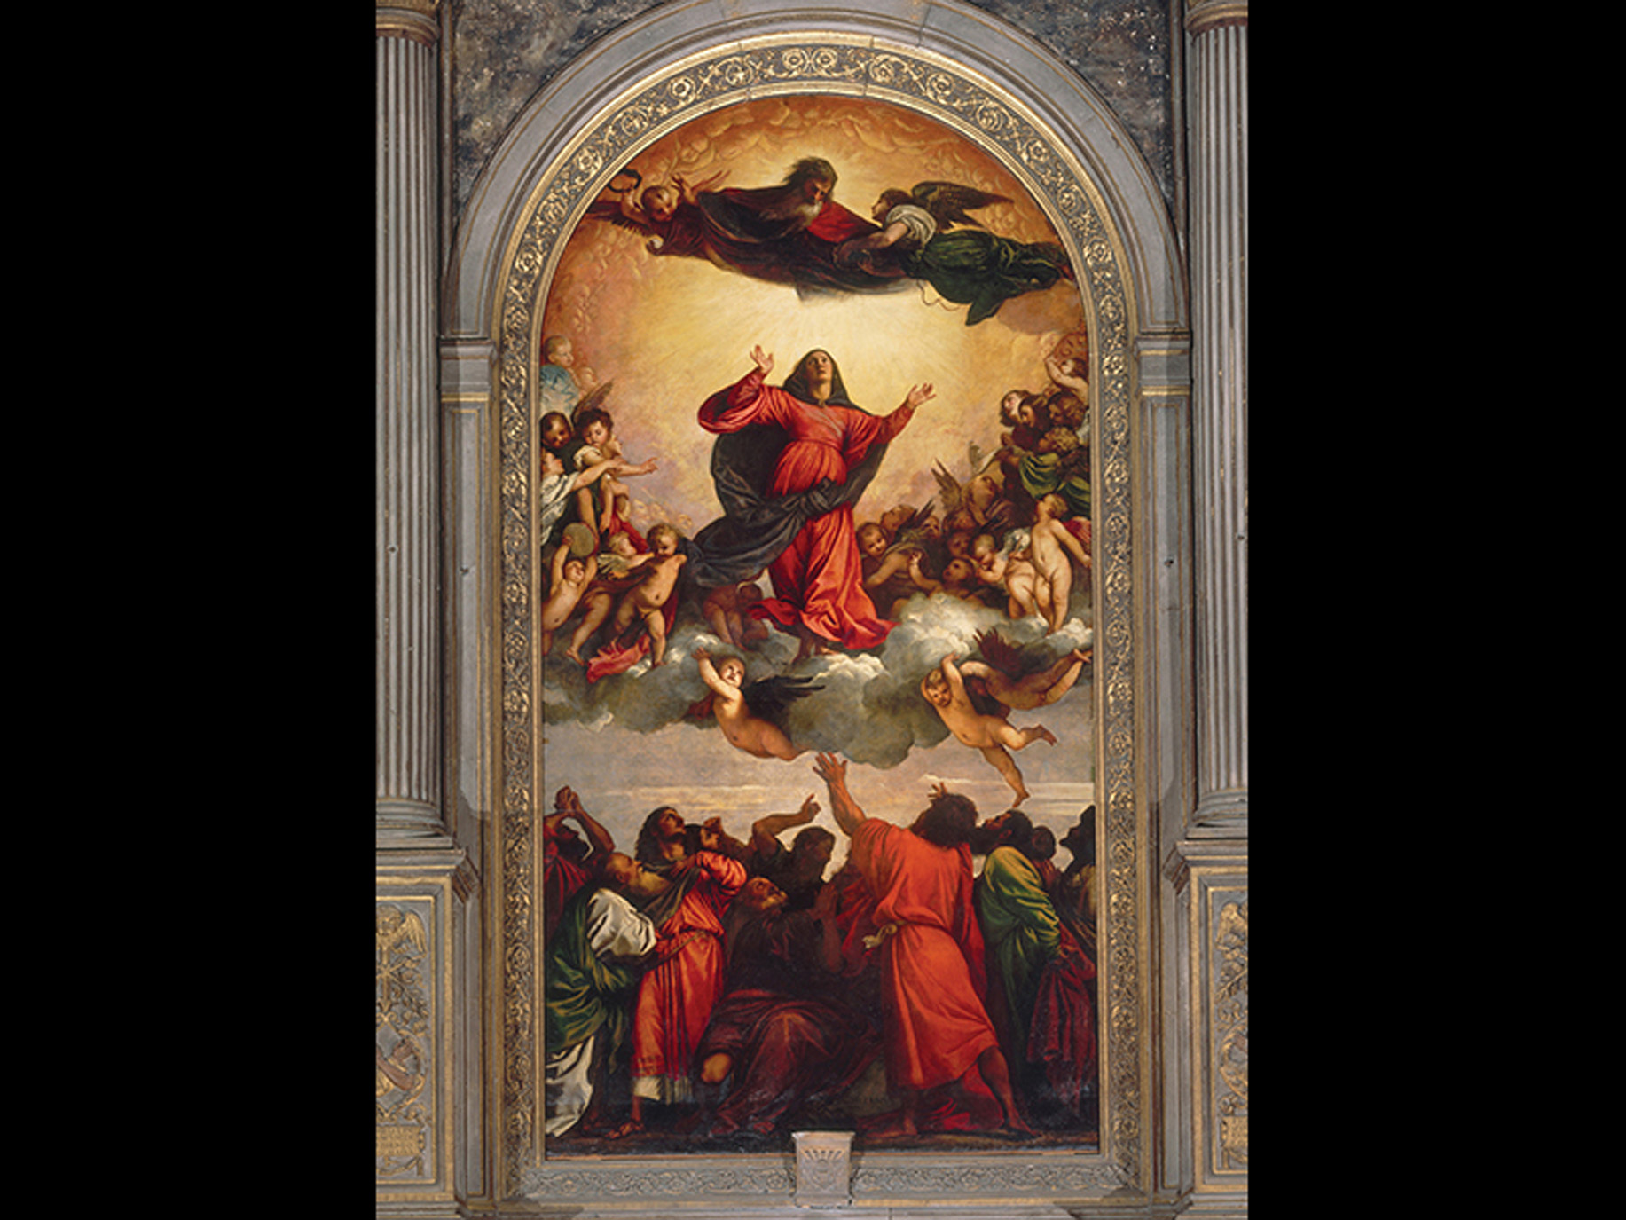

Figure 3-4 Titian, Assumption and Consecration of the Virgin, C a, 1516-18
Oil on wood,
Santa Maria Gloriosa dei Frari, Venice. © 2015.
Photo Scala, Florence.

Slide 12
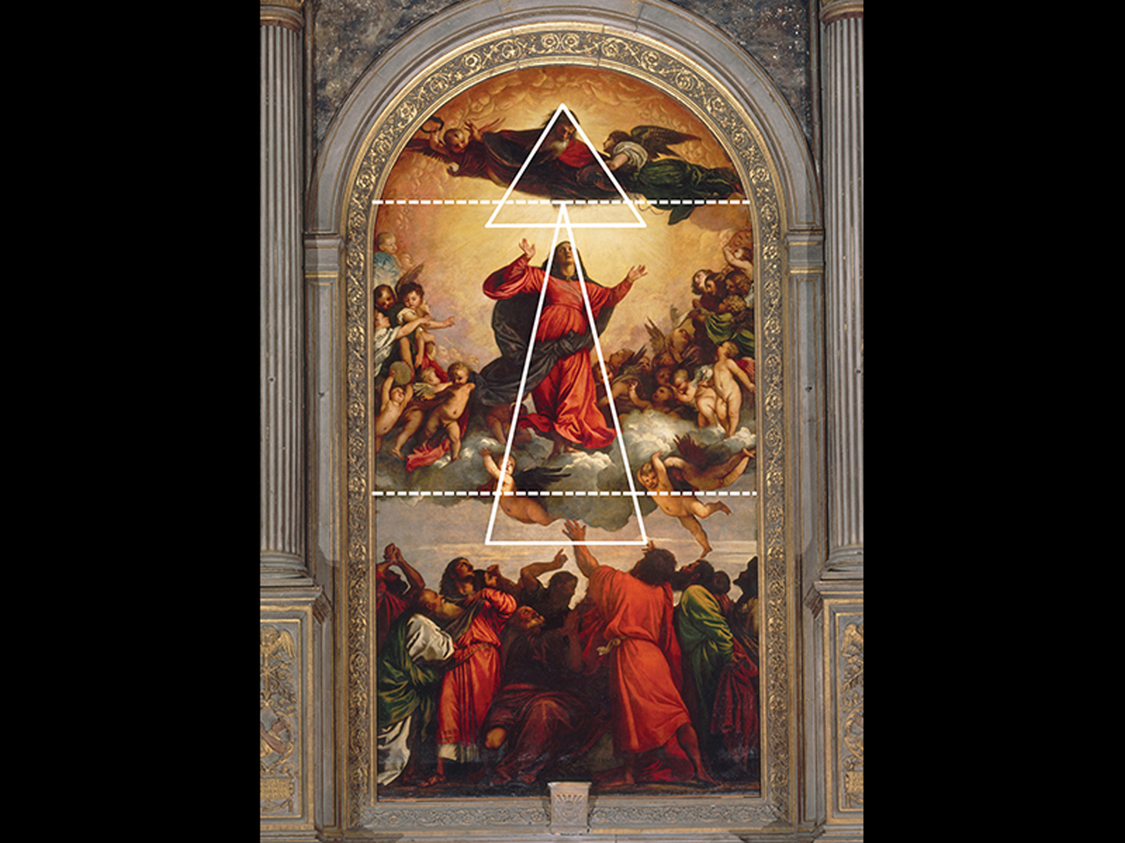
Figure 3-5 Line analysis of Titian, Assumption and Consecration of the Virgin, C a, 1516-18
© 2015. Photo Scala, Florence.

Slide 13
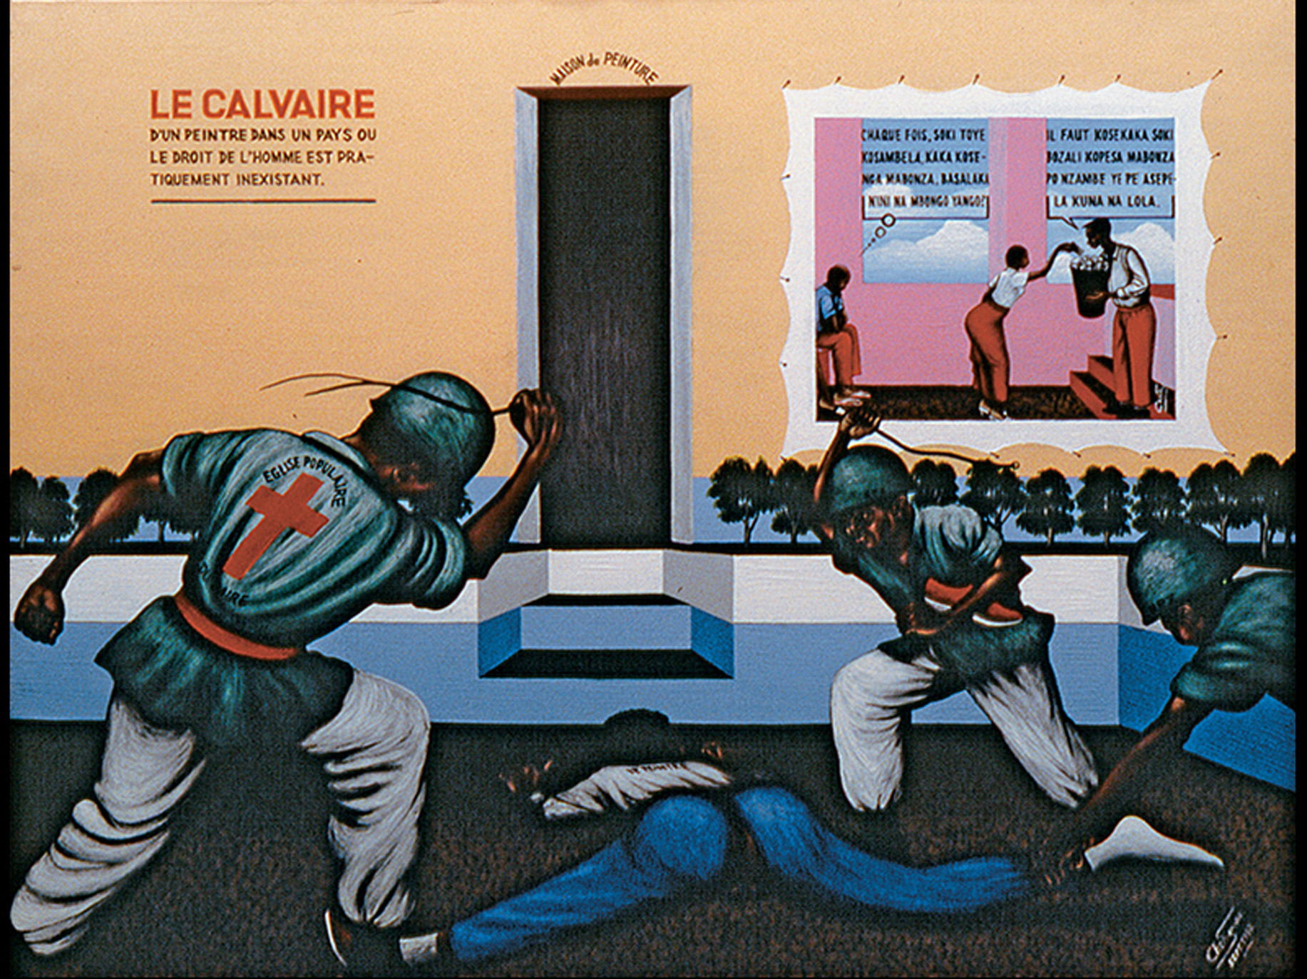

Figure 3-6 Chéri Samba, Calvary, 1992
Acrylic on canvas,
Photo courtesy of Annina Nosei Gallery,
New York. © Chéri Samba.

Slide 14
Qualities of Line
Rembrandt van Rijn employs expressive force with lines in The Three Crosses.
  The source of divine light is absent of line and lines become denser the farther they appear from it.
  Darkness shrouds the area around Christ and fills the moment with emotion.

Slide 15
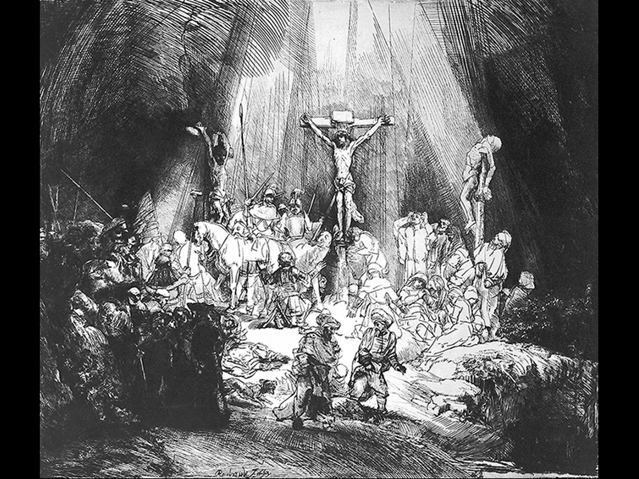

Figure 3-7 Rembrandt Van Rijn, The Three Crosses, 1653
Etching.
1842,0806.139. © The Trustees of the
British Museum

Slide 16
Expressive Qualities of Line (1 of 6)
Vincent van Gogh’s The Starry Night conveys a nocturnal landscape with loose, free lines.
  Lines are created with impasto, a thick application.
  Prior to the creation of this work, van Gogh created over 500 works and letters that exhibit the expressive energy he sought to release through this work.

Slide 17
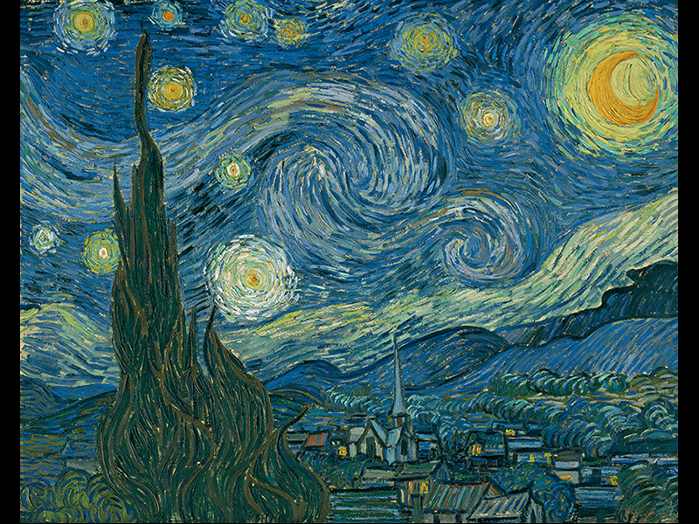

Figure 3-8 Vincent Van Gogh, The Starry Night, 1889
Oil on canvas,
Museum of Modern Art, New York. Acquired
through the Lillie P. Bliss Bequest, 472.1941. © 2015 Digital image, Museum of Modern Art, New York/Scala, Florence.

Slide 18
The Creative Process (1 of 5)
From Painting to Drawing: Vincent van Gogh’s The Sower
  A letter to painter John Russell expressed van Gogh’s interest in the subject.
  The artist experienced difficulty with color, first utilizing a yellow and violet palette and failing to create a place for the viewer’s eye to rest.
    It was heavily revised.

Slide 19
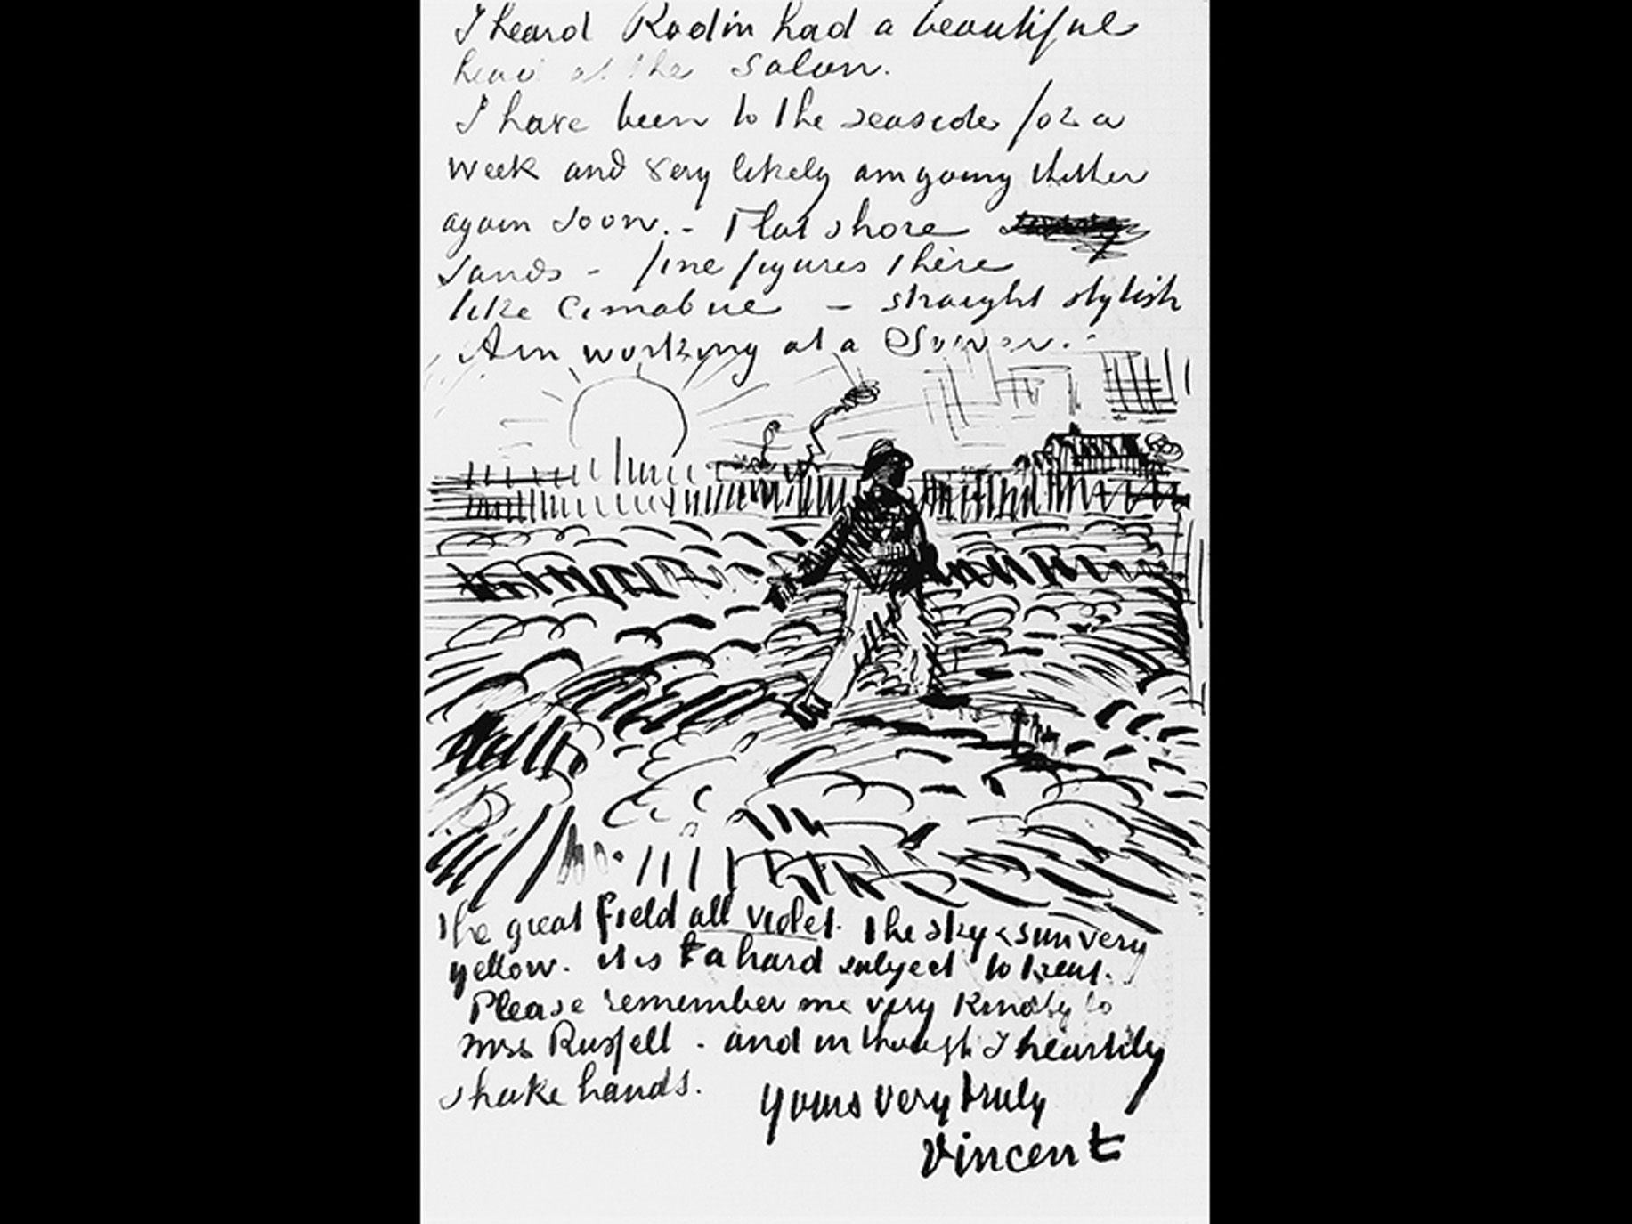

Figure 3-9 Vincent Van Gogh, Letter to John Peter Russell, June 17, 1888
Ink on laid paper,
Solomon R. Guggenheim Museum,
New York. Thannhauser Collection, Gift, Justin K. Thannhauser, 1978.2514.18. © Solomon R. Guggenheim Foundation, New York. Photo by Robert E. Mates.

Slide 20
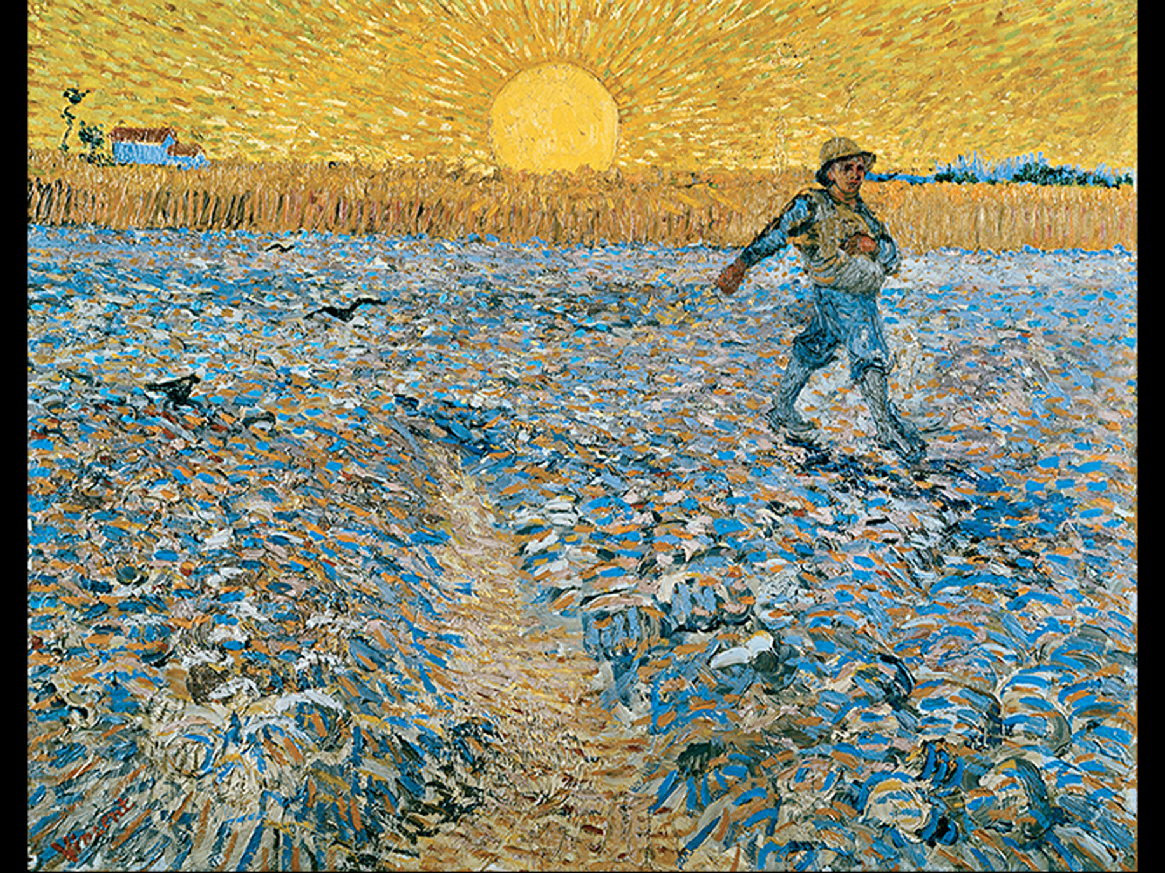

Figure 3-10 Vincent Van Gogh, The Sower, 1888
Oil on canvas,
Signed, lower left: Vincent.
Collection Kröller-Müller Museum, Otterlo, The Netherlands.

Slide 21
The Creative Process (2 of 5)
From Painting to Drawing: Vincent van Gogh’s The Sower
  The sower was redone in a drawn study, where the subject was drawn larger and the house and tree on the left were eliminated.
    Lines herein were grouped into five or ten with their own direction and flow.

Slide 22
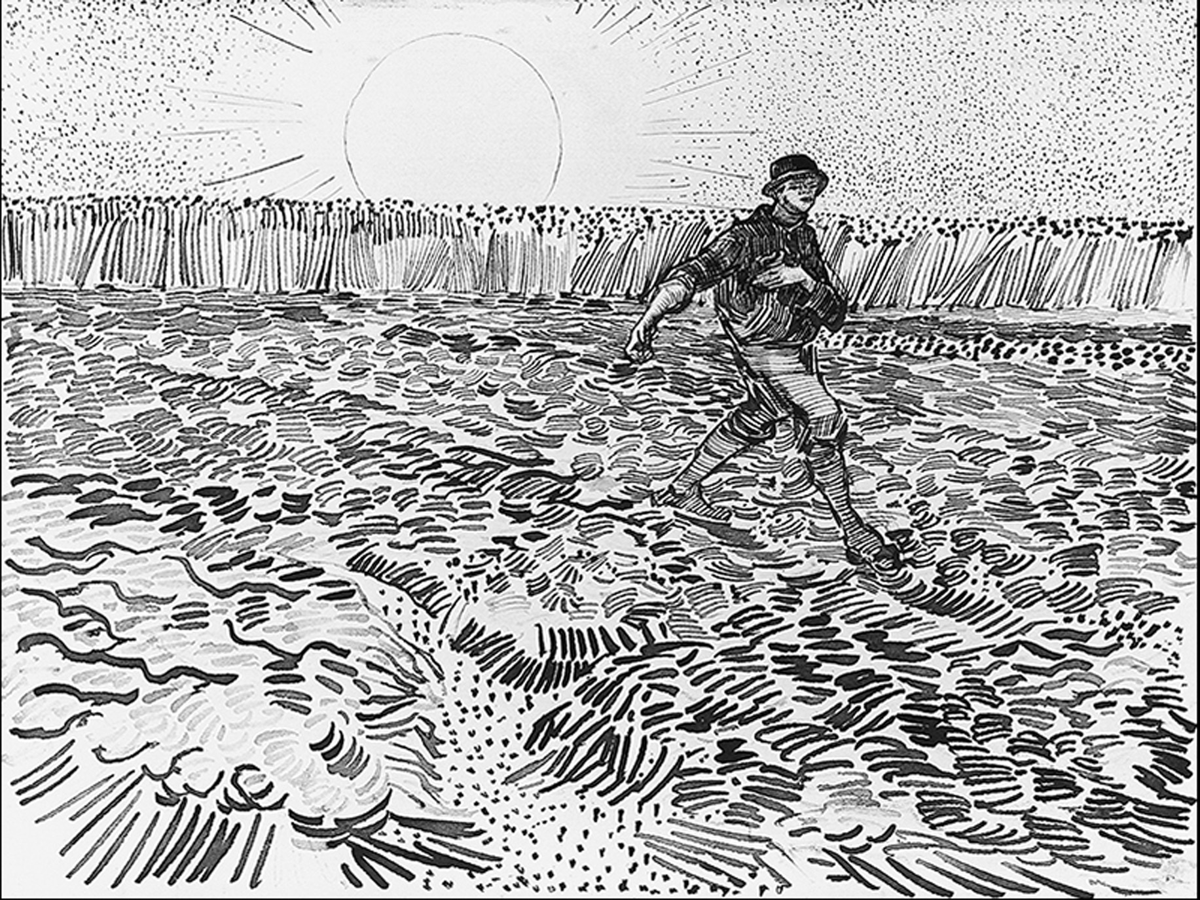

Figure 3-11 Vincent Van Gogh, The Sower, 1888
Drawing. Pencil, reed pen, and brown and black ink on wove paper
Van Gogh Museum, Amsterdam. Courtesy of Vincent van Gogh Foundation, Amsterdam.

Slide 23
Expressive Qualities of Line (2 of 6)
Sol LeWitt’s use of line is controlled, logical, and organized, in great contrast to van Gogh’s style.
  Works are often generated by museum staff; if a museum “owns” a LeWitt, they merely own the instructions on how to make it.
  Each work has a unique appearance each time the space produces it.

Slide 24
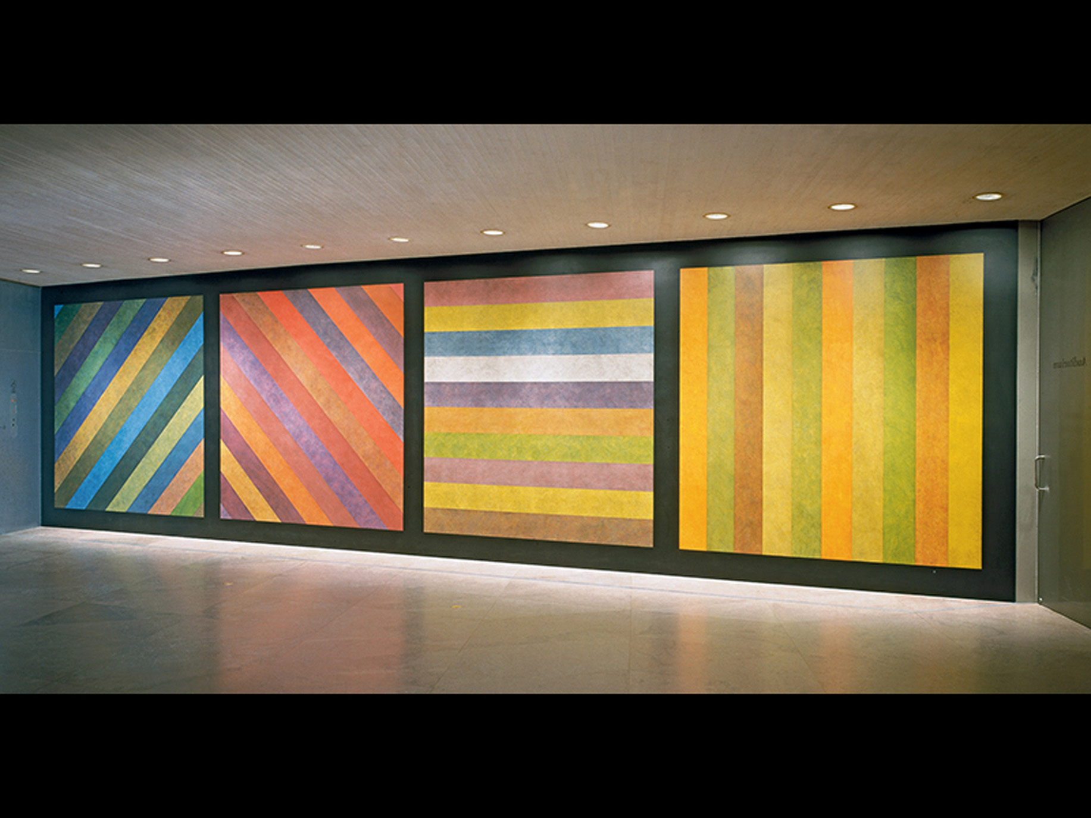
Figure 3-12 Sol LeWitt, Wall Drawing
No. 681 C, A wall divided vertically into four equal squares separated and bordered by black bands. Within each square, bands in one of four directions, each with color ink washes superimposed. 1993. Colored ink washes, image: 10 × 37’. National Gallery of Art, Washington, D.C. Dorothy and Herbert Vogel Collection, Gift of Dorothy Vogel and Herbert Vogel, Trustees, 1993.41.1. Photo © Board of Trustees, National Gallery of Art, Washington, D.C. © 2015 LeWitt Estate/Artists Rights Society (A R S), New York.

Slide 25
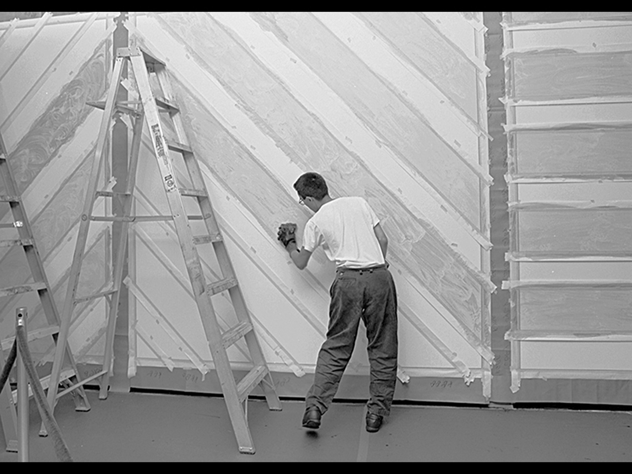
Figure 3-13a Installation of Wall Drawing
No. 681 C.August 25, 1993. National Gallery of Art, Washington, D.C.Photo © Board of Trustees, National Gallery of Art, Washington, D.C.

Slide 26
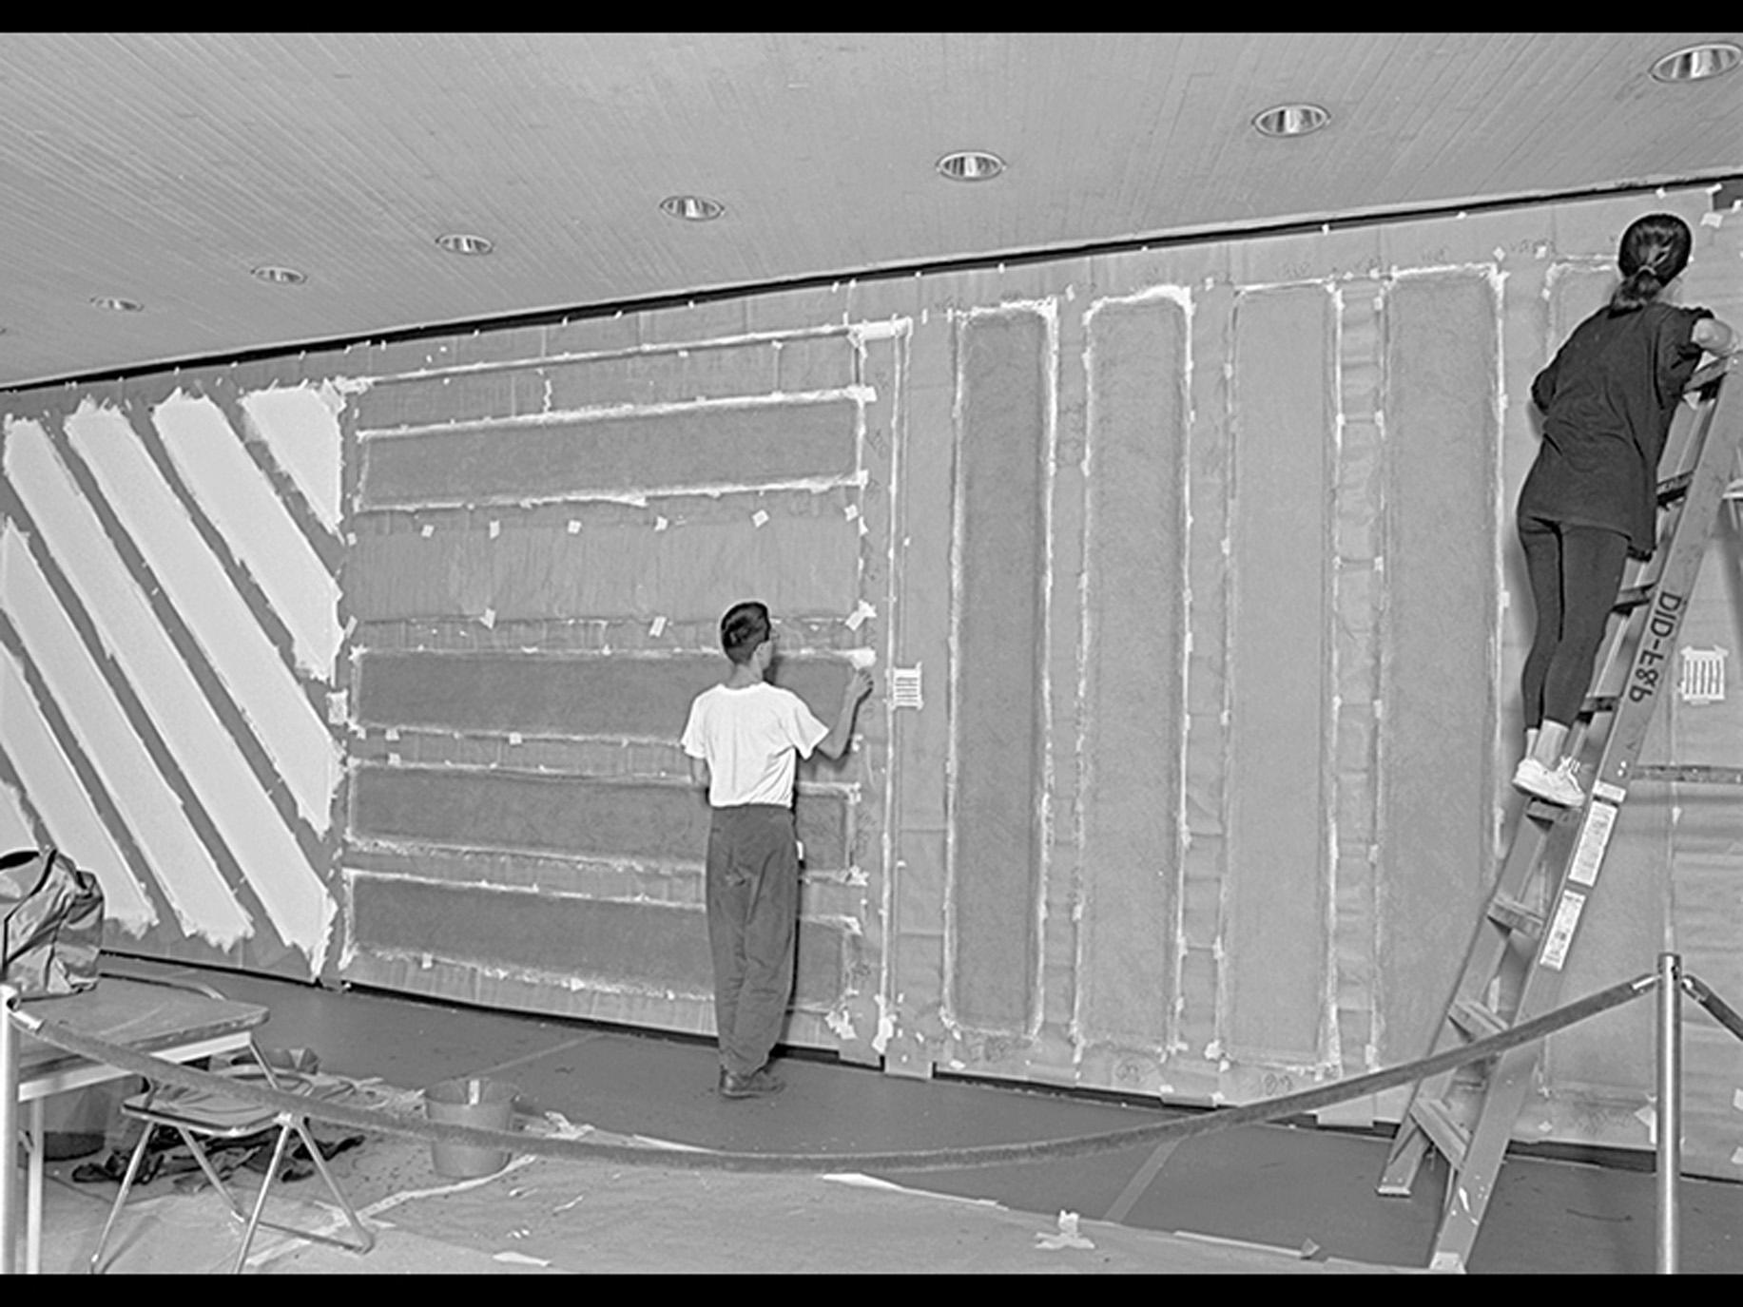
Figure 3-13b Installation of Wall Drawing
No. 681 C.August 25, 1993. National Gallery of Art, Washington, D.C.Photo © Board of Trustees, National Gallery of Art, Washington, D.C.

Slide 27
Expressive Qualities of Line (3 of 6)
A grid, or pattern of vertical and horizontal lines crossing, lends a sense of unity to a composition.
Pat Steir’s The Brueghel Series... is based on the Brueghel painting Flowers in a Blue Vase.
  It is a vanitas painting, a reminder about the transience of the material world.

Slide 28
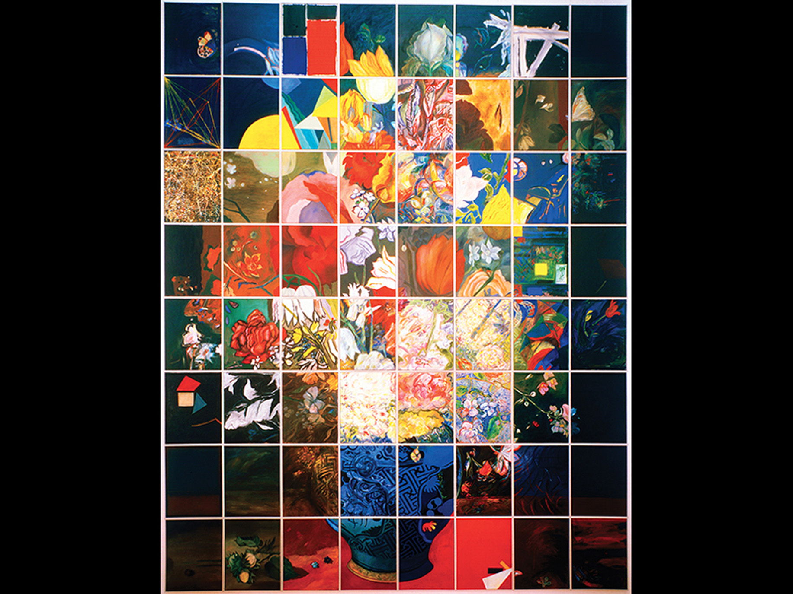

Figure 3-14 Pat Steir, The Brueghel Series: A Vanitas of Style, 1983-84
Oil on canvas, 64 panels, each
Courtesy of the artist and
Cheim & Read

Slide 29
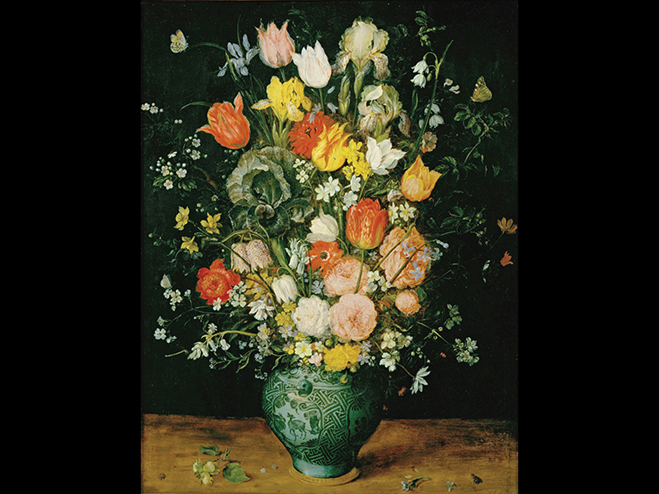

Figure 3-15 Jan Brueghel the Elder, Flowers in a Blue Vase, 1599
Oil on oakwood,
Kunsthistorisches Museum, Vienna.
a k g-image/Erich Lessing.

Slide 30
Expressive Qualities of Line (4 of 6)
Steir reproduced a series of 64 panels in the style of different artists through history.
  The range of styles is brought together by the grid that contains them.

Slide 31
Expressive Qualities of Line (5 of 6)
Relic 12 by Chinese-born Hung Liu represents a courtesan surrounded by symbols from Chinese painting.
  Vertical drips of paint resemble raindrops.
  Center, a red square holds the Chinese characters for “female” and “Nu-Wa,” the creation goddess.

Slide 32
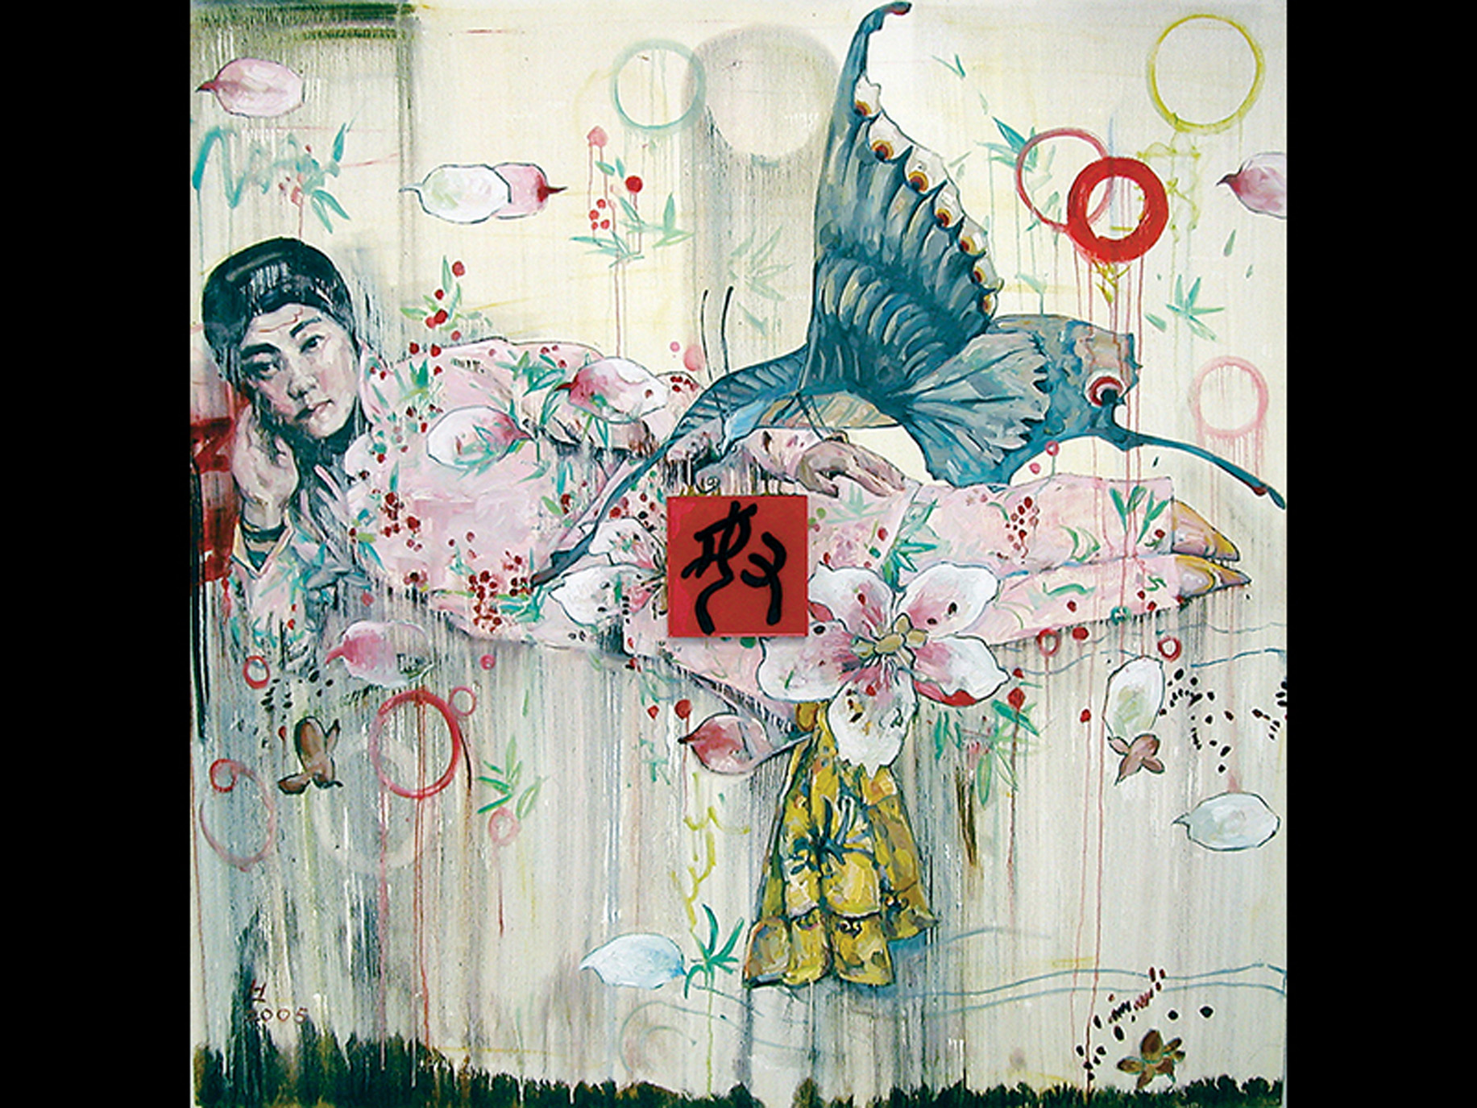

Figure 3-16 Hung Liu, Relic 12, 2005
Oil on canvas and lacquered wood
Courtesy of Nancy Hoffman
Gallery, New York.

Slide 33
Expressive Qualities of Line (6 of 6)
Wenda Gu creates imaginary calligraphies in human hair that has been collected from around the world.
  united nations-china monument: temple of heaven exhibits pseudo-script in four languages, creating an imaginary space in which a “united nations” of diverse cultures could meet.

Slide 34
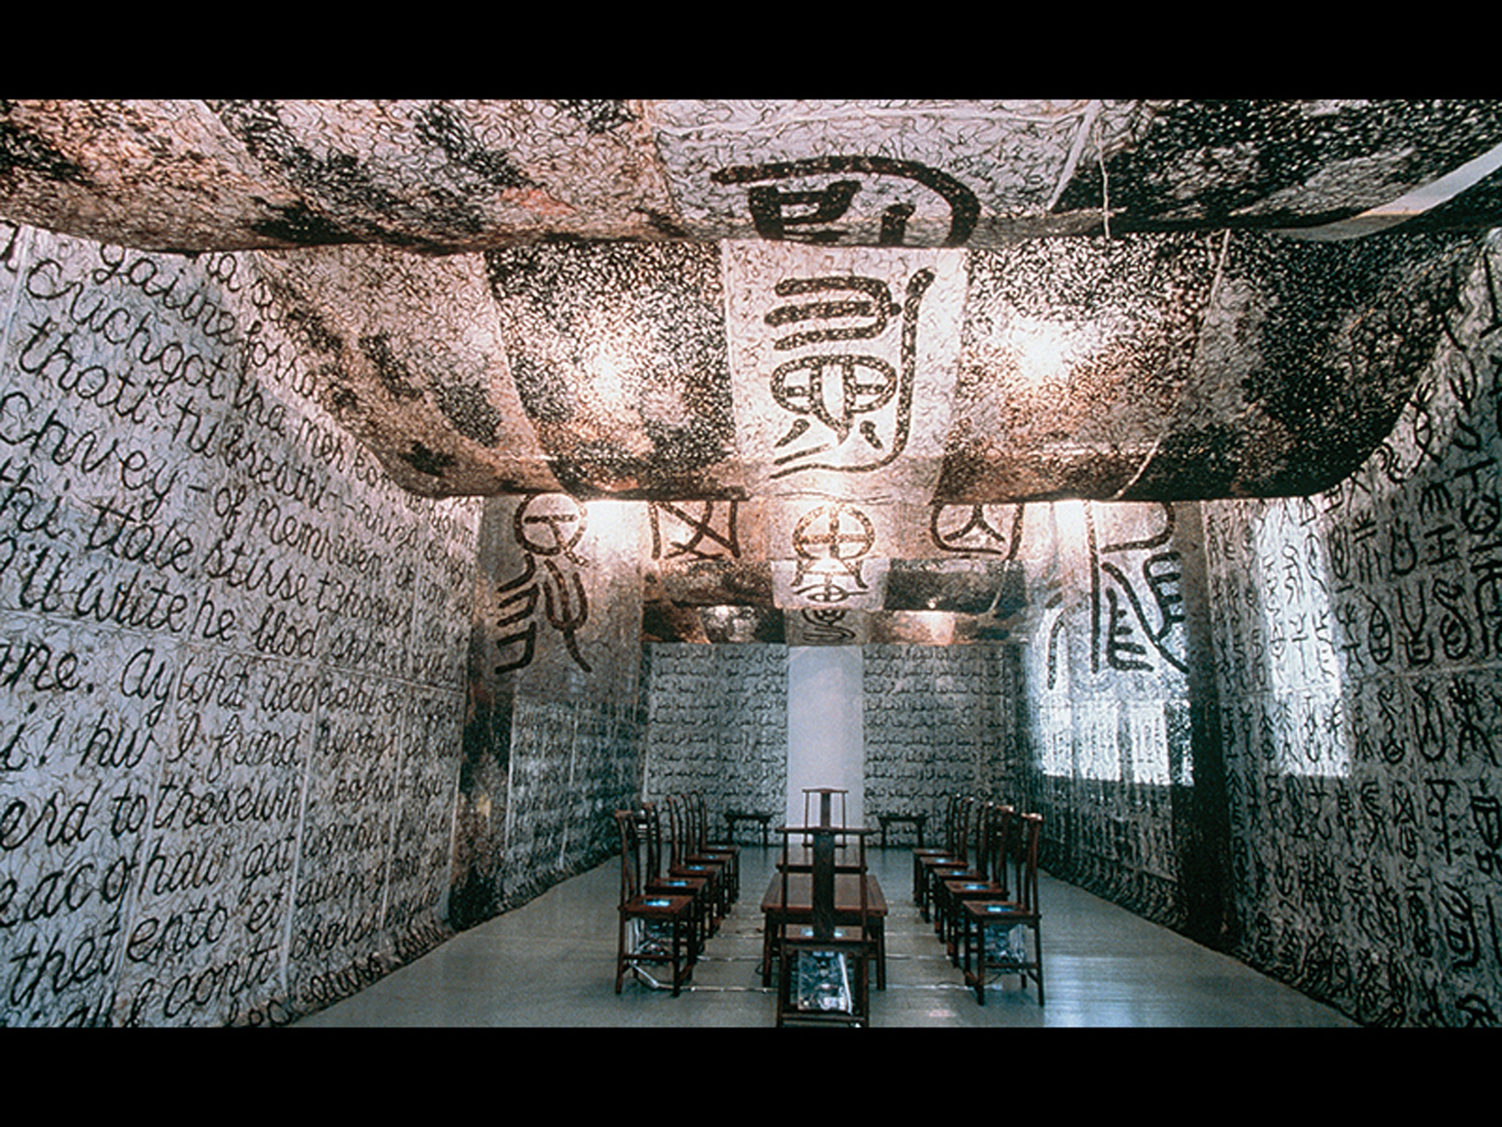

Figure 3-17 Wenda Gu, United Nations-China Monument: Temple of Heaven, 1998
Site-specific installation commissioned by the Asia Society, New York for inside out, P S1 Contemporary Art Center, New York. Temple of pseudo-English, Chinese, Hindi, and Arabic made of human hair curtains collected from all over the world, 12 Ming-style chairs with television monitors installed in their seats, 2 Ming-
style tables, and video film.
.Courtesy of the artist.

Slide 35
The Creative Process (3 of 5)
The Drip as Line: Hung Liu’s Three Fujins
  Liu lived in China during Mao’s Cultural Revolution and was taught to paint in a strict Russian Social Realist Style with precise, hard-edged lines.
  After being granted a passport to study in the U.S., she began to utilize freer line closer to Western abstraction.

Slide 36
The Creative Process (4 of 5)
The Drip as Line: Hung Liu’s Three Fujins
  Virgin/Vessel, painted from a photograph, juxtaposes a sexual scene with an image of a woman who was forced into prostitution due to foot-binding.
  Three Fujins depicts concubines with birdcages, representations of their captivity.

Slide 37
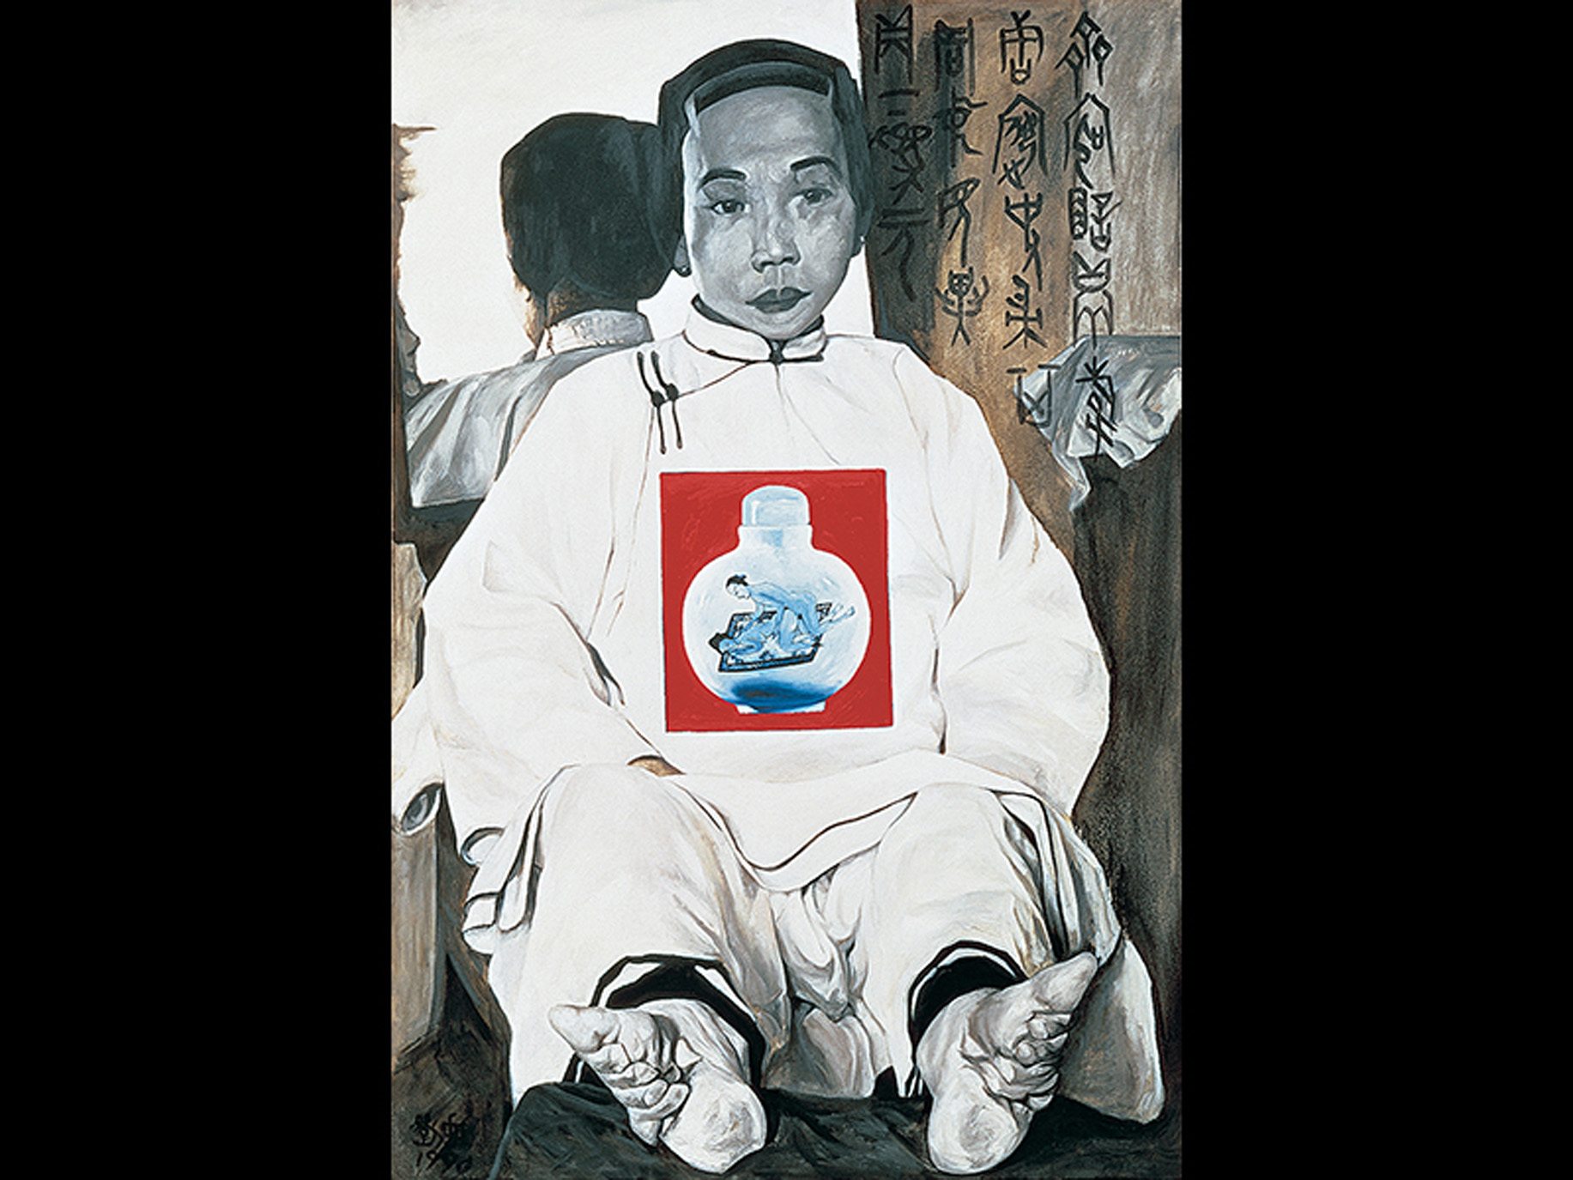

Figure 3-18 Hung Liu, Virgin/Vessel, 1990
Oil on canvas, broom,
Collection of Bernice and Harold Steinbaum.
. Courtesy of Nancy Hoffman Gallery, New York.

Slide 38
The Creative Process (5 of 5)
The Drip as Line: Hung Liu’s Three Fujins
  Liu describes “the drop” as something that gives her a sense of liberation from the works she had done in China, and an element that makes her work closer to the Chinese traditions of calligraphy and landscape painting.

Slide 39
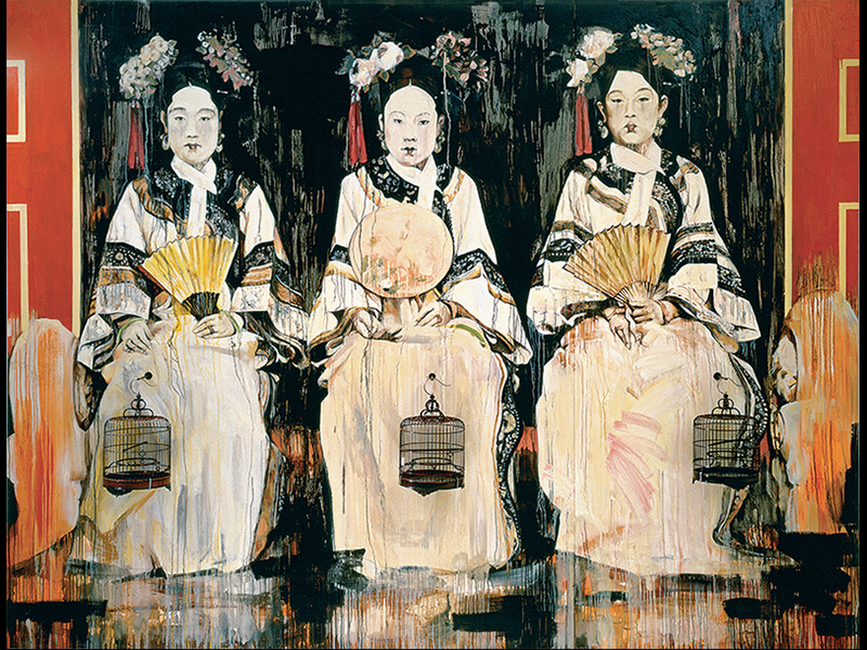

Figure 3-19 Hung Liu, Three Fujins, 1995
Oil on canvas, bird cages,
Private collection, Washington,
D.C. Courtesy of Nancy Hoffman Gallery, New York.

Slide 40
Line Orientation (1 of 2)
Strongly horizontal and vertical linear compositions create a sense of rational control.
The charcoal study of Jacques-Louis David’s Death of Socrates reveals the figure of Socrates in mathematical parallels and perpendiculars.
  Despite the dramatic pose, order rationalizes Socrates’ suicide.

Slide 41
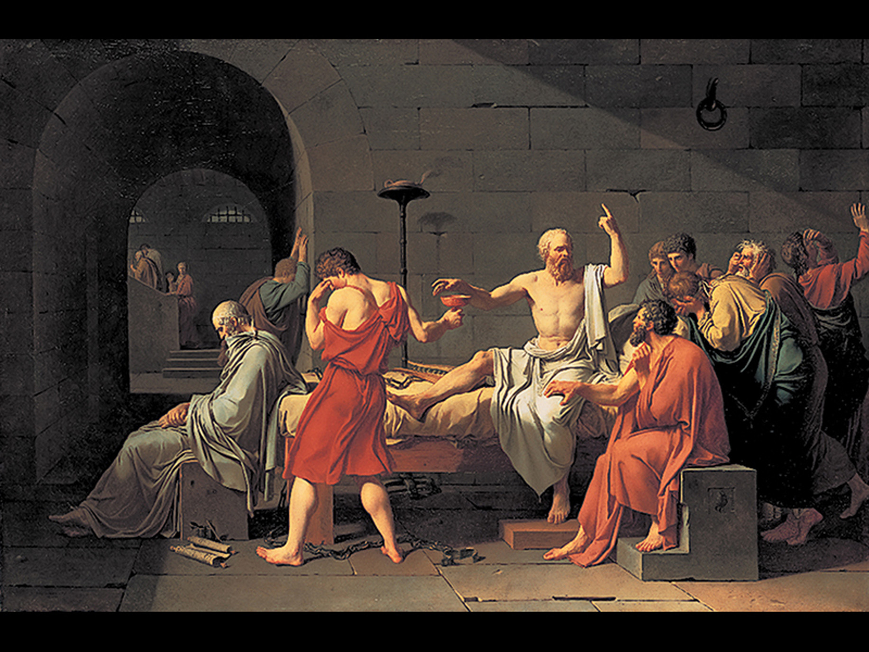

Figure 3-20 Jacques-Louis David, The Death of Socrates, 1787
Oil on canvas,
Metropolitan Museum of Art, New York
Catherine Lorillard Wolfe Collection, Wolfe Fund, 1931.45. © 2015. Image copyright Metropolitan Museum of Art/Art Resource/Scala, Florence.

Slide 42
Line Orientation (2 of 2)
Study for The Death of Sardanapalus by Eugène Delacroix lacks a grid structure, favoring a sweeping diagonal.
  In the dramatic scene, Sardanapalus has his horses, dogs, servants, and wives slain.
  Figures are depicted with swirling curves, agitated and chaotic.

Slide 43
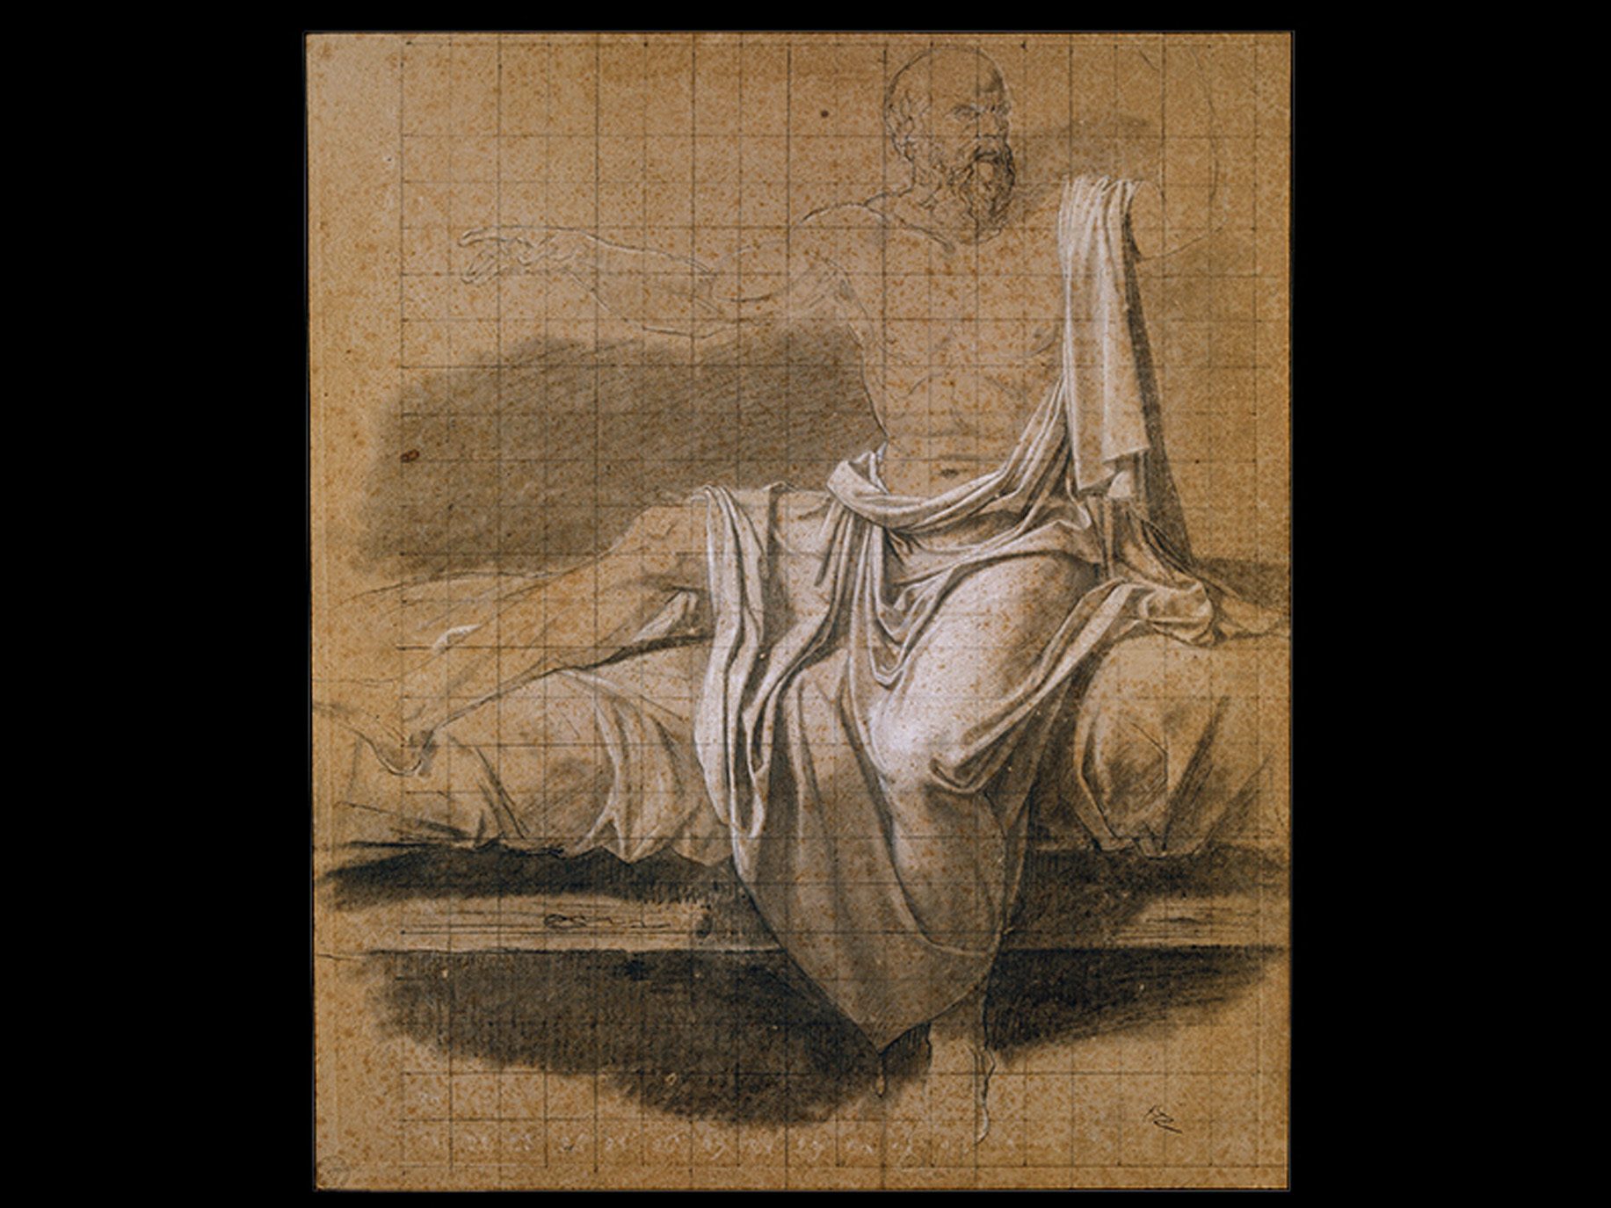

Figure 3-21 Jacques-Louis David, Study for the Death of Socrates, 1787
Charcoal heightened in white on gray-brown paper,
Musée Bonnat, Bayonne, France. Inv. N I513; A I1890. Photo © R M N.

Slide 44
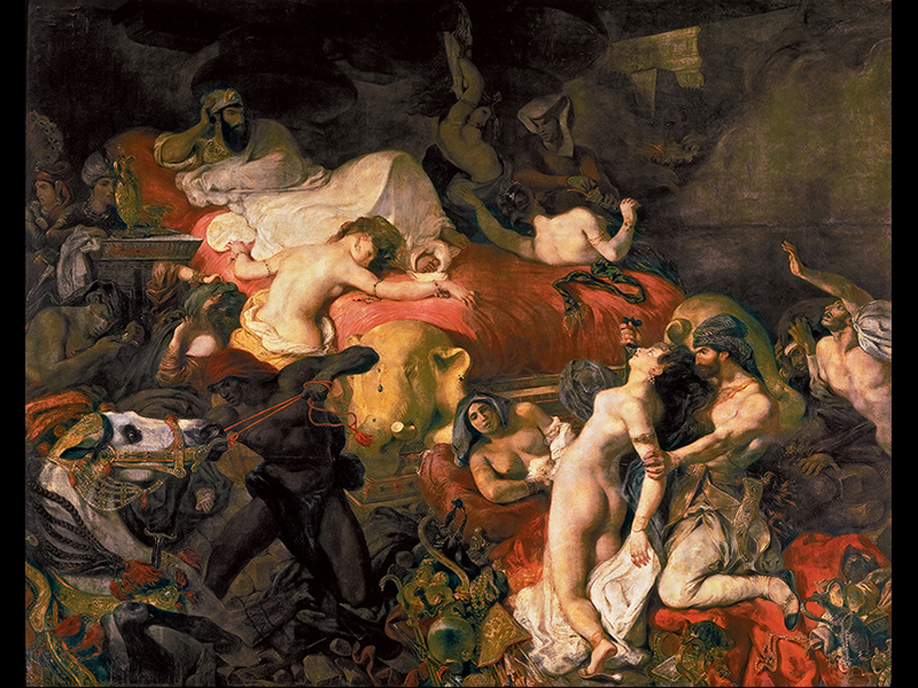
Figure 3-22 Eugène Delacroix, The Death of Sardanapalus, 1827
Oil on canvas,
Musée du Louvre, Paris.Inv. R F2346.
Photo © R M N-Grand Palais (musée du Louvre)/Hervé Lewandowski.

Slide 45
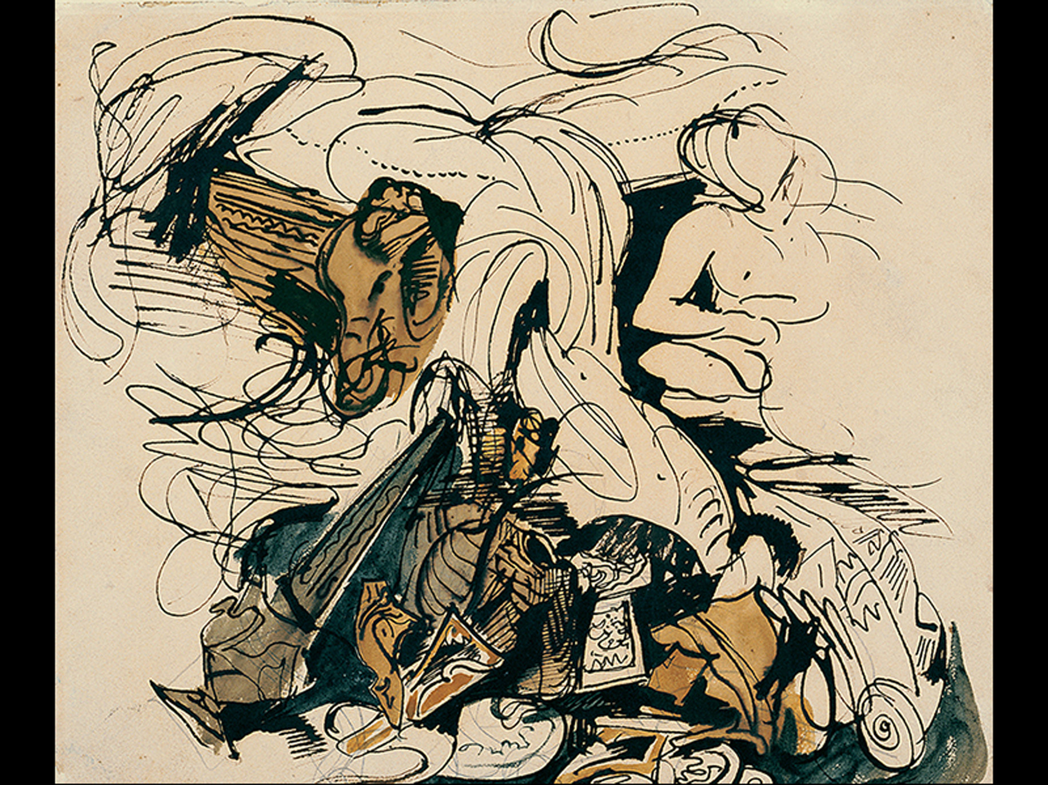

Figure 3-23 Eugène Delacroix, Study for The Death of Sardanapalus, 1827
Pen, watercolor, and pencil,
Cabinet des Dessins,
Musée du Louvre, Paris. Inv. R F5274-recto. Photo © R M N Grand Palais (musée du Louvre)/Thierry Le Mage.

Slide 46
The Critical Process: Thinking about Line (1 of 2)
In the depiction of anatomy, cultural bias defines the use of line.
Male forms are associated with vertical and horizontal geometries.
Female forms are identified with more loose, gestural, and intuitive lines.
Zeus or Poseidon exhibits a similar mathematical grid to David’s Socrates.

Slide 47
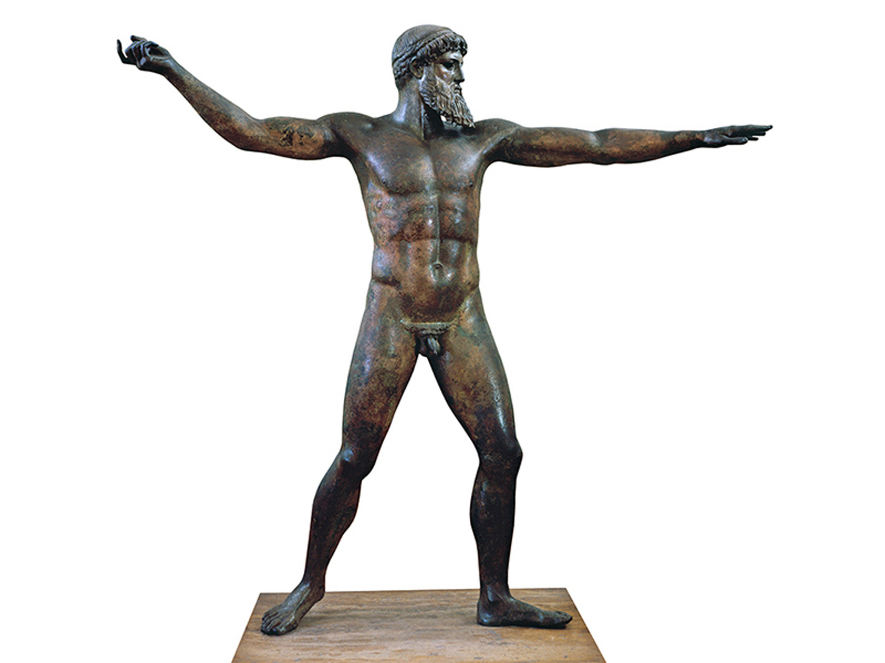

Figure 3-24 Zeus, or Poseidon
c a. 460 B C E. Bronze, Height
National Archaeological Museum,
Athens. Inv. 15161. © Craig & Marie Mauzy, Athens.

Slide 48
The Critical Process: Thinking about Line (2 of 2)
Robert Mapplethorpe’s photograph of the winner of the first Women’s Bodybuilding Championship suggests a feminist critique of Western conventional lines.

Slide 49
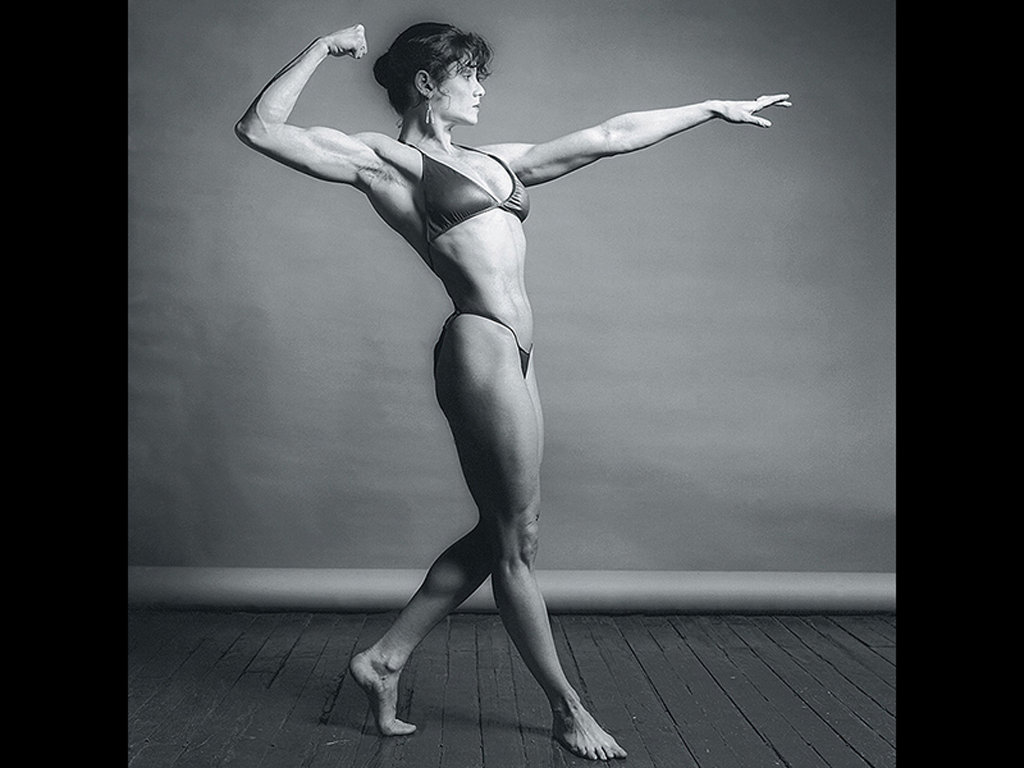
Figure 3-25 Robert Mapplethorpe, Lisa Lyon, 1982
Used by permission of Art + Commerce. © Robert Mapplethorpe Foundation.

Slide 50
Thinking Back
1. Distinguish among outline, contour, and implied line.
2. Describe the different qualities that lines might possess.

Slide 51

Copyright

