Slide 1
Operations Report
BMW Company

Slide 2

Introduction.
Bayerische Motoren Werke (BWM) is a German founded automobile engineering company.
The automobile segment deals with the development, manufacturing, assembling, as well as selling of cars (Tate, Bals, & Ellram, 2018, P. 20).
Notes:
Bayerische Motoren Werke (BWM) is a German founded automobile engineering company. Currently, BMW is best known for its excellence in manufacturing and production of cars and motorcycles. Majority of BMW products are shipped under the BMW Motorrad Tate, Bals, & Ellram, 2018, P. 20).. The company operates varied business segments which include motorcycles, automotive, financial services, in addition to other key segments.

Slide 3
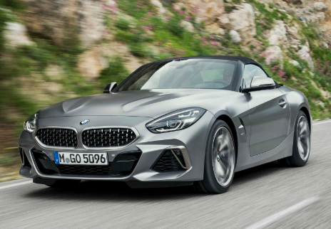
Background of the BMW Company
The BMW company was established in 1916 by Franz Josef Popp, Karl Rapp, and Camilo Castiglioni.
BMW is headquartered in Munich, Bavaria (Tate et al., 2018, P. 45).
In 2012, the BMW company was highly embraced and listed as one of the most reputable companies in the world by Forbers.com after holding about 60% of the total surveys.
Notes:
The BMW company was established in 1916 by Franz Josef Popp, Karl Rapp, and Camilo Castiglioni. It is headquartered in Munich, Bavaria (Tate et al. 2018). Since its establishment, the company has made an effort to become one of the most reputable top performers in the automobile industry. In 2012, the BMW company was highly embraced and listed as one of the most reputable companies in the world by Forbers.com after holding about 60% of the total surveys. The company also offers a variety of vehicle spares and financial services in the wider automobile market.

Slide 4
Operations Strategies of BMW.
Operations Report on BMW Company (HRC)
  The Human-Robot Collaboration technology at BMW has hardly outperformed the greatest proportion of all-robot and all-human teams (Tate, Bals, & Ellram, 2018, P. 20)
BMW’s Mission Statement
  To become the world's foremost provider of premium products as well as premium services for individual mobility in the year 2020 (Tate et al., 2018).
BMW’s Core Competencies.
  Effective brand management.
  Significant leadership competence in the global market.
  Product differentiation.
  Profitability trends
Notes:
The Human-Robot Collaboration technology at BMW has hardly outperformed the greatest proportion of all-robot and all-human teams, an aspect which has reduced human idle time in the company by 84% (Tate, Bals, & Ellram, 2018, P. 20).
The BMW mission is “to become the world's foremost provider of premium products as well as premium services for individual mobility in the year 2020" (Tate et al., 2018).
The BMW is aligned with two core strategies; that is, to be profitable and to cultivate long-term value from technological, structural as well as cultural perspectives.
BMW competencies include attained through effective brand management in conjunction with outstanding design (Bollig, Ardey, & Sautter., 2015). The firm has been committed to developing innovative technologies for future products and services. The automobile industry has been overcrowded with many top performing products from other companies such as Mercedes and hence effective product differentiation is the only probable technique which would relieve the company from stiff competition and help in accessing the anticipated competence.

Slide 5
BMW’s Operations Process.
Flowchart for the BMW company production process.
The Chassis Production Unit.
The Electro-Coating.
The surface finish center.
The Pre-Asssembly
The Final Assembly Line
Notes:
Step 1: The Chassis Production Unit.
Car’s frame is comprised of aluminum rather than steel, an aspect which makes the body increasingly stiffer and saves the car’s weight. Car’ frame is comprised of over 2000 welds in this stamp, and only qualified workers at BMW are eligible for performing it.
Step 2: The E-Coating Process.
The frame is moved to another Unit where it is protected from rust. It is the immersed in chemicals where it is roasted in 360 degrees to get coated from both sides.
Step 3: The surface finish center
In this step, workers are mandated to major on components of the car like the engine, instrumental panel, and doors. Moreover, the worker’s polishes the body and outlines the perfect finish.
Step4: The Pre-Assembly
In this step, workers are mandated to major on components of the car like the engine, instrumental panel, and doors.
Step 5: The Final Assembly
The final assembly line is sanctioned into seven core units.

Slide 6
Continuation on BMW Operations Process …
b. BMW company’s inventory policy.
  Raw materials are managed through careful examination based on the budgeted cost of inputs against what has been purchased as raw materials.
  as STASAM which compares the results of all estimation methods in each inventory (Tate, Bals, & Ellram, 2018).
c. HRC Sustainability in Operations.
  Minimization the negative effects on the environment. Technology.
  Electrification and innovations.
  Role model for other global companies by accessing full green electricity
Notes:
Inventory management is a highly underscored element in the context of BMW. The company advocates for a high level of accountability and transparency. (Tate, Bals, & Ellram, 2018).
Sustainability is attained through minimize the negative effects on the environment. Technology has enabled the extension of the earliest phases of production to the repossessing and reusing of material at the end of the vehicle life.
Through HRC, the firm strives to exist as a role model for other global companies by accessing full green electricity operations by 2020.

Slide 7
Quality at BMW.
a). Quality of manufacturing.
  BMW underscores on the aspect of professionalism for quality customer services.
  The company has increasingly relied on HRC technology to ensure increased productivity (Wheaton & Schrott., 2018).
  The company has opted for unending research and development as a basis for innovations.
Notes:
It underscores on the aspect of professionalism for quality customer services. The company has increasingly relied on HRC technology to ensure increased productivity, an aspect which has paved the way for digitalization of services as per the customer expectations (Wheaton & Schrott., 2018). The company has opted for unending research and development as a basis for innovations.

Slide 8
Continuation on Quality at BMW
b) The BMW builds on quality in varied ways.
  BMW ensures quality assurance stretching from the development stage of vehicle.
  BMW has effective quality management system that voluntarily requires the BMW centers to assess every operation practice (Mariel & Minner, 2015).
  BMW Group has an ISO certificate which certifies that the company complies with the demanding targets.
c) BMW TQM tools.
  BMW has launched a stream of innovative products as a basic tool in the automobile market (Wheaton & Schrott, 2018).
  BMW’s logistic activity has been committed to ensuring the proper flow of an organization with the aim of availing necessary resources the corresponding needs.
Notes:
The company has adopted a fully effective quality management system that voluntarily requires the BMW centers to assess every operation practice, every production procedure and every job description throughout the leadership (Mariel & Minner, 2015). BMW ensures quality assurance stretching from the development stage of vehicle. BMW has effective quality management system that voluntarily requires the BMW centers to assess every operation practice (Mariel & Minner, 2015).
BMW Group has an ISO certificate which certifies that the company complies with the demanding targets defined during development for the environmental impacts during sourcing, production, usage, and subsequent recycling.
The company has availed logistic concerns to the purchase, the handle, the inventory management, and storage as well as methods of administration of sales.

Slide 9
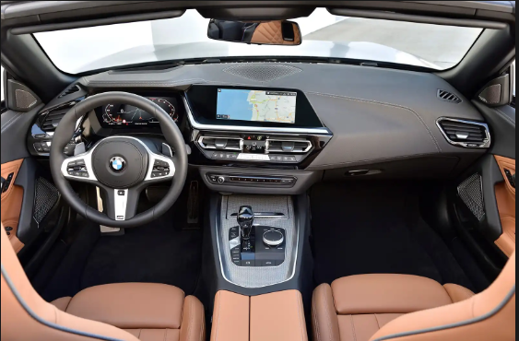
BMW’s Capacity Planning.
Operations Management Lessons
HRC requires higher initial capital investments.
There might be technical errors made by robotics.
HRC technology has substantiated decline in skilled manpower in the company.
HRC brings inflexibility in production.
Notes:
HRC requires higher initial capital investments. Overreliance of HRC might lead to the creation of poor quality products due to the lack of proper inspection for technical errors made by robotics. HRC technology has substantiated decline in skilled manpower in the company. Assembly lines cannot be modified fully to fit the HRC based practice and hence leading to inflexibility in production.

Slide 10
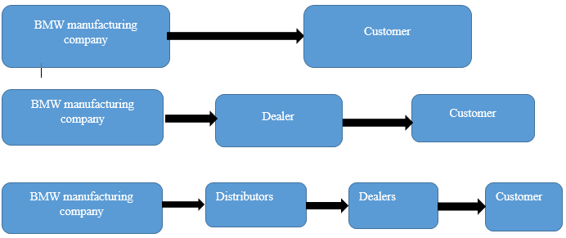
BMW Supply Chain.
BMW’s major supply chains.
Notes:
Information from the plays a core role in enhancing BMW’s operation process and increased profitability. Data from the supply chain helps the company to identify new target market in the global market. The company is quite reflective of the demand and cash flow in the chain.
The logistics team is mandated to ensure persistent supply of goods and services to the customers of the global market. The BMW proficient logistics ensures accurate delivery of goods and services at the right time.

Slide 11
Conclusion.
BMW is among the top performing companies based on the current trends in the automobile industry.
HRC technology will enhance future of BMW (Mariel & Minner, 2015). .
There is a need to emphasize on the quality of the product in relation to customer expectations.
BMW should deploy its efforts in research and development.
Notes:
BMW is among the top performing companies based on the current trends in the automobile industry. The company operations are complement with new strategies which aligns with the HRC technology and future BMW. This study has been very informative.
There is a need to emphasize on the quality of the product in relation to customer expectations. It is worth to recommend that BMW should deploy its efforts in research and development to examine and establish potential solutions to ever-changing customer expectations.

Slide 12
Bibliography.
Bollig, M., Ardey, N. and Sautter, M., 2015. The BMW Power E Drive Concept’s Drivetrain. MTZ worldwide, 76(10), pp.4-9.
Kallich, S., Graf, H., Schaller, K.V. and Ritter, S., 2019. The New BMW Motorrad Boxer Engine with ShiftCam Technology. MTZ worldwide, 80(4), pp.32-39.
Mariel, K. and Minner, S., 2015. Strategic capacity planning in automotive production networks under duties and duty drawbacks. International Journal of Production Economics, 170, pp.687-700.
Tate, W., Bals, L. and Ellram, L. eds., 2018. Supply Chain Finance: Risk Management, Resilience and Supplier Management. Kogan Page Publishers.
Wheaton, B. and Schrott, B., 2018. Total Quality Management. Theory and Practice: Englischsprachiger Text mit zweisprachigem Index. Walter de Gruyter GmbH & Co KG.

