Slide 1
Islam: There is a great deal of diversity in the etymology (origin of words/names), theology (attributes of God), and emphasis (stress on some doctrines/practices) within monotheism (belief in the existence of only one god whose generic name is El/Allah*) as represented by the three monotheistic religions of:
"Islam" (an Arabic word for complete 'devotion/submission/surrender' to God alone or ‘Unity God’ as the creator and ruler of the universe [see Quran 3:19, 3:85, 10:72, 2:128, 10:72; 2:133; 12:101, 10:84, 3:52]);
"Christianity" (the word etymology is derived from 'Christ’ [a translation of a Greek adjective meaning ‘anointed’ and often ‘anointed one’] which refers [hundreds of times in the Christian Bible] to Jesus [see Matthew 1:1, Acts 11:26, 26:28; 1 Peter 1:1, 4:16] as the Son of God and the second person of the Holy Trinity or ‘Trinity God’: Father, Son, and Holy Spirit; &
"Judaism" (the word etymology is derived from the name of the tribe and/or territory or kingdom of 'Judah' [see Genesis 29:35, 37:26-27] from which the word Jews is also derived---i.e., Judaism is the religion of the Jews).
To better understand diversity within monotheism (especially the concept of the 'Unity God' versus the 'Trinity God’), compare/contrast the following SPECIFIC verses or passages from the Quran and the Bible (PowerPoint slides 1-9):
Compare/contrast Quran 1:1-7 with Matthew 6:9-13
Compare/contrast John 3:16, John 19:16-22 and Matthew 27:46,50 with Quran 112:1-4 and Quran 4:156-158
Compare/contrast Psalm 2:7, Exodus 4:22, Jeremiah 31:9, and Mark 12:29 with Quran 112:1-4 and Quran 2:255
Compare/contrast Psalm 82:6 and John 10:34 with Quran 3:79-80
The Opening (Quran 1:1-7):
1. “In the name of God [Allah*], the Lord of Mercy, the Giver of Mercy!
2. Praise belongs to God, Lord of the Worlds,
3. the Lord of Mercy, the Giver of Mercy,
4. Master of the Day of Judgment.
5. It is You we worship; it is You we ask for help.
6. Guide us to the straight path:
7. the path of those You have blessed, those who incur no anger and who have not gone astray.” Ameen
Lord’s Prayer (Matthew 6:9-13):
9. “This, then, is how you should pray:
'Our Father [God] in heaven, hallowed be your name,
10. your kingdom come, your will be done on earth as it is in heaven.
11. Give us today our daily bread.
12. Forgive us our debts, as we also have forgiven our debtors.
13. And lead us not into temptation, but deliver us from the evil one.`” Amen
*The name “Allah" (sometimes spelled "El") is the original generic name of God among the original/native Muslim, Christian, and Jewish followers of monotheism. The name Allah/EL [Arabic: [الله still lives in the Biblical names EL Shaddai, ELohim, BethEL, IshmaEL, IsraEL, MichaEL, EmanuEL, SamuEL, etc. It still lives in the last few Aramaic words attributed to Jesus in his native language while on the cross: “Eli, Eli, lema sabachthani?” (which means “My God, my God, why have you forsaken me?”) [Matthew 27:46; see also Psalm 22:1, in Jewish Bible 22:2]

Slide 2
Compare John 3:16, John 19:16-22 & Matthew 27:46,50 with Quran 112:1-4 and Quran 4:156-158
“For God so loved the world that he gave his one and only Son, that whoever believes in him shall not perish but have eternal life.” John 3:16
“Say, He is God the One, God the eternal. He fathered no one nor was He fathered. No one is comparable to Him.” Quran 112:1-4
“So the soldiers took charge of Jesus. Carrying his own cross, he went out to the place of the Skull (which in Aramaic is called Golgotha). There they crucified him, and with him two others—one on each side and Jesus in the middle. Pilate had a notice prepared and fastened to the cross. It read: JESUS OF NAZARETH, THE KING OF THE JEWS. Many of the Jews read this sign, for the place where Jesus was crucified was near the city, and the sign was written in Aramaic, Latin and Greek. The chief priests of the Jews protested to Pilate, ‘Do not write THE KING OF THE JEWS, but that this man claimed to be king of the Jews. Pilate answered, ‘What I have written, I have written.’” John 19:16-22
“About three in the afternoon Jesus cried out in a loud voice, ‘Eli, Eli, lema sabachthani?’ (which means ‘My God, my God, why have you forsaken me?’)…. And when Jesus had cried out again in a loud voice, he gave up his spirit.” Matthew 27:46,50
“And because they disbelieved and uttered a terrible slander against Mary, and said, ‘We have killed the Messiah, Jesus son of Mary, the Messenger of God.’ (They did not kill him, nor did they crucify him, though it was made to appear like that to them; those that disagreed about him are full of doubt, with no knowledge to follow, only supposition: they certainly did not kill him---No! God raised him up to Himself. God is almighty and wise. There is not one of the People of the Book who will not believe in [Jesus] before his death, and on the Day of Resurrection he will be a witness against them.)” Quran 4:156-158
The Christians believe in Jesus as Son of God, the Muslims believe in Jesus [Essa] as a prophet of God, and the Jews do not believe in Jesus as Son of God or prophet of God

Slide 3
Compare Psalm 2:7, Exodus 4:22, Jeremiah 31:9, and Mark 12:29 with Quran 112:1-4
“I will proclaim the decree of the LORD: He said to me, "You are my Son; today I have become your Father.” Psalm 2:7
“Then say to Pharaoh, 'This is what the LORD says: Israel is my firstborn son” Exodus 4:22
“They will come with weeping; they will pray as I bring them back. I will lead them beside streams of water on a level path where they will not stumble, because I am Israel's father, and Ephraim is my firstborn son.” Jeremiah 31:9
“The Lord our God, the Lord is one.” Mark 12:29
“Say, He is God the One, God the eternal. He fathered no one nor was He fathered. No one is comparable to Him.” Quran 112:1-4
Given Islam’s strong emphasis on monotheism (the oneness of God or Unity God ), Prophet Muhammad told his companions that Quran 112 (the above 4 verses) is “worth a third of the Quran.” Sahih Bukhari

Slide 4
Compare Psalm 82:6 and John 10:34 with Quran 3:79-80
“I said, ‘You are “gods”; you are all sons of the Most High.’” Psalm 82:6
“Jesus answered them [the Jews], “Is it not written in your Law, ‘I have said you are “gods.”’ John 10:34
“No person to whom God had given the Scripture, wisdom, and prophethood would ever say to people, ‘Be my servants, not God’s.’ [He would say], ‘You should be devoted to God because you have taught the Scripture and studied it closely.’ He would never command you to take angels and prophets as lords. How could he command you to be disbelievers after you had devoted yourself to God.” Quran 3:79-80

Slide 5
Basic Do’s and Don’ts in the Quran and the Bible
Quran 17:23-39
Exodus 20:2-17
23 Your Lord has commanded that you should worship none but Him, and that you be kind to your parents. If either or both of them reach old age with you, say no word that shows impatience with them, and do not be harsh with them, but speak to them respectfully
24 and, out of mercy, lower your wing in humility towards them and say, ‘Lord, have mercy on them, just as they cared for me when I was little.’
25 Your Lord knows best what is in your heart. If you are good, He is most forgiving to those who return to Him.
26 Give relatives their due, and the needy, and travelers—do not squander your wealth wastefully:
27 those who squander are the brothers of Satan, and Satan is most ungrateful to his Lord—
28 but if, while seeking some bounty that you expect from your Lord, you turn them down, then at least speak some word of comfort to them.
29 Do not be tight-fisted, nor so open-handed that you end up blamed and overwhelmed with regret.
30 Your Lord gives abundantly to whoever He will, and sparingly to whoever He will: He knows and observes His servants thoroughly.
31 Do not kill your children for fear of poverty—We shall provide for them and for you—killing them is a great sin.
32 And do not go anywhere near adultery: it is an outrage, and an evil path.
33 Do not take life—which god has made sacred—except by right. If anyone is killed wrongly, We have given authority to the defender of his rights, but he should not be excessive in taking life, for he is already aided [by God].
34 Do not go near the orphan’s property, except with the best intentions, until he reaches the age of maturity. Honor your pledges: you will be questioned about your pledges.
35 Give full measure when you measure, and weigh with accurate scales: that is better and fairer in the end.
36 Do not follow blindly what you do not know to be true: ears, eyes, and heart, you will be questioned about all these.
37 Do not strut arrogantly about the earth: you cannot break it open, nor match the mountains in height.
38 The evil of all these is hateful to your Lord.
39 [Prophet], this is some of the wisdom your Lord has revealed to you: do not set up another god beside God, or you will be thrown into Hell, blamed and rejected
² "I am the LORD your God, who brought you out of Egypt, out of the land of slavery.
³ "You shall have no other gods before ^{[a]} me.
⁴ "You shall not make for yourself an idol in the form of anything in heaven above or on the earth beneath or in the waters below. ⁵ You shall not bow down to them or worship them; for I, the LORD your God, am a jealous God, punishing the children for the sin of the fathers to the third and fourth generation of those who hate me, ⁶ but showing love to a thousand {generations} of those who love me and keep my commandments.
⁷ "You shall not misuse the name of the LORD your God, for the LORD will not hold anyone guiltless who misuses his name.
⁸ "Remember the Sabbath day by keeping it holy. ⁹ Six days you shall labor and do all your work, ¹⁰ but the seventh day is a Sabbath to the LORD your God. On it you shall not do any work, neither you, nor your son or daughter, nor your manservant or maidservant, nor your animals, nor the alien within your gates. ¹¹ For in six days the LORD made the heavens and the earth, the sea, and all that is in them, but he rested on the seventh day. Therefore the LORD blessed the Sabbath day and made it holy.
¹² "Honor your father and your mother, so that you may live long in the land the LORD your God is giving you.
¹³ "You shall not murder.
¹⁴ "You shall not commit adultery.
¹⁵ "You shall not steal.
¹⁶ "You shall not give false testimony against your neighbor.
¹⁷ "You shall not covet your neighbor's house. You shall not covet your neighbor's wife, or his manservant or maidservant, his ox or donkey, or anything that belongs to your neighbor.“ Footnotes: Exodus 20:3 Or besides
Mark 12:28-34
The Greatest Commandment
²⁸ One of the teachers of the law came and heard them debating. Noticing that Jesus had given them a good answer, he asked him, “Of all the commandments, which is the most important?”
²⁹ “The most important one,” answered Jesus, “is this: ‘Hear, O Israel: The Lord our God, the Lord is one.^{[e]} ³⁰ Love the Lord your God with all your heart and with all your soul and with all your mind and with all your strength.’^{[f]} ³¹ The second is this: ‘Love your neighbor as yourself.’^{[g]} There is no commandment greater than these.”
³² “Well said, teacher,” the man replied. “You are right in saying that God is one and there is no other but him. ³³ To love him with all your heart, with all your understanding and with all your strength, and to love your neighbor as yourself is more important than all burnt offerings and sacrifices.”
³⁴ When Jesus saw that he had answered wisely, he said to him, “You are not far from the kingdom of God.” And from then on no one dared ask him any more questions.

Slide 6
People of the Book [Christians and Jews], let us arrive at a statement that is common to us all: we worship God alone
“Say [Prophet], ‘People of the Book, let us arrive at a statement that is common to us all: we worship God alone, we ascribe no partner to Him, and none of us takes others beside God as lords.’ If they turn away, say, ‘Witness our devotion to Him.’ People of the Book, why do you argue about Abraham when the Torah and the Gospels were not revealed until after his time? Do you not understand? You argue about some things of which you have some knowledge, but why do you argue about things of which you know nothing? God knows and you do not. Abraham was neither a Jew nor a Christian. He was upright and devoted to God, never an idolater, and the people who are closest to him are those who truly follow his ways, this Prophet, and [true] believers—God is close to [true] believers.” Quran 3:64
“Say [Prophet], ‘We [Muslims] believe in God and in what has been send down to us and to Abraham, Ishmael, Isaac, Jacob, and the Tribes. We believe in what has been given to Moses, Jesus, and the prophets from their Lord. We do not make a distinction between any of the [prophets]. It is to Him that we devote ourselves.’” Quran 3:84
“They say, ‘Become Jews or Christians, and you will be rightly guided.’ Say [Prophet], ‘No, [ours is] the religion of Abraham, the upright, who did not worship any god besides God.’ So [you believers], say, ‘We believe in God and in what was sent down to us and what was sent down to Abraham, Ishmael, Isaac, Jacob, and the Tribes, and what was given to Moses, Jesus, and all the prophets by their Lord. We make no distinction between any of them, and we devote ourselves to Him.” Quran 2:135-136
“People of the Book, Our Messenger has come to make clear to you much of what you have kept hidden of the Scripture and to overlook much [you have done]” Quran 5:15
“People of the Book, Our Messenger comes to you now, after a break in the sequence of messengers, to make things clear for you in case you should say, ‘No one has come to give us good news or to warn us.’” Quran 5:19
“You who believe, believe in God and His Messenger and in the Scripture He sent down to His Messenger , as well as what He sent down before. Anyone who does not believe in God, His angels, His Scriptures, His messengers, and the Last Day has gone far, far astray” Quran 4:136
“[Believers], argue only in the best way with the People of the Book, except those of them who act unjustly. Say, ‘We believe in what was revealed to us and in what was revealed to you; our God and your God is one [and the same]; we are devoted to Him’.” Quran 29:46
Abu Huraira reported in the book Sahih Muslim that Prophet Mohamed said: "Both in this world and in the Hereafter, I am the nearest of all the people to Essa/Jesus, the son of Mary. They asked how? He said The prophets are like brothers with different mothers. Their Religion is one.”
Ibn Abbas reported in the book Sahih Elbukhari that Prophet Mohamed said to a group of Jews “We have a closer connection with Moses than you have.”
Jesus: “Do not think that I have come to abolish the Law or the Prophets; I have not come to abolish them but to fulfill them.” Matthew 5:17

Slide 7
Declaration on the Relation of the Church to non-Christian Religions
NOSTRA AETATE
PROCLAIMED BY HIS HOLINESS
POPE PAUL VI
ON OCTOBER 28, 1965 http://www.vatican.va/archive/hist_councils/ii_vatican_council/documents/vat-ii_decl_19651028_nostra-aetate_en.html
1. In our time, when day by day mankind is being drawn closer together, and the ties between different peoples are becoming stronger, the Church examines more closely her relationship to non-Christian religions. In her task of promoting unity and love among men, indeed among nations, she considers above all in this declaration what men have in common and what draws them to fellowship.
One is the community of all peoples, one their origin, for God made the whole human race to live over the face of the earth.(1) One also is their final goal, God. His providence, His manifestations of goodness, His saving design extend to all men,(2) until that time when the elect will be united in the Holy City, the city ablaze with the glory of God, where the nations will walk in His light.(3)
Men expect from the various religions answers to the unsolved riddles of the human condition, which today, even as in former times, deeply stir the hearts of men: What is man? What is the meaning, the aim of our life? What is moral good, what sin? Whence suffering and what purpose does it serve? Which is the road to true happiness? What are death, judgment and retribution after death? What, finally, is that ultimate inexpressible mystery which encompasses our existence: whence do we come, and where are we going?
2. From ancient times down to the present, there is found among various peoples a certain perception of that hidden power which hovers over the course of things and over the events of human history; at times some indeed have come to the recognition of a Supreme Being, or even of a Father. This perception and recognition penetrates their lives with a profound religious sense.
Religions, however, that are bound up with an advanced culture have struggled to answer the same questions by means of more refined concepts and a more developed language. Thus in Hinduism, men contemplate the divine mystery and express it through an inexhaustible abundance of myths and through searching philosophical inquiry. They seek freedom from the anguish of our human condition either through ascetical practices or profound meditation or a flight to God with love and trust. Again, Buddhism, in its various forms, realizes the radical insufficiency of this changeable world; it teaches a way by which men, in a devout and confident spirit, may be able either to acquire the state of perfect liberation, or attain, by their own efforts or through higher help, supreme illumination. Likewise, other religions found everywhere try to counter the restlessness of the human heart, each in its own manner, by proposing "ways," comprising teachings, rules of life, and sacred rites. The Catholic Church rejects nothing that is true and holy in these religions. She regards with sincere reverence those ways of conduct and of life, those precepts and teachings which, though differing in many aspects from the ones she holds and sets forth, nonetheless often reflect a ray of that Truth which enlightens all men. Indeed, she proclaims, and ever must proclaim Christ "the way, the truth, and the life" (John 14:6), in whom men may find the fullness of religious life, in whom God has reconciled all things to Himself.(4)
The Church, therefore, exhorts her sons, that through dialogue and collaboration with the followers of other religions, carried out with prudence and love and in witness to the Christian faith and life, they recognize, preserve and promote the good things, spiritual and moral, as well as the socio-cultural values found among these men.
3. The Church regards with esteem also the Moslems. They adore the one God, living and subsisting in Himself; merciful and all- powerful, the Creator of heaven and earth,(5) who has spoken to men; they take pains to submit wholeheartedly to even His inscrutable decrees, just as Abraham, with whom the faith of Islam takes pleasure in linking itself, submitted to God. Though they do not acknowledge Jesus as God, they revere Him as a prophet. They also honor Mary, His virgin Mother; at times they even call on her with devotion. In addition, they await the day of judgment when God will render their deserts to all those who have been raised up from the dead. Finally, they value the moral life and worship God especially through prayer, almsgiving and fasting.
Since in the course of centuries not a few quarrels and hostilities have arisen between Christians and Moslems, this sacred synod urges all to forget the past and to work sincerely for mutual understanding and to preserve as well as to promote together for the benefit of all mankind social justice and moral welfare, as well as peace and freedom.
4. As the sacred synod searches into the mystery of the Church, it remembers the bond that spiritually ties the people of the New Covenant to Abraham's stock.
Thus the Church of Christ acknowledges that, according to God's saving design, the beginnings of her faith and her election are found already among the Patriarchs, Moses and the prophets. She professes that all who believe in Christ-Abraham's sons according to faith (6)-are included in the same Patriarch's call, and likewise that the salvation of the Church is mysteriously foreshadowed by the chosen people's exodus from the land of bondage. The Church, therefore, cannot forget that she received the revelation of the Old Testament through the people with whom God in His inexpressible mercy concluded the Ancient Covenant. Nor can she forget that she draws sustenance from the root of that well-cultivated olive tree onto which have been grafted the wild shoots, the Gentiles.(7) Indeed, the Church believes that by His cross Christ, Our Peace, reconciled Jews and Gentiles. making both one in Himself.(8)
The Church keeps ever in mind the words of the Apostle about his kinsmen: "theirs is the sonship and the glory and the covenants and the law and the worship and the promises; theirs are the fathers and from them is the Christ according to the flesh" (Rom. 9:4-5), the Son of the Virgin Mary. She also recalls that the Apostles, the Church's main-stay and pillars, as well as most of the early disciples who proclaimed Christ's Gospel to the world, sprang from the Jewish people.
As Holy Scripture testifies, Jerusalem did not recognize the time of her visitation,(9) nor did the Jews in large number, accept the Gospel; indeed not a few opposed its spreading.(10) Nevertheless, God holds the Jews most dear for the sake of their Fathers; He does not repent of the gifts He makes or of the calls He issues-such is the witness of the Apostle.(11) In company with the Prophets and the same Apostle, the Church awaits that day, known to God alone, on which all peoples will address the Lord in a single voice and "serve him shoulder to shoulder" (Soph. 3:9).(12)
Since the spiritual patrimony common to Christians and Jews is thus so great, this sacred synod wants to foster and recommend that mutual understanding and respect which is the fruit, above all, of biblical and theological studies as well as of fraternal dialogues.
True, the Jewish authorities and those who followed their lead pressed for the death of Christ;(13) still, what happened in His passion cannot be charged against all the Jews, without distinction, then alive, nor against the Jews of today. Although the Church is the new people of God, the Jews should not be presented as rejected or accursed by God, as if this followed from the Holy Scriptures. All should see to it, then, that in catechetical work or in the preaching of the word of God they do not teach anything that does not conform to the truth of the Gospel and the spirit of Christ.
Furthermore, in her rejection of every persecution against any man, the Church, mindful of the patrimony she shares with the Jews and moved not by political reasons but by the Gospel's spiritual love, decries hatred, persecutions, displays of anti-Semitism, directed against Jews at any time and by anyone.
Besides, as the Church has always held and holds now, Christ underwent His passion and death freely, because of the sins of men and out of infinite love, in order that all may reach salvation. It is, therefore, the burden of the Church's preaching to proclaim the cross of Christ as the sign of God's all-embracing love and as the fountain from which every grace flows.
5. We cannot truly call on God, the Father of all, if we refuse to treat in a brotherly way any man, created as he is in the image of God. Man's relation to God the Father and his relation to men his brothers are so linked together that Scripture says: "He who does not love does not know God" (1 John 4:8).
No foundation therefore remains for any theory or practice that leads to discrimination between man and man or people and people, so far as their human dignity and the rights flowing from it are concerned.
The Church reproves, as foreign to the mind of Christ, any discrimination against men or harassment of them because of their race, color, condition of life, or religion. On the contrary, following in the footsteps of the holy Apostles Peter and Paul, this sacred synod ardently implores the Christian faithful to "maintain good fellowship among the nations" (1 Peter 2:12), and, if possible, to live for their part in peace with all men,(14) so that they may truly be sons of the Father who is in heaven.(15)
NOTES
1. Cf. Acts 17:26
2. Cf. Wis. 8:1; Acts 14:17; Rom. 2:6-7; 1 Tim. 2:4
3. Cf. Apoc. 21:23f.
4. Cf 2 Cor. 5:18-19
5. Cf St. Gregory VII, letter XXI to Anzir (Nacir), King of Mauritania (Pl. 148, col. 450f.)
6. Cf. Gal. 3:7
7. Cf. Rom. 11:17-24
8. Cf. Eph. 2:14-16
9. Cf. Lk. 19:44
10. Cf. Rom. 11:28
11. Cf. Rom. 11:28-29; cf. dogmatic Constitution, Lumen Gentium (Light of nations) AAS, 57 (1965) pag. 20
12. Cf. Is. 66:23; Ps. 65:4; Rom. 11:11-32
13. Cf. John. 19:6
14. Cf. Rom. 12:18
15. Cf. Matt. 5:45

Slide 8
Some Attributes of God in The Quran
Quran 1:2-4 “Praise belongs to God, Lord of the Worlds, the Lord of Mercy, the Giver of Mercy, Master of the Day of Judgment.”
Quran 2:255 "God: there is no god but Him, the Ever Living, the Ever Watchful. Neither slumber nor sleep overtakes Him. Who is there that can intercede with Him except by His leave? He knows what is before them and what is behind them, but they do not comprehend any of His knowledge except what He wills. His throne extends over the heavens and the earth; it does not weary Him to preserve them both. He is the Most High, the Tremendous.”
Quran 24:35 “God is the Light of the heavens and earth. His Light is like this: there is a niche, and in it a lamp, the lamp inside a glass, a glass like a glittering star, fuelled from a blessed olive tree from neither east nor west, whose oil almost gives light even when no fires touches it--light upon light--god guides whoever He will to his Light; God draws such comparisons for people; God has full knowledge of everything.“
Quran 42:11 "There is nothing like Him.“
Quran 57:1-4 “Everything in the heavens and earth glorifies God—He is the Almighty, the Wise. Control of the heavens and earth belongs to Him; He gives life and death; He has power over all things. He is the First and the Last; the Outer and the Inner; He has knowledge of all things.”
Quran 59:22-24 “He is God: there is no other god but Him. It is He who knows what is hidden as well as what is in the open, He is the Lord of Mercy, the Giver of Mercy. He is God: there is no other god but Him, the Controller, the Holy One, Source of Peace, Granter of Security, Guardian over all, the Almighty, the Compeller, to whom all greatness belongs; God is far above anything they consider to be His partner. He is God: the Creator, the Originator, the Fashioner. The best names belong to Him. Everything in the heavens and earth glorifies Him: He is the Almighty, the Wise.”
Quran 6:100-103 “Yet they made the jinn [unseen beings] partners with God, though He created them, and without any true knowledge they attribute sons and daughters to Him. Glory be to Him! He is far higher than what they ascribe to Him, the Creator of the heavens and earth! How could He have children when He has no spouse, when He created all things, and has full knowledge of all things? This is God, your Lord, there is no God but Him, the Creator of all things, so worship Him; He is in charge of everything. No vision can take Him in, but He takes in all vision. He is the All Subtle , the All Aware.”
Quran 3:18 “God bears witness that there is no god but Him, as do the angels and those who have knowledge. He upholds justice. There is no god but Him, the Almighty, the All Wise.”
Quran 3:26-27 “Say, ‘God, holder of all control, You give control to whoever You will and remove it from whoever You will; You elevate whoever You will and humble whoever You will. All that is good lies in Your hand: You have power over everything. You merge night into day and day into night; You bring the living out of the dead and the dead out of the living; You provide limitlessly for whoever You will.”
Quran 112:1-4 "Say, 'He is God the One, God the eternal. He fathered no one nor was He fathered. No one is comparable to Him.’”

Slide 9
If God had so willed, He would have made you one community, but He wanted to test you through that which He has given you, so race to do good
“We revealed the Torah with guidance and light, and the prophets, who had submitted to God, [and] the rabbis and the scholars all judged according to it for the Jews in accordance with that part of God’s Scripture which they were entrusted to preserve, and to which they were witness. So [Children of Israel] do not fear people, fear Me; do not barter away My messages for a small price; those who do not judge according to what God has sent down are rejecting [God’s teaching]. In the Torah We prescribed for them a life for a life, an eye for an eye, a nose for a nose, an ear for an ear, a tooth for a tooth, an equal wound for a wound: if anyone forgoes this out of charity, it will serve as atonement for his bad deeds. Those who do not judge according to what God has revealed are doing grave wrong.
We sent Jesus, son of Mary, in their footsteps, to confirm the Torah that had been sent before him: We gave him the Gospel with guidance, light, and confirmation of the Torah already revealed—a guide and lesson for those who take heed of God. So let the followers of the Gospel judge according to what God has sent down in it. Those who do not judge according to what God has revealed are lawbreakers.
We sent to you [Muhammad] the Scripture with the truth, confirming the Scriptures that came before it, and with final authority over them: so judge between them according to what God has sent down. Do not follow their whims, which deviate from the truth that has come to you. We have assigned a law and a path to each of you. If God had so willed, He would have made you one community, but He wanted to test you through that which He has given you, so race to do good: you will all return to God and He will make clear to you the matters you differed about.” Quran 5:44-48
“God will judge between the believers, those who follow the Jewish faith, the Sabians, the Christians, the Magians, and the idolaters on the Day of Resurrection; God witnesses all things” Quran 22:17

Slide 10
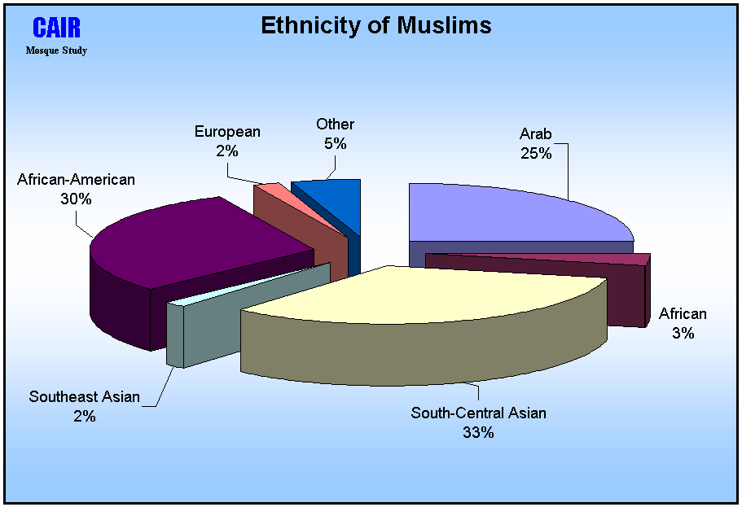
Ethnicity of America’s Estimated 7 Million Muslims
Mosque Study 2001, Council on American-Islamic Relations (CAIR)
http://www.cair-net.org/mosquereport/

Slide 11
Ethnic Breakdown of Regular Mosque Participants
(Total percentage of ethnic group in mosques)
2000 2011
South Asian . . . . . . . . . . . . . . . . . . .33% . . . . . . . . .33%
Arab . . . . . . . . . . . . . . . . . . . . . . ... .25% . . . . . . . . .27%
African American . . . . . . . . . . . .. . .30% . . . . . . . . .24%
African (sub-Saharan) . . . . . . . . . . . .3% . . . . . . . . . .9%
European (Bosnians, etc) . . . . . . . . . .2% . . . . . . . . . .2%
Iranian . . . . . . . . . . . . . . . . . . . . . .... .1% . . . . . . . . . .2%
White American . . . . . . . . . . . . . . . . .2% . . . . . . . . . .1%
Caribbean . . . . . . . . . . . . . . . . . . . . ...1% . . . . . . . . . .1%
Southeast Asian . . . . . . . . . . . . . . .. . .1% . . . . . . . . . .1%
Latino . . . . . . . . . . . . . . . . . . . . . . . ...1% . . . . . . . . . .1%
Turkish . . . . . . . . . . . . . . . . . . . . . .... .1% . . . . . . . . . .1%
Source: The American Mosque 2011: Report Number 1, page 13, http://www.cair.com/Portals/0/pdf/The-American-Mosque-2011-web.pdf

Slide 12
Major Findings of "The American Mosque 2011: Report Number 1 from the US Mosque Study 2011"
• The number of mosques and mosque participants continue to show significant growth. The US Mosque Survey 2011 counted a total of 2,106 mosques; as compared to the year 2000 when 1,209 mosques were counted—representing a 74% increase from 2000.
• Muslims who attend Eid Prayer (the high holiday prayers after Ramadan and Hajj) increased from about 2 million in 2000 to about 2.6 million in 2011. The total Muslim population cannot be determined by this figure, but it does call into question the low estimates of 1.1-2.4 million Muslims in America. If there are 2.6 million Muslims who pray the Eid prayer, then the total Muslim population should be closer to the estimates of up to 7 million.
• The American mosque is a remarkably young institution: over three-fourths (76%) of all existing mosques were established since 1980.
• The vast majority of mosques are located in metropolitan areas but the percentage of mosques in urban areas is decreasing and the percentage of mosques in suburban areas is increasing: in 2000 16% of mosques were located in suburbs and in 2011 28% of mosques are now located in suburbs.
• Mosques remain an extremely diverse institution. Only 3% of mosques have only one ethnic group that attends that mosque. South Asians, Arabs, and African Americans remain the dominant groups but significant numbers of newer immigrants have arrived, including Somalis, West Africans and Iraqis.
• Shi’ite mosques are also expanding in numbers, especially since the 1990s. Over 44% of all Shi’ite mosques were established in the decade of the 1990s.
• The majority of mosque leaders (56%) adopt the more flexible approach of looking to interpretations of Quran and Sunnah (the normative practice of Prophet Muhammad) that take into account the overall purposes of Islamic Law and modern circumstances. Only 11% of mosque leaders prefer the more traditional approach of the classical legal schools of thought—madhhabs. A little over 1% of all mosque leaders follow the salafi way.
• Mosque leaders endorse Muslim involvement in American society. Over 98% of mosque leaders agree that Muslims should be involved in American institutions; and 91% agree that Muslims should be involved in politics.
• The vast majority of mosque leaders do not feel that overall American society is hostile to Islam. Only 25% of mosque leaders in 2011 believe that American society is hostile to Islam. In 2000 the majority of mosque leaders (54%) agreed that American society is hostile to Islam.
http://www.cair.com/Portals/0/pdf/The-American-Mosque-2011-web.pdf

Slide 13
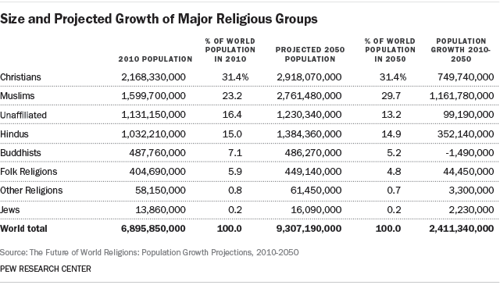
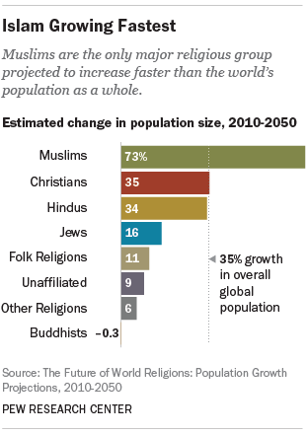
People of no religion outnumber Christians in England and Wales – study, Proportion of population who identify as having no religion rose from 25% in 2011 to 48.5% in 2014, surveys show, http://www.theguardian.com/world/2016/may/23/no-religion-outnumber-christians-england-wales-study

Slide 14
The Quran
  The Quran is the basis of Islamic law and theology
Muslims believe that the Quran is the word of God, revealed to the Prophet Muhammad via the archangel Gabriel, and intended for all times, all places, and all people (as noted in Quran 34:28)
The Quran is the complete collection of the words Muhammad recited to the people and said this is the revelation of God
The Quran was the starting point of all the Islamic sciences. Arabic grammar, phonetics, rhetoric, calligraphy, an so on, were developed for the purpose of understanding, reading, describing, and writing down the Quran
The Quran confirms the Torah and the Gospel/Injeel and refers to the Christians and the Jews by using the honorific term ahl al-kitab (the ‘People of the Book’).
The Quran comprises over 6000 verses (ranging in length from 1 word to 1 page) arranged into 114 suras or sections (ranging in length from 1 line to over 40 pages). The size of the Quran is roughly comparable to that of the Torah (the first five books of the Old Testament) or the Gospels (the four biblical narratives covering the life and death of Jesus Christ, and written, according to tradition, respectively by Matthew, Mark, Luke, and John) of the New Testament (the second part of the Christian Bible).
By one count, the English Christian Bible (which has a little bit over 770,000 words) is TEN TIMES longer than the Arabic Quran (which has a little bit over 77,000 words). But while the Christian Bible includes almost all Christian Scriptures (over 60 Biblical texts), the Quran does not include the Hadith books.

Slide 15
The Quran
  “The Quran is the axial text of a major religious civilization and a major world language. For both Islamic civilization and the Arabic language the Quran consecrates a finality of authority granted to few texts in history. Muslim piety regards the Quran as supremely eloquent, supremely wise, and immune from all error or falsehood. Its immaculate nature extends to its physical copies, which are considered inviolable and untouchable except by one in a state of ritual purity. Good Muslim manners dictate that copies of the Quran cannot be bought, only piously bestowed in return for a pious gift from the buyer. Through the centuries, Islamic art and calligraphy have lavished upon it many of their most enduring and magnificent masterpieces. When recited, it flows with a sonority which common Muslim opinion holds to be capable of causing tears of repentance and comfort or else a shiver of fear and trembling.”—Tarif Khalidi, “Introduction” to The Qur’an: A New Translation, Penguin Classics, 2008.

Slide 16
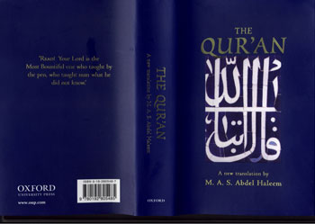
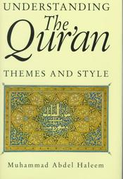
“Do not follow blindly what you do not know to be true: ears, eyes, and heart, you will be questioned about all these” Quran 17:36
“Assumptions can be of no value at all against the Truth” Quran 10:36
“Refrain from following your own desire, so that you can act justly” Quran 4:135
“Lord! We obeyed our masters and our chiefs and they led us astray” Quran 33:67
“None can inform you [Prophet] like the one who is all aware” Quran 35:14
“[Prophet], do not rush to recite before the revelation is fully complete but say, ‘Lord, increase me in knowledge!’” Quran 20:114
“Believers, if a troublemaker brings you news, check it first, in case you wrong others unwittingly and later regret what you have done” Quran 49:6
The translation of The Quran by Abdel Haleem is the one used in these PowerPoint slides

Slide 17
Say, ‘I am only a human being, like you, to whom it has been revealed that your God is One’
“Say [Prophet], ‘If the whole ocean were ink for writing the words of my Lord, it would run dry before those words were exhausted’—even if We were to add another ocean to it. Say, ‘I am only a human being, like you, to whom it has been revealed that your God is One’—anyone who fears to meet his Lord should do good deeds and give no one a share in the worship due to his Lord.” Quran 18:109-110

Slide 18
I lived a whole lifetime among you before it came to me
“Say, ‘If God has so willed, I would not have recited it to you, nor would He have made it known to you. I lived a whole lifetime among you before it came to me. How can you not understand?” Quran10:16

Slide 19
We sent to you [Muhammad] the Scripture with the truth, confirming the Scriptures that came before it
“We sent to you [Muhammad] the Scripture with the truth, confirming the Scriptures that came before it, and with final authority over them: so judge between them according to what God has sent down. Do no follow their whims, which deviate from the truth that has come to you. We have assigned a law and a path to each of you. If God has so willed, He would have made one community, but He wanted to test you through that which He has given you, so race to do good: you will all return to God and He will make clear to you the matters you differed about.” Quran 5:48

Slide 20
We tell you [Prophet] the best of stories
“We tell you [Prophet] the best of stories in revealing this Quran to you. Before this you were one of those who knew nothing about them” Quran 12:3

Slide 21
Examples of Prophets and Messengers mentioned in the Quran
"We said, 'Adam, live with your wife in this garden. Both of you eat freely there as you will, but do not go near this tree, or you will both become wrongdoers'." Quran 2:35
"And it was said, 'Noah, descend in peace from Us, with blessings on you and on some of the communities that will spring from those who are with you'." Quran 11:48
"We called out to him, 'Abraham, you have fulfilled the dream.' This is how We reward those who do good--it was a test to prove [their characters]." Quran 37:104-106
"'Moses! Draw near! Do not be afraid, for you are one of those who are safe'." Quran 28:31
"God said, 'Jesus, I will take you back and raise you up to Me: I will purify you of the disbelievers. To the Day of Resurrection I will make those who followed you superior to those who disbelieved you. Then you will all return to Me and I will judge between you regarding your differences." Quran 3:55
“Muhammad is only a messenger before whom many messengers have been and gone. If he died or was killed, would you revert to your old ways? If anyone did so, he would not harm God in the least. God will reward the grateful.” Quran 3: 144.

Slide 22
If we had sent this Quran down to a mountain
“If we had sent this Quran down to a mountain, you [Prophet] would have seen it humbled and split apart in its awe of God: We offer people such imagery so that they may reflect” Quran 59:21
God has sent down the most beautiful of all teachings
“God has sent down the most beautiful of all teachings: a Scripture that is consistent and draws comparisons; that causes the skins of those in awe of their Lord to quiver. Then their skins and their hearts soften at the mention of God: such is God’s guidance. He guides with it whoever He will; no one can guide those God leaves to stray” Quran 39:23

Slide 23
We have sent the Scripture down to you explaining everything
“We have sent the Scripture down to you explaining everything, and as guidance and mercy and good news to those who submit to God” Quran 16:89

Slide 24
They could not produce anything like it
“Say, ‘Even if all mankind and jinn [unseen beings] came together to produce something like this Quran, they could not produce anything like it, however much they helped each other” Quran 17:82

Slide 25
This Quran does indeed show the straightest way
“This Quran does indeed show the straightest way. It gives the faithful who do right the good news that they will have a great reward” Quran 17:9

Slide 26
We have made it easy to learn lessons from the Quran
“We have made it easy to learn lessons from the Quran: will anyone take heed?” Quran 54:17

Slide 27
God commands justice
“God commands you [people] to return things entrusted to you to their rightful owners, and, if you judge between people, to do so with justice: God’s instructions to you are excellent, for He hears and sees everything.” Quran 4:58
“You who believe, uphold justice and bear witness to God, even if it is against yourselves, your parents, or your close relatives. Whether the person is rich or poor, God can best take care of both. Refrain from following your own desire, so that you can act justly—if you distort or neglect justice, God is fully aware of what you do.” Quran 4:135
“You who believe, be steadfast in your devotion to God and bear witness impartially: do not let hatred of others lead you away from justice, but adhere to justice, for that is closer to awareness of God. Be mindful of God: God is well aware of all that you do.” Quran 5:8
“God commands justice, doing good, and generosity towards relatives and He forbids what is shameful, blameworthy, and oppressive. He teaches you, so that you may take heed.” Quran 16:90
“God may still bring about affection between you and your present enemies—God is all powerful, God is most forgiving and merciful— 8 and He does not forbid you to deal kindly and justly with anyone who has not fought you for your faith or driven you out of your homes: God loves the just. 9 But God forbids you to take as allies those who have fought against you for your faith, driven you out of your homes, and helped others to drive you out: any of you who take them as allies will truly be wrongdoers.” Quran 60:7-9
Prophet Muhammad said: "I am only a human being, and you (people) bring your disputes to me. May be some of you are more eloquent/persuasive in their plea than others, I give judgement on their behalf according to what I hear from them. Therefore, if I give (by error) somebody something which by right belongs to his brother, he must NOT take it for I have only given him a piece of Fire." Sahih Muslim and Sahih Bukhari…. [In this hadith, the Prophet is indicating that no matter how just judges might be, they are only human beings whose rulings could be influenced by the presentation of the case of any of the parties. He is also reminding those who might be given (by error) something which by right belongs to others, that judge rulings would not make permissible what God had prohibited].
“Say [Prophet], ‘I have no control over benefit or harm, [even] to myself, except as God may please: if I had knowledge of what is hidden, I would have abundant good things and no harm could touch me. I am no more than a bearer of warning, and good news to those who believe’” Quran 7:188

Slide 28
Those who have been attacked are permitted to take up arms
“Those who have been attacked are permitted to take up arms because they have been wronged—God has the power to help them—those who have been driven unjustly from their homes only for saying, ‘Our Lord id God.’ If God did not repel some people by means of others, many monasteries, churches, synagogues, and mosques, where God’s name is much invoked, would have been destroyed. God is sure to help those who help His cause –God is strong and mighty.” Quran 22:39-40
“Fighting has been ordained for you, though it is hard for you. You may dislike something although it is good for you, or like something although it is bad for you: God knows and you do not. They ask you [Prophet] about fighting in the sacred month. Say, ‘Fighting in that month is a great offence, but to bar others from God’s path, to disbelieve in Him, prevent access to the Sacred Mosque, and expel its people, are still greater offences in God’s eyes: persecution is worse than killing.” Quran 2:216-217
“Believers, when you meet the disbelievers in battle, never turn your backs on them: if anyone does so on such a day—unless manœuvering to fight or to join a fighting group—he incurs the wrath of God, and Hell will be his home, a wretched destination!” Quran 8:15-16
“Prophet, God is enough for you, and for the believers who follow you. Prophet, urge the believers to fight: if there are twenty of you who are steadfast, they will overcome two hundred, and a hundred of you, if steadfast, will overcome a thousand of the disbelievers, for they are people who do not understand. Bu God has lightened your burden for now, knowing that there is weakness in you—a steadfast hundred of you will defeat two hundred and a steadfast thousand of you will defeat two thousand, by God’s permission: God is with the steadfast.” Quran 8:64-66
“Do you consider giving water to pilgrims and tending the Sacred Mosque to be equal to the deeds of those who believe in God and the Last Day and who strive in God’s path? They are not equal in God’s eyes. God does not guide such benighted people. Those who believe, who migrated and strove hard in God’s way with their possessions and their persons, are in God’s eyes much higher in rank; it is they who will triumph; and their Lord gives them the good news of His mercy and pleasure, Gardens where they will have lasting bliss and where they will remain for ever: truly, there is a tremendous reward with God.” Quran 9:19-22

Slide 29
Fight in God’s cause against those who fight you, but do not overstep the limits
“Fight in God’s cause against those who fight you, but do not overstep the limits: God does not love those who overstep the limits.” Quran 2:190
“Your Lord has revealed to the angels: ‘I am with you: give the believers firmness: I shall put fear into the hearts of the disbelievers—strike above the neck and strike all their fingers.” Quran 8:12
“When you meet the disbelievers in battle, strike them in the neck, and once they are defeated, bind any captives firmly—later you can release them as a grace or for ransom—until the toils of war have ended.” Quran 47:4

Slide 30
“if anyone kills a person—unless in retribution for murder or spreading corruption in the land—it is as if he kills all mankind, while if any saves a life it is as if he saves the lives of all mankind” Quran 5:32
Prophet Muhammad said: “Whoever killed a Mu'ahid (a person who is granted the pledge of protection by the Muslims) shall not smell the fragrance of Paradise though its fragrance can be smelt at a distance of forty years (of traveling).” Sahih Bukhari
Prophet Muhammad said: “The best jihad ['jihad' means human effort, struggle, or striving to promote what is right, to prevent what is wrong, and to be a better person or to defend the community] is a word of truth flung in the face of a tyrant." Sunan Ibn Majeh
Article 51 of the United Nations Charter: “Nothing in the present Charter shall impair the inherent right of individual or collective self-defence if an armed attack occurs against a Member of the United Nations, until the Security Council has taken measures necessary to maintain international peace and security. Measures taken by Members in the exercise of this right of self-defence shall be immediately reported to the Security Council and shall not in any way affect the authority and responsibility of the Security Council under the present Charter to take at any time such action as it deems necessary in order to maintain or restore international peace and security.” https://legal.un.org/repertory/art51.shtml

Slide 31
Quran 9 was revealed when the Hudaybiya Treaty between Prophet Muhammad and the Quraysh tribe of Mecca was broken by the Beni Bakr tribe (allied with Quraysh) who attacked the Khuzaa tribe (allied with Prophet Muhammad)
“1 A release by God and His Messenger from the treaty you [believers] made with the idolaters [is announced]—2 you [idolaters] may move freely about the land for four months, but you should bear in mind both that you will not escape God, and that God will disgrace those who defy [Him]. 3 On the Day of the Great Pilgrimage [there will be] a proclamation from God and His Messenger to all people: ‘God and His Messenger are released from [treaty] obligations to the idolaters. It will be better for you [idolaters] if you repent; know that you cannot escape God if you turn away.’ [Prophet], warn those who ignore [God] that they will have a painful punishment. 4 As for those idolaters who have honoured the treaty you [believers] made with them and who have not supported anyone against you: fulfil your agreement with them to the end of their term. God loves those who are mindful of Him. 5 When the [four] forbidden months are over, whenever [inside and outside the Sanctuary in Makkah] you encounter the idolaters, kill them, seize them, besiege them, wait for them at every lookout post; but if they repent, maintain the prayer, and pay the prescribed alms, let them go on their way, for God is most forgiving and merciful. 6 If anyone of the idolaters should seek your protection [Prophet], grant it to him so that he may hear the word of God, then take him to a place safe for him, for they are people who do not know.” Quran 9:1—6
“God has purchased the persons and possessions of the believers in return for the Garden—they fight in God’s way: they kill and are killed—this is a true promise given by Him in the Torah, the Gospel, and the Quran. Who could be more faithful to his promise than God? So be happy with the bargain you have made: that is the supreme triumph.” Quran 9:111

Slide 32
Examples of Biblical warfare narrative
"You must destroy all the peoples the Lord your God gives over to you. Do not look on them with pity and do not serve their gods, for that will be a snare to you." Deuteronomy 7:16
"When you march up to attack a city, make its people an offer of peace. 11 If they accept and open their gates, all the people in it shall be subject to forced labor and shall work for you. 12 If they refuse to make peace and they engage you in battle, lay siege to that city. 13 When the Lord your God delivers it into your hand, put to the sword all the men in it. 14 As for the women, the children, the livestock and everything else in the city, you may take these as plunder for yourselves. And you may use the plunder the Lord your God gives you from your enemies. 15 This is how you are to treat all the cities that are at a distance from you and do not belong to the nations nearby. 16 However, in the cities of the nations the Lord your God is giving you as an inheritance, do not leave alive anything that breathes. 17 Completely destroy[a] them—the Hittites, Amorites, Canaanites, Perizzites, Hivites and Jebusites—as the Lord your God has commanded you. 18 Otherwise, they will teach you to follow all the detestable things they do in worshiping their gods, and you will sin against the Lord your God." Deuteronomy 20:10-18
“When the trumpets sounded, the army shouted, and at the sound of the trumpet, when the men gave a loud shout, the wall collapsed; so everyone charged straight in, and they took the city. 21 They devoted the city to the Lord and destroyed with the sword every living thing in it—men and women, young and old, cattle, sheep and donkeys.” Joshua 6:20-21
"That day Joshua took Makkedah. He put the city and its king to the sword and totally destroyed everyone in it. He left no survivors. And he did to the king of Makkedah as he had done to the king of Jericho." Joshua 10:28
“Do not seek revenge or bear a grudge against anyone among your people, but love your neighbor as yourself. I am the Lord.” Leviticus 19:18
“But I tell you, do not resist an evil person. If anyone slaps you on the right cheek, turn to them the other cheek also.” Matthew 5:39

Slide 33
Examples of punishment for sexual sin in the Bible and the Quran
“‘If a man commits adultery with another man’s wife—with the wife of his neighbor—both the adulterer and the adulteress are to be put to death.'" Bible, Leviticus 20:10
“‘If a man has sexual relations with a man as one does with a woman, both of them have done what is detestable. They are to be put to death; their blood will be on their own heads.'" Bible, Leviticus 20:13
"Strike the adulteress and the adulterer one hundred times. Do not let compassion for them keep you from carrying out God's law--if you belief in God and the last Day--and ensure that a group of believers witness the punishment." Quran 24:2
"If any of your women commit a lewd act, call four witnesses from among you, then, if they testify to their guilt, keep the women at home until death comes to them or until God shows them another way. If two men commit a lewd act, punish them both; if they repent and mend their ways, leave them alone--God is always ready to accept repentance, He is full of mercy. But God only undertakes to accept repentance from those who do evil out of ignorance and soon afterwards repent: these are the ones God will forgive, He is all knowing, all wise. It is not true repentance when people continue to do evil until death confronts them and then say, 'Now I repent,' nor when they die defiant: We have prepared a painful torment for these." Quran 4:15-18

Slide 34
Consult with them about matters & Give what you can spare
“By an act of mercy from God, you [Prophet] were gentle in your dealings with them—had you been harsh, or hard-hearted, they would have dispersed and left you—so pardon them and ask forgiveness for them. Consult with them about matters, then, when you have decided on a course of action, put your trust in God: God loves those who put their trust in Him” Quran 3:159.
“What you have been given is only the fleeting enjoyment of this world. Far better and more lasting is what God will give to those who believe and trust in their Lord; who shun great sins and gross indecencies; who forgive when they are angry; respond to their Lord; keep up the prayer; conduct their affairs by mutual consultation; give to others out of what We have provided for them; and defend themselves when they are oppressed. Let harm be requited by an equal harm, though anyone who forgives and puts things right will have his reward from God Himself---He does not like those who do wrong. There is no cause to act against anyone who defends himself after being wronged. But there is cause to act against those who oppress people and transgress in the land against all justice---they will have an agonizing torment---though if a person is patient and forgives, this is one of the greatest things.” Quran 42:36-43
“They ask you [Prophet] about intoxicants and gambling: say, ‘There is great sin in both, and some benefit for people: the sin is greater than the benefit.’ They ask you what they should give: say, ‘Give what you can spare.’ In this way, God makes His messages clear to you, so that you may reflect on this world and the next.” Quran 2:219-220
“You who believe, give charitably from the good things you have acquired and that We have produced for you from the earth. Do not give away the bad things that you yourself would only accept with your eyes closed: remember that God is self-sufficient, worthy of all praise. Satan threatens you with the prospect of poverty and commands you to do fool deeds; God promises you His forgiveness and His abundance: God is limitless and all knowing, and He gives wisdom to whoever He will. Whoever is given wisdom has truly been given much good, but only those with insight bear this in mind.” Quran 2:267-269
“None of you [believers] will attain true piety unless you give out of what you cherish: whatever you give, God knows about it very well.” Quran 3:92

Slide 35
Be Tolerant
“Be tolerant and command what is right: pay no attention to foolish people” Quran 7:199
“There is no compulsion in religion” Quran 2:256
“You have your religion and I have mine” Quran 109:6
Prophet Muhammad warned his companions about people similar to those often referred to today as 'fundamentalists' or 'extremists' or 'terrorists':
It was reported in a number of Hadith books that a man (named Dhul-Khuwaysirah al-Tamimi) accused Prophet Muhammad publically for being 'unjust' when he included four tribal chiefs 'whose hearts need winning over' in the list of alms recipients [see Quran 9:60, slide 87; see also the reference to the 'Hypocrites' in Quran 9:58-59 and Quran 63:1-11]. When one of Prophet Muhammad's companions asked permission to harm/kill the man (Dhul-Khuwaysirah al-Tamimi), Prophet Muhammad ordered him to leave the man alone. When the man left, Prophet Muhammad said to his companions this man has followers and people of that ilk whose offspring "will recite the Quran continuously and elegantly but it will not pass their throats [it will never reach their hearts]. You would regard your prayer as insignificant in comparison to their prayer, and you would regard your fasting as insignificant in comparison to their fasting. They will pass out of Islam [leave Islam] as an arrow passes out of the prey." Sahih Bukhari and Sahih Muslim

Slide 36
Those Who Believe and Do Good Deeds
“Those who believe, do good deeds, keep up the prayer, and pay the prescribed alms will have their reward with their Lord: no fear for them, nor will they grieve” Quran 2:277
The Quran emphasizes the importance of combining “belief/faith” with “righteous deeds” in dozens of verses such as Quran 2:25, 82, 277; Quran, 3:57; Quran 4:57, 122, 173; Quran5:9, 93, etc.…..
The Hadith also emphasizes the importance of ‘intention’ when acting. Prophet Muhammad said: “Actions are only according to intentions, and to each only what he intended.” Sahih Bukhari

Slide 37
There truly are signs in the creation of the heavens and earth
“There truly are signs in the creation of the heavens and earth, and in the alteration of night and day, for those with understanding, who remember God standing, sitting, and lying down, who reflect on the creation of the heavens and earth: Our Lord! You have not created all this without purpose—You are far above that!—so protect us from the torment of the Fire” Quran 3:190-191
“Have you [Prophet] not seen how God sent water down from the sky and that We produce with it fruits of varied colors; that there are in the mountains layers of white and red of various hues, and jet black; that there are various colors among human beings, wild animals, and livestock too? It is those of His servants who have knowledge who stand in true awe of God. God is almighty, most forgiving.” Quran 35:27-28

Slide 38
Goodness does not consist in turning your face towards East or West
“Goodness does not consist in turning your face towards East or West. The true good are those who believe in God and the Last Day, in the angels, the Scripture, and the prophets; who give away some of their wealth, however much they cherish it, to their relatives, to orphans, the needy, travellers and beggars, and to liberate those in bondage; those who keep up the prayer and pay the prescribed alms; who keep pledges whenever they make them; who are steadfast in misfortune, adversity, and times of dangers. These are the ones who are true, and it is they who are aware of God.” Quran 2:177

Slide 39
When you converse in secret, do not do so in a way that is sinful
“You who believe, when you converse in secret, do not do so in a way that is sinful, hostile, and disobedient to the Messenger, but in a way that is good and mindful [of God].” Quran 58:9

Slide 40
The garment of God-consciousness is the best of all garments
“Children of Adam, We have given you garments to cover your nakedness—and as adornment for you; the garment of God-consciousness is the best of all garments—this is one of God’s signs, so that people may take heed” Quran 7:26
“Prophet, tell your wives, your daughters, and women believers to make their outer garments hang low over them so as to be recognized and not insulted: God is most forgiving, most merciful” Quran 33:59
“[Prophet], tell believing men to lower their eyes and guard their private parts: that is purer for them. God is well aware of everything they do. And tell believing women that they should lower their eyes, guard their private parts, and not display their charms beyond what [it is acceptable] to reveal; they should draw their coverings over their necklines and not reveal their charms except to their husbands, their fathers, their husbands’ sons, their brothers, their brothers’ sons, their sisters’ sons, their womenfolk, their slaves, such men as attend them who have no desire, or children who are not yet aware of women’s nakedness; they should not stamp their feet so as to draw attention to any hidden charms. Believers, all of you, turn to God so that you may prosper.” Quran 24:30-31

Slide 41
Avoid committing sin, whether openly or in secret
“Avoid committing sin, whether openly or in secret, for those who commit sin will be repaid for what they do” Quran 6:120
“Whoever has done an atom’s-weight of good will see it, but whoever has done an atom’s-weight of evil will see that” Quran 99:7-8

Slide 42
The life of this world is only an illusory pleasure
“Bear in mind that the present life is just a game, a diversion, and attraction, a cause of boasting among you, of rivalry in wealth and children. It is like plants that spring up after the rain: their growth at first delights the sowers, but then you see them wither away, turn yellow, and become stubble. There is terrible punishment in the next life as well as forgiveness and approval from God; the life of this world is only an illusory pleasure. So race for your Lord’s forgiveness and a Garden as wide as the heavens and earth, prepared for those who believe in God and His messengers: that is God’s bounty, which He bestows on whoever He pleases. God’s bounty is infinite. ” Quran 57:21-22

Slide 43
Whoever has done a good deed will have it ten times to his credit
“Whoever has done a good deed will have it ten times to his credit, but whoever has done a bad deed will be repaid only with its equivalent—they will not be wronged” Quran 6:160

Slide 44
Good and evil cannot be equal
“Good and evil cannot be equal. [Prophet], repel evil with what is better and your enemy will become as close as an old and valued friend, but only those who are steadfast in patience, only those who are blessed with great righteousness, will attain to such goodness. If a prompting from Satan should stir you, seek refuge with God: He is the All Hearing and the All Knowing” Quran 41:34-36

Slide 45
A good word is like a good tree
“[Prophet], do you not see how God makes comparisons? A good word is like a good tree whose root is firm and whose branches are high in the sky, yielding constant fruit by its Lord’s leave—God makes such comparisons for people so that they may reflect—but an evil word is like a rotten tree, uprooted from the surface of the earth, with no power to endure” Quran 14:24-26

Slide 46
But [even in a battle] when you are offered a greeting, respond with a better one, or at least return it
“Whoever speak for a good cause will share in its benefits and whoever speaks for a bad cause will share in its burden: God controls everything. But [even in a battle] when you [believers] are offered a greeting, respond with a better one, or at least return it: God keeps account of everything” Quran 4:85-86

Slide 47
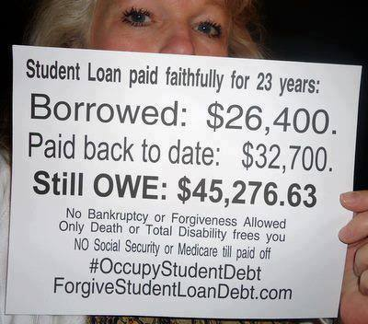
Prohibition of usury in the Quran and the Bible
“Whatever you lend out in usury to gain value through other people’s wealth will not increase in God’s eyes, but whatever you give in charity, in your desire for God’s countenance, will earn multiple rewards” Quran 30:39
“You who believe, do not consume usurious interest, doubled and redoubled. Be mindful of God so that you may prosper” Quran 3:130
“But those who take usury will rise up on the Day of Resurrection like someone tormented by Satan’s touch. That is because they say, ‘Trade and usury are the same,’ but God has allowed trade and forbidden usury. Whoever, on receiving God’s warning, stops taking usury may keep his past gains—God will be his judge—but whoever goes back to usury will be an inhabitant of the Fire, there to remain. God blights usury, but blesses charitable deeds with multiple increase: He does not love the ungrateful sinner. You who believe, beware of God: give up any outstanding dues from usury, if you are true believers. If you do not, then be warned of war from God and His Messenger. You shall have your capital if you repent, and without suffering loss or causing others to suffer loss. If the debtor is in difficulty, then delay things until matters become easier for him; still, if you were to write it off as an act of charity, that would be better for you, if only you knew.” Quran 2:275-80
“If you lend money to one of my people among you who is needy, do not treat it like a business deal; charge no interest.“ Exodus 22:25
“If any of your fellow Israelites become poor and are unable to support themselves among you, help them as you would a foreigner and stranger, so they can continue to live among you. Do not take interest or any profit from them, but fear your God, so that they may continue to live among you. You must not lend them money at interest or sell them food at a profit.” Leviticus 25:35-37
“Do not charge a fellow Israelite interest, whether on money or food or anything else that may earn interest. You may charge a foreigner interest, but not a fellow Israelite, so that the Lord your God may bless you in everything you put your hand to in the land you are entering to possess. Deuteronomy 23:19-20 (Bible Gateway)
“19 You shall not charge interest to your brother—interest on money or food or anything that is lent out at interest. 20 To a foreigner you may charge interest, but to your brother you shall not charge interest” Deuteronomy 23:19-20 (Bible, Gideon)
“20 You shall not deduct interest from loans to your countrymen, whether in money or food or anything else that can be deducted as interest; 21 but you may deduct interest from loans to foreigners.” Deuteronomy 23:20-21 (The Jewish Bible)
“[He] who has never lent money at interest, or accepted a bribe against the innocent. The man who acts thus shall never be shaken.” Psalms 15:5 (The Jewish Bible)
“The rich rule over the poor, And the borrower is a slave to the lender.” Proverb 22:7 (The Jewish Bible)
40% of Americans can't cover a $400 emergency expense, CNN, 5/22/2018, https://money.cnn.com/2018/05/22/pf/emergency-expenses-household-finances/index.html
USURY – All usury was banned by Christian doctrine, as it was by Muslim doctrine. In the late Middle Ages the problem of financing the royal exchequer and setting up capitalist institutions in the face of the Christian ban on usury was resolved by allowing Jews to act as bankers. Truth In Media, 6/13/2015, https://truthinmedia.net/2015/06/13/usury-and-treaties-based-on-humiliation-dont-work/
The Torah, the Gospel, the Quran, and Greek and Roman thinkers had strong warnings against the “virus” of usury, which “is not in money itself… but rather in the hearts of people.” Valentine Katasonov, Interest: Loan, Justiciable, Reckless, Denver: Outskirt Press, 2015, p 32-33

Slide 48
Joseph's Dreams in the Quran and the Bible
Quran 12:4-7, 111
Genesis 37:5-11
4 Joseph said to his father, ‘Father, I dreamed of eleven stars and the sun and the moon: I saw them all bow down before me,’ 5 and he replied, ‘My son, tell your brothers nothing of this dream, or they may plot to harm you—Satan is man’s sworn enemy. 6 Your Lord will choose you, teach you to interpret dreams, and perfect His blessing on you and the House of Jacob, just as He perfected it earlier on your forefathers Abraham and Isaac: Your Lord is all knowing and wise.’ 7 There are lessons in the story of Joseph and his brothers for all who seek them… 111 There is a lesson in the stories of such people for those who understand. This revelation is no fabrication: it is a confirmation of the truth of what was sent before it; an explanation of everything; a guide and blessing for those who believe
NB: Quran 12: about 4,000 words
5 Joseph had a dream, and when he told it to his brothers, they hated him all the more. 6 He said to them, "Listen to this dream I had: 7 We were binding sheaves of grain out in the field when suddenly my sheaf rose and stood upright, while your sheaves gathered around mine and bowed down to it."
8 His brothers said to him, "Do you intend to reign over us? Will you actually rule us?" And they hated him all the more because of his dream and what he had said.
9 Then he had another dream, and he told it to his brothers. "Listen," he said, "I had another dream, and this time the sun and moon and eleven stars were bowing down to me."
10 When he told his father as well as his brothers, his father rebuked him and said, "What is this dream you had? Will your mother and I and your brothers actually come and bow down to the ground before you?" 11 His brothers were jealous of him, but his father kept the matter in mind.
NB: Genesis 37-50: about 11,000 words

Slide 49


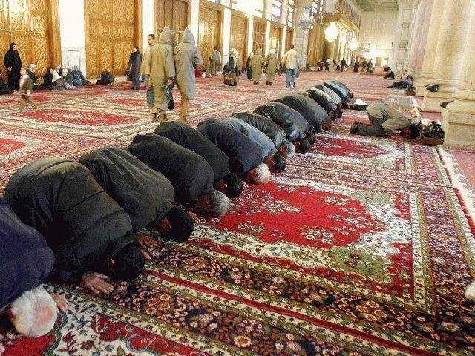
Be wary of the limits to Quran translation
For example, the Arabic word “sujood” in the Quran is widely translated to English as “prostration.” However, the words “sujood” and “prostration” refer to two different situations:
Sujood: A position of conscious surrender to God in the Muslim prayer in which the forehead (and the nose), the hands, the knees, and the toes all touch the ground
Prostration: An abrupt failure of function or complete physical exhaustion… Abject submission; the emotional equivalent of prostrating your body… The process of being made powerless or the condition of powerlessness
The Free Dictionary

Slide 50
Timeline of the Life of Muhammad http://www.pbs.org/muhammad/timeline_html.shtml
570 Muhammad's Birth and Infancy
575 Muhammad Becomes an Orphan
578 Muhammad in Mecca in Care of an Uncle
580-594 Muhammad's Teens
594 Muhammad Acts as Caravan Agent for Wealthy Tradeswoman, Khadija
595-609 Muhammad's Marriage and Family Life
610 Muhammad Receives First Revelation
613 Muhammad Takes his Message Public
622 Muhammad and the Muslims Emigrate to Medina
625-628 The Military Period
630 The Conquest of Mecca
630-632 Muhammad's Final Years

Slide 51
About Prophet Muhammad
“Say [Prophet], ‘I am only a human being, like you, to whom it has been revealed that your God is One’—anyone who fears to meet his Lord should do good deeds and give no one a share in the worship due to his Lord.” Quran 18:110
“God has been truly gracious to the believers in sending them a Messenger from among their own, to recite His revelations to them, to make them grow purity, and to teach them the Scripture and wisdom—before that they were clearly astray”---Quran 3:164
“The Messenger of God is an excellent model for those of you who put your hope in God and the Last Day and remember Him often”---Quran 33:21
“Truly you have a noble character.” Quran 68:4
“It was only as a mercy that We sent you [Prophet] to all people.” Quran 21:107
Quran 33:40 refers to Muhammad as “God’s Messenger and the seal of the prophets.”
Quran 7:157 refers to Muhammad as “the Messenger—the unlettered prophet they find described in the Torah that is with them, and in the Gospel—who commands them to do right and forbids them to do wrong, who makes good things lawful to them and bad things unlawful, and relieves them of their burdens, and the iron collars that were on them. So it is those who believe him, honour and help him, and follow the light which has been sent down with him, who will succeed.”
“His morals were (nothing but) Qur’an.”---Prophet Muhammad’s wife Aisha
Prophet Muhammad “was the only man in history who was supremely successful on both the religious and secular levels” —Michael H. Hart, The 100: A Ranking of the Most Influential Persons in History, Citadel, 1978, 1992, 2000.
"He was neither tall and lanky, nor short and heavy set. When he looked at someone he looked them in the eyes. He was the most generous hearted of men, the most truthful of them in speech, the most mild tempered of them and the noblest of them in lineage. Anyone who would describe him would say I never saw before or after him the like of him”---Muhammad, described by a contemporary
“He remains, I think, more than anything else a great role model”---M. Cherif Bassiouni
Prophet Muhammad’s “life was a tireless campaign against greed, injustice, and arrogance”… “He felt very, very strongly identified with the poor and disadvantaged for the rest of his life”--- Karen Armstrong
“The beauty of it is, we live our lives through his examples, but he's not God. Our reverence is to God. And our reference is to him [Prophet Muhammad]”---Najah Bazzy
"Prophet Muhammad was a man, he was flesh and blood, who brought one of the most eloquent revelations to mankind. He’s set an example to mankind through his behavior, through his actions, a living example." Kevin James
"This man has unified people. He has taught them monotheism. He has brought them to peace." Michael Wolfe
Muhammad "did everything within his power to prevent himself from being worshipped. Because he recognized that that was a danger inherent in religious tradition. That the object of worship becomes the messenger, and not, uh, the one sending the message." Hamza Yusuf
“Muhammad is the kind of person who combines political and military and social and religious and intellectual dimensions of life in ways that are important for those of us in the 21st century who are struggling to put together complete lives ourselves”---John Voll

Slide 52
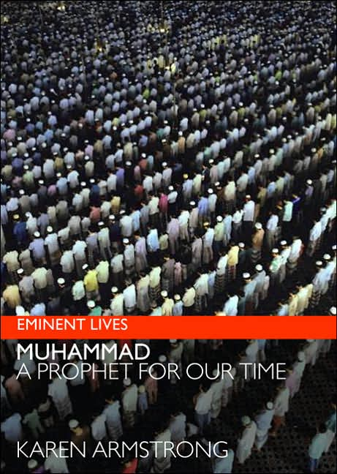
Muhammad was born in 570 CE, and over the following sixty years built a thriving spiritual community, laying the foundations of a religion that changed the course of world history. There is more historical data on his life than on that of the founder of any other major faith, and yet his story is little known.
Karen Armstrong's immaculately researched new biography of Muhammad will enable readers to understand the true origins and spirituality of a faith that is all too often misrepresented as cruel, intolerant, and inherently violent. An acclaimed authority on religious and spiritual issues, Armstrong offers a balanced, in-depth portrait, revealing the man at the heart of Islam by dismantling centuries of misconceptions. Armstrong demonstrates that Muhammad's life—a pivot point in history—has genuine relevance to the global crises we face today.

Slide 53
Mohammed is now the third most popular boy's name in England. So why this shabby effort to conceal it?
Daily Mail, 9/10/2009 http://www.dailymail.co.uk/debate/columnists/article-1212368/Mohammed-popular-boys-England-So-shabby-effort-conceal-it.html#
“This week, the Office of National Statistics published a list of the most popular boys' names in Britain: Jack, Oliver, Thomas, Harry, Joshua, Alfie, Charlie, Daniel.
They reflect a cultural tradition as old as the nation's history, and would provoke approving nods from Jack the Ripper, Oliver Cromwell, Thomas Becket and Harry Hotspur.
There is just one small problem: the list is deceitful. In reality, the third most popular choice for boy children born last year in England and Wales was not Thomas, but Mohammed.
The ONS explains blithely that it had no intent to deceive. Its normal practice is to catalogue different spellings separately, as in Mohammed, Muhammed and so on.
But if you add these variants together, as surely seems logical, then Mohammed is right up there, near the top of the list.
Unfortunately, in recent times we have been given plentiful cause for paranoia about attempts by official bodies to conceal from us information about the changing face of Britain which our rulers know that many people will not like.”

Slide 54
American University of Beirut Professor of History Kamal Salibi argues that to read and understand the consonantal Hebrew Bible, Arabic is better equipped than the academically derived and never spoken language of Rabbinical Hebrew [let alone Israeli Hebrew]
Was Prophet Mohamed mentioned by name or described in the Bible?
While the English translation of the Bible does not seem to have Prophet Mohamed mentioned or described in the Torah and the Gospel, the Quran states that Prophet Mohamed is described in both the Torah and the Gospel/Injeel:
“God said, ‘I bring My punishment on whoever I will, but My mercy encompasses all things. I shall ordain My mercy for those who are conscious of God and pay the prescribed alms; who believe in Our Revelations; who follow the Messenger—the unlettered prophet they find described in the Torah that is with them, and in the Gospel—who commands them to do right and forbids them to do wrong, who makes good things lawful to them and bad things unlawful, and relieves them of their burdens, and the iron collars that were on them. So it is those who believe him, honour and help him, and who follow the light which has been sent down with him, who will succeed” Quran 7:156-157
“Jesus, son of Mary, said, ‘Children of Israel, I am sent to you by God, confirming the Torah that came before me and bringing good news of a messenger to follow me whose name will be Ahmad” Quran 61:6. NB: [Ahmad, like Muhammad, means ‘praised’ or ‘beloved’ for his good character]
“Some of them were uneducated, and know the Scripture only through wishful thinking. They rely on guesswork. So woe to those who write the Scripture with their own hands and then claim, ‘This is from God,’ in order to make some small gain. Woe to them for what their hands have written! Woe to them for all that they have earned” Quran 2:78-79.
Could Quran 2:78-79 (7th century AD) be referring to the translation, interpretation, and vocalization of the received consonantal Hebrew Bible by the Babylonian and Palestinian Masoretes as well as those who produced the Septuagint in Hellenistic Alexandria between the 6th and 10th centuries A.D?
Professor Salibi considers both Rabbinical Hebrew and Israeli Hebrew as derivative languages, which “provide no key for unraveling the mysteries of the Biblical Hebrew from which they were academically derived.” He stresses that the received consonantal Hebrew Bible has been “consistently mistranslated” and those involved in its interpretation and vocalization between the sixth and tenth centuries A.D. “did not know Hebrew as a spoken language” because it had passed out of common usage about 1000 years earlier. Therefore the Hebrew Bible was essentially redacted, compiled, and in some cases authored by scholars and writers (such as the Babylonian and Palestinian Masoretes as well as those who produced the Septuagint in Hellenistic Alexandria) whose day-to-day language was not Biblical Hebrew. Naturally those writers faced many problems of interpretation and vocalization while they worked hard to avoid committing the sacrilege of altering the received consonantal spelling of the Hebrew Bible. This is why the Masoretes often resorted to producing notes advising that some words are “written but not to be read” (kethiybh we lo’qerey) whereas other words are “to be read but not written” (qerey we lo’ kethiybh). Salibi concludes that to read and understand the consonantal Hebrew Bible, Arabic is better equipped than the academically derived and never spoken language of Rabbinical Hebrew (let alone Israeli Hebrew). Sources: K. Salibi, The Historicity of Biblical Israel: Studies in 1 & 2 Samuel, London: NABU Publications, 1998, pages 5, 6, and 16. K. Salibi, The Bible Came from Arabia, London: Jonathan Cape, 1985, page 3.
“The bridegroom in the Song of Songs [5:16] was interpreted in the Targums as the Messiah”---Sigmund Mowinckel, He That Cometh: The Messiah Concept in the Old Testameent and Later Judaism, Translated by G. W. Anderson, William B. Eerdmans Publishing Company, Grand Rapids Michigan/CAmbridge, U.K., 2005, page 283.
Watch the following 2 video clips & see whether they might be indicative of the points made by the Quran, by Professor Salibi, and by Mowinckel. One of the clips indicates that Muhammad was mentioned by name in the Hebrew Bible (Song of Solomon 5:16), but his name was translated to other languages as a word (instead of keeping it as a proper name):
https://www.youtube.com/watch?v=cur_6aYs_7k
http://www.youtube.com/watch?v=lS2m0OomSDk

Slide 55
St. Paul’s Trip to Arabia
“I did not go to anyone for advice, nor did I go to Jerusalem to see those who were apostles before me. Instead, I went at once to Arabia and then I returned to Damascus.” Galatians 1:16-17
“In his epistle to the Galatians, Paul himself asserts that his career as an apostle of Christ started with a trip to Arabia, roundly denying the truth of what other people were saying in his own time about the matter. According to the book of Acts, Paul began his apostolic career with a visit to Jerusalem, which was clearly untrue. Equally suspicious was the fact that Paul only spoke about his visit to Arabia, without making the least hint regarding the motive for it…
At this point, we had to make our first assumption: there must have been some secret connection between the Jesus mission and Arabia which the available Christian scriptures are careful not to divulge. With the help of the Koran and certain early Islamic traditions, we were able to satisfy ourselves that this first assumption was reasonable. There was actually an Arabian prophet called Jesus who did not die on the cross, and whose career antedated that of the Palestinian Jesus by about four centuries. This early Jesus was called Issa; the latter one was called Jeshu. In the Greek of the Christian scriptures, both names equally, lend themselves to transliteration as Iesous, or Jesus…
Of some of our conclusions, we can be reasonably certain: for example, that there was, historically, an Israelite prophet called Jesus (Issa), and also the cult of an Arabian god by the name (Al Issa), apart from the historical Jesus (Jeshu) of the Gospels. Others are reasonable deductions based on given information: for example, that Paul, when he visited Arabia, secured copies of local scriptures—some relating to Jesus the prophet; some to Jesus the god—which he and others after him used, in addition to the texts of the Old Testament, to develop the New Testament image of the Gospel Jesus as the eternal Son of God and the living Christ.” K. Salibi, Conspiracy in Jerusalem: The Hidden Origins of Jesus, I.B. Taurus & Co. Ltd, London, 1988, pages 187-189.
Notes:
55
25

Slide 56
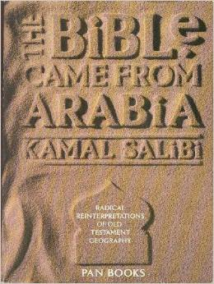
The Bible Came From Arabia
By American University of Beirut Professor of History Kamal Salibi
London: Jonathan Cape 1988
The desert lowland region along the west coast of he Arabian peninsula is called Tihamah [تهامة] and “is actually the Tehom mentioned in more than thirty passages of the text of the Hebrew Bible” p. 76
Egypt knew no Pharaohs nor Israelites, By Ashraf Ezzat, 2015, (Book trailer), https://www.youtube.com/watch?v=EE9Lbu9_bVA

Slide 57
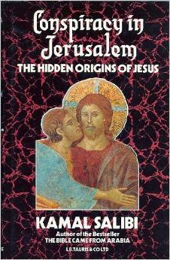
Conspiracy in Jerusalem:
The Hidden Origins of Jesus
By Kamal Salibi
Professor of history at the American University of Beirut
London: I.B. Taurus & Co. Ltd, 1988

Slide 58
Basic Information about Biblical Texts
“The New Testament is the Christian scriptures, originally written in Greek, which have been added to the Hebrew scriptures of the Old Testament to form the Christian Bible. These Christian scriptures comprise four accounts of the career of Jesus called the Gospels (Matthew, Mark, Luke and John), and a report of the activity and preaching of the early followers of Jesus, which is called Acts of the Apostles (usually referred to as Acts)… In addition, there are the Epistles—a selection from the surviving correspondence of various apostles, mainly concerned with religious instructions. The New Testament contains twenty-one epistles, thirteen of them attributed to Paul, the man generally reckoned to have been the founder of Christianity. Finally, there is a book of eschatological prophecy called Revelation… The Old Testament—or Hebrew Bible—is composed of three categories of scriptures. First are the five books of ‘Instruction’, called the Torah, and traditionally attributed to Moses (Genesis, Exodus, Leviticus, Numbers and Deuteronomy). Next are the twenty-one books of the ‘Prophets’. Six of these are basically historical chronicles (Joshua, Judges, 1 Samuel, 2 Samuel, 1 Kings, 2 Kings); the others are records of the oracles of three ‘major’ prophets (Isaiah, Jeremiah, Ezekiel), and twelve ‘minor’ ones (Hosea, Joel, Amos, Obadiah, Jonah, Micah, Nahum, Habakkuk, Zephaniah, Haggai, Zechariah and Malachi). Finally, there are the thirteen books called the ‘Writings’ (Ruth, 1 Chronicles, 2 Chronicles, Ezra, Nehemiah, Esther, Job, Psalms, Proverbs, Ecclesiastes, The Song of Solomon, Lamentations, Daniel). Of the Writings, two books are exceptional in the Hebrew Bible because they include long passages in Aramaic (Daniel 2:4—7:28; Ezra 4:8—6:18). While the five books of the Torah are taken to represent the original monotheism of the Biblical Israelites, and remain the sole scriptures accepted by surviving Israelite communities such as the Samaritans, the Torah, Prophets and Writings, together, form the scriptures of the evolved form of the original Israelite monotheism, which we know as Judaism. In addition to the Hebrew Bible, Judaism accepts the authority of a corpus of interpretations of the Torah and other traditional Jewish teachings written down in the early centuries of the Christian era, and collectively known as the Talmud… In addition to the four ‘canonical’ gospels, whose contents are regarded by Christian church tradition as authentic, there are a number of others—all of them of later authorship—which have long been rejected as ‘apocryphal’, or of doubtful authority. That there were Christian scriptures which are older than the canonical Gospels is virtually certain, although many New Testament scholars today prefer to speak of the Gospel sources more cautiously and ambiguously as ‘traditions’. Most of these pre-Gospel Christian scriptures must have been written not in Greek but in Aramaic, the native language of Jesus and his disciples. Paul occasionally mentioned such scriptures and sometimes quoted from them in his epistles, as he also quoted from the regular Israelite scriptures. Indeed, in one epistle he referred to his ‘books … and especially the ones made of parchments’ (2 Timothy 4:13).” Kamal Salibi, Conspiracy in Jerusalem: The Hidden Origins of Jesus, I.B. Taurus & Co. Ltd Publishers, London, 1988, pages 3-4

Slide 59
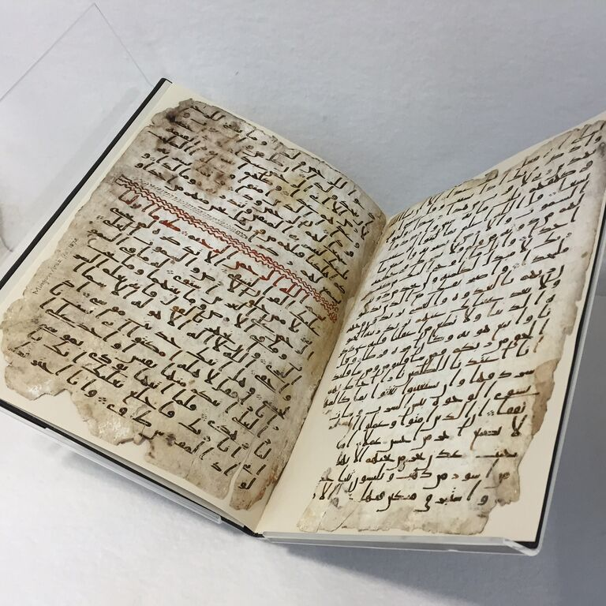
Secret £14million Bible in which 'Jesus predicts coming of Prophet Muhammad' unearthed in Turkey
1,500-Year-Old Quran Manuscript Could Be Oldest Known Copy
LiveScience, 7/22/2015,
http://www.livescience.com/51638-quran-manuscript-oldest-known-copy.html
BBC, 7/22/2015, http://www.bbc.com/news/business-33436021
A secret Bible in which Jesus is believed to predict the coming of the Prophet Muhammad to Earth has sparked serious interest from the Vatican.
Pope Benedict XVI is claimed to want to see the 1,500-year-old book, which many say is the Gospel of Barnabas, that has been hidden by the Turkish state for the last 12 years. The £14million handwritten gold lettered tome, penned in Jesus' native Aramaic language, is said to contain his early teachings and a prediction of the Prophet's coming. The leather-bound text, written on animal hide, was discovered by Turkish police during an anti-smuggling operation in 2000. It was closely guarded until 2010, when it was finally handed over to the Ankara Ethnography Museum, and will soon be put back on public display following a minor restoration... In line with Islamic belief, the Gospel treats Jesus as a human being and not a God. It rejects the ideas of the Holy Trinity and the Crucifixion and reveals that Jesus predicted the coming of the Prophet Muhammad. In one version of the gospel, he is said to have told a priest: 'How shall the Messiah be called? Muhammad is his blessed name'...
Protestant pastor İhsan Özbek said it was unlikely to be authentic... Theology professor Ömer Faruk Harman said a scientific scan of the bible may be the only way to reveal how old it really is. Daily Mail, 2/24/2012, http://www.dailymail.co.uk/news/article-2105714/Secret-14million-Bible-Jesus-predicts-coming-Prophet-Muhammad-unearthed-Turkey.html
“Jesus, son of Mary, said, ‘Children of Israel, I am sent to you by God confirming the Torah that came before me and bringing good news of a messenger to follow me whose name will be Ahmad’*” Quran 61:6. *Ahmad, like Muhammad, means ‘praised’ for his good character

Slide 60
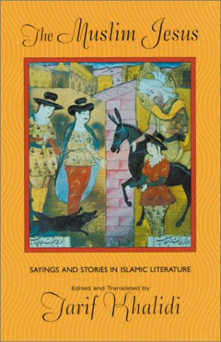
As a Western religion, Islam gives primacy to the patriarchs Abraham, Isaac and Jacob and considers Jesus to be a holy prophet. In The Muslim Jesus: Sayings and Stories in Islamic Literature, Tarif Khalidi brings together Islamic primary sources about Jesus from the eighth to the 18th centuries. Included are mystical works, historical texts about prophets and saints and, of course, the foundational words about Jesus in the Qur'an. "As a whole," Khalidi explains, these writings "form the largest body of texts relating to Jesus in any non-Christian literature." Khalidi pays particular attention to the literary quality of the texts and the role "the Muslim Jesus" has played in both Muslim piety and Muslim-Christian relations. --Editorial Review from Publishers Weekly. Copyright 2001 Cahners Business Information, Inc.
This work presents in English translation the largest collection ever assembled of the sayings and stories of Jesus in Arabic Islamic literature. In doing so, it traces a tradition of love and reverence for Jesus that has characterized Islamic thought for more than a thousand years. An invaluable resource for the history of religions, the collection documents how one culture, that of Islam, assimilated the towering figure of another, that of Christianity. As such, it is a work of great significance for the understanding of both, and of profound implications for modern-day inter-sectarian relations and ecumenical dialogue.
Tarif Khalidi’s introduction and commentaries place the sayings and stories in their historical context, showing how and why this “gospel” arose and the function it served within Muslim devotion. The Jesus that emerges here is a compelling figure of deep and life-giving spirituality. The sayings and stories, some 300 in number and arranged in chronological order, show us how the image of this Jesus evolved throughout a millennium of Islamic history.—Harvard University Press
Harvard University Press, 2001

Slide 61
<<Jesus said to his people, “Do not talk much without the mention of God, lest your hearts grow hard; for the hard heart is far from God, but you do not know. Do not examine the sins of people as though you were lords, but examine them, rather, as though you were servants. Men are of two kinds: the sick and the healthy. Be merciful to the sick and give thanks to God for health”>> page 52
<<Jesus said, “If it is a day of fasting for one of you, let him anoint his head and beard and wipe his lips so that people will not know that he is fasting. If he gives with the right hand, let him hide this from his left hand. If he prays, let him pull down the door curtain, for God apportions praise as He apportions livelihood”>> page 53
<<Jesus said, “Son of Adam, if you do a good deed, try to forget it, for it abides with Him who will not forget it.” He then recited the following [Quranic] verse: “’We do not neglect the reward of him who does a good deed.’ If you commit an evil deed, let it remain right before your eyes.” Ibn al-Warraq said, “Near your eyes.” page 56
<<Jesus used to tell his followers, “Take mosques to be your homes, houses to be stopping places. Eat from the plants of the wilderness and escape from this world in peace.” Sharik said, “I mentioned this to Sulayman, who added, ‘and drink pure water.’” page 58
<<Jesus said, “There are four [qualities] which are not found in one person without causing wonder: silence, which is the beginning of worship; humility before God; an ascetic attitude toward the worlds; and poverty.” page 59
<<Jesus and his disciples passed by a dog’s carcass. The disciples said, “How foul is his stench!” Jesus said, “How white are his teeth!” He said this in order to teach them a lesson—namely, to forbid slander.>> page 122
<<Jesus was asked, “Spirit and Word of God, who is the most seditious of men? He replied, “The scholar who is in error. If a scholar errs, a host of people will fall into error because of him.” page 61
Harvard University Press, 2001

Slide 62
The Hadith
(sayings attributed to the Prophet Muhammad)
In general Muslims scholars define the Hadith as: The attested reports of the sayings and actions of Prophet Muhammad as well as his tacit approval or criticism of something said or done in his presence.
Unlike the Quran, the Hadith was not compiled during Prophet Muhammad’s life. Therefore a Hadith is often classified as ‘sound’ (sahih), ‘fair’ (hasan), ‘weak’ (daeef), or even ‘fabricated’ (mawdoo’) depending on the reliability and memory of everyone in the chain of reporters/transmitters/narrators of the Hadith and depending on other vetting practices used by various schools of Islamic law and theology.
The best known Hadith books of the Sunna school of Islamic law & theology include Sahih Bukhari, Sahih Muslim, Sunan Tirmithi, Sunan Abi Dawood, Sunan Ibn Majah, Sunan Nisa’i, Muwatta Malik, and Musnad Ahmed.
The best known Hadith books of the Shia Twelver school of Islamic law & theology include Kitab Al-Kafi, Man la yahduruhu al-Faqih, Al-Tahdhib, and Al-Istibsar.
The best known Hadith books of the Ibadhi school of Islamic law & theology include Tartib Al-Musnad, al-Jāmi' al-Sahih or Musnad Al-Rabi' bin Habib.
While Muslims are unanimous as to the authenticity of the Arabic text of the Quran, they are not unanimous as to the authenticity of some of the Hadith

Slide 63
The Hadith literature provides evidence for the Prophet’s way of life (sunna)
The Hadith may emphasize what is in the Quran, explain the manner in which something should be carried out, or introduce teaching based on certain Quranic verses or principles

Slide 64
Examples of Hadith
Prophet Muhammad Said:
“I am a human being, so when I command you about a thing pertaining to religion, do accept it, and when I command you about a thing out of my personal opinion, keep it in mind that I am a human being.” Source: Sahih Muslim
“I am a human being like you and liable to forget like you. So if I forget remind me” Source: Sahih Bukhari and Sahih Muslim

Slide 65
Prophet Muhammad Said:
"If you guarantee me six things on your part I shall guarantee you Paradise:
Speak the truth when you talk,
keep a promise when you make it,
when you are trusted with something fulfill your trust,
avoid sexual immorality,
lower your gaze (out of modesty),
and restrain your hands from injustice.“
Source: Musnad Ahmed
“It is enough for a man to prove himself a liar when he goes on narrating whatever he hears.” Source: Sahih Muslim

Slide 66
Prophet Muhammad Said:
“He who said his prayer, but did not recite the Opening chapter of the Holy Book, his prayer is incomplete”
Sahih Muslim

Slide 67
Prophet Muhammad Said:
“None of you [truly] believes until he loves for his brother or for his neighbor that which he loves for himself.” Sahih Muslim
“Whoever amongst you sees an evil, he must change it with his hand; if he is unable to do so, then with his tongue; and if he is unable to do so, then with his heart; and that is the weakest form of Faith.” Sahih Muslim
“The believers in their mutual kindness, compassion, and sympathy are just like one body. When one of the limbs suffers, the whole body responds to it with wakefulness and fever.” Sahih Bukhari and Sahih Muslim
Do you have to rescue someone in danger? BBC, 7/21/2017, http://www.bbc.com/news/world-us-canada-40680895
‘The kids are my life,’ a dad said of his missing family. Then he was charged with killing them, The Washington Post, 8/16/2018, https://www.washingtonpost.com/news/true-crime/wp/2018/08/16/the-kids-are-my-life-a-dad-said-of-his-missing-family-then-he-was-charged-with-killing-them/

Slide 68
Prophet Muhammad Said:
“Love the one whom you love moderately, perhaps one day he/she will be someone whom you dislike, and dislike the one for whom you have hatred moderately, perhaps one day he/she will be one whom you love.” Sunan At-Tirmithee
A man asked Prophet Muhammad (repeatedly): "Advise me!". Prophet Muhammad said (repeatedly): "Do not get angry." Sahih Bukhari
Prophet Muhammad said: "The strong person is not the wrestler, but the strong person is one who controls himself when angry." Sahih Muslim

Slide 69
Prophet Muhammad said
“Even if you have seen all the signs of the Last Day in front of you, if you have a small plant in your hand, go ahead and plant that.”
Musnad Ahmad
“Be mindful of God wherever you are, follow up a bad deed with a good deed and it will erase it, and behave decently towards people.” Sunan At-Tirmidhi

Slide 70
Prophet Muhammad Said:
“I have left among you the Book of God, and if you hold fast to it, you would never go astray.”
Sahih Muslim

Slide 71
Prophet Muhammad Said:
I leave behind me two things, the Qur'an and my Sunnah and if you follow these you will never go astray.
Ibn Ishaq’s Essira ennabawiyya

Slide 72
Prophet Muhammad Said:
“I have left among you something of such a nature that if you adhere to it you will not go astray: God's Book and my close relatives who belong to my household.”
Sunan Tirmithi

Slide 73
Prophet Muhammad Said:
“In place of the Torah[1] I was given the Seven Long Ones (sab'a tiwal)[2], in place of the Zaboor [Psalms][3] I was given the Hundreds (me’een)[4], and in place of the Injeel [Gospel][5] I was given the Mathani[6], and I was given the Muvassal[7] in addition.” Source: Musnad Imam Ahmed
[1] The first five books of the Old Testament: Genesis, Exodus, Leviticus, Numbers, and Deuteronomy.
[2] The seven longest surah/chapters of the Quran: Quran 2, 3, 4, 5, 6, 7, 8 and 9 (the latter two chapters being considered here as One chapter).
[3] Muslims believe that the Psalms, known as Zaboor in the Quran, were revealed to Prophet David by God in the same way that the Torah was revealed to Moses, the Gospels to Jesus, and the Quran to Muhammad.
[4] The terms Hundreds/me’een refer to the surah/chapters of the Quran which have about 100 verses and are listed after the Seven Long Ones. Some consider the Hundreds to include Quran 10 to Quran 18.
[5] The first four books of the New Testament: Matthew, Mark, Luke, and John (the four evangelists).
[6] Some consider the Mathani as the suras/chapters of Quran 19 to Quran 48 or 49 (we should note that Quran 26 has 227 SHORT verses).
[7] Some consider the Muvassal as the surah/chapters from Quran 50 to Quran 114 (the last surah/chapter listed in the Quran).

Slide 74
“They ask you [Prophet] about the Hour [End of Time/End of Days/Day of Judgment], ‘When will it happen?’ Say, ‘My Lord alone has knowledge of it… if I had knowledge of what is hidden, I would have abundant good things and no harm could touch me.”
“They ask you [Prophet] about the Hour, ‘When will it happen?’ Say, ‘My Lord alone has knowledge of it: He alone will reveal when its time will come, a time that is hidden from both the heavens and earth. All too suddenly it will come upon you.’ They ask about it as if you were eager [to find out]. Say, ‘God alone has knowledge of [when it will come], though most people do not realize it.’ Say [Prophet], ‘I have no control over benefit or harm, even to myself, except as God may please: if I had knowledge of what is hidden, I would have abundant good things and no harm could touch me. I am no more than a bearer of a warning and good news to those who believe.’” Quran 7:187-188

Slide 75
Prophet Muhammad Said:
“When a human being dies, his work for God comes to an end except for three: a lasting charity, knowledge that benefits others, and a good child who calls on God for his favor.” Sahih Muslim
A man came to the Prophet and said, ‘O Messenger of God! Who among the people is the most worthy of my good companionship? The Prophet (PBUH) said: Your mother. The man said, ‘Then who?’ The Prophet said: Then your mother. The man further asked, ‘Then who?’ The Prophet said: Then your mother. The man asked again, ‘Then who?’ The Prophet said: Then your father." Sahih Bukhari and Sahih Muslim
“We have commanded man to be good to his parents—his mother struggled to carry him and struggled to give birth to him; his bearing and weaning took a full thirty months—and when he has grown to manhood and reached the age of forty to say, ‘Lord, help me to be truly grateful for Your favours to me and to my parents; help me to do good work that pleases You; make my offspring good. I am one of those who devote themselves to You.” Quran 46:15

Slide 76
Excerpts from Prophet Muhammad's Farewell Sermon
"O people, lend me an attentive ear, for I know not whether, after this year, I will ever be among you again. Therefore, listen to what I am saying to you very carefully and take these words to those who could not be present today....
Hurt no one so that no one may hurt you. Remember that you will indeed meet your Lord, and that He will indeed reckon your deeds. God has forbidden you to take interest; therefore, all interest obligations shall henceforth be waived. Your capital, however, is yours to keep. You will neither inflict nor suffer inequity.....
Every right arising out of homicide in pre-Islamic days is henceforth waived, and the first such right I waive is that arising from the murder of Rabi`ah ibn Al-Harith [a relative of the Prophet]....
O people, beware of Satan, for the safety of your religion. He has lost all hope that he will ever be able to lead you astray in big things, so beware of following him in small things...
Treat your women well and be kind to them, for they are your partners and committed helpers. And it is your right that they do not make friends with anyone of whom you do not approve, as well as never commit adultery.
O people, listen to me in earnest. Worship God, say your five daily prayers, fast during the month of Ramadan, and give the share of Zakah in your wealth. Perform Hajj if you can afford to. All mankind is from Adam and Eve. An Arab has no superiority over a non-Arab, nor does a non-Arab have any superiority over an Arab; also a white has no superiority over a black, nor does a black have any superiority over a white except by piety and good action....
I leave behind me two things, the Qur'an and my example, the Sunnah, and if you follow these you will never go astray.
All those who listen to me shall pass on my words to others, and those to others again; and may the last ones understand my words better than those who listen to me directly. Be my witness, O God, that I have conveyed Your message to Your people."
Source : IslamOnline.net, http://www.islamonline.net/English/In_Depth/mohamed/1424/kharitah/article02.shtml

Slide 77
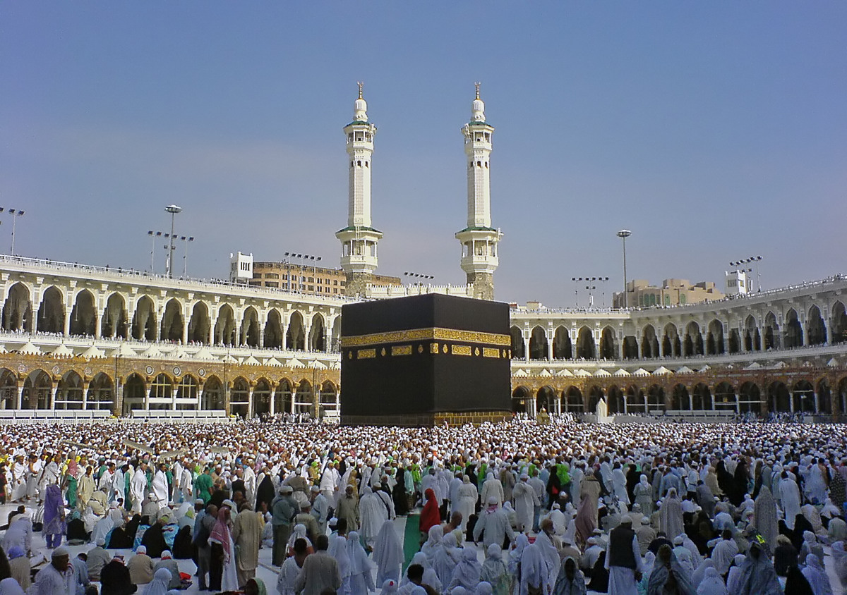
Holy Mosque in Makkah/Mecca (The Holiest City in Islam)
Since one of the names of Mecca is Beit El (House of Allah). It could be interesting to re-examine the geographies of Genesis 12, 13, & 35
“[Prophet], say, ‘God speaks the truth, so follow Abraham’s religion: he had true faith and he was never an idolater.’ The first House [of worship] to be established for mankind was the one at Becca [Mecca]. It is a blessed place; a source of guidance for all people; there are clear sign in it; it is the place where Abraham stood; whoever enters it is safe. Pilgrimage to the House is a duty owed to God by people who are able to undertake it. Those who reject this [should know that] God has no need of anyone.” Quran 3:95-97
Notes:
21

Slide 78
Holy Mosque in Makkah/Mecca (The Holiest City in Islam)
“As Abraham and Ishmael built up the foundations of the House [they prayed], ‘Our Lord, accept [this] from us. You are the All Hearing, the All Knowing. Our Lord, make us devoted to You; make our descendants into a community devoted to You. Show us how to worship and accept our repentance, for You are the Ever Relenting, the Most Merciful. Our Lord, make a messenger of their own rise up from among them, to recite Your revelations to them, teach them the Scripture and wisdom, and purify them: You are the Mighty, the Wise.” Quran 2:127-129
The source of the picture is not available at this time
Notes:
21

Slide 79
Holy Mosque in Makkah/Mecca (The Holiest City in Islam)
“[Prophet], say, ‘God speaks the truth, so follow Abraham’s religion: he had true faith and he was never an idolater.’ The first House [of worship] to be established for mankind was the one at Becca [Mecca]. It is a blessed place; a source of guidance for all people; there are clear sign in it; it is the place where Abraham stood; whoever enters it is safe. Pilgrimage to the House is a duty owed to God by people who are able to undertake it. Those who reject this [should know that] God has no need of anyone.” Quran 3:95-97
Notes:
21

Slide 80
Holy Mosque in Makkah/Mecca (The Holiest City in Islam)
“We showed Abraham the site of the House, saying, ‘Do not assign partners to Me. Purify My House for those who circle around it, those who stand to pray, and those who bow and prostrate themselves. Proclaim the pilgrimage to all people. They will come to you on foot and on every kind of swift mount, emerging from every deep mountain pass to attain benefits and celebrate God’s name, on specified days, over the livestock He has provided for them—feed yourselves and the poor and unfortunate—sot let the pilgrims perform their acts of cleansing, fulfil their vows, and circle around the Ancient House.’” Quran 22:26-29
Notes:
21

Slide 81
Holy Mosque in Makkah/Mecca (The Holiest City in Islam)
“… ‘We commanded Abraham and Ishmael: ‘Purify My House for those who walk around it, those who stay there, and those who bow and prostrate themselves in worship.” Quran 2:125-126
Notes:
21

Slide 82
Holy Mosque in Makkah/Mecca (The Holiest City in Islam)
“He said, ‘I will go to my Lord: He is sure to guide me. Lord, grant me a righteous son,’ so We gave him the good news that he would have a patient son. When the boy was old enough to work with his father, Abraham said, ‘My son, I have seen myself sacrificing you in a dream. What do you think?’ he said, ‘Father, do as you are commanded and, God willing, you will find me steadfast.’ When they had both submitted to God, and he had laid his son down on his face, We called out to him, `Abraham, you have fulfilled the dream.’ This is how We reward those who do good—it was a test to prove [their true character]—We ransomed his son with a momentous sacrifice, and We let him be praised by succeeding generations: Peace be upon Abraham!’ This is how We reward those who who do good: truly he was one of Our faithful servants. We gave Abraham the good news of Isaac—a prophet and a righteous man—and blessed him and Isaac too: some of their offspring were good, but some clearly wronged themselves.” Quran 37:99-113 (see also Gen 22:2)
Notes:
21

Slide 83
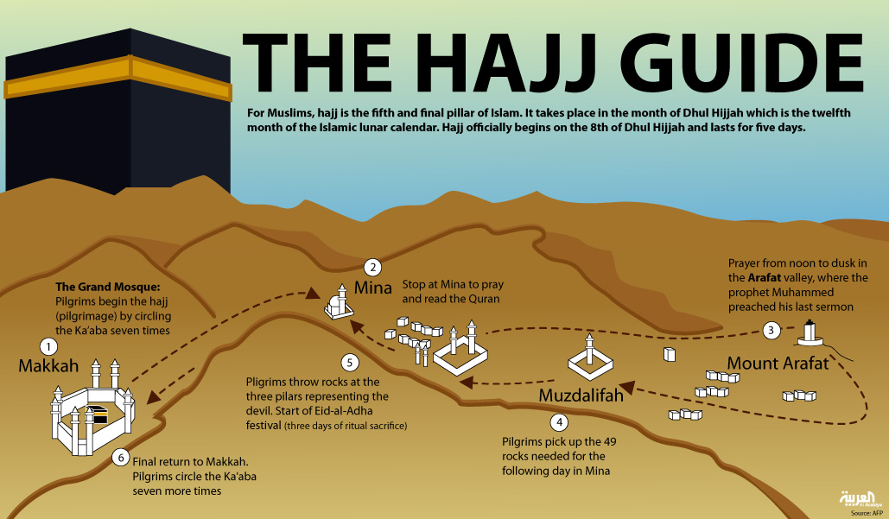
Since the Hajj (Pilgrimage to Mecca) predates Prophet Muhammad and represents a re-enactment of the Call of Abraham, the geography of the following Biblical verse comes to mind: “From there he [Abraham] went on toward the hills east of Bethel and pitched his tent, with Bethel on the west and Ai on the east. There he built an altar to the Lord and called on the name of the Lord.” Genesis 12:8
http://english.alarabiya.net/en/special-reports/hajj-2013/2013/10/03/Hajj-the-significance-of-the-fifth-pillar-of-Islam.html

Slide 84
Holy Mosque in Makkah/Mecca (The Holiest City in Islam)
“Abu Dharr reported: I said: Messenger of God [Prophet Muhammad], which mosque was set up first on the earth? He said: Al-Masjid al-Haram (the sacred Mosque in Mecca). I (again) said: Then which next? He said: Al-Masjid Aqsa [the furthest Mosque in Elquds/Jerusalem]” Sahih Muslim

Slide 85
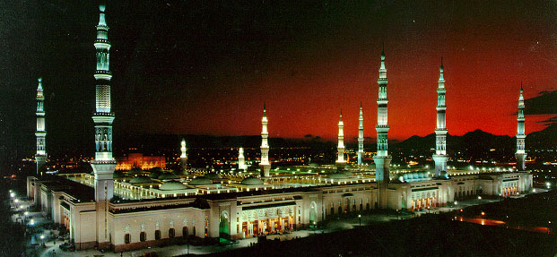
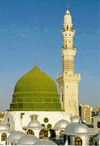
Holy Mosque of the Prophet, Medina
http://www.islamicity.com/Culture/MOSQUES/Madinah/PMM.htm
Prophet Muhammad said: “Set out deliberately on a journey only to three mosques: the Sacred Mosque [in Makkah], the Aqsa Mosque [in Jerusalem] , and this mosque of mine [in Medina]” Sahih Bukhari

Slide 86
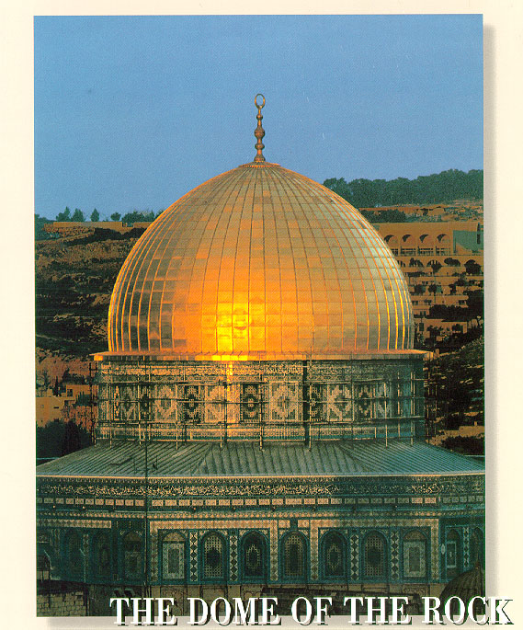
The Dome of the Rock Mosque, Jerusalem/ElQuds
“Glory to Him who made His servant travel by night from the sacred place of worship [in Mecca] to the furthest place of worship [in Jerusalem], whose surroundings We have blessed, to show him some of Our signs: He alone is the All Hearing, the All Seeing” Quran 17:1
UNESCO: Al-Aqsa Mosque/Al-Haram Al-Sharif in ElQuds/Jerusalem “is a Muslim holy site of worship and an integral part of a World Heritage Site.”
United Nations Educational, Scientific and Cultural Organization, UNESCO,
Decision Code: 40 COM 7A.13
Themes: Conservation, List of World Heritage in Danger
Properties (1): Old City of Jerusalem and its Walls
Session: 40th session of the Committee (40 COM)
Year: 2016
State of conservation reports: 2016 Old City of Jerusalem and its Walls, http://whc.unesco.org/en/decisions/6818)
http://www.islamicity.com/Culture/MOSQUES/Jerusalem/DRock.htm

Slide 87
The Five Pillars of Islam
Faith: (1) Belief in One God (see PowerPoint slide 8): Quran 2:255; Quran 24:35; Quran 42:11; Quran 112:1-4; Quran 58:7; Quran 6:74-90, Quran 3:64; Quran 11:25-28; Quran 2:124-136; Quran 21:48-92; Quran 2:30-37; Quran 3:18; Quran 3:26-27; Quran 6:103; Quran 38:75; Quran 55:27; (2) Belief in God’s angels: Q2:30-34, 98, 161, 177, 210, 285; (3) Belief in God’s scriptures: Quran 5:44-48; Quran 4:163; Quran 87:19; Quran 2:136; Quran 3:84; (4) Belief in God’s messengers: Quran 2:177, 210, 285; Quran 3:84; Quran 4:163; Quran 6:74-92; (5) Belief in the day of judgment: Quran 2:4, 177; Quran 4:162; Quran 9:19; Quran 27:3; Quran 34:21; Quran 4:136
Prayer: Quran 2:238 (“Take care to do your prayers, praying in the best way, and stand before God in devotion”); Quran 4:103; Quran 5:6 (“You who believe, when you are about to pray, wash your faces and your hands and arms up to the elbows, wipe your heads, wash your feet up to the ankles and, if required, wash your whole body”); Quran 11:114 (“[Prophet], keep up the prayer at both ends of the day, and during parts of the night, for good things drive bad away—this is a reminder for those who are aware”); Quran 17:78 (“So perform the regular prayers in the period from the time the sun is past its zenith till the darkness of the night, and [recite] the Quran at dawn—dawn recitation is always witnessed—and during the night wake up and pray, as an extra offering of your own, so that your Lord may raise you to a [highly] praised status”); Quran 62:9 (“Believers! When the call to prayer is made on the day of congregation [Friday], hurry towards the reminder of God and leave off your trading—that is better for you, if only you knew—then when the prayer has ended, disperse in the land and seek our God’s bounty. Remember God often so that you may proper”)
Almsgiving: Quran 9:103 (“In order to cleanse and purify them [Prophet], take alms out of their property and pray for them—your prayer will be a comfort to them. God is all hearing, all knowing”) and Quran 9:60 (“Alms are meant only for the poor, the needy, those who administer them, those whose hearts need winning over, to free slaves and help those in debt, for God’s cause, and for travelers in need. This is ordained by God; God is all knowing and wise”)
Fasting: Quran 2:183-185 (“You who believe, fasting is prescribed for you, as it was prescribed for those before you, so that you may be mindful of God. Fast for a specific number of days, but if one of you is ill, or on a journey, then on other days later. For those who can fast only with extreme difficulty, there is a way to compensate—feed a needy person. But if anyone does good of his own accord, it is better for him, and fasting is better for you, if only you knew. It was in the month of Ramadan that the Quran was revealed as guidance for mankind, clear messages giving guidance and distinguishing between right and wrong. So any one of you who sees in that month should fast, and anyone who is ill or on a journey should make up for the lost days by fasting on other days later. God wants ease for you, not hardship. He wants you to complete the prescribed period and to glorify Him for having guided you, so that you may be thankful”)
Pilgrimage: Quran 3:95-97 (“[Prophet], say, ‘God speaks the truth, so follow Abraham’s religion: he had true faith and he was never an idolater.’ The first House [of worship] to be established for people was the one at Bakka [an old name of Mecca]. It is a blessed place; a source of guidance for all people; there are clear signs in it; it is the place where Abraham stood to pray; whoever enters it is safe. Pilgrimage to the House is a duty owed to God by people who are able to undertake it. Those who reject this [should know that] God has no need of anyone”)
On the importance of ‘intentions,’ Prophet Muhammad said: “Actions are only according to intentions, and to each only what he intended.” Sahih Bukhari
On the importance of ‘hearts,' Prophet Muhammad said: "Verily, God does not look to your bodies nor to your faces but He looks to your hearts.” Sahih Muslim

Slide 88
The Hadith of Gabriel
On the authority of Omar who said: One day while we were sitting with the Messenger of God (peace be upon him), there came before us a man with extremely white clothing and extremely black hair. There were no signs of travel on him and none of us knew him. He [came and] sat next to the Prophet (peace be upon him). He supported his knees against the knees of the Prophet [peace be upon him] and put his hands on his [the man] thighs.
He said, 'O Muhammad, tell me about Islam (submission to God).'
The Messenger of God (peace be upon him) said, 'Islam is to testify that there is none worthy of worship except God and that Muhammad is the Messenger of God, to establish [the ritual] prayer, to pay the Zakat [alms tax], to fast [the month of] Ramadan, and to make pilgrimage to the House [the Kaaba in Mecca] if you have the means to do so.'
He said, 'You have spoken truthfully [or correctly].' We were amazed that he asks the question and then he says he had spoken truthfully.
He said, 'Tell me about Iman (faith).' He [the Messenger of God] (peace be upon him) responded, 'It is to believe in God, His angels, His books, His messengers, and the Last Day and to believe in the divine decree, [both] the good and the evil thereof.' He said, 'You have spoken truthfully.'
He said, 'Tell me about Ihsan (goodness).' He [the Prophet] answered, 'It is that you worship God as if you see Him. And even though you do not see Him [you know] He sees you.'
He said, 'Tell me about [the time of the] Hour.' He [the Prophet (peace be upon him)] answered, 'The one being asked does not know more than the one asking.'
He said, 'Tell me about its signs.'
He answered, 'The salve-girl shall give birth to her master; and you will see the barefooted, scantily-clothed, destitute shepherds competing in constructing lofty buildings.'
Then he went away.
I stayed for a long time.
Then he [the Prophet (peace be upon him)] said, 'O Omar, do you know who the questioner was?' He said, 'God and His Messenger know best.'
He said, 'It was [the Angel] Gabriel who came to teach you your religion'
Adapted from: Jamaal al-Din M Zarabozo, “He Came to Teach You Your Religion"--The Hadith of the Angel Gabriel Explaining the Foundations of Islam, Imaan and Ihsaan, 1997, pages 4-5.

Slide 89
Islamic Law (الشريعة)
*In general, Muslim scholars define the overall purpose of Islamic law as bringing benefits and warding off harms to the individual and society (in general, warding off harms has priority over bringing benefits: dar’ al-mafasid awla min jalb al-masalih). For example,
“God commands justice, doing good, and generosity towards relatives and He forbids what is shameful, blameworthy, and oppressive. He teaches you, so that you may take heed.” Quran 16:90
“Help one another to do what is right and good; do not help one another towards sin and hostility.” Quran 5:2
“If anyone kills a person—unless in retribution for murder or spreading corruption in the land—it is as if he kills all mankind, while if any saves a life it is as if he saves the lives of all mankind.” Quran 5:32
“They ask you [Prophet] about intoxicants and gambling: say, ‘There is great sin in both, and some benefit for people: the sin is greater than the benefit.’” Quran 2:219
“[Believers], do not revile those they call on beside God in case they, in their hostility and ignorance, revile God.” Quran 6:108
*Muslim scholars define the following five necessary benefits that must be protected under Islamic law: (1) religion, (2) life, (3) mind, (4) offspring, and (5) property. To bring benefits and ward off harms to the individual and society, Muslim scholars use the Quran, the Sunna (Prophet’s words, deeds, and endorsements), consensus of Muslim scholars, and analogy or reasoning to derive and issue Islamic rulings (ahkam), which make all human actions fall into five categories: obligatory (fard) such as the required five pillars of Islam, recommended (mandoob) such as permissible extra devotion beyond the obligatory, disliked (makrooh) such as turning the head towards the right or towards the left (for no valid reason) when facing the direction of the Sacred Mosque in Mecca during prayer), prohibited (haraam) such as harming or killing or adultery, and permissible (mubaah) such as doing things that are NOT obligatory, NOT recommended, NOT disliked, and NOT prohibited.
*"In classical form the Sharia differs from Western [secular] systems of law in two principal respects.
In the first place the scope of the Sharia is much wider, since it regulates an individual’s relationship not only with one’s neighbours and with the state, which is the limit of most other legal systems, but also with God and with one’s own conscience. Ritual practices, such as the daily prayers, almsgiving, fasting, and pilgrimage, are an integral part of Sharīʿah law and usually occupy the first chapters in the legal manuals. The Sharīʿah is also concerned as much with ethical standards as with legal rules, indicating not only what an individual is entitled or bound to do in law but also what one ought, in conscience, to do or refrain from doing...
The second major distinction between the Sharīʿah and Western legal systems is the result of the Islamic concept of law as the expression of the divine will." Encyclopedia Britannica, accessed December 26, 2016, https://www.britannica.com/topic/Shariah

Slide 90
Major commandments in Islam (Basic Do’s and Don’ts in Islam)
"23 Your Lord has commanded that you should worship none but Him, and that you be kind to your parents. If either or both of them reach old age with you, say no word that shows impatience with them, and do not be harsh with them, but speak to them respectfully
24 and, out of mercy, lower your wing in humility towards them and say, ‘Lord, have mercy on them, just as they cared for me when I was little.’
25 Your Lord knows best what is in your heart. If you are good, He is most forgiving to those who return to Him.
26 Give relatives their due, and the needy, and travelers—do not squander your wealth wastefully:
27 those who squander are the brothers of Satan, and Satan is most ungrateful to his Lord—
28 but if, while seeking some bounty that you expect from your Lord, you turn them down, then at least speak some word of comfort to them.
29 Do not be tight-fisted, nor so open-handed that you end up blamed and overwhelmed with regret.
30 Your Lord gives abundantly to whoever He will, and sparingly to whoever He will: He knows and observes His servants thoroughly.
31 Do not kill your children for fear of poverty—We shall provide for them and for you—killing them is a great sin.
32 And do not go anywhere near adultery: it is an outrage, and an evil path.
33 Do not take life—which god has made sacred—except by right. If anyone is killed wrongly, We have given authority to the defender of his rights, but he should not be excessive in taking life, for he is already aided [by God].
34 Do not go near the orphan’s property, except with the best intentions, until he reaches the age of maturity. Honor your pledges: you will be questioned about your pledges.
35 Give full measure when you measure, and weigh with accurate scales: that is better and fairer in the end.
36 Do not follow blindly what you do not know to be true: ears, eyes, and heart, you will be questioned about all these.
37 Do not strut arrogantly about the earth: you cannot break it open, nor match the mountains in height.
38 The evil of all these is hateful to your lord.
39 [Prophet], this is some of the wisdom your Lord has revealed to you: do not set up another god beside God, or you will be thrown into Hell, blamed and rejected" Quran 17:23-39
“Say, ‘Come! I will tell you what your Lord has really forbidden you. Do not ascribe anything as a partner to Him; be good to your parents; do not kill your children fearing poverty’---We will provide for you and for them---‘stay well away from committing obscenities, whether openly or in secret; do not take life, which God has made sacred, except by right. This is what He commands you to do: so that you may use your reason. Stay well away from the property of orphans, except with the best [intentions], until they come of age; give full measure and weight, according to justice’---We do not burden any soul with more than it can bear---’when you speak, be just, even if it concerns a relative; keep any promises you make in God’s name. This is what He commands you to do, so that you may take heed’---this is My path, leading straight, so follow it, and do not follow other ways: they will lead you away from it---‘This is what He commands you to do, so that you may refrain from wrongdoing’” Quran 6:151-153
“Say [Prophet], ‘My Lord only forbids disgraceful deeds—whether they be open or hidden—and sin and unjustified aggression, and that you, without His sanction, associate things with Him, and that you say things about Him without knowledge’” Quran 7:33
On the lawful and the unlawful in Islam, Prophet Muhammad Said: “That which is lawful is clear and that which is unlawful is clear, and between the two of them are doubtful matters about which many people do not know. Thus he who avoids doubtful matters clears himself in regard to his religion and his honor, but he who falls into doubtful matters [eventually] falls into that which is unlawful, like the shepherd who pastures around a sanctuary, all but grazing therein. Truly every king has a sanctuary, and truly God's sanctuary is His prohibitions. Truly in the body there is a morsel of flesh, which, if it be whole, all the body is whole, and which, if it is diseased, all of [the body] is diseased. Truly, it is the heart.” Sahih Bukhari

Slide 91
Islamic Calendar
The Islamic calendar began in 622 AD (Year 1 of Hijra or 1 AH)
Hijra is the migration of Prophet Muhammad from Mecca to Medina
The Islamic calendar was established by Caliph Omar in 638 AD
The Islamic calendar is a lunar calendar (Quran 9:36, 10:5)
The Islamic calendar is 354 days (11 days shorter than the solar year because the lunar month is 29 or 30 days)
Ramadan is the 9th month in the Islamic lunar calendar during which observing Muslims fast during the daytime from dawn to sunset.
For example, if Ramadan 1439 AH began on May 16, 2018 AD, Ramadan 1440 AH should begin about 11 days earlier (around May 5, 2019).

Slide 92
God is greater (four times)
I testify that there is no god but God (two times)
I testify that Mohammed is God’s Messenger (two times)
Hasten to prayer (two times)
Hasten to success (two times)
Hasten to the best act (two times)
God is greater (two times)
There is no god but God (two times)
Note: “I testify that the Commander of the faithful Ali is the vicegerent of God” is not a part of the call to prayer (Adhan or Iqamah). But it is preferable that it is pronounced after I testify that Mohammed is God’s Messenger with the intention of Qurbat (closeness), http://www.sistani.org/english/book/48/2216/
One example of Unity and Diversity of Islamic Rituals:
Islamic Call to Prayer
or
Athaan
according to dominant Shia (left) and Sunna (right) Islamic schools
God is greater (four times)
I testify that there is no god but God (two times)
I testify that Mohammed is God’s Messenger (two times)
Hasten to prayer (two times)
Hasten to success (two times)
God is greater (two times)
There is no god but God (one time)
Note: For the Dawn Prayer, the caller adds the following words twice “prayer is better than sleep” after the words “Hasten to success”
http://www.youtube.com/watch?v=GhFxsUiLQiY
Sufism
"Sufism is based on (the assumption) that the method of those people (who later on came to be called Sufis) had always been considered by the important early Muslims, the men around Muhammad and the men of the second generation, as well as those who came after them, as the path of truth and right guidance. The (Sufi) approach is based upon constant application to divine worship, complete devotion to God, aversion to the false splendor of the world, abstinence from the pleasure, property, and position to which the great mass aspires, and retirement from the world into solitude for divine worship. These things were general among the men around Muhammad and the early Muslims. Then, worldly aspirations increased in the second century [AH, eighth AD] and after. People now inclined toward worldly affairs. At that time, the special name of Sufis (Sufiyah and Mutasawwifah) was given to those who aspired to divine worship." The Mugaddimah, Ibn Khaldun [greatest Arab historian, 1332-1406 AD], Translated by Franz Rosenthal, accessed 7/8/2018, https://asadullahali.files.wordpress.com/2012/10/ibn_khaldun-al_muqaddimah.pdf
Sufism
“Sufism, mystical Islamic belief and practice in which Muslims seek to find the truth of divine love and knowledge through direct personal experience of God... Nearly every Sufi order traces its lineage to Muhammad through ʿAlī [Prophet Muhammad’s cousin, son-in-law, fourth Muslim caliph/successor of Prophet Muhammad, and the first imam and the ancestor of all subsequent imams in Islamic Shia schools]. Sufis, whether Sunni or Shīʿite, believe that ʿAlī inherited from the Prophet the spiritual power (wīlāyah or walāyah) that makes the inner journey to God possible... Though the roots of Islamic mysticism formerly were supposed to have stemmed from various non-Islamic sources in ancient Europe and even India, it now seems established that the movement grew out of early Islamic asceticism [often involving self-denial and abstinence from sensual pleasures as a measure of spiritual discipline in an inner journey to God] that developed as a counterweight to the increasing worldliness of the expanding Muslim community; only later were foreign elements that were compatible with mystical theology and practices adopted and made to conform to Islam.” Encyclopedia Britannica, accessed June 17, 2018, https://www.britannica.com/topic/Sufism

Slide 93
One example of political diversity in Islam:
Tantawi and Qardawi (Two Leading Muslim Scholars from Egypt) Express Opposed Views on Gaza Tunnel Barrier
01/01/2010 A council of leading Muslim clerics has supported the Egyptian government's construction of an underground barrier along the border with Gaza to impede tunneling by smugglers, a report said on Friday.
The Islamic Research Council of Al-Azhar University, Sunni Islam's highest seat of learning, said that the tunnels were used to smuggle drugs and threatened Egypt's security, the Al-Masri Al-Yawm newspaper reported.
"It is one of Egypt's legitimate rights to place a barrier that prevents the harm from the tunnels under Rafah, which are used to smuggle drugs and other (contraband) that threaten Egypt's stability," the paper quoted the clerics as saying.
"Those who oppose building this wall are violating the commands of Islamic law," they added, after a meeting attended by Egypt's top cleric Sheikh Mohammed Said Tantawi, who is a government appointee…
Earlier this week, the chairman of the International Union for Muslim Scholars Sheikh Yousuf al-Qaradawi slammed the barrier as an "unjustified crime" and as such was banned by Islam.
Sheikh Qaradawi said, in a statement, that the barrier Egypt had begun constructing was meant to "pressure the Palestinians in Gaza to surrender to Israel."
"What Egypt is building these days on its border with Gaza is a prohibited act from the Islamic perspective," the prominent Islamic scholar said. "It aims to close off Gaza and tighten the siege imposed on its people so that they give in to the Israeli demands," Sheikh Qaradawi added--Al-Manar TV, 1/1/2010, http://www.almanar.com.lb/NewsSite/NewsDetails.aspx?id=117883&language=en
Excerpts from a 1998 interview with Carter’s National Security Advisor Zbigniew Brzezinski:
Question: “it has been said and repeated Islamic fundamentalism represents a world menace today.”
Brzezinski: “Nonsense! It is said that the West had a global policy in regard to Islam. That is stupid. There isn't a global Islam. Look at Islam in a rational manner and without demagoguery or emotion. It is the leading religion of the world with 1.5 billion followers. But what is there in common among Saudi Arabian fundamentalism, moderate Morocco, Pakistan militarism, Egyptian pro-Western or Central Asian secularism? Nothing more than what unites the Christian countries.” Interview with Zbigniew Brzezinski, President Jimmy Carter's National Security Adviser, Le Nouvel Observateur, Paris, 15-21 January 1998, Posted at globalresearch.ca 15 October 2001, http://www.globalresearch.ca/articles/BRZ110A.html ; https://www.globalresearch.ca/the-cias-intervention-in-afghanistan-u-s-recruitment-of-islamic-terrorists-started-in-1979-zbigniew-brzezinski/5629070

Slide 94
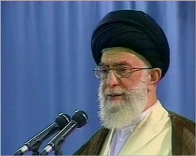
Sunni world welcomes Shia leader’s fatwa
TEHRAN – A number of Sunni figures have hailed the fatwa recently issued by Supreme Leader of the Islamic Revolution Seyyed Ali Khamenei that prohibits insulting the companions of Prophet Muhammad (S) and his wives.
In a statement issued on Sunday, Ahmad al-Tayyib, the chancellor of Al-Azhar University of Islamic Sciences, said Ayatollah Khamenei’s fatwa (religious edict) was prudent and timely and would help ram the door shut to fitna (creating divisions among Muslims).
“I received the blessed fatwa with appreciation,” he added.
Such insults have always been a source of controversy and disputes between Shia and Sunni Muslims and prevented them from forging a robust unity against common enemies, the Press TV correspondent in Cairo quoted him as saying.
Ayatollah Khamenei’s fatwa was issued after Kuwaiti Shia cleric Yasser Al-Habib insulted Aisha, a wife of Prophet Muhammad (S). The Kuwaiti cabinet voted this week to revoke his citizenship. Tehran Times, 10/5/2010, http://www.tehrantimes.com/Index_view.asp?code=227879
"Neither the Shia Muslims allied with the British MI6 are Shias, nor the Sunni mercenaries of the American CIA are Sunnis, as they are both anti-Islamic (mercenaries)"--- Iranian Leader of Islamic Revolution Ayatollah Seyyed Ali Khamenei, Islamic Republic News Agency, 1/9/2015, http://www.irna.ir/en/News/81457345/
Iran's Supreme Leader Ali Khamenei, who is reported to have issued a fatwa some time ago against nuclear weapons, has said: "We fundamentally reject nuclear weapons." BBC, 11/11/2010, https://web.archive.org/web/20101114015229/http://www.bbc.co.uk/news/world-middle-east-11709428
خامنئي يحرّم الإساءة للسيدة عائشة
أفتى المرشد الأعلى للجمهورية الإسلامية في إيران علي خامنئي بتحريم الإساءة إلى أم المؤمنين السيدة عائشة رضي الله عنها، أو النيل من الرموز الإسلامية لأهل السنة والجماعة.
وأفادت وكالة أنباء مهر الإيرانية شبه الرسمية أن فتوى خامنئي جاءت رداً على نداء وجهه جمع من [ال]علماء و[ال]مثقفين في السعودية عقب الإساءات الأخيرة التي وجهها رجل دين شيعي مقيم في لندن لأم المؤمنين عائشة.
يذكر أن الناشط الشيعي ياسر الحبيب الذي يحمل الجنسية الكويتية أقام حفلا في لندن بمناسبة ذكرى وفاة السيدة عائشة، وأطلق فيه تصريحاته المسيئة إلى أم المؤمنين. وقد بثت هذه التصريحات في شريط مصور نشر على موقعه الإلكتروني.
وأسفرت هذه التصريحات عن موجة من الردود الشاجبة من قبل المسلمين السنة الذين طالبوا الحكومة الكويتية بالسعي إلى تسلم الحبيب أو سحب الجنسية منه، وهو ما قامت به الحكومة لاحقا.
المصدر:الجزيرة، الجمعة 22/10/1431 هـ - الموافق 1/10/2010 م ،
http://www.aljazeera.net/news/pages/200b8f00-763f-440b-a95a-d73418baeaad

Slide 95
Major Muslim dynasties and states before the First World War (1914-18)
After the death of Prophet Muhammed in 632 AD, a number Muslim caliphs or successors and dynasties founded a number of states in different eras and in different areas, something which ultimately contributed to a great deal of cultural unity and political diversity in and beyond the Middle East region:
The Rashidun caliphate/state 632-661 (Medina, Saudi Arabia)
The Umeyyad dynasty/state 661-750 (Damascus, Syria)
The Abbasid dynasty/state 762-1258 (Baghdad, Iraq)
The Idrisid dynasty/state 789-921 (Fez, Morocco)
The Aghlabid dynasty/state 800-909 (Kairouan, Tunisia)
The Fatimid dynasty/state 909-1171 (Cairo, Egypt)
The Umayyad dynasty/state in Spain 929-1031 (Cordoba, Spain)
The Almoravid dynasty/state 1040-1147 (Marrakesh, Morocco)
The Almohad dynasty/state 1121-1269 (Marrakesh, Morocco)
The Ottoman dynasty/state 1453-1924 (Istanbul, Turkey)
The Safavid dynasty/state 1501-1736 (Asfahan, Iran)
The Mughal dynasty/state 1526-1857 (Delhi, India)
Note that Mecca and ElQuds or Jerusalem were not made capitals of any major Muslim dynasty or state

Slide 96
USA-Egypt Relations
“Ties With Egypt Army Constrain Washington
WASHINGTON — Most nations, including many close allies of the United States, require up to a week’s notice before American warplanes are allowed to cross their territory. Not Egypt, which offers near-automatic approval for military overflights, to resupply the war effort in Afghanistan or to carry out counterterrorism operations in the Middle East, Southwest Asia or the Horn of Africa.
Losing that route could significantly increase flight times to the region.
American warships are also allowed to cut to the front of the line through the Suez Canal in times of crisis, even when oil tankers are stacked up like cars on an interstate highway at rush hour. Without Egypt’s cooperation, military missions could take days longer…
“We need them for the Suez Canal, we need them for the peace treaty with Israel, we need them for the overflights, and we need them for the continued fight against violent extremists who are as much of a threat to Egypt’s transition to democracy as they are to American interests,” said Gen. James N. Mattis, who retired this year as head of the military’s Central Command.”
The New York Times, 8/17/2013, http://www.nytimes.com/2013/08/17/world/middleeast/us-officials-fear-losing-an-eager-ally-in-the-egyptian-military.html?hp&_r=0
"One of the things that excites me the most about those possibilities is the degree to which, when I meet with President al-Sisi or Mohamed bin Zayed of the Emirates, or King Abdullah of Saudi Arabia, they all talk about what the region could be like with peace. They view the economic prowess of Israel as an asset to all of them.” John Kerry, Secretary of State, Willard Hotel, Washington, DC, December 7, 2014, http://www.state.gov/secretary/remarks/2014/12/234743.htm

Slide 97
USA-UAE Relations
The United States has enjoyed friendly relations with the U.A.E. since 1971.
Private commercial ties, especially in petroleum (the U.A.E. is the only GCC state to allow private-sector participation in its oil and gas sector), have developed into friendly government-to-government ties, which include security cooperation.
The U.A.E. is the United States’ single largest export market in the Middle East and North Africa region, with $14.4 billion in exports (in 2008) and more than 1000 U.S. firms operating locally (in 2013).
There are nearly 50 weekly non-stop flights to the U.A.E. from six U.S. cities.
The U.A.E. is a leading partner in U.S. counterterrorism efforts, providing assistance in the military, diplomatic, and financial arenas since September 11, 2001. In 2009, the U.A.E. was the largest foreign buyer of U.S. defense equipment. U.A.E. ports host more U.S. Navy ships than any port outside the U.S.
  Source: Background Note: United Arab Emirates, March 16, 2011, http://www.state.gov/r/pa/ei/bgn/5444.htm
  U.S. Relations With United Arab Emirates, June 11, 2013, http://www.state.gov/r/pa/ei/bgn/5444.htm
According to one U.S. Embassy official in Abu Dhabi, there are some 40,000 American citizens living in the United Arab Emirates in 2011, up from some 30,000 a few years ago.

Slide 98





The Israel Lobby in the United States
The founder of the AIPAC (one of the main branches of the Israel lobby), I. L. “Si” Kenen, was head of the American Zionist Committee for Public Affairs in 1951, which was registered as a foreign lobbying group [required to register under the Foreign Agents Registration Act, http://www.law.cornell.edu/uscode/22/611.html]. Kenen reorganized it as a U.S. lobbying organization—the American Zionst Committee for Public Affairs—in 1953-54, and the new organization was renamed AIPAC in 1959. Kenen relied on psersonal contacts with key legislators rather than public campaigns or mass mobilization, and AIPAC generally followed “Kenen’s Rules” to advance Israel’s cause. Rule No. 1. was: “Get behind legislation; don’t step out in front of it (that is, keep a low profile)” ---Mearsheimer and Walt, The Israel Lobby, p. 118.
The Shah of Iran, a friend of Israel, answers questions about the Israel lobby in a 1976 interview with Jewish journalist Mike Wallace. OccupyingTheMind, 7/27/2012, https://www.youtube.com/watch?v=jsTxfH6tnww
Israeli Prime Minister Ariel Sharon: “we, the Jewish people control America, and the Americans know it," The Washington Report on Middle East Affairs, 10/3/2001, https://www.wrmea.org/old-html/sharon-to-peres-don-t-worry-about-american-pressure-we-control-america.html
Prince Charles, heir to British Throne, wrote in 1986: "Surely some U.S. president has to have the courage to stand up and take on the Jewish lobby in U.S.? I must be naive, I suppose!" Israel Hayom, 11/12/2017, http://www.israelhayom.com/2017/11/12/1986-prince-charles-letter-reveals-shocking-thoughts-on-j
The Lobby-USA, https://electronicintifada.net/content/watch-film-israel-lobby-didnt-want-you-see/25876
Paul Findley, They dare to speak out (1985)
Edward Tivnan, The Lobby (1987)
Jonathan Jeremy Goldberg, Jewish power (1996)
James Petras, The Power of Israel in the United States (2006)
Mearsheimer & Walt, The Israel lobby and U.S. foreign policy (2007).
Mark Green (ed.), Persecution, Privilege & Power (2008)
Jeff Gates, Guilt by Association: How Deception and Self-Deceit Took America to War (2008)
Grant Smith, Big Israel: How Israel’s Lobby Moves America (2016)
The United States government is strongly involved in the Palestine-Israel conflict, which continues to define US relations with other countries and contributes to US isolation from the international community as indicated by the most recent United Nations General Assembly vote on the "right of the Palestinian people to self-determination': 177 countries in favor, 7 against (Canada, Federated States of Micronesia, Israel, Marshall Islands, Nauru, Palau, United States), with 4 abstentions (Cameroon, Côte d’Ivoire, South Sudan, Tonga). United Nations, 12/19/2016, https://www.un.org/press/en/2016/ga11879.doc.htm
Why Talking about the Israel Lobby Matters https://www.youtube.com/channel/UCHUzbq68PYLE_n_Sn_DuYAg/videos
http://www.policyconference.org/gallery/speakers2019.asp
101 Jewish And Pro-Israel Groups Ask [250 U.S.] Universities To Oppose BDS [boycotts of the Jewish state], Forward and JTA, 12/4/2018, https://forward.com/fast-forward/415346/101-jewish-and-pro-israel-groups-ask-universities-to-oppose-israel/
Governor Pence Ceremonially Signs Bill Affirming Indiana's Support of Israel, Vote Smart, 5/27/2016, https://votesmart.org/public-statement/1102418/governor-pence-ceremonially-signs-bill-affirming-indianas-support-of-israel
Trump says Democratic Party is ‘anti-Israel’ and ‘anti-Jewish’, The Washington Post, 3/8/2019, https://www.washingtonpost.com/politics/trump-says-democratic-party-is-anti-israel-and-anti-jewish/2019/03/08/aaeed4d6-41b1-11e9-9361-301ffb5bd5e6_story.html
Senate Democrat Schumer, who is Jewish, reminded Trump about "neo-Nazis" and "Charlottesville", Roll Call, 3/8/2019, https://www.rollcall.com/news/congress/schumer-trump-redefined-chutzpah
“Steven Rosen, the former AIPAC official who has been indicted for allegedly passing classified documents to Israel, illustrated AIPAC’s power for the New Yorker’s Jeffrey Goldberg by putting a napkin in front of him and saying, “In twenty-four hours, we could have the signatures of seventy senators on this napkins.’ These are not idle boasts”—Mearsheimer and Walt, p. 10-11.
“76 senators sign AIPAC-backed letter seeking added pressure on Iran: WASHINGTON (JTA) — An AIPAC-backed letter urging President Obama to exert greater pressure on Iran to end its suspected nuclear weapons program garnered the signatures of 76 senators.”–-- Jewish Telegraphic Agency, August 4, 2013, http://www.jta.org/2013/08/04/news-opinion/politics/aipac-backed-letter-on-iran-garners-76-senate-signatures

Slide 99
U.S. commitment to the security and prosperity of the State of Israel
1. “The bonds between the United States an d Israel are unbreakable and the commitment of the United States to the security of Israel is ironclad… I and my administration have made the security of Israel a priority. It‘s why we‘ve increased cooperation between our militaries to unprecedented levels. It‘s why we‘re making our most advanced technologies available to our Israeli allies. It‘s why, despite tough fiscal times, we‘ve increased foreign military financing to record levels. And that includes additional support –- beyond regular military aid -– for the Iron Dome anti-rocket system… So make no mistake, we will maintain Israel‘s qualitative military edge… You also see our commitment to our shared security in our determination to prevent Iran from acquiring nuclear weapons. Here in the United States, we‘ve imposed the toughest sanctions ever on the Iranian regime… You also see our commitment to Israel‘s security in our steadfast opposition to any attempt to de-legitimize the State of Israel. As I said at the United Nations last year, Israel’s existence must not be a subject for debate,‘ and ‗efforts to chip away at Israel‘s legitimacy will only be met by the unshakeable opposition of the United States.‘ So when the Durban Review Conference advanced anti-Israel sentiment, we withdrew. In the wake of the Goldstone Report, we stood up strongly for Israel‘s right to defend itself. When an effort was made to insert the United Nations into matters that should be resolved through direct negotiations between Israelis and Palestinians, we vetoed it… No vote at the United Nations will ever create an independent Palestinian state. And the United States will stand up against efforts to single Israel out at the United Nations or in any international forum. Israel‘s legitimacy is not a matter for debate. That is my commitment; that is my pledge to all of you [AIPAC Policy Conference 2011].‖--U.S. President Barack Obama (5/22/2011)
2. “I am a Zionist… You don't have to be a Jew to be a Zionist‖--U.S. Senator Joseph R. Biden (Shalom TV, 3/27/2007).
3. “I have a deep personal commitment to Israel.” --U.S. Secretary of State Hillary Clinton (Haaretz, 4/20/2010)
4. “Not a day goes by -- not one -- when my colleagues and I do not work hard to defend Israel's security and legitimacy at the United Nations”—Obama's Ambassador to the United Nations, Susan Rice, The Huffington Post, 3/6/2012, http://www.huffingtonpost.com/2012/03/06/aipac-susan-rice-obama-israel_n_1323398.html
5. Thomas L. Friedman of The New York Times asked US President Obama whether he was worried about Israel. “It is amazing to see what Israel has become over the last several decades,” he answered. “To have scratched out of rock this incredibly vibrant, incredibly successful, wealthy and powerful country is a testament to the ingenuity, energy and vision of the Jewish people. And because Israel is so capable militarily, I don’t worry about Israel’s survival." The New York Times, 8/8/2014, http://www.nytimes.com/2014/08/09/world/middleeast/fear-of-another-benghazi-drove-white-house-to-airstrikes-in-iraq.html

Slide 100
Commitment to Israel's security and well being has been a cornerstone of U.S. policy in the Middle East since Israel's founding in 1948, in which the United States played a key supporting role
The U.S. and Israel have several agreements including: Joint Political, Security, and Economic cooperation; Acquisition and Cross-Servicing; Status of Forces; Prevention of the Supply of Arms and Related Materiel to Terrorist Groups; War Reserve Stockpile for Allies; U.S.-Israel Reciprocal Defense Procurement; and others. Israel participates in various engagements and exercises with the U.S. military including: Sentinal Star, pilot exchange, Noble Dina, and others.
United States European Command, (12/6/2014) http://www.eucom.mil/mission/the-region/israel

Slide 101
U.S.-ISRAEL RELATIONS http://www.state.gov/r/pa/ei/bgn/3581.htm
The United States was the first country to recognize Israel as a state in 1948. Since then, Israel has become, and remains, America’s most reliable partner in the Middle East. Israel and the United States are bound closely by historic and cultural ties as well as by mutual interests.
Israel's founding was preceded by more than 50 years of efforts to establish a sovereign state as a homeland for the Jewish people. The1917 Balfour Declaration asserted the British Government's support for the creation “in Palestine of a national home for the Jewish people.” …
The United States is committed to realizing the vision of a two state solution to the Israeli-Palestinian conflict: an independent, viable and contiguous Palestinian state as the homeland of the Palestinian people, alongside the Jewish State of Israel. In July 2013 the Israelis and the Palestinians began negotiations on a final status agreement between the parties.
The U.S.-Israel bilateral relationship is strong, anchored by over $3 billion in Foreign Military Financing annually. In addition to financial support, the U.S. participates in a high level of exchanges with Israel, to include joint military exercises, military research, and weapons development. Through the Joint Counterterrorism Group and a semi-annual Strategic Dialogue, the U.S. and Israel have enhanced their cooperation in fighting terrorism.
The United States is Israel's largest single trading partner. The top five U.S. exports to Israel are: diamonds, machinery, agricultural products, aircraft, and optic and medical instruments. The top five U.S. imports from Israel are: diamonds, pharmaceutical products, machinery, optic and medical instruments, and agricultural products. U.S. direct investment in Israel is primarily in the manufacturing sector, as is Israeli investment in the United States. The United States and Israel have had a free trade agreement since 1985, serving as the foundation for expanding trade and investment between the two countries by reducing barriers and promoting regulatory transparency. To facilitate economic cooperation, the two countries convene a Joint Economic Development Group each year to discuss economic conditions in both countries and possible economic reforms for the coming year.
The U.S. and Israel also coordinate scientific and cultural exchanges through the Binational Science Foundation, the Binational Agricultural Research and Development Foundation, and the U.S.-Israeli Education Foundation.
Professors Mearsheimer and Walt wrote “To note one sign of Israel’s privileged position among U.S. allies: since 1976, six l Israeli leaders have addressed joint sessions of Congress, a higher total than for any other country. A trivial indicator, perhaps, but it is still striking given that these six leaders represented a country whose 2007 population was less than that of New York.” Mearsheimer and Walt, The Israel Lobby and U.S. Foreign Policy, pages VII-VIII

Slide 102
Genesis of the Dhahran Airfield
“The construction of the Dhahran Airfield materialized not as the result of a request from the Saudi government but from urgent US requirements in 1942 and 1944, originating in the Military Air Transport Command (MATS). Most compelling for the United States was a strategic requirement for the fastest, cheapest, and most secure transit of its aircraft carrying personnel and war equipment eastward from Cairo. Washington also feared the depletion of its domestic oil supplies undergirding this transit; the war was going to be fought on fossil fuels as much as anything else. The United States needed overflight, refueling, and landing rights. Ibn Saud needed just about everything, but specifically food and consumer goods that had been cut off by the war, silver coinage for payrolls, subventions to keep the tribes in line, and cash income from whatever source. US generalized planning for air routes across South Asia to the Far Eastern theater began in February 1942, barely three months after the bombing of Pearl Harbor. The United States and Britain wanted to obtain overflight rights and airfield to shorten their eastward air route between Cairo and Karachi by 212 miles and to avoid expensive landings and takeoffs at Habaniyya in Iraq and Abadan in Iran. When the British North African campaign against Nazi forces under Field Marshall Rommel was at its height in mid-1942, an alternative route via Khartoum and across Saudi Arabia was tentatively explored with Saudi officials by both US and British officers. Direct overflight of unpopulated areas was quickly obtained from Ibn Saud in 1942. MATS, however, still wanted fueling, maintenance, and emergency landing bases. The British had already secure bases at Muharraq in Bahrain and in Sharja on the Trucial Coast, where, by long-standing treaties, they fully managed the foreign relations of the seven tribal rulers. However, Muharraq’s runways in Bahrain were salt marsh and soft, and Washington needed runways capable of sustaining heavy loads. The alternative of crossing Saudi Arabia would require the building of one or more airfields in Saudi Arabia’s Eastern Province. Although Ibn Saud was formally neutral, his sympathies were clearly with the Allied nations .” Parker Hart, Saudi Arabia and the United States: Birth of a Security Partnership, Indiana University Press, 1998, p. 14
According to professors Mearsheimer and Walt, “America's first significant involvement in the security politics of the [Middle East] region was a nascent partnership with Saudi Arabia in the mid-1940s (intended by both parties as a check on British ambitions in the region). Mearsheimer and Walt, The Israel Lobby and U.S. Foreign Policy, page 7.

Slide 103
The Palestine question was the main concern during the historic encounter between President Roosevelt and King Ibn Saud in 1945
“President Roosevelt took the initiative of inviting Ibn Saud to meet with him for the first time in February 1945 on board of the USS Quincy on Great Bitter Lake in the Suez Canal. At the meeting, following warm pleasantries and evidence of mutual goodwill (including Roosevelt's gift to the king of one of his wheelchairs), the entire meeting became a vigorous exchange on the Palestine question. This had been the central theme of earlier correspondence between the two leaders, beginning with a letter from Ibn Saud to the president dated November 29, 1938, and the president’s reply of January 2, 1939. In July 1943, Roosevelt had ordered Harold Hoskins, the son of American missionaries and a speaker of Arabic, to Saudi Arabia to determine by personal contact with Ibn Saud whether the king would be willing to meet with Chaim Weizman or other representatives of the Jewish Agency. The purpose would be to seek a ‘solution of basic problems affecting Palestine acceptable to both Arabs and Jews.’ Hoskins was personally well received. His report to Roosevelt recounted a weeklong visit to Riyadh, where he held frequent sessions alone with Ibn Saud. The king was appreciative of the opportunity Hoskins offered to speak frankly on many sensitive topics without an interpreter. The subject dealt with were many, but Palestine was the main concern. The king chose his words to the president with the utmost care. He said he could neither enter into such talks himself nor authorize a representative to do so. He feared a stage-by-stage wipeout of the Palestinian Arab population; also, he revealed a personal hatred of Weizman, based on Weizman’s alleged attempt to bribe him with 20 million pounds sterling, to be ‘guaranteed’ by President Roosevelt. The king later told me that Weizman’s proposed intermediary was H. St. John Philby.” Hoskins made his report to Roosevelt in person in a one-hour breakfast talk on September 27, 1943, only a few days before the scheduled arrival in Washington of Princes Faisal and Khalid. To Hoskins, Roosevelt expressed full understanding of the reason for the king’s refusal to meet with Weizman, and the president also showed irritation that his name had been mentioned as a guarantor, for which, he said, there was no basis in fact. The nearest he ever came to bordering on a discussion of this subject, Roosevelt said, was a suggestion he made several years earlier to Stephen Wise, chairman of the American Zionist Emergency Council, that if the Jews wanted to get more land in Palestine, they might well think of buying arable land outside of Palestine and assisting Arabs financially to move from Palestine to such areas. Roosevelt also told Hoskins that he favored an international trusteeship for Palestine, as recommended by the Department of State.”
Source: Parker Hart, Saudi Arabia and the United States: Birth of a Security Partnership, Indiana University Press, 1998, pp. 38-39
See also William Eddy’s memorandum of the conversation printed in Foreign Relations of the United States, 1945, vol. 8, pp. 1-3 and 7-9 , and in Eddy’s personal account, F.D.R. Meets Ibn Sa’ud, published in 1954.

Slide 104
U.S. Commitment to Saudi security
When U.S. President Truman signed the Saudi-Aramco “fifty-fifty” profit-sharing agreement in late 1950, he wrote a letter to Saudi King Ibn Saud affirming:
“I wish to renew to Your Majesty the assurances which have been made to you several times in the past, that the United States is interested in the preservation of the integrity of Saudi Arabia. No threat to your Kingdom could occur which would not be a matter of immediate concern to the United States.” Quoted in Leonardo Maugeri, The Age of Oil: The Mythology, History, and Future of the World’s Most Controversial Resource, Guilford, Connecticut: The Lyons Press, 2006, page 59.
US Ambassador to Saudi Arabia Parker Hart remembers these words of His Royal Highness Prince Faisal in September 1963: “Since 1943 I have considered the interests of my country and community to be the same as those of the United States. We differ in nothing basic… After Allah we trust in America.” Parker Hart, Saudi Arabia and the United States: Birth of a Security Partnership, Indiana University Press, 1998, p. xvii.
US Ambassador to Saudi Arabia Parker Hart: “Although it was certainly in the interest of the US-Saudi security partnership that Faisal become king [after deposing his brother King Saud on November 1, 1964], I certify firsthand, whatever others may say, that this accession was 100 percent Saudi, completely free of any US or other foreign influence… As my scheduled May 1965 departure had neared, Faisal showed his gratitude for US assistance over the years not by words of thanks but by asking me to request that the US government assume the position of national manager of Saudi development contracts. The United States would thus stand between him and all prospective contractors for military construction, studying and evaluating all major proposals and supervising their execution. Before leaving for Washington and appointment as ambassador to Turkey, I had one final duty that gave me special pleasure—that of signing an agreement, with royal counselor Rashad Fira’awn signing on behalf of Faisal, that named the US Corps of Engineers to this exceptional role in the long-term development programs of Saudi Arabia. Thus began a still-surviving multibillion-dollar Saudi relationship with the corps that has yielded substantial returns to the US taxpayer. This relationship also greatly augmented Saudi military readiness and proved its value in Operations Desert Shield and Desert Storm.” Parker Hart, Saudi Arabia and the United States: Birth of a Security Partnership, Indiana University Press, 1998, pp. 246, 250-251
“Saudi Arabia, which is a staunch friend and which has a leadership in whom we have high confidence, has been extremely helpful to us on international economic issues. We recognize the need to create an environment which is secure, while respecting the Arab desire to protect their sovereignty through the absence of foreign bases on their soil.” [US President Jimmy Carter’s] National Security Adviser [Zbigniew] Brzezinski, Interview on ABC’s “Issues and Answers,” April 27, 1980, Current Policy No. 173, United States Department of State, Bureau of Public Affairs, Washington, DC, pp. 1-4, page 3.

Slide 105
U.S.-SAUDI ARABIA RELATIONS http://www.state.gov/r/pa/ei/bgn/3584.htm
The United States and Saudi Arabia established full diplomatic relations in 1940. Saudi Arabia's unique role in the Arab and Islamic worlds, its possession of the world's largest reserves of oil, and its strategic location make its friendship important to the United States. The United States and Saudi Arabia share common concerns and consult closely on wide range of regional and global issues. As the region is going through a period of great transformation, the United States appreciates Saudi Arabia’s leadership in working toward a peaceful and prosperous future for the region. Saudi Arabia is also a strong partner in regional security and counterterrorism efforts, providing military, diplomatic, and financial cooperation. It works closely with U.S. law enforcement to safeguard both countries' national security interests.
Saudi Arabia is ‘largest U.S. trading partner’ in the Middle East
The Saudi Arabian General Investment Authority (SAGIA) has said that the United States is the largest trading partner of Saudi Arabia and the Kingdom is the largest market for U.S. exports in the Middle East.... SAGIA disclosed that the volume of trade exchange between the two countries reached $62 billion (SR233 billion) last year[2014]. Alarabiya, 9/5/2015, http://english.alarabiya.net/en/business/economy/2015/09/05/Saudi-Arabia-is-largest-trading-partner-and-export-market-for-U-S-.html

Slide 106
The Five Major Middle East Events of 1979
1. In February 1979, Ayatollah Khomeini returned from exile after the Shah monarchy in Iran was overthrown, Iran ended its alliance with Israel, expelled the Israelis from Iran, and began its concrete support for the Palestinians by turning the Israeli embassy in Iran into the Embassy of Palestine in Iran.
*Watch (15mn): Face to Face with the Ayatollah imam khomeini Arafinterview CBS News, https://www.youtube.com/watch?v=ArW8BGv1RyM
*Watch (3mn): PLO President at Hails Iranian Revolution, https://www.youtube.com/watch?v=65xpvmCsm-c
*Key moments in the 1979 Iran hostage crisis at US Embassy, The Associated Press 11/3/2019, https://www.sfgate.com/news/world/article/Key-moments-in-the-1979-Iran-hostage-crisis-at-US-14806819.php
2. In March 1979, the United States sponsored the signing of a peace treaty between Israel and Egypt that ended the state of war that had existed between the two countries. http://www.britannica.com/EBchecked/topic/91061/Camp-David-Accords/284489/A-framework-for-peace
*Iran cut diplomatic relations with Egypt when Egypt signed a peace treaty with Israel. http://www7.irna.ir/ar/News/82129585/
4. In November 1979, the Great Mosque [in Mecca] was at the centre of a rebellion against the Saudi royal family when it was seized by a group of several hundred Islamic militants led by Juhaymān al-ʿUtaybī and Muḥammad bin ʿAbd Allāh al-Qaḥṭānī. The insurgents denounced the impiety of the Saʿūd family and claimed that Qaḥṭānī was the mahdī*, an Islamic messianic figure. ttp://www.britannica.com/EBchecked/topic/254837/Great-Mosque-of-Mecca
https://www.presstv.com/Detail/2020/02/03/617816/Aljazeera-French-mercenaries-Mecca-seizure
When the rebellion was crashed, many of the Saudi and non-Saudi Islamic militants were reoriented and deployed to become anti-Soviet mujahidin in Afghanistan before evolving into the Al-Qaida, ISIS, and other armed groups to be deployed as ground forces for “regime change” in other countries such as Libya, Syria, etc..
3. In July 1979, United States President Carter signed a covert action finding on July 3, 1979 (https://dgibbs.faculty.arizona.edu/sites/dgibbs.faculty.arizona.edu/files/afghan-ip.pdf) authorizing the CIA to equip Afghan tribal resistance forces (collectively known as the mujahedin) with weapons. CIA, Afghanistan: 1979–87, https://www.cia.gov/library/center-for-the-study-of-intelligence/csi-publications/books-and-monographs/agency-and-the-hill/12-The%20Agency%20and%20the%20Hill_Part2-Chapter9.pdf
5. In December 1979, the Soviet Union intervened militarily in support of the Afghan communist government in its conflict with anticommunist Muslim guerrillas during the Afghan War (1978–92) and remained in Afghanistan until mid-February 1989, http://www.britannica.com/EBchecked/topic/1499983/Soviet-invasion-of-Afghanistan
When the Soviet Union collapsed in 1991, Soviet Jews were allowed to EMIGRATE to Palestine & accelerate the dispossession of the Palestinians through the rapid expansion of Jewish settlements on Palestinian lands

Slide 107
The Fall of the Shah
“The Iranian disaster shattered the strategic pivot of a protected tier shielding the crucial oil-rich region of the Persian Gulf from possible Soviet intrusion. The northeast frontier of Turkey, the northern frontiers of Iran and Pakistan, and the neutral buffer of Afghanistan created a formidable barrier, which was pierced once Iran ceased to be America’s outpost… p. 356] Zbigniew Brzezinski, Power and Principle: Memoirs of the National Security Adviser 1977-1981, New York: Farrar, Straus, Giroux, 1983
U.S. Had Key Role in Iraq Buildup: Declassified documents show that Rumsfeld traveled to Baghdad at a time when Iraq was using chemical weapons on an "almost daily" basis in defiance of international conventions... As part of its opening to Baghdad, the Reagan administration removed Iraq from the State Department terrorism list in February 1982... The U.S. tilt toward Iraq was enshrined in National Security Decision Directive 114 of Nov. 26, 1983, one of the few important Reagan era foreign policy decisions that still remains classified [in 2002]. According to former U.S. officials, the directive stated that the United States would do "whatever was necessary and legal" to prevent Iraq from losing the war with Iran. The Washington Post, 12/30/2002, https://www.washingtonpost.com/archive/politics/2002/12/30/us-had-key-role-in-iraq-buildup/133cec74-3816-4652-9bd8-7d118699d6f8/
William Casey, President Reagan's Director of Central Intelligence, made a secret trip to Baghdad in March 1982. After his visit the United States removed Saddam Hussein's Iraq from the list of countries supporting terrorism -- a decision that allowed Iraq to acquire sensitive U.S. technology. The New York Times, 4/22/1991, http://www.nytimes.com/1991/04/22/opinion/abroad-at-home-gangsters-in-charge.html
Saudi Minister of Foreign Affairs Adel Al-Jubeir: "The Kingdom of Saudi Arabia and the United States have been allies for eight decades now... We were able to switch Egypt from the Soviet camp to the Western camp... We worked together in Afghanistan and we prevailed. And 1990, of course, everybody remembers the invasion of Kuwait and the liberation of Kuwait by a coalition of over 30 countries that was put together by the United States and the Kingdom of Saudi Arabia." THE BROOKINGS INSTITUTION, SAUL/ZILKHA ROOM, WHAT’S NEXT IN U.S.-SAUDI RELATIONS, A CONVERSATION WITH H.E. ADEL AL-JUBEIR, MINISTER OF FOREIGN AFFAIRS, KINGDOM OF SAUDI ARABIA, Washington, D.C. Thursday, March 22, 2018, https://www.brookings.edu/wp-content/uploads/2018/03/fp_20180322_saudi_us_transcript.pdf
Saudi Arabia's leading cleric Sheik Abdelaziz bin Baz's fatwa [religious decree] in support of the war against the Soviets: "Undoubtedly, the Jihad in Afghanistan is an Islamic Jihad, and it is obligatory on all Muslims to encourage and support it." Ibn Baz Fatwas, Volume 27, Book on Da`wah, An interview by the Pakistani magazine: Takbir, Internet Archive, Accessed 2/7/2018, https://web.archive.org/web/20150420084024/http://www.qsep.com/modules.php?name=ilm&d_op=article&sid=500 ; https://binbaz.org.sa/fatwas/7022/%D8%A7%D9%84%D8%AC%D9%87%D8%A7%D8%AF-%D9%81%D9%8A-%D8%A7%D9%81%D8%BA%D8%A7%D9%86%D8%B3%D8%AA%D8%A7%D9%86-%D9%88%D8%B3%D8%A8%D9%84-%D8%AF%D8%B9%D9%85%D9%87

Slide 108
The Iranian Revolution and the Palestine-Israel Conflict
Since 1979 Iran has ended its alliance with Israel, severed all diplomatic and commercial ties with Israel, expelled the Israelis from Iran, declared that Israel is an illegitimate state, and began its concrete support for the Palestinians by (a) designating the annual International Day of Quds/Jerusalem, (b) turning the Israeli embassy in Iran into the Embassy of Palestine in Iran, (c) founding the Quds/Jerusalem [Special Operations] Force, (d) deciding to pay an amount worth $7,000 to every Palestinian family of a martyr of the intifada/uprising in Jerusalem, and $30,000 to every Palestinian family whose home Israel has demolished for the participation of one of its sons in the intifada/uprising, and (e) enacting a new Iranian constitution which stipulates (in Article 16) that the Arabic Language must be taught "in all classes of secondary school and in all areas of study" and stipulates (in Article 146) that "the establishment of any kind of foreign military base in Iran, even for peaceful purposes, is forbidden." https://www.youtube.com/watch?v=65xpvmCsm-c ; https://www.youtube.com/watch?v=ArW8BGv1RyM ; https://www.jpost.com/Middle-East/Iran-News/Rouhani-to-Swiss-president-Israel-is-illegitimate-561443 ; http://en.mfa.ir/uploads/Constitution_8032.pdf ; https://uk.reuters.com/article/uk-israel-palestinians-iran-idUKKCN0VX20H
Khomeini was quoted (5/10/1979): “Moses would have nothing to do with these pharaoh-like Zionists who run Israel... We recognize our [Iranian] Jews as separate from those godless, bloodsucking Zionists.” Tablet, 12/30/2014, http://tabletmag.com/jewish-news-and-politics/187519/how-iran-kept-its-jews
"Our concerns with Iran extend far beyond the nuclear issue... We will not relent in our efforts to confront Iran’s destabilizing behavior... That is exactly why Secretary Kerry was in the UAE yesterday, and it is exactly why the President will visit Saudi Arabia next month." U.S. Deputy Secretary of State William J. Burns, Washington, DC, February 19, 2014, http://www.state.gov/s/d/2014/221809.htm
Iran's allies, not atoms, preoccupy Israeli generals, http://www.reuters.com/article/2015/05/05/us-iran-nuclear-israel-allies-idUSKBN0NQ1CC20150505
Tamir Pardo (chief of Israel’s elite, feared and revered Mossad, from 2011 to 2016)’s view would be that Iran’s conventional weapons threaten Israel more than its nuclear program (at least as things currently stand.), The Jerusalem Post, 8/17/2018, https://www.jpost.com/Israel-News/Former-Mossad-chief-reveals-revolutionary-plan-for-defeating-Hezbollah-565086
Iranian President Ahmadinejad Greeted by Anti-Zionist Jews in New York in 2007
https://www.youtube.com/watch?v=q_XAeqtY7Sk
Larry King asks Iranian President Ahmadinejad about the Holocaust, Zionism and Israel - 22 Sept. 2010, https://www.youtube.com/watch?v=O_MegAmVPSE
Iranian President Ahmadinejad on Jews, Larry King,
https://www.youtube.com/watch?v=_vYXcna8Pxw
FlashPoint Interview: Jeff Blankfort (part 1: 7mn; part 2: 6mn), https://www.youtube.com/watch?v=CNf2SntA3pk
Rare Video: Nelson Mandela Speaking on Palestine [Extracts] (12 mn), https://www.youtube.com/watch?v=i5TiUhhm7cQ
From Friends to Foes: How Israel and Iran Turned Into Arch-enemies
The two countries enjoyed good relations for 30 years, but since the Islamic Revolution of 1979, Israel and Iran have been a study in enmity – despite not sharing a border or having any territorial disputes, Haaretz, 5/8/2018, https://www.haaretz.com/middle-east-news/iran/MAGAZINE-how-israel-and-iran-went-from-allies-to-enemies-1.6049884
Saban Forum 2013: A Conversation with President Barack Obama, http://www.youtube.com/watch?v=hVRZOazaWKQ
[Former US Secretary of State] Colin Powell leaked emails: Israel has '200 nukes all pointed at Iran', former US secretary of state says, The Independent, 9/16/2016, http://www.independent.co.uk/news/world/americas/colin-powell-leaked-emails-nuclear-weapons-israel-iran-obama-deal-a7311626.html
Therefore Iran’s main “problem” with Israel is Iran’s support for Palestine, NOT Iran’s nuclear program. Iran’s main “problem” with the United States is Iran’s main “problem” with Israel. Iran’s main “problem” with Saudi Arabia is Iran’s main “problem” with the United States.

Slide 109
Excerpts from Saudi Arabia’s Basic Law of Governance and Iran’s Constitution
Saudi Arabia's Basic Law of Governance
Date: 27/8/1412 h [1 March 1992]
By the help of Allah Almighty
We, Fahd bin Abdul Aziz, the king of the kingdom of Saudi Arabia, consistent with the public interest, and in view with the development of the state in different fields, in addition to our enthusiasm to achieve our prospected objectives, we ordered the following:
First: Issue the basic law of governance according to the context herein below…
Article 1: The kingdom of Saudi Arabia is a sovereign Arab Islamic state. Its religion is Islam, and its constitution is the Holy Qur'an and the prophet's (peace be upon him) Sunnah (traditions). Its language is the Arabic language, and its capital city is Riyadh.
Article 5: (a) The Regime in Saudi Arabia is Monarchy. (b) The dynasty right shall be confined to the sons of the founder, King Abdul Aziz bin Abdurrahman Al Faisal Al Saud and the sons of sons. The most eligible among them shall be recognized as king, to rule in accordance with the Holy Qur'an and the prophet's Sunnah. (c) The king appoints the crown prince and may relieve him of his duties by royal decree. (d) The crown prince shall devote full time to his job and to any other duties assigned to him by the king. (e) The powers of the king shall be assumed by the crown prince on the king's death (e) The crown prince shall assume the powers of the king on the king's death until the Bai'ah "Allegiance" is set.
Article 6: Citizens shall pledge allegiance to the king on the basis of the Holy Qur'an and the prophet's Sunnah, as well as on the principle of hearing and obeying both in straitened circumstances and prosperity & in pleasant and unpleasant times.
Article 7: The authority of the regime is derived from the Holy Qur'an and the prophet's Sunnah which rule over this and all other state laws.
Article 8: The system of governance in the kingdom of Saudi Arabia is based on justice, consultation "Shoura" and equality according to the Islamic Shari'ah (the law of islam)…
Article 14: All natural resources bestowed by god, both under or above ground, of the country or in its territorial waters, or within its terrestrial and maritime limits, as well as the revenues of these resources shall be owned by the state as specified by the law. .http://www.mofa.gov.sa/sites/mofaen/ServicesAndInformation/aboutKingDom/SaudiGovernment/Pages/BasicSystemOfGovernance35297.aspx
The Constitution of the Islamic Republic of Iran
Preamble: ... The Form of Government in Islam: In the view of Islam, government does not derive from the interests of a class, nor does it serve the domination of an individual or a group. Rather, it represents the fulfillment of the political ideal of a people who bear a common faith and common outlook, taking an organized form in order to initiate the process of intellectual and ideological evolution towards the final goal, i.e., movement towards Allah.... the Constitution provides the necessary basis for ensuring the continuation of the Revolution at home and abroad... to assure the continuation of the struggle for the liberation of all deprived and oppressed peoples in the world.
The Principles of Governance of the Just Holy Person In keeping with the principles of governance and the perpetual necessity of leadership, the Constitution provides for the establishment of leadership by a holy person possessing the necessary qualifications and recognized as leader by the people (this is in accordance with the saying "The direction of affairs is in the hands of those who are learned concerning God and are trustworthy in matters pertaining to what He permits and forbids"). Such leadership will prevent any deviation by the various organs of State from their essential Islamic duties...
The Economy is a Means, Not an End….
Woman in the Constitution…
An Ideological Army… for fulfilling the ideological mission of jihad in God's way…
Article 1 [Form of Government]: The form of government of Iran is that of an Islamic Republic, endorsed by the people of Iran on the basis of their longstanding belief in the sovereignty of truth and Koranic justice, in the referendum of 29 and 30 March 1979, through the affirmative vote of a majority of 98.2% of eligible voters, held after the victorious Islamic Revolution led by Imam Khumayni...
Article 7 [Consultative Bodies]: (1) In accordance with the command of the Koran contained in the verse "Their affairs are by consultations among them" [42:38] and "Consult them in affairs" [3:159], consultative bodies -- such as the Islamic Consultative Assembly, the Provincial Councils, and the City, Region, District, and Village Councils and the likes of them -- are the decision-making and administrative organs of the country. (2) The nature each of these councils, together with the manner of their formation, their jurisdiction, and scope of their duties and functions, is determined by the Constitution and laws derived from it...
Article 16 [Arabic Language]: Since the language of the Koran and Islamic texts and teachings is Arabic, and since Persian literature is thoroughly permeated by this language, it must be taught after elementary level, in all classes of secondary school and in all areas of study...
Article 146 [No Foreign Military Base]: The establishment of any kind of foreign military base in Iran, even for peaceful purposes, is forbidden. http://en.mfa.ir/uploads/Constitution_8032.pdf
Top Saudi Cleric Says Iranians Are 'Not Muslims', Haaretz, 9/6/2016, http://www.haaretz.com/middle-east-news/iran/1.740544

Slide 110
Excerpts from the writings of Juhayman bin Mohammed bin Seif al-Oteibi, leader of the takeover of the Great Mosque in Mecca in November [1979], as translated by The New York Times
“Today the Moslems are not united under one Imam. Each nation has its own ruler. They rule as opportunists. While showing their allegiance to Islam they support the infidels and the outlaws. Some of them ally themselves and make peace with the Jews. Others ally themselves and make peace with the Communists. Still others ally themselves and make peace with the Christians and give sanctuary to the Shiites, who have rejected the faith…
Ever since the rule of King Abdel Aziz [Ibn Saud] has settled down in the [Arabian] peninsula you find that people have become ignorant of the ways of Islam. Those with poor insight and awareness see some good in the Islamic rule, but they fail to see what it hides in the way of suspending the struggle for Islam [Jihad], in the alliance with Christians and in the pursuit of worldly things. Our belief is that the continued rule [of these rulers] is a destruction of God’s religion even if they pretend to uphold Islam. We ask God to relieve us of them all.
The best and most obvious example [of the deception by the rulers] is the founder of their state, King Abdel Aziz and the tribal elders who share his power, who are in agreement and in support of his policies or silent about his wrongdoings. He called upon the Ikhwans, may God rest their souls, to support him on the basis of the Holy Koran and the tenets of the religion as the Imam of all the Moslems. They fought for him, spread the faith and opened the country for him. But as soon as his power was established and as soon as he secured what he wanted, he allied himself with the Christians and stopped the Jihad outside the [Arabian] peninsula.” Excerpts From Zealot's Writings: 'Ignorant of Ways of Islam' 'A Form of Humiliation’, New York Times (1923-Current file); Feb 25, 1980; ProQuest Historical Newspapers: The New York Times (1851-2010), pg. A10
“The siege lasted two weeks. Crushing the rebels, who were led by Saudi preacher Juhayman al Uteybi, required the use of artillery, heavy armor and poison gas -- as well as assistance from the Central Intelligence Agency and French commandos. Hundreds, if not thousands, of people paid with their lives.” Wall Street Journal, Eastern edition [New York, N.Y] 18 Sep 2007: A.8.

Slide 111
We Created Al Qaeda to Fight the Soviets in Afghanistan
Jimmy Carter’s National Security Adviser Zbigniew Brzezinski admitted on CNN that the U.S. organized and supported Bin Laden and the other originators of “Al Qaeda” in the 1970s to fight the Soviets.
Brzezinski told Al Qaeda’s forefathers – the Mujahadin:
“We know of their deep belief in god – that they’re confident that their struggle will succeed. That land over – there is yours – and you’ll go back to it some day, because your fight will prevail, and you’ll have your homes, your mosques, back again, because your cause is right, and god is on your side.” Watch the video clip at: https://www.youtube.com/watch?v=A9RCFZnWGE0
Q [uestion to Brzezinski]: And neither do you regret having supported the Islamic fundamentalism, having given arms and advice to future terrorists?
B[rzezinski]: What is most important to the history of the world? The Taliban or the collapse of the Soviet empire? Some stirred-up Moslems or the liberation of Central Europe and the end of the cold war? …
New madrassas sprouted, funded and supported by Saudi Arabia and U.S. Central Intelligence Agency, where students were encouraged to join the Afghan resistance. “Sleeping With the Devil: How U.S. and Saudi Backing of Al Qaeda Led to 9/11,” The Washington Post, 9/5/2012, http://www.washingtonsblog.com/2012/09/sleeping-with-the-devil-how-u-s-and-saudi-backing-of-al-qaeda-led-to-911.html
American scholar Dennis Etler (who has a decades-long interest in international affairs) told Press TV that Brzezinski was “a Zionist Polish Catholic, not Jewish as some seem to assert.” Veterans Today, 5/30/2017, http://www.veteranstoday.com/2017/05/30/presstv-former-us-national-security-adviser-brzezinski-dies-at-89/
Afghans' Misery Reflected in Record-Low Well-Being Measures, Gallup, 10/26/2018, https://news.gallup.com/poll/244118/afghans-misery-reflected-record-low-measures.aspx
“Saudi Arabia, which is a staunch friend and which has a leadership in whom we have high confidence, has been extremely helpful to us on international economic issues.” [US President Jimmy Carter’s] National Security Adviser [Zbigniew] Brzezinski, Interview on ABC’s “Issues and Answers,” April 27, 1980, Current Policy No. 173, United States Department of State, Bureau of Public Affairs, Washington, DC, pp. 1-4, page 3.
"We were providing the means to wage this war... and it's entirely true that this was a war that was fought with our goal but with their blood"----Frank Anderson, Former CIA Director, Afghan Taskforce, U.S. involvement in Afghanistan during the 1980s, https://www.youtube.com/watch?v=L9DaOgpukbA , WP 10/14/1994 https://www.washingtonpost.com/archive/politics/1994/10/14/2-cia-officers-choose-retirement-over-demotion/83f92f16-f271-4d2a-b23c-ec17eec1a27b/?utm_term=.75d680f8c9c0
"Neither the Shia Muslims allied with the British MI6 are Shias, nor the Sunni mercenaries of the American CIA are Sunnis, as they are both anti-Islamic (mercenaries)"--- Iranian Leader of Islamic Revolution Ayatollah Seyyed Ali Khamenei, Islamic Republic News Agency, 1/9/2015, http://www.irna.ir/en/News/81457345/

Slide 112
Video clips: Hillary Clinton : We created Al-Qaeda https://www.youtube.com/watch?v=Dqn0bm4E9yw ; http://www.youtube.com/watch?v=kzQ2KZWfjgs
Former US Secretary Hillary Clinton explains how the US government had helped to create the Al-Qaida jihad in Afghanistan in the 1980s, but she did not explain that the main reason was to support Israel by forcing the Soviet Union to lift a ban on the emigration of Soviet Jews to Palestine, as indicated by the Jackson-Vanik amendment to the 1974 Trade Act and by statements/policies under Presidents Nixon and Reagan
Jimmy Carter’s National Security Adviser Zbigniew Brzezinski launches the jihad in Afghanistan in 1979, https://www.youtube.com/watch?v=A9RCFZnWGE0
“Advertisements, paid for from CIA funds, were placed in newspapers and newsletters around the world offering inducements and motivations to join the [Islamic] Jihad.” (Pervez Hoodbhoy, Peace Research, 1 May 2005), Global Research, 9/9/2010, http://www.globalresearch.ca/9-11-analysis-from-ronald-reagan-and-the-soviet-afghan-war-to-george-w-bush-and-september-11-2001/20958
From U.S., the ABC's of Jihad---“the United States spent millions of dollars to supply Afghan schoolchildren with textbooks filled with violent images and militant Islamic teachings, part of covert attempts to spur resistance to the Soviet occupation. The primers, which were filled with talk of jihad and featured drawings of guns, bullets, soldiers and mines, have served since then as the Afghan school system's core curriculum. Even the Taliban used the American-produced books, though the radical movement scratched out human faces in keeping with its strict fundamentalist code... The agency [U.S. Agency for International Development] spent $51 million on the university's education programs in Afghanistan from 1984 to 1994... Children were taught to count with illustrations showing tanks, missiles and land mines... During the Taliban era, censors purged human images from the books. One page from the texts of that period shows a resistance fighter with a bandolier and a Kalashnikov slung from his shoulder. The soldier's head is missing. Above the soldier is a verse from the Koran. Below is a Pashtu tribute to the mujaheddin, who are described as obedient to Allah. Such men will sacrifice their wealth and life itself to impose Islamic law on the government, the text says.” The Washington Post, March 23, 2002, https://www.washingtonpost.com/archive/politics/2002/03/23/from-us-the-abcs-of-jihad/d079075a-3ed3-4030-9a96-0d48f6355e54/
The Taliban indoctrinates kids with jihadist textbooks paid for by the U.S.----"Printed both in Pashto and Dari, Afghanistan's two major languages, books such as 'The Alphabet for Jihad Literacy' were produced under the auspices of the U.S. Agency for International Development by the University of Nebraska at Omaha and smuggled into Afghanistan through networks built by the CIA and Pakistan's military intelligence agency, the ISI [Pakistan’s Inter-Service Intelligence].... the Pashto version includes such chilling entries as 'T' is for 'topak,' or gun. How do you use the word? 'My uncle has a gun,' the entry reads. "He does jihad with the gun." [later The United Nations' education agency] UNICEF destroyed at least a half-million of these 'militarized' schoolbooks. But the consequences of decades-old American policies in the region still linger, in ways both big and small." The Washington Post, 12/8/2014, https://www.washingtonpost.com/news/worldviews/wp/2014/12/08/the-taliban-indoctrinates-kids-with-jihadist-textbooks-paid-for-by-the-u-s/
‘Infidels are our enemy’: Afghan fighters cherish old American schoolbooks----"[New York University professor Dana] Burde managed to find several old copies of the Pashto-language books and a 2011 edition on sale in the Pakistani city of Peshawar. The majority of the book’s 41 lessons glorify violence in the name of religion. 'My uncle has a gun,' reads the entry for the letter T, using the Pashto word for 'gun,' 'topak.' 'He does jihad with the gun.'.... 'Our religion is Islam. Muhammad is our leader. All the Russians and infidels are our enemy.'" Aljazeera America, 12/7/2014, http://america.aljazeera.com/articles/2014/12/7/afghan-fighters-americantextbooks.html
'Cubs of Caliphate': Europol warns that ISIS-trained children pose REAL threat to EU, RT, Published on Aug 2, 2016, https://www.youtube.com/watch?v=NkbGmzgKYw4
Qatari Foreign Minister reveals a wider anti-Syria conspiracy , https://www.youtube.com/watch?v=9f33l30kQxg ; https://journal-neo.org/2017/11/18/revelations-of-a-high-profile-qatari-officials-reveal-a-wider-anti-syria-conspiracy/
Saudi Crown Prince Mohammed bin Salman: "Al-Qaeda leaders, ISIS leaders, they were all Muslim Brotherhood first... We used the Muslim Brotherhood in the Cold War—we did, both of us [Saudi Arabia and the United States]... This is what America wanted us to do." The Atlantic, 4/2/2018, https://www.theatlantic.com/international/archive/2018/04/mohammed-bin-salman-iran-israel/557036
The Clintons earn most of their money from paid speeches [In 2014 Hillary Clinton garnered $10.5 million from speaking fees], CNN, 8/12/2016,
http://money.cnn.com/2016/08/12/news/economy/hillary-clinton-2015-tax-return/index.html

Slide 113
Israeli Prime Minister Menachem Begin gives Christian Zionist pastor a private jet, while Saudi Prince Salman provides $25 million a month to the Muslim Mujahedeen
Israeli Prime Minister Menachem Begin’s Likud government gave fundamentalist Christian pastor and televangelist Jerry Falwell a private jet in 1979, and made him in 1980 the only non-Jew to receive the Jabotinsky Medal for “outstanding achievement.” When Israel bombed and destroyed the Iraqi nuclear reactor near Baghdad in 1981, Prime Minister Begin reportedly called Falwell before calling President Reagan, asking Falwell to “get to work for me” and explain Israel’s action to the American people . Mearsheimer and Walt, The Israel Lobby, 2007, pp. 135-136
In 1996, The Third International Christian Zionist Congress resolved that “the Land which He promised to His People is not to be partitioned…. It would be further error for the nations to recognize a Palestinian state in any part of Eretz Israel” Mearsheimer and Walt, 2007, page 135
“[Prince] Salman [who became king of Saudi Arabia in January 2015] also oversaw the collection of private funds to support the Afghan mujahideen in the 1980s, working very closely with the kingdom’s Wahhabi clerical establishment. In the early years of the war, before the U.S. and the kingdom ramped up their secret financial support for the anti-Soviet insurgency, this private Saudi funding was critical to the war effort. At the war’s peak, Salman was providing $25 million a month to the mujahideen." Brookings, 1/23/2015, http://www.brookings.edu/research/opinions/2015/01/23-next-king-saudi-arabia-salman-family-sheriff-riedel
The decade of 1979-1989 can be viewed as the turning point for Pakistan’s educational system. It was the bedrock on which militant extremism was founded, and has left indelible imprints on the Pakistani nation... Religious schools, or madrasas, not only mushroomed, but also received official government patronage and international funding. After the Soviet invasion of Afghanistan in 1979, the United States prodded Afghanistan and Pakistan to support a “holy war” or jihad against the Soviets. Arab states were asked to fund this jihad against the Communists, and also to contain the new Islamic Revolution in Iran led by Ayatollah Ruhollah Khomeini. Nasim Ashraf, The Islamization of Pakistan, 1979-2009, The Middle East Institute, Washington, DC, http://www.mei.edu/sites/default/files/publications/2009.07.Islamization%20of%20Pakistan.pdf
Pakistani Prime Minister Imran Khan told the United States (in an interview with the Washington Post on 12/6/2018): We're not your "hired gun" anymore. The Economic Times, 12/7/2018, https://economictimes.indiatimes.com/news/defence/were-not-your-hired-gun-anymore-imran-khan-tells-us/articleshow/66986345.cms
Abdul Rahman Al-Sudais, Imam of the Grand Mosque in Mecca (Saudi Arabia) sparked anger on social media for claiming: Today the Kingdom of Saudi Arabia (under the leadership of the Custodian of the Two Holy Mosques, King Salman) and the United States of America (under the leadership of President Trump) are "steering--praise be to God--the world and humanity to security, peace, stability, and prosperity." TRT World, 9/17/2017, https://twitter.com/trtworld/status/910220704691269632
MbS [Saudi Crown Prince Mohammed bin Salman]: "Al-Qaeda leaders, ISIS leaders, they were all Muslim Brotherhood first. Osama bin Laden, Ayman al-Zawahiri, the leader of ISIS. This is very clear... We used the Muslim Brotherhood in the Cold War—we did, both of us [Saudi Arabia and the United States]... This is what America wanted us to do." Saudi Crown Prince: Iran's Supreme Leader 'Makes Hitler Look Good'---In a wide-ranging conversation, Prince Mohammed bin Salman also recognized the Jewish people’s right to “their own land.” The Atlantic, 4/2/2018, https://www.theatlantic.com/international/archive/2018/04/mohammed-bin-salman-iran-israel/557036/
Jamal Khashoggi, a Saudi journalist who knew bin Laden in Jidda: Osama was just like many of us who become part of the [Muslim] Brotherhood movement in Saudi Arabia, Vanity Fair, January 1, 2006, https://www.vanityfair.com/news/2006/01/peter-bergen-on-osama-200601
Saudi minister of Islamic Affairs, Call and Guidance Abdullatif bin Abdulaziz al-Sheikh stressed that Muslim Brotherhood inflicted injustice and harmed Islam and Muslims, Al Arabiya, 8/16/2018, http://english.alarabiya.net/en/News/gulf/2018/08/16/Saudi-minister-Abdullatif-Al-Sheikh-Muslim-Brotherhood-harmed-Islam-.html
Evangelical Christians see Trump as 'man of God‘: Major evangelical leaders such as Franklin Graham and Jerry Falwell Jr. defend Trump and see him as an ally in the culture wars The Jerusalem Post, 9/1/2018, https://www.jpost.com/American-Politics/Evangelical-Christians-see-Trump-as-man-of-God-566249
US Senator Chris Murphy exposes US government complicity in the ongoing war, blockade, and cholera in Yemen, Senator Chris Murphy,
Published on 11/14/2017, https://www.youtube.com/watch?v=YcdzEPaLyWk
Prophet Muhammad said: “The best jihad is a word of truth flung in the face of a tyrant.” Sunan Ibn Majeh
“You who believe, obey God and the Messenger, and those in authority among you..” Quran 4:59

Slide 114
The Jackson-Vanik Amendment
[“the United States shall not conclude any commercial agreement with any such country, during the period beginning with the date on which the President determines that such country— (1) denies its citizens the right or opportunity to emigrate”]
“During the Cold War, the United States and the West used the issue of human rights as a platform to question the policies and ultimately the legitimacy of the Soviet Union. One aspect of that strategy was the Jackson-Vanik amendment to the 1974 Trade Act, which denied normal trading relations to non-market economies that restricted emigration rights. The amendment was particularly targeted to the Soviet Union’s practice at the time to deny Jews permission to emigrate.” The Legacy and Consequences of Jackson-Vanik: Reassessing Human Rights in 21st Century Russia , When: February 4, 2010; Where: Woodrow Wilson Center, 1300 Pennsylvania Ave., NW, Washington, DC, http://www.wilsoncenter.org/index.cfm?topic_id=1424&fuseaction=topics.item&news_id=588828
According to some, former US Secretary of State Henry Kissinger’s duplicity regarding Jackson-Vanik “would come to involve hiding a secret letter in which the Soviets backed off from a deal under which they would be waived from Jackson-Vanik in exchange for allowing 60,000 Jews to emigrate. (The jig was up only when the Soviets angrily printed the letter in one of their newspapers.)” JTA, 12/13/2010, http://blogs.jta.org/politics/
The Administration has begun consultations with Congress and interested groups on the possibility of graduating Russia and other countries of the former Soviet Union from the provisions of the Jackson-Vanik amendment.
“The Jackson-Vanik Amendment is contained in Title IV of the 1974 Trade Act. It effectively denies unconditional normal trade relations to certain countries, including Russia, that had non-market economies and that restricted emigration rights. Normal trade relations may be extended, on a conditional basis, to a country subject to the law only if the President determines that it complies with the freedom of emigration requirements of the amendment. Semi-annual reports on continued compliance of that country must be submitted to Congress. The President may also waive the emigration requirements.
Since 1994, Russia has been found in compliance with the Amendment's freedom of emigration requirements. It continues to be subject to semi-annual compliance reviews. Ending the application of the Jackson-Vanik provisions to Russia requires legislation by Congress. This is a prerequisite to the extending unconditional or permanent normal trade relations to Russia.
Jackson-Vanik has been an extraordinary success in securing freedom of emigration in the Soviet Union and its successor states. Since 1975, 573,000 refugees -- many of them Jews, evangelical Christians and Catholics -- from areas of the former Soviet Union have been resettled in the United States. The Russian Jewish community in the United States today numbers between 750,000 and 1 million, though some estimates are twice as high. An estimated 1 million more Jews have immigrated to Israel during that time. For fiscal year 2001, 3,875 refugees from Russia were resettled.”–The White House, http://georgewbush-whitehouse.archives.gov/news/releases/2001/11/20011113-16.html
“That [Jewish] emigration [from the Soviet Union] existed at all was due to the actions of "realists" in the White House… In 1969, we introduced it into the presidential channel as a humanitarian issue because we judged that a foreign policy confrontation would lead to rejection and an increase of tensions with the Soviets. As a result, Jewish emigration rose from 700 a year in 1969 to near 40,000 in 1972. The total in Nixon's first term was more than 100,000. We also submitted, with some success, several hundred hardship cases at regular intervals. To maintain this flow by quiet diplomacy, we never used these figures for political purposes.” Henry Kissing, Washington Post, 12/26/2010, http://www.washingtonpost.com/wp-dyn/content/article/2010/12/23/AR2010122304552.html

Slide 115
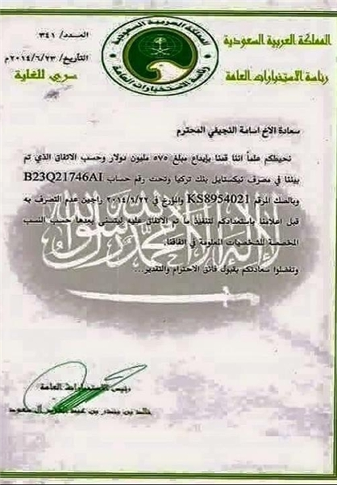
Saudileaks 18: S. Arabia Deposited $575mln to Ex-Iraqi Speaker's Account after Mosul's Fall
TEHRAN (FNA)- Former Iraqi Parliament Speaker Osama al-Nujaifi received over half a billion dollars from the Saudi government 13 days after the fall of Mosul city by the ISIL in 2014, according to one of the documents gained and released by the Yemen Cyber Army after its May hacking of the Saudi Foreign Ministry.
The Saudi Foreign Ministry was hacked by the Yemen Cyber Army in May, and a copy of its information was sent to FNA and another one to the whistleblower website WikiLeaks.
One of the documents released by the YCA showed a letter written by Director General of the Saudi Interior Ministry Bandar bin Abdulaziz Al Saud to Nujaifi saying that Riyadh had deposited $575mln to a Turkish bank 13 days after Mosul's fall on June 10, 2014. FARS News Agency, 6/23/2015, http://english.farsnews.com/newstext.aspx?nn=13940402000971
http://media.farsnews.com/media/Uploaded/Files/Images/1394/04/02/13940402000375.jpg
Turkey ‘allows Syria rebel training’---BBC, 10/13/2014, http://www.bbc.com/news/world-middle-east-29591916
WikiLeaks founder Julian Assange said on Russia’s Rossiya-1 TV channel: "Saudi has been one of the dogs of the United States in the Middle East on a leash, and you think the man is walking a dog, but sometimes, if it is a big dog, the dog starts pulling a man." Sputnik International, 6/28/2015, http://sputniknews.com/middleeast/20150628/1023947807.html
Saudis to Host Syrian Rebel Training--ABCNews, 9/10/2014, http://abcnews.go.com/Politics/wireStory/us-official-saudis-host-syrian-rebel-training-25418990

Slide 116
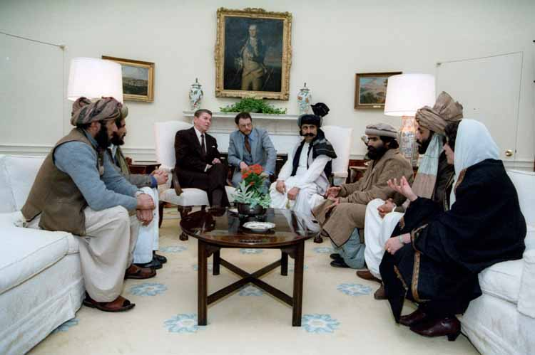
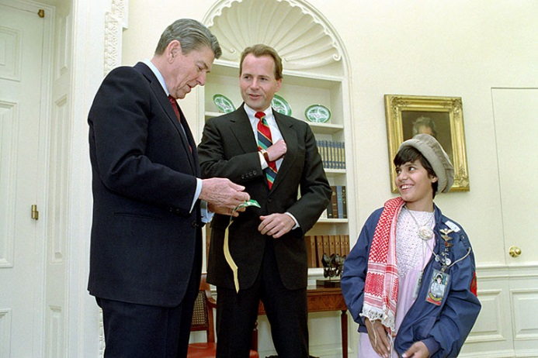
Origins of the Afghan jihad of the 1980s
“Let's begin with Afghanistan… In 8 years more than a million Afghans have been killed; more than 5 million have been driven into exile… Let me repeat: We will continue to support the Mujahidin” [President Ronald Reagan’s] Remarks to the World Affairs Council of Western Massachusetts in Springfield, April 21, 1988, https://www.youtube.com/watch?v=G0TsBjFX7Fk
US Secretary of State George Shultz wrote that Ronald Reagan put “Soviet Jewry at the top of his agenda”---The Jewish Movement in the Soviet Union, p. 420.
“Statement on the International Day of Concern for Soviet Jews, March 15, 1984: …The United States Government […] actively supported the right of Soviet Jews […] to emigrate from the U.S.S.R. if they so choose.” https://reaganlibrary.archives.gov/archives/speeches/1984/84mar.htm
A specially equipped C-141 Starlifter transport carrying William Casey touched down at a military air base south of Islamabad in October 1984 for a secret visit by the CIA director to plan strategy for the war against Soviet forces in Afghanistan. Helicopters lifted Casey to three secret training camps near the Afghan border, where he watched mujaheddin rebels fire heavy weapons and learn to make bombs with CIA-supplied plastic explosives and detonators... Casey wanted to ship subversive propaganda through Afghanistan to the Soviet Union's predominantly Muslim southern republics. The Pakistanis agreed, and the CIA soon supplied thousands of Korans," The Washington Post, 7/19/1992, http://www.globalissues.org/article/258/anatomy-of-a-victory-cias-covert-afghan-war
President Reagan nominated Jewish Neoconservative Paul D. Wolfowitz to be an Assistant Secretary of State, October 28, 1982 (Wolfowitz was the actual architect of the Iraq war of 2003 when he was Deputy Secretary of Defense)
President Nixon was reported saying (in the Nixon-era Oval Office tapes released by the Nixon Library) that the United States “can’t blow up the world because of it [the emigration of Jews from the Soviet Union].”---JTA, 12/13/2010, http://blogs.jta.org/politics/
President Reagan meeting with Afghan Freedom Fighters [jihadis] to discuss Soviet atrocities in Afghanistan, 2/2/1983, https://reaganlibrary.archives.gov/archives/photographs/atwork.html
President Reagan meeting with Congressman David Dreier and Hazrat Khan from Afghanistan, injured by Soviets, in the oval office. 1/27/88. https://reaganlibrary.archives.gov/archives/photographs/atwork.html

Slide 117
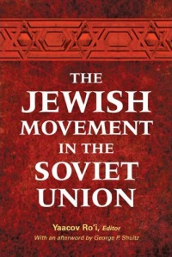
Anatoly Shcharansky, one of the Zionist leaders of the Jewish Movement in the Soviet Union, has suggested that “the Jewish emigration movement was a significant factor in the Soviet Union’s final disintegration.” Yaacov Ro’i, “Introduction: From Disaffection to Political Opportunity and Activism,” In The Jewish Movement in the Soviet Union, edited by Yaacov Ro’i, With an Epilogue by George P. Shultz, Woodrow Wilson Center Press Washington, DC; The John Hopkins University Press, Baltimore, 2012, pp. 1-12, page 11.
Natan Sharansky: “Having been raised as an assimilated Jew in the Soviet Union, I discovered my Jewish identity and belonging to the Jewish people thanks to Israel,” The Jerusalem Post, 12/10/2019, https://www.jpost.com/Israel-News/Genesis-Prize-Foundation-names-Natan-Sharansky-2020-winner-610432
“(JTA) — A local politician from the party of Russian President Vladimir Putin has accused Jews of destroying Russia… The Russian Jewish Congress condemned the lawmaker.” JTA, 2/14/2014, http://www.jta.org/2014/02/14/news-opinion/world/pro-kremlin-lawmaker-jews-destroyed-russia
Bin Laden and al-Qaida's other leaders claim they destroyed the Soviet Union---The Guardian, 9/27/2011, http://www.theguardian.com/world/2011/sep/27/10-myths-about-afghanistan

Slide 118
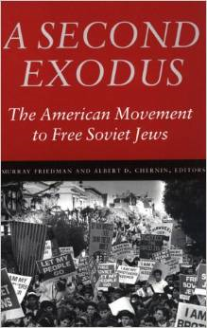
The complex “Western” campaign for Soviet Jews began in 1952-53 with the creation of the Israeli Liaison Bureau, better known under its code name Nativ, and continued until 1989-91
Once the Israelis lit a fire underneath it, the Soviet Jewish cause was embraced by widening circles of American Jews, both among the American Jewish establishment with the guidance of Nativ and among Jewish grassroots groups
More than a million Jews have come out of he Soviet Union since the movement began...
This has to be seen as one of the great exoduses in Jewish history. The means for bringing this emigration about was the Soviet Jewry movement (SJM), a mobilization of Jews and their friends throughout the world to bring pressure on the Communist regime…
The SJM began not in the United States but in Israel….
The SJM developed against the backdrop of the cold war”
1999

Slide 119
The CIA and the origins of Jihadism and terrorism in Afghanistan & Syria
CIA Mission involves "conducting effective covert action as directed by the President.” CIA, Posted: Apr 04, 2007 03:54 PM, Last Updated: Mar 24, 2016 12:17 PM, https://www.cia.gov/about-cia/cia-vision-mission-values
“Generally speaking, covert actions are activities that the CIA might undertake in other countries to accomplish a US foreign policy objective without the hand of the US government becoming known or apparent to the outside world. Thus, it is something different from “collection”: it is doing something in another country beyond merely gathering information. The Agency might use the same people for both kinds of activity, but functionally, the Agency and the Congress have treated these roles differently.” CIA, OVERSIGHT OF COVERT ACTION, https://www.cia.gov/library/center-for-the-study-of-intelligence/csi-publications/books-and-monographs/agency-and-the-hill/12-The%20Agency%20and%20the%20Hill_Part2-Chapter9.pdf
The three monotheistic religions in the area have in common a repugnance to the atheism of communist doctrine and this factor could become an important asset in promoting Western objectives in the area [p.4]. Annex to NSC 129, Top Secret Security, April 7, 1952, https://nsarchive2.gwu.edu/NSAEBB/NSAEBB78/propaganda%20059.pdf
Following the Iranian revolution and BEFORE the Soviet military intervention in Afghanistan in December 1979, United States President Carter signed a covert action finding in January 1980 [actually July 3, 1979, https://dgibbs.faculty.arizona.edu/sites/dgibbs.faculty.arizona.edu/files/afghan-ip.pdf] authorizing the CIA to equip Afghan tribal resistance forces (collectively known as the mujahedin) with weapons. To keep US involvement secret, the operation would acquire Soviet weapons through countries like China and Egypt and transport them to the resistance forces through Pakistan. In 1981 the new Reagan administration began to increase the funding of the Afghan program and Saudi Arabia matched US funding. CIA, Afghanistan: 1979–87, https://www.cia.gov/library/center-for-the-study-of-intelligence/csi-publications/books-and-monographs/agency-and-the-hill/12-The%20Agency%20and%20the%20Hill_Part2-Chapter9.pdf
CIA ramping up covert training program for moderate Syrian rebels, The Washington Post, 10/2/2013, https://www.washingtonpost.com/world/national-security/cia-ramping-up-covert-training-program-for-moderate-syrian-rebels/2013/10/02/a0bba084-2af6-11e3-8ade-a1f23cda135e_story.html
Virginian State Senator Richard Black: "Indeed, ISIS did not even exist until the U.S. invaded Iraq and then Syria. The Syrian government effectively suppressed every hint of terrorism until CIA program Timber Sycamore began supplying arms and jihadist recruits to terrorists in Syria around 2012. The U.S., UK, France, Saudi Arabia and Qatar deliberately established terror networks in Syria in an effort to overthrow the nation,” VT, 12/14/2019, https://www.veteranstoday.com/2019/12/14/terrorism-is-us-policy-in-syria-senator-richard-black//
Behind the Sudden Death of a $1 Billion Secret C.I.A. War in Syria, The New York Times, 8/2/2017, https://www.nytimes.com/2017/08/02/world/middleeast/cia-syria-rebel-arm-train-trump.html
Qatari Foreign Minister on coalition war against Syria, https://www.youtube.com/watch?v=9f33l30kQxg ; https://journal-neo.org/2017/11/18/revelations-of-a-high-profile-qatari-officials-reveal-a-wider-anti-syria-conspiracy/
Saudi Crown Prince honoured by the CIA, Diplomat Magazine, 2/13/2017, http://www.diplomatmagazine.nl/2017/02/13/saudi-crown-prince-honoured-cia/
Spread of Wahhabism was done at request of West during Cold War – Saudi crown prince, RT, 3/28/2018, https://www.rt.com/news/422563-saudi-wahhabism-western-countries/

Slide 120
The Christian Zionist Branch of the Israel Lobby
Former Congressman Paul Findley notes the paradox: “Mainline Christians who accept the legitimacy of the Jewish faith but question some policies of the Jewish state are branded anti-Semitic, while evangelical Christians who back Israel but doubt the theological validity of Judaism are welcome as allies.” The Christian Science Monitor, August 2, 1985, http://www.csmonitor.com/1985/0802/bfindl-f.html
The Evangelical-Jewish Alliance, The Christian Century, June 28, 2003, http://www.religion-online.org/article/the-evangelical-jewish-alliance/
Evangelicals Declare Trump A Friend Of The Jews, Forward, 12/12/2017, https://forward.com/fast-forward/389860/evangelicals-declare-trump-a-friend-of-the-jews/
(1) provides financial support to the Jewish settler movement
(2) opposes any territorial concession to the Palestinians
(3) contributes to tourism in Israel, a lucrative economic sector generating
$2.8 billion in 2004 p138 and 400 [4.5 million tourists visited Israel in 2019, JP, 1/5/2020]
(4) Yet the influence of the Christian Zionists should not be overstated
(5) In sharp contrast to the groups like AIPAC, Christian Zionists lack the organizational capacity to analyze national security topic
(6) They lack the organizational capacity to offer specific legislation guidance on concrete foreign policy issues
(7) They also lack the financial power of the major pro-Israel groups
(8) They do not have the same media presence when it comes to the Middle East issues
(9) Therefore Christian Zionists “are best seen as a significant adjunct to the Jewish elements of the lobby, but not its most important part”---Source: John Mearsheimer and Stephen Walt, The Israel lobby and U.S. foreign policy (2007), p. 132-139 https://www.youtube.com/watch?v=aRyVzVNY1fI
[Israeli Prime Minister Binyamin Netanyahu] Bibi: Christian Zionists our top friends, Jerusalem Post, 4/7/2008, http://www.jpost.com/Israel/Bibi-Christian-Zionists-our-top-friends
Stephen Bannon [executive chairman of Breitbart News]: “I’m a Proud Christian Zionist”, VT, 11/15/2017, https://www.veteranstoday.com/2017/11/15/stephen-bannon-im-a-proud-christian-zionist/
Allies for Armageddon: The Rise of Christian Zionism, VT, 11/28/2017, https://www.amazon.com/Allies-Armageddon-Rise-Christian-Zionism/dp/0300116985?tag=veteranstoday-20
Leader of Christian Zionists Named Head of Campus Anti-BDS Group, Forward, 7/8/2015, http://forward.com/news/311662/leader-of-christian-zionists-named-head-of-adelson-campus-anti-bds-group/
Jonathan Farrell: Why I'm a Christian Zionist, The Global Jewish Channel (GJC), 9/10/2017, https://www.youtube.com/watch?v=e0w06Ro5pcY&list=PLEVTqoofQtWO7topNOIO8EDp1c3PNwCxi&index=10
Noor Dahri: I'm a Muslim Zionist. Here's why… Thankfully, the Arab countries of the Gulf are slowly realizing that Israel is not an enemy, GJC, 11/5/2017, https://www.youtube.com/watch?v=BC9GlA55sCI&list=PLEVTqoofQtWO7topNOIO8EDp1c3PNwCxi&index=2
How the White House is courting evangelicals on its Israeli-Palestinian peace plan, NCR, 3/29/2019, https://www.ncronline.org/news/politics/how-white-house-courting-evangelicals-its-israeli-palestinian-peace-plan
US Senator Biden: “I am a Zionist …You don't have to be a Jew to be a Zionist”, Shalom TV, 3/27/2007
"[T]housands of [Evangelical/Zionist] Christians coming to the [Israeli-occupied Palestinian] West Bank to work for free for Jewish settlers [who do not believe in Jesus]," Forward, 12/7/2018, https://forward.com/news/415630/inside-the-evangelical-money-flowing-into-the-west-bank
Rabbi Yechiel Eckstein raised millions in Christian donations for Israel. Now the late activist’s daughter steps into his shoes, Forward, 2/26/2019, https://www.jta.org/2019/02/26/israel/rabbi-yechiel-eckstein-raised-millions-in-christian-donations-for-israel-now-the-late-activists-daughter-steps-into-his-shoes
Israeli Rabbi Ovadia Yosef said: “The sole purpose of non-Jews is to serve Jews”, Jewish Telegraphic Agency, October 7, 2013 http://www.jta.org/2013/10/07/life-religion/ovadia-yosef-founder-of-shas-and-sephardi-sage-dies-at-93
Evangelicals Led Drive To Name Jerusalem As Capital, AIPAC Stayed On Sidelines... Vice President Mike Pence, has served as Christian Zionists’ main channel to the White House, Forward, 12/6/2017, https://forward.com/news/national/389233/evangelicals-led-drive-to-name-jerusalem-as-capital-aipac-stayed-on-sidelin/
This Jewish Group [Israel365, https://www.israel365.com/] Uses ‘Biblical Prophecy’ To Grow Christian Support For Israel, Forward, 9/8/2018, https://forward.com/news/israel/403254/israeli-evangelical-news-website-mixes-current-events-with-biblical/
[US Vice President Michael] Pence will be the first sitting vice president or president to speak to the Christian Zionist organization in its 11-year history, The Washington Post, 7/17/2017, https://www.washingtonpost.com/news/made-by-history/wp/2017/07/17/what-you-need-to-know-about-mike-pences-speech-to-christians-united-for-israel/?utm_term=.cb4e4e2efa51
Why Do Fundamentalist Christians Support Israel – Right Or Wrong? VT, 12/14/2018, https://www.veteranstoday.com/2018/12/14/why-do-fundamentalist-christians-support-israel-right-or-wrong/
The Scofield Bible—The Book That Made Zionists of America’s Evangelical Christians, https://www.wrmea.org/2015-october/the-scofield-bible-the-book-that-made-zionists-of-americas-evangelical-christians.html
Church heads against Israeli 'racist bill that will harm Christians', The Jerusalem Post, 12/22/2018, https://www.jpost.com/Israel-News/Church-heads-against-Israeli-racist-bill-that-will-harm-Christians-575064

Slide 121
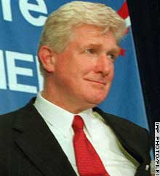
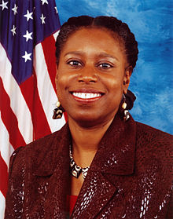
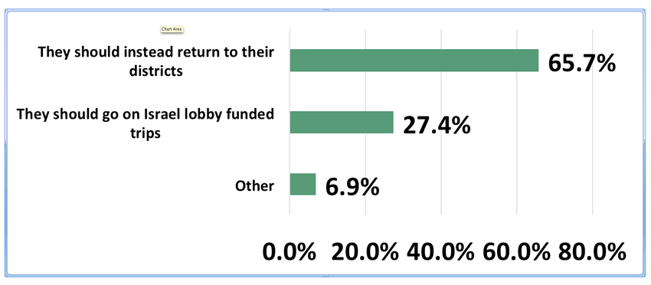
Moran steps down from leadership post
Lawmaker under fire for saying Jews push war with Iraq
Lawmaker under fire for saying Jews support Iraq war
Moran apologizes; White House blasts comments
https://www.youtube.com/watch?v=nF1pVexReqA
The Iraq War Began March 19, 2003
CNN, March 14, 2003. http://www.cnn.com/2003/ALLPOLITICS/03/14/moran.remarks/index.html
CNN, March 11, 2003, http://www.cnn.com/2003/ALLPOLITICS/03/11/moran.jews/index.html
Watch [Former US Congresswoman] Cynthia McKinney: US Lawmakers FORCED to Support Israel! https://www.youtube.com/watch?v=w_VNOk7Wv5A
“Visit your district, not Israel” 65.7 percent of Americans tell Congress
IRmep Poll: 41 House Democrats are now visiting Israel during the Congressional recess on a trip funded by a tax-exempt pro-Israel charity linked to the U.S. Israel lobby group AIPAC. Source: IRmep representative poll of 2,000 American adults through Google Surveys on August 8-10 [2019], https://www.irmep.org/polls/

Slide 122
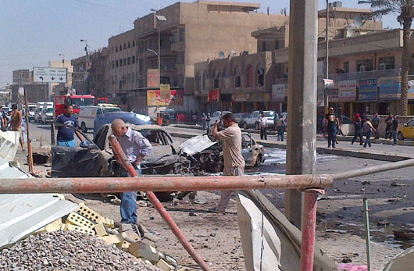
Iraq: Ten Years, a Million Lives and Trillions Of Dollars Later
Ten years ago today the debate over the Iraq war came to Congress in the form of a resolution promoted by the Bush administration. The war in Iraq will cost the United States as much as $5 trillion. It played a role in spurring the global financial crisis. Four thousand, four hundred and eighty eight Americans were killed. More than 33,000 were injured. As many as 1,000,000 innocent Iraqi civilians were killed. The monetary cost of the war to Iraq is incalculable. A sectarian civil war has ravaged Iraq for nearly a decade. Iraq has become home to al-Qaeda. The war in Iraq was sold to Congress and the American people with easily disproved lies. We must learn from this dark period in American history to ensure that we do not repeat the same mistakes. And we must hold accountable those who misled the American public. --Former presidential candidate Rep. Dennis Kucinich, Washington Report on Middle East Affairs, November/December 2012, Page 11,
http://www.wrmea.org/wrmea-archives/520-washington-report-archives-2011-2015/nov-dec-2012/11464-what-they-said-iraq-ten-years-a-million-lives-and-trillions-of-dollars-later.html
Chilcot: Intelligence reports confirm Iraq war created ISIS . RT, 7/7/2016, https://www.rt.com/uk/349872-invasion-created-isis-intelligence
Death toll from devastating ISIS truck bomb in Baghdad rises to nearly 300, CNN, 7/7/2016, http://www.cnn.com/2016/07/07/middleeast/iraq-baghdad-bomb-toll-rises/
Iraqis inspect the site of a car bomb in central Baghdad’s Karrada district, Sept. 30, 2012. Nine car bombs and a shooting occurred that day in six Iraqi cities and towns, killing at least 15 people and wounding 42, officials said. (W.G. Dunlop/AFP/GettyImages)
Civilian death toll in Iraq doubles to 17,000 in 2014 ‘due to rise of ISIS’---RT, 1/1/2015, http://rt.com/news/219223-iraq-civilian-death-toll/
An average of 20 American veterans committed suicide daily in 2014, the US Department of Veterans Affairs revealed in its “most comprehensive” study of vet suicide rates yet. RT, 7/8/2016, https://www.rt.com/usa/350048-20-veterans-committed-suicide-every/

Slide 123
A Strategy for Israel in the 1980s: The idea that all the Arab states should be broken down, by Israel, into small units, occurs again and again in Israeli strategic thinking. For example, Ze'ev Schiff, the military correspondent of Ha'aretz (and probably the most knowledgeable in Israel, on this topic) writes about the "best" that can happen for Israeli interests in Iraq: "The dissolution of Iraq into a Shi'ite state, a Sunni state and the separation of the Kurdish part" (Ha'aretz 6/2/1982). by Oded Yinon (with a foreword by, and translated by Israel Shahak), http://cosmos.ucc.ie/cs1064/jabowen/IPSC/articles/article0005345.html#6n
A Clean Break: A New Strategy for Securing the Realm [Israel], Prepared by the Jerusalem-based Institute for Advanced Strategic and Political Studies' Study Group on a New Israeli Strategy Toward 2000: A report prepared in 1996 by a neoconservative study group led by Richard Perle for Israeli Prime Minister Benjamin Netanyahu. We read in the report: “Israel can shape its strategic environment, in cooperation with Turkey and Jordan, by weakening, containing, and even rolling back Syria. This effort can focus on removing Saddam Hussein from power in Iraq — an important Israeli strategic objective in its own right — as a means of foiling Syria’s regional ambitions.”
Participants in the Study Group on "A New Israeli Strategy Toward 2000:"
Richard Perle [ https://www.pbs.org/thinktank/transcript1017.html ], American Enterprise Institute, Study Group Leader
James Colbert, Jewish Institute for National Security Affairs
Charles Fairbanks, Jr., Johns Hopkins University/SAIS
Douglas Feith, Feith and Zell Associates
Robert Loewenberg, President, Institute for Advanced Strategic and Political Studies
Jonathan Torop, The Washington Institute for Near East Policy
David Wurmser, Institute for Advanced Strategic and Political Studies
Meyrav Wurmser, Johns Hopkins University http://www.informationclearinghouse.info/article1438.htm
“ If we destroy the Taliban in Afghanistan, and I’m confident we will, and we then go on to destroy the regime of Saddam Hussein, and we certainly could if we chose to do so, I think we would have an impressive case to make to the Syrians… We could deliver a short message, a two-word message: “You're next.”---- Richard Perle, Chairman of the Defense Policy Board, an advisory panel to the Defense Department, and a resident fellow of the American Enterprise Institute, “Next Stop, Iraq,” FPRI, 11/14/2001, http://www.fpri.org/article/2012/08/next-stop-iraq/
US Secretary of State Colin Powell has called on Syria and Lebanon to end all support for [anti-Israel] groups Washington classifies as terrorist organisations. BBC, 5/3/2003, http://news.bbc.co.uk/2/hi/middle_east/2995483.stm
The Obama administration said repeatedly that Syrian President Assad “must go” before ending the Syria war which killed hundreds of thousands of Syrians and threw millions into refugee camps, published 9/24/2014, https://www.youtube.com/watch?v=SSBRk10E5R8
Hillary Clinton Email Achieve informs us that Assad “must go” because that is “the best way to help Israel,” US Department of State, 11/30/2015, https://wikileaks.org/clinton-emails/Clinton_Email_November_Release/C05794498.pdf
Donald Trump, "We Spent $6 Trillion Dollars In The Middle East! We Could Have Rebuilt Our Country!" https://www.youtube.com/watch?v=1jF2M5-knXk
Israel Secretly Armed and Funded 12 Syrian Rebel Groups, Report Says, Haaretz, 9/6/2018, https://www.haaretz.com/israel-news/report-israel-secretly-armed-and-funded-12-syrian-rebel-groups-1.6462729
Inside Israel’s Secret Program to Back Syrian Rebels, Foreign Policy, 9/6/2018, https://foreignpolicy.com/2018/09/06/in-secret-program-israel-armed-and-funded-rebel-groups-in-southern-syria/
Israel Struck 200 Targets in Syria in the Past Year and a Half, Haaretz, 9/4/2018, https://www.haaretz.com/israel-news/.premium-israel-struck-200-targets-in-syria-in-the-past-year-and-a-half-1.6450610
Israel Gives Secret Aid to Syrian Rebels, The Wall Street Journal, 6/18/2017, https://www.wsj.com/articles/israel-gives-secret-aid-to-syrian-rebels-1497813430
Israel acknowledges it is helping Syrian rebel fighters, Times of Israe, 6/29/2015, https://www.timesofisrael.com/yaalon-syrian-rebels-keeping-druze-safe-in-exchange-for-israeli-aid/
"Since the Iranian revolution in 1979, Syria and Iran have maintained a strategic alliance." Source: Syria's alignment with Iran and efforts to encourage Syrian defection, Rasmussen, Zachary Bret. The University of Utah, ProQuest Dissertations Publishing, 2011. 1488722.
U.S. General Wesley Clark: U.S. Military Plan To Overthrow 7 Countries In 5 Years. WATCH the first 2mn:40s video clip: https://www.youtube.com/watch?v=hss1xDQPooo
Dividing Iraq – From Op-Eds, To News, To Truth. Global Research, 5/29/2017, https://www.globalresearch.ca/tracing-the-history-of-the-partitioning-of-iraq/5592441
US Senator Biden proposes partitioning Iraq into 3 regions, NBC News, 5/1/2006, http://www.nbcnews.com/id/12572371/ns/world_news-mideast_n_africa/t/biden-proposes-partitioning-iraq-regions/
“As soon as Baghdad fell in mid-April 2003, Israeli leaders began urging the United States to concentrate on Damascus," Mearsheimer and Walt, The Israel Lobby, page 272

Slide 124
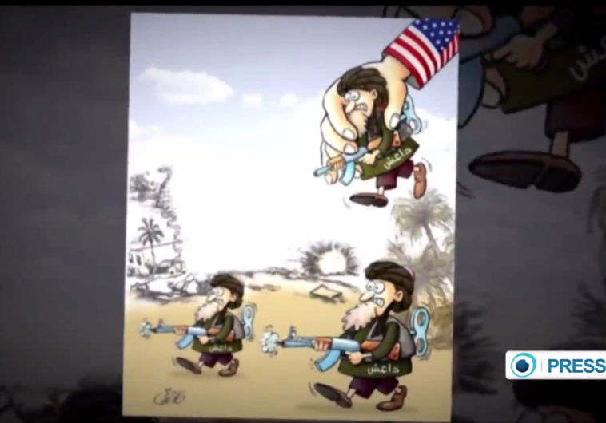
Arms Airlift to Syria Rebels Expands, With Aid From C.I.A
The New York Times, 3/24/2013, http://www.nytimes.com/2013/03/25/world/middleeast/arms-airlift-to-syrian-rebels-expands-with-cia-aid.html
Defense Intelligence Agency: “Establish a Salafist Principality in Syria”, Facilitate Rise of Islamic State [i.e., Caliphate] “In Order to Isolate the Syrian Regime”---Declassified DIA document
On Monday, May 18, 2015, the conservative government watchdog group Judicial Watch published a selection of formerly classified documents obtained from the U.S. Department of Defense and State Department through a federal lawsuit…
The DIA report, formerly classified “SECRET//NOFORN” and dated August 12, 2012, was circulated widely among various government agencies, including CENTCOM, the CIA, FBI, DHS, NGA, State Dept., and many others.
This is the highest level internal U.S. intelligence confirmation of the theory that western governments fundamentally see ISIS as their own tool for regime change in Syria. Global Research, 5/22/2015, http://www.globalresearch.ca/defense-intelligence-agency-create-a-salafist-principality-in-syria-facilitate-rise-of-islamic-state-in-order-to-isolate-the-syrian-regime/5451216
US ex-intelligence chief [Lieutenant General Michael Flynn] on ISIS rise: It was 'a willful Washington decision'---RT, 8/10/2015, https://www.rt.com/usa/312050-dia-flynn-islamic-state/
Saudi cleric swears by God that the Caliphate is coming! https://www.youtube.com/watch?v=E33T3vAK968
Turkey Smuggled Jihadist Fighters into Syria, Israel National News, 6/5/2015, http://www.israelnationalnews.com/News/News.aspx/196350#.VXLy3ZvbLDc
Iranian cartoon contest links US, Israel to ISIS
Jerusalem Post, 5/25/2015, http://www.jpost.com/Middle-East/ISIS-cartoon-contest-in-Tehran-draws-works-from-forty-countries-404012

Slide 125
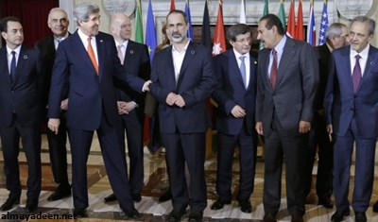
The War On/In Syria; Why?
The Obama administration: Syrian President Assad “must go”, https://www.youtube.com/watch?v=SSBRk10E5R8
Why? Clinton Email: because that is “the best way to help Israel,” https://wikileaks.org/clinton-emails/Clinton_Email_November_Release/C05794498.pdf
/
Netanyahu and Graham,
https://www.youtube.com/watch?v=QjZj1YGXetk
Friedman joins Graham
https://www.youtube.com/watch?v=VsRDwfFWEQc
What Do Israelis Think About Americans?
http://forward.com/articles/216074/what-do-israelis-think-about-americans-start-with/
Obama asks Congress for $500 million to train Syria rebels, Los Angeles Times, 6/26/2014, http://www.latimes.com/world/middleeast/la-fg-obama-syria-20140627-story.html
http://www.globalresearch.ca/twenty-six-things-about-the-islamic-state-isil-that-obama-does-not-want-you-to-know-about/5414735
Iran cooperates with Russia in Syria, https://www.youtube.com/watch?v=qBB4rv9fgkQ China helps Syria, https://www.youtube.com/watch?v=pzuPA5_E6FI
Syria: Assad's full interview with RT and Russian journalists in Damascus, https://www.youtube.com/watch?v=QUmYnA22oI4
US Virginia State Senator Richard Black on the war in/on Syria (45mn) , https://www.youtube.com/watch?v=FR_s9Uff5NQ
WSJ: Gulf States Offer to Normalize Ties with Zionist Entity, Al Manar TV, 5/16/2017, http://english.almanar.com.lb/263811
Who's with the US on Syria airstrike and who isn't,
CNN, 4/7/2017,
http://www.cnn.com/2017/04/07/world/syria-us-strike-world-reaction/index.html
U.S. Secretary of State
https://www.youtube.com/watch?v=t3KfmjdviHM
Syrian Islamist rebel chief
UK Foreign Secretary
Qatari Foreign Minister
https://www.youtube.com/watch?v=9f33l30kQxg
https://journal-neo.org/2017/11/18/revelations-of-a-high-profile-qatari-officials-reveal-a-wider-anti-syria-conspiracy/
Saudi Foreign Minister
https://www.veteranstoday.com/2019/02/03/saudi-arabia-says-it-went-nuclear-in-2014-and-america-knows-it
Turkish Foreign Minister
[Israeli] Housing Minister: Assad needs to be assassinated, Israel National News, 5/6/2017, http://www.israelnationalnews.com/News/News.aspx/229717
US Vice President Biden blames US allies for rise of ISIS, https://www.youtube.com/watch?v=AoQO81hKC3A
Israel hits ‘military airport west of Damascus’ Syria Times, 1/13/2017, http://syriatimes.sy/index.php/news/local/28648-new-occupation-missile-attack-on-mezzeh-military-airport-west-of-damascus
Google planned to help Syria rebels to bring down Assad regime, leaked Hillary Clinton emails claim, The Independent, 3/22/2016, http://www.independent.co.uk/life-style/gadgets-and-tech/news/google-syria-rebels-defection-hillary-clinton-emails-wikileaks-a6946121.html
Israeli Rabbi Ovadia Yosef said: “The sole purpose of non-Jews is to serve Jews.”, while Israeli Prime Minister Benjamin Netanyahu said: Rabbi Ovadia "worked greatly to enhance Jewish heritage.” Jewish Telegraphic Agency, October 7, 2013 http://www.jta.org/2013/10/07/life-religion/ovadia-yosef-founder-of-shas-and-sephardi-sage-dies-at-93
Top [Qatar-based Egyptian] cleric Qaradawi calls for Jihad against Hezbollah, Assad in Syria, Alarabiya, 6/2/2013, http://english.alarabiya.net/en/News/middle-east/2013/06/02/Top-cleric-Qaradawi-calls-for-Jihad-against-Hezbollah-Assad-in-Syria.html
Former Mossad head Dagan: Israel should do whatever it can to bring down Syria’s Assad, Jewish Telegraphic Agency, April 29, 2013, http://www.haaretz.com/news/diplomacy-defense/former-mossad-head-dagan-israel-should-do-whatever-it-can-to-bring-down-syria-s-assad.premium-1.518081
Saudi cleric Mohamad al-Arifi declares Jihadim against Syria, https://www.youtube.com/watch?v=TadzfSjZ6yM
American cleric John Hagee on Iran/Hamas/Hezbollah/Syria, https://www.youtube.com/watch?v=nZZM-8F_JYk , https://www.youtube.com/watch?v=unwH2hUuyKo ,
American Rabbi David Weiss Rips the Ideology of Zionism, Published on May 4, 2009, https://www.youtube.com/watch?v=P_ZiVRedU-4
Israel urged the United States to change the regimes in both Iraq and Syria, Mearsheimer & Walt, The Israel Lobby, p. 272
UN puts cost of Syria war destruction at $388 billion (excluding economic cost of 'human loss' due to death and displacement), The Times of Israel, 8/8/2018, https://www.timesofisrael.com/un-puts-cost-of-syria-war-destruction-at-388-billion/
MBS [Saudi Crown Prince Mohammed bin Salman]: "Al-Qaeda leaders, ISIS leaders, they were all Muslim Brotherhood first. Osama bin Laden, Ayman al-Zawahiri,
the leader of ISIS. This is very clear... We used the Muslim Brotherhood in the Cold War—we did, both of us [Saudi Arabia and the United States]... This is what
America wanted us to do." MBS also recognized the Jewish people’s right to “their own land.” The Atlantic, 4/2/2018, https://www.theatlantic.com/international/archive/2018/04/mohammed-bin-salman-iran-israel/557036/
This brings to mind a Roman-Persian rivalry map on the eve of the advent of Islam, https://upload.wikimedia.org/wikipedia/commons/4/40/NE_565ad.jpg

Slide 126
[U.S. Senator Rand] Paul: US has been arming ISIS in Syria
Sen. Rand Paul (R-Ky.) said Sunday that the Sunni militants taking over Iraq have quickly gained power because the United States has armed their group in Syria. “I think we have to understand first how we got here,” he said on CNN’s “State of the Union.” “We have been arming [the Islamic State in Iraq and Syria] ISIS in Syria.” ISIS, an al Qaeda offshoot, has been collaborating with the Syrian rebels whom the Obama administration has been arming in their efforts to overthrow Syrian President Bashar al-Assad, Paul explained. The Hill, 6/22/2014, http://thehill.com/policy/international/210168-us-has-been-arming-isis-in-syria-sen-paul-claims
President Obama may have justified arming ISIS when he said in an interview with CBS News: "I think this notion that somehow there was this ready-made, moderate Syrian force that was able to defeat Assad is simply not true." The Washington Post, 6/22/2014, http://www.washingtonpost.com/blogs/post-politics/wp/2014/06/22/obama-says-isis-poses-a-medium-and-long-term-threat-to-americans
The reason, President Obama added, “that we did not just start taking a bunch of airstrikes all across Iraq as soon as ISIL came in was because that would have taken the pressure off of [Prime Minister Nuri Kamal] al-Maliki.” The New York Times, 8/8/2014, https://www.nytimes.com/2014/08/09/opinion/president-obama-thomas-l-friedman-iraq-and-world-affairs.html
We will stand by Isis until Maliki steps down, says leader of Iraq's biggest tribe, The Telegraph, 6/29/2014, http://www.telegraph.co.uk/news/worldnews/middleeast/iraq/10934438/We-will-stand-by-Isis-until-Maliki-steps-down-says-leader-of-Iraqs-biggest-tribe.html
U.S. Troops to Begin Establishing Syrian Opposition Training Sites, Jan. 23, 2015 –DoD, http://www.defense.gov/news/newsarticle.aspx?id=128026
US ex-intelligence chief [Lieutenant General Michael Flynn] on ISIS rise: It was 'a willful Washington decision'---RT, 8/10/2015, https://www.rt.com/usa/312050-dia-flynn-islamic-state/
US contributed to ISIS creation, now tries to claim victory over it – Iraqi VP talks tough, VT, 7/22/2017, http://www.veteranstoday.com/2017/07/22/us-contributed-to-isis-creation-now-tries-to-claim-victory-over-it-iraqi-vp-talks-tough/

Slide 127
Axis1 countries engage in terrorism blame game after their failure to bring down the Syrian government
Biden blames US allies in Middle East for rise of ISIS
RT, October 03, 2014, video clip: https://www.rt.com/news/192880-biden-isis-us-allies/ , https://www.youtube.com/watch?v=AoQO81hKC3A
Two NATO allies accusing each other of helping terrorists. Erdogan says U.S.-led coalition gives support to terrorist groups in Syria, Reuters, 12/27/2017, http://www.reuters.com/article/us-mideast-crisis-syria-turkey-idUSKBN14G1EU
"Turkey and the U.S., Ankara’s biggest ally in the Western defense organization NATO, are embroiled in a new row over the Syrian civil war and are publically accusing each other of helping terrorists." Daily News, 8/1/2017, http://www.hurriyetdailynews.com/two-nato-allies-accusing-each-other-of-helping-terrorists.aspx?PageID=238&NID=116176&NewsCatID=409
Saudi, UAE, Bahrain, Egypt cut ties with Qatar over terrorism. The UAE has given Qatar’s diplomatic mission in Abu Dhabi 48 hours to leave the country, Gulf News, 6/5/2017,
http://gulfnews.com/news/gulf/saudi-arabia/saudi-uae-bahrain-egypt-cut-ties-with-qatar-over-terrorism-1.2038481
Netanyahu Confirms: Israel Operates in Syria 'From Time to Time'
Prime Minister Benjamin Netanyahu said Tuesday “we operate in Syria from time to time to prevent Syria from becoming a front against us.” Haaretz, 12/1/2015, http://www.haaretz.com/israel-news/.premium-1.689490
'I Have Confirmed Evidence'
Turkey’s president Recep Tayyip Erdogan claims US-led coalition forces have ‘supported ISIS’, The Sun, 12/27/2016, https://www.thesun.co.uk/news/2484782/turkeys-president-tayyip-erdogan-claims-us-led-coalition-forces-have-supported-isis/
Video clip: Erdogan: 'Confirmed evidence' US-led coalition supports ISIS & other terrorists in Syria, RT, 12/27/2016, https://www.youtube.com/watch?v=3vAZK3_gH34

Slide 128
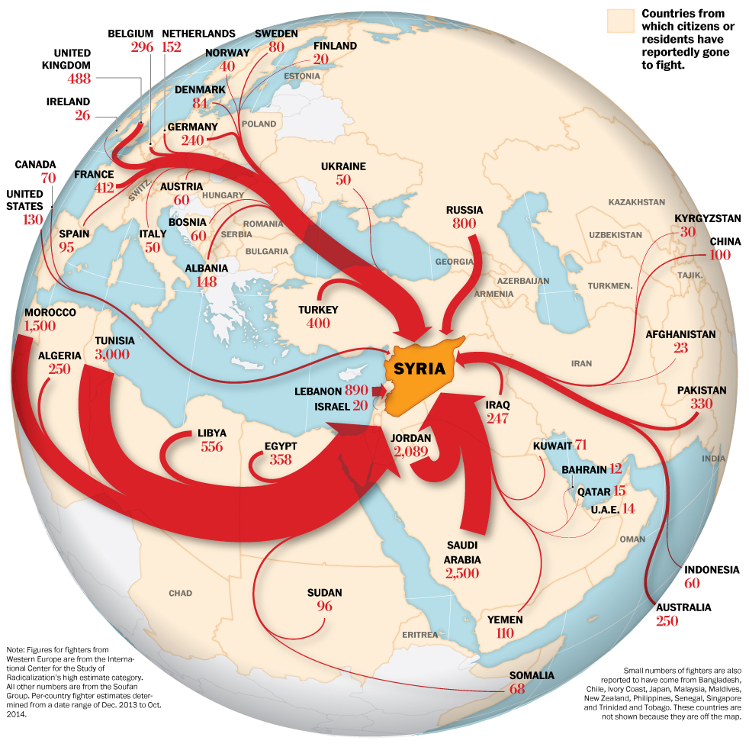
Foreign fighters flow to Syria
Washington Post, 10/11/2014, http://www.washingtonpost.com/world/foreign-fighters-flow-to-syria/2014/10/11/3d2549fa-5195-11e4-8c24-487e92bc997b_graphic.html
According to the World Bank, the war in Syria destroyed the social and economic fabric of the country, killed over 320,000 people, displaced more than half the country's population, cost $226 billion to the country's economy, and led to the loss of 538,000 jobs annually between 2010 and 2015, Daily Mail, 7/10/2017, http://www.dailymail.co.uk/wires/afp/article-4682362/War-cost-226-billion-Syria-economy-World-Bank.html
Former Prime Minister of Qatar Hamad Bin Jassim announced that a total of $137 billion was wasted on the attempts to topple Syrian President Assad’s government, VT, 11/28/2017, https://www.veteranstoday.com/2017/11/28/revelations-of-a-high-profile-qatari-official-reveal-a-wider-anti-syria-conspiracy/comment-page-1/
Syria conflict: UK planned to train and equip 100,000 rebels, BBC, 7/3/2014, http://www.bbc.com/news/uk-28148943
Obama: “if you look at the number of Americans killed since 9/11 by terrorism, it's less than 100. If you look at the number that have been killed by gun violence, it's in the tens of thousands.” BBC, 7/24/2015, http://www.bbc.com/news/world-us-canada-33646542

Slide 129
Islamic ethics and values of human brotherhood and the virtue of good deeds, words, and intentions
“People, We created you all from a single man and a single woman, and made you into nations and tribes so that you should get to know one another. In God's eyes, the most honoured of you are the ones most aware of Him: God is all knowing, all aware.” Quran 49:13
“Believers, no one group of men should jeer at another, who may after all be better than them; no one group of women should jeer at another, who may after all be better than them; do not speak ill of one another; do not use offensive nicknames for one another, How bad it is to be called a mischief-maker after accepting faith! Those who do not repent of this behaviour are evildoers.” Quran 49:11
“Believers, avoid making too many assumptions—some assumptions are sinful—and do not spy on one another or speak ill of people behind their backs: would any of you like to eat the flesh of your dead brother? No, you would hate it. So be mindful of God: God is ever relenting, most merciful.” Quran 49:12
“Believers, if a troublemaker brings you news, check it first, in case you wrong others unwittingly and later regret what you have done” Quran 49:6
“Whoever has done an atom’s-weight of good will see it” Quran 99:7
“But [even in a battle] when you [believers] are offered a greeting, respond with a better one, or at least return it: God keeps account of everything” Quran 4:85-86
“God may still bring about affection between you and your present enemies—God is all powerful, God is most forgiving and merciful— 8 and He does not forbid you to deal kindly and justly with anyone who has not fought you for your faith or driven you out of your homes: God loves the just. 9 But God forbids you to take as allies those who have fought against you for your faith, driven you out of your homes, and helped others to drive you out: any of you who take them as allies will truly be wrongdoers.” Quran 60:7-9
Prophet Muhammad said: “All mankind is from Adam and Eve. An Arab has no superiority over a non-Arab, nor does a non-Arab have any superiority over an Arab; also a white has no superiority over a black, nor does a black have any superiority over a white except by piety and good action.” From Prophet Muhammad's Farewell Sermon
Prophet Muhammad’s close companions include Salman the Persian, Bilal the Ethiopian, and Suhaib the Roman. Aljami’ Alsagheer
Prophet Muhammad said: “None of you [truly] believes until he loves for his brother or for his neighbor that which he loves for himself.” Sahih Muslim
Prophet Muhammad said: “Actions are only according to intentions, and to each only what he intended.” Sahih Bukhari
Prophet Muhammad said: "Verily, God does not look to your bodies nor to your faces but He looks to your hearts.” Sahih Muslim
Prophet Muhammad’s cousin, son-in-law, fourth Muslim caliph/successor of Prophet Muhammad, and the first imam and the ancestor of all subsequent imams in Islamic Shia schools, Ali said: “Humans are of two types: Either your brother in faith, or equal in humanity.” Nahjulbalagha

Slide 130
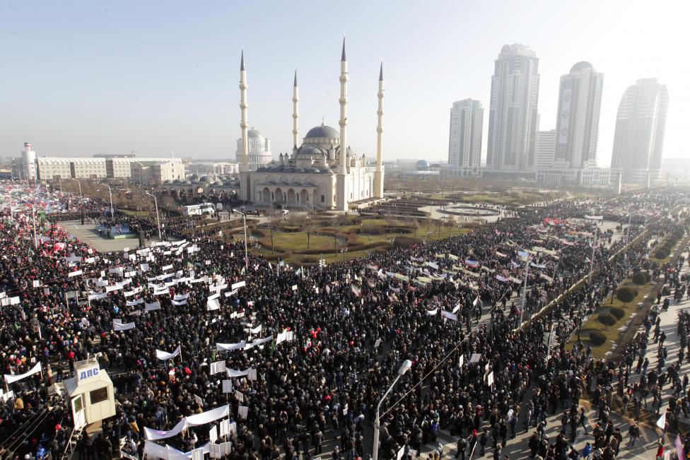
Chechens protest Mohammad cartoons
People attend a rally to protest against satirical cartoons of prophet Mohammad, near the Heart of Chechnya mosque in Grozny, Chechnya, [Russia], January 19, 2015. REUTERS/Eduard Korniyenko
http://www.reuters.com/news/picture/chechens-protest-mohammad-cartoons?articleId=USRTR4M1JH

Slide 131
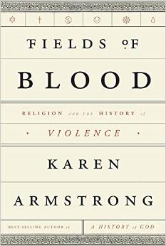
The book
Fields of Blood makes vividly clear that religion is not the problem
https://www.bookbrowse.com/bb_briefs/detail/index.cfm/ezine_preview_number/10051/fields-of-blood
‘Muhammad cartoons’ and the Israeli Mossad strategy to polarize a West-East confrontation:
Dutch anti-Islam politician [Geert] Wilders shows Mohammed cartoons on national TV, RT, 6/25/2015, http://rt.com/news/269569-geert-wilders-mohammad-cartoons/
[Geert] Wilders, who speculates that some of his ancestors were Jewish, felt completely at home upon his arrival in Israel. "It felt like I had been there before," he says. Spiegel, 3/27/2008, http://www.spiegel.de/international/europe/islam-critic-wilders-a-missionary-with-dark-visions-a-543627.html
Wilders, who in his youth lived for two years on an Israeli moshav in the Jordan Valley, has called Israel “a place where I feel home” and said it was “close to his heart.” He has also called Israel a “canary in the coal mine” and “the West’s first line of defense against Islam.” Jewish Telegraphic Agency, 3/15/2017, http://www.jta.org/2017/03/15/news-opinion/world/dutch-anti-islam-party-of-geert-wilders-finishes-2nd-to-ruling-party-in-exit-polls
The caricatures in Middle East politics, What is the political background of "Flemming Rose" the cultural editor of Jyllands-Posten, who solicited, selected and published the cartoons? Professor James Petras, 2/26/2006, http://petras.lahaine.org/articulo.php?p=9&more=1&c=1
“From the 1980s on Jewish organizations have promoted Holocaust commemoration and education, with Holocaust Studies now a required part of most western school curricula, laws specifically prohibiting questioning of the official Israeli-sanctioned version of WWII history concerning the Jews, and Holocaust Museums in at least 20 US cities and another 30 in other countries. Though Muslims played no role whatsoever in the persecution of Jews in Europe under the Nazis, this Holocaust industry is a central part of the campaign to vilify Islam. David Hotowitz has organized ‘Islamofascism Awareness Week’ (IFAW) on close to 100 college campuses since 2007, identifying Islam with Nazism.” Eric Walberg, Geopolitics and the Great Games, Clarity Press, 2011, page 203.
Israeli Prime Minister “Benjamin Netanyahu blames Holocaust on Palestinian leader Haj Amin al-Husseini”---- The Independent, 10/21/2015, http://www.independent.co.uk/news/world/middle-east/benjamin-netanyahu-blames-holocaust-on-palestinian-leader-haj-amin-al-husseini-a6702091.html
Major Jewish Leader Spent $1M On Secret Group Pushing Anti-Muslim Campaign Ads, Forward, 4/5/2018, https://forward.com/fast-forward/398216/major-jewish-leader-spent-1m-on-secret-group-pushing-anti-muslim-campaign/?attribution=articles-hero-item-text-5
AIPAC [a branch of the Israel lobby] Gave $60K to Group That Inspired Trump's Muslim Ban, Haaretz, 3/16/2017, http://www.haaretz.com/us-news/.premium-1.777541
Charity Headed By U.S. Ambassador To Israel Gave Money To Terrorist Group, Forward, 5/13/2018, https://forward.com/news/breaking-news/400955/charity-headed-by-david-friedman-us-envoy-to-israel-gave-money-to-former/
The Supreme Court upheld President Trump’s ban on travel from several predominantly Muslim countries, The New York Times, 6/26/2018, https://www.nytimes.com/2018/06/26/us/politics/supreme-court-trump-travel-ban.html
New Zealand mosque attacks suspect praised Trump in manifesto, Aljazeera, 3/16/2019, https://www.aljazeera.com/news/2019/03/zealand-mosques-attack-suspect-praised-trump-manifesto-190315100143150.html
The head of the Zionist Organization of America, Morton Klein, told a congressional committee that the New Zealand mosque shooter was a “left-wing” terrorist, Forward, 4/9/2019, https://forward.com/fast-forward/422317/zoa-mort-klein-new-zealand-white-nationalist-left-wing/

Slide 132
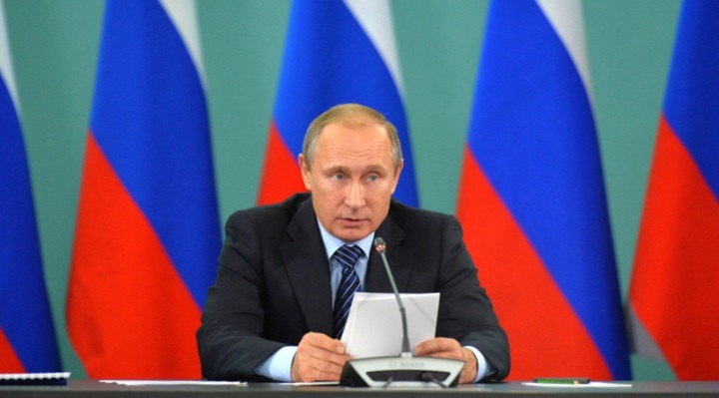
Putin: ISIS financed from 40 countries, including G20 members
Putin Tells Everyone Exactly Who Created ISIS
https://www.youtube.com/watch?v=OQuceU3x2Ww
President Vladimir Putin says he’s shared Russian intelligence data on Islamic State financing with his G20 colleagues: the terrorists appear to be financed from 40 countries, including some G20 member states. During the summit, “I provided examples based on our data on the financing of different Islamic State (IS, formerly ISIS/ISIL) units by private individuals. This money, as we have established, comes from 40 countries and, there are some of the G20 members among them,” Putin told the journalists. Putin also spoke of the urgent need to curb the illegal oil trade by IS. RT, 11/16/2015, https://www.rt.com/news/322305-isis-financed-40-countries/
Sarin materials brought via Turkey & mixed in Syrian ISIS camps – Turkish MP to RT, RT, 12/14/2015, https://www.rt.com/news/325825-sarin-gas-syria-turkey/
Russian President Vladimir Putin
Prince Charles thinks the conflict in Syria is linked to Climate Change: “There is very good evidence indeed that one of the major reasons for this horror in Syria was a drought that lasted for about five or six years,” he told Sky News, adding that climate change is having a “huge impact” on conflict and terrorism. https://www.youtube.com/watch?v=wq0yFsYNMtg

Slide 133
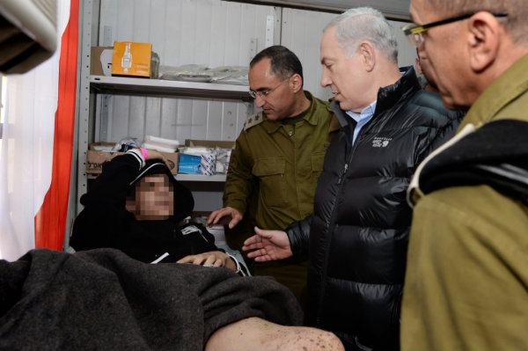
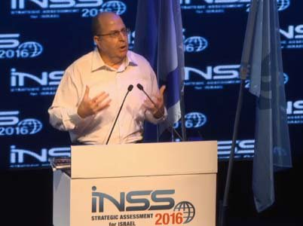
Syrian Rebels Thank Netanyahu for Israel's Compassion
Fighting each other’s wars
One of the leaders of the Syrian opposition forces on Friday expressed his appreciation for the compassion and care offered to victims of Syria's ongoing civil war by Prime Minister Benjamin Netanyahu and the Israeli people.
Speaking from Istanbul, Mohammed Badie told Israel Radio that he and other Syrian rebel leaders were deeply thankful for the goodwill fellow Syrians had experienced at the hands of Israel as they continue to struggle against the regime of Bashar Assad. Badie said that Netanyahu's public visit to the Israeli army field hospital that processes wounded Syrians crossing the border had sent an "important message" both to average Syrians and the Assad regime. Israel Today, 2/23/2014, http://www.israeltoday.co.il/NewsItem/tabid/178/nid/24453/Default.aspx
Netanyahu visits a field hospital set up along the border to assist wounded Syrian rebels before sending them to larger medical facilities in Israel
Speaking at the Institute for National Security Studies' (INSS) conference in Tel Aviv, [Israel] Defense Minister Moshe Ya'alon would “prefer ISIS” to Iran (“our main enemy”). RT, 1/20/2016, https://www.rt.com/news/329502-isis-iran-threat-israel/
Press TV: US, Israel drones gather data for Syria militants, Veterans Today, 7/31/2016, http://www.veteranstoday.com/2016/07/31/press-tv-us-israel-drones-gather-data-for-syria-militants/
Netanyahu warned: “Don't strengthen Iran to weaken Islamic State” Haaretz, 9/11/2014, http://www.haaretz.com/news/diplomacy-defense/.premium-1.615382
“IS has so far not actively targeted the Jewish state or even made it a central talking point in its endless PR messaging” Daniel Levy, “The Islamic State in the Jewish state’s wing mirror,” European Council on Foreign Relations, 10/2/2014, http://www.ecfr.eu/content/entry/commentary_the_islamic_state_in_the_jewish_states_wing_mirror328

Slide 134
Genesis of contemporary ‘jihad’ (Why? By whom? For whom?)
From U.S., the ABC's of Jihad---“the United States spent millions of dollars to supply Afghan schoolchildren with textbooks filled with violent images and militant Islamic teachings, part of covert attempts to spur resistance to the Soviet occupation [at the time the Soviet Union banned Jewish emigration to Palestine]. The primers, which were filled with talk of jihad and featured drawings of guns, bullets, soldiers and mines, have served since then as the Afghan school system's core curriculum. Even the Taliban used the American-produced books, though the radical movement scratched out human faces in keeping with its strict fundamentalist code... The agency [U.S. Agency for International Development] spent $51 million on the university's education programs in Afghanistan from 1984 to 1994... Children were taught to count with illustrations showing tanks, missiles and land mines... During the Taliban era, censors purged human images from the books. One page from the texts of that period shows a resistance fighter with a bandolier and a Kalashnikov slung from his shoulder. The soldier's head is missing. Above the soldier is a verse from the Koran. Below is a Pashtu tribute to the mujaheddin, who are described as obedient to Allah. Such men will sacrifice their wealth and life itself to impose Islamic law on the government, the text says.” The Washington Post, March 23, 2002, https://www.washingtonpost.com/archive/politics/2002/03/23/from-us-the-abcs-of-jihad/d079075a-3ed3-4030-9a96-0d48f6355e54/
The Taliban indoctrinates kids with jihadist textbooks paid for by the U.S.----"Printed both in Pashto and Dari, Afghanistan's two major languages, books such as 'The Alphabet for Jihad Literacy' were produced under the auspices of the U.S. Agency for International Development by the University of Nebraska at Omaha and smuggled into Afghanistan through networks built by the CIA and Pakistan's military intelligence agency, the ISI [Pakistan’s Inter-Service Intelligenc].... the Pashto version includes such chilling entries as 'T' is for 'topak,' or gun. How do you use the word? 'My uncle has a gun,' the entry reads. "He does jihad with the gun." [later The United Nations' education agency] UNICEF destroyed at least a half-million of these 'militarized' schoolbooks. But the consequences of decades-old American policies in the region still linger, in ways both big and small." The Washington Post, 12/8/2014, https://www.washingtonpost.com/news/worldviews/wp/2014/12/08/the-taliban-indoctrinates-kids-with-jihadist-textbooks-paid-for-by-the-u-s/
‘Infidels are our enemy’: Afghan fighters cherish old American schoolbooks----"[New York University professor Dana] Burde managed to find several old copies of the Pashto-language books and a 2011 edition on sale in the Pakistani city of Peshawar. The majority of the book’s 41 lessons glorify violence in the name of religion. 'My uncle has a gun,' reads the entry for the letter T, using the Pashto word for 'gun,' 'topak.' 'He does jihad with the gun.'.... 'Our religion is Islam. Muhammad is our leader. All the Russians and infidels are our enemy.'" Aljazeera America, 12/7/2014, http://america.aljazeera.com/articles/2014/12/7/afghan-fighters-americantextbooks.html
“Advertisements, paid for from CIA funds, were placed in newspapers and newsletters around the world offering inducements and motivations to join the [Islamic] Jihad.” (Pervez Hoodbhoy), Peace Research, 1 May 2005 Global Research, 9/9/2010, http://www.globalresearch.ca/9-11-analysis-from-ronald-reagan-and-the-soviet-afghan-war-to-george-w-bush-and-september-11-2001/20958

Slide 135
British police question boy who spelled 'terrorist' by mistake
LONDON---A 10-year-old Muslim boy has been questioned by British police in the north of England after mistakenly writing in an English lesson that he lived in a "terrorist house", the BBC reported on Wednesday.
The boy had intended to write that he lived in a "terraced" house but teachers did not realize he had made an error and reported the boy to the police in accordance with new counter-terrorism rules, which critics say are focused on Muslim communities.
Police interviewed the boy and examined a computer at the family home. The family has demanded an apology from both the police and the school, the BBC said.
"They shouldn't be putting a child through this," the BBC quoted the boy's cousin as saying. To protect the identity of the child, the BBC did not give names in its report.
"He's now scared of writing, using his imagination," the cousin was quoted as saying.
(Reporting by Guy Faulconbridge; Editing by Louise Ireland)
Reuters, 1/20/2016, http://www.reuters.com/article/us-britain-security-boy-idUSKCN0UY12O
Scapegoating Islam in America w/ Arsalan Iftikhar, RT, 5/17/2016, https://www.youtube.com/watch?v=APDa2X3ve2k

Slide 136
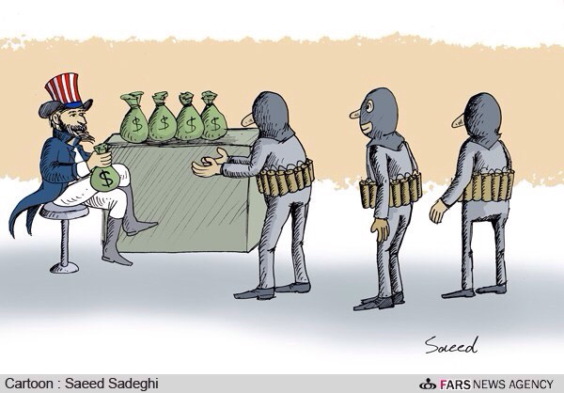
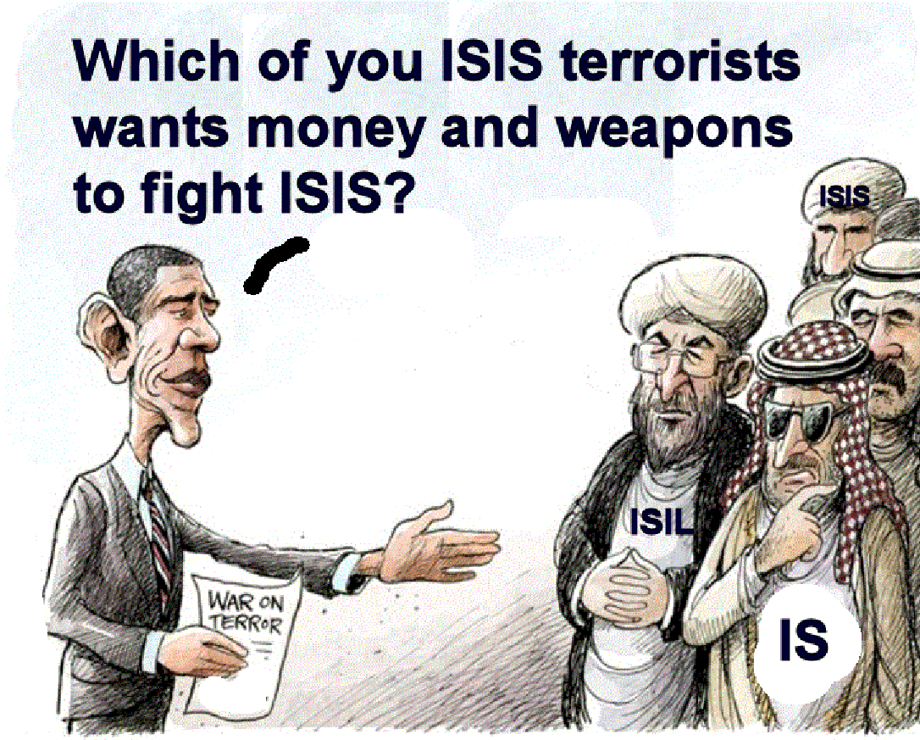
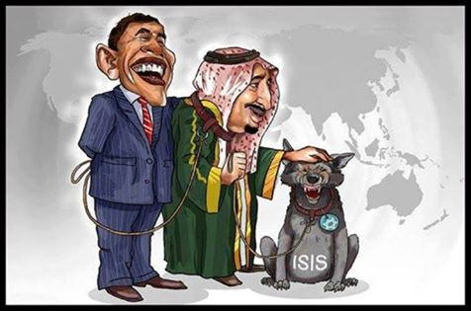
US Sends 200 More Troops to Syria Days after Obama Lifts Ban on Arms Supplies to Rebels, Global Research, 12/10/2016, http://www.globalresearch.ca/us-sends-200-more-troops-to-syria-days-after-obama-lifts-ban-on-arms-supplies-to-rebels/5561697
Obama asks Congress for $500 million to train Syria rebels, LA Times, 6/26/2014, http://www.latimes.com/world/middleeast/la-fg-obama-syria-20140627-story.html
US ex-intelligence chief [Lieutenant General Michael Flynn] on ISIS rise: It was 'a willful Washington decision'---RT, 8/10/2015, https://www.rt.com/usa/312050-dia-flynn-islamic-state/
"President Barack Obama [who won the Nobel Peace Prize in 2009] came into office seven years ago pledging to end the wars of his predecessor, George W. Bush. On May 6 [2016], with eight months left before he vacates the White House, Obama passed a somber, little-noticed milestone: He has now been at war longer than Bush, or any other American president," Atlanta Journal-Constitution, 5/17/2016, http://www.myajc.com/news/news/president-obama-two-full-terms-fighting-wars/nrNgX/
Turkey ‘allows Syria rebel training’---BBC, 10/13/2014, http://www.bbc.com/news/world-middle-east-29591916
Saudis to Host Syrian Rebel Training—ABC News, 9/10/2014, http://abcnews.go.com/Politics/wireStory/us-official-saudis-host-syrian-rebel-training-25418990
Trump: Obama is the founder of ISIS, https://www.youtube.com/watch?v=-hUENxmN9pM
Aaron Holmes, "Twitter just suspended over 88,000 accounts tied to a Saudi disinformation campaign," Busness Insider, 12/20/019, https://www.businessinsider.com/twitter-removed-accounts-saudi-arabia-disinformation-campaign-2019-12
Report: Israel sold $250 million of sophisticated spy systems to Saudi Arabia, The Washington Post, 10/28/2018, https://www.jpost.com/Middle-East/Report-Israel-sold-250m-of-sophisticated-spy-systems-to-Saudi-Arabia-570539
US Secretary of State Mike Pompeo: "I was the CIA director. We lied, we cheated, we stole. We had entire training courses." https://www.youtube.com/watch?v=DPt-zXn05ac
Over 25 Years Of U.S. Plans To Destabilize Syria “The ultimate intention was to topple Iran, one of Syria’s closest allies.”
The Syria Times, 3/7/2017,
http://syriatimes.sy/index.php/editorials/commentary/29474-over-25-years-of-u-s-plans-to-destabilize-syria
https://matrixbob.files.wordpress.com/2014/09/obama-terrorists.gif
https://www.youtube.com/watch?v=Dqn0bm4E9yw

Slide 137
Saudi Arabia Warns of Economic Fallout if Congress Passes 9/11 Bill, The New York Times, 4/15/2016, http://www.nytimes.com/2016/04/16/world/middleeast/saudi-arabia-warns-ofeconomic-fallout-if-congress-passes-9-11-bill.html
Senate passes bill allowing 9/11 victims to sue Saudi Arabia, Reuter, 5/17/2016, http://www.reuters.com/article/us-saudi-usa-congress-idUSKCN0Y8239
Congress releases secret '28 pages' on alleged Saudi 9/11 ties, CNN, 7/15/2016, http://www.cnn.com/2016/07/15/politics/congress-releases-28-pages-saudis-9-11/
Saudi foreign minister welcomes release of pages from 9-11 report, Reuters, 7/15/2016, http://www.reuters.com/article/us-saudi-usa-minister-idUSKCN0ZV2JL?mod=related&channelName=politicsNews
US Supreme Court Ruling: Seizure of Two Billion Dollars in Iranian Assets. “Highway Robbery”
Iran says the deduction of around USD two billion in frozen Iranian assets recently authorized by a US court ruling is “highway robbery,” vowing that the Islamic Republic will retrieve the sum.
According to Press TV, last Wednesday, the US Supreme Court ruled that the money had to be turned over to the American families of the people killed in a 1983 bombing of a US Marine Corps barracks in the Lebanese capital of Beirut and other attacks blamed on Iran.
Iran has denied any role in the attack, and the money confiscated under the US court ruling belongs to the Central Bank of Iran (CBI). The assets have been blocked under US sanctions...
“The judgment by the Supreme Court and the other, even more absurd judgment by a New York circuit court deciding that Iran should pay damages for 9/11 are the height of absurdity,” Iran’s Foreign Minister Mohammad Javad Zarif told The New Yorker in an interview published on Monday...
On Monday, Zarif had said that Iran would act to sue the United States at the International Court of Justice (ICJ) at The Hague to retrieve the USD two billion. Global Research, 4/27/2016, http://www.globalresearch.ca/us-supreme-court-ruling-seizure-of-two-billion-dollars-in-iranian-assets-highway-robbery/5522072

Slide 138
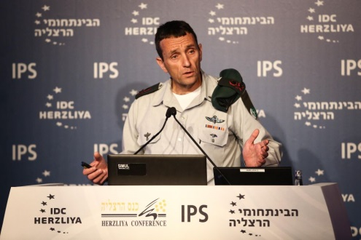
Excerpts from Israel Military Intelligence chief Maj. Gen. Herzi Halevy's speech at the Herzliya Conference at the Interdisciplinary Center in Herzliya, Israel:
"there has never been an army that knows as much about its enemy as we know about Hezbollah... But still, the next war will not be simple, it will not be easy."
Halevy pointed to two competing groups in the Muslim world: the Shiite Iran, which despite its “legitimate” status in the wake of last year’s Iran nuclear deal continues to fund attacks on Israel, and the “pragmatic” Sunni nations led by Saudi Arabia, whose interests have increasingly begun to align with Israel.
Throughout the Middle East, both Iran and Saudi Arabia have lots of fingers in lots of pots. The two countries have direct involvement in the Yemenite and Syrian civil wars.
In Syria, Iran has already lost “250 people, and that’s just their fighters from the Islamic Revolutionary Guard Corps. That’s not counting the Shiite militias that are managed by Iran,” he said.
All this, despite the fact that it [Iran] continues to call for Israel’s destruction and gives the military wings of Hamas, Hezbollah and the Islamic Jihad “60 percent of their budgets,” Halevy said.
Iran has also taken the lead on the cyber warfare front against Israel, he said, carrying out digital attacks themselves and also providing training to Hezbollah to do the same.
On the other side, he said, are the “pragmatic Sunnis” — mostly the Gulf states — who are leading the fight against Iran.
“Saudi Arabia is more proactive, trying to lead the Sunni camp in the Middle East. It’s a country that has perhaps stabilized and gotten stronger in its fight against Iran,” he said.
“Some of the interests of the pragmatic Sunni countries are getting closer to our interests,” Halevy said. “This is an interesting development, and there is an opportunity in it.”
Times of Israel, 6/15/2016, http://www.timesofisrael.com/intelligence-chief-warns-of-growing-gaps-between-israel-neighbors/
Military Intelligence chief Maj. Gen. Herzl Halevy speaks at the Herzliya Conference at the Interdisciplinary Center in Herzliya on June 15, 2016. (Adi Cohen Zedek)
Saudi Prince Turki Al Faisal denounced Iran’s backing for "Hezbollah in Lebanon, Hamas in Palestine, [and] the Islamic Jihad in Palestine” against Israel, Alarabiya, 7/10/2016, http://english.alarabiya.net/en/webtv/reports/2016/07/10/Full-speech-of-Prince-Turki-Al-Faisal-at-the-Paris-Rally-to-Free-Iran.html

Slide 139
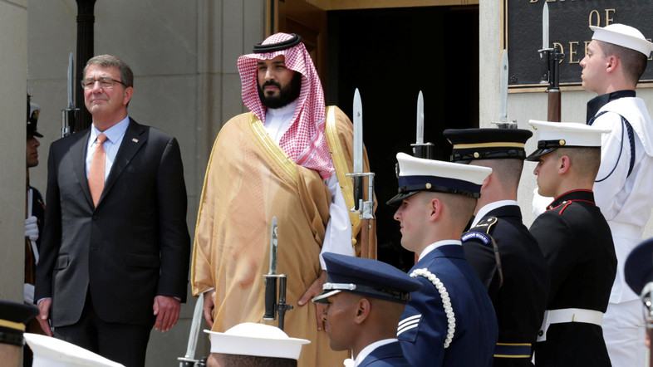
Saudi, US defense ministers meet at Pentagon
US Secretary of Defense Ash Carter: “This is our 10th in-depth conversation…. We’ll be discussing ways to further cooperate on conventional and asymmetric threats in the region these include delivering ISIL a lasting defeat, addressing the situation in Yemen, and countering Iran’s belying influence. We’ll also discuss joint capabilities including expanded coordination on special operation forces.”
Saudi Arabia’s Deputy Crown Prince and Defense Minister Mohammed bin Salman: “I am today in a country that is an ally to the kingdom, in a very sensitive time, in a kind of region with many threats surrounding us… either when it comes to the instability of some countries or the interference in the internal affairs of countries, or terrorism.”
“The US and its allies in the region have the responsibility to meet and deal with these challenges that might pose as a threat to the entire world and today we are working hard and seriously to face these challenges.”
Muhammed Bin Salman with Mark Zuckerberg, Deputy Crown Prince Mohammed bin Salman visited the headquarters of Facebook and met with founder and president Mark Zuckerberg. Published on Jun 23, 2016, https://www.youtube.com/watch?v=UuCSmHgB2zQ
Saudi deputy crown prince to meet Trump, investment in focus, Reuters, 3/13/2017, http://www.reuters.com/article/us-saudi-usa-idUSKBN16K06Z
Obama administration offered $115b​n in weapons to Saudi Arabia: report, https://www.theguardian.com/us-news/2016/sep/08/obama-administration-offered-115-billion-weapons-saudi-arabia-report
Israeli military chief in US for meetings on security, military cooperation, JTA, 7/31/2016, http://www.jta.org/2016/07/31/news-opinion/united-states/idf-chief-arrives-in-u-s-for-meetings-on-security-military-cooperation
US Secretary of Defense Ash Carter (L) hosts an enhanced honor cordon to welcome Saudi Arabia's Deputy Crown Prince and Minister of Defense Mohammed bin Salman to the Pentagon in Washington, U.S., June 16, 2016. (Reuters) . Alarabiya, 6/16/2016, http://english.alarabiya.net/en/special-reports/deputy-crown-prince-visits-us/2016/06/16/US-Defense-Secretary-Ash-Carter-to-host-Saudi-Deputy-Crown-Prince.html
Watch: Israel receives its first stealth fighter, the F-35: Israeli Air Force gets F-35, its first 5th generation fighter and first stealth aircraft... With a per-unit cost of roughly $100 million and a total program cost of well over $1.5 trillion, the F-35 has become one of the most expensive weapons development programs in history. Israel National News, 6/22/2016, http://www.israelnationalnews.com/News/News.aspx/213975#.V2rqacv2bDc and https://www.youtube.com/watch?v=AvYEHZa_z_U
Trump advisor: We'll give Israel more aid than Obama, Israel National News, 6/22/2016, http://www.israelnationalnews.com/News/News.aspx/213980#.V2rsfcv2bDc

Slide 140
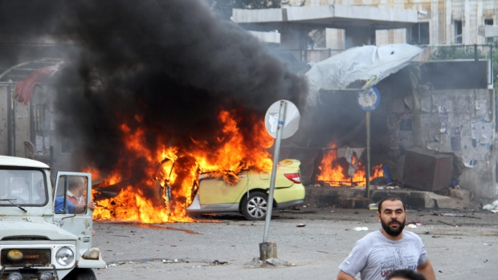
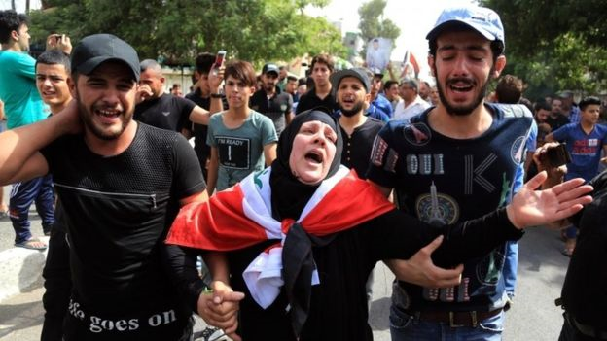
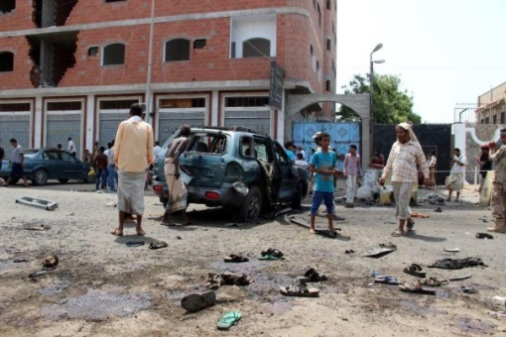
Syria bombings claimed by ISIS kill 148 at hospital, bus station, CBC, 5/23/2016, http://www.cbc.ca/news/politics/syria-isis-bombings-1.3596282
Death toll from devastating ISIS truck bomb in Baghdad rises to nearly 300, CNN, 7/7/2016, http://www.cnn.com/2016/07/07/middleeast/iraq-baghdad-bomb-toll-rises/
Yemen suicide bombings: Isis claim responsibility for attack which killed at least 40 people in Aden, The Independent, 5/23/2016, http://www.independent.co.uk/news/world/middle-east/yemen-bombing-aden-isis-al-qaeda-daesh-islamic-state-saudi-arabia-a7042896.html
Iran ‘foils 50 planned ISIS attacks’, Israel National News, 7/5/2016, http://www.israelnationalnews.com/News/News.aspx/214500
Twin explosions tore through a demonstration by members of Afghanistan's mainly Shi'ite Hazara minority in Kabul on Saturday, killing at least 80 people and wounding more than 230 in a suicide attack claimed by Islamic State, Reuters, 7/23/2016, http://www.reuters.com/article/us-afghanistan-protests-idUSKCN1030GB
Chilcot: Intelligence reports confirm Iraq war created ISIS, RT, 7/7/2016, https://www.rt.com/uk/349872-invasion-created-isis-intelligence

Slide 141
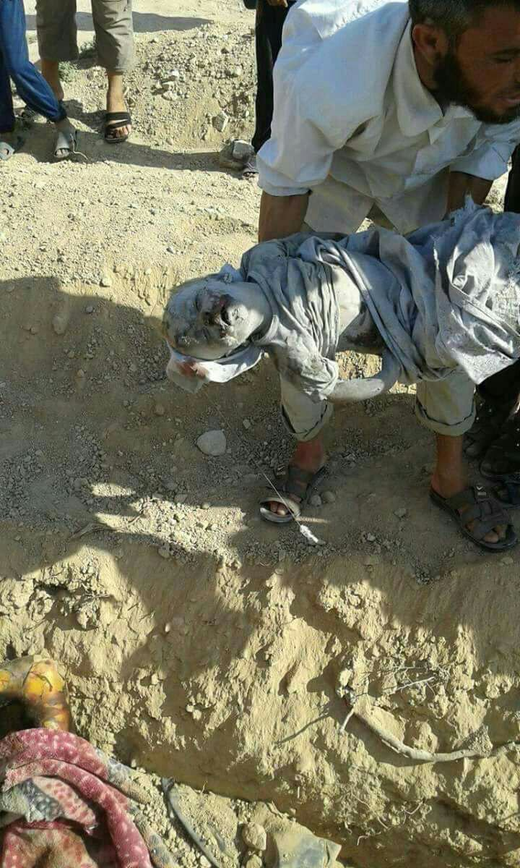
‘Bloody massacres’: Syria appeals to UN after French & US airstrikes ‘kill over 140 civilians’
Syria is demanding the UN take action after it says French war planes killed more than 120 civilians during airstrikes on Tuesday near the Turkish-Syrian border. The deaths came just a day after US air assaults killed a further 20 people in Manbij.
Damascus wants the organization to look into atrocities committed by France, which is a member of the US-led international coalition, after it targeted the village of Toukhan Al-Kubra, located near the Turkish-Syrian border and the city of Manbij…
“The French unjust aggression claimed the lives of more than 120 civilians, most of them are children, women and elderly, in addition to tens of wounded citizens, the majority of them are also children and women as reports say that the fate of scores of other civilians who still under debris are unknown too,” the Syrian Foreign Ministry wrote, as cited by the Syrian Arab News Agency.
The mass death toll in Toukhan Al-Kubra came just a day after US war planes killed around 20 people, mainly women and children, while many more were injured in and around the city of Manbij, the Foreign Ministry states.
“The government of the Syrian Arab Republic condemns, with the strongest terms, the two bloody massacres perpetrated by the French and US warplanes and those affiliated to the so-called international coalition which send their missiles and bombs to the civilians instead of directing them to the terrorist gangs… Syria also affirms that those who want to combat terrorism seriously should coordinate with the Syrian government and army,” the ministry added.
In the letter, the Syrian Foreign Ministry added that it condemns the continued support by the US, France, Saudi Arabia, the UK and Qatar to terrorist organizations such as Al-Nusra Front and Jaish Al-Islam, despite these groups having clear links to Islamic State (IS, formerly ISIS/ISIL) and Al-Qaeda.
RT, 7/20/2016, https://www.rt.com/news/352255-france-syria-civilians-dead/

Slide 142
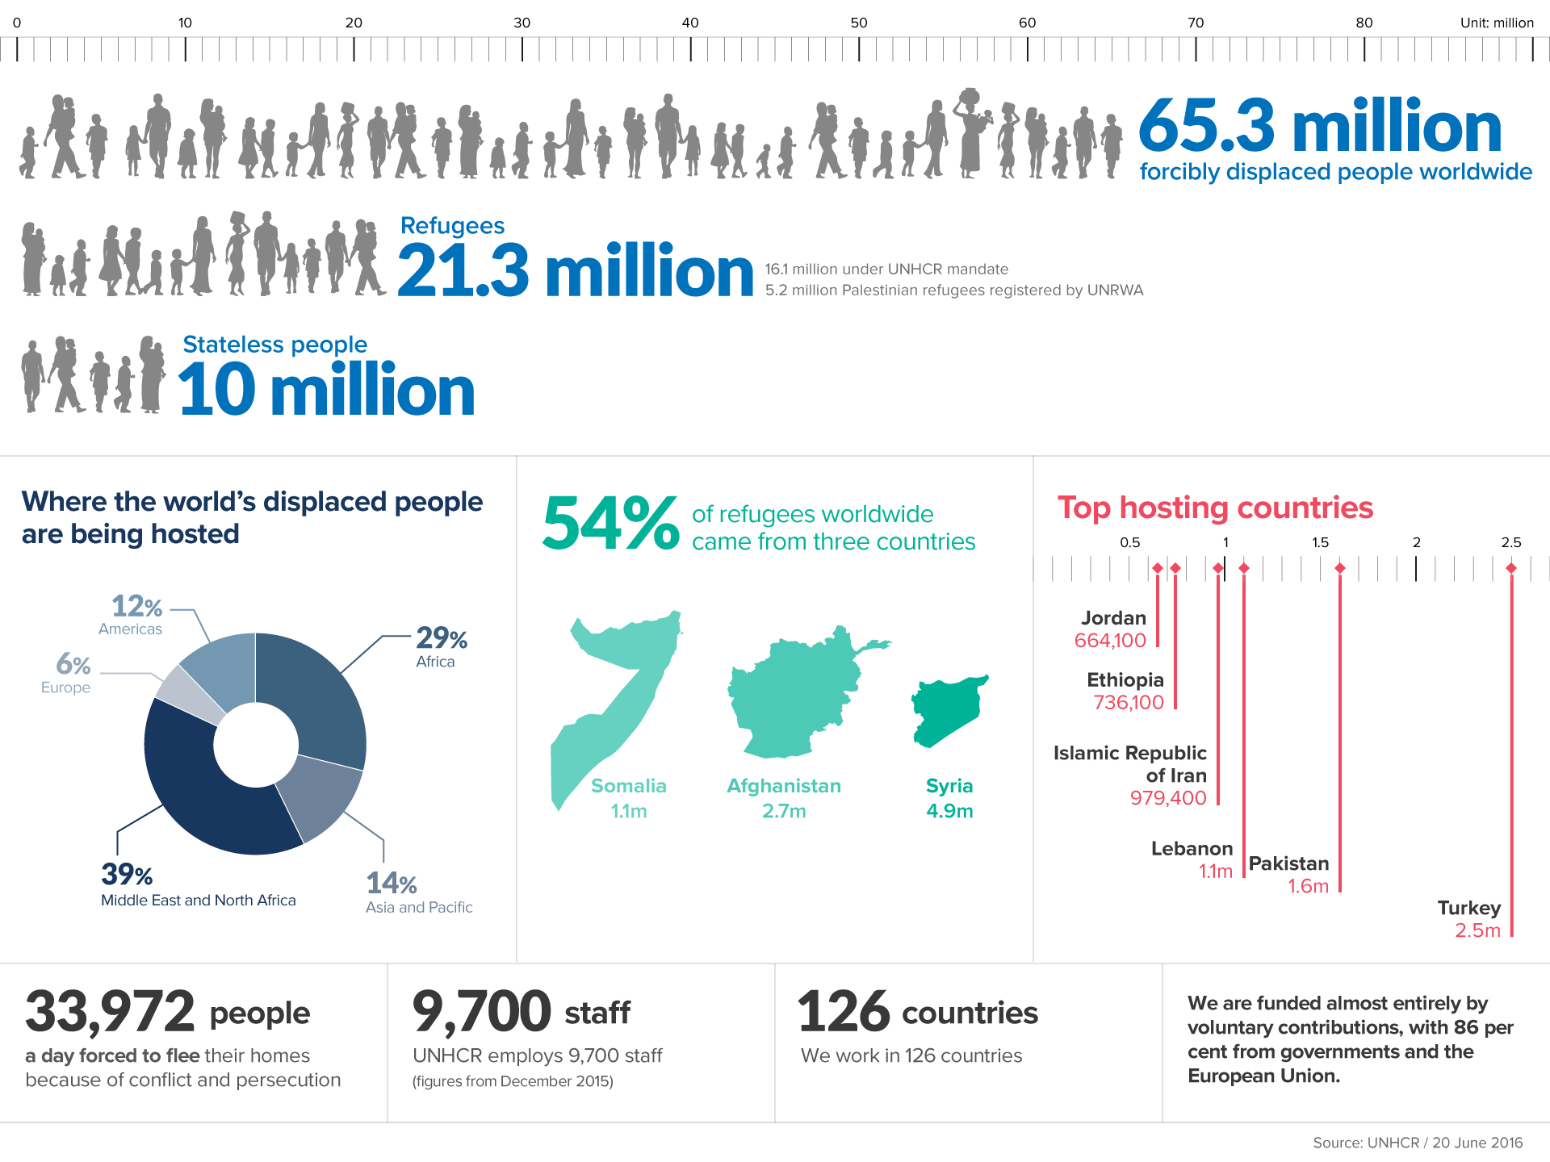
65 million people displaced worldwide, breaking all records – UNHCR
The UN has released alarming displacement statistics claiming 65 million people are now displaced worldwide. Syria and Afghanistan have raised the bar to set the new world record.
RT, 6/20/2016, https://www.rt.com/news/347417-un-report-displaced-refugees/
http://www.unhcr.org/en-us/figures-at-a-glance.html
UNHCR Global Trends report finds 65.3 million people, or one person in 113, were displaced from their homes by conflict and persecution in 2015. The study found that three countries produce half the world’s refugees. Syria at 4.9 million, Afghanistan at 2.7 million and Somalia at 1.1 million together accounted for more than half the refugees under UNHCR’s mandate worldwide. Colombia at 6.9 million, Syria at 6.6 million and Iraq at 4.4 million had the largest numbers of internally displaced people. United Nations High Commissioner for Refugees (UNHCR), 6/20/2016, http://www.unhcr.org/en-us/news/latest/2016/6/5763b65a4/global-forced-displacement-hits-record-high.html
Syria Crisis: One Million Refugee Children
https://www.youtube.com/watch?v=pjN28GraSP Q

Slide 143
Gun violence killed or injured over
40,000 in the United States in 2015
Gun Violence Archive is an online archive of gun violence incidents collected from over 1,500 media, law enforcement, government and commercial sources daily in an effort to provide near-real time data about the results of gun violence.
Mass Shooting at Orlando’s Pulse Nightclub
A total of 50 people were killed in the shooting; an additional 53 were injured. [The mass shooter was identified as Omar Seddique Mateen, an American citizen born to Muslim immigrants from Afghanistan]. City of Orlando, 6/12/2016, http://www.cityoforlando.net/police/mass-shooting-at-orlandos-pulse-nightclub/
"We could hear him [Omar Mateen] talking to 911 saying that the reason why he's doing this is because he wants America to stop bombing his country [Afghanistan?]. From that conversation from 911 he pledges allegiance to ISIS," said Patience Carter, 20, who was trapped in a bathroom stall at the nightclub as Mateen prowled outside. Reuters, 6/15/2016, http://www.reuters.com/article/us-florida-shooting-idUSKCN0Z017C
When the dispatcher asked for his name, Mateen replied: "My name is I pledge of allegiance to Abu Bakr al-Baghdadi of the Islamic State.” Mateen "told the negotiator to tell America to stop bombing Syria and Iraq.” CNN, 6/20/2016, http://www.cnn.com/2016/06/20/us/orlando-nightclub-shooting/
FBI calls Orlando massacre both hate crime & terrorism, RT, 6/15/2016, https://www.rt.com/usa/346848-fbi-orlando-hate-crime-terrorism/
Academic records indicate that Omar Mateen had exhibited chronic behavioral problems during his youth. Also his first wife described him as a mentally disturbed man. Reuters, 6/18/2016, http://www.reuters.com/article/us-florida-shooting-idUSKCN0Z30JX
Gun violence archive 2014
Total Number of Incidents 51,820
Number of Deaths 12,593
Number of Injuries 23,034
Number of Children (age 0-11)
Killed/Injured 628
Number of Teens (age 12-17)
Killed/Injured 2,368
Mass Shooting 280
Officer Involved Incident
Officer Shot/Killed 260
Officer Involved Incident
Perpetrator Shot/Killed 795
Home Invasion 2,611
Defensive Use 1,591
Accidental Shooting 1,605
Data Validated: June 13, 2016
Gun violence archive 2015
Total Number of Incidents 53,272
Number of Deaths 13,429
Number of Injuries 27,002
Number of Children (age 0-11)
Killed/Injured 698
Number of Teens (age 12-17)
Killed/Injured 2,693
Mass Shooting 330
Officer Involved Incident
Officer Shot/Killed 319
Officer Involved Incident
Perpetrator Shot/Killed 896
Home Invasion 2,358
Defensive Use 1,295
Accidental Shooting 1,965
Data Validated: June 13, 2016
GVA is not, by design an advocacy group. The mission of GVA is to document incidents of gun violence and gun crime to provide raw, verified data to those who need to use it in their research, advocacy or writing. http://www.gunviolencearchive.org/about, 1718 M Street, N.W. PMB #126, Washington, DC 20036-4504,
Obama: “if you look at the number of Americans killed since 9/11 by terrorism, it's less than 100 [before Orlando’s mass shooting]. If you look at the number that have been killed by gun violence, it's in the tens of thousands.” BBC, 7/24/2015, http://www.bbc.com/news/world-us-canada-33646542
Texas allows guns in college classrooms under new law, Reuters, 8/1/2016, http://www.reuters.com/article/us-texas-guns-idUSKCN10C2FS
America's gun culture in 10 charts, BBC, 11/15/2017, http://www.bbc.com/news/world-us-canada-41488081

Slide 144
Excerpts from Donald Trump’s speech to AIPAC
I speak to you today as a lifelong supporter and true friend of Israel. I am a newcomer to politics, but not to backing the Jewish state... In spring of 2004 at the height of the violence in the Gaza Strip, I was the grand marshal of the 40th Salute to Israel Parade, the largest-single gathering in support of the Jewish state...
My number-one priority is to dismantle the disastrous deal with Iran...Iran is a problem in Iraq, a problem in Syria, a problem in Lebanon, a problem in Yemen and will be a very, very major problem for Saudi Arabia. Literally every day, Iran provides more and better weapons to support their puppet states. Hezbollah, Lebanon received — and I’ll tell you what, it has received sophisticated anti-ship weapons, anti-aircraft weapons and GPS systems and rockets like very few people anywhere in the world and certainly very few countries have. Now they’re in Syria trying to establish another front against Israel from the Syrian side of the Golan Heights. In Gaza, Iran is supporting Hamas and Islamic jihad. And in the West Bank, they’re openly offering Palestinians $7,000 per terror attack and $30,000 for every Palestinian terrorist’s home that’s been destroyed. A deplorable, deplorable situation...
Secondly, we will totally dismantle Iran’s global terror network which is big and powerful, but not powerful like us...
Third, at the very least, we must enforce the terms of the previous deal to hold Iran totally accountable. And we will enforce it like you’ve never seen a contract enforced before, folks, believe me. Iran has already, since the deal is in place, test-fired ballistic missiles three times. Those ballistic missiles, with a range of 1,250 miles, were designed to intimidate not only Israel, which is only 600 miles away, but also intended to frighten Europe and someday maybe hit even the United States. And we’re not going to let that happen. We’re not letting it happen. And we’re not letting it happen to Israel, believe me. Do you want to hear something really shocking? As many of the great people in this room know, painted on those missiles in both Hebrew and Farsi were the words “Israel must be wiped off the face of the earth.”
... discussions have been swirling about an attempt to bring a Security Council resolution on terms of an eventual agreement between Israel and Palestine. Let me be clear: An agreement imposed by the United Nations would be a total and complete disaster.
The United States must oppose this resolution and use the power of our veto, which I will use as president 100 percent... When I’m president, believe me, I will veto any attempt by the UN to impose its will on the Jewish state. It will be vetoed 100 percent...
In Palestinian society, the heroes are those who murder Jews. We can’t let this continue. We can’t let this happen any longer. You cannot achieve peace if terrorists are treated as martyrs... In Palestinian textbooks and mosques, you’ve got a culture of hatred that has been fomenting there for years... We will move the American embassy to the eternal capital of the Jewish people, Jerusalem...
I love the people in this room. I love Israel. I love Israel. I’ve been with Israel so long in terms of I’ve received some of my greatest honors from Israel, my father before me, incredible. My daughter, Ivanka, is about to have a beautiful Jewish baby.
Republican presidential candidate Donald Trump spoke to the American Israel Public Affairs Committee (AIPAC) on Monday evening, March 21, 2016, at its annual conference in Washington, DC., http://www.timesofisrael.com/donald-trumps-full-speech-to-aipac/
Excerpts from Hillary Clinton’s Speech to AIPAC
It is wonderful to be here and see so many friends. I’ve spoken at a lot of AIPAC conferences in the past, but this has to be one of the biggest yet, and there are so many young people here, thousands of college students… (APPLAUSE) … from hundreds of campuses around the country. I think we should all give them a hand for being here and beginning their commitment to this important cause. (APPLAUSE)You will keep the U.S.-Israel relationship going strong. You know, as a senator from New York and secretary of State… (APPLAUSE) I’ve had the privilege of working closely with AIPAC members to strengthen and deepen America’s ties with Israel... And your support helped us expand security and intelligence cooperation, developed the Iron Dome missile defense system, build a global coalition to impose the toughest sanctions in history on Iran and so much more.
Since my first visit to Israel 35 years ago, I have returned many times and made many friends. I have worked with and learned from some of Israel’s great leaders...
The United States and Israel must be closer than ever, stronger than ever and more determined than ever to prevail against our common adversaries...
I hope a new 10-year defense memorandum of understanding is concluded as soon as possible to meet Israel’s security needs far into the future. (APPLAUSE) That will also send a clear message to Israel’s enemies that the United States and Israel stand together united. It’s also why, as president, I will make a firm commitment to ensure Israel maintains its qualitative military edge...
One of the first things I’ll do in office is invite the Israeli prime minister to visit the White House. (APPLAUSE) And I will send a delegation from the Pentagon and the joint chiefs to Israel for early consultations... There is much Americans can learn from Israel, from cybersecurity to energy security to water security and just on an everyday people- to-people level... Many of the young people here today are on the front lines of the battle to oppose the alarming boycott, divestment and sanctions movement known as BDS. (APPLAUSE) Particularly at a time when anti-Semitism is on the rise across the world...
The second choice we face is whether we will have the strength and commitment to confront the adversaries that threaten us, especially Iran... We cannot forget that Tehran’s fingerprints are on nearly every conflict across the Middle East, from Syria to Lebanon to Yemen. The Iranian Revolutionary Guard Corps and its proxies are attempting to establish a position on the Golan from which to threaten Israel, and they continue to fund Palestinian terrorists. In Lebanon, Hezbollah is amassing an arsenal of increasingly sophisticated rockets and artillery that well may be able to hit every city in Israel... If I’m elected the leaders of Iran will have no doubt that if we see any indication that they are violating their commitment not to seek, develop or acquire nuclear weapons, the United States will act to stop it, and that we will do so with force if necessary. (APPLAUSE) Iranian provocations, like the recent ballistic missile tests, are also unacceptable and should be answered firmly and quickly including with more sanctions. (APPLAUSE) Those missiles were stamped with words declaring, and I quote, “Israel should be wiped from the pages of history.”
....The United States must also continue to enforce existing sanctions and impose additional sanctions as needed on Iran and the Revolutionary Guard for their sponsorship of terrorism, illegal arms transfers, human rights violations and other illicit behaviors like cyber attacks.
Democratic presidential candidate Hillary Clinton spoke to the American Israel Public Affairs Committee Monday about the relationship between the United States and Israel, Times, 3/21/2016, http://time.com/4265947/hillary-clinton-aipac-speech-transcript/

Slide 145
Excerpts from Saudi Arabia’s Basic Law of Governance and Iran’s Constitution
Saudi Arabia's Basic Law of Governance
Date: 27/8/1412 h [1 March 1992]
By the help of Allah Almighty
We, Fahd bin Abdul Aziz, the king of the kingdom of Saudi Arabia, consistent with the public interest, and in view with the development of the state in different fields, in addition to our enthusiasm to achieve our prospected objectives, we ordered the following:
First: Issue the basic law of governance according to the context herein below…
Article 1: The kingdom of Saudi Arabia is a sovereign Arab Islamic state. Its religion is Islam, and its constitution is the Holy Qur'an and the prophet's (peace be upon him) Sunnah (traditions). Its language is the Arabic language, and its capital city is Riyadh.
Article 5: (a) The Regime in Saudi Arabia is Monarchy. (b) The dynasty right shall be confined to the sons of the founder, King Abdul Aziz bin Abdurrahman Al Faisal Al Saud and the sons of sons. The most eligible among them shall be recognized as king, to rule in accordance with the Holy Qur'an and the prophet's Sunnah. (c) The king appoints the crown prince and may relieve him of his duties by royal decree. (d) The crown prince shall devote full time to his job and to any other duties assigned to him by the king. (e) The powers of the king shall be assumed by the crown prince on the king's death (e) The crown prince shall assume the powers of the king on the king's death until the Bai'ah "Allegiance" is set.
Article 6: Citizens shall pledge allegiance to the king on the basis of the Holy Qur'an and the prophet's Sunnah, as well as on the principle of hearing and obeying both in straitened circumstances and prosperity & in pleasant and unpleasant times.
Article 7: The authority of the regime is derived from the Holy Qur'an and the prophet's Sunnah which rule over this and all other state laws.
Article 8: The system of governance in the kingdom of Saudi Arabia is based on justice, consultation "Shoura" and equality according to the Islamic Shari'ah (the law of islam)…
Article 14: All natural resources bestowed by god, both under or above ground, of the country or in its territorial waters, or within its terrestrial and maritime limits, as well as the revenues of these resources shall be owned by the state as specified by the law. .http://www.mofa.gov.sa/sites/mofaen/ServicesAndInformation/aboutKingDom/SaudiGovernment/Pages/BasicSystemOfGovernance35297.aspx
The Constitution of the Islamic Republic of Iran
Preamble: ... The Form of Government in Islam: In the view of Islam, government does not derive from the interests of a class, nor does it serve the domination of an individual or a group. Rather, it represents the fulfillment of the political ideal of a people who bear a common faith and common outlook, taking an organized form in order to initiate the process of intellectual and ideological evolution towards the final goal, i.e., movement towards Allah.... the Constitution provides the necessary basis for ensuring the continuation of the Revolution at home and abroad... to assure the continuation of the struggle for the liberation of all deprived and oppressed peoples in the world.
The Principles of Governance of the Just Holy Person In keeping with the principles of governance and the perpetual necessity of leadership, the Constitution provides for the establishment of leadership by a holy person possessing the necessary qualifications and recognized as leader by the people (this is in accordance with the saying "The direction of affairs is in the hands of those who are learned concerning God and are trustworthy in matters pertaining to what He permits and forbids"). Such leadership will prevent any deviation by the various organs of State from their essential Islamic duties...
The Economy is a Means, Not an End….
Woman in the Constitution…
An Ideological Army… for fulfilling the ideological mission of jihad in God's way…
Article 1 [Form of Government]: The form of government of Iran is that of an Islamic Republic, endorsed by the people of Iran on the basis of their longstanding belief in the sovereignty of truth and Koranic justice, in the referendum of 29 and 30 March 1979, through the affirmative vote of a majority of 98.2% of eligible voters, held after the victorious Islamic Revolution led by Imam Khumayni...
Article 7 [Consultative Bodies]: (1) In accordance with the command of the Koran contained in the verse "Their affairs are by consultations among them" [42:38] and "Consult them in affairs" [3:159], consultative bodies -- such as the Islamic Consultative Assembly, the Provincial Councils, and the City, Region, District, and Village Councils and the likes of them -- are the decision-making and administrative organs of the country. (2) The nature each of these councils, together with the manner of their formation, their jurisdiction, and scope of their duties and functions, is determined by the Constitution and laws derived from it...
Article 16 [Arabic Language]: Since the language of the Koran and Islamic texts and teachings is Arabic, and since Persian literature is thoroughly permeated by this language, it must be taught after elementary level, in all classes of secondary school and in all areas of study...
Article 146 [No Foreign Military Base]: The establishment of any kind of foreign military base in Iran, even for peaceful purposes, is forbidden. http://en.mfa.ir/uploads/Constitution_8032.pdf
Top Saudi Cleric Says Iranians Are 'Not Muslims', Haaretz, 9/6/2016, http://www.haaretz.com/middle-east-news/iran/1.740544

Slide 146
Hillary Clinton Email Archive
ArchiveUNCLASSIFIED U.S. Department of State Case No. F-2014-20439 Doc No. C05794498 Date: 11/30/2015
The best way to help Israel deal with Iran's growing nuclear capability is to help the people of Syria overthrow the regime of Bashar Assad…
It is the strategic relationship between Iran and the regime of Bashar Assad in Syria that makes it possible for Iran to undermine Israel's security — not through a direct attack, which in the thirty years of hostility between Iran and Israel has never occurred, but through its proxies in Lebanon, like Hezbollah, that are sustained, armed and trained by Iran via Syria. The end of the Assad regime would end this dangerous alliance. Israel's leadership understands well why defeating Assad is now in its interests. Speaking on CNN's Amanpour show last week, Defense Minister Ehud Barak argued that "the toppling down of Assad will be a major blow to the radical axis, major blow to Iran.... It's the only kind of outpost of the Iranian influence in the Arab world...and it will weaken dramatically both Hezbollah in Lebanon and Hamas and Islamic
Jihad in Gaza."
Bringing down Assad would not only be a massive boon to Israel's security, it would also ease Israel's understandable fear of losing its nuclear monopoly… The rebellion in Syria has now lasted more than a year…
With his life and his family at risk, only the threat or use of force will change the Syrian dictator Bashar Assad's mind…
But success in Syria would be a transformative event for the Middle East. Not only would another ruthless dictator succumb to mass opposition on the streets, but the region would be changed for the better as Iran would no longer have a foothold in the Middle East from which to threaten Israel and undermine stability in the region. Unlike in Libya, a successful intervention in Syria would require substantial diplomatic and military leadership from the United States. Washington should start by expressing its willingness to work with regional allies like Turkey, Saudi Arabia, and Qatar to organize, train and arm Syrian rebel forces. The announcement of such a decision would, by itself, likely cause substantial defections from the Syrian military. Then, using territory in Turkey and possibly Jordan, U.S. diplomats and Pentagon officials can start strengthening the opposition..
The second step is to develop international support for a coalition air operation. Russia will never support such a mission, so there is no point operating through the UN Security Council…
Arming the Syrian rebels and using western air power to ground Syrian helicopters and airplanes is a low-cost high payoff approach. https://wikileaks.org/clinton-emails/Clinton_Email_November_Release/C05794498.pdf

Slide 147
What are the biggest threats in 2016?
According to The World Economic Forum’s Global Risks Report 2016, the top five highest concerns (mass involuntary migration, state collapse, interstate conflict, unemployment or underemployment, and governance failure) in the next 18 months, as nominated by 750 experts, are essentially blamed on current events in the Middle East region.
Mass involuntary migration (more than half of recent refugees come from three conflict-ridden countries – Syria, Afghanistan and Somalia)
State collapse (fragile or failing governments leave a space for armed groups to move in, and potentially export conflicts across borders, as ISIS have done in Iraq and Syria)
Interstate conflict (in Syria, Iraq and Yemen, for example, conflicts become more likely to take on regional and global dimensions)
Unemployment or underemployment (almost 30% of young people in the Middle East are unemployed, the highest rate of any region in the world)
Governance failure (the problem is pervasive across Latin America and sub-Saharan Africa and is among the top three most likely risks in the Middle East and North Africa, East Asia and the Pacific, and Central Asia)
Source: "What are the biggest threats in 2016?" The World Economic Forum’s Global Risks Report 2016, https://www.weforum.org/agenda/2016/01/what-are-the-biggest-threats-in-2016/

Slide 148

Great Game III Endgame
“Israel’s behind-the-scenes role in the major GGIII wars in Afghanistan and Iraq recaps the US role in earlier games:
In GGI, the wars took place far from the US, and the US emerged relatively unscathed compared to its allies, which were weakened and indebted to the US.
In GGII, the US mostly used proxies and subversion to dispose of undesirable regimes, and was generously rewarded by the Soviet collapse and the opening up the entire Eurasian heartland.
The GGIII wars cost Israel nothing; on the contrary, its sales of weapons have increased dramatically. But they have burdened the US with huge expenditures and troop commitments while putting the US at the center of the fighting. As the US destroys itself through overreach, fighting Israel’s wars (in the case of Afghanistan, a neocon war inspired by Israel strategy), Israel, like the US in GGI&II, is free to expand its relations around the world...
Whether intentional or not, the result has been both the weakening of Israel’s Arab and Muslim enemies and a sharp decline in the US economy and its authority abroad.” Eric Walberg, page 211.
“No lobby has managed to divert US foreign policy as far from what the American national interest would otherwise suggest, while simultaneously convincing Americans that US and Israeli interests are essentially identical.” John Mearsheimer and Stephen Walt, quoted by Eric Walberg, page 214.

Slide 149
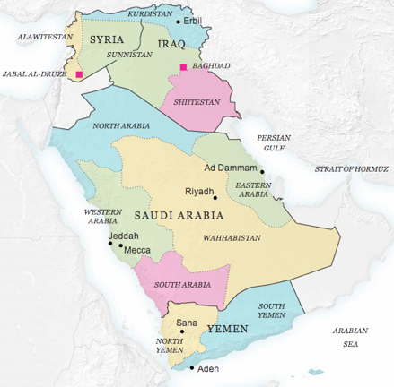
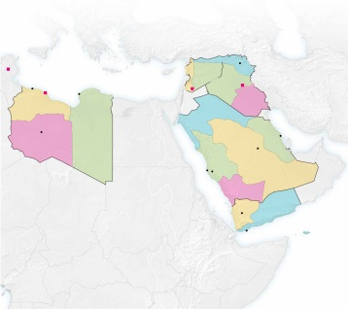
How 5 Countries Could Become 14
Slowly, the map of the Middle East could be redrawn.
An analysis by Robin Wright, The New York Times, 9/28/2013, http://www.nytimes.com/interactive/2013/09/29/sunday-review/how-5-countries-could-become-14.html
SYRIA: THE TRIGGER?
Sectarian and ethnic rivalries could break it into at least three pieces:
1. Alawites, a minority that has controlled Syria for decades, dominate a coastal corridor.
2. A Syrian Kurdistan could break off and eventually merge with the Kurds of Iraq.
3. The Sunni heartland secedes and then may combine with provinces in Iraq to form Sunnistan.
SPILLOVER TO IRAQ
In the simplest of several possibilities, northern Kurds join Syrian Kurds. Many central areas, dominated by Sunnis, join Syria’s Sunnis. And the south becomes Shiitestan. It’s not likely to be so clean.
LIBYA UNGLUED
As a result of powerful tribal and regional rivalries, Libya could break into its two historic parts — Tripolitania and Cyrenaica — and possibly a third Fezzan state in the southwest.
YEMEN SPLITS
The poorest Arab country could break (again) into two pieces following a potential referendum in South Yemen on independence.
PRE-MONARCHY SAUDI ARABIA
Long term, Saudi Arabia faces its own (suppressed) internal divisions that could surface as power shifts to the next generation of princes. The kingdom’s unity is further threatened by tribal differences, the Sunni-Shiite divide and economic challenges. It could break into the five regions that preceded the modern state.
In a more powerful twist, all or part of South Yemen could then become part of Saudi Arabia. Nearly all Saudi commerce is via sea, and direct access to the Arabian Sea would diminish dependence on the Persian Gulf — and fears of Iran’s ability to cut off the Strait of Hormuz.
Ian Greenhalgh, "ESSENTIAL READING: The Zionist plan for the Middle East," VT, 1/9/2017,
http://www.veteranstoday.com/2017/01/09/the-zionist-plan-for-the-middle-east/

Slide 150
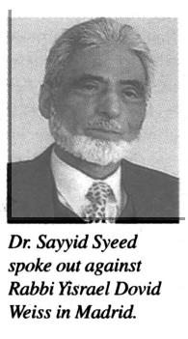
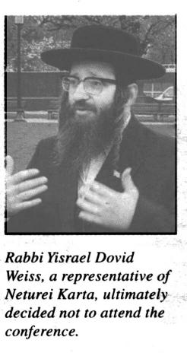
Islamic Society of North America http://www.isna.net and American Jewish groups [like the Foundation for Ethnic Understanding https://ffeu.org and the Union for Reform Judaism https://urj.org] call for a ban against Neturei Karta [an anti-Israel Jewish group] at a Saudi-run interfaith conference
In first, Saudi king hosts Israeli rabbi [David Rosen who is a member of the board of directors of the King Abdullah International Center for Interreligious and Intercultural Dialogue] at royal palace [in a move indicative of the monarchy’s desire to further open itself up to the Western world], The Times of Israel, 2/24/2020, https://www.timesofisrael.com/in-first-saudi-king-hosts-israeli-rabbi-at-royal-palace/
http://www.nkusa.org/
U.S. imam calls for Neturei Karta ban at Saudi-run interfaith conference: “Madrid- A top American Muslim leader and American Jewish groups formed an unlikely alliance this week against a fiercely anti-Zionist chasidic group at an interfaith conference in Madrid, spearheaded by Saudi Arabia's King Abdullah… Dr. Sayyid Syeed, national director of the Islamic Society of North America, said he was upset by the planned participation in the conference, which opened this week, of Rabbi Yisrael Dovid Weiss, a representative of Neturei Karta from upstate Monsey. Rabbi Weiss was to be the only Jewish leader to address the gathering sponsored by the Saudi-affiliated Muslim World League. Syeed said he immediately called Adel al-Jubeir, Saudi ambassador to the U.S., to complain about the Neturei Karta invitation. "I told the ambassador that we strongly protested the invitation, which was not only an affront to our friends in the Jewish community, but to us as well." Syeed's organization, considered one of the most influential Muslim groups in North America, has instituted joint programming in the past several years with Jewish groups like the Union for Reform Judaism and Foundation for Ethnic Understanding.” The New York Jewish Week, 7/18/2008
“The Rothschild foundation focuses on arts, culture, health, social entrepreneurship and intercultural dialogue - specifically between the Jewish and Muslim communities.” The Jerusalem Post, 5/25/2019, https://www.jpost.com/Israel-News/Rothschild-Foundation-chooses-new-chairman-Miki-Kliger-590633
"In the 19th century the Rothschild family was no less than the central bank of Europe... Without the financial backing of the Rothschilds, kings found it difficult to go to war." Eytan Avriel and Guy Rolnik, “Family Values,” Haaretz, 11/5/2010, https://www.haaretz.com/1.5135495
"[Israeli] Mossad and Saudi Arabian intelligence agents communicate well, the agency’s former chief [Tamir Pardo] indirectly revealed in an interview with Intelligence Matters podcast host and former CIA director Michael Morell," The Jerusalem Post, 5/24/2019, https://www.jpost.com/Arab-Israeli-Conflict/Mossad-Saudi-intel-officials-get-along-well-says-former-chief-590531
"Prince Salman [who became king of Saudi Arabia in January 2015] also oversaw the collection of private funds to support the Afghan mujahideen in the 1980s, working very closely with the kingdom’s Wahhabi clerical establishment. In the early years of the war, before the U.S. and the kingdom ramped up their secret financial support for the anti-Soviet insurgency, this private Saudi funding was critical to the war effort. At the war’s peak, Salman was providing $25 million a month to the mujahideen." Brookings, 1/23/2015, http://www.brookings.edu/research/opinions/2015/01/23-next-king-saudi-arabia-salman-family-sheriff-riedel
MBS [Saudi Crown Prince Mohammed bin Salman]: "Al-Qaeda leaders, ISIS leaders, they were all Muslim Brotherhood first. Osama bin Laden, Ayman al-Zawahiri,
the leader of ISIS. This is very clear... We used the Muslim Brotherhood in the Cold War—we did, both of us [Saudi Arabia and the United States]... This is what
America wanted us to do." MBS also recognized the Jewish people’s right to “their own land.” The Atlantic, 4/2/2018, https://www.theatlantic.com/international/archive/2018/04/mohammed-bin-salman-iran-israel/557036/
Senior Saudi religious scholar and former justice minister, Sheikh Muhammad bin Abdul Karim bin Abdulaziz al-Issa, has visited the former Nazi concentration camp Auschwitz in Poland along with a Jewish group, days before the Tel Aviv regime is going to commemorate the Holocaust in the occupied Jerusalem al-Quds. Press TV, 1/24/2020, https://www.presstv.com/Detail/2020/01/24/616946/Senior-Saudi-scholar-visits-Auschwitz-camp-ahead-of-Holocaust
Meetings between Prime Minister Benjamin Netanyahu and Saudi Crown Prince Mohammad bin Salman or leaders of other Gulf states will not take place before the March 2 election, Rabbi Marc Schneier told The Jerusalem Post on Tuesday. The Jerusalem Post, 2/12/2020, https://www.jpost.com/Israel-News/Netanyahu-meetings-with-Saudis-Gulf-leaders-wont-happen-before-election-617244

Slide 151
Who the Jewish Billionaires Are Backing for 2016
Forward, 5/21/2015, http://forward.com/news/national/308582/who-the-jewish-billionaires-are-backing-in-2016/
According to Forward, April 19, 2016, http://forward.com/news/national/308582/who-the-jewish-billionaires-are-backing-in-2016/, there are FOUR categories of American Jewish political activism in the United States:
(1) the small army of Jewish progressive activists — antiwar, environmental, labor, immigration, minority rights, gender rights (such as Bernie Sanders)
(2) The big Jewish campaign donors for the Republicans (such as Sheldon Adelson and Paul Singer)
(3) The big Jewish campaign donors for the Democrats (such as David Geffen and Haim Saban)
(4) The major American Jewish organizations (such as the Conference of Presidents of the more than 50 Major American Jewish Organizations, which is defined as “The central coordinating body on international and national concerns")
Number 2 and number 3 are the two groups of big campaign donors, roughly evenly matched between Democrats and Republicans, with a slight edge to Democrats in numbers, though probably not in total cash.
Poll: Israeli Jews favor Hillary, but say Trump is better for Israel ‘policy’, http://www.jta.org/2016/09/07/news-opinion/israel-middle-east/poll-israeli-jews-favor-hillary-but-say-trump-is-better-for-israel-policy
Donald Trump says Israel will be destroyed unless he is elected, http://www.jta.org/2016/09/06/news-opinion/politics/donald-trump-says-israel-will-be-destroyed-unless-he-is-elected
Adelson, wife questioned by Israeli police as part of Netanyahu corruption probe, i24news, 6/26/2017, https://www.i24news.tv/en/news/israel/148882-170626-adelson-wife-questioned-by-israeli-police-as-part-of-netanyahu-corruption-probe
The top THREE on The Jerusalem Post's 50 Most Influential Jews of 2016 are: (1) the big Jewish campaign donor for the Democrats (Haim Saban), (2) the Prime Minister of Israel (Benjamin Netanyahu), and (3) the big Jewish campaign donor for the Republicans (Sheldon Adelson), http://www.jpost.com/50-Influencers-2016

Slide 152
Israel Defense Minister Avigdor Liberman: “The three main problems with which we have to deal are Iran, Iran, Iran.”
Israel Defense Minister Liberman meets [US] Secretary of Defense James Mattis to discuss a range of defense-related issues. Defense Minister Avigdor Liberman met on Friday in Munich with U.S. Secretary of Defense James Mattis. It was the first meeting between the two since Mattis assumed office... During the meeting, the two ministers discussed a series of issues, led by Iran. Liberman said, “The three main problems with which we have to deal are Iran, Iran, Iran. We must build a real and effective coalition that can deal with the terrorism that it is spreading around the world, with its development of missiles and with its nuclear arms race.” Israel National News, 2/17/2017, http://www.israelnationalnews.com/News/News.aspx/225191
US Secretary of State Rex Tillerson: "The Trump administration is currently conducting across the entire government a review of our Iran policy... Iran is the world’s leading state sponsor of terrorism and is responsible for intensifying multiple conflicts and undermining U.S. interests in countries such as Syria, Yemen, Iraq, and Lebanon, and continuing to support attacks against Israel... Iran maintains a longstanding hostility towards Israel, providing weapons, training, and funding to Hamas and other Palestinian terrorist organizations. In deed and in propaganda, Iran foments discord. Just yesterday, the regime reportedly exhibited a missile marked “Death to Israel” during a military parade.“ US Department of State, 4/27/2017, https://www.state.gov/secretary/remarks/2017/04/270341.htm
Saudi Deputy Crown Prince: Iran is trying to control the Muslim world, Al Arabiya, 5/2/2017, http://english.alarabiya.net/en/News/gulf/2017/05/02/Saudi-Deputy-Crown-Prince-Iran-is-trying-to-control-the-Muslim-world.html
“Iran, since 1979, has been an enemy of the United States, and has engaged in state-sponsored terrorism, is a genuine threat to Israel and many of our allies, and engages in all kinds of destructive behavior... And my view has never been that we should throw our traditional allies [the Saudis] overboard in favor of Iran”----US President Obama, quoted in The Atlantic, April 2016 Issue, http://www.theatlantic.com/magazine/archive/2016/04/the-obama-doctrine/471525/
“I have also imposed new sanctions on entities and individuals who support Iran's ballistic missile program, and reaffirmed our unbreakable alliance with the State of Israel." Donald Trump's Congress speech (full text), Updated 12:54 AM ET, Wed March 1, 2017, http://www.cnn.com/2017/02/28/politics/donald-trump-speech-transcript-full-text/
Israeli Housing and Construction Minister and former IDF general Yoav Galant says: "We are crossing a red line and, in my view, the time has come to assassinate [Syrian President Bashar al-] Assad... And when we finish with the tail of the serpent, we will reach the head of the serpent, which can be found in Tehran, and we will deal with it, too.” RT, 5/16/2017, https://www.rt.com/news/388580-israel-minister-assad-assassination/

Slide 153
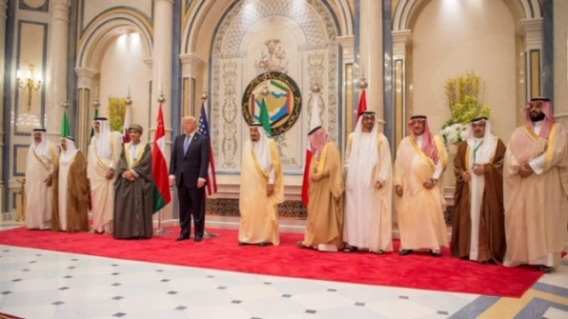

TRUMP: “Without Us the Gulf States Won’t Exist” https://www.youtube.com/watch?v=n7efwC2UJ0M
Donald Trump meets with Gulf leaders in landmark Riyadh summit,
US President Donald Trump on Sunday is meeting with heads from Gulf Cooperation Council (GCC) in Riyadh to discuss the region’s security threats including the ones coming from Iran as well as trade ties. Al Arabiya, 5/21/2017, https://english.alarabiya.net/en/News/gulf/2017/05/21/Trump-readies-for-more-meetings-after-his-1st-tremendous-day-in-Saudi-.html
“It’s good for Israel” Jewish Telegraphic Agency, 6/6/2017, http://www.jta.org/2017/06/06/news-opinion/united-states/arab-countries-are-turning-on-qatar-what-does-it-mean-for-israel
Iran’s Supreme Leader: Saudi Arabia ‘cow milked’ by US, Washington Post, 5/27/2017, https://www.washingtonpost.com/world/the_americas/irans-supreme-leader-saudi-arabia-cow-milked-by-us/2017/05/27/7d09e534-4301-11e7-b29f-f40ffced2ddb_story.html
US-Islamic summit begins in Riyadh with more than 50 leaders participating, Al Arabiya English, 5/21/2017, https://english.alarabiya.net
Saudi family names their daughter ‘Ivanka’ in honor of President Trump, The Washington Post, 5/5/2017, https://www.washingtonpost.com/news/worldviews/wp/2017/05/05/saudi-family-names-their-daughter-ivanka-in-honor-of-trump/
Qatar's ties with Hamas and recent alleged statements by its emir, Sheikh Tamim bin Hamad al-Thani, in support of Iran may have finally plunged the Gulf into a crisis, Business Standard, 6/5/2017, http://www.business-standard.com/article/international/gulf-nations-conflict-explained-why-4-arab-nations-snapped-ties-with-qatar-117060500477_1.html
The $1bn hostage deal that enraged Qatar’s Gulf rivals: Doha reportedly paid al-Qaeda affiliate and Iran to win release of royal hunting party, Financial Times, 6/5/2017, https://www.ft.com/content/dd033082-49e9-11e7-a3f4-c742b9791d43?mhq5j=e3
Trump Takes Credit for Saudi Move Against Qatar, a U.S. Military Partner, The New York Times, 6/6/2017, https://www.nytimes.com/2017/06/06/world/middleeast/trump-qatar-saudi-arabia.html

Slide 154

“Both he [Saudi foreign minister Adel al-Jubeir] and US Secretary of State Rex Tillerson made clear the arms deal [$110 billion] was aimed at countering Iran,” Donald Trump meets with Gulf leaders in landmark Riyadh summit, Al Arabiya, 5/21/2017, https://english.alarabiya.net/en/News/gulf/2017/05/21/Trump-readies-for-more-meetings-after-his-1st-tremendous-day-in-Saudi-.html
Saudi Arabia's New Crown Prince Mohammed Bin Salman Is Good News for Israel and U.S., Haaretz, 6/21/2017, http://www.haaretz.com/middle-east-news/.premium-1.797007
Saudi Arabia pressures Qatar to curb ties with Iran and stop all support for Palestinian Hamas. BBC, 7/5/2017, http://www.bbc.com/news/world-middle-east-40173757
US President Donald Trump, flanked by White House senior advisor Jared Kushner (2nd R) and chief economic advisor Gary Cohn (R), delivers remarks to reporters after meeting with Saudi Arabia’s Deputy Crown Prince and Minister of Defense Mohammed bin Salman (L) at the Ritz Carlton Hotel in Riyadh, Saudi Arabia, May 20, 2017. (Reuters)
“I think that Mr. Trump and his associates are going to be very strong, not merely in support for the Jewish state, but also in support for the Jewish people.” Prime Minister Netanyahu, CBS, 12/11/2017, http://www.cbsnews.com/news/trump-feels-very-warmly-about-israel-jews-says-netanyahu-60-minutes/
Meet the Jews in the Trump administration, Times of Israel, 1/28/2017, http://www.timesofisrael.com/meet-the-jews-in-the-trump-administration /
US Senate advances sanctions bill against Iran despite Islamic State attack, i24news, 6/8/2017, https://www.i24news.tv/en/news/international/147319-170608-us-senate-advances-sanctions-bill-against-iran-despite-islamic-state-attack
USA President Donald Trump Dancing in Saudi Arabia on Ardha Music [a war dance involving swords and daggers], 5/20/2017, https://www.youtube.com/watch?v=W146lbl0zaM
King Salman presents Trump with Saudi Arabia’s top civilian honor, Arab News, 5/20/2017, http://www.arabnews.com/node/1102196/saudi-arabia
Israel now sees Saudi Arabia as "a partner with a vital interest in stopping Iran... Israeli Prime Minister Benjamin Netanyahu is deeply invested in the informal alliance between Israel and the Sunni Arab states... AIPAC takes its cues from Israel’s government on which battles to pick... Jared Kushner, seen as one of the U.S. officials closest to Israel, helped negotiate the Saudi deal." Jewish Telegraphic Agency, 5/30/2017, http://www.jta.org/2017/05/30/news-opinion/politics/trump-wants-to-sell-lots-of-weapons-to-saudi-arabia-why-are-israel-and-its-friends-keeping-quiet
Deadly rhetoric: Saudi Arabia opens war of words with Iran, RT, 5/16/2017, https://www.rt.com/op-edge/388519-saudi-arabia-war-iran/
CIA creates new body dedicated to Iran operations: report, i24news, 6/2/2017, https://www.i24news.tv/en/news/international/americas/146890-170602-cia-creates-new-body-dedicated-to-iran-operations
IRAN ATTACK: ISIS claims responsibility for pair of assaults in Tehran, Fox news, 6/7/2017, http://www.foxnews.com/world/2017/06/07/shooting-at-iranian-parliament-building-reportedly-injures-security-guard.html

Slide 155
The Times of Israel described US President Trump's speech in Saudi Arabia as a "carefully scripted speech, ahead of his visit to Israel."
Excerpts from Trump's speech in Saudi Arabia:
"Our goal is a coalition of nations...
we signed historic agreements with the Kingdom [of Saudi Arabia] that will invest almost $400 billion in our two countries and create many thousands of jobs in America and Saudi Arabia.
This landmark agreement includes the announcement of a $110 billion Saudi-funded defense purchase...
This agreement will help the Saudi military to take a greater role in security operations...
Saudi Arabia and a regional coalition have taken strong action against Houthi militants in Yemen...
I also applaud the Gulf Cooperation Council for blocking funders from using their countries as a financial base for terror, and designating Hezbollah as a terrorist organization last year. Saudi Arabia also joined us this week in placing sanctions on one of the most senior leaders of Hezbollah...
From Lebanon to Iraq to Yemen, Iran funds, arms, and trains terrorists, militias, and other extremist groups that spread destruction and chaos across the region. For decades, Iran has fueled the fires of sectarian conflict and terror.
It is a government that speaks openly of mass murder, vowing the destruction of Israel, death to America, and ruin for many leaders and nations in this room...
Among Iran’s most tragic and destabilizing interventions have been in Syria...
All nations of conscience must work together to isolate Iran, deny it funding for terrorism, and pray for the day when the Iranian people have the just and righteous government they deserve...
The decisions we make will affect countless lives...
I ask you to join me, to join together, to work together, and to FIGHT together— BECAUSE UNITED, WE WILL NOT FAIL." Full text of Donald Trump’s speech in Saudi Arabia, The Times of Israel, 5/21/2017, http://www.timesofisrael.com/donald-trumps-speech-in-saudi-arabia/
Excerpts from Trump’s speech in Israel:
"On my first overseas trip as president, I have come to this sacred and ancient land to reaffirm the unbreakable bond between the United States and the State of Israel... We love Israel; we respect Israel. And I send your people the warmest greetings from your friend and ally, all of the people in the United States of America. We are with you." Full Transcript of Donald Trump's Speech After Landing at Israel's Ben Gurion Airport in Tel Aviv, Haaretz, 5/22/2017, http://www.haaretz.com/israel-news/1.790941

Slide 156
Examples of political manipulation of ethnic identity http://ffeu.org/
Demographer Steven M. Cohen: “Anything that fosters ethnic identity in America actually helps Jewish continuity. It makes the culture more empathetic to perpetuation of ethnic group ties.” Forward, 6/19/2015, http://forward.com/news/breaking-news/310378/us-census-may-add-controversial-israeli-category/
Muslim group [CAIR] appoints Jew as Philadelphia director, JTA, 10/18/2013, http://www.jta.org/2013/10/18/news-opinion/united-states/muslim-group-appoints-jew-as-their-philadelphia-director
J Street U’s new Muslim president says she’s ‘culturally Jewish’, JTA, 9/3/2015, http://www.jta.org/2015/09/03/news-opinion/united-states/j-street-us-new-muslim-president-is-culturally-jewish
US Muslims raise money to mend vandalized Jewish cemetery, PressTV, 2/22/2017, http://www.presstv.com/Detail/2017/02/22/511633/US-Muslims-Jewish-cemetary
Jewish people give Muslims key to their synagogue after town's mosque burns down, The Independent, 2/1/2017, http://www.independent.co.uk/news/world/americas/victoria-islamic-centre-mosque-fire-texas-jews-give-key-synagogue-muslims-worship-gofundme-a7556331.html
Israel Lobby Initiates Hispanic Strategy, IRmep, 10/4/2006, http://www.irmep.org/hispanic.htm
Jews and Muslims ramp up alliances in wake of Trump’s election, Jewish Telegraphic Agency, 11/14/2016, http://www.jta.org/2016/11/14/news-opinion/united-states/jews-and-muslims-ramp-up-alliances-in-wake-of-trumps-election
Congressman floats conspiracy theory that George Soros organized Charlottesville rally, JTA, 10/6/2017, https://www.jta.org/2017/10/06/news-opinion/united-states/charlottesville-rally-was-secretly-organized-by-george-soros-congressman-says
Sadiq Khan: London's Muslim Zionist mayor, Middle East Eye, 24 May 2016, http://www.middleeasteye.net/columns/sadiq-khan-londons-very-exclusive-mayor-565273955
Zac Goldsmith and Sadiq Khan back Tel Aviv festival in London, Jewish News Online, 2/1/2016, http://jewishnews.timesofisrael.com/zac-goldsmith-and-sadiq-khan-back-tel-aviv-festival-in-london/
London’s Muslim mayor calls for complete ban on Hezbollah, Jewish Telegraphic Agency, 7/7/2017, http://www.jta.org/2017/07/07/news-opinion/world/londons-muslim-mayor-calls-for-complete-ban-on-hezbollah
Indian Americans and American Jews: Advancing a trilateral alliance, The Jerusalem Post, 7/6/2017, http://www.jpost.com/Opinion/Indian-Americans-and-American-Jews-Advancing-a-trilateral-alliance-498989
Obama pushes ahead with plan to rejuvenate black-Jewish alliance, Jewish Telegraphic Agency, 1/13/ 2009, http://www.jta.org/2009/01/13/news-opinion/politics/obama-pushes-ahead-with-plan-to-rejuvenate-black-jewish-alliance
Breitbart News Network: Born In The USA, Conceived In Israel, Breitbart, 11/17/2015, http://www.breitbart.com/big-journalism/2015/11/17/breitbart-news-network-born-in-the-usa-conceived-in-israel/
How Steve Bannon and Breitbart News Can Be Pro-Israel — and Anti-Semitic at the Same Time, Forward, 11/15/2016, http://forward.com/news/israel/354402/how-steve-bannon-and-breitbart-news-can-be-pro-israel-and-anti-semitic-at-t/
Jewish senator calls on Jewish Trump Cabinet members to resign, JTA, 8/20/2017, http://www.jta.org/2017/08/20/news-opinion/politics/jewish-senator-calls-on-jewish-trump-cabinet-members-to-resign
Religion is not asked about at all in US census because of ‘objections by American Jewry’, Forward, 6/19/2015, http://forward.com/news/breaking-news/310378/us-census-may-add-controversial-israeli-category/

Slide 157
Gelb’s Idea of Partitioning Iraq
Leslie Gelb, former editor and columnist for The Times and president emeritus of the Council on Foreign Relations, wrote in The New York Times of 11/25/2003:
The United States should “move in stages toward a three-state solution: Kurds in the north, Sunnis in the center and Shiites in the south.”
Senator Joseph R. Biden of Delaware, chairman of the Foreign Relations Committee and candidate for the Democratic presidential nomination, picked up the idea, while The New York Times of 19 August 2007 dubbed it “The Biden-Gelb plan.”
10 new wars that could be unleashed as a result of the one against ISIS
[partly because the U.S. strategy relies on a variety of regional allies and local armed groups who are often bitterly at odds].
WAR NO. 1: U.S.-backed Syrian Kurdish forces and Turkish-backed Arab forces
WAR NO. 2: Turkey and the Syrian Kurds
WAR NO. 3: Syrian Kurds and the Syrian government
WAR NO. 4: The United States and Syria
WAR NO. 5: Turkey and Syria
WAR NO. 6: Iraqi Kurds and the Iraqi government
WAR NO. 7: Iraqi Kurds and Shiite militias
WAR NO. 8: Kurds against Kurds
WAR NO. 9: Sunni Arabs against Shiites and/or Kurds
WAR NO. 10: The remnants of the Islamic State against everyone
The Islamic State still controls a big chunk of territory in Syria and Iraq. Offensives to control its twin capitals, Mosul and Raqqa, have yet to begin. If the groups who are supposed to participate in the offensives fight among themselves, those battles could be delayed indefinitely.
Even if they don’t, these other conflicts, left unresolved, will herald long-term instability in the region. Military gains are not being matched by political solutions to the wider chaos and dysfunction that enabled the rise of the Islamic State in the first place. If the current war begets new wars, the Islamic State may yet endure.
The Washington Post, 9/7/2016, https://www.washingtonpost.com/news/worldviews/wp/2016/09/07/10-new-wars-that-could-be-unleashed-as-a-result-of-the-one-against-isis /
The “best” that can happen for Israeli interests in Iraq: “The dissolution of Iraq into a Shi'ite state, a Sunni state and the separation of the Kurdish part” (Ha'aretz 6/2/1982).
Prime Minister Benjamin Netanyahu announced Sunday evening that Israel supports the establishment of an independent Kurdish state in northern Iraq. Haaretz, 6/30/2014, http://www.haaretz.com/news/diplomacy-defense/.premium-1.601997

Slide 158

On 27 September, the Senate passed a resolution (75-23) urging the Bush administration to support "a political settlement among Iraq's major factions based upon the provisions of the Constitution of Iraq that create a federal system of government and allow for the creation of federal regions." CNN.com 9/30/07…. Heartland Eurasian Review of Geopolitics [originally created in China and Italy!?] apparently made and posted this map on its website, http://temi.repubblica.it/limes-heartland/iraqs-partition/1106
http://www.nytimes.com/2014/06/15/opinion/sunday/ross-douthat-changing-maps-in-the-mideast.html

Slide 159
How 5 Countries Could Become 14
Slowly, the map of the Middle East could be redrawn
An analysis by Robin Wright, The New York Times, 9/28/2013, http://www.nytimes.com/interactive/2013/09/29/sunday-review/how-5-countries-could-become-14.html
Why Pentagon Continues to ‘Lose’ Arms in War Zones, VT, 5/28/2017, http://www.veteranstoday.com/2017/05/28/why-pentagon-continues-to-lose-arms-in-war-zones/
U.S. failed to keep proper track of more than $1 billion in weapons and equipment in Iraq, The Washington Post, 5/24/2017, https://www.washingtonpost.com/news/checkpoint/wp/2017/05/24/u-s-failed-to-keep-proper-track-of-more-than-1-billion-in-weapons-and-equipment-in-iraq/
How Many Guns Did the U.S. Lose Track of in Iraq and Afghanistan? Hundreds of Thousands, The New York Times, 8/23/2016, https://www.nytimes.com/2016/08/23/magazine/how-many-guns-did-the-us-lose-track-of-in-iraq-and-afghanistan-hundreds-of-thousands.html?
Jabhat Fatah al Sham [al-Qaeda's affiliate in Syria] Field Commander Says US Provides Group With TOW Missiles, Sputnik news, 9/26/2016, https://sputniknews.com/middleeast/201609261045724904-jabhat-fatah-al-sham-us-tow/
US-trained Division 30 rebels 'betray US and hand weapons over to al-Qaeda's affiliate in Syria', The Telegraph, 9/22/2015, http://www.telegraph.co.uk/news/worldnews/middleeast/syria/11882195/US-trained-Division-30-rebels-betrayed-US-and-hand-weapons-over-to-al-Qaedas-affiliate-in-Syria.html
Pentagon loses track of $500 million in weapons, equipment given to Yemen, The Washington Post, 3/17/2015,
https://www.washingtonpost.com/world/national-security/pentagon-loses-sight-of-500-million-in-counterterrorism-aid-given-to-yemen/2015/03/17/f4ca25ce-cbf9-11e4-8a46-b1dc9be5a8ff_story.html
U.S. accidentally delivered weapons to the Islamic State by airdrop, militants say, The Washington Post, 10/21/2014, https://www.washingtonpost.com/news/checkpoint/wp/2014/10/21/u-s-accidentally-delivered-weapons-to-the-islamic-state-by-airdrop-militants-allege/

Slide 160
Defining Terrorism: “Premeditated, politically motivated violence perpetrated against noncombatant [including military personnel who at the time of the incident are unarmed or not on duty] targets by subnational groups or clandestine agents, usually intended to influence an audience”--- Title 22 of the United States Code, Section 2656f(d), http://www.state.gov/www/global/terrorism/1999report/intro.html
The Global Terrorism Index definition: “the threatened or actual use of illegal force and violence by a non-state actor to attain a political, economic, religious, or social goal through fear, coercion, or intimidation”. … This database does not include acts of state terrorism. Global Terrorism Index 2016, http://economicsandpeace.org/wp-content/uploads/2016/11/Global-Terrorism-Index-2016.2.pdf
Body Count, Casualty Figures after 10 Years of the “War on Terror”: Iraq, Afghanistan, Pakistan, First international edition (March 2015), http://www.psr.org/assets/pdfs/body-count.pdf
Unworthy Victims: Western Wars Have Killed Four Million Muslims Since 1990, Stop the War Coalition, 6/16/2017, http://www.stopwar.org.uk/index.php/news-comment/2615-unworthy-victims-western-wars-have-killed-four-million-muslims-since-1990
[Islamophobian and Roosterphobia [Alektorophobia]:] A Mauritanian folktale tells us about a roosterphobe, who would almost lose his mind whenever he encountered a rooster. "Why are you so afraid of the rooster?" the psychiatrist asked him. "The rooster thinks I’m corn." "You’re not corn. You’re a very big man. Nobody can mistake you for a tiny ear of corn," the psychiatrist said. "I know that, Doctor. But the rooster doesn’t." For years, I’ve been trying to convince the U.S. government that I am not corn. Mohamedou Ould Slahi: [read by Dominic West], "Inside the U.S. Torture Chambers: Prisoner's Guantánamo Diary Details 12 Years of Abuse, Terror," Democracy Now, 1/22/2015, https://www.democracynow.org/2015/1/22/inside_the_us_torture_chambers_prisoners
Fear of Chickens Is Surprisingly Common, and It’s Called Alektorophobia, Huffposts, 3/30/2017, http://www.huffingtonpost.com/modern-farmer/alektorophobia-fear-of-ch_b_9547596.html

Slide 161

Not a single war in recent years has started without powerful press ‘artillery’ --RT editor-in-chief
Five-year-old wounded Syrian boy Omran Daqneesh.
© Mahmoud Rslan / Aleppo Media Center / Global Look Press
“Everyone remembers the boy Omran, who became a symbol of Assad’s so-called ‘atrocities.’ This photo was on the front covers of all world media, spread by all of the mainstream. Of course, who wouldn’t feel sorry for a boy dug up from under the rubble, covered in blood and soot? We found the boy’s family a month ago. His father supports Assad, and he told us this really scary story about how an infamous humanitarian organization basically snatched the boy out of his father’s hands, not letting him perform first aid, to take the photos and give them to the journalists. And he is not being heard.” RT, 7/5/2017, https://www.rt.com/news/395336-media-russia-china-simonyan/
Syria and Organized Crime, Duff Interview, VT, 7/23/2017, http://www.veteranstoday.com/2017/07/23/syria-and-organized-crime-duff-interview/

Slide 162

‘The Dirty War on Syria’ has relied on a level of mass disinformation not seen in living memory. In seeking ‘regime change’ the big powers sought to hide their hand, using proxy armies of ‘Islamists’, demonizing the Syrian Government and constantly accusing it of atrocities. In this way Syrian President Bashar al Assad, a mild-mannered eye doctor, became the new evil in the world.
The popular myths of this dirty war—that it is a ‘civil war’, a ‘popular revolt’ or a sectarian conflict—hide a murderous spree of ‘regime change’ across the region. The attack on Syria was a necessary consequence of Washington’s ambition, stated openly in 2006, to create a ‘New Middle East’. After the destruction of Afghanistan, Iraq and Libya, Syria was next in line.
The terrible massacres were mostly committed by western backed jihadists, then blamed on the Syrian Army. The western media and many western NGOs parroted the official line. Back book cover.
Promotion of sectarianism in the Middle East mostly comes from Washington’s key allies, Saudi Arabia, the other Gulf monarchies, and the ethnic cleansers of Israel. They share the US aim of keeping the region weak and divided. P. 2
In sum we can conclude that the US has built a command relationship with all the anti-Syrian terrorist groups, including, al Nusra ISIS, either directly or through its close regional allies, the Saudis, Qatar, Israel and Turkey. Washington has attempted to play a ‘double game’ in Syria and Iraq, using its old doctrine of ‘plausible deniability’ to maintain the fiction of a ‘war on terrorism’ for as long as is possible. P. 183
US Virginia State Senator Richard Black on the war in/on Syria (45mn), Published on Sep 5, 2018, https://www.youtube.com/watch?v=FR_s9Uff5NQ
US Senator Chris Murphy exposes US government complicity in the ongoing war, blockade, and cholera in Yemen (15mn), Published on 11/14/2017, https://www.youtube.com/watch?v=YcdzEPaLyWk
Ending Yemen’s war without perpetuating a ‘southern Hezbollah’, The Hill, 9/12/2018, https://thehill.com/opinion/international/405882-ending-yemens-war-without-perpetuating-a-southern-hezbollah
The former Prime Minister of Qatar announced that a total of 137 billion dollars was wasted on the attempts to topple Syrian President Assad’s government , https://journal-neo.org/2017/11/18/revelations-of-a-high-profile-qatari-officials-reveal-a-wider-anti-syria-conspiracy/
US Vice President Biden blames US allies for rise of ISIS, https://www.youtube.com/watch?v=AoQO81hKC3A
US ex-intelligence chief [Lieutenant General Michael Flynn] on ISIS rise: It was 'a willful Washington decision'---RT, 8/10/2015, https://www.rt.com/usa/312050-dia-flynn-islamic-state/
UN puts cost of Syria war destruction at $388 billion (excluding economic cost of 'human loss' due to death and displacement), The Times of Israel, 8/8/2018, https://www.timesofisrael.com/un-puts-cost-of-syria-war-destruction-at-388-billion/
Israel supplied weapons to Syrian rebels, outgoing army chief acknowledges, JTA, 1/15/2019, https://www.jta.org/quick-reads
US Secretary of State John Kerry In Leaked Audio Admits U.S. Allowed Rise Of ISIS To Force Assad Out Of Power, Western Journal, 1/6/2017, https://www.youtube.com/watch?v=t3KfmjdviHM
The reason, President Obama added, “that we did not just start taking a bunch of airstrikes all across Iraq as soon as ISIL came in was because that would have taken the pressure off of [Iraqi Prime Minister Nuri Kamal] al-Maliki.” The New York Times, 8/8/2014, https://www.nytimes.com/2014/08/09/opinion/president-obama-thomas-l-friedman-iraq-and-world-affairs.html
2016

Slide 163
Excerpts from ‘Jihad Literacy’
Dana Burde: "[T]he US today is one of the biggest promoters of counterterrorism and democratic state-building in the [Afghan] region, yet so few Americans (including me) were aware that our taxpayer dollars had once been used to fund violent jihad and build a militantly Islamist society... In fact, the US created children’s textbooks (for grades 1–12) designed to inspire militancy, as well as the Alphabet of Jihad Literacy, a series of adult literacy lessons for mujahideen. All were funded and supported by a US government aid project, administered through the University of Nebraska at Omaha, designed in large part to support the Cold War struggle against the Soviets [In a 2011 blog post, one Pakistani journalist summarizes the story in just three sentences: Imagine that you learnt the alphabet and numbers with images of Kalashnikovs and tanks instead of apples and oranges. During the mid to late 1980s, a USAID funded project printed millions of textbooks in Peshawar. The funds came from Saudi Arabia and the books were distributed amongst school children in Afghanistan and in new madrassas across Pakistan. (El Edroos 2011)2]... Schools throughout Afghanistan used these textbooks, or slightly modified versions of them, from the mid-1980s until the mid-2000s. Many madrassas—schools dedicated to the study of Islam—on the Afghan-Pakistan border also used these materials (El Edroos 2011), and despite the fact that the Afghan government has a new (and improved) set of books, many schools and madrassas on both sides of the border continue to use the US-sponsored jihadist books today because of the way they teach violence as an obligation of religion. Indeed, in insurgent-controlled regions of Afghanistan, reports indicate that the Taliban demand that schools use these texts if they want to remain open (pers. interviews March 4, 2013; Glad 2009)... Then I discuss the Soviet invasion and the responses from the US, Saudi Arabian, and Pakistani governments that supported the Afghan mujahideen... Finally, I show how the US became involved in the business of promoting violent jihad and provide an analysis of the jihadist textbooks sponsored by USAID and the University of Nebraska at Omaha… The bulk of the violent material appears in grades 1–6. Until recently, the only academic discussion of these books appeared in a short but compelling article by Craig Davis (2002).
Davis’ excerpt from the introduction to the Dari alphabet20 in a first-grade language-arts book warrants repeating here:
Alif [is for] Allah.
Allah is one.
Bi [is for] Father (baba).
Father goes to the mosque . . .
Pi [is for] Five (panj).
Islam has five pillars . . .
Ti [is for] Rifle (tufang).
Javad obtains rifles for the Mujahidin . . .
Jim [is for] Jihad.
Jihad is an obligation. My [uncle] went to the jihad. Our brother gave water to the
Mujahidin . . .
Dal [is for] Religion (din).
Our religion is Islam. The Russians are the enemies of the religion of Islam . . .
Zhi [is for] Good news (muzhdih).
The Mujahidin missiles rain down like dew on the Russians. My brother gave me good
news that the Russians in our country taste defeat . . .
Shin [is for] Shakir.
Shakir conducts jihad with the sword. God becomes happy with the defeat of the
Russians . . .
Zal [is for] Oppression (zulm).
Oppression is forbidden. The Russians are oppressors. We perform jihad against the
oppressors . . .
Vav [is for] Nation (vatn).
Our nation is Afghanistan. . . . The Mujahidin made our country famous. . . . Our
Muslim people are defeating the communists. The Mujahidin are making our dear
country free. Source: Burde, Dana. Schools for Conflict or for Peace in Afghanistan, Columbia University Press, 2014. ProQuest Ebook Central, http://ebookcentral.proquest.com/lib/insu-ebooks/detail.action?docID=1643186. Created from insu-ebooks on 2018-01-24 14:15:20.

Slide 164
What Do Israelis Think About Americans? Start With Disdain
View Ally as Naive, Especially on Middle East Issues
…… “I know what America is,” Netanyahu, then on political hiatus after an election defeat, told the settlers when one asked whether his proposal for a “large scale” attack on the Palestinians would be met with global condemnation. “America is a thing that can be easily moved, moved in the right direction. They will not bother us… Let’s suppose they [the Bush administration] will say something. So they say it — so what? Eighty per cent of the Americans support us. It’s absurd! We have such [great] support there! And we say… what shall we do with this [support]?”
The Jewish Daily Forward, 3/8/2015, http://forward.com/articles/216074/what-do-israelis-think-about-americans-start-with/
The United States government is strongly involved in the Palestine-Israel conflict, which continues to define US relations with other countries and contributes to US isolation from the international community as indicated by the most recent United Nations General Assembly vote on the "right of the Palestinian people to self-determination': 177 countries in favor, 7 against (Canada, Federated States of Micronesia, Israel, Marshall Islands, Nauru, Palau, United States), with 4 abstentions (Cameroon, Côte d’Ivoire, South Sudan, Tonga). United Nations, 12/19/2016, https://www.un.org/press/en/2016/ga11879.doc.htm
Citing anti-Israel bias, U.S. to withdraw from UNESCO [United Nations’ Paris-based cultural, scientific, and educational organization], Politico, 10/12/2017, https://www.politico.com/story/2017/10/12/united-states-withdraws-unesco-243708
"One by one, 14 members of the U.N. Security Council spoke out against President Donald Trump's decision to recognize Jerusalem as the capital of Israel [the UN Security Council has only 15 members, including the US], Fox News, 12/9/2017, http://www.foxnews.com/world/2017/12/09/14-security-council-members-criticize-us-action-on-jerusalem.html
"U.S. vetoes U.N. resolution rejecting Trump’s decision on Jerusalem... All 14 other members supported the resolution, underscoring the U.S. isolation on the issue." The Washington Post, 12/18/2017, https://www.washingtonpost.com/world/national-security/us-vetoes-un-resolution-rejecting-trumps-decision-on-jerusalem/2017/12/18/4e683732-e421-11e7-ab50-621fe0588340_story.html?utm_term=.684214f9ebce
“Most Israelis think Americans are pro-Israel and we can sell them anything, especially mud from the Dead Sea. Or — just regular mud with a ‘Dead Sea’ sticker on it.”
Israeli Embassy Official Caught on Camera Discussing 'Taking Down' British Lawmakers, Haaretz, 1/8/2017, http://www.haaretz.com/israel-news/1.763613
Attorney Jeff Gates on displacing 'facts' with 'fictions', https://www.youtube.com/watch?v=pNjb1MGmGDc
“Seven Basic Propaganda Devices” that “engage the emotions” & “downplay rationality”, http://muzzlewatch.com/wp-content/wujshasbara.pdf
The 193-member United Nations General Assembly has overwhelmingly voted [128 in favor; 9 against: Guatemala, Honduras, Israel, Marshall Islands, Micronesia, Nauru, Palau, Togo, and United States; with 35 abstentions and 21 absences] to declare US recognition of Jerusalem as the capital of Israel "null and void" and must be cancelled. BBC, 12/21/2017, http://www.bbc.com/news/world-middle-east-42446027

Slide 165
Leading Pro-Israel American Jews Urge America to Fight BDS Not ISIS
The World Jewish Congress is strongly supporting a bill in the U.S. Senate that intends to fight back against BDS, World Jewish Congress, accessed 8/1/2017, http://www.worldjewishcongress.org/en/bdsrallycongress
Henry Kissinger (an American Jewish diplomat who served as United States Secretary of State and National Security Advisor under two US administrations) and Thomas Friedman (an American Jewish journalist who writes weekly columns for The New York Times) warn US President Donald Trump NOT to destroy ISIS in Syria because doing so will serve the interests of Iran. Rather Trump "should let ISIS be Assad’s, Iran’s, Hezbollah’s and Russia’s headache — the same way we encouraged the mujahedeen fighters to bleed Russia in Afghanistan,” The New York Times, 4/12/2017, https://www.nytimes.com/2017/04/12/opinion/why-is-trump-fighting-isis-in-syria.html, Newsweek, 8/8/2017, http://www.newsweek.com/kissinger-warns-trump-isis-keeping-iran-check-he-must-not-let-it-fill-void-647766
Israeli companies talking to Saudi Arabia about $500b. ‘Smart City’ … “What politicians don’t understand: things don’t happen unless there are business opportunities.” The Jerusalem Post, 10/27/2017, http://www.jpost.com/Business-and-Innovation/Israeli-companies-likely-talking-to-Saudi-Arabia-about-500-bil-smart-city-508429
Israeli Channel 13 reported that former [Israeli] Mossad Director Tamir Pardo paid a secret visit to Riyadh [Saudi Arabia] in early 2014, Al Manar TV, 2/13/2019, http://english.almanar.com.lb/679230
Report: Israel sold $250 million of sophisticated spy systems to Saudi Arabia, The Washington Post, 10/28/2018, https://www.jpost.com/Middle-East/Report-Israel-sold-250m-of-sophisticated-spy-systems-to-Saudi-Arabia-570539
Trump's Peace Plan Could Be Called 'Unexecutable,' Pompeo Tells Jewish Leaders, Haaretz, 6/3/2019, https://www.haaretz.com/us-news/.premium-trump-s-peace-plan-could-be-called-unexecutable-mike-pompeo-tells-jewish-leaders-1.7315983
Trump tells Russia, Syria to 'STOP!' bombing jihadist-held Idlib i24news, 6/3/2019, https://www.i24news.tv/en/news/international/middle-east/1559537945-trump-tells-russia-syria-to-stop-bombing-jihadist-held-idlib

Slide 166
President Donald Trump formally recognized Jerusalem as Israel’s capital (12/6/2017)
The US 104th Congress enacted Public Law 104–45—NOV. 8, 1995, titled 'Jerusalem Embassy Act of 1995’, https://www.congress.gov/104/plaws/publ45/PLAW-104publ45.pdf
On December 6, 2017, US President Donald Trump formally recognized Jerusalem as Israel’s capital in a historic speech, VOX 12/6/2017, https://www.vox.com/2017/12/6/16742640/trump-jerusalem-israel-speech-full-text
Palestinian President Mahmoud Abbas demands UN takes charge of peace process after Trump’s recognition of Jerusalem as capital of Israel. The Guardian, 12/13/2017, https://www.theguardian.com/world/2017/dec/13/recep-tayyip-erdogan-unite-muslim-world-trump-east-jerusalem
Leaders of the 57-nation Organization of the Islamic Conference gathered in Turkey on 12//13/2017 and condemned U.S. President Donald Trump’s decision to recognize Jerusalem as the capital of Israel as unlawful. Voice of America, 12/13/2017, https://www.voanews.com/a/islamic-world-meeting-regarding-trump-jerusalem-choice/4161688.html
US Embassy relocation to Jerusalem: World leaders react to Trump's decision, FRANCE 24 English, Published on Dec 6, 2017, https://www.youtube.com/watch?v=DF9t3CBJZyA
Watch Palestinian President Abbas's reaction to Trump's Jerusalem decision, FRANCE 24 English, Published on Dec 6, 2017, https://www.youtube.com/watch?v=BE0F8PPBEzc
What's The Impact of Trump’s Jerusalem Shift? The New York Times, Published on Dec 8, 2017, https://www.youtube.com/watch?v=v1-G6f7c9fU
Trump's decision on Jerusalem is an assault on Palestinians: Kwara kekana, SABC Digital News, Published on Dec 8, 2017, https://www.youtube.com/watch?v=0m93dkHtijY
Pastor John Hagee Delivers Benediction at Opening of US Embassy in Jerusalem, Israel, Hagee Ministries, Published on May 14, 2018, https://www.youtube.com/watch?v=u-9XM-q8cdg
Recognizing God's Hand in Donald Trump's Election, The 700 Club, 11/6/2017, https://www.youtube.com/watch?v=aRcnJPQqY0c
https://www.veteranstoday.com/2019/12/07/was-13-only-like-in-lawsuit-new-epstein-accusers-partially-confirm-accusations-against-trump-rape-and-murder/
Rabbi Chaim Mentz reacts to U.S. Embassy opening in Jerusalem amid deadly Gaza clashes, FOX 11 Los Angeles, Published on May 16, 2018, https://www.youtube.com/watch?v=uRgoAbrSjGw
Numerous Jewish groups castigated President Trump this weekend over his speech on Saturday to the Israeli American Council, accusing him of using anti-Semitic tropes while trying to appeal to Jewish voters. The Washington Post, 12/9/2019, https://www.washingtonpost.com/nation/2019/12/09/trump-israeli-american-council-anti-semitic-claims/
Israeli military shoot and kill Palestinian protesters in Gaza, CBC News, May 14, 2018, https://www.youtube.com/watch?v=_st6dcSOxJE

Slide 167





Saudi Crown Prince honoured by the CIA Diplomat Magazine, 2/13/2017, http://www.diplomatmagazine.nl/2017/02/13/saudi-crown-prince-honoured-cia/
Saudi journalists support Israel over [Palestinian] Hamas in latest battles: "Our hearts are with you. May Allah protect Israel and its people," wrote Abd Al-Hamid Al-Hakim, former director of the Middle East Center for Strategic and Legal Studies in Jeddah. The Jerusalem Post, 5/7/2019, https://www.jpost.com/Middle-East/Saudi-journalists-support-Israel-over-Hamas-in-latest-battles-589053
President Trump: We're losing everything “defending” Saudi Arabia, 4/28/2019, https://www.youtube.com/watch?v=Mlji5_3NrP8
President Trump: Israel would be in big trouble without Saudi Arabia, Israel National News, 11/22/2018, http://www.israelnationalnews.com/News/News.aspx/255130
US 2006 National Security Strategy proclaims that the United States faces "no greater challenge from a single country than from Iran." Quoted by Mohsen Milani, “Tehran’s Take: Understanding Iran’s U.S. Policy,” Foreign Affairs (July/August 2009), pp. 42–62, http://www.foreignaffairs.com/articles/65123/mohsen-m-milani/tehrans-take .
Saudi Crown Prince Meets AIPAC [the Israel lobby], Other Jewish Leaders During US Visit, AntiWar, 3/29/2018, https://news.antiwar.com/2018/03/29/saudi-crown-prince-meets-aipac-other-jewish-leaders-during-us-visit/
Repression Under Saudi Crown Prince Tarnishes Reforms, Human Rights Watch, 11/4/2019, https://www.hrw.org/report/2019/11/04/high-cost-change/repression-under-saudi-crown-prince-tarnishes-reforms
‘That’s peanuts to you’: Trump brings props showing Saudi weapons purchases, published 3/20/2018, https://www.youtube.com/watch?v=9O0uR03s7m4
This photo provided by Embassy of the Kingdom of Saudi Arabia , dual U.S.-Israeli national Joel Rosenberg shakes hands with Crown Prince Mohamed bin Salman at a palace in Jiddah, Saudi Arabia, on Tuesday, Sept. 10, 2019. The Saudi government published photos of the meeting, which took place on Tuesday and was attended by leading American-Christian Zionist leaders, including Rosenberg. The nine-person delegation also includes Rev. Johnnie Moore, a co-chairman of President Donald Trump's Evangelical Advisory Council, and Larry Ross, once a longtime spokesman for one of America's most well-known evangelicals Billy Graham. (Embassy of the Kingdom of Saudi Arabia via AP), Yahoo, 9/10/2019, https://news.yahoo.com/us-christian-evangelical-delegation-meets-183706540.html
Saudi crown prince implicated in hack of Jeff Bezos’s phone, U.N. report will say, The Washington Post, 1/21/2020, https://www.washingtonpost.com/politics/saudi-crown-prince-implicated-in-hack-of-jeff-bezoss-phone-un-report-will-say/2020/01/21/62c3f73a-3ca2-11ea-b90d-5652806c3b3a_story.html
Bin Salman
Netanyahu
Trump
U.S.-Israeli national and Zionist leader Joel Rosenberg meets Saudi Crown Prince Bin Salman
Saudi Arabia's New Crown Prince Mohammed Bin Salman Is Good News for Israel and U.S., Haaretz, 6/21/2017, http://www.haaretz.com/middle-east-news/.premium-1.797007
VT, 12/31/2019, https://www.veteranstoday.com/2019/12/31/saudi-fun/

Slide 168
Iraq Condemns U.S. Air Strikes As Unacceptable And Dangerous
Huffpost, 12/30/2019, https://www.huffpost.com/entry/iraq-condemns-us-air-strikes_n_5e0aa405c5b6b5a713b2fe25
Protesters Attack U.S. Embassy in Iraq, Chanting ‘Death to America’, The New York Times, 12/31/2019, https://www.nytimes.com/2019/12/31/world/middleeast/baghdad-protesters-us-embassy.html
Iraqi Protesters Break Into U.S. Embassy After Airstrikes; Ambassador Evacuated, Haaretz, 12/31/2019, https://www.haaretz.com/middle-east-news/iraq/thousands-of-iraqi-protesters-try-to-storm-u-s-embassy-after-airstrikes-1.8342605
US Embassy in Iraq evacuated amid angry protests over airstrike on PMU, PressTV, 12/31/2019, https://www.presstv.com/Detail/2019/12/31/615008/Iraq-Baghdad-funeral-US-embassy
US Attacks Iraqi Military Hundreds of Miles from “Incident”..where Oil Company Contractor Killed while Stealing Iraqi Crude, VT, 12/31/2019, https://www.veteranstoday.com/2019/12/31/us-attacks-iraqi-military-hundreds-of-miles-from-incident-where-oil-company-contractor-killed-while-stealing-iraqi-crude/
US sending additional forces to protect embassy threatened by protesters in Iraq, CNN, 12/31/2019, https://www.cnn.com/2019/12/31/politics/iraq-embassy-additional-forces-mark-esper/index.html
This is not a Warning, it is a Threat,” Trump declared in a tweet on Tuesday afternoon, adding that Iran will “pay a very BIG PRICE!” for the embassy siege earlier in the day, Russia Today, 12/31/2019, https://www.rt.com/news/477237-trump-threat-iran-iraq-protests/
Trump says Iran will ‘pay a very big price’ if lives are lost at any US facility, Alarabiya, 1/1/2020, https://english.alarabiya.net/en/News/middle-east/2020/01/01/Trump-says-Iran-will-pay-a-very-big-price-if-lives-are-lost-at-any-US-facility.html
Major General Qassem Soleimani, the commander of the Quds Force of Iran’s Islamic Revolution Guards Corps (IRGC), and Abu Mahdi al-Muhandis, the second-in-command of Iraq’s Popular Mobilization Units (PMU), have been killed in US airstrikes in the Iraqi capital Baghdad, media reports say, VT, 1/3/2020, https://www.veteranstoday.com/2020/01/02/breaking-us-assassinates-top-iran-military-leader-war-with-iran-is-on/
Democratic presidential contenders on Friday condemned the air strike that killed Iranian military commander Qassem Soleimani, saying President Donald Trump’s decision was reckless and could lead the United States to another war in the Middle East. Reuters, 1/4/2020, https://www.reuters.com/article/us-usa-election-iran/u-s-democratic-contenders-condemn-iran-strike-warn-of-war-idUSKBN1Z21WG
Celebrities are upset that Donald Trump killed Qassem Soleimani, The Postmillennial, 1/4/2020, https://www.thepostmillennial.com/celebrities-are-upset-that-donald-trump-killed-qassem-soleimani/
Anti-US threats flood Twitter and Instagram after Qassim Soleimani's death, The Telegraph, 1/4/2020, https://www.telegraph.co.uk/technology/2020/01/04/pro-soleimani-threats-flood-twitter-instagram-generals-death/
IRAQ: War Launched to Protect Israel – Bush Adviser, INTER PRESS SERVICE News Agency, Mar 29 2004, http://www.ipsnews.net/2004/03/iraq-war-launched-to-protect-israel-bush-adviser/ ; Mearsheimer & Walt, The Israel Lobby and U.S. Foreign Policy, New York: Farrar, Straus and Giroux I, 2007, page 31

Slide 169
Frankenstein’s Monster-Style Blowback Terrorism
Blowback terrorism from British sponsorship of Zionism in Palestine
Blowback terrorism from American sponsorship of Jihadism in Afghanistan
On July 22, 1946, the Irgun Zionist organization bombed the King David Hotel in Jerusalem which hosts the Headquarters of the British Government of Palestine and the British Armed Forces in Palestine and Transjordan
On September 11, 2001, the Al-Qaeda Jihadist organization coordinated suicidal attacks against U.S. landmarks, including the World Trade Center in New York and the Pentagon in Washington
In 2015 General Odierno, US Army Chief of Staff, noted that the United States Army Operating Concept 2020–2040 should be based on:
Dealing with an operating environment that will include reduced budgets;
Integrating efforts of multinational partners and NGOs to achieve common goals;
Creating an atmosphere that is favorable for creating multiple dilemmas for the enemy, https://www.ausa.org/sites/default/files/DR-15-1-The-Army-Operating-Concept-2020-2040-Winning-in-a-Complex-World.pdf
Frankenstein, the title character in Mary Wollstonecraft Shelley’s novel Frankenstein, the prototypical “mad scientist” who creates a monster by which he is eventually killed. Britannica, accessed 1/1/20, https://www.britannica.com/topic/Frankenstein#ref173804

Slide 170
Trump: Israel would be in big trouble without Saudi Arabia
Israel National News, 11/22/2018, http://www.israelnationalnews.com/News/News.aspx/255130
Trump: I Told Saudi King Salman He Wouldn't Last for Two Weeks Without U.S. Military Backing
Haaretz, 10/3/2018, https://www.haaretz.com/us-news/trump-i-told-saudi-king-he-wouldn-t-last-for-two-weeks-without-u-s-backing-1.6517717
Excerpts from "What’s Next in U.S.-Saudi Relations, a Conversation with H.E. Adel Al-Jubeir, Minister of Foreign Affairs, Kingdom of Saudi Arabia”
[1] "The Kingdom of Saudi Arabia and the United States have been allies for eight decades now.
[2] They have seen the coming and breaking of many storms.
[3] In the 1950s and ’60s, we worked together to defeat radicalism emanating from Nasser and other revolutionary states in the Middle East.
[4] In the ’70s and ’80s, we worked together to roll back the Soviet Union. We were able to switch Egypt from the Soviet camp to the Western camp.
[5] We did the same thing in Somalia in the 1960s and ’70s, sorry.
[6] We pushed back against Soviet encroachment towards the Gulf.
[7] We worked together in Afghanistan and we prevailed.
[8] And 1990, of course, everybody remembers the invasion of Kuwait and the liberation of Kuwait by a coalition of over 30 countries that was put together by the United States and the Kingdom of Saudi Arabia.
[9] Today we are facing numerous challenges in our region.
[10] We are facing extremism and terrorism.
[11] We are facing a crisis in Syria.
[12] We are facing working together to support Iraq and maintaining its unity and helping Iraq rebuild the nation after many years of devastation.
[13] We are working together to contain Iran.
[14] We are working together to support the legitimate government of Yemen.
[15] We are working together to see what we can do about Libya...
[16] The situation in Syria, for example, is a tragedy. More than 500,000 people killed, 12 million people displaced, millions of refugees outside of Syria...
[17] With regards to the Arab-Israeli conflict, I mean, the Kingdom’s position has been consistent since the late King Fahd offered the eight-point plan that was adopted by the Arab world that calls for a two-state solution: the Palestinian state on the 67 borders, with East Jerusalem as its capital…
[18] We have, between Saudi private and government investments, we probably have close to $800 billion invested in the U.S. We still look to the U.S. as an attractive destination because of political stability and because of your dynamic economy. For infrastructure we have committed $20 billion to invest in infrastructure projects in the U.S.....
[19] Women can drive come June. Women can attend sports events... One of our senior ulama, religious scholars, issued an important statement saying women don’t have to wear black abaya.”
THE BROOKINGS INSTITUTION, SAUL/ZILKHA ROOM, WHAT’S NEXT IN U.S.-SAUDI RELATIONS, A CONVERSATION WITH H.E. ADEL AL-JUBEIR, MINISTER OF FOREIGN AFFAIRS, KINGDOM OF SAUDI ARABIA, Washington, D.C. Thursday, March 22, 2018, https://www.brookings.edu/wp-content/uploads/2018/03/fp_20180322_saudi_us_transcript.pdf
Trump: U.S. troops will remain in the Middle East for Israel
The Washington Post, 11/28/2018, https://www.jpost.com/Middle-East/Trump-US-troops-will-remain-in-the-Middle-East-for-Israel-572997
President George Washington’s Farewell Address to the People of the United States (1796): "a passionate attachment of one nation for another produces a variety of evils.” https://www.senate.gov/artandhistory/history/resources/pdf/Washingtons_Farewell_Address.pdf
Jim W. Dean is Managing Editor of Veterans Today: "Aramco credit rating hit may kill planned stock offering---Crown Prince bin Salman is getting a real life lesson that, while he may be the sole power leader of Saudi Arabia which allows him to have female car-driving activists tortured in prison, he does not control his credit rating. He also cannot control how ineffective his troops and mercenaries are fighting in Yemen. He cannot control what Iran does. And he has claimed he had no control of a major hit- and body-disposal team flying all the way to Turkey to murder the unfortunate Saudi activist Mr. Khashoggi. In terms of international prestige, the Prince is a dead man walking. As long as he is a controllable chicken to be plucked by Western arms merchants and a pawn for the Israelis, he is just keeping the leadership seat warm until a better replacement is found. https://www.veteranstoday.com/2019/10/08/aramco-credit-rating-hit-may-kill-planned-stock-offering

Slide 171


Think critically about who is ‘calling the shots’ in this Israeli-Jewish American official meeting about the formulation of “American” Middle East policy:
US President Donald Trump senior adviser Jared Kushner, US special Middle East envoy Jason Greenblatt, US ambassador to Israel David Friedman, Israeli Prime Minister Benjamin Netanyahu and Israeli ambassador to US Ron Dermer in Jerusalem. Benjamin Netanyahu – Facebook, i24News, 2/27/2019, https://www.i24news.tv/en/news/international/middle-east/196122-190227-kushner-tours-middle-east-in-attempt-to-draw-support-for-us-peace-plan
White House Reviews Military Plans Against Iran, in Echoes of Iraq War, NYT, 5/13/2019, https://www.nytimes.com/2019/05/13/world/middleeast/us-military-plans-iran.html
Only Israel Benefits From US War in IRAN, VT, 5/16/2019, https://www.veteranstoday.com/2019/05/16/only-israel-benefits-from-us-war-in-iran/
[T]housands of [Evangelical/Zionist] Christians coming to the [Israeli-occupied Palestinian] West Bank to work for free for Jewish settlers [who do not believe in Jesus]," Forward, 12/7/2018, https://forward.com/news/415630/inside-the-evangelical-money-flowing-into-the-west-bank
U.S. General Clark reveals a 2001 military plan by pro-Israel neoconservatives to have America overthrow 7 Middle East countries in 5 years https://www.youtube.com/watch?v=hss1xDQPooo
Israeli Rabbi Ovadia Yosef said: “The sole purpose of non-Jews is to serve Jews”, while Israeli Prime Minister Benjamin Netanyahu said: Rabbi Ovadia "worked greatly to enhance Jewish heritage.”
Jewish Telegraphic Agency, October 7, 2013, http://www.jta.org/2013/10/07/life-religion/ovadia-yosef-founder-of-shas-and-sephardi-sage-dies-at-93
Even State Department’s Top Mideast Official In Dark About Kushner’s Peace Plan, Forward, 10/30/2019, https://forward.com/fast-forward/434008/jared-kushner-israeli-palestinian-peace-state-department/
The New York Times publishes (4/25/2019) a cartoon of Israeli Prime Minister Benjamin Netanyahu as guide-dog for blind US President Donald Trump as a depiction of Israel-US relationship. Israel National News, 4/27/2019,
http://www.israelnationalnews.com/News/News.aspx/262320
“Most Israelis think Americans are pro-Israel and we can sell them anything, especially mud from the Dead Sea. Or — just regular mud with a ‘Dead Sea’ sticker on it.” The Jewish Daily Forward, 3/8/2015, http://forward.com/articles/216074/what-do-israelis-think-about-americans-start-with
Israeli Rabbi Eliezer Kashtiel: "The gentiles will want to be our slaves. Being a slave to a Jew is the best." Times of Israel, 4/30/2019, https://www.timesofisrael.com/embracing-racism-rabbis-at-pre-army-yeshiva-laud-hitler-urge-enslaving-arabs/
Trump Signs anti-Semitism Executive Order [to suppress criticism of Israel], Haaretz, 12/12/2019, https://www.haaretz.com/us-news/.premium-hanukkah-comes-early-at-white-house-as-trump-signs-anti-semitism-executive-order-1.8259863
Columbia University accused of anti-Semitic discrimination in first case related to Trump executive order, JTA, 12/23/2019, https://www.jta.org/quick-reads/columbia-university-accused-of-anti-semitic-discrimination-in-first-case-since-trump-executive-order
Israeli Prime Minister Benjamin Netanyahu gets standing ovations from US Congress, The Telegraph, Published on Mar 3, 2015, https://www.youtube.com/watch?v=0KMVhb57RqI
Trump, Netanyahu say discussed advancement of 'Mutual Defense Treaty', i24NEWS, September 14, 2019, https://www.i24news.tv/en/news/israel/diplomacy-defense/1568475473-trump-says-discussed-mutual-defense-treaty-with-netanyahu?
Review carefully this slide and this New York Times cartoon’s depiction of who is ‘calling the shots’ in the US-Israel relationship and the overall “American” Middle East policy
Gordon Duff: "It’s very clear that the policy of the United States is controlled from outside the United States." VT, 12/30/2019, https://www.veteranstoday.com/2019/12/30/breaking-iraqi-president-condemns-us-duff-on-press-tv-tour-de-force-analysis/
The blind man:
US President
Donald Trump
“Meet the Jews in the Trump administration,” The Times of Israel, 1/28/2017, http://www.timesofisrael.com/meet-the-jews-in-the-trump-administration/
Israeli Prime Minister Netanyahu: “America is a thing that can be easily moved, moved in the right direction.” The Jewish Daily Forward, 3/8/2015, http://forward.com/articles/216074/what-do-israelis-think-about-americans-start-with/
The guide dog:
Israeli Prime Minister Benjamin Netanyahu
Israeli Prime Minister Ariel Sharon: “we, the Jewish people control America, and the Americans know it.” Washington Report on Middle East Affairs, 10/3/2001, https://www.wrmea.org/old-html/sharon-to-peres-don-t-worry-about-american-pressure-we-control-america.html
Israeli Prime Minister Netanyahu: "I proposed to Trump & Putin to form a U.S.-Russia-Israel trilateral committee that will meet in Jerusalem to discuss the security situation in the Middle East & both of them agreed”. i24news, 5/30/2019, https://www.i24news.tv/en/news/international/middle-east/1559193675-israel-to-host-unprecedented-us-russia-security-summit-on-middle-east

Slide 172


Iran showcases new defense cooperation [with Syria] in blow to U.S., Israel
Both Syria and Iran want to show off the military cooperation and the official connections between Tehran and Damascus in light of US pressure for Iran to leave [Syria]. The Jerusalem Post, 8/27/2018, https://www.jpost.com/Middle-East/Iran-showcases-new-defense-cooperation-in-blow-to-US-Israel-565878
Iran’s Islamic Revolution Guards Corps (IRGC) has shot down an intruding American spy drone in the country’s southern coastal province of Hormozgan. Press TV, 6/20/2019, https://www.presstv.com/Detail/2019/06/20/598942/Iran-IRGC-US-spy-drone
Three Attacks in the World’s Oil Choke Point, The New York Times, 6/21/2019, https://www.nytimes.com/interactive/2019/06/21/world/middleeast/map-us-iran-drone-attack.html
Millions of people in Iran and elsewhere are marking the International Quds/[Jerusalem] Day to condemn a Middle East plan touted by US President Donald Trump as the "deal of the century". Press TV, 5/31/2019, https://www.presstv.com/Detail/2019/05/31/597362/Palestine-quds-day-rallies-Sinwar-Kushner
An Iranian officer of Revolutionary Guards, with Israel flag drawn on his boots, is seen during graduation ceremony, held for the military cadets in a military academy, in Tehran, Iran June 30, 2018.
(photo credit: Tasnim News Agency/Handout Via Reuters)
Report on [Israel's] IDF funding Syrian rebels pulled on request of ‘army’s censor’ – Jerusalem Post to RT: The IDF has forced the Jerusalem Post to remove its explosive report on the Israeli military giving weapons to the Syrian rebels, the newspaper’s managing editor confirmed to RT... The deleted report comes on the heels of another major disclosure. On Monday, the IDF announced that Israel has carried out more than 200 strikes on Syrian targets in the past year and a half. RT, 9/6/2018, https://www.rt.com/news/437719-jerusalem-post-idf-censor/
Israel supplied weapons to Syrian rebels, outgoing army chief acknowledges, JTA, 1/15/2019, https://www.jta.org/quick-reads
'Israel Will Decline, and Jews Will Be a Persecuted Minority. Those Who Can Will Flee to America', Haaretz, 1/18/2019, https://www.haaretz.com/israel-news/.premium.MAGAZINE-israel-will-decline-and-jews-will-be-persecuted-those-who-can-will-flee-1.6848498

Slide 173

Where the top 2020 presidential candidates stand on anti-Semitism, Israel and other Jewish issues
By JTA Staff, December 12, 2019 3:25 pm
https://www.jta.org/2019/12/12/politics/where-the-top-2020-presidential-candidates-stand-on-anti-semitism-israel-and-other-issues-that-matter-to-jewish-voters
In 1986, in a speech to the Senate about arms sales to the Middle East, Biden said, “It’s about time we stop apologizing for our support for Israel, there’s no apology to be made. It is the best $3 billion investment we make. If there weren’t an Israel, the United States of America would have to invent an Israel to protect her interests in the region.”
Here’s a list of Trump’s most momentous moves in relation to the Jewish state:
Recognized Jerusalem as Israel’s capital
Moved the U.S. embassy from Tel Aviv to Jerusalem
Recognized Israeli sovereignty over the Golan Heights
Sent a fierce Israel defender, Nikki Haley, to the United Nations, where she used her office to bash the institution for anti-Israel bias
Slashed U.S. funding for the Palestinians
Pulled out of the Iran nuclear deal Israeli Prime Minister Benjamin Netanyahu despises.
https://www.jta.org/2019/12/12/politics/where-does-president-trump-stand-on-anti-semitism-israel-and-other-issues-that-matter-to-jewish-voters-in-2020
https://www.jta.org/2019/12/12/united-states/where-does-joe-biden-stand-on-anti-semitism-israel-and-other-issues-that-matter-to-jewish-voters-in-2020
After President Trump unveiled his Israeli-Palestinian peace plan on 1/27/2020, White House senior advisor Jared Kushner, one of the key architects of the plan, went on Sky News Arabia to defend his bona fides: “I’ve been studying this now for three years,” he said. “I’ve read 25 books on it, I’ve spoken to every leader in the region, I’ve spoken to everyone who’s been involved in this.” Many people on social media mocked the idea that reading 25 books was enough for the former real estate scion to be qualified to craft a major peace plan. “I have just read 25 books and am here to perform your open-heart surgery,” Washington Post humor columnist Alexandri Petri wrote in a fake op-ed. The White House did not respond to the Forward’s inquiry asking what those 25 books were. Forward, 1/30/2020, https://forward.com/news/breaking-news/439181/jared-kushner-israeli-palestinian-books/
When Netanyahu slept at the Kushners — media tales of Trump’s Jewish confidants… Jared Kushner once lent Benjamin Netanyahu his bed., Washington Post, 2/14/2017, https://www.jpost.com/American-Politics/When-Netanyahu-slept-at-the-Kushners-and-other-media-tales-of-Trumps-Jewish-confidantes-481486
Israeli military shoot and kill Palestinian protesters in Gaza, CBC News, May 14, 2018, https://www.youtube.com/watch?v=_st6dcSOxJE
ICC [International Criminal Court] to launch full investigation into Israeli war crimes, Middle East Eye, 12/20/2019, https://www.middleeasteye.net/news/icc-launch-full-investigation-israeli-war-crimes
US 'firmly' opposes ICC [International Criminal Court] probe into alleged Israeli war crimes: Pompeo, Devdiscourse, 12/21/2019, https://www.devdiscourse.com/article/international/803493-us-firmly-opposes-icc-probe-into-alleged-israeli-war-crimes-pompeo

Slide 174
Iraq Condemns U.S. Air Strikes As Unacceptable And Dangerous
Huffpost, 12/30/2019, https://www.huffpost.com/entry/iraq-condemns-us-air-strikes_n_5e0aa405c5b6b5a713b2fe25
Protesters Attack U.S. Embassy in Iraq, Chanting ‘Death to America’, The New York Times, 12/31/2019, https://www.nytimes.com/2019/12/31/world/middleeast/baghdad-protesters-us-embassy.html
Iraqi Protesters Break Into U.S. Embassy After Airstrikes; Ambassador Evacuated, Haaretz, 12/31/2019, https://www.haaretz.com/middle-east-news/iraq/thousands-of-iraqi-protesters-try-to-storm-u-s-embassy-after-airstrikes-1.8342605
US Embassy in Iraq evacuated amid angry protests over airstrike on PMU, PressTV, 12/31/2019, https://www.presstv.com/Detail/2019/12/31/615008/Iraq-Baghdad-funeral-US-embassy
US Attacks Iraqi Military Hundreds of Miles from “Incident”..where Oil Company Contractor Killed while Stealing Iraqi Crude, VT, 12/31/2019, https://www.veteranstoday.com/2019/12/31/us-attacks-iraqi-military-hundreds-of-miles-from-incident-where-oil-company-contractor-killed-while-stealing-iraqi-crude/
US sending additional forces to protect embassy threatened by protesters in Iraq, CNN, 12/31/2019, https://www.cnn.com/2019/12/31/politics/iraq-embassy-additional-forces-mark-esper/index.html
This is not a Warning, it is a Threat,” Trump declared in a tweet on Tuesday afternoon, adding that Iran will “pay a very BIG PRICE!” for the embassy siege earlier in the day, Russia Today, 12/31/2019, https://www.rt.com/news/477237-trump-threat-iran-iraq-protests/
Trump says Iran will ‘pay a very big price’ if lives are lost at any US facility, Alarabiya, 1/1/2020, https://english.alarabiya.net/en/News/middle-east/2020/01/01/Trump-says-Iran-will-pay-a-very-big-price-if-lives-are-lost-at-any-US-facility.html
Major General Qassem Soleimani, the commander of the Quds Force of Iran’s Islamic Revolution Guards Corps (IRGC), and Abu Mahdi al-Muhandis, the second-in-command of Iraq’s Popular Mobilization Units (PMU), have been killed in US airstrikes in the Iraqi capital Baghdad, media reports say, VT, 1/3/2020, https://www.veteranstoday.com/2020/01/02/breaking-us-assassinates-top-iran-military-leader-war-with-iran-is-on/
Democratic presidential contenders on Friday condemned the air strike that killed Iranian military commander Qassem Soleimani, saying President Donald Trump’s decision was reckless and could lead the United States to another war in the Middle East. Reuters, 1/4/2020, https://www.reuters.com/article/us-usa-election-iran/u-s-democratic-contenders-condemn-iran-strike-warn-of-war-idUSKBN1Z21WG
Celebrities are upset that Donald Trump killed Qassem Soleimani, The Postmillennial, 1/4/2020, https://www.thepostmillennial.com/celebrities-are-upset-that-donald-trump-killed-qassem-soleimani/
Anti-US threats flood Twitter and Instagram after Qassim Soleimani's death, The Telegraph, 1/4/2020, https://www.telegraph.co.uk/technology/2020/01/04/pro-soleimani-threats-flood-twitter-instagram-generals-death/
Kevin Barrett and J Michael Springmann comment on the murder of Gen Qassem Soleimani, Press TV, January 4, 2020, https://www.veteranstoday.com/2020/01/04/press-tv-kevin-barrett-and-j-michael-springmann-comment-on-the-murder-of-gen-qassem-soleimani/
Iraqi lawmakers have unanimously approved a bill, demanding the withdrawal of US military forces from the country following the assassination of Iran's top military commander, Lt. Gen. Qassem Soleimani, and the second-in-command of Iraq's Popular Mobilization Units (PMU), Abu Mahdi al-Muhandis. Press TV, 1/5/2020, https://www.presstv.com/Detail/2020/01/05/615421/Iraqi-lawmakers-draft-US-forces
Satellite photos taken Wednesday show that an Iranian missile strike has caused extensive damage at the Ain al-Assad air base in Iraq, which hosts U.S. and coalition troops. NPR, 1/8/2020, https://www.npr.org/2020/01/08/794517031/satellite-photos-reveal-extent-of-damage-at-al-assad-air-base
IRAQ: War Launched to Protect Israel – Bush Adviser, INTER PRESS SERVICE News Agency, Mar 29 2004, http://www.ipsnews.net/2004/03/iraq-war-launched-to-protect-israel-bush-adviser/ ; Mearsheimer & Walt, The Israel Lobby and U.S. Foreign Policy, New York: Farrar, Straus and Giroux I, 2007, page 31

Slide 175


Geopolitics and culture:
From British-sponsored Zionism to American-sponsored Jihadism
Presentation to the Annual Conference of the Indiana Academy of the Social Sciences, Indiana University Southeast in New Albany, Indiana, October 12, 2018
Dr. Mohamed Elyassini, Indiana State University
This paper examines the strategic deployment of ‘culture’ in the service of ‘geopolitics.’ It compares how British-sponsored Zionism and American-sponsored Jihadism were designed to mobilize, excite, uproot, recruit, radicalize, and deploy alien Jews and Muslims in order to achieve complex geopolitical goals.
http://faculty.indstate.edu/melyassini/Geopolitics%20and%20Culture.pdf
Zionist and Jihadist recruits flock to Palestine and Syria, respectively
Palestine-Israel
Israel Ministry of Foreign Affairs, 2/2011, http://mfa.gov.il/MFA/AboutIsrael/People/Pages/SOCIETY-%20Jewish%20Society.aspx
Washington Post, 10/11/2014, http://www.washingtonpost.com/world/foreign-fighters-flow-to-syria/2014/10/11/3d2549fa-5195-11e4-8c24-487e92bc997b_graphic.html

