Slide 1
Race and crime
Name
Institution
Course
Date

Slide 2
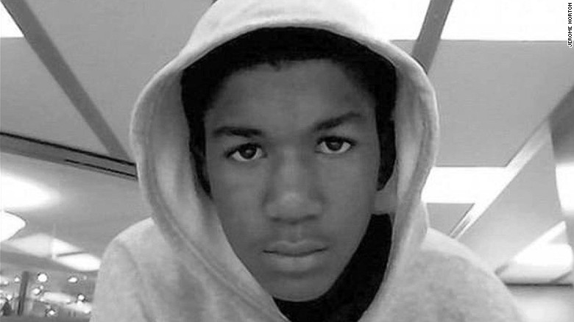
Introduction : CNN News.
The Shooting and death of Trayvon Martin and the shooter, George Zimmerman NOT GUILTY n
Race and crime
The incidence of the shooting of Trayvon Martin, 17years old, happened in February 2012.
Former watch captain George Zimmerman was acquitted in the case. Trayvon was an African-American high school student born in 1995, and they lived in Miami Gardens, Florida, with his mother, Sybrina Fulton.
He received a ten-day suspension from Krop Senior High School and visited Tracy Martin's father in Sanford, Florida. The rest was served under the discovery of drug residue in his book bag. George Michael Zimmerman was born in 1983.
He was a part-time student at Seminole state college and a neighborhood watch captain for the retreat at Twin Lakes gated community in Sanford, Florida.

Slide 3
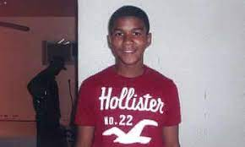
Race and crime
Race and crime have a long history in America for being challenging.
Events that are significant in society can change into symbolic importance and change the perspective reality of the society, for instance, when media captures it and publishes it as if the event has less attention.
The murder of Trayvon Martin and the trial of George Zimmerman primarily impacted society and encouraged the uprising to a point where people's perception of race relations was largely impacted

Slide 4
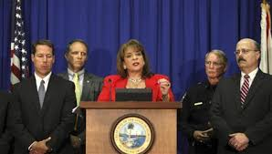
Case Investigation
The focus investigation of the case did not only focus on the death of the young Trayvon and the innocence or guilt of George Zimmerman, the community night watchman. Still, it exclusively went deep into the dark side of Racism, racial profiling, and gun control.
The report read, a racist white man with a gunshot, a young black boy with skittles in his pocket and Arizona iced tea in hand, while chatting with his girlfriend and got away with murder.
The Trayvon supporter and people against Racism were chatting about and demanding their rights as a minority.
the other side, those who supported Zimmerman were protesting, claiming self-defense.

Slide 5
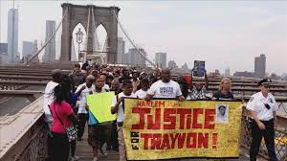
Trayvon supporters and the results
The details and evidence of the case seemed to be altered, but the protest was loud and clear. The case, therefore, awakened historical problems of past days, as the community was expected to grow but instead they going backward.
Racism was now the trial as unlawful demonstrations, and the act of criminology was performed on the streets in response to the case, and Racism became the real issue.
The demonstration along the streets reawakened the issues of the community through racial segregation that was part of the activities in those days.
The protest made the case heard since the culprit was covered because he was a native American.

Slide 6
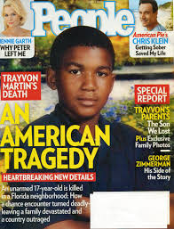
Significant of the report
The content of the case is significant with Racism and crime since continuous protest of people raised the alarm the relevant authority to follow the case following the raised issues.
Media also played a big role in publishing and report on in-depth details of the cause of the case and not just reporting the murder case.
Media groups such as e NBC, MSNBC, CBS, NPR, and CNN reported this matter, but CNN was the only media group that reported the real issue with facts. The report from CNN thus made supporters of Trayvon raise their voice for justice of the boy.

Slide 7
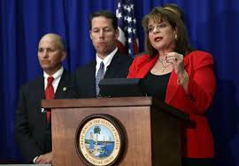
Media evidence
Coverage of the Trayvon Martin and George Zimmerman case may be viewed as not being “fair and balanced.”
This is evidenced by delayed justice, as even after the shooting, Zimmerman is set free. Zimmerman is believed to be white while Trayvon is an African American, Zimmerman reports the shooting as self-defense to him, but people around him were heard stopping him from doing the act,
Other media groups reported a piece of shallow information about the case. They reported the murder of Trayvon by Zimmerman, which was referred to as self-defense.
CNN reports the same case with deep details about the cause of the murder, with Racism being the main cause of the incidence.

Slide 8
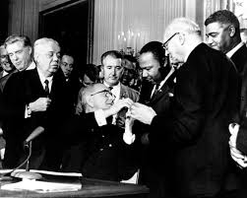
Investigators report
According to CNN, Zimmerman, calls 911 a police assistance number reporting of his shooting to Trayvon as self-defense, but neighbors had earlier cautioned him over the incident.
He is instructed by the authority not to get out of his SUV or approach the person, but he ignores the advice and proceeds with the action.
Zimmerman disregards the instruction and goes ahead to shoot Martin, claiming it was self-defense.
The case is reported, and the police report note indicates that Zimmerman was bleeding from the back of the head and the nose.

Slide 9
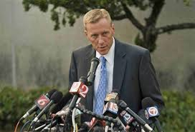
Media criticism
On criticism, Fox News reports the crime with supporting photos and commentaries, which help explain the news in detail.
The Fox News timeline and the photo do not have plays on the words with the stated facts. This news covered less evidenced news due to biasness as the news favored Zimmerman through reporting self-defense of the white man.
In connection to the coverage done by CNN, Fox News appears less ubiquitous with less influence on the outcomes.
Those in the pro-Trayvon camp sought to portray Zimmerman as a racist, and those on Zimmerman’s side attempted to portray Martin as a thug looking for trouble.

