Slide 1
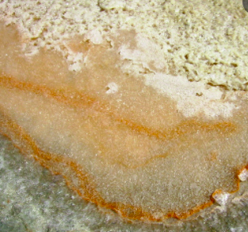
Halophilic Microorganisms
Name of student
Institution
Date

Slide 2
Nature of Halophilic microorganisms
Halophilic microorganisms are a type of extremophilic organisms that love to live in salty environments.
They grow and develop in conditions with extremely high salt concentrations.
Based on research, microorganisms are found in marine Salterns. Halophiles are also available in hypersaline lakes, Great Salt Lake.
The Halophilic microorganisms can be classified under different categories based on the level of salt concentration in the areas they live in.
the four major categories include extreme halophiles, borderline extreme, moderate and halotolerant halophiles. In the tree of life, the microorganisms are found under bacteria and Archaea kingdom.
Fungi and Algae are classified under the Eukaryotic halophilic microorganisms.

Slide 3
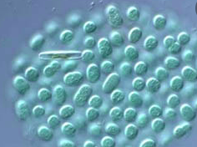
Adaptations to the environment
One of the halophilic microorganisms' major adaptive properties is that their cytoplasm isosmotic with the surrounding fluid.
Halophiles use two specific strategies to maintain the most appropriate osmotic pressure in the cytoplasm.
The first method occurs with the accumulation of potassium and chloride concentration.
Under this strategy, the intracellular enzymatic machinery should keep the protein in the required conformation at specific salt concentrations.
Halophiles have a highly concentrated proteome, and their proteins denature when exposed to low salt.
Obligate halophilic Archaea rely on the salt-in strategy because they can maintain their activities at saturating salt concentration.
Hypersaline environment

Slide 4
Adaptations to the environment
Halophiles are also adapted to their environment through biosynthesis or accumulation of osmolytes, including ectoin and glycine betaine.
Cells that use biosynthesis remove salt from the cytoplasm frequently. A high concentration of organic solutes interferes with the regular enzymatic function.
Halophilic protein organisms are different from non-halophilic homologous proteins by the difference in reaction to low salt concentration by maintaining active conformation in specific environments.
Hypersaline conditions are favorable to protein aggregation and cause a decrease in water molecules.
Recent studies show that halophilic proteins bind salt and water molecules in solvent conditions, and the ability depends on the number of acidic amino acids.

Slide 5
Reference
Harding, T., Roger, A. J., & Simpson, A. G. (2017). Adaptations to high salt in a halophilic protist: differential expression and gene acquisitions through duplications and gene transfers. Frontiers in microbiology, 8, 944. https://doi.org/10.3389/fmicb.2017.00944

