Slide 1
The Spleen
Name
Institutional Affiliation

Slide 2
Anatomical Location
Its in close proximity to other organs in the abdomen
Contacts the anterior surface of the left kidney at medial position
Its anterior position relates to the stomach
Tail of the pancreas related to the hilum of the spleen (Medial)
Its posterior surface relates with the diaphragm, left lung and Ribs 9-11

Slide 3
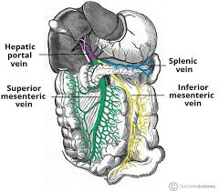
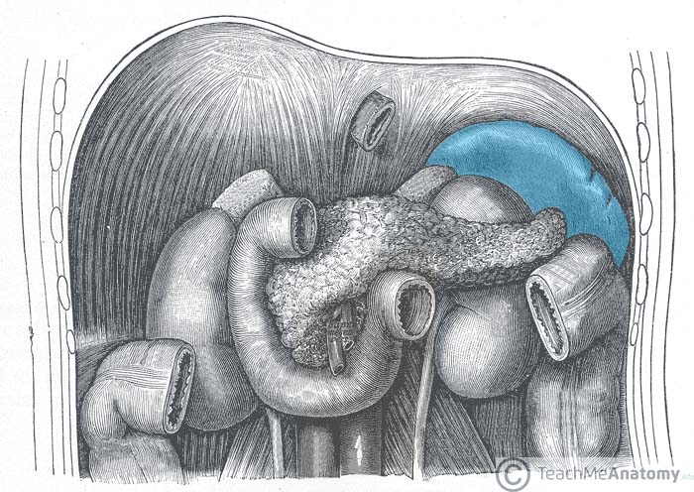
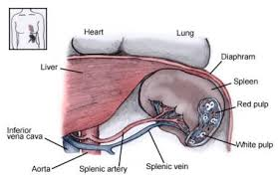
Continued…
The spleen is part of the human body’s lymphatic system.
It’s the size of a clenched fist and at an optimum size, can hold blood up to a cupful.

Slide 4
Anatomical Description
Its situated in the upper left of the abdomen and is protected by the rib cage
It’s the size of a fist and takes the shape of a shoe
In most cases its about four inches long
It sits relative to the 9th and 11th rib
Situated in the left hypochondrium and partially in the epigastrium (Meléndez, 2017)

Slide 5
Cont…
It’s a dark red to blue black organ
Petroianu (2012) notes that the spleen’s gross appearance and size vary with the species.
However, the splenic weight remains fairly constant with body weight.

Slide 6
Cells and Tissues in the organ
The spleen is made up of two main tissues known as the white pulp and the red pulp.
The red pulp consists of splenic cords and venous sinuses
Splenic cords are composed of reticular fibres, reticular cells and macrophages
The splenic cords are associated with mononuclear cells, lymphocytes, hematopoietic cells and plasma cells
According to Alenkina (2016), Venus sinuses can be traced all over the red pulp
They are held loosely by endothelial cells on the floor membrane between the endolithial cells and the reticular fibres of the red pulp

Slide 7
The White Pulp
The second main tissue that makes up the spleen
Subdivided into three major components namely the periarteriolar lymphoid sheath, follicles and marginal zone (Vaiphei, 2012)
Lymphocytes, macrophages, dendritic cells, plasma cells also make up the white pulp
The follicles are composed of B- cells and CD4+ T cells

Slide 8
Homeostasis
As part of the lymphatic system, the spleen plays a critical role in maintaining homeostasis
It helps in cleaning cellular waste as well as maintaining fluid balance
Cesta (2006) notes that the organ is crucial for making substances that are essential in healing inflammations
The red and white pulp tissues are responsible for red blood cell clearance.
The T and B cells work to filter the blood of pathogens and to perform immunologic functions that are unique to the spleen
Principally, the spleen is a crucial organ for iron metabolism, and a filter for blood- borne pathogens and atigens

Slide 9
Prediction
There are several problems that are predictable if the spleen fails to maintain homeostasis. They include: immlamatory and degenerative kind of diseases.
Its also likely that the risk for infection from viruses and bacteria will be higher.
Increased susceptibility to metabolic disorders

Slide 10
Other Problems
Other predictable problems include anaemia, parasitic infections, viral and bacterial infections

Slide 11
Spleen Diseases
There are a number of diseases that are specific to the spleen. They include:
Ruptured spleen mainly caused by accidents
Thrombocytopenia bleeding caused by lack of enough
Spleen infarction which refers to the reduction of blood supply to the spleen
Sickle cell disease is a condition that blocks the flow of blood due to abnormal flow of blood consequently leading to organ damage.
Splenomegaly

Slide 12
Splenomegaly
This is a condition that occurs when the spleen becomes abnormally enlarged
Although the disease can affect anyone, people who have monocleosis, Gauchers’s disease and Niemann- Pick disease are at a higher risk
This condition interferes with the vital functions of the spleen.
As it grows, it starts to filter normal red blood cells alongside the abnormal ones.
Similarly, the condition leads to excess platelets that may eventually clog the spleen

Slide 13
Causes of Splenomegaly
Its causes include the following:
Liver disease that may lead to increased vascular pressure
Venous thrombosis
Hermatologic malignancies that lead to infiltration of spleen by Neoplastic cells
Splenic congestion
Chronic infection from
Focal lesions
Infiltrative disorders (Schepper & Vanhoenacker, 2012)

Slide 14
Anatomical and Functional changes
According to Cesta (2006) the spleen may become palpated to more than two centimetres below the costal margin.
In some cases, the spleen may extend into the abdomen and pelvis.
Functionally, the distribution of red cells and plasma are greatly influenced.
Accumulation of ethrocytes in the spleen reduces the flow of red blood cells in circulation
A research also revealed that increase in plasma volume was primarily responsible for high blood volumes related to spleen size

Slide 15
Relationship to the System
As highlighted, the lymphatic system is an interconnected web of tissues and organs that rid the body of toxins and waste
The system is made up of lymphatic vessels connected to lymph nodes where filtering takes place.
Other system parts include tonsils, thymus and adenoid, thymus and bone marrow.
Due to the functional nature of the spleen, its system affects the immune system since it produces lymphocytes that generate antibodies that counter viral or bacterial infections

Slide 16
References
Alenkina, I. V., Oshtrakh, M. I., Felner, I., Vinogradov, A. V., Konstantinova, T. S., & Semionkin, V. A. (2016). Iron in spleen and liver: Some cases of normal tissues and tissues from patients with hematological malignancies. https://doi.org/10.1063/1.4966006
Cesta, M. F. (2006). Normal structure, function, and histology of the spleen. Toxicologic Pathology, 34(5), 455- 465. https://doi.org/10.1080/01926230600867743
Meléndez, R. D. (2017). The spleen: To spleen or not to spleen in hematologic diseases and in vector borne Hemoparasites. AMBIENT SCIENCE, 3 & 4(Sp1, Sp2 & 01). https://doi.org/10.21276/ambi.2017.04.sp1.ga01
Petroianu, A. (2012). Historical aspects of spleen and splenic surgeries. The Spleen, 3-19. https://doi.org/10.2174/978160805273811101010003
Schepper, A. D., & Vanhoenacker, F. (2012). Medical imaging of the spleen. Springer Science & Business Media.
Vaiphei, K. (2012). Histology and histopathology of the spleen. The Spleen, 37-74. https://doi.org/10.2174/978160805273811101010037

