Slide 1
Teen Suicide
Student’s Name
Institution

Slide 2

Overview of Teens Suicide
Suicide is when a teen causes his or her death purposefully.
Adolescents exhibit suicidal ideations.
People aged between 15 to 24 are more likely to commit suicide as per Centers for Disease Control and Prevention (CDC).
Boys are more likely to commit suicide than girls.
Teens are exposed to the risk of contemplating suicide when they can easily access firearms.
Overdosing with medications is another method used by adolescents who would to commit suicide.
Most teens tend to show certain warning signs like depression and anxiety (Thomson, 2018).

Slide 3

Teens at Risk of Committing Suicide
Past attempt of suicide
Family violence
Showing impulsive behaviors
Undesirable life happenings like death of a family member
Family history of mental or substance abuse
Family history of suicide
Stigmatization within the community

Slide 4

Contributing Factors
Low self esteem
Having academic struggles
Depression and anxiety
Having a history of being sexually or physically abused
Substance abuse like involvement in consuming narcotics
Teens who lack support from their families
Chronic disease and disability

Slide 5
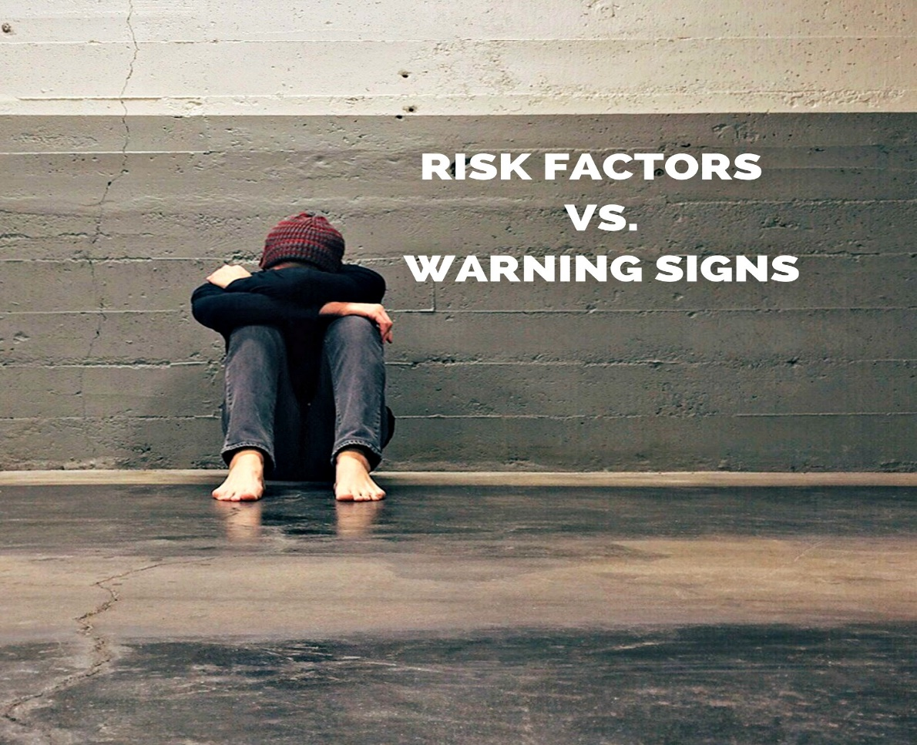
Contributing Factors Cont’
Being a victim of bullying
Cultural beliefs that consider suicide a noble course in resolving personal dilemmas.
Difficulties in accessing highly required services like finances.
Stigma related with asking for help.
Ease of accessing firearms.
Mental disorders
Lack of behavioral healthcare

Slide 6

Contributing Factors Cont’
Loss of a friend or a family member
Family changes like divorce
Family history of suicide
Stigmatization for being an LGBT youth
Separation from friends and siblings
Being punished wrongfully
Often nagging teens

Slide 7

Warning Signs of Teen Suicide
Feeling bored
Losing interest in doing normal activities
indulging in alcohol and drug abuse
Withdrawal from family as well as friends
Depict changes in both eating and sleeping habits
Obsession with death
Expressing strange thoughts

Slide 8

Warning Signs of Teen Suicide Cont’
Showing mood swings.
Feeling of hopelessness regarding situations.
Engaging in risky or self-destructive activities.
Developing changes in personality such as easily agitated.
Talking about committing suicide
Engaging in reckless behavior without thinking of the possible danger.
Talking concerning being burden to other people.

Slide 9

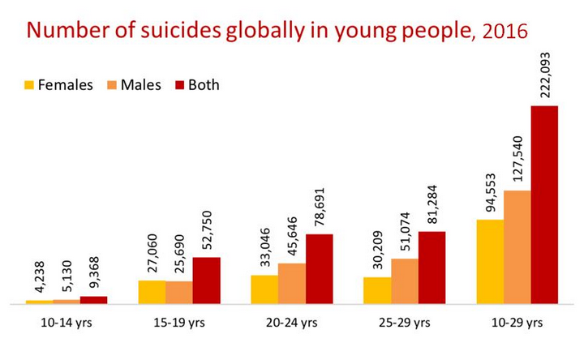
Prevalence of Health Risk

Slide 10
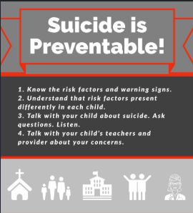
My Role as a Healthcare Practitioner
Monitor the major risk factors for suicide as they are important for intervention.
Screening of the suicide risk factor portrayed by teens.
Offering counseling to teens with suicidal ideations.
Administering appropriate medications such as anti-depressants.
Providing problem-solving skills that will ensure teens with suicidal ideations get the required help in averting suicide.
Ensure that teens are provided with effective protective factors like having strong connections with the family and social institutions.
Providing diverse clinical interventions necessary for helping teens to overcome suicidal thoughts.

Slide 11
My Role as a Healthcare Practitioner
Monitor and supervise at-risk teens by listening to them.
Assess the results of the therapy and medication administered to the patient.
Accept and control the emotional reactions of the patient by educating him or her concerning better practices to avert suicidal thoughts.
I will consider the common risk factors in teens and provide suicide-specific psychotherapy important in overcoming the suicidal behavior(Glodstein et al., 2018).
Compel parents to attend to their teens and offer them the necessary help.
Prepare the parents and teens concerning the warning symptoms of suicidal ideations.
Recommend services that will help the adolescents cope with the disorder of depression and anxiety.

Slide 12
Ways to Identify a problem
When a teen does not eat or sleep.
When a teen has become withdrawn from friends and families.
When an adolescent has become overly anxious and depressed.
When a teen has indulged in binge drinking and substance abuse.
When having conversations with teens showing suicidal behavior, it will be easy to identify their problem.
When a teen drastically undergo a change in personality that makes them become more agitated.
When an adolescent has suffered from bullying from his or her peers.

Slide 13
How to address the problem
Encourage a healthy lifestyle by helping teens to eat well and have enough sleep.
Consider the services of a health practitioner when a teen exhibit suicidal ideations (Ross, 2019).
Discourage isolation by ensuring teens spend more time with supportive friends and family
Paying attention to the behaviors of teens and never shrugging off the warning signs.
Listening to teens and hearing their concern is pivotal in mitigating depressing issues they encompass.
Holding more open conversations with teenagers to ensure they freely communicate their minds.
There is need to ensure meaningful treatment for teens having suicidal ideation or behavior.

Slide 14
How to address the problem cont’
Give support to teens in undergoing their treatment plans.
Ensure safe storage of firearms and medications.
Often communication with your teens concerning their mental or depressive disorders.
Know the warning signs shown by teens and look for appropriate help from a health practitioner or counselor.
Helping teen to cope with the loss of a loved one.
Having conversations with teens to ask them concerning their strange change of behavior or personality.
Ensuring that teens do not feel neglected or isolated by frequently communicating to them.

Slide 15
References
Glodstein, S. L., DiMarco, M., Painter, S., & Ramos‐Marcuse, F. (2018). Advanced practice registered nurses attitudes toward suicide in the 15‐to 24‐year‐old population. Perspectives in psychiatric care, 54(4), 557-563.
Ross, M. (2019). SUICIDE PREVENTION METHODS WITHIN A MODERN-DAY SOCIETY: FOCUSING ON MENTAL HEALTH IN OUR SCHOOL PREVENTION PROGRAMS.
Thomson, J. D. (2018). Depression and Suicide in Teens Today. PUBLISHER’S PAGE, 37.

