Slide 1
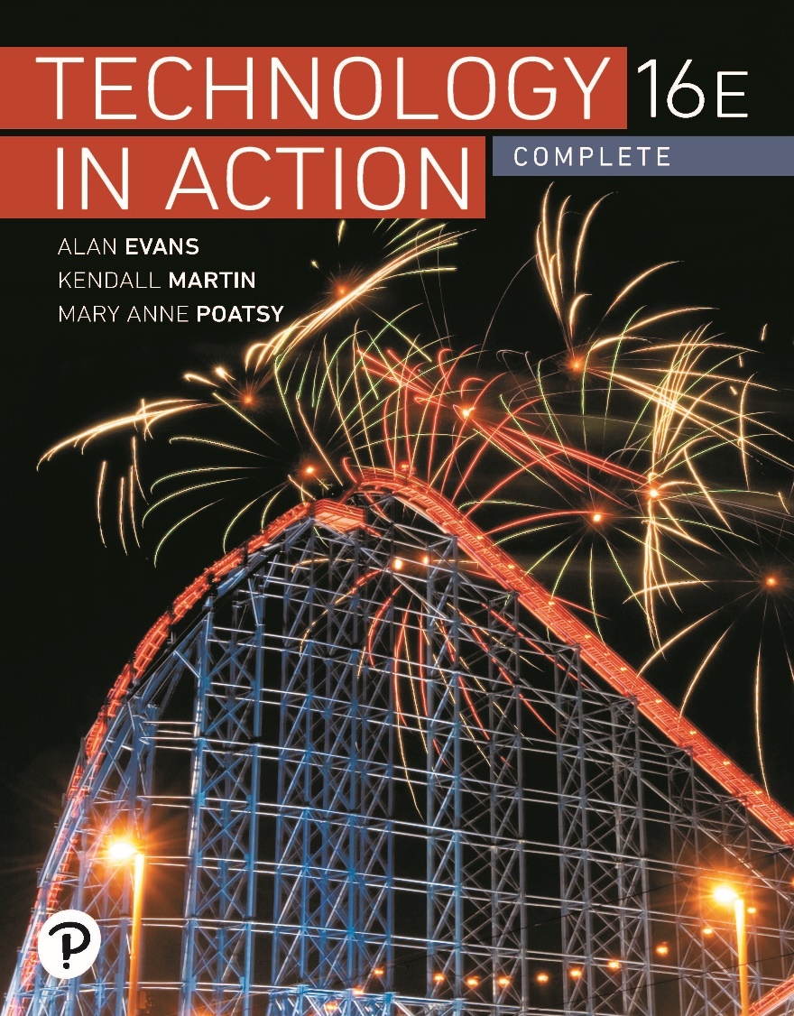
Technology in Action
16th Edition
Appendix A
The History of the Personal Computer

Slide 2
Learning Objectives (1 of 3)
A.1 Describe the earliest personal computer ever designed.
A.2 Describe the distinguishing features of the Apple I and Apple II.
A.3 Describe the first portable computer.
A.4 Describe the development of the IBM PC.
A.5 Explain why BASIC was an important step in revolutionizing the software industry.
A.6 Explain why the development of the operating system was an important step in PC development.
Notes:
The learning objectives are:
A.1 Describe the earliest personal computer ever designed.
A.2 Describe the distinguishing features of the Apple I and Apple II.
A.3 Describe the first portable computer.
A.4 Describe the development of the IBM PC.
A.5 Explain why BASIC was an important step in revolutionizing the software industry.
A.6 Explain why the development of the operating system was an important step in PC development.

Slide 3
Learning Objectives (2 of 3)
A.7 List early application software that was developed for the PC.
A.8 Describe the features of the Lisa and Macintosh computers and their predecessor, the Xerox Alto.
A.9 List the first successful web browsers.
A.10 Discuss the features of the Pascalene calculator and the Jacquard loom that inspired modern computer elements.
Notes:
Additional learning objectives are:
A.7 List early application software that was developed for the PC.
A.8 Describe the features of the Lisa and Macintosh computers and their predecessor, the Xerox Alto.
A.9 List the first successful web browsers.
A.10 Discuss the features of the Pascalene calculator and the Jacquard loom that inspired modern computer elements.

Slide 4
Learning Objectives (3 of 3)
A.11 Discuss the contributions of Babbage’s engines and the Hollerith Tabulating Machine to modern computing.
A.12 Discuss the features of the Z1, the Atansoff–Berry Computer, and the Mark I.
A.13 Discuss the major features of the Turing Machine, the ENIAC, and the UNIVAC.
A.14 Describe the milestones that led to each “generation” of computers.
Notes:
Additional learning objectives are:
A.11 Discuss the contributions of Babbage’s engines and the Hollerith Tabulating Machine to modern computing.
A.12 Discuss the features of the Z1, the Atansoff–Berry Computer, and the Mark I.
A.13 Discuss the major features of the Turing Machine, the ENIAC, and the UNIVAC.
A.14 Describe the milestones that led to each “generation” of computers.

Slide 5
Early Personal Computers
The First Personal Computer: The Altair
(Objective A.1)
1975
  Sold as a kit
  No keyboard—used switches for input
  No monitor—used lights for output
Bill Gates and Paul Allen among first owners
  Wrote compiling program
Notes:
The Altair 8800 debuted in 1975, touted as the first personal computer. It was sold as a kit for $395.
Switches were used for input and lights for output, and the machine had a total of 256 bytes of memory.
Bill Gates and Paul Allen were among the first owners and wrote a compiler to run the BASIC computer language on the Altair. Their success led to the formation of Microsoft.

Slide 6
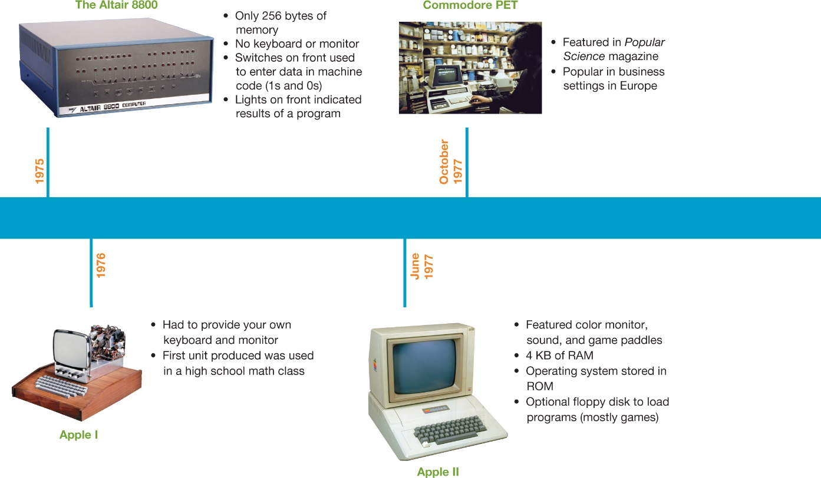
Early Personal Computers
The Apple I and II
(Objective A.2)
Built by Steve Jobs and Steve Wozniak
Operating system stored in ROM
Notes:
Steve Wozniak and Steve Jobs built a personal computer, the Apple I, in Wozniak’s garage and formed the Apple Computer Company in 1976. A year later, in 1977, the Apple II was born.
One of its biggest innovations was that the operating system was stored in read-only memory (ROM). Previously, the operating system had to be rewritten every time the computer was turned on.

Slide 7
Enter the Competition
The Osborne: The Birth of Portable Computing
(Objective A.3)
Introduced in 1981
Weighed 24.5 pounds
5-inch screen
Cost $1,795
Overnight success
Notes:
The Osborne Company introduced the industry’s first portable computer, the Osborne, in April 1981. It weighed 24.5 pounds, its screen was just 5 inches wide, and it cost $1,795. It was an overnight success.

Slide 8
Enter the Competition
IBM PCs
(Objective A.4)
Prior to 1980—IBM known for mainframes
1981—entered small-computer market with IBM PC
  Started at $1,565
  Sold at retail outlets
  Named “1982 Machine of the Year”
Notes:
IBM recognized it needed to get into the personal computer market, and in August 1981, IBM released its first personal computer named the IBM PC.
It was sold for $1,565 through retail outlets such as Sears to reach the home market, and it quickly dominated the playing field.
In January 1983, Time magazine named the IBM PC “1982 Machine of the Year.”

Slide 9
Other Important Advancements
The Importance of BASIC (1 of 2)
(Objective A.5)
Programming languages in the 1950s
  FORTRAN, ALGOL, and COBOL
  Used mainly by businesses
  Used to create financial, statistical, and engineering programs
Notes:
The software industry began in the 1950s with the development of programming languages such as FORTRAN, ALGOL, and COBOL. These languages were used mainly by businesses to create financial, statistical, and engineering programs for corporate enterprises.

Slide 10
Other Important Advancements
The Importance of BASIC (2 of 2)
(Objective A.5)
Beginners All-Purpose Symbolic Instruction Code (BASIC)
  Introduced in 1964
  Revolutionized software industry
  Easily learned by beginning programmers
  Became key language for PC
  Led to creation of Microsoft
Notes:
The 1964 introduction of Beginners All-Purpose Symbolic Instruction Code (BASIC) revolutionized the software industry. BASIC was a programming language that the beginning programming student could easily learn. It thus became enormously popular, and the key language of the PC. This program led to the creation of Microsoft, a company that produced software for the microcomputer.

Slide 11
Other Important Advancements
The Advent of Operating Systems (1 of 2)
(Objective A.6)
Early programs and data saved on audiocassettes
Programs needed to be rewritten each time
Floppy disk drive was introduced in 1978
Programs could be saved so operating systems were developed
Notes:
Data on the earliest PCs was stored on audiocassettes (not floppy disks).
Many programs were not saved or reused.
With the floppy drive, introduced in 1978, programs could be saved with more efficiency, and operating systems were developed.

Slide 12
Other Important Advancements
The Advent of Operating Systems (2 of 2)
(Objective A.6)
Operating systems coordinate with specific processor chip
  Apple computers—Motorola chips: Disk Operating System (DOS)
  PCs—Intel 8080 chips: Control Program for Microcomputers (CP/M)
  Microsoft—Intel chips: MS-DOS
    Operating system for IBM PCs
    Created by Bill Gates
Notes:
Disk Operating System (DOS), developed by Wozniak and introduced in December 1977, was the OS that controlled the first Apple computers.
The Control Program for Microcomputers (CP/M), developed by Gary Kildall, was the first OS designed for the Intel 8080 chip (the processor for PCs).
In 1980, when IBM approached Bill Gates at Microsoft to write an OS program for the IBM PC, Gates wrote an OS program and developed MS-DOS for IBM computers.

Slide 13
Other Important Advancements
Software Application Explosion: VisiCalc and Beyond
(Objective A.7)
Spreadsheets
  VisiCalc
  Lotus 1-2-3
  Microsoft Excel
Word processing
  WordStar
  Word for MS-DOS
  WordPerfect
Notes:
Inclusion of floppy disk drives in personal computers not only facilitated the storage of operating systems, but also set off a software application explosion.
In 1978, Dan Bricklin recognized the potential for a spreadsheet program that could be used on PCs. He and his friend Bob Frankston created the program VisiCalc.
After VisiCalc, other electronic spreadsheet programs entered the market: Lotus 1-2-3 in 1983 and Microsoft Excel in 1985.
Meanwhile, word processing software was gaining a foothold. WordStar, the first word processing application, came out in disk form in 1979. Competitors such as Word for MS-DOS (the precursor to Microsoft Word) and WordPerfect soon entered the market.

Slide 14
The Graphical User Interface and the Internet Boom
Xerox and Apple’s Lisa and Macintosh (1 of 3)
(Objective A.8)
Graphical user interface (GUI) allowed users to interact with computer more easily
Previously used command- or menu-driven interfaces
Apple the first company to use the GUI
Notes:
Another important advancement in PCs was the introduction of the graphical user interface (GUI), which allowed users to interact with the computer more easily.
Prior to the development of the GUI, users had to use complicated command- or menu-driven interfaces.
Apple was the first company to take full commercial advantage of the GUI.

Slide 15
The Graphical User Interface and the Internet Boom
Xerox and Apple’s Lisa and Macintosh (2 of 3)
(Objective A.8)
Xerox Alto (1972)
  Introduced What You See Is What You Get (WYSIWYG)
  File management system with directories and folders
  Mouse and network connectivity
  Never sold commercially
Notes:
In 1972, Xerox was hard at work in its Palo Alto Research Center designing a PC named the Alto, it included a mouse and a file management system with directories and folders. The computer included a word processor, based on the What You See Is What You Get (WYSIWYG) principle, that incorporated a file management system with directories and folders. For a variety of reasons, Xerox never sold the Alto commercially.

Slide 16
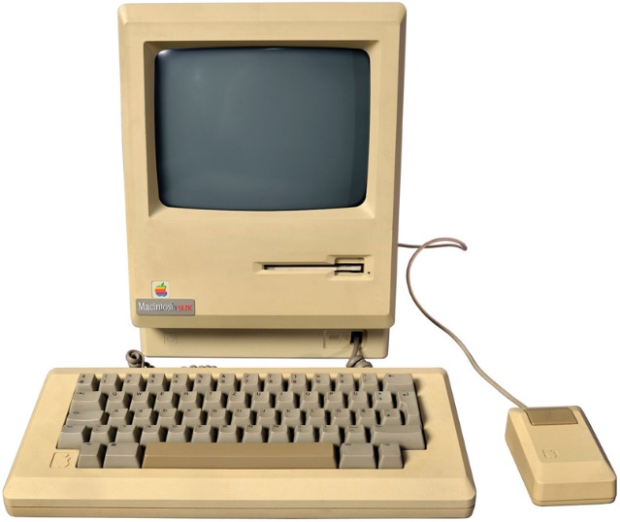
The Graphical User Interface and the Internet Boom
Xerox and Apple’s Lisa and Macintosh (3 of 3)
(Objective A.8)
Apple Lisa (1983)
  First successful PC using GUI
  Windows, drop-down menus, icons, a file system with folders and files
  Very expensive
Apple Macintosh (1984)
  1/3 cost of Lisa
  Introduced 3.5-inch floppy disk
Notes:
In 1983, Apple introduced the Lisa, the first successful PC brought to market to use a GUI. It incorporated a user interface similar to the Alto, including features such as windows, drop-down menus, icons, a file system with folders and files, and a mouse.
In 1984, Apple introduced the Macintosh, which was everything the Lisa was and then some, at about a third of the cost. The Macintosh was also the first personal computer to introduce 3.5-inch floppy disks with a hard cover.

Slide 17
The Graphical User Interface and the Internet Boom
The Internet Boom
(Objective A.9)
1993—Mosaic browser introduced
1994—Netscape launched
1995—Internet Explorer introduced by Microsoft
1998—Netscape became open source
Notes:
The GUI made it easier for users to work on the computer. The Internet provided another reason for consumers to buy computers. Now they could conduct research and communicate with each other in a new and convenient way.
In 1993, the Web browser Mosaic was introduced, and it allowed users to view multimedia on the Web.
In 1994, the Mosaic development team developed the commercial Web browser Netscape. Netscape’s popularity grew quickly, and it became a predominant browser software.
IBM-compatible PCs became the PC system of choice when, in 1995, Microsoft introduced Internet Explorer.
In 1998, Netscape moved to the open source market and would no longer charge for the product.

Slide 18
Making the Personal Computer Possible: Early Computers
The Pascalene Calculator and the Jacquard Loom (1 of 2)
(Objective A.10)
Pascalene
  First accurate mechanical calculator
  Created by Blaise Pascal in 1642
  Used revolutions of gears to count by tens
  Could be used to add, subtract, multiply, and divide
  Basic design used in mechanical calculators for 300 years
Notes:
The Pascalene was the first accurate mechanical calculator. This machine, created by French mathematician Blaise Pascal in 1642, used revolutions of gears, like odometers in cars do, to count by tens. The Pascalene could be used to add, subtract, multiply, and divide. The basic design of the Pascalene was so sound that it lived on in mechanical calculators for more than 300 years.

Slide 19
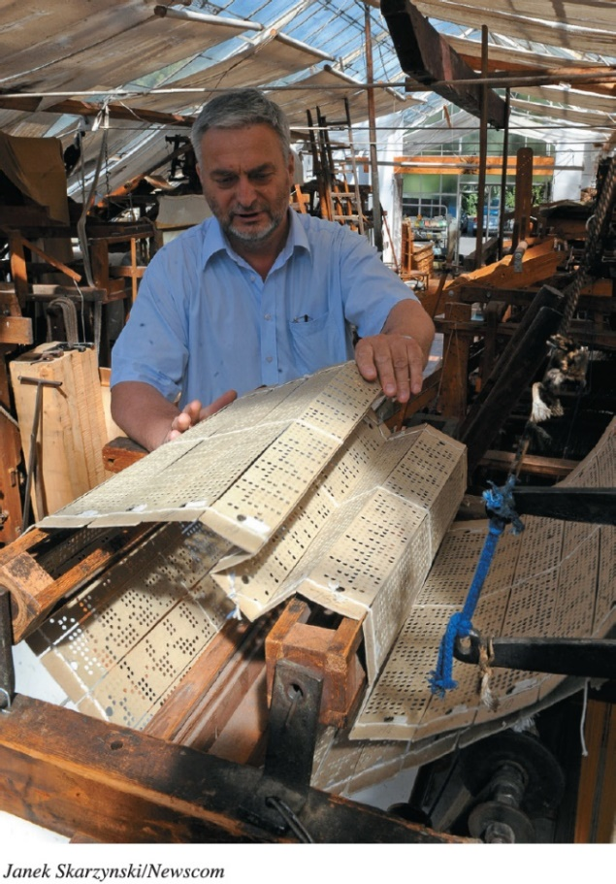
Making the Personal Computer Possible: Early Computers
The Pascalene Calculator and the Jacquard Loom (2 of 2)
(Objective A.10)
Jacquard loom
  Created by Joseph Jacquard
  Revolutionized fabric industry
  Cards had punched holes, automated weaving complex patterns
  Process adopted later to record and read data in computers using punch cards
Notes:
Nearly 200 years later, Joseph Jacquard revolutionized the fabric industry by creating a machine that automated the weaving of complex patterns. Although not a counting or calculating machine, the Jacquard loom was significant because it relied on stiff cards with punched holes to automate the process. Much later, this process would be adopted as a means to record and read data by using punch cards in computers.

Slide 20
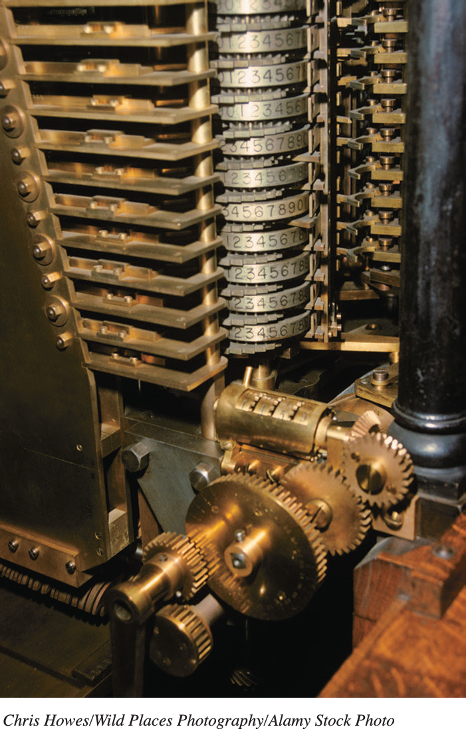
Making the Personal Computer Possible: Early Computers
Babbage’s Engines and the Hollerith Tabulating Machine (1 of 2)
(Objective A.11)
1834: Analytical Engine
  Designed by Charles Babbage
  First automatic calculator
  Never developed
  Drawings and descriptions similar to today’s computers
Notes:
In 1834, Charles Babbage designed the first automatic calculator, called the Analytical Engine.
Although it was never developed, Babbage’s detailed drawings and descriptions of the Analytical Engine include components similar to those found in today’s computers, including the store (akin to RAM) and the mill (a central processing unit), as well as input and output devices.

Slide 21
Making the Personal Computer Possible: Early Computers
Babbage’s Engines and the Hollerith Tabulating Machine (2 of 2)
(Objective A.11)
1890: Hollerith Tabulating Machine
  Created by Herman Hollerith
  U.S. Census Bureau—tabulate census data
  Automatically reads data from punch cards
1896: Hollerith started Tabulating Machine Company
  Later became International Business Machines (IBM)
Notes:
In 1890, Herman Hollerith was the first to take Jacquard’s punch-card concept and apply it to computing. Hollerith developed a machine that used punch cards to tabulate census data. Up until that time, census data had been tabulated manually in a long, laborious process. Hollerith’s tabulating machine automatically read data that had been punched onto small punch cards, speeding up the tabulation process. Hollerith’s machine became so successful that he left the Census Bureau in 1896 to start the Tabulating Machine Company. His company later changed its name to International Business Machines, or IBM.

Slide 22
Making the Personal Computer Possible: Early Computers
The Z1, the Atanasoff–Berry Computer, and the Harvard Mark I (1 of 3)
(Objective A.12)
1936: Z1
  Created by Konrad Zuse
  Mechanical calculator
  Included control unit and separate memory functions
  Important breakthrough for future computer design
Notes:
German inventor Konrad Zuse is credited with creating a mechanical calculator, called the Z1, in 1936. The Z1 is thought to be the first computer to include features that are integral to today’s systems, including a control unit and separate memory functions. These were important breakthroughs for future computer design.

Slide 23
Making the Personal Computer Possible: Early Computers
The Z1, the Atanasoff–Berry Computer, and the Harvard Mark I (2 of 3)
(Objective A.12)
1939: Atanasoff–Berry Computer (ABC)
  Created by John Atanasoff and Clifford Berry
  First electrically powered digital computer
  Used vacuum tubes to store data
  First computer to use the binary system
Notes:
In 1939, John Atanasoff and Clifford Berry built the first electrically powered digital computer, called the Atanasoff-Berry Computer (ABC). The computer was the first to use vacuum tubes to store data. Most important, it was the first computer to use the binary system. The design of the ABC would end up being central to that of future computers.

Slide 24
Making the Personal Computer Possible: Early Computers
The Z1, the Atanasoff–Berry Computer, and the Harvard Mark I (3 of 3)
(Objective A.12)
1930s–1950s: Mark series of computers
  Created by Howard Aiken and Grace Hopper
  Used by U.S. Navy for ballistic and gunnery calculations
  Aiken designed the computer
  Hooper did the programming
Notes:
From the late 1930s to the early 1950s, Howard Aiken and Grace Hopper designed the Mark series of computers at Harvard University. These computers were used by the Navy for ballistic and gunnery calculations. Aiken, an electrical engineer and physicist, designed the computer, and Hopper did the programming. The Harvard Mark I, finished in 1944, could perform all four arithmetic operations (addition, subtraction, multiplication, and division).

Slide 25
Making the Personal Computer Possible: Early Computers
The Turing Machine, the ENIAC, and the UNIVAC (1 of 3)
(Objective A.13)
1936: Turing Machine
  Abstract computer model—could perform logical operations
  Hypothetical model—mathematically defined a mechanical procedure
  Infinite tape that could be read, written to, and erased—precursor to today’s RAM
Notes:
In 1936, British mathematician Alan Turing created an abstract computer model that could perform logical operations. The Turing Machine was not a real machine, but rather a hypothetical model that mathematically defined a mechanical procedure (or algorithm).
Turing’s concept described a process by which the machine could read, write, or erase symbols written on squares of an infinite paper tape. This concept of an infinite tape that could be read, written to, and erased was the precursor to today’s RAM.

Slide 26
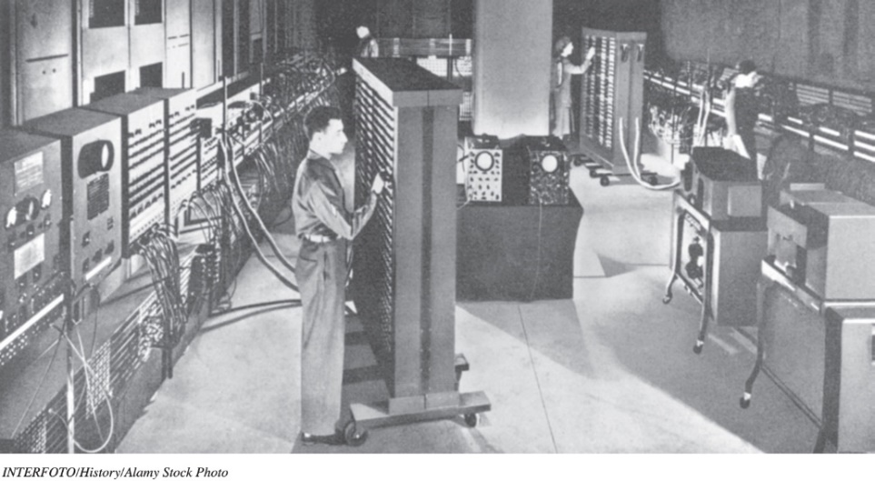
Making the Personal Computer Possible: Early Computers
The Turing Machine, the ENIAC, and the UNIVAC (2 of 3)
(Objective A.13)
1944: Electronic Numerical Integrator and Computer (ENIAC)
  First successful high-speed electronic digital computer
  Big and clumsy
  Used 18,000 vacuum
  tubes
  Filled 1,800 square
  feet
Notes:
The Electronic Numerical Integrator and Computer (ENIAC) was created by John W. Mauchly and J. Presper Eckert at the University of Pennsylvania and was placed into operation in 1944. The ENIAC is generally thought of as the first successful high-speed electronic digital computer. It used nearly 18,000 vacuum tubes and filled approximately 1,800 square feet of floor space.

Slide 27
Making the Personal Computer Possible: Early Computers
The Turing Machine, the ENIAC, and the UNIVAC (3 of 3)
(Objective A.13)
1951: Universal Automatic Computer (UNIVAC)
  First commercially successful digital computer
  Operated on magnetic tape, not punch cards
  Considered first-generation computer
  Last to use vacuum tubes to store data
Notes:
The Universal Automatic Computer (UNIVAC) was the first commercially successful electronic digital computer and was completed in June 1951. It operated on magnetic tape. This set it apart from its competitors, which ran on punch cards.
The UNIVAC and computers like it were considered first-generation computers and were the last to use vacuum tubes to store data.

Slide 28
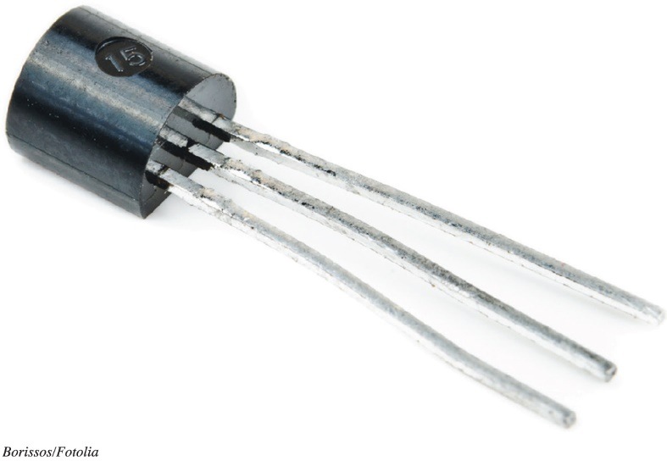
Making the Personal Computer Possible: Early Computers
Transistors and Beyond (1 of 4)
(Objective A.14)
1945: Transistors
  Invented at Bell Laboratories
  Replaced vacuum tubes
  Considered second generation computers
Notes:
In 1945, scientists at the Bell Laboratories invented the transistor as a means of storing data. The transistor replaced the bulky vacuum tubes of earlier computers and was smaller and more powerful.

Slide 29
Making the Personal Computer Possible: Early Computers
Transistors and Beyond (2 of 4)
(Objective A.14)
1958: Integrated circuits
  Invented by Jack Kilby of Texas Instruments
  Small chip containing thousands of transistors
  Enabled computers to become smaller and lighter
  Considered third-generation computers
Notes:
In 1958, Jack Kilby, while working at Texas Instruments, invented the world’s first integrated circuit, a small chip capable of containing thousands of transistors. This consolidation in design enabled computers to become smaller and lighter. The computers in this early integrated-circuit generation were considered third-generation computers.

Slide 30
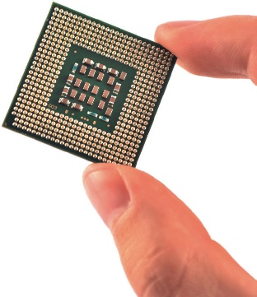
Making the Personal Computer Possible: Early Computers
Transistors and Beyond (3 of 4)
(Objective A.14)
1971: Microprocessor
  Introduced by Intel Corporation
  Small chip containing millions of transistors
  Functions as the central processing unit (CPU)
  Considered fourth-generation
  computers
Notes:
In 1971, the Intel Corporation introduced the microprocessor chip, a small chip containing millions of transistors. The microprocessor functions as the CPU. Computers that use a microprocessor chip are called fourth-generation computers.

Slide 31
Making the Personal Computer Possible: Early Computers
Transistors and Beyond (4 of 4)
(Objective A.14)
First-generation (1944)
  Used vacuum tubes to store data
Second-generation (1945)
  Used transistors to store data
Third-generation (1958)
  Used integrated circuits
Fourth-generation (1971–today)
  Uses microprocessor chip
Notes:
Computers have been classified into four generations. The first generation used vacuum tubes for memory. The second generation used transistors. Integrated circuits were the hallmark of third-generation computers. Fourth-generation computers use the microchip.

Slide 32

Copyright
All rights reserved. No part of this publication may be reproduced, stored in a retrieval system, or transmitted, in any form or by any means, electronic, mechanical, photocopying, recording, or otherwise, without the prior written permission of the publisher. Printed in the United States of America.

