Slide 1

Technology in Action
16th Edition
Appendix B
Careers in IT

Slide 2
Learning Objectives
B.1 List the reasons why IT fields are attractive to students pursuing bachelor’s degrees.
B.2 Explain the various challenges of IT careers.
B.3 List and describe the various IT careers for which you can train.
B.4 Explain the various ways you can prepare for a career in IT.
B.5 Explain the various ways you can find a career in IT.
Notes:
The learning objectives are:
B.1 List the reasons why IT fields are attractive to students pursuing bachelor’s degrees.
B.2 Explain the various challenges of IT careers.
B.3 List and describe the various IT careers for which you can train.
B.4 Explain the various ways you can prepare for a career in IT.
B.5 Explain the various ways you can find a career in IT.

Slide 3
Rewards of Working in Information Technology (1 of 2)
(Objective B.1)
IT Workers Are in Demand
IT Jobs Pay Well
IT Jobs Are Not Going “Offshore”
  Outsourcing
  Offshoring
Women Are in High Demand in IT Departments
Notes:
According to projections by the U.S. Department of Labor’s Bureau of Labor Statistics, computer-related jobs are expected to be among the fastest growing occupations through 2024.
The average starting salary for computer science majors with bachelor’s degrees was projected to be $66,005.
In the global economy in which we now operate, the job outlook includes the risk of jobs being outsourced, possibly to other countries (a process known as offshoring). Outsourcing is a process whereby a business hires a third-party firm to provide business services (e.g., customer-support call centers) that were previously handled by in-house employees.
Currently, women make up about 26% of the IT workforce. This presents a huge opportunity for women who have IT skills, because many IT departments are actively seeking to diversify their workforces.

Slide 4
Rewards of Working in Information Technology
(2 of 2)
(Objective B.1)
You Have a Choice of Working Location
You Constantly Meet New Challenges
You Work in Teams
You Don’t Need to Be a Mathematical Genius
IT Skills Are Transferable
Notes:
In this case, location refers to the setting in which you work. IT jobs can be office based, field based, project based, or home based.
You’ll need to work hard to keep your skills up to date. You’ll spend a lot of time in training and self-study trying to learn new systems and techniques.
Most IT jobs require constant interaction with other workers, usually in team settings.
Certain IT careers such as programming involve a fair bit of math. IT employers also value such attributes as creativity, marketing, and artistic style, especially in jobs that involve working on the Internet or with social media.
Most computing skills are transferable from industry to industry.

Slide 5

Challenges of IT Careers
(Objective B.2)
Stress
Women Are in the
Minority
Lifelong Learning
Is Required
Notes:
Most IT jobs are hectic. Whereas the average American works 42 hours a week, the average IT staff person works 45 hours a week and is on call for another 24 hours.
A majority of IT jobs are filled by men and in most IT departments, women are underrepresented.
Keeping up with the changes in IT can also cause some stress.

Slide 6
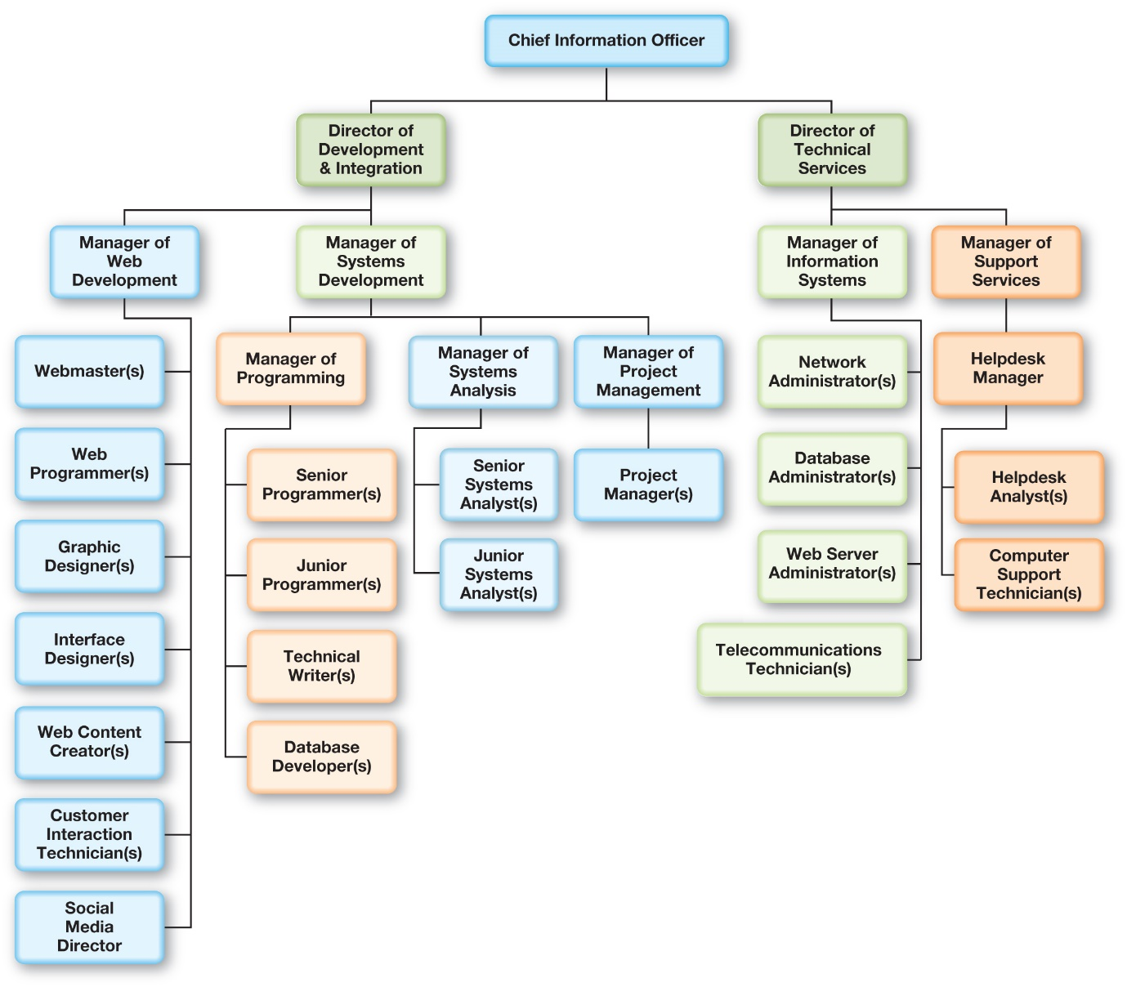
Choosing Your Realm of IT (1 of 3)
(Objective B.3)
Notes:
This figure shows the organization chart for a large IT department. At its top is the chief information officer (CIO), who has overall responsibility for the development, implementation, and maintenance of information systems and their infrastructure.

Slide 7
Choosing Your Realm of IT (2 of 3)
(Objective B.3)
Web development
    Web content creators
    Interface designers
    Web programmers
    Customer interaction technicians
    Social media directors
Systems development
    Systems analysts
    Programmers
    Project managers
    Technical writers
    Network administrators
    Database developers
Notes:
There are two paths in the development and integration:
Web development consists of the following:
Web content creators
Interface designers
Web programmers
Customer interaction technicians
Social media directors
Systems development consists of the following:
Systems analysts
Programmers
Project managers
Technical writers
Network administrators
Database developers

Slide 8
Choosing Your Realm of IT (3 of 3)
(Objective B.3)
Information systems
  Network administrators
  Database administrators (DBAs)
  Web server administrators
  Telecommunications technicians
Support services
  Helpdesk analysts
  Computer support technicians
Notes:
Technical services jobs are vital to keeping IT systems running.
Information systems consists of the following:
Network administrators
Database administrators
Web server administrators
Telecommunications technicians
Support services consists of the following:
Helpdesk analysts
Computer support technicians

Slide 9
Preparing for a Job in IT
(Objective B.4)
Get educated
  Best to attend a degree-granting college or university
Investigate professional certifications
Get experience
Do research
Notes:
Most employers today have an entry-level requirement of a college degree, a technical institute diploma, appropriate professional certifications, experience in the field, or a combination of these:
Get educated with degrees in computer science, management information systems, or information technology from a 2- or 4-year college or university.
Investigate professional certifications.
Get experience.
Do research.

Slide 10
Getting Started in an IT Career
(Objective B.5)
Use career resources at your school
Develop relationships with your instructors
Start networking
Check corporate websites for jobs
Visit online employment sites
Notes:
Use the career resources at your school. Many employers recruit at schools, and most schools maintain a placement office to help students find jobs.
Develop relationships with your instructors. Many college instructors still work in or previously worked in the IT industry.
Start networking. Many jobs are never advertised but instead are filled by word of mouth.
Check corporate websites for jobs. Many corporate websites list current job opportunities.
Visit online employment sites. Most of these sites allow you to store your résumé online, and many sites allow employers to browse résumés to find qualified employees.

Slide 11

Copyright
All rights reserved. No part of this publication may be reproduced, stored in a retrieval system, or transmitted, in any form or by any means, electronic, mechanical, photocopying, recording, or otherwise, without the prior written permission of the publisher. Printed in the United States of America.

