Slide 1

Technology in Action
16th Edition
Chapter 1
The Impact of Technology in a Changing World

Slide 2
Learning Objectives (1 of 2)
1.1 Describe various technological tools being used to impact national and global issues.
1.2 Describe various global social issues that are being affected by technology.
1.3 Describe how technology is changing how and why we connect and collaborate with others.
1.4 Summarize how technology has impacted the way we choose and consume products and services.
1.5 Characterize computer literacy and explain why it is important to be computer literate.
Notes:
The learning objectives are:
1.1 Describe various technological tools being used to impact national and global issues.
1.2 Describe various global social issues that are being affected by technology.
1.3 Describe how technology is changing how and why we connect and collaborate with others.
1.4 Summarize how technology has impacted the way we choose and consume products and services.
1.5 Characterize computer literacy and explain why it is important to be computer literate.

Slide 3
Learning Objectives (2 of 2)
1.6 Describe artificial intelligence systems and explain their main goals.
1.7 Describe how artificial intelligence and other information technologies are important in many careers.
1.8 Define ethics and describe various ethical systems.
1.9 Describe influences on the development of your personal ethics.
1.10 Present examples of how technology creates ethical challenges.
Notes:
Additional learning objectives are:
1.6 Describe artificial intelligence systems and explain their main goals.
1.7 Describe how artificial intelligence and other information technologies are important in many careers.
1.8 Define ethics and describe various ethical systems.
1.9 Describe influences on the development of your personal ethics.
1.10 Present examples of how technology creates ethical challenges.

Slide 4
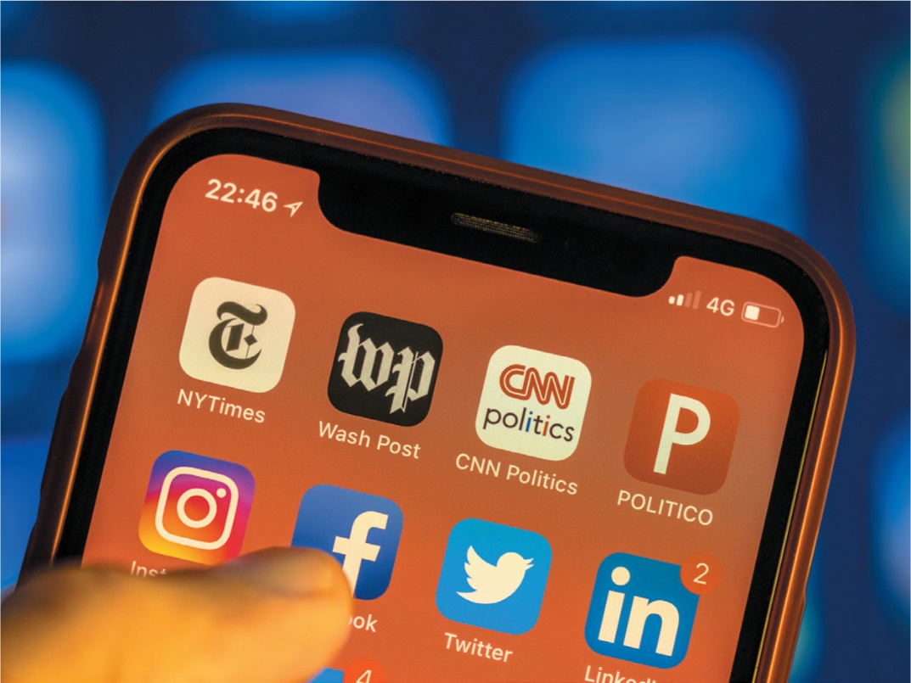
Technology in a Global Society
(Objective 1.1)
Accelerating change around the world
Galvanizing people in new ways
Notes:
Recent political and global issues are showing that technology is accelerating change around the world and galvanizing groups of people in new ways.

Slide 5

Technology in a Global Society
Impact of Tools of Modern Technology (Objective 1.1)
Social networking tools enable groups to connect and exchange ideas
Crisis-mapping tools collect and map information
Notes:
Twitter, Facebook, and Instagram enable people to connect and exchange ideas. These same tools are also bringing together people facing similar problems to fight for social change.
Crisis-mapping tools collect information and then maps it, instantly making the information publicly available.

Slide 6
Technology in a Global Society
Global Issues (1 of 3)
(Objective 1.2)
Health care
  Develop and deliver vaccines
  Increased vaccine production
  Computer programs help to design new helmets
The Environment
  Data could alert scientists to new trends
Notes:
Health Care
Researchers say there is a nearly 100 percent chance of a flu pandemic in the next century. Technology could help us develop and deliver vaccines to save lives.
Computationally intense modeling software is helping researchers increase the pace of vaccine production, saving lives.
Computer programs have collected sensor data from impacts on the field, which scientists have analyzed and used to create a new kind of helmet used by college programs and the NFL to better distribute the impact of collisions.
Environment
Tagged with geographical information, data could alert scientists to new trends in our environment.

Slide 7
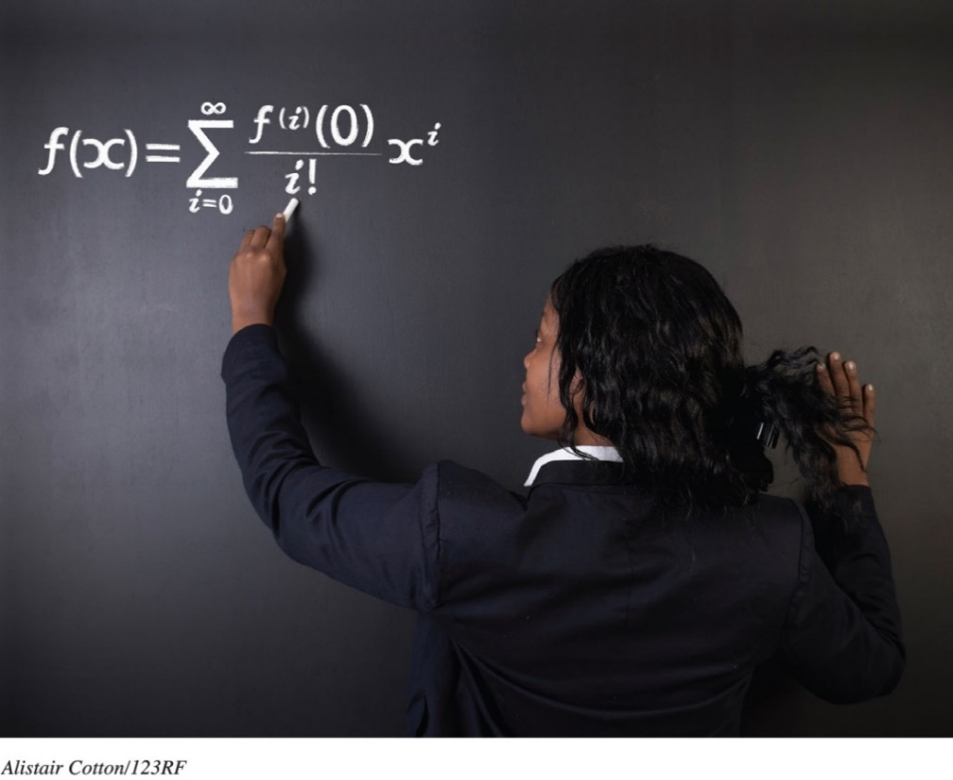
Technology in a Global Society
Global Issues (2 of 3)
(Objective 1.2)
The Digital Divide
  Gap exists between levels of Internet access and availability of technical tools
  Prevents use of all minds to solve planet’s problems
Notes:
There is a great gap in the levels of Internet access and the availability of technical tools in different regions of the world. The term coined for this difference in ease of access to technology is the digital divide. One danger of a digital divide is that it prevents us from using all the minds on the planet to solve the planet’s problems.

Slide 8
Technology Connects Us with Others
Technology Impacts How and Why We Connect and Collaborate (1 of 2) (Objective 1.3)
We collaborate for the benefit of others
  Web 2.0
    Allows easy content contribution
    Facilitates easy connections with others
  Cognitive Surplus
    Combination of leisure time and tools to be creative
Notes:
As more web applications appeared that allowed everyone to become a “creator” of the web, a new kind of Internet came into being. Nicknamed Web 2.0, it had a set of new features and functionality that allowed users to contribute content easily and to be easily connected to each other. Now everyone could collaborate internationally at the click of a mouse.
Cognitive surplus is the combination of leisure time and the tools to be creative.

Slide 9
Technology Connects Us with Others
Technology Impacts How and Why We Connect and Collaborate (2 of 2) (Objective 1.3)
Business
  Support others’ dreams
  Crowdfunding is asking for small donations from a large number of people
Notes:
One of the most profound ways we can connect with each other is to support other people’s dreams.
Crowdfunding is asking for small donations from a large number of people.

Slide 10
Technology Connects Us with Others
Technology Impacts How We Consume (1 of 2)
(Objective 1.4)
Marketing technology helps us to:
  Decide what to purchase
  Actually buy goods and services
Marketing
  QR (quick response) codes
  Crowdsourcing
Notes:
Technology is changing how to decide what to purchase and how we actually purchase goods and services.
QR (quick response) codes link to online information and video content.
Marketers are aware of the phenomenon of crowdsourcing (checking in with the voice of the crowd.)

Slide 11
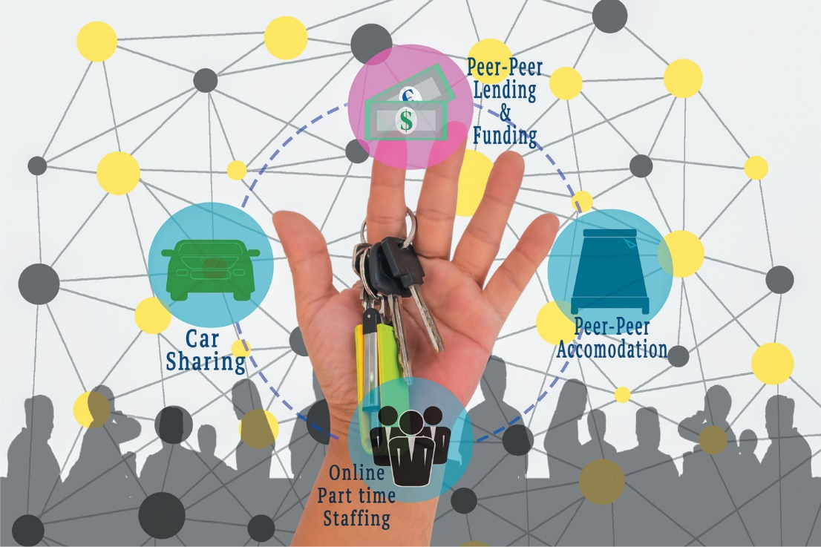
Technology Connects Us with Others
Technology Impacts How We Consume (2 of 2)
(Objective 1.4)
Access Versus Ownership
  ZipCar
  Citi Bike
  Collaborative
  consumption
Notes:
Access vs. ownership: Even the idea of ownership is evolving thanks to new technologies. Items like cars and bicycles can become “subscriptions” instead of large one-time purchases.
ZipCar allows hundreds of thousands of people to use shared cars.
Citi Bike is catching on in many U.S. cities as a convenient and eco-friendly way to get around a metropolitan area.
Collaborative consumption implies that we are joining together as a group to use a specific product more efficiently.

Slide 12
The Importance of Computer Literacy
Computer Literacy
(Objective 1.5)
Computer literacy
  Understand capabilities and limitations of computers
  Know how to use safely and efficiently
Notes:
Computer literacy means you understand the capabilities and limitations of computers and you know how to use them safely and efficiently.

Slide 13
Artificial Intelligence
Artificial Intelligence Basics (1 of 3)
(Objective 1.6)
Intelligence—ability to acquire and apply knowledge and skills
  Experiences, reasoning, problem solving, perception, and using language
Artificial intelligence (AI)—systems or machines which perform tasks usually associated with human intelligence
Notes:
Intelligence is the ability to acquire and apply knowledge and skills.
Sociologists point to characteristics that make human beings intelligent, such as learning from experiences, reasoning, problem solving, perception, and using language.
Artificial intelligence (AI) is a branch of computer science that focuses on creating computer systems or computer-controlled machines able to perform tasks usually associated with human intelligence.

Slide 14
Artificial Intelligence
Artificial Intelligence Basics (2 of 3)
(Objective 1.6)
Goal in 1950s was to create a machine that could think like a human
Central goals of AI
  Natural language processing (NLP)
  Perception
  Knowledge representation
  Planning
  Problem solving
  Learning
Notes:
In the 1950s, at the dawn of AI research, the goal was to create a machine that could think like a human.
Today, AI researchers are looking to develop systems inspired by how humans think.
AI’s central goals can be grouped into these categories: natural language processing (NLP), perception, knowledge representation, planning, problem solving, and learning.

Slide 15
Artificial Intelligence
Artificial Intelligence Basics (3 of 3)
(Objective 1.6)
Major developments contributing to functional AI systems
  Expert systems
  Artificial neural networks
  Advances in machine learning
Notes:
Many information technology developments have contributed to the functional AI systems that we have today, including expert systems, artificial neural networks, and advances in machine learning.

Slide 16
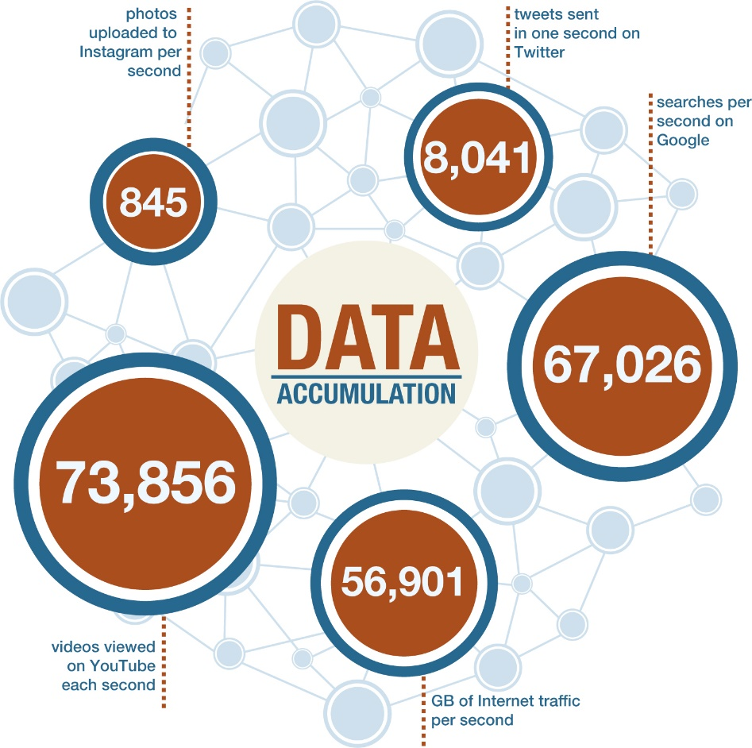
Working with Artificial Intelligence and Other Information Technologies
Technology and Career Opportunities (1 of 6) (Objective 1.7)
Retail
  Data mining
    Process of searching huge amounts of data for patterns
    Respond to consumer buying/usage patterns
Notes:
Businesses use a technique known as data mining, the process of searching huge amounts of data with the hope of finding a pattern. Managers can use mined data to for example, determine that if a certain product is to sell well, they must lower its price—especially if they cut the price at one store and see sales increase. Data mining allows retailers to respond to consumer buying patterns.

Slide 17
Working with Artificial Intelligence and Other Information Technologies
Technology and Career Opportunities (2 of 6) (Objective 1.7)
Banking
  Uses AI to help spot fraud
Transportation
  Autopilots on commercial airplanes
  Autonomous vehicles
Robots and Embodied Agents
Notes:
Credit card processors and banks use AI systems to analyze huge volumes of transaction data to spot fraud.
The transportation industry has used autopilots on commercial airplanes for years, and autonomous vehicles should soon be available.
Many robots are deployed in industrial settings doing hazardous, repetitive, or boring tasks.

Slide 18
Working with Artificial Intelligence and Other Information Technologies
Technology and Career Opportunities (3 of 6) (Objective 1.7)
Education
  Intelligent personal assistants (IPAs) assist students with their individualized learning plans
  Speed up the grading process
  Plagiarism checkers
Notes:
The education industry uses computer technology.
Intelligent personal assistants assist students with their individualized learning plans (ILPs).
They can speed up the grading process.
They are being used as plagiarism checkers.

Slide 19
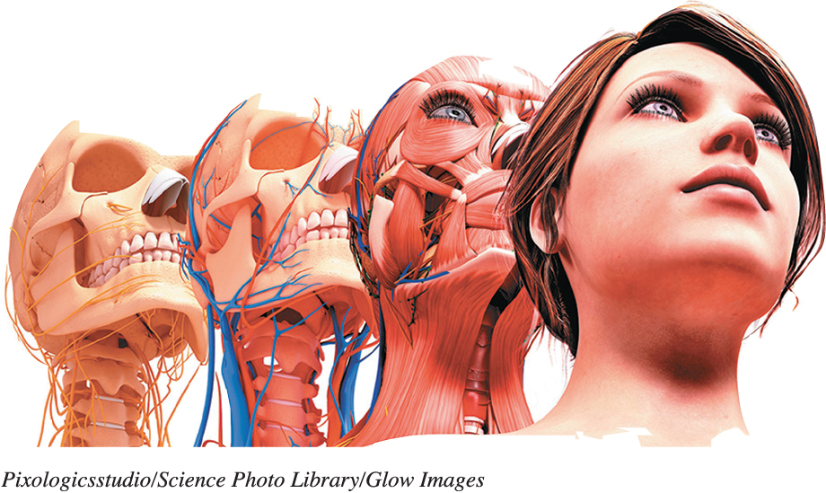
Working with Artificial Intelligence and Other Information Technologies
Technology and Career Opportunities (4 of 6) (Objective 1.7)
Law Enforcement
  Computers used in cars
  Facial reconstruction
  Computer forensics
Notes:
Computers are being used in police cars and crime labs to solve an increasing number of crimes.
Facial reconstruction systems can turn a skull into a finished digital image of a face, allowing quick identification.
A law enforcement specialty called computer forensics is growing in importance in order to fight modern crime. Computer forensics analyzes computer systems with specific techniques to gather potential legal evidence.

Slide 20
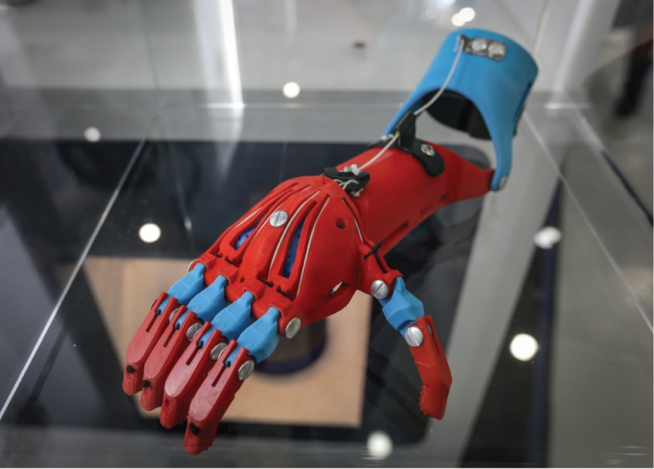
Working with Artificial Intelligence and Other Information Technologies
Technology and Career Opportunities (5 of 6) (Objective 1.7)
Medicine
  Help doctors diagnose unfamiliar conditions
  Being integrated into patient information systems
  Used to design and construct prosthetic devices
Notes:
AI can help doctors quickly diagnose conditions with which they’re not familiar.
AI is also being integrated directly into patient information systems.
The design and construction of prosthetic devices is another area of medicine impacted by modern technology.

Slide 21

Working with Artificial Intelligence and Other Information Technologies
Technology and Career Opportunities (6 of 6) (Objective 1.7)
Psychology
  MACH—My Automated Conversation CoacH
  Affective computing
Notes:
Researchers have developed a system to help improve interpersonal skills for people with autism. MACH (My Automated Conversation CoacH) is a computer system that generates an on-screen person that can conduct a job interview or appear ready for a first date.
Affective computing is computing that can recognize and simulate human emotions. Engineers work to create computers that process data faster. Psychologists and computer scientists are working toward a more complete understanding of human behavior.

Slide 22
Ethical Computing
Defining Ethics
(Objective 1.8)
Ethics: the study of morals and specific moral choices made
Laws: formal, written standards designed to apply to everyone
Unethical behavior: not conforming to approved standards
Amoral behavior: no sense of right and wrong
Notes:
Ethics is the study of the general nature of morals and of the specific moral choices individuals make.
Laws are formal, written standards designed to apply to everyone.
Unethical behavior is not conforming to a set of approved standards of behavior.
Amoral behavior occurs when a person has no sense of right and wrong.

Slide 23
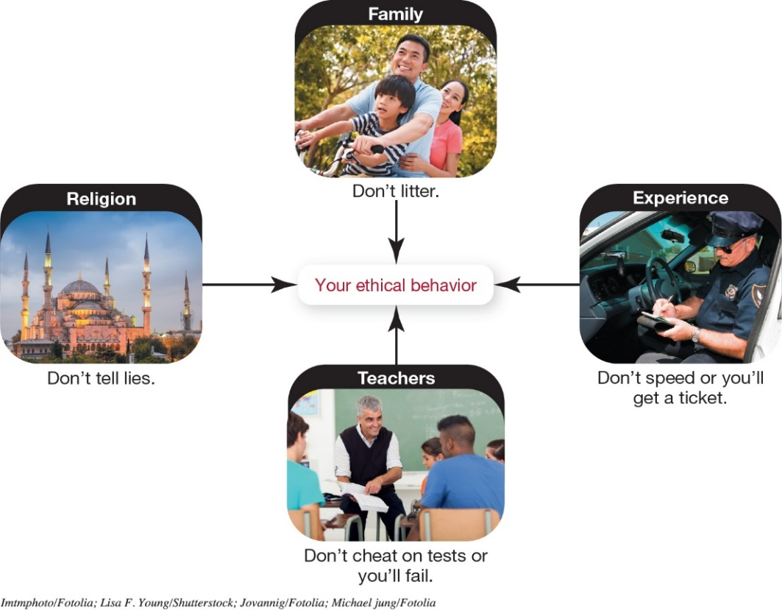
Ethical Computing
Personal Ethics
(Objective 1.9)
Determining Your Personal Ethics
  Describe yourself
  List key principles you believe in
  Identify external influences
  Consider why
  Prepare statement of values
Notes:
Determining your personal ethics involves:
Describe yourself.
List the key principles you believe in.
Identify external influences.
Consider why.
Prepare a statement of values.

Slide 24
Ethical Computing
Ethics and Technology (1 of 3)
(Objective 1.10)
Intellectual Property
  Work that is the result of someone’s creativity and knowledge
  Protected by copyrights, patents, and trademarks
Privacy
  Control and privacy of information will continue to be a fine balancing act
Notes:
Intellectual property is work that is the result of someone’s creativity and knowledge.
It is protected by copyright law and documented by copyrights, patents, and trademarks.
The control and privacy of information will continue to be a fine balancing act for the foreseeable future.

Slide 25
Ethical Computing
Ethics and Technology (2 of 3)
(Objective 1.10)
Social Justice
  Predictive policing to prevent crime
  Military and government secrets and previously secret documents (WikiLeaks)
Liability
  3D printing can lead to quality control issues
Censorship
  Global differences in website blocking
Notes:
Predictive policing is the gathering of data from different sources, analyzing it, and then using the results to prevent future crime.
Another social justice issue affected by technology is whether there are things, such as military and government secrets and communication related to ongoing negotiations with foreign governments, the public does not have a right to see.
3D printing can lead to quality control issues.
Various countries have different policies on website blocking.

Slide 26
Ethical Computing
Ethics and Technology (3 of 3)
(Objective 1.10)
Social Activism
  Hacktivism is using computers and computer networks in a subversive way
  Often manifests as denial of service attacks
Automated Robotic Machinery
  Self-driving cars
  Choose between sets of bad choices
Notes:
Hacktivism is using computers and computer networks in a subversive way.
Hacktivism often manifests itself as denial of service attacks.
Automobiles now contain sophisticated robotic systems to exercise control over the vehicle.
But who controls the ethical constraints by which automated robotic machinery like this operates? Consider a selection between a set of bad choices. You suddenly find that you either have to brake, knowing you will still hit the school bus ahead of you, swerve into oncoming traffic, or swerve to the other side into a tree.

Slide 27

Copyright
All rights reserved. No part of this publication may be reproduced, stored in a retrieval system, or transmitted, in any form or by any means, electronic, mechanical, photocopying, recording, or otherwise, without the prior written permission of the publisher. Printed in the United States of America.

