Slide 1

Technology in Action
16th Edition
Chapter 2
Looking at Computers: Understanding the Parts

Slide 2
Learning Objectives (1 of 3)
2.1 Describe the four main functions of a computer system and how they interact with data and information.
2.2 Define bits and bytes, and describe how they are measured, used, and processed.
2.3 List common types of computers, and discuss their main features.
2.4 Identify the main types of keyboards and touch screens.
2.5 Describe the main types of mice and pointing devices.
2.6 Explain how images, sounds, and sensor data are input into computing devices.
Notes:
The learning objectives are:
2.1 Describe the four main functions of a computer system and how they interact with data and information.
2.2 Define bits and bytes, and describe how they are measured, used, and processed.
2.3 List common types of computers, and discuss their main features.
2.4 Identify the main types of keyboards and touch screens.
2.5 Describe the main types of mice and pointing devices.
2.6 Explain how images, sounds, and sensor data are input into computing devices.

Slide 3
Learning Objectives (2 of 3)
2.7 Describe options for outputting images and audio from computing devices.
2.8 Describe various types of printers, and explain when you would use them.
2.9 Describe the functions of the motherboard and RAM.
2.10 Explain the main functions of the CPU.
2.11 Describe the various means of storing data and information with computing devices.
Notes:
Additional learning objectives are:
2.7 Describe options for outputting images and audio from computing devices.
2.8 Describe various types of printers, and explain when you would use them.
2.9 Describe the functions of the motherboard and RAM.
2.10 Explain the main functions of the CPU.
2.11 Describe the various means of storing data and information with computing devices.

Slide 4
Learning Objectives (3 of 3)
2.12 Describe common types of ports used today.
2.13 Describe how to manage power consumption on computing devices.
2.14 Define ergonomics, and discuss the ideal physical setup for using computing devices.
Notes:
Additional learning objectives are:
2.12 Describe common types of ports used today.
2.13 Describe how to manage power consumption on computing devices.
2.14 Define ergonomics, and discuss the ideal physical setup for using computing devices.

Slide 5
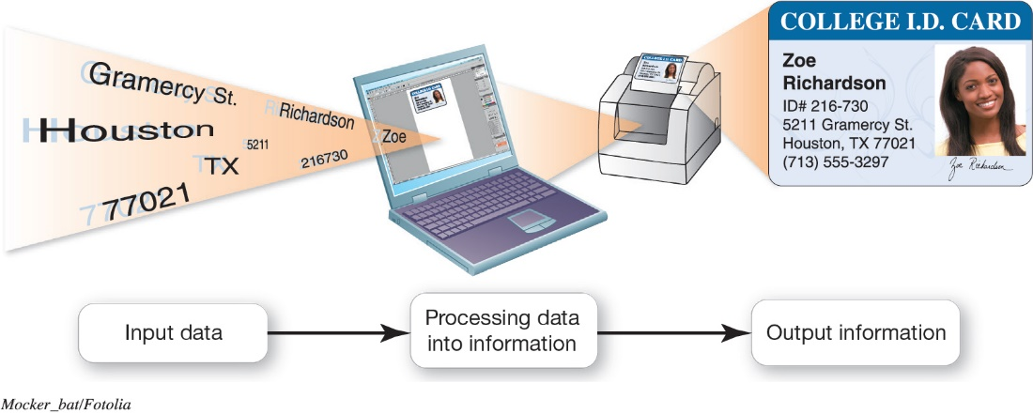
Understanding Your Computer
Computers are Data Processing Devices (Objective 2.1)
Computer performs four major functions
Input: Gathers data, allows entering data
Process: Manipulates, calculates, or organizes data
Output: Displays data and information
Storage: Saves data and information
Notes:
4
Strictly defined, a computer is a data processing device that performs four major functions:
1. Input: It gathers data, or allows users to enter data.
2. Process: It manipulates, calculates, or organizes that data into information.
3. Output: It displays data and information in a form suitable for the user.
4. Storage: It saves data and information for later use.

Slide 6
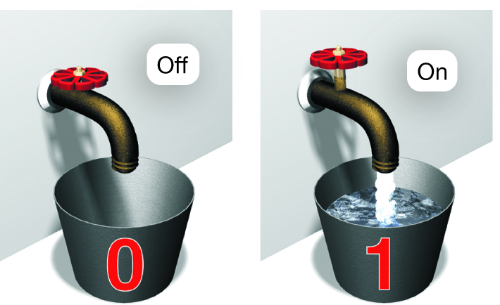
Understanding Your Computer
Binary: The Language of Computers
(Objective 2.2)
Bit
  Binary digit
  0 or 1
Byte
  Unique combinations of 8 bits of 0s and 1s
Kilobytes, megabytes, gigabytes, terabytes, and petabytes
Notes:
6
Computers need a language they understand. Binary language consists of two digits: 0 and 1.
Each 0 and 1 is a binary digit, or bit for short. Eight binary digits (or bits) combine to create one byte.
In computers, each letter, number, and special character consists of a unique combination of eight bits.
Files can be quite large, containing thousands or millions of bytes.

Slide 7
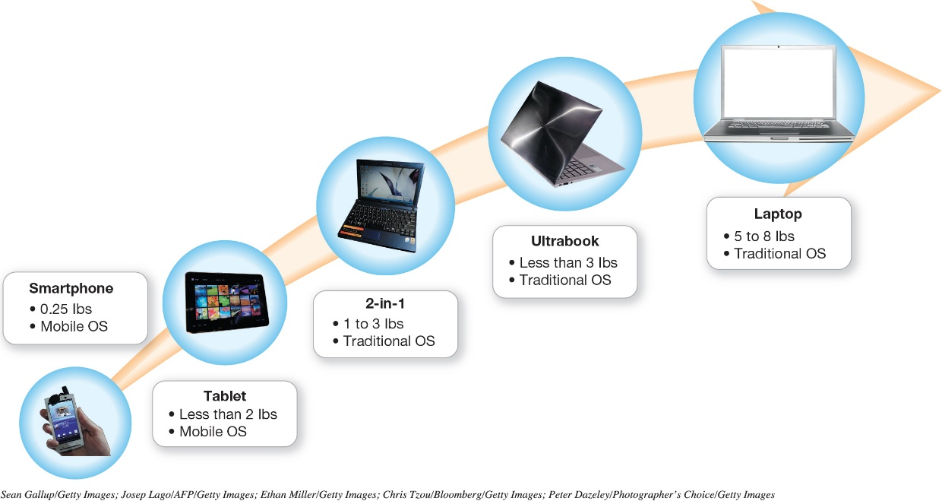
Understanding Your Computer
Types of Computers
(Objective 2.3)
Cell phones
Tablets
Laptops and their variants
Stationary computers
Notes:
8
Types of computers include:
Cell phones
Tablets
Laptops and their variants
Stationary computers

Slide 8
Input Devices
Physical Keyboards and Touch Screens (Objective 2.4)
Used to enter data and instructions
Examples
  Keyboard
  Touch screen
  Stylus
  Virtual keyboard
Notes:
12
An input device enables you to enter data and instructions into your computer. Examples include:
Keyboard
Touch screen
Stylus
Virtual keyboard

Slide 9
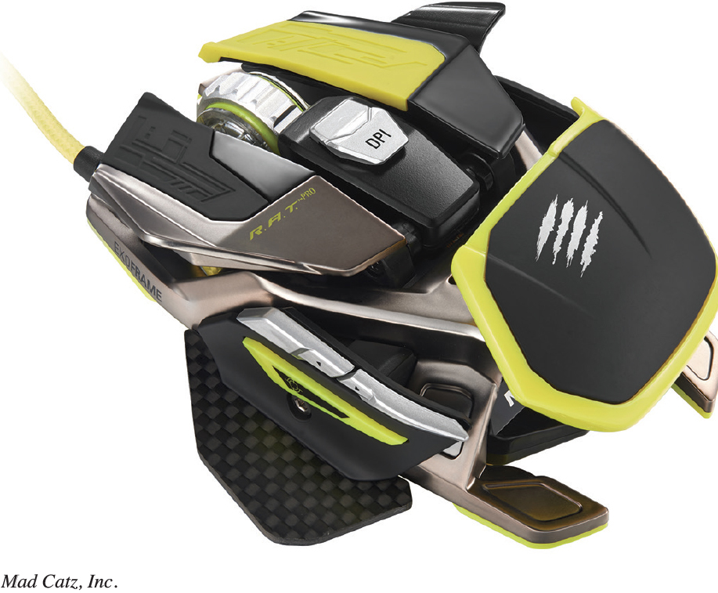
Input Devices
Mice and Other Pointing Devices
(Objective 2.5)
Mouse
Touch pad (trackpad)
Game controllers
Notes:
12
Other input devices include:
Mouse
Touch pad (trackpad)
Game controllers

Slide 10
Input Devices
Image, Sound, and Sensor Input
(Objective 2.6)
Popular for images
  Digital cameras
  Camcorders
  Mobil device cameras
  Flatbed scanners
  Webcams
Popular for sound
  Microphone with voice recognition software
Sensors
Notes:
12
Popular input devices for images include:
Digital cameras
Camcorders
Mobil device cameras
Flatbed scanners
Webcams
Popular input devices for sound are:
Microphone with voice recognition software
Various sensors are also used to detect or measure things

Slide 11
Output Devices
Image and Audio Output (1 of 3)
(Objective 2.7)
Send data out of the computer in the form of:
  Text
  Pictures
  Sounds
  Video
Examples
  Monitors
  Printers
  Speakers and headphones/earbuds
Notes:
23
An output device lets you send processed data out of your computer in the form of text, pictures, sounds, or video.
The most common output device is a monitor, which displays text, graphics, and video as soft copies (copies you can see only on-screen).
Another common output device is a printer, which creates hard copies—copies you can touch—of text and graphics.
Speakers and headphones (or earbuds) are the output devices for sound.

Slide 12
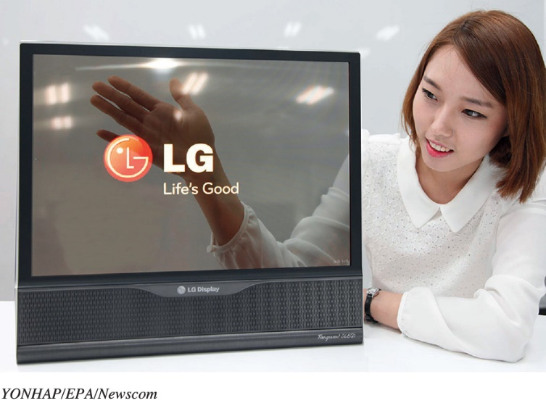
Output Devices
Image and Audio Output (2 of 3)
(Objective 2.7)
Types of display screens
  Liquid crystal display (LCD)
  Light-emitting diode (LED)
  Organic light-emitting diode (OLED)
How they work
  Pixels
  Aspect ratio
  Resolution
Notes:
23
The most common monitor is a liquid crystal display (LCD), also called a flat-panel monitor. It is light and energy-efficient.
Light-emitting diode (LED) technology is more energy-efficient and has better color accuracy and thinner panels than LCD monitors.
Organic light-emitting diode (OLED) displays use organic compounds that produce light when exposed to an electric current. Unlike LCDs and LEDs, OLEDs do not require a backlight and therefore draw less power and have a thinner display.
How they work:
Pixels refer to picture elements.
Aspect ratio is the relationship between the height and width of the screen.
Resolution is the amount of pixels that can be displayed.

Slide 13
Output Devices
Image and Audio Output (3 of 3)
(Objective 2.7)
Speaker
  Output device for sound
  Surround-sound speakers
  Wireless speaker systems
Headphones or earbuds
  Hearing might be damaged by excessive volume when using earbuds
Notes:
Most computers include inexpensive speakers. These speakers are sufficient to play audio clips from the web and enable you to participate in videoconferencing or phone calls made over the Internet.
A surround-sound speaker is a system of speakers and audio processing that envelops the listener in a 360-degree field of sound.
Wireless speaker systems are available to help you avoid cluttering up your rooms with speaker wires.
Headphones or earbuds plug into the same jack to which speakers connect. Hearing might be damaged by excessive volume when using earbuds.

Slide 14
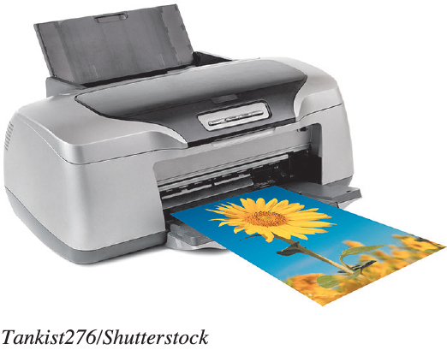
Output Devices
Printers (1 of 2)
(Objective 2.8)
Inkjet
  Affordable
  High-quality color
  Quick and quiet
Laser
  Faster printing speed
  Higher-quality printouts
  More expensive
Notes:
30
Inkjet printers are affordable and produce high-quality color printouts quickly and quietly. They spray tiny drops of ink onto paper.
Laser printers use laser beams and static electricity to deliver toner onto the correct areas of the page. Heat fuses the toner to the page.

Slide 15
Output Devices
Printers (2 of 2)
(Objective 2.8)
Cloud-ready printers
All-in-one printer
  Printer, scanner, copier, and fax
Large format printer
  Prints oversize images
3D printer
Notes:
An all-in-one printer combines the functions of a printer, scanner, copier, and fax machine into one machine and can use either inkjet or laser technology.
A large format printer prints oversize pictures that require the drawing of precise and continuous lines, such as maps and architectural plans. Plotters provide a greater level of precision than laser or inkjet printers.
A 3D printer is used to print three-dimensional models.

Slide 16
Processing and Memory on the Motherboard
The Motherboard and Memory
(Objective 2.9)
Motherboard
  CPU
  ROM, RAM, and cache
  Slots for expansion cards
  Sound/video cards
  Network interface card (NIC)
Notes:
42
The motherboard is located inside the system unit and contains the central electronic components of the computer:
The computer's processor (CPU)
Read-only memory (ROM), random access memory (RAM), and cache memory.
Slots for expansion cards, which provide additional functionality.
Sound cards connect speakers and a microphone. Video cards provide connections for the monitor.
The network interface card (NIC) enables a computer to connect with other computers and provides high-speed Internet connections.

Slide 17
Processing and Memory on the Motherboard
Processing (1 of 2)
(Objective 2.10)
Central processing unit (CPU) or processor
  “Brains” of the computer
  Controls all functions of the computer’s components
  Processes all commands and instructions
  Gigahertz (billions of tasks per second)
Notes:
43
The central processing unit (CPU, or processor) is sometimes referred to as the “brains” of the computer because it controls all the functions performed by the computer’s other components and processes all the commands issued to it by software instructions.
Current systems run at speeds measured in gigahertz, or billions of machine cycles per second.

Slide 18
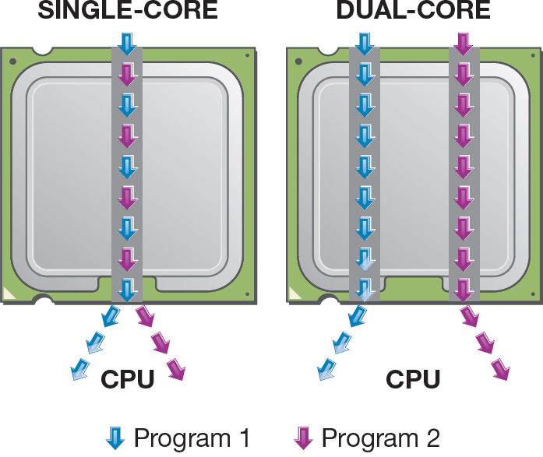
Processing and Memory on the Motherboard
Processing (2 of 2)
(Objective 2.10)
CPU performance measures
  Processor speed measured in hertz (Hz)
    Gigahertz (GHz)
  Number of cores
    Single
    Dual
    Quad
    Ten
Notes:
43
Processor speed is measured in units of hertz. Hertz is a measurement of machine cycles per second.
Current systems run at speeds measured in gigahertz, or billions of machine cycles per second. Therefore, a 3.8 GHz processor performs at 3.8 billion machine cycles per second.
CPU performance is also affected by the number of cores, or processing paths, the processor has. Processors have been designed that have two, four, and even ten cores.

Slide 19
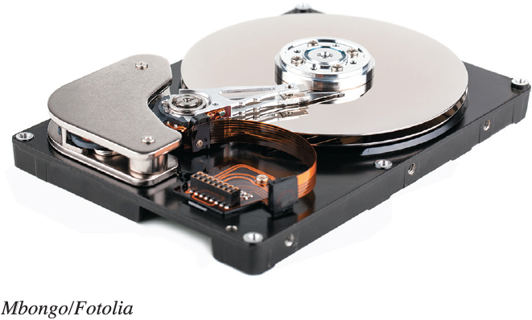
Storing Data and Information
Storage Options on Computing Devices (1 of 3) (Objective 2.11)
Local storage devices
  Hard disk drive
    Primary storage device
    Nonvolatile storage
    Internal drive
    External hard drive
  Solid-state drive (SSD)
Notes:
36
The hard disk drive is your computer’s primary device for permanent storage of software and documents.
Hard drives are nonvolatile storage devices.
An internal hard drive resides in the unit and holds all permanently stored programs and data.
External hard drives reside outside the unit and connect via a USB port.
Solid-state drives have no moving parts, so they’re more efficient, run with no noise, emit little heat, and require little power.

Slide 20
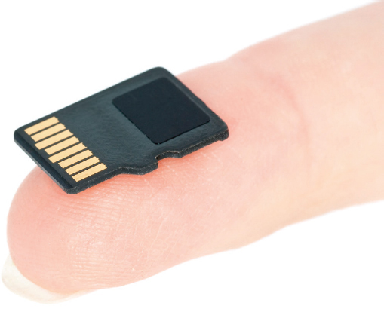
Storing Data and Information
Storage Options on Computing Devices (2 of 3) (Objective 2.11)
Portable storage options
  Flash drive
  Flash memory card
Notes:
36
A flash drive (jump drive, USB drive, or thumb drive) uses solid-state flash memory, storing information on an internal memory chip.
A flash memory card, such as an SD card also uses solid-state flash memory.

Slide 21
Storing Data and Information
Storage Options on Computing Devices (3 of 3) (Objective 2.11)
Cloud storage
  Files stored on the Internet
  Some amount is free
  Can purchase additional storage
Notes:
36
Cloud storage refers to files being stored on the Internet.
Most companies offer a limited amount of space for free.
Additional space can be purchased.

Slide 22
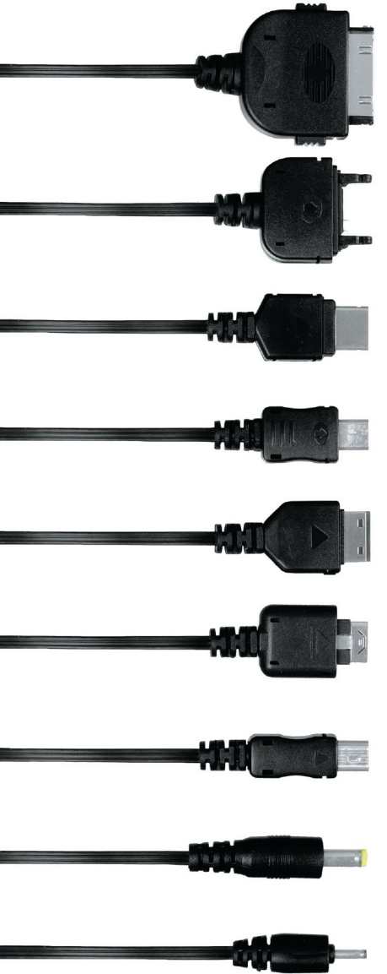
Connecting Peripherals to the Computer Ports
(Objective 2.12)
Thunderbolt
  Transfer speeds up to 40 Gbps
Universal serial bus (USB) port
  Transfer speeds of 10 Gbps
Connectivity port
  Ethernet port
  Up to 10,000 Mbps
HDMI port
Notes:
Thunderbolt provides a transfer rate of 40 Gbps.
Universal serial bus (USB) ports are used to connect input and output devices to computers.
The USB 3.1 standard provides transfer speeds of 10 Gbps and charges devices faster than previous USB ports.
Connecting computers can be done through an Ethernet port with transfer speeds of 10,000 Mbps
HDMI ports are used for high definition audio and video.

Slide 23
Power Management and Ergonomics
Power Controls and Power Management
(Objective 2.13)
Battery drain
Power supply
Sleep mode
Warm/cold boot
Hibernate
Notes:
46
For portable devices, it is important to know which devices drain the battery the most.
The computer’s power supply provides power for the devices.
In sleep mode, all documents in RAM stay in RAM when the computer is put to sleep.
When a computer is restarted, it is called a warm boot. When the computer is started from a powered down state, it is referred to as a cold boot.
When a computer hibernates, it stores all the documents from RAM on the hard drive.

Slide 24

Power Management and Ergonomics
Setting It All Up: Ergonomics (1 of 2)
(Objective 2.14)
Ergonomics
Guidelines
  Monitor position
  Adjustable chair
  Proper typing position
  Breaks
  Adequate lighting
Notes:
46
Ergonomics deals with the design and location of machines and furniture so that the people using them are not subjected to an uncomfortable or unsafe experience.
These guidelines can help keep you comfortable and productive:
Position your monitor correctly.
Purchase an adjustable chair.
Assume a proper position while typing.
Take breaks from computer tasks.
Ensure that the lighting is adequate.

Slide 25
Power Management and Ergonomics
Setting It All Up: Ergonomics
(Objective 2.14)
Assistive (adaptive) technologies
  Voice recognition or special keyboards for visually impaired
  Special trackballs for users with motor control issues
Notes:
46
Assistive (or adaptive) technologies are products, devices, equipment, or software that are used to maintain, increase, or improve the functional capabilities of individuals with disabilities.
For visually impaired users and individuals who cannot type with their hands, voice recognition is a common option. For those users whose visual limitations are less severe, keyboards with larger keys are available.
Users with motor control issues may have difficulty with pointing devices. To aid such users, special trackballs are available that can be manipulated with one finger and can be attached to almost any surface, including a wheelchair.

Slide 26

Copyright
All rights reserved. No part of this publication may be reproduced, stored in a retrieval system, or transmitted, in any form or by any means, electronic, mechanical, photocopying, recording, or otherwise, without the prior written permission of the publisher. Printed in the United States of America.

