Slide 1

Technology in Action
16th Edition
Chapter 4
Application Software: Programs That Let You Work and Play

Slide 2
Learning Objectives (1 of 3)
4.1 Compare application software and system software.
4.2 Explain the differences between commercial software and open source software, and describe models for software distribution.
4.3 Explain the different options for purchasing software.
4.4 Describe how to install and uninstall software.
4.5 Explain the considerations around the decision to upgrade your software.
4.6 Explain how software licenses function.
Notes:
The learning objectives are:
4.1 Compare application software and system software.
4.2 Explain the differences between commercial software and open source software, and describe models for software distribution.
4.3 Explain the different options for purchasing software.
4.4 Describe how to install and uninstall software.
4.5 Explain the considerations around the decision to upgrade your software.
4.6 Explain how software licenses function.

Slide 3
Learning Objectives (2 of 3)
4.7 Categorize the types of application software used to enhance productivity and describe their uses and features.
4.8 Summarize the types of software that large and small businesses use.
4.9 Describe the uses and features of digital multimedia software.
4.10 Describe the uses and features of digital audio software.
Notes:
Additional learning objectives are:
4.7 Categorize the types of application software used to enhance productivity and describe their uses and features.
4.8 Summarize the types of software that large and small businesses use.
4.9 Describe the uses and features of digital multimedia software.
4.10 Describe the uses and features of digital audio software.

Slide 4
Learning Objectives (3 of 3)
4.11 Describe the features of app creation software.
4.12 Categorize educational and reference software and explain their features.
Notes:
Additional learning objectives are:
4.11 Describe the features of app creation software.
4.12 Categorize educational and reference software and explain their features.

Slide 5
Software Basics
Application vs. System Software
(Objective 4.1)
Software—set of instructions that tells the computer what to do
Two basic types of software
  Application software
  System software
Notes:
Software refers to a set of instructions that tell the computer what to do.
Your computer has two basic types of software:
Application software is used to do tasks at home, school, and work.
System software helps run the computer and coordinates instructions between application software and the computer’s hardware devices.

Slide 6
Software Basics
Distributing Software
(Objective 4.2)
Ways software is created
  Proprietary (commercial)
  Open source (free)
Ways software is distributed
  Local installation
  Software as a Service (SaaS)
  Subscription
Notes:
There are two ways software is created:
Proprietary (commercial) software is created by companies for profit and then sold to you.
Open source software is software that is available free of charge and with few licensing and copyright restrictions.
There are various ways to distribute software:
Local installation
Software as a Service (SaaS)
Subscription

Slide 7
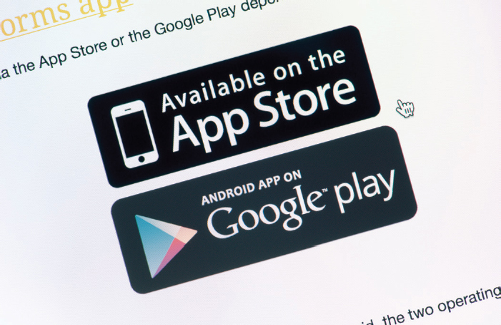
Managing Your Software
Purchasing Software
(Objective 4.3)
DVD from brick and mortar store
Downloading from the Internet (as purchase or subscription)
Student discounts
Freeware
Beta version
Notes:
Normally software can be acquired through a brick and mortar store or by downloading it from the Internet.
Students can often find discounted software.
Freeware is copyrighted software that you do not have to pay for.
A beta version is a trial version used to help the company debug its software.

Slide 8
Managing Your Software
Installing and Uninstalling Software
(Objective 4.4)
System requirements
Restore point
Full installation
Custom installation
Recovering from a computer crash
Uninstalling software
Recovery drive
Notes:
Every program has a set of system requirements that specify the minimum recommended standards.
It is good to set a restore point before installing new software.
A full installation copies all the most commonly used files to your hard drive.
In a custom installation, you decide which features you want installed.
Uninstalling software removes it from your hard drive.
Creating a Recovery drive helps you recover from a computer crash.

Slide 9
Managing Your Software
Upgrading Software
(Objective 4.5)
Upgrades/updates not needed for subscriptions or SaaS
Is it cost effective?
Between upgrades are software updates or patches
Notes:
Upgrades and updates are not required if you have a subscription to the software or are using software as a service (SaaS).
There’s no need to rush out and buy the latest version of a software program every time one is available. Consider whether you use the software frequently enough to justify an upgrade.
In between upgrades, developers will make available software updates (sometimes referred to as software patches).

Slide 10
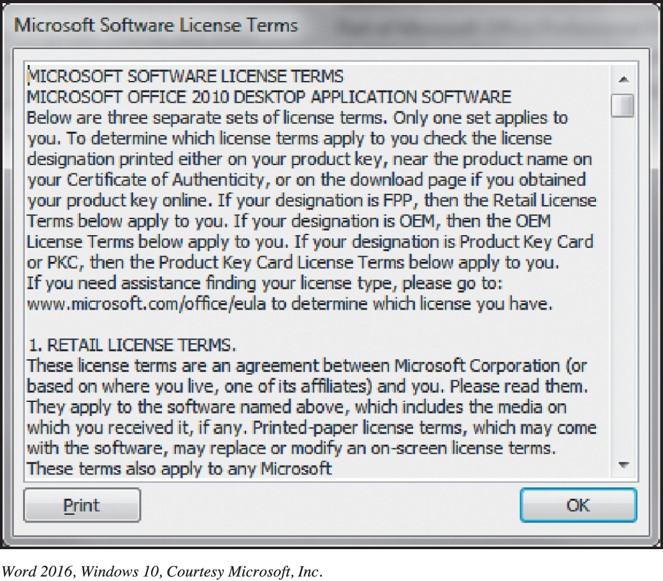
Managing Your Software
Software Licenses
(Objective 4.6)
End User License Agreement (EULA)
States the following:
  Ultimate owner
  Copies allowed
  # of installations
  allowed
  Warranties
Copyleft
Notes:
A software license, also known as an End User License Agreement (EULA), is an agreement between you, the user, and the software company.
Generally, the agreement states who the ultimate owner of the software is, under what circumstances copies of the software can be made, and whether the software can be installed on any other machine. Finally, the license agreement will state what, if any, warranty comes with the software.
The concept of redistributing modified open source software under the same terms as the original software is known as copyleft.

Slide 11
Productivity and Business Software
Productivity Software (1 of 9)
(Objective 4.7)
Lets you perform various tasks required at home, school, and business
  Proprietary—Microsoft Office and Apple iWork
  Open source—LibreOffice
  Web-based—Microsoft Office Online, Google Docs, Zoho, and ThinkFree
Notes:
Productivity software lets you perform various tasks required at home, school, and business.
Proprietary—Microsoft Office and Apple iWork
Open Source—LibreOffice
Web-based—Microsoft Office Online, Google Docs, Zoho, and ThinkFree

Slide 12
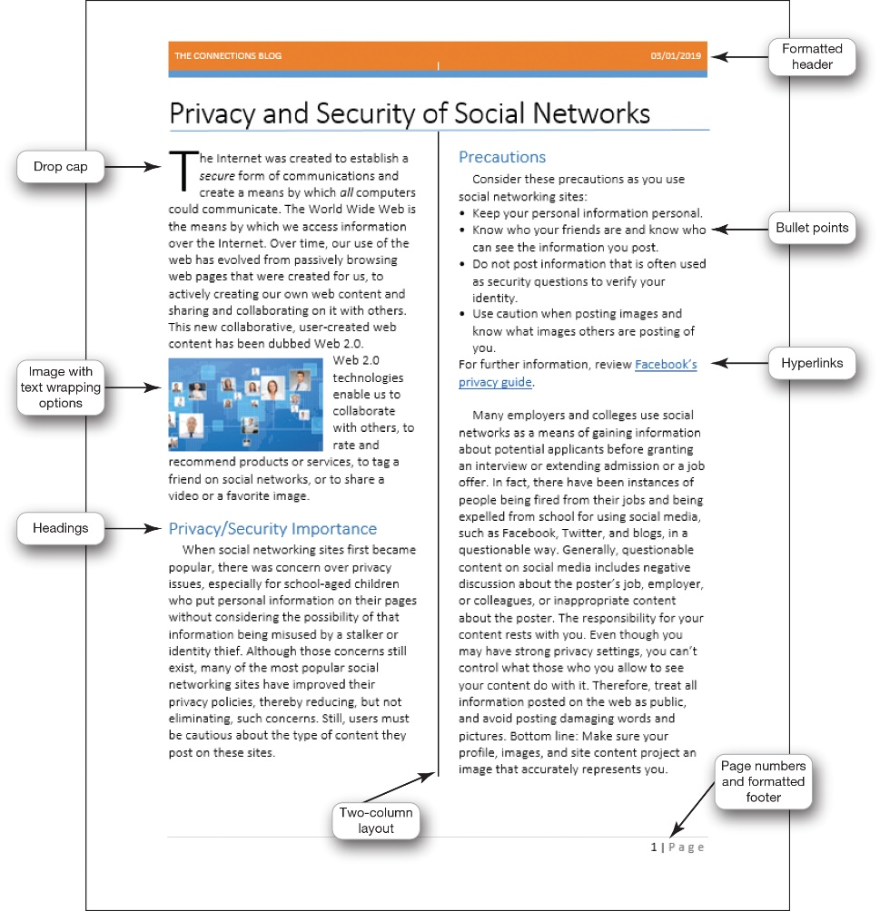
Productivity and Business Software
Productivity Software (2 of 9)
(Objective 4.7)
Word processing—creates and edits documents
  Research papers
  Class notes
  Résumés
Program examples
  Word
  Writer
Notes:
Word processing software is used to create and edit documents such as research papers, class notes, and résumés.
Microsoft Word is the most popular word processing program that you can buy and install on your computer.
If you are looking for a more affordable alternative, you might want to try an open source alternative such as Writer, a word processing program from LibreOffice.

Slide 13
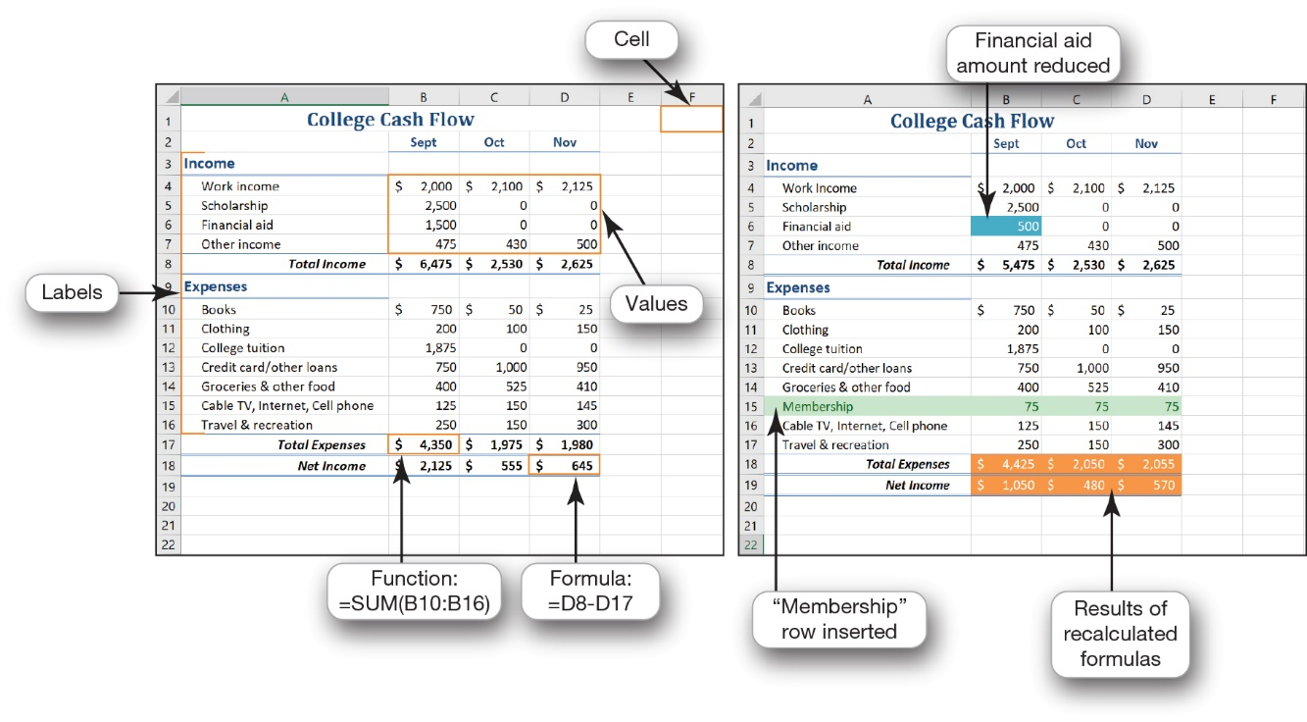
Productivity and Business Software
Productivity Software (3 of 9)
(Objective 4.7)
Spreadsheet—performs calculations and numerical analyses
Data types
  Text
  Values and dates
  Formulas
  Functions
Examples
  Microsoft Excel
  LibreOffice Calc
Notes:
Spreadsheet software lets you make calculations and perform numerical analyses.
Microsoft Excel and LibreOffice Calc are two examples of spreadsheet software. One benefit of spreadsheet software is that it can automatically recalculate all formulas and functions in a spreadsheet when values for some of the inputs change.

Slide 14
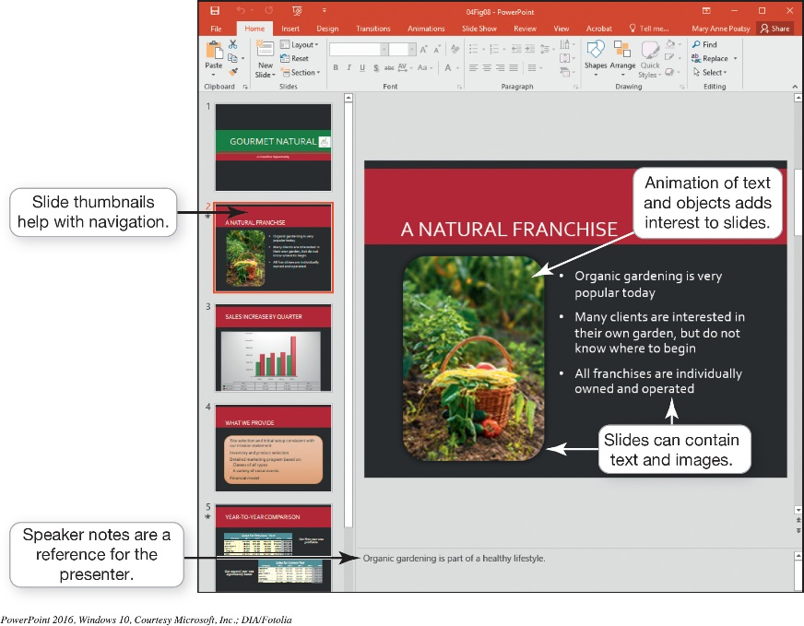
Productivity and Business Software
Productivity Software (4 of 9)
(Objective 4.7)
Presentation software
  Tips for designing good presentations
    Use images
    Be careful with color
    Use bullets for key points
    Consider font size and style
    Minimize animation and background audio
Notes:
Here are tips for designing good presentations:
Use images: Images can convey thoughts or illustrate points.
Be careful with color.
Use bullets for key points: The limit is four to six bulleted points per slide.
Consider font size and style: Keep the font size large enough to read from the back of the room.
Keep animation and background audio to a minimum.

Slide 15
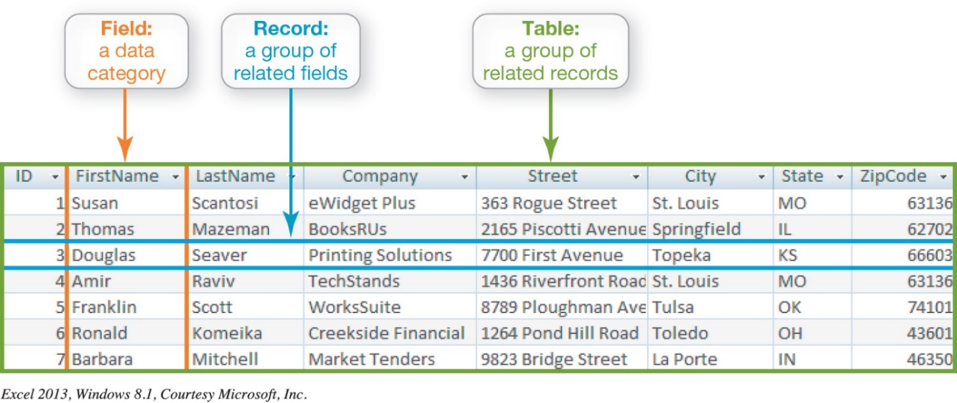
Productivity and Business Software
Productivity Software (5 of 9)
(Objective 4.7)
Database software—stores and organizes data
  Organization
    Fields
    Records
    Tables
Notes:
Database software programs, such as Oracle, MySQL, and Microsoft Access, are powerful applications that let you store and organize data.
Traditional databases are organized into fields, records, and tables.

Slide 16
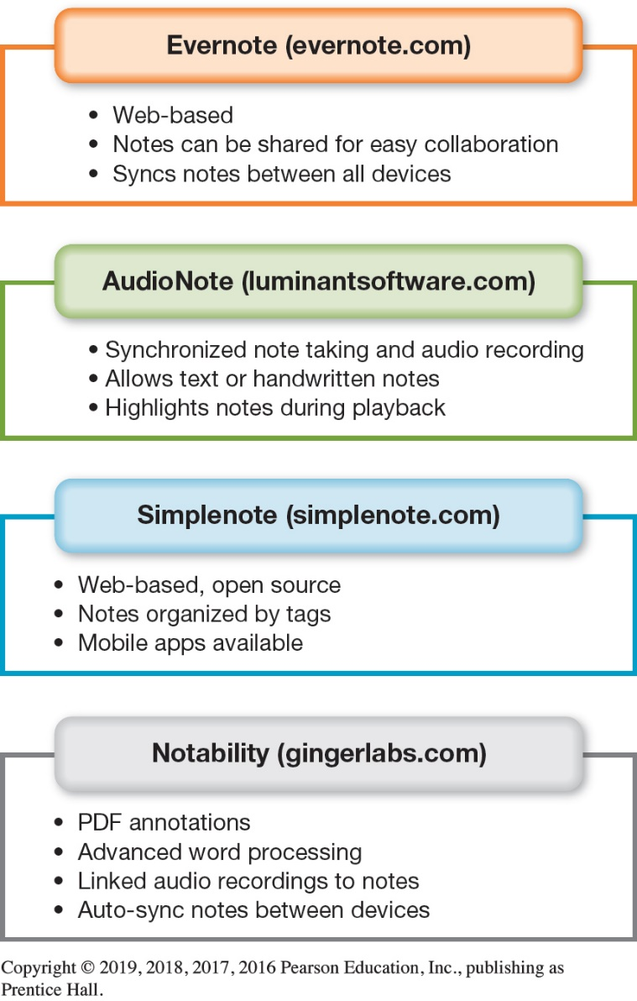
Productivity and Business Software
Productivity Software (6 of 9)
(Objective 4.7)
Note-taking software
  OneNote
  Evernote
Notes:
Microsoft OneNote is a popular note-taking and organizational tool you can use for research, brainstorming, and collaboration.
You can organize notes into tabbed sections.
You can access notes from other Microsoft Office applications.
A free online option, Evernote, lets you take notes via the web, your phone, or your computer and then sync your notes between your devices. You can share your notes with other Evernote users for easy collaboration.

Slide 17
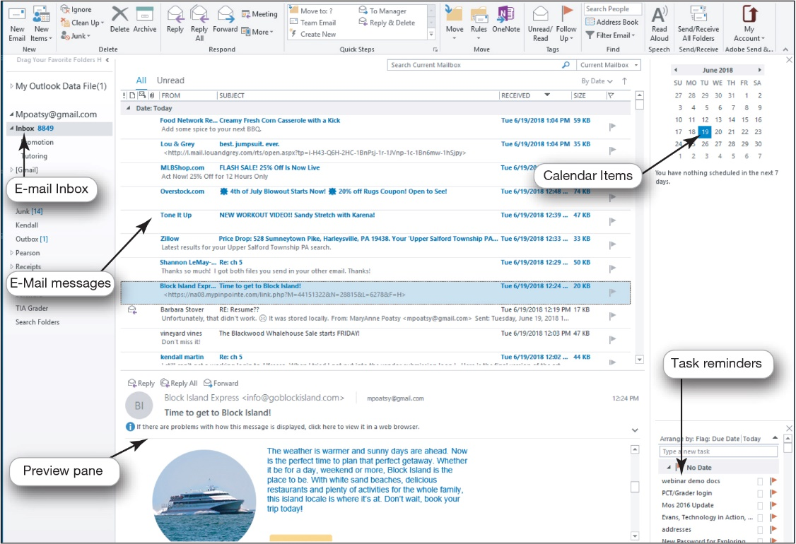
Productivity and Business Software
Productivity Software (7 of 9)
(Objective 4.7)
Personal information manager (PIM)
  Manages e-mail, contacts, calendars, and tasks
  Outlook
  Web-based PIMs
    Yahoo!
    Google
  Other options
    Toodledo
    OmniFocus
Notes:
Most productivity suites contain some form of personal information manager (PIM) software to help you manage e-mail, contacts, calendars, and tasks. Microsoft Outlook is a widely used PIM program.
Yahoo! and Google also include coordinating calendars and contacts similar to Microsoft Outlook.
Toodledo is a free program that coordinates well with Microsoft Outlook, and OmniFocus is a more full-featured option for Mac devices.

Slide 18
Productivity and Business Software
Productivity Software (8 of 9)
(Objective 4.7)
Productivity software features
  A wizard walks through the steps necessary to complete a task
  A template is a predesigned form
  A macro is a small program that groups a series of commands
Notes:
A wizard walks through the steps necessary to complete a task.
A template is a predesigned form.
A macro is a small program that groups a series of commands.

Slide 19
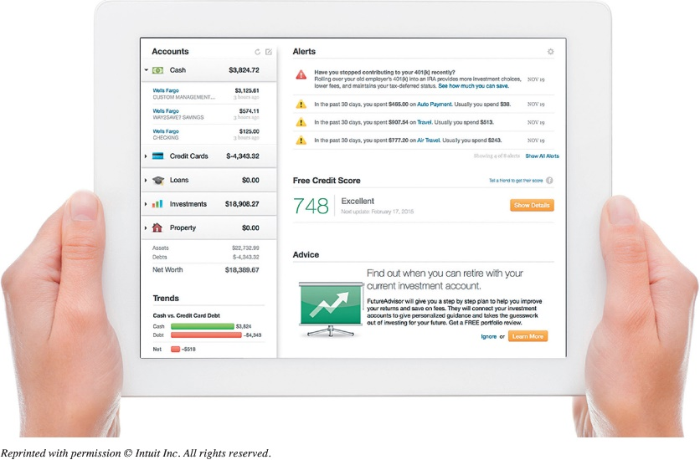
Productivity and Business Software
Productivity Software (9 of 9)
(Objective 4.7)
Personal financial software—manages daily finances
  Electronic checkbook registers
  Automatic bill payment tools
  Tax preparation software
    Intuit TurboTax
    H&R Block Tax
Notes:
Financial planning software helps you manage your daily finances.
Financial planning programs include electronic checkbook registers and automatic bill payment tools. With these features, you can make recurring monthly payments, such as rent or student loans, with automatically scheduled online payments.
Tax preparation software, such as Intuit Turbo Tax and H&R Block Tax, lets you prepare your state and federal taxes on your own.

Slide 20
Productivity and Business Software
Business Software (1 of 2)
(Objective 4.8)
Small business software
  Accounting software
    Track accounts receivable and payable
    Inventory management, payroll, and billing
  Desktop publishing (DTP) software
    Design books and publications
  Web authoring software
    Design web pages
Notes:
Accounting software helps small business owners manage their finances more efficiently by providing tools for tracking accounts receivable and accounts payable. In addition, these applications offer inventory management, payroll, and billing tools.
If your business requires newsletters, catalogs, annual reports, or other large, complicated publications, consider using desktop publishing (DTP) software.
Web authoring software allows even a novice to design interesting and interactive web pages without knowing any HTML code.

Slide 21
Productivity and Business Software
Business Software (2 of 2)
(Objective 4.8)
Software for large and specialized businesses
  Vertical market software is designed for a specific industry
  Computer-aided design (CAD) programs create automated designs, technical drawings, and 3D model visualizations
  Home or landscape planning
Notes:
Vertical market software is designed for a specific industry such as real estate.
Computer-aided design (CAD) programs create automated designs, technical drawings, and 3D model visualizations.
Home or landscape planning software, such as SketchUp, can be used in designing home improvements.

Slide 22
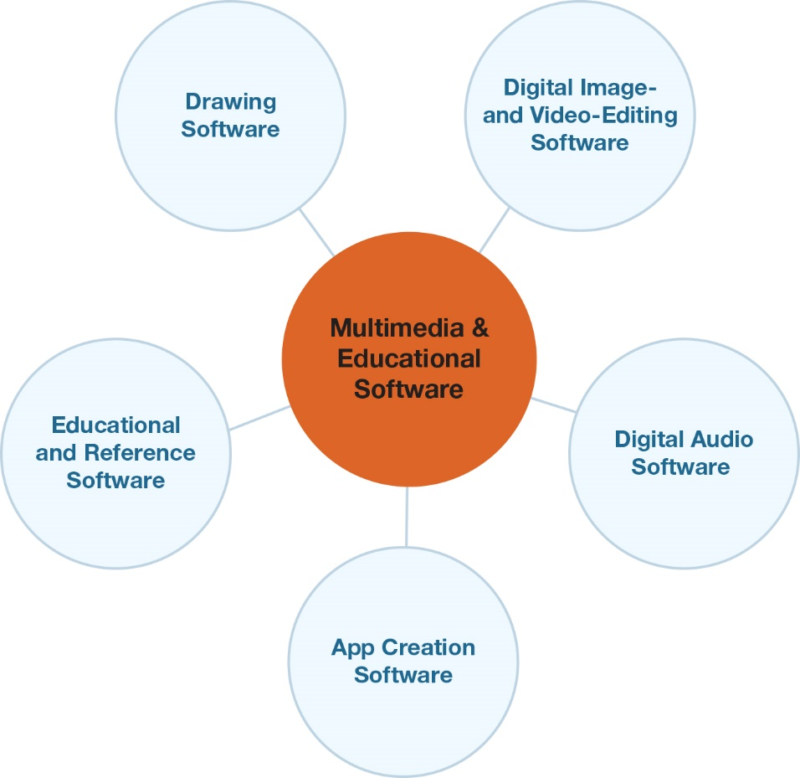
Multimedia and Educational Software
Digital Multimedia Software (1 of 3)
(Objective 4.9)
Multimedia software
  Includes digital image, video-editing, and digital audio software
  Used to produce computer games, animations, and movies
Notes:
Multimedia software includes digital image, video-editing, and digital audio software and is used to produce computer games, animations, and movies.

Slide 23
Multimedia and Educational Software
Digital Multimedia Software (2 of 3)
(Objective 4.9)
Multimedia software
  Image-editing software used to edit photos
  Video-editing software used to refine videos
Notes:
Image-editing software, such as Adobe Photoshop and Corel PaintShop Pro, is used to edit photos.
Digital video-editing software, such as Adobe Premiere Pro and Apple’s Final Cut Pro, is used to refine videos.

Slide 24
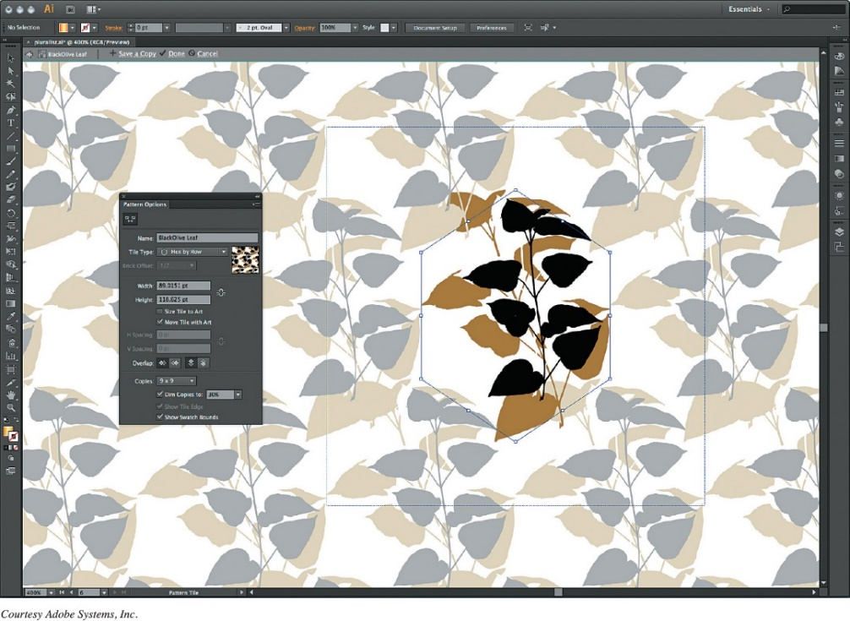
Multimedia and Educational Software
Digital Multimedia Software (3 of 3)
(Objective 4.9)
Multimedia software
  Drawing software lets you create
    Two-dimensional,
    line-based drawings
    Technical diagrams
    Animations
  Professional-level
    Adobe Illustrator
Notes:
Drawing software lets you create or edit 2D, line-based drawings. You can use it to create technical diagrams or original nonphotographic drawings, animations, and illustrations using standard tools.
Adobe Illustrator includes tools that let you create professional-quality creative and technical illustrations.

Slide 25
Multimedia and Educational Software
Digital Audio Software
(Objective 4.10)
Digital audio files
Downloaded music files, audiobooks, or podcasts
  Compressed: MP3, AAC, WMA
  Uncompressed: WAV, AIFF
Digital audio workstation software (DAWs)
Audio-editing software
Notes:
Digital audio files, such as downloaded music files, audiobooks, or podcasts, may be stored on your computer.
MP3 is the most common audio compression format, but there are other compressed formats, such as AAC and WMA.
You might also see uncompressed audio files on your computer, such as WAV and AIFF files.
Digital audio workstation software, such as Apple GarageBand, lets you create and record your own audio files.
Audio-editing software, such as Audacity, includes tools that make editing audio files easy.

Slide 26
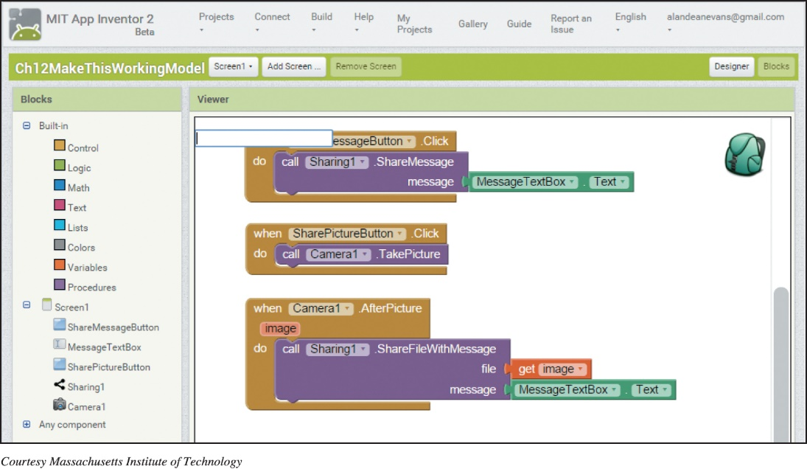
Multimedia and Educational Software
App Creation Software
(Objective 4.11)
App creation software—programming environments that produce apps that run on mobile devices
  App Inventor
  Thunkable
  Corona SDK
  Unity
  RPG Maker
Notes:
App creation software are programming environments that can produce apps that run on various mobile devices.
MIT’s App Inventor web application and Thunkable can be used to create functional apps for Android and Apple mobile devices.
Corona SDK is a free programming environment that has been used to develop games and business apps.
Unity and RPG Maker provide the tools you need to explore game design and creation.

Slide 27
Multimedia and Educational Software
Educational and Reference Software
(Objective 4.12)
Educational and reference software examples
  Test preparation
  Simulation
  Trip planning
  Home design/improvement
  Course management
  Genealogy
Notes:
Educational and reference software includes the following:
Test preparation—Designed to improve your performance on standardized tests.
Simulation—Allows you to experience a real situation through a virtual environment.
Trip planning—Generates maps and provides driving instructions; some incorporate hotel, restaurant, and other trip information.
Home design/improvement—Provides 2D or 3D templates and images to let you better visualize indoor and outdoor remodeling projects and landscaping ideas.
Course management—Web-based software system that creates a virtual learning experience, including course materials, tests, and discussion boards.
Genealogy—Helps chart the relationships between family members through multiple generations.

Slide 28

Copyright
All rights reserved. No part of this publication may be reproduced, stored in a retrieval system, or transmitted, in any form or by any means, electronic, mechanical, photocopying, recording, or otherwise, without the prior written permission of the publisher. Printed in the United States of America.

