Slide 1

Technology in Action
16th Edition
Chapter 5
System Software: The Operating System, Utility Programs, and File Management

Slide 2
Learning Objectives (1 of 2)
5.1 Discuss the functions of the operating system.
5.2 Explain the most popular operating systems for personal use.
5.3 Explain the different kinds of operating systems for machines, networks, and business.
5.4 Explain how the operating system provides a means for users to interact with the computer.
5.5 Explain how the operating system helps manage hardware such as the processor, memory, storage, and peripheral devices.
Notes:
The learning objectives are:
5.1 Discuss the functions of the operating system.
5.2 Explain the most popular operating systems for personal use.
5.3 Explain the different kinds of operating systems for machines, networks, and business.
5.4 Explain how the operating system provides a means for users to interact with the computer.
5.5 Explain how the operating system helps manage hardware such as the processor, memory, storage, and peripheral devices.

Slide 3
Learning Objectives (2 of 2)
5.6 Explain how the operating system interacts with application software.
5.7 Discuss the process the operating system uses to start up the computer and how errors in the boot process are handled.
5.8 Describe the main features of the Windows interface.
5.9 Summarize how the operating system helps keep your computer organized and manages files and folders.
5.10 Outline the tools used to enhance system productivity, back up files, and provide accessibility.
Notes:
Additional learning objectives are:
5.6 Explain how the operating system interacts with application software.
5.7 Discuss the process the operating system uses to start up the computer and how errors in the boot process are handled.
5.8 Describe the main features of the Windows interface.
5.9 Summarize how the operating system helps keep your computer organized and manages files and folders.
5.10 Outline the tools used to enhance system productivity, back up files, and provide accessibility.

Slide 4
Operating System Fundamentals
Operating System Basics (1 of 2)
(Objective 5.1)
System basics
  Operating system (OS)
  Utility programs
Operating system functions
  Manages computer’s hardware
  Allows application software to work with CPU
  Manage, schedule, coordinate tasks
Notes:
System software consists of two primary types of programs: the operating system (OS) and utility programs.
The operating system has three primary functions:
• It manages the computer’s hardware.
• It provides a consistent means for application software to work with the central processing unit.
• It is responsible for the management, scheduling, and coordination of tasks.

Slide 5
Operating System Fundamentals
Operating System Basics (2 of 2)
(Objective 5.1)
User interface
  How user interacts with computer
  Desktop, icons, and menus
OS categories
  Single- or multi-user
  Single- or multi-task
Notes:
Other functions of the operating system include the user interface, which is how users interact with the computer. It includes desktop, icons, and menus.
When operating systems were originally developed, they were designed for a single user performing one task at a time. Modern operating systems provide the ability to multitask, which means that the computer can perform more than one process at a time and accommodate multiple users.

Slide 6
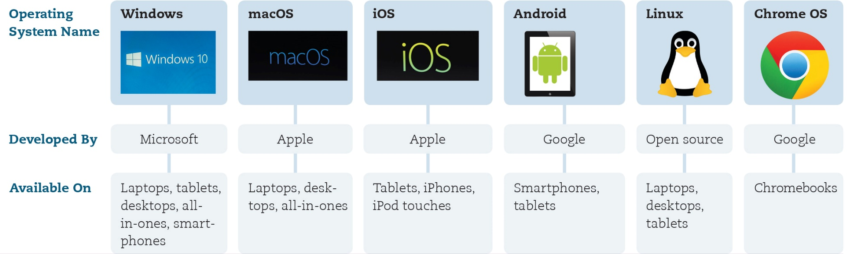
Understanding System Software
Operating Systems for Personal Use (1 of 3)
(Objective 5.2)
Notes:
Common operating systems for a variety of devices.

Slide 7
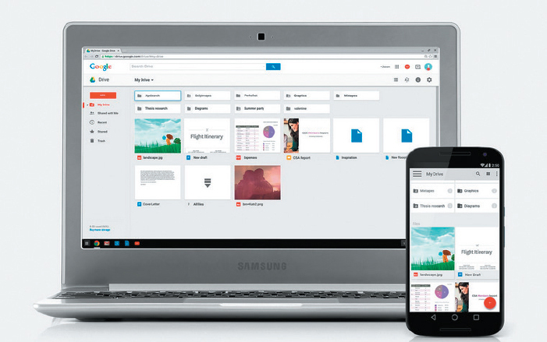
Understanding System Software
Operating Systems for Personal Use (2 of 3)
(Objective 5.2)
Top three for personal computers
  Windows
  macOS
  Linux
Mobile OS
  Android
  iOS
  Windows
Web-based
  Google Chrome OS
Notes:
The top three operating systems for personal computers are:
Microsoft Windows
Apple’s macOS
Linux
Personal devices require special operating systems as well. These include:
Android
iOS
Microsoft Windows
Google Chrome OS is a web-based OS. With the Chrome OS, virtually no files are installed on your computing device. Rather, the main functionality of the OS is provided through a web browser.

Slide 8
Understanding System Software
Operating Systems for Personal Use (3 of 3)
(Objective 5.2)
Linux
  Open source
  Personal computers
  Web servers
  Distributions (distros)
Platform
Upgrade OS decision
Notes:
Linux is an open source OS designed for use on personal computers and web servers.
Linux is available for download in various packages known as distributions or distros.
The combination of an OS and a specific processor is referred to as a computer’s platform.
The decision to update to the newest features of your OS depends on which OS you’re using.

Slide 9
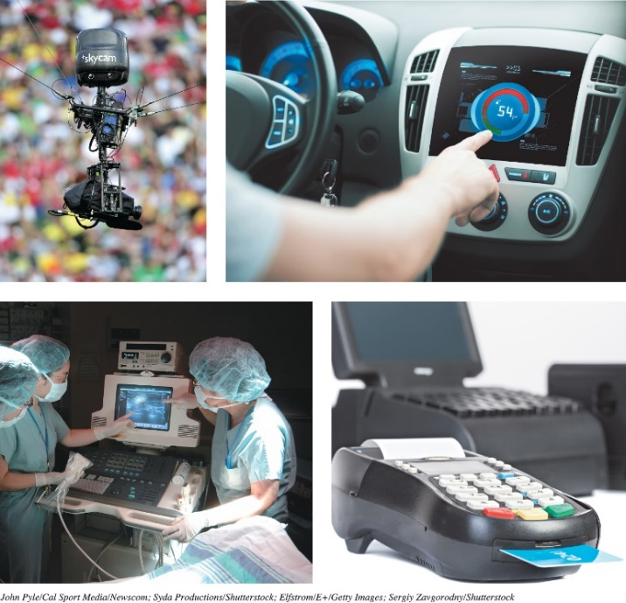
Understanding System Software
Operating Systems for Machinery, Networks, and Business (1 of 2)
(Objective 5.3)
Real-time OS (RTOS)
  Machine that performs
  repetitive series of specific
  tasks in precise time
Multiuser operating system
  Known as network OS
  Allows multiple users access to the computer at the same time
  Unix
Notes:
Specialized operating systems are needed for machinery, networks, and business.
Machinery that performs a repetitive series of specific tasks in an exact amount of time requires a real-time operating system (RTOS).
Multiuser operating systems allow multiple users access to the computer at the same time.
UNIX is a multiuser, multitasking OS that is used as a network OS.

Slide 10
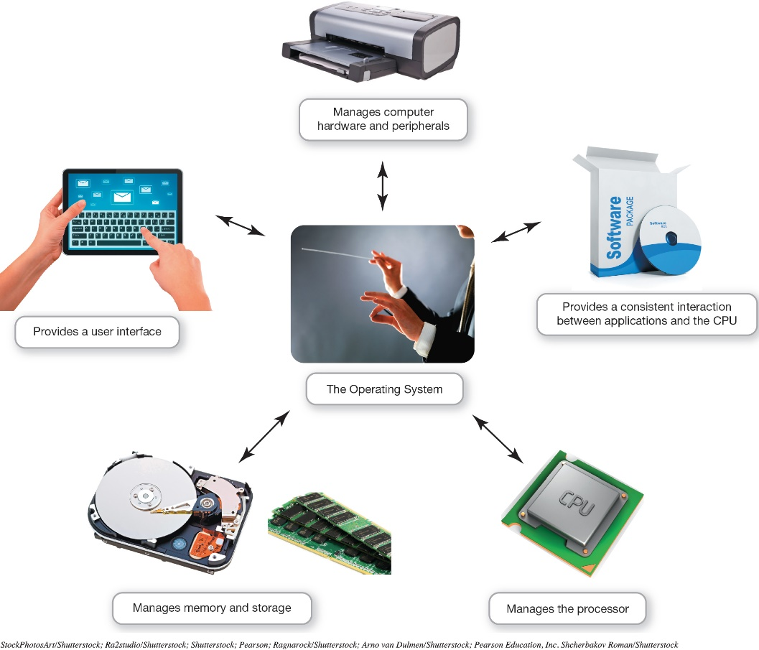
Understanding System Software
Operating Systems for Machinery, Networks, and Business (2 of 2)
(Objective 5.3)
OS—coordinates and directs the flow of data and information
Notes:
The operating system is like an orchestra's conductor. It coordinates and directs the flow of data and information through the computer system.

Slide 11
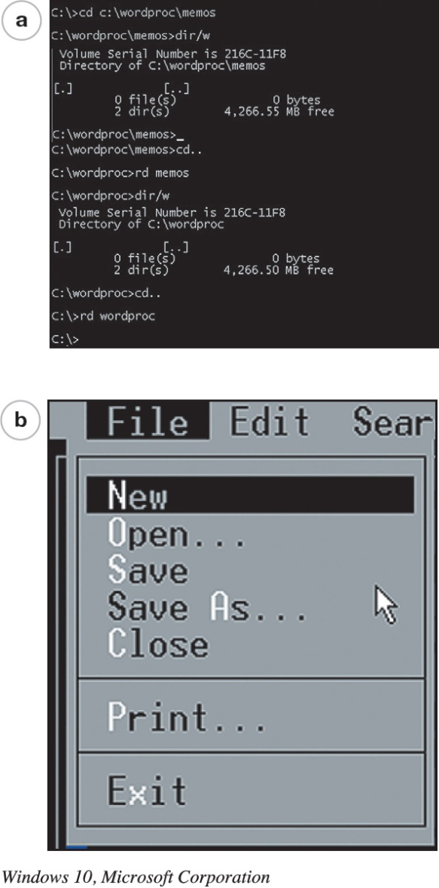
What the Operating System Does
The User Interface
(Objective 5.4)
Enables user to interact
with the computer
Types of interfaces
  Command-driven interface
  Menu-driven interface
  Graphical user interface (GUI)
Notes:
The OS provides a user interface that lets you interact with the computer.
In a command-driven interface, you enter commands to communicate with the computer system.
A menu-driven interface is one in which you choose commands from menus displayed on the screen. This eliminated the need for users to know every command.
Current operating systems use a graphical user interface (GUI). GUIs display graphics and use the point-and-click technology of the mouse and cursor.

Slide 12
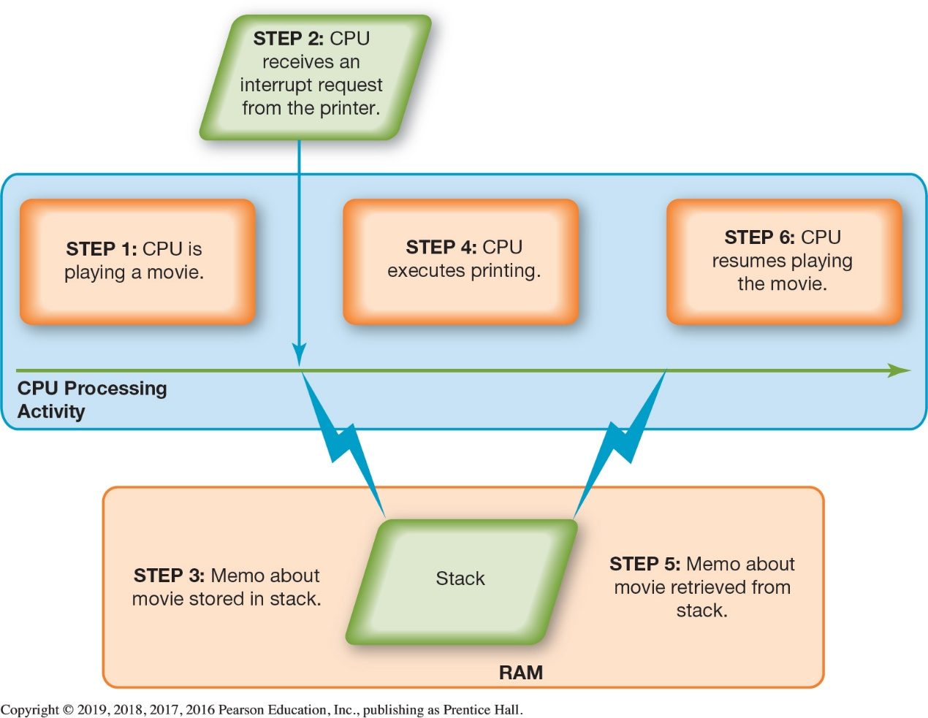
What the Operating System Does
Hardware Coordination (1 of 3)
(Objective 5.5)
Event
Interrupt handler
Preemptive multitasking
Spooler
Notes:
Every keystroke, every mouse click (or touch on the screen), and each signal to the printer and from the Blu-ray drive creates an action, or event, in the respective device to which the OS responds.
Every device has its own type of interrupt, which is associated with an interrupt handler, a special numerical code that prioritizes the requests.
These requests are placed in the interrupt table in the computer’s primary memory (RAM). The OS processes the task assigned a higher priority before processing a task assigned a lower priority. This is called preemptive multitasking.
The spooler is a program that helps coordinate all print jobs currently being sent to the printer.

Slide 13
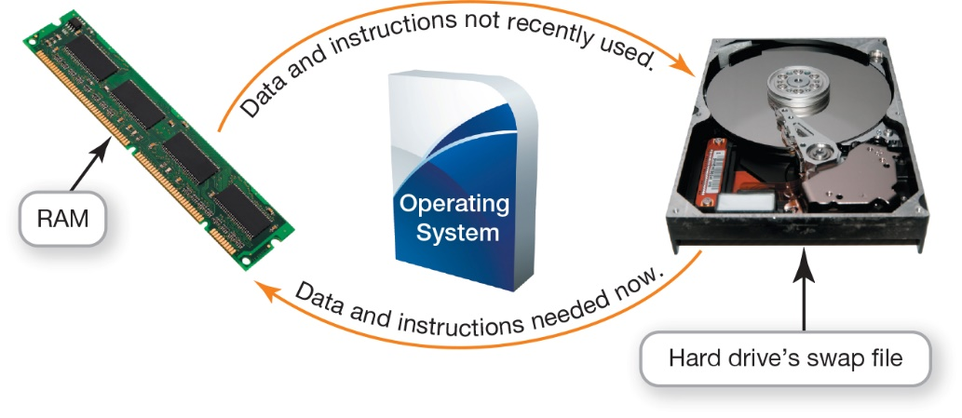
What the Operating System Does
Hardware Coordination (2 of 3)
(Objective 5.5)
Memory and storage management
  RAM—limited capacity
  Borrowing drive space is called virtual memory
  Increase RAM to avoid using virtual memory
  Swap file
    Paging
    Thrashing
Notes:
RAM has limited capacity.
When there isn’t enough room in RAM, it borrows room from the hard drive.
Borrowing hard drive space is called virtual memory.
When more RAM is needed, the OS swaps out from RAM the data or instructions that haven't been used recently and moves them to a temporary storage area on the hard drive.
Increasing the amount of RAM helps the computer to avoid having to send data and instructions to virtual memory.
The process of swapping is known as paging.
Excessive paging is called thrashing.

Slide 14
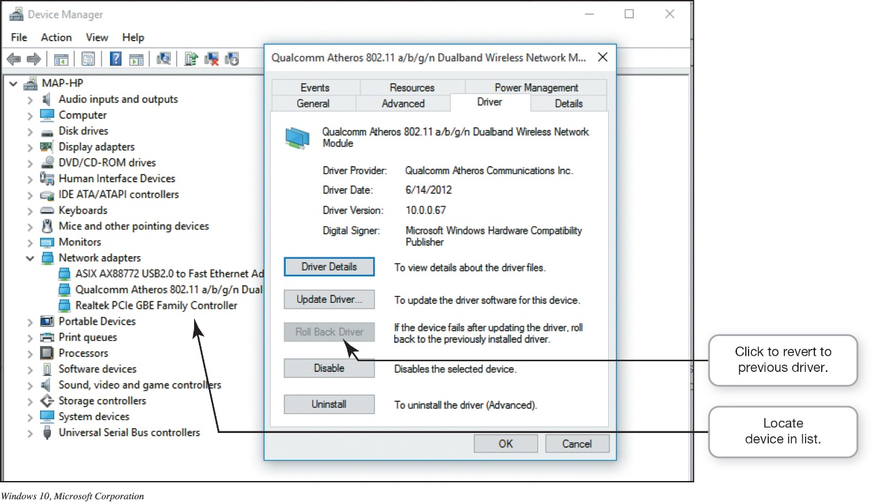
What the Operating System Does
Hardware Coordination (3 of 3)
(Objective 5.5)
Hardware and peripheral device management
  Device driver
  Plug and Play
  (PnP)
  Roll Back
Notes:
Each device attached to your computer comes with a special program called a device driver that facilitates communication between the device and the OS.
Plug and Play (PnP) is a software and hardware standard designed to facilitate the installation of new hardware in PCs by including in the OS the drivers these devices need in order to run.
Windows has a Roll Back Driver feature that removes a newly installed driver and replaces it with the last one that worked.

Slide 15
What the Operating System Does
Software Application Coordination
(Objective 5.6)
Application programming interface (API)
  Blocks of code the CPU recognizes
  Used for similar procedures
  Example: Microsoft Direct X
Notes:
Every computer program, no matter what its type or manufacturer, needs to interact with the CPU using computer code.
Rather than having the same blocks of code for similar procedures in each program, the OS includes the blocks of code, called an application programming interface.
Microsoft DirectX, for example, is a group of multimedia APIs built into the Windows OS that improves graphics and sounds.

Slide 16
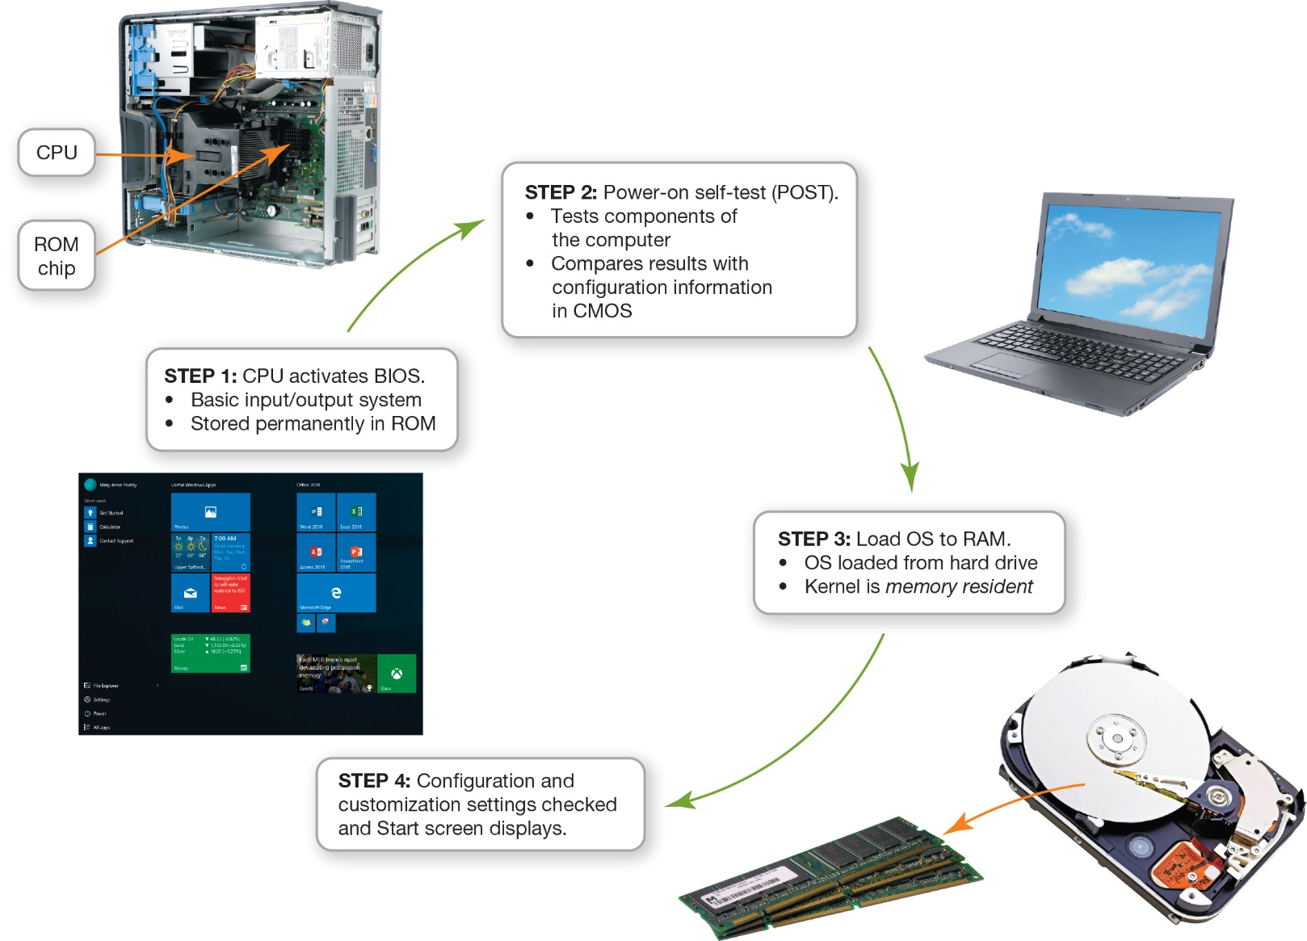
Starting Your Computer
The Boot Process (1 of 3)
(Objective 5.7)
Notes:
The boot process consists of four basic steps.

Slide 17
Starting Your Computer
The Boot Process (2 of 3)
(Objective 5.7)
Step 1: Activating BIOS
  Manages the exchange of data between the OS and the input and output devices
  BIOS is also responsible for loading the OS into RAM
Step 2: Performing the Power-On Self-Test
  Ensures that essential peripheral devices are attached and operational
Notes:
Step 1: Activating BIOS
This manages the exchange of data between the OS and the input and output devices.
BIOS is also responsible for loading the OS into RAM.
Step 2: Performing the Power-On Self-Test
This ensures that essential peripheral devices are attached and operational.

Slide 18
Starting Your Computer
The Boot Process (3 of 3)
(Objective 5.7)
Step 3: Loading the OS
  System files loaded into RAM
  Kernel, essential component of the OS, is then loaded
Step 4: Checking Further Configurations and Customizations
  Registry contains configurations used by the OS and applications
Notes:
Step 3: Loading the OS
System files are loaded into RAM.
The kernel, the essential component of the OS, is then loaded.
Step 4: Checking Further Configurations and Customizations
The registry contains configurations used by the OS and applications.

Slide 19
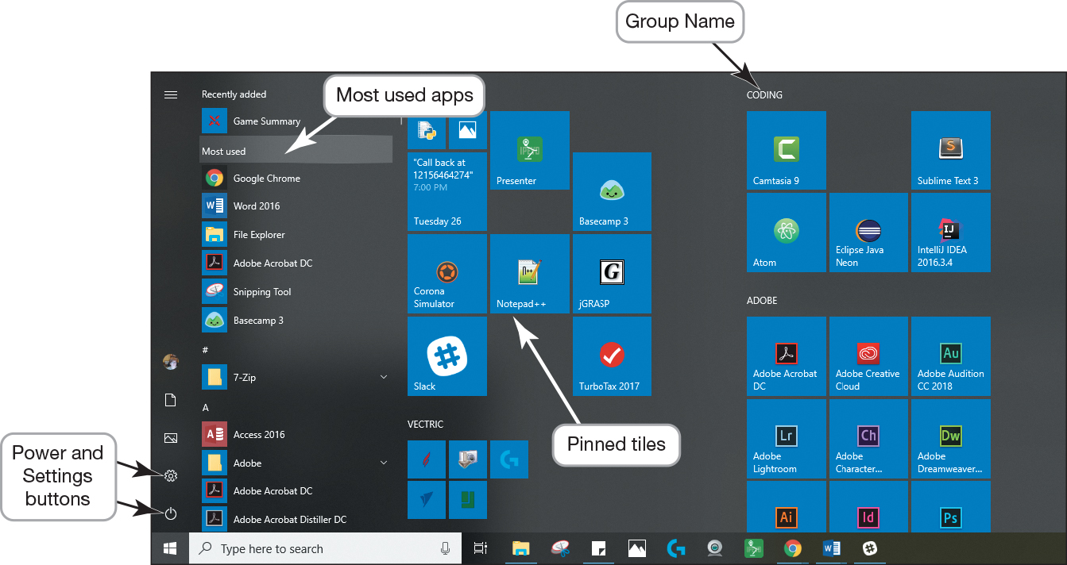
The Windows Interface
Using Windows 10 (1 of 2)
(Objective 5.8)
Desktop
  Primary working
  area
Taskbar
  Displays open
  and favorite applications for easy access
Start menu
  Provides access to all applications and apps installed on your device
Notes:
The desktop is the primary working area on the computer.
The taskbar displays open and favorite applications for easy access.
The Start menu provides access to all applications and apps installed on your device.

Slide 20
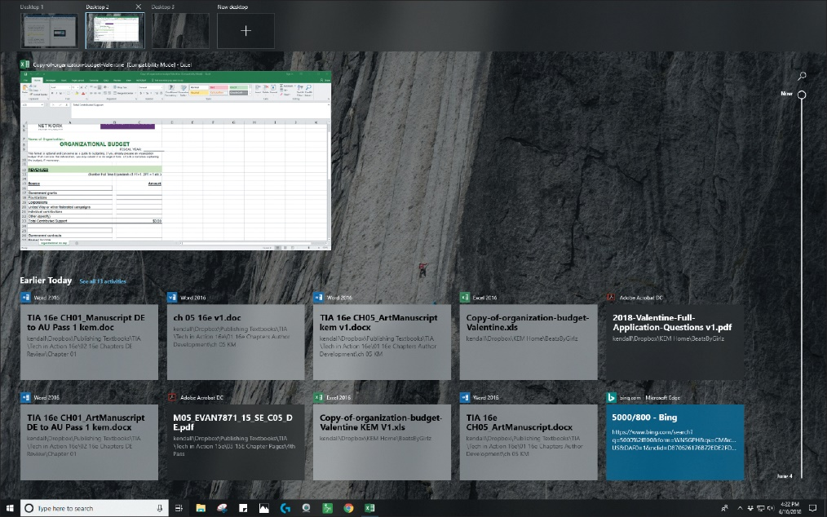
The Windows Interface
Using Windows 10 (2 of 2)
(Objective 5.8)
Pinning
  Choosing which applications are tiles on the Start menu
Virtual desktops
  Allow you to organize
  groups of windows
  into different displays
Notes:
Pinning is the process of choosing which applications are tiles on the Start menu.
Virtual desktops allow you to organize groups of windows into different displays.

Slide 21
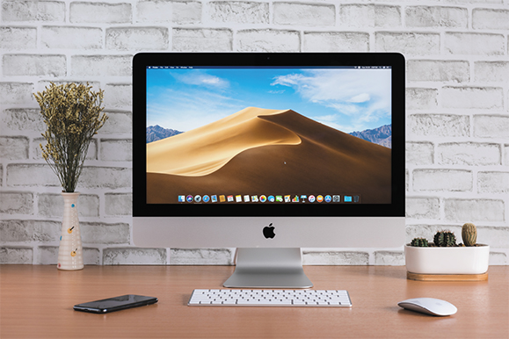
The Windows Interface
User Interfaces for Other OSs (1 of 2)
(Objective 5.8)
macOS and Windows
  Not compatible with each other
  Similar in functionality
Notes:
Although the macOS and the Windows operating systems aren’t compatible, they’re extremely similar in terms of functionality.

Slide 22
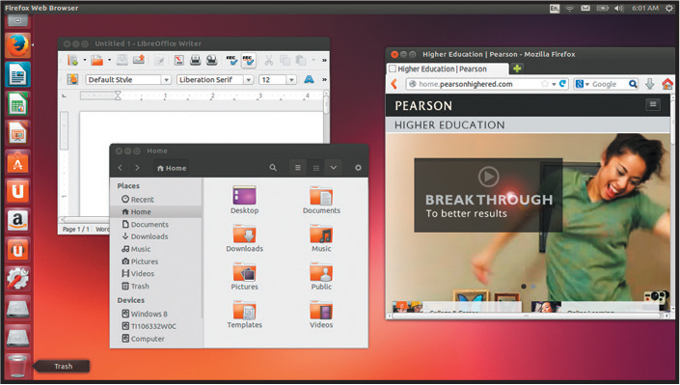
The Windows Interface
User Interfaces for Other OSs (2 of 2)
(Objective 5.8)
Linux
  Most interfaces are based on familiar Windows and macOS paradigms
Notes:
Different versions of Linux feature different user interfaces, but most of them, like Ubuntu, are based on familiar Windows and macOS paradigms such as using icons to launch programs and having apps run in a window environment.

Slide 23
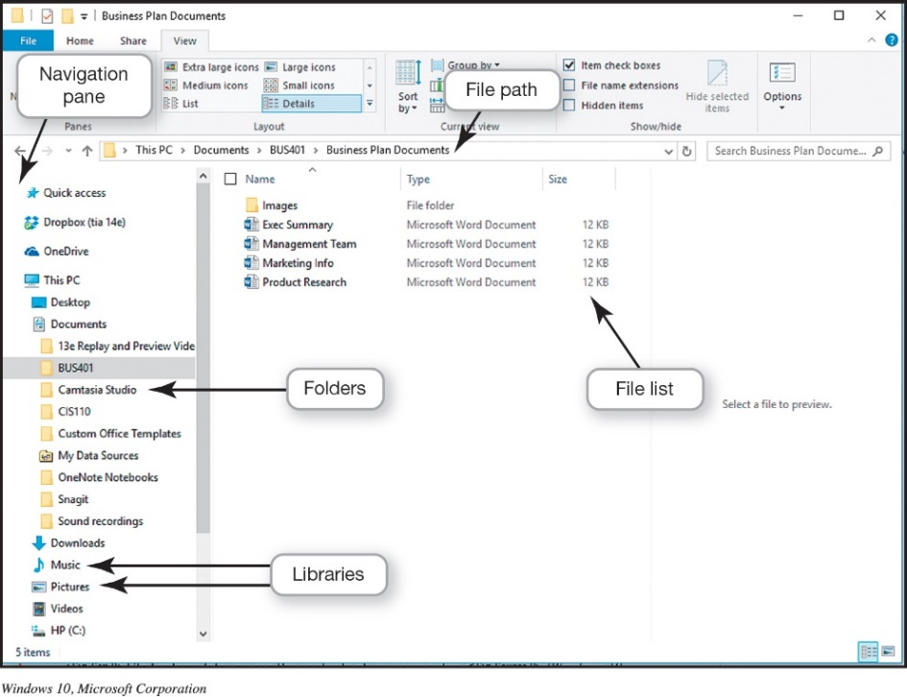
File Management
Organizing Your Files (1 of 8)
(Objective 5.9)
Directory
  Hierarchical structure of the computer’s contents
    Drives
    Libraries
    Folders
    Subfolders
    Files
  Root directory (C:)
    Top of the filing structure
Notes:
An additional function of the OS is to enable file management, which provides an organizational structure to the computer’s contents.
Windows organizes your computer in a hierarchical directory structure composed of drives, libraries, folders, subfolders, and files.
The C: drive is like a large filing cabinet in which all files are stored. The C: drive is the top of the filing structure of your computer, referred to as the root directory.

Slide 24
File Management
Organizing Your Files (2 of 8)
(Objective 5.9)
File
  Collection of program instructions or data
  Treated as a single unit
  Stored on permanent storage device
Folder—collection of files
Notes:
In an OS, a file is a collection of program instructions or data that is stored and treated as a single unit.
A folder is a collection of files.

Slide 25
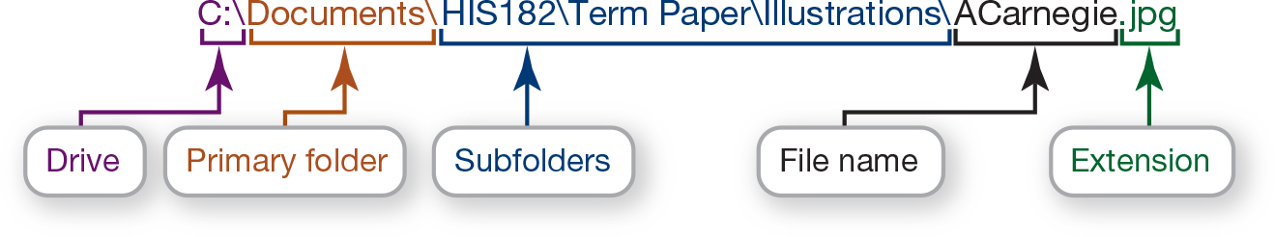
File Management
Organizing Your Files (3 of 8)
(Objective 5.9)
File path
  Windows—backslash \
  Linux—forward slash /
  macOS—colon:
Notes:
The location of a file is determined by its file path. When specifying the path, Windows uses the backslash (\), Linux uses the forward slash (/), and macOS uses the colon (:).

Slide 26
File Management
Organizing Your Files (4 of 8)
(Objective 5.9)
File Explorer
  Main tool for finding, viewing, and managing computer contents
  Shows the location and contents of every drive, folder, and file
Notes:
In Windows, File Explorer is the main tool for finding, viewing, and managing the contents of your computer. It shows the
location and contents of every drive, folder, and file.

Slide 27
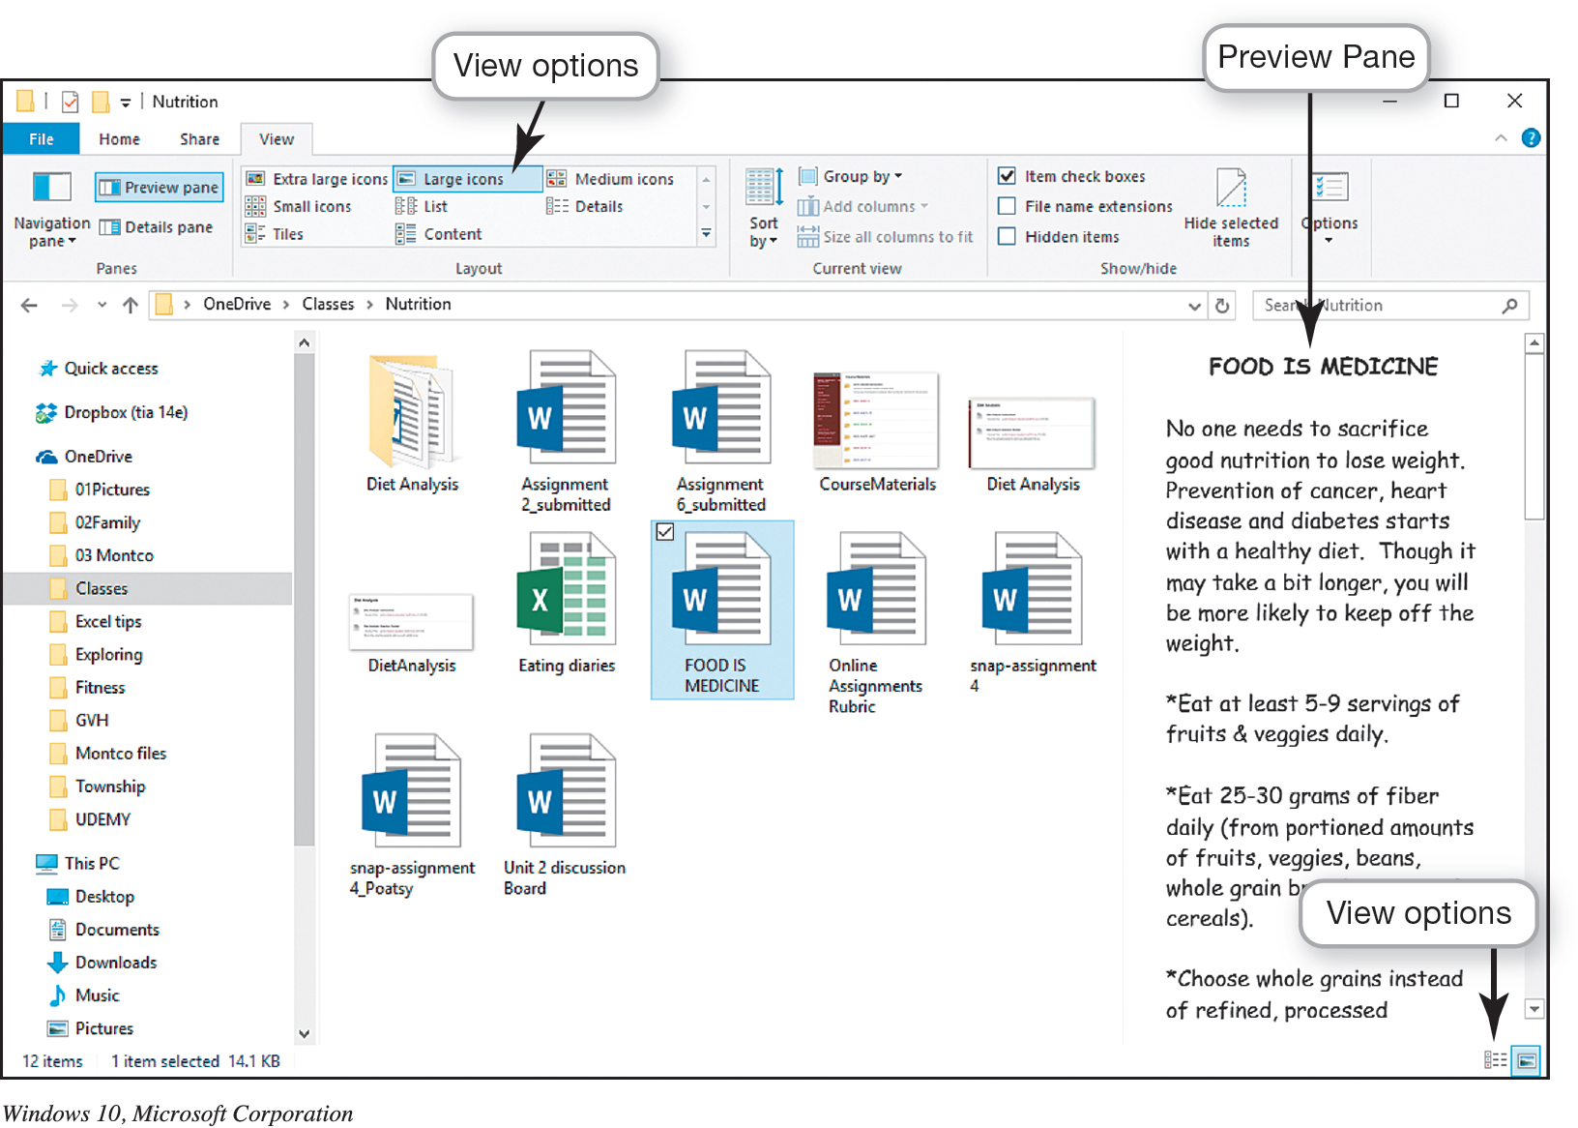
File Management
Organizing Your Files (5 of 8)
(Objective 5.9)
Notes:
This figure illustrates that the Large Icons view is a good way to display the contents of files and folders. The Preview pane on the right lets you see the first page of your document without first opening it. Large Icons is a good way to view files and folders, especially images.

Slide 28
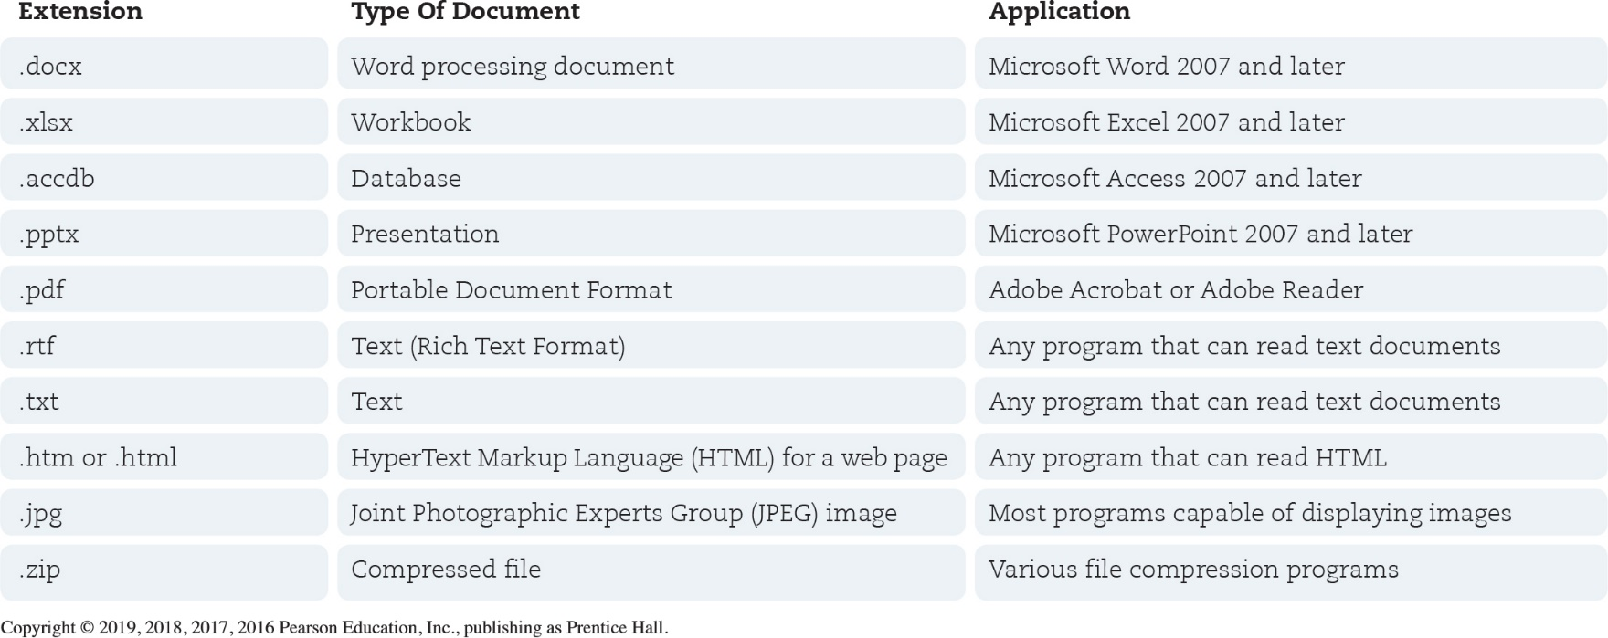
File Management
Organizing Your Files (6 of 8)
(Objective 5.9)
Naming files
  File name
  Extension (file type)
Notes:
The first part of a file, or the file name, is generally the name you assign to the file when you save it.
In a Windows application, an extension, or file type, follows the file name and a period or dot (.).
The table lists some common file extensions and the types of documents they indicate.

Slide 29
File Management
Organizing Your Files (7 of 8)
(Objective 5.9)
Copying, moving, and deleting files
  Open
  Copy
  Cut
  Rename
  Delete
  Recycle bin
Notes:
You can perform many file management actions.
You can open a file by double-clicking the file from its storage location.
You can copy a file to another location using the Copy command.
To move a file from one location to another, use the Cut command.
You can rename a file.
You can delete files or folders.
The Recycle Bin is represented by an icon that looks like a recycling bin, where files deleted from the hard drive reside until you permanently purge them from your system.

Slide 30
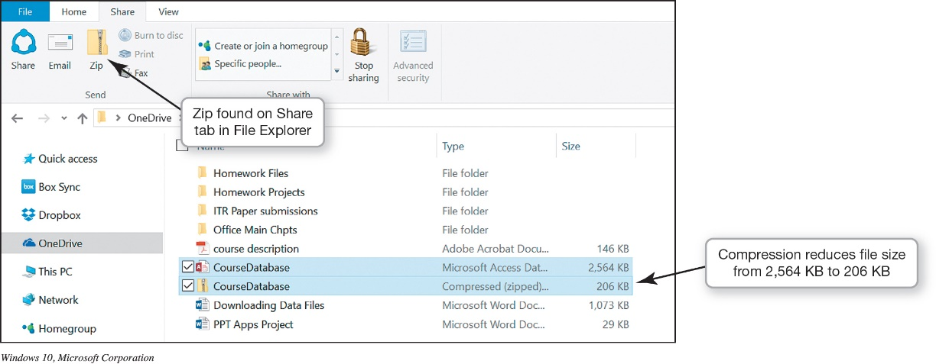
File Management
Organizing Your Files (8 of 8)
(Objective 5.9)
File compression utility
  Make a large file more compact
  Easier and faster
  to send files
  Built-in file
  compression
Notes:
File compression makes a large file more compact, making it easier and faster to send large attachments by e-mail, upload them to the web, or save them to a disc.
Windows has a built-in file compression utility that takes out redundancies in a file to reduce the file size. You can also obtain several standalone freeware and shareware programs, such as WinZip and StuffIt, to compress your files.

Slide 31
Utility Programs
Windows Administrative Utilities (1 of 4)
(Objective 5.10)
Utility programs
  Incorporated into the operating system
    Firewall and file-compression utilities
  Standalone utility programs
    Antivirus and security programs
    Freeware
Notes:
Utility programs are small applications that perform special functions and come in three flavors:
Those that are included with the OS.
Those sold as standalone programs.
Those offered as freeware—anti-malware software like Ad-Aware from Lavasoft.
In general, the basic utilities designed to manage and tune the computer hardware are incorporated into the operating system.
The standalone utility programs typically offer more features or an easier user interface for backup, security, diagnostic, or recovery functions.

Slide 32
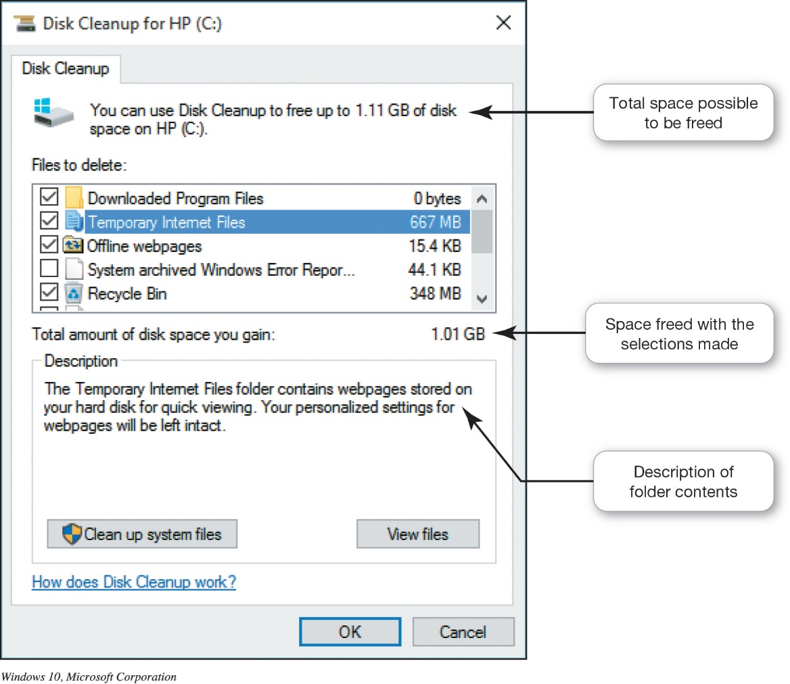
Utility Programs
Windows Administrative Utilities (2 of 4)
(Objective 5.10)
System performance utilities
  Disk Cleanup
  Task Manager
  Disk
  Defragmenter
Notes:
Disk Cleanup removes unnecessary files from your hard drive.
If a program has stopped working, you can use the Windows Task Manager utility to check on the program or to exit the nonresponsive program.
Disk defragmentation rearranges fragmented data so that related file pieces are unified.

Slide 33
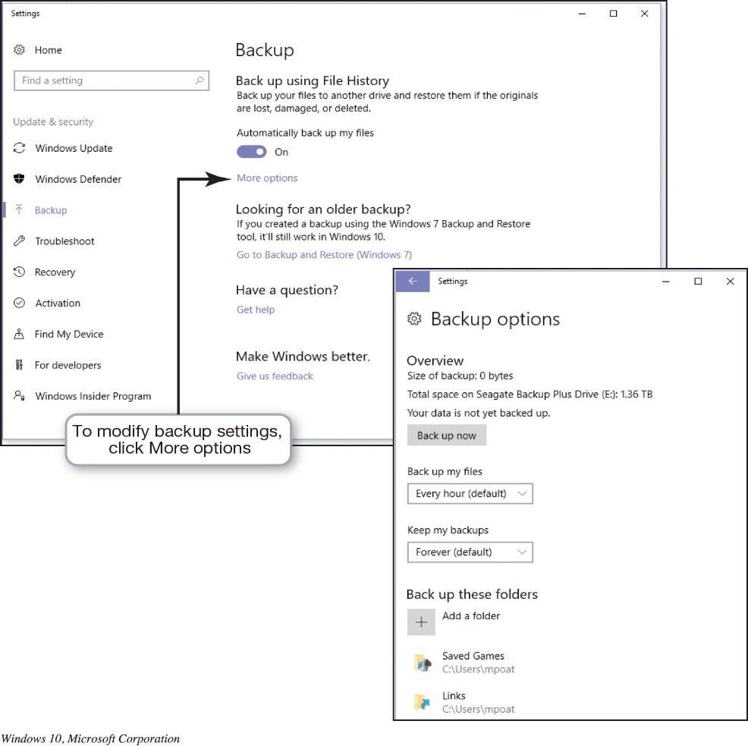
Utility Programs
Windows Administrative Utilities (3 of 4)
(Objective 5.10)
File and system backup utilities
  File History
  System Restore
Notes:
When you use the File History utility, you can have Windows automatically create a duplicate of your libraries, desktop, contacts, and favorites and copy it to another storage device.
Windows has a utility called System Restore that lets you roll your system settings back to a specific date when everything was working properly.

Slide 34
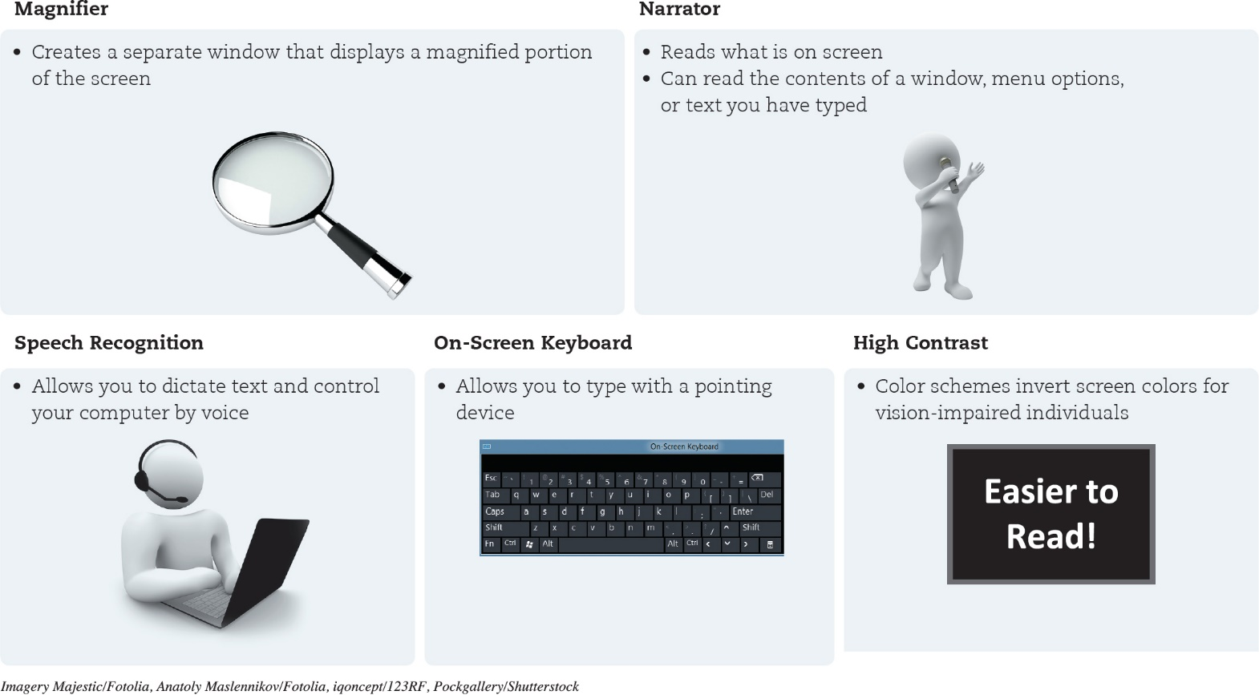
Utility Programs
Windows Administrative Utilities (4 of 4)
(Objective 5.10)
Accessibility utilities
  Designed for users with special needs
Notes:
Microsoft Windows includes Ease of Access settings, which is a centralized location for assistive technology and tools to adjust accessibility settings.
In Ease of Access, you can find tools to help users with disabilities. If you’re not sure where to start or what settings might help, a questionnaire asks you about routine tasks and provides a personalized recommendation for settings that will allow you to better use your computer.

Slide 35

Copyright
All rights reserved. No part of this publication may be reproduced, stored in a retrieval system, or transmitted, in any form or by any means, electronic, mechanical, photocopying, recording, or otherwise, without the prior written permission of the publisher. Printed in the United States of America.

