Slide 1
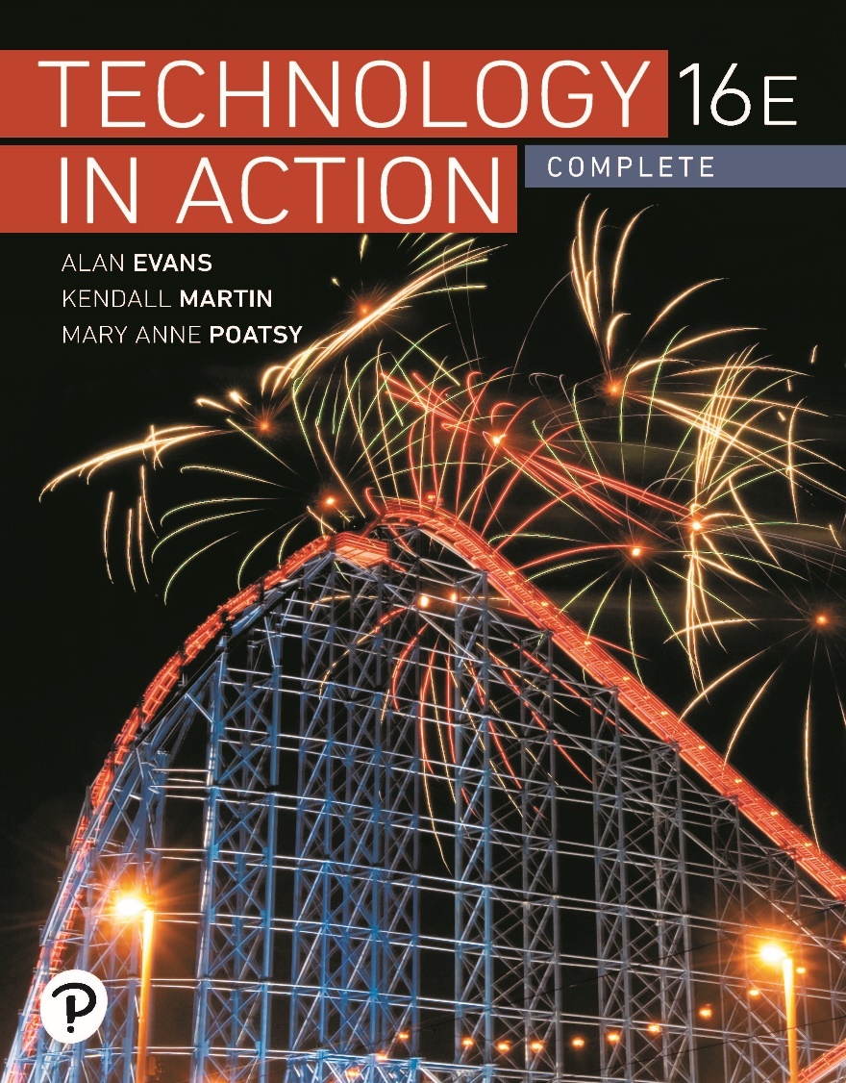
Technology in Action
16th Edition
Chapter 6
Understanding and Assessing Hardware: Evaluating Your System

Slide 2
Learning Objectives (1 of 2)
6.1 Describe the changes in CPU performance over the past several decades.
6.2 Compare and contrast a variety of computing devices.
6.3 Describe how a CPU is designed and how it operates.
6.4 Describe tools used to measure and evaluate CPU performance.
6.5 Discuss how RAM is used in a computer system.
6.6 Evaluate whether adding RAM to a system is desirable.
Notes:
The learning objectives are:
6.1 Describe the changes in CPU performance over the past several decades.
6.2 Compare and contrast a variety of computing devices.
6.3 Describe how a CPU is designed and how it operates.
6.4 Describe tools used to measure and evaluate CPU performance.
6.5 Discuss how RAM is used in a computer system.
6.6 Evaluate whether adding RAM to a system is desirable.

Slide 3
Learning Objectives (2 of 2)
6.7 Classify and describe the major types of nonvolatile storage drives.
6.8 Evaluate the amount and type of storage needed for a system.
6.9 Describe the features of video cards.
6.10 Describe the features of sound cards.
6.11 Describe steps you can take to optimize your system’s reliability.
6.12 Discuss how to recycle, donate, or dispose of an older computer.
Notes:
Additional learning objectives are:
6.7 Classify and describe the major types of nonvolatile storage drives.
6.8 Evaluate the amount and type of storage needed for a system.
6.9 Describe the features of video cards.
6.10 Describe the features of sound cards.
6.11 Describe steps you can take to optimize your system’s reliability.
6.12 Discuss how to recycle, donate, or dispose of an older computer.

Slide 4
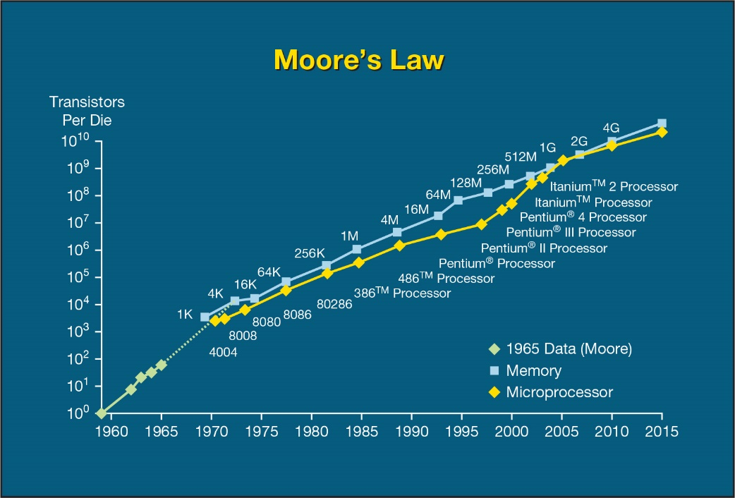
Your Ideal Computing Device
Moore’s Law
(Objective 6.1)
New technologies emerge quickly
Things to consider
  Speed
  Moore’s Law
  System components
    DRAM
    Hard drive
Notes:
New technologies emerge so quickly, there never seems to be a perfect time to buy a new computer.
A rule of thumb, called Moore’s Law, describes the pace at which central processing units improve. This rule predicts that CPU capacity will double about every two years.
Dynamic random access memory (DRAM) increases about 60% every year, and hard drives have been growing in storage capacity by some 50 percent each year.

Slide 5
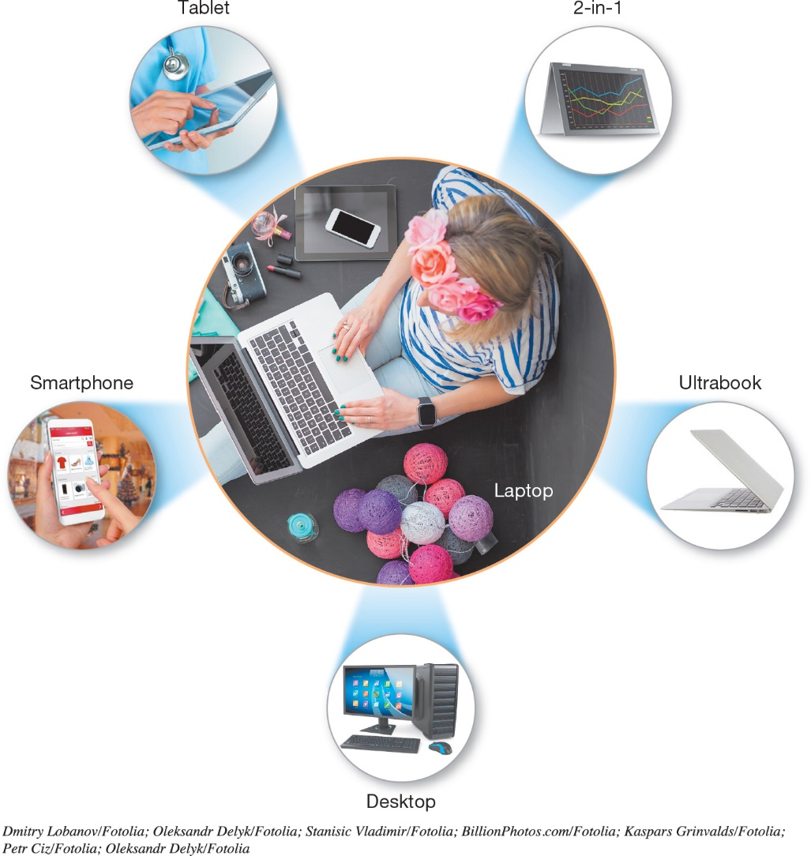
Your Ideal Computing Device
Selecting a Computing Device
(Objective 6.2)
Large number of choices
  Smartphones
  Tablets
  Ultrabooks
  2-in-1s
  Laptops
  Desktops
Notes:
How do you know what’s best for you? A large number of choices are on the market:
Smartphones
Tablets
Ultrabooks
2-in-1s
Laptops
Desktops

Slide 6
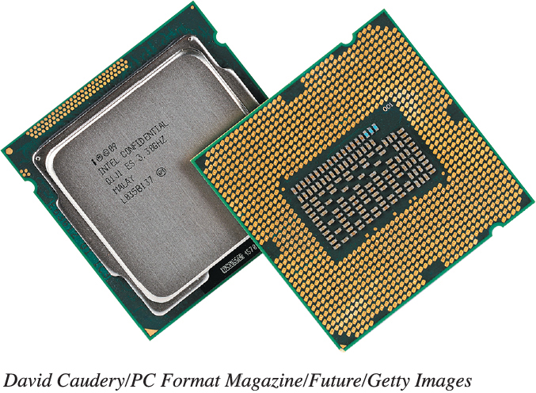
Evaluating the CPU Subsystem
How the CPU Works (1 of 6)
(Objective 6.3)
The CPU
  Located on motherboard
  Processes instructions
  Performs calculations
  Manages the flow of information
  Intel and AMD processors
Notes:
The CPU is located on the system motherboard and is responsible for processing instructions, performing calculations, and managing the flow of information through your computer. The dominant processors on the market are sold by Intel and AMD.

Slide 7
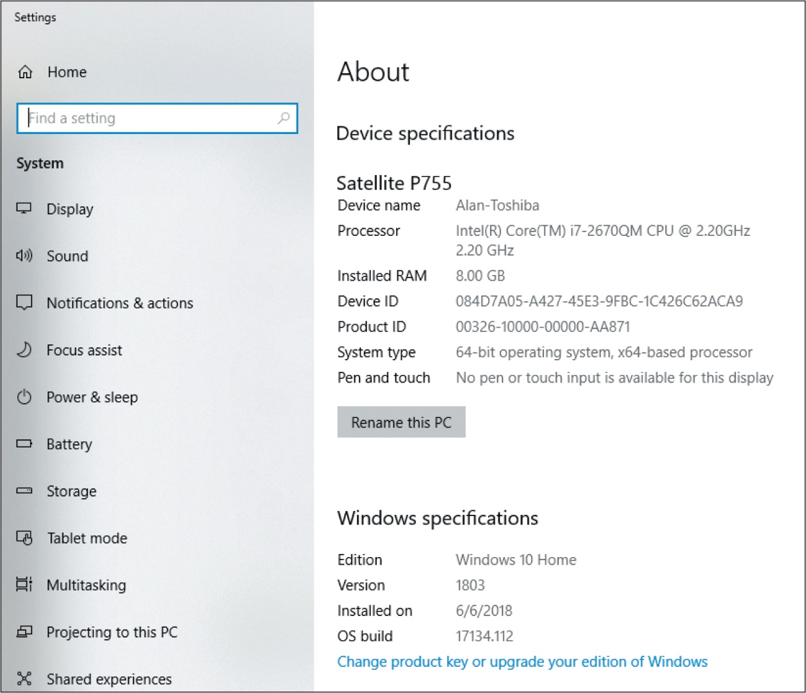
Evaluating the CPU Subsystem
How the CPU Works (2 of 6)
(Objective 6.3)
Notes:
If you have a PC, the System window will show you the type of CPU you have installed.

Slide 8
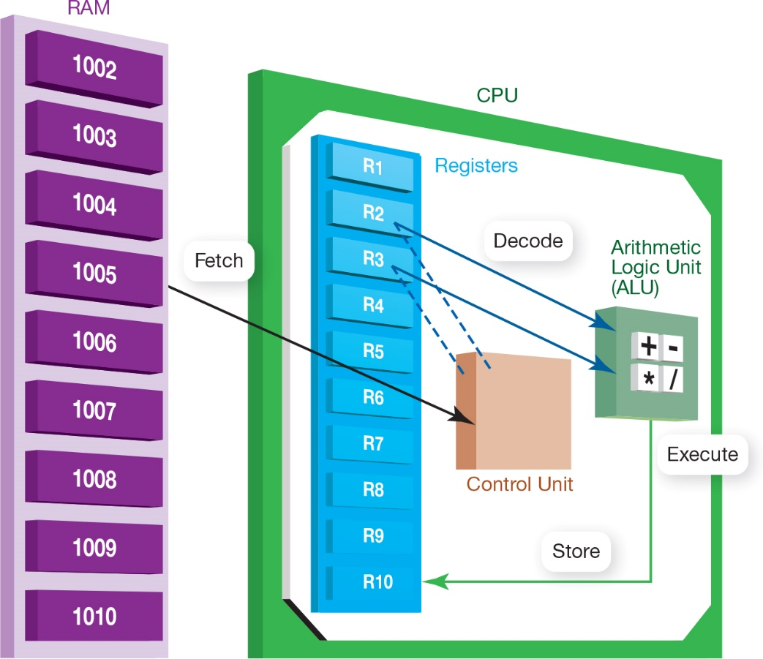
Evaluating the CPU Subsystem
How the CPU Works (3 of 6)
(Objective 6.3)
Machine cycle
  Fetch
  Decode
  Execute
  Store
Two units
  Control unit
  Arithmetic logic
  unit (ALU)
Notes:
When the CPU performs a program instruction, it goes through the same steps:
It fetches the required piece of data or instruction from RAM.
It decodes the instruction into something the computer can understand.
It executes the instruction.
It stores the result to RAM before fetching the next instruction.
This process is called a machine cycle.
The CPU is composed of two units: the control unit and the arithmetic logic unit.

Slide 9
Evaluating the CPU Subsystem
How the CPU Works (4 of 6)
(Objective 6.3)
CPU’s processing power
  Clock speed
  Overclocking
  Cores
  Parallel processing
  Cache memory
Notes:
A CPU’s processing power is determined by:
Clock speed
Number of cores
Parallel processing
Amount of cache memory
The clock speed dictates how many instructions the CPU can process each second.
Overclocking means that you run the CPU at a faster speed than the manufacturer recommends.

Slide 10
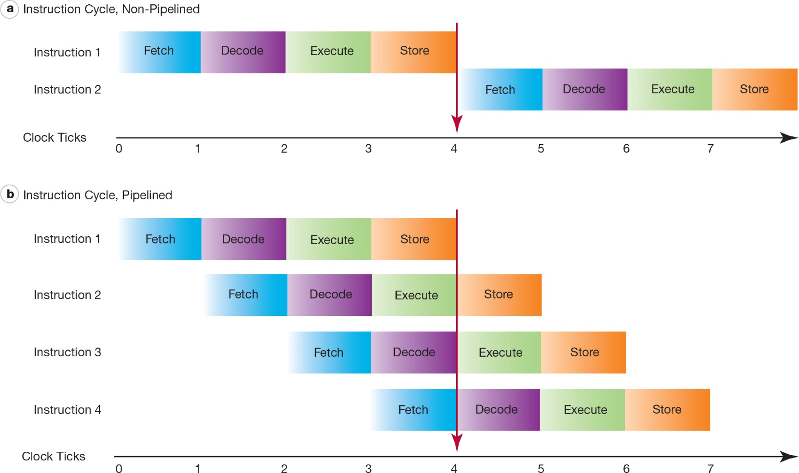
Evaluating the CPU Subsystem
How the CPU Works (5 of 6)
(Objective 6.3)
Notes:
Pipelining is a technique that allows the CPU to work on more than one instruction at the same time.

Slide 11
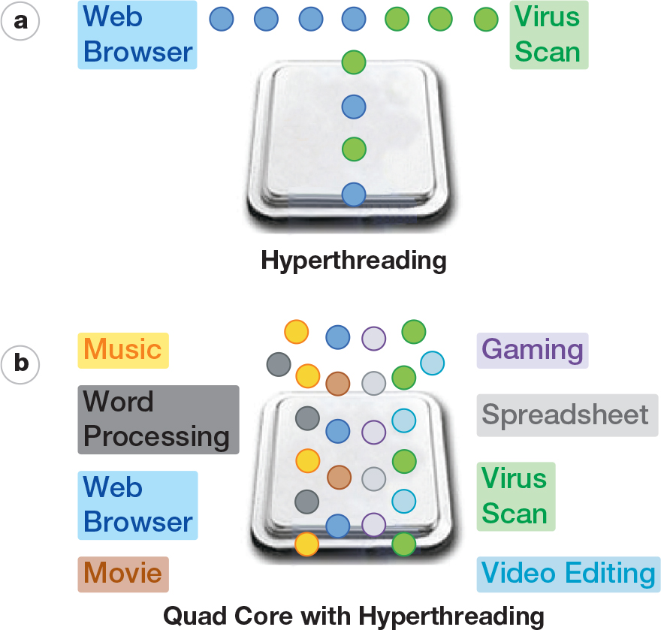
Evaluating the CPU Subsystem
How the CPU Works (6 of 6)
(Objective 6.3)
Notes:
Hyperthreading provides quicker processing of information by enabling a new set of instructions in a different program (or thread) to start executing before the previous set has finished.

Slide 12
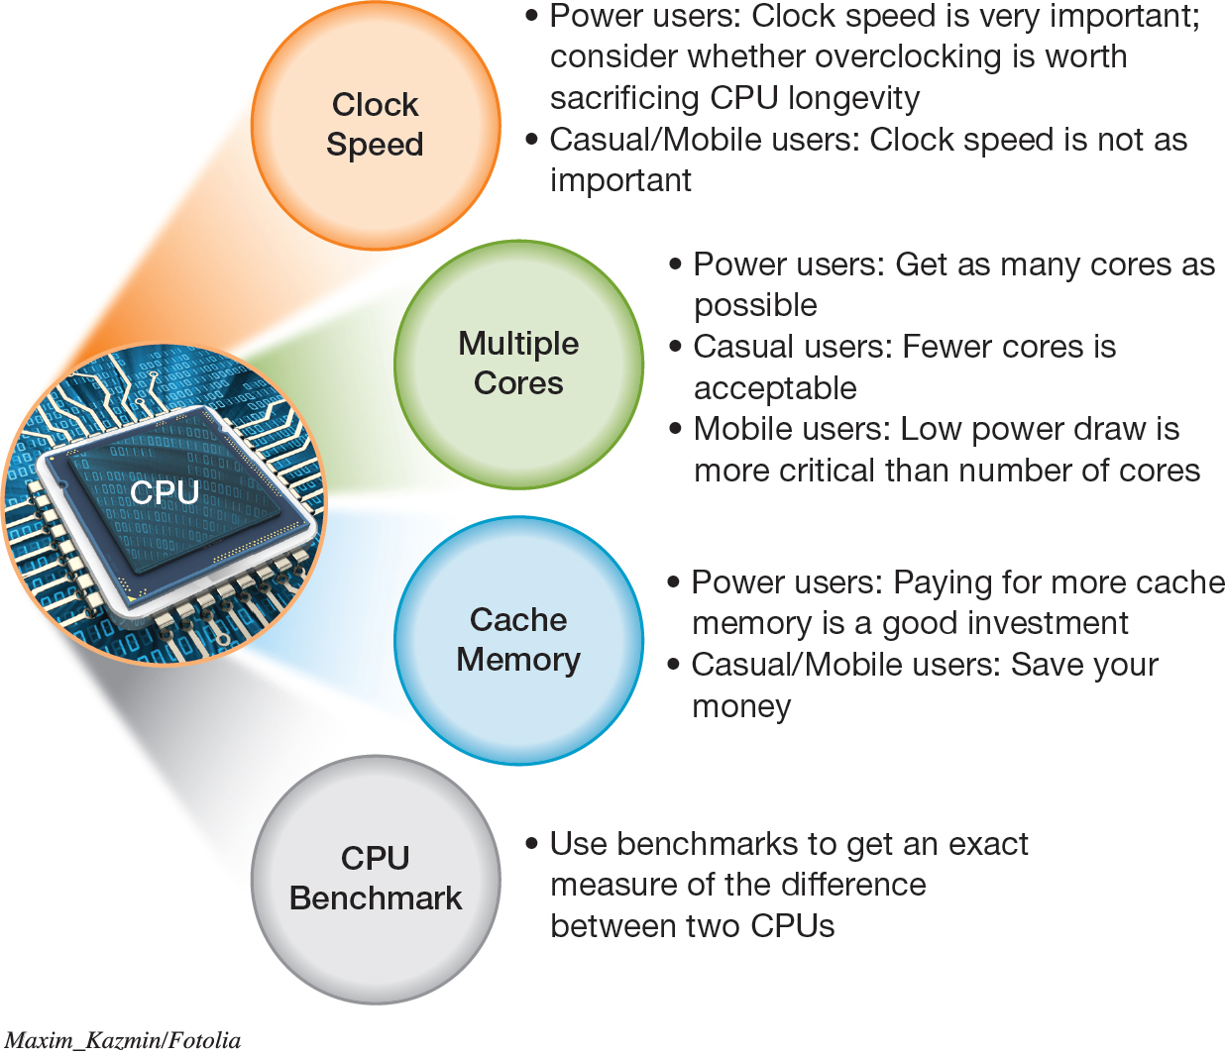
Evaluating the CPU Subsystem
Measuring CPU Performance
(Objective 6.4)
Notes:
Factors to consider as you decide which specific CPU is right for you.

Slide 13
Evaluating the Memory Subsystem
Random Access Memory (1 of 4)
(Objective 6.5)
Random access memory (RAM)
  Short-term memory storage
  Volatile storage
Read-only memory (ROM)
  Critical startup instructions
  Nonvolatile storage
Notes:
Random access memory is your computer’s temporary storage space. Although RAM is a form of storage, it really is the computer’s short-term memory.
RAM is an example of volatile storage. When the power is off, the data stored in RAM is cleared out. In addition to RAM, systems always include nonvolatile storage devices for permanent storage of instructions and data. Read-only memory holds critical start-up instructions. Hard drives provide the largest nonvolatile storage capacity.

Slide 14
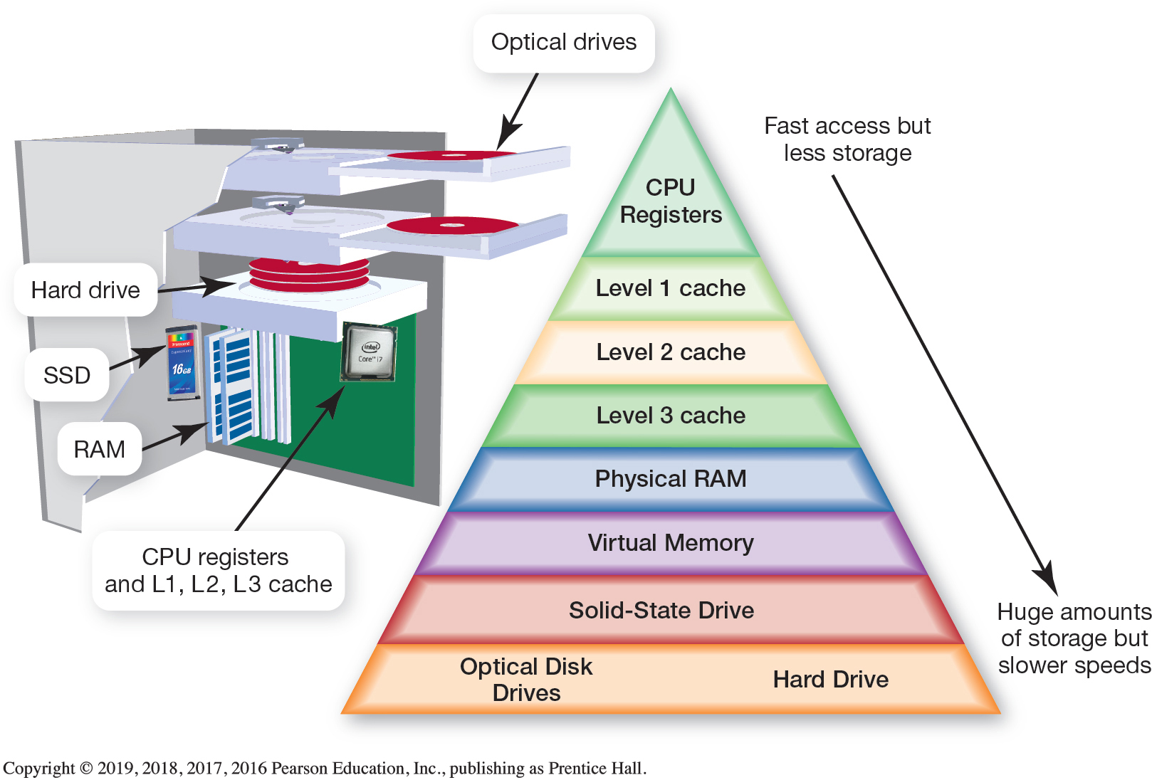
Evaluating the Memory Subsystem
Random Access Memory (2 of 4)
(Objective 6.5)
Notes:
It’s one million times faster to retrieve data from RAM than from a hard drive. This time is measured in nanoseconds, whereas pulling data from a hard drive takes an average of 10 milliseconds.
The figure shows the types of memory and storage in your system. Each of these has its own tradeoff of speed versus price.
Because the fastest memory is more expensive, systems are designed with much less of it.

Slide 15
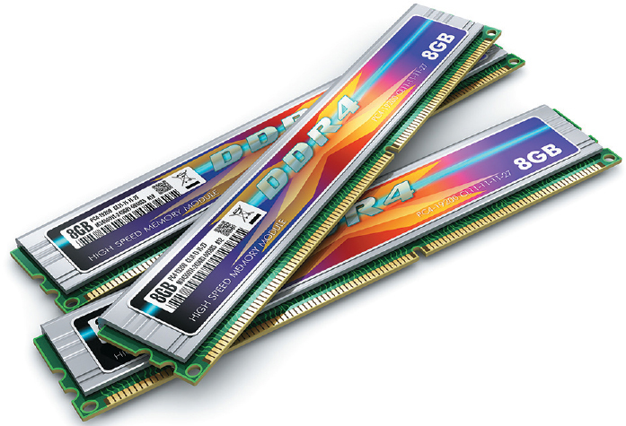
Evaluating the Memory Subsystem
Random Access Memory (3 of 4)
(Objective 6.5)
Types of RAM
  Double data rate 3 (DDR3)
  Double data rate 4 (DDR4)
  Double data rate 5 (DDR5)
Memory modules
Dual inline memory modules (DIMMs)
Notes:
There are different types of RAM. In most systems, the type of RAM used is double data rate 3 (DDR3) memory modules, which is available in several speeds. The higher the speed, the better the performance. DDR5 memory, which has an even faster data transfer rate, is seen in high-performance video graphics cards.
RAM appears in the system on memory modules, small circuit boards that hold RAM chips and fit into slots on the motherboard.
Today’s systems are dual inline memory modules (DIMMs), which are small circuit boards that hold several memory chips.

Slide 16
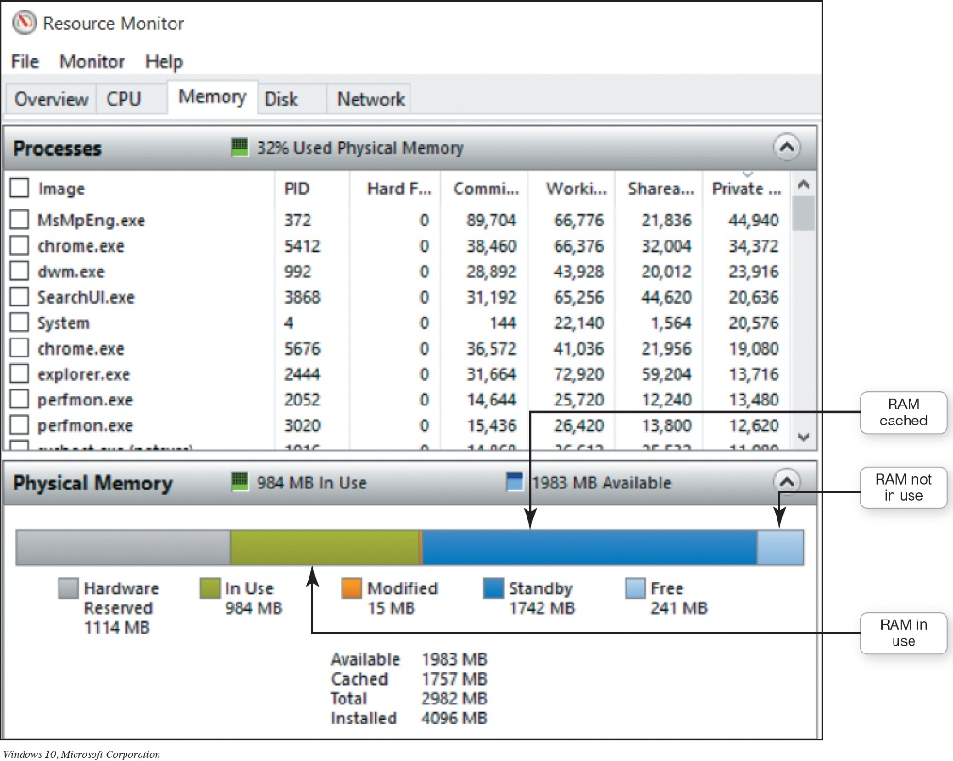
Evaluating the Memory Subsystem
Random Access Memory (4 of 4)
(Objective 6.5)
SuperFetch
  Preloads often used programs into system memory
Resource monitor
  Displays how computer
  resources are being used
Notes:
SuperFetch, a feature of Windows, preloads often used programs into system memory.
The resource monitor shows you how your RAM is being used.

Slide 17
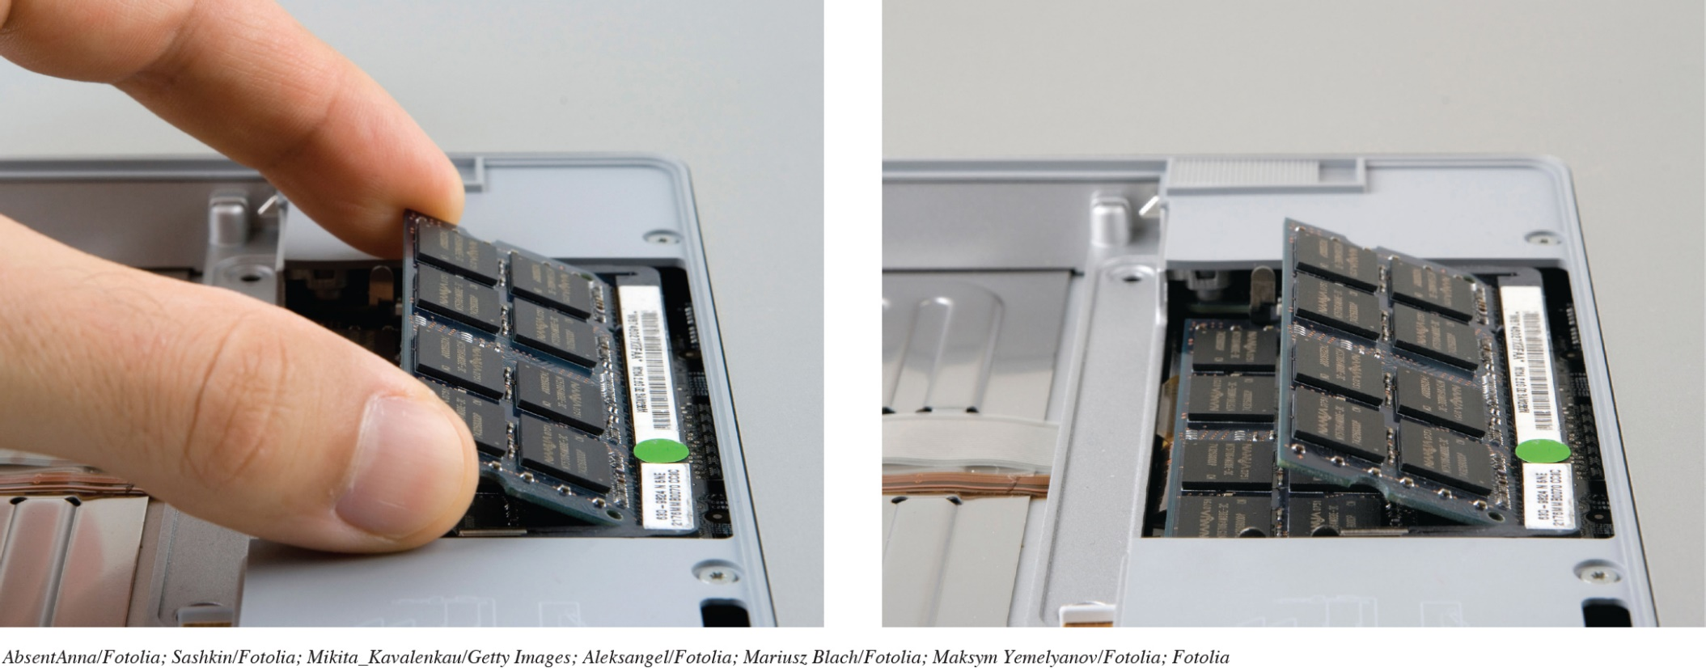
Evaluating the Memory Subsystem
Adding RAM
(Objective 6.6)
Limited to motherboard’s capacity
Easy to install
Notes:
Adding RAM is limited to the motherboard’s capacity in how many slots are available and the total capacity of each slot.
RAM is fairly easy to install.

Slide 18
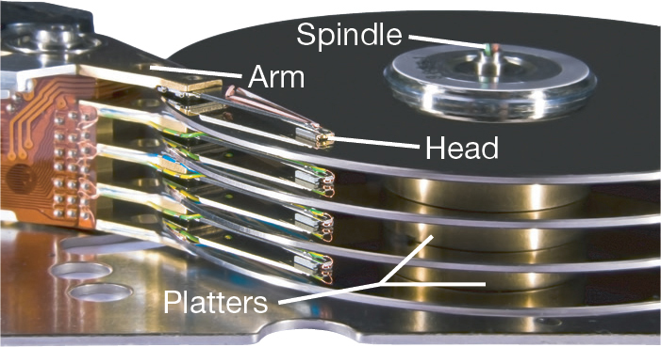
Evaluating the Storage Subsystem
Types of Storage Drives (1 of 2)
(Objective 6.7)
Mechanical hard drives
  Coated platters stacked on a spindle
  Data saved as pattern of magnetized spots of 1s and 0s
  Access time is the time
  it takes to find the data
  and make it available
Notes:
A hard drive has several coated, round, thin plates of metal stacked on a spindle. Each plate is called a platter.
When data is saved, a pattern of magnetized spots is created. When the spots are aligned in one direction, they represent a 1; when aligned in the other direction, they represent a 0.
These are the smallest pieces of data that computers can understand. Your computer translates these patterns of magnetized spots into data.
Access time is the amount of time it takes the drive to find the data and make it available for processing.

Slide 19
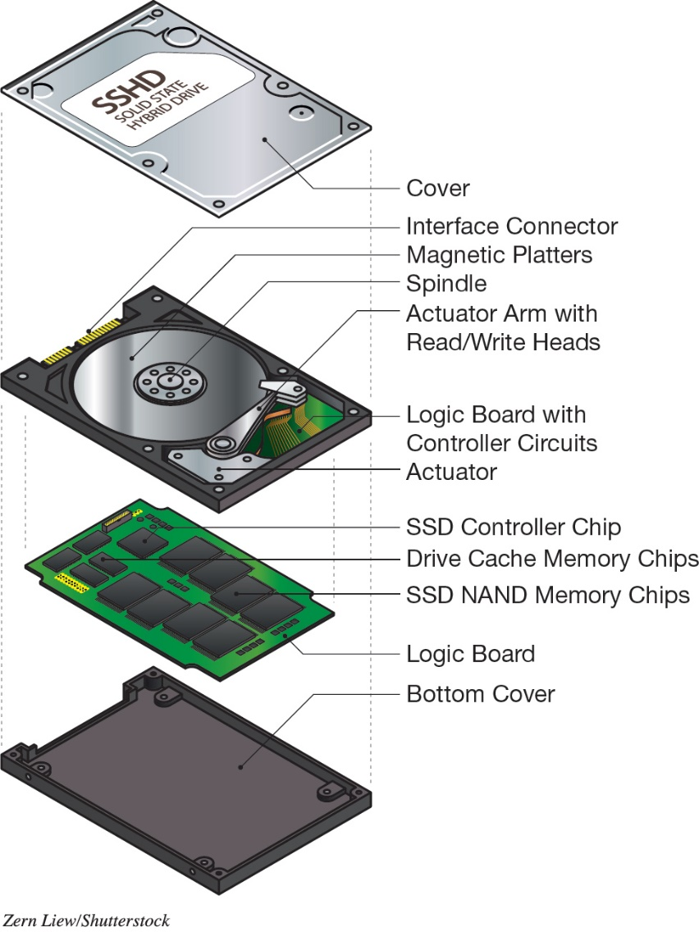
Evaluating the Storage Subsystem
Types of Storage Drives (2 of 2)
(Objective 6.7)
Solid state drives
  Fast access times
  Generate little heat
  Run with no noise
  Require little power
Solid state hybrid drives
Notes:
A solid-state drive (SSD) uses electronic memory and has no mechanical motors or moving parts. Having no mechanical motors allows SSDs to offer incredibly fast access times.
In addition, SSDs run with no noise, generate very little heat, and require very little power, making them a popular option in ultrabooks.
The SSHD drive is a single unit that contains both a SSD and a mechanical hard drive.

Slide 20
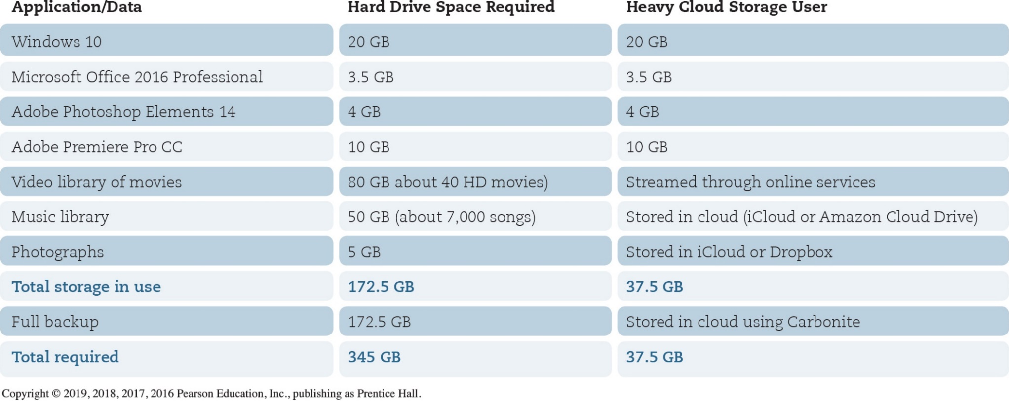
Evaluating the Storage Subsystem
Storage Needs (1 of 3)
(Objective 6.8)
Notes:
The table shows an example of storage calculation.

Slide 21
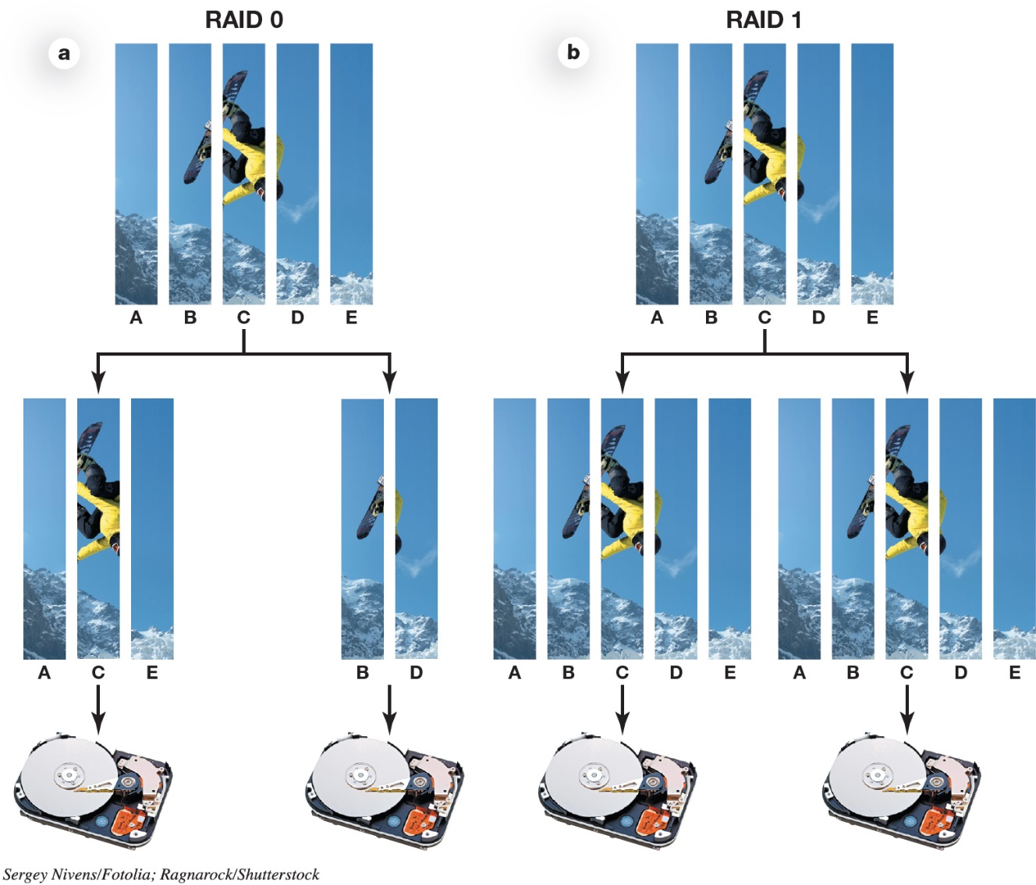
Evaluating the Storage Subsystem
Storage Needs (2 of 3)
(Objective 6.8)
Redundant array of independent disks (RAID)
  RAID 0
  RAID 1
Notes:
A redundant array of independent disks (RAID) is a set of strategies for using more than one drive in a system.
RAID 0 and RAID 1 are the most popular options for consumer machines.

Slide 22
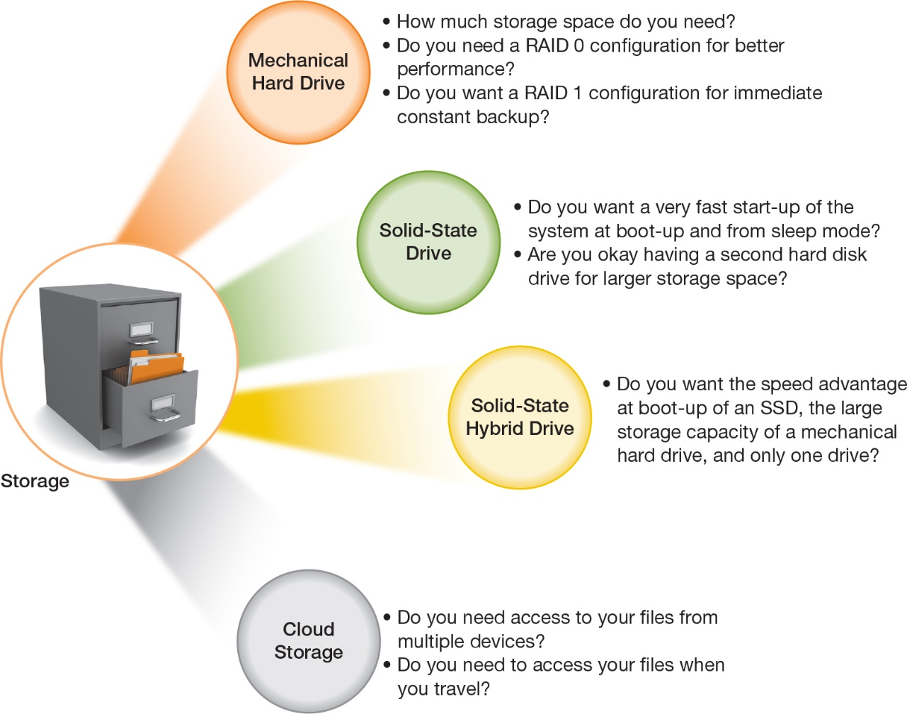
Evaluating the Storage Subsystem
Storage Needs (3 of 3)
(Objective 6.8)
Notes:
The figure summarizes the factors you should consider in evaluating your storage subsystem.

Slide 23
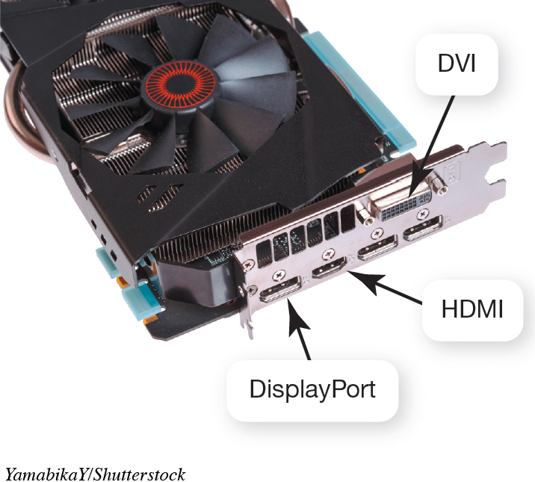
Evaluating the Media Subsystems
Video Cards (1 of 2)
(Objective 6.9)
Video display depends on two components
  Video card
  Monitor
Ports
  HDMI
  DVI
  DisplayPort adapter
Notes:
The way video is displayed depends on two components: your video card and your monitor.
Modern video cards let you connect video equipment using a number of different ports:
HDMI ports for high-definition TVs, Blu-ray players, or gaming consoles
DVI ports for digital LCD monitors
DisplayPort adapters, a newer style of port that can connect to digital monitors or projectors

Slide 24
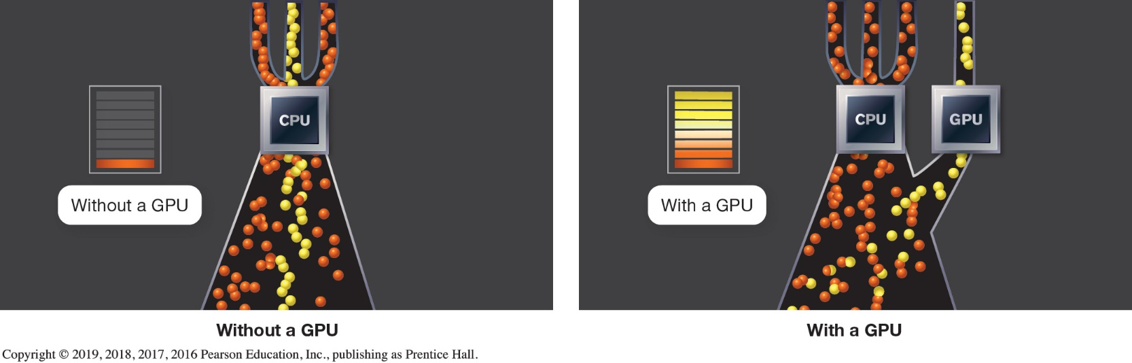
Evaluating the Media Subsystems
Video Cards (2 of 2)
(Objective 6.9)
Video memory
Screen Resolution
  Found in Advanced Display Settings
Graphics Processing Unit (GPU)
Notes:
Video systems include their own RAM, called video memory.
Information about your system’s video card is found in the Advanced Display Settings of the Screen Resolution window.
Displaying graphics demands a lot of computational work from the CPU. Video cards come with their own graphics processing unit (GPU).
The figure shows that the CPU can run much more efficiently when a GPU does all of the graphics computation.

Slide 25
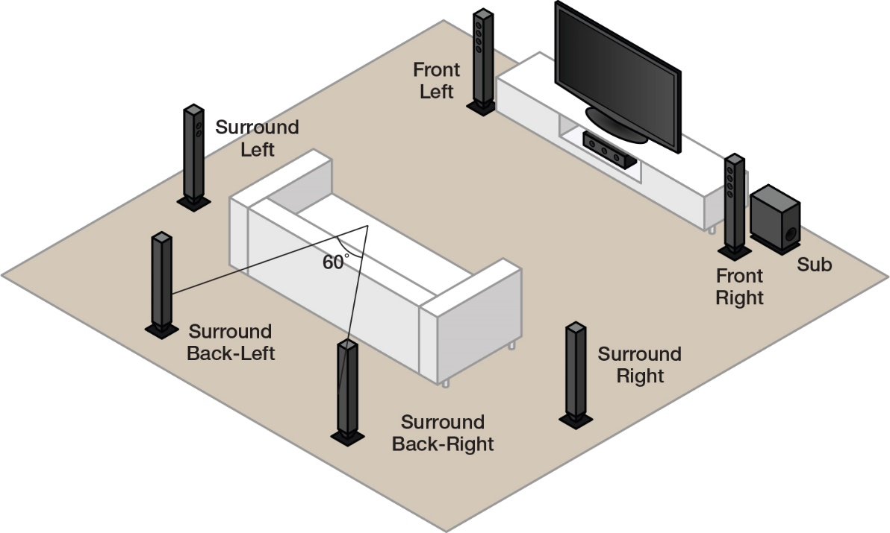
Evaluating the Media Subsystems
Sound Cards
(Objective 6.10)
Speakers and a sound card
3D sound technology
Surround sound
Dolby Digital 7.1
MIDI interface
Notes:
If you play games, music, and video, you might want to upgrade your speakers or sound card.
3D sound technology is better at convincing the human ear that sound is omnidirectional.
Surround sound makes the listener experience sound as if it were coming from all directions.
Dolby Digital 7.1 takes digital sound and reproduces it in eight channels—seven for the listening field, and the eighth for low-frequency sound, which is sent to a subwoofer.
MIDI is an electronics standard that allows different kinds of electronic instruments to communicate with each other and with computers.

Slide 26
Evaluating System Reliability and Moving on
Maintaining System Reliability (1 of 2)
(Objective 6.11)
Reliability
  Install antivirus program
  Install spyware and adware
  Clear out unnecessary files
  Run Disk Defragmenter
  Automate key utilities
Notes:
There are several important issues to consider to increase your system’s reliability:
Install an antivirus program.
Install a spyware and adware program.
Clear out unnecessary files.
Run Disk Defragmenter.
Automate key utilities.

Slide 27
Evaluating System Reliability and Moving on
Maintaining System Reliability (2 of 2)
(Objective 6.11)
System crashes
  Try System Restore
  Check amount of RAM
  Investigate any error codes
  Search with Google
  Consider Windows Reset
Notes:
If your system crashes you might:
Try System Restore.
Check amount of RAM.
Investigate any error codes.
Search with Google.
Consider a Windows Reset.

Slide 28
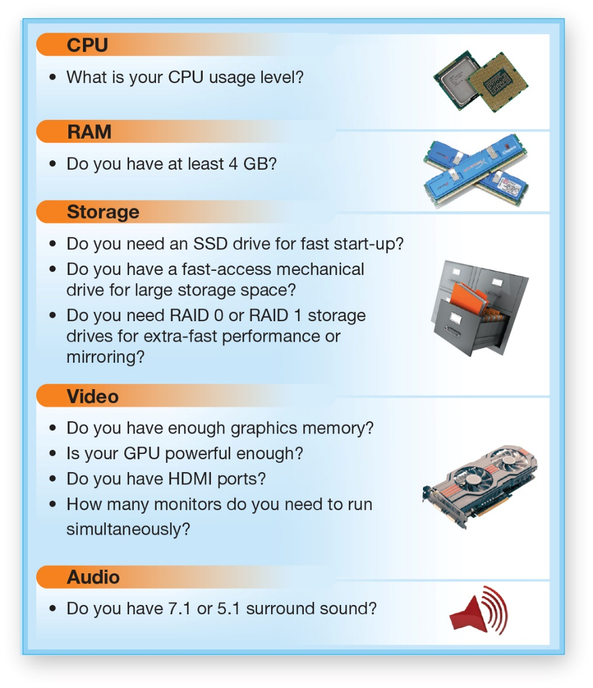
Evaluating System Reliability and Moving on
Getting Rid of Your Old Computer (1 of 2)
(Objective 6.12)
Notes:
When considering an upgrade or buying a new system, consider these factors.

Slide 29
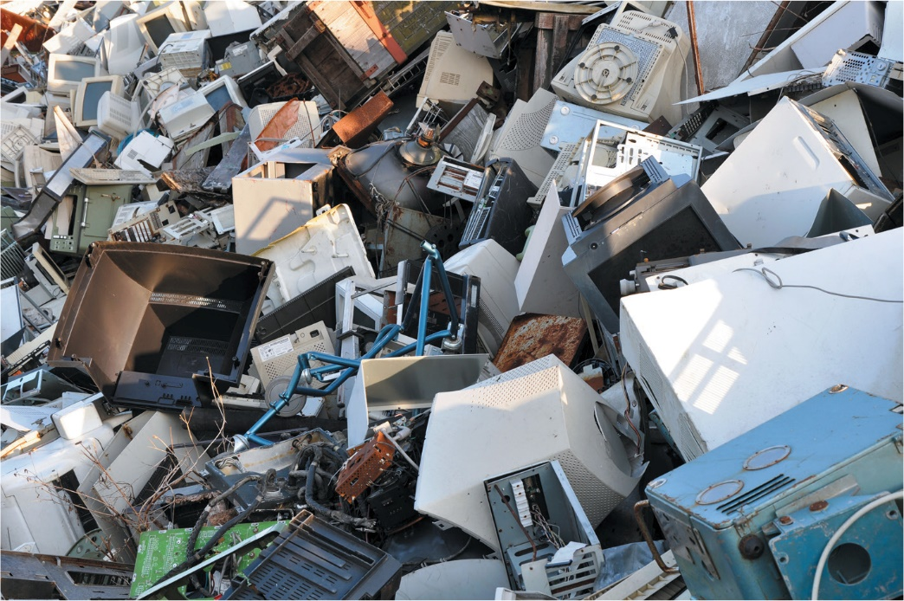
Evaluating System Reliability and Moving on
Getting Rid of Your Old Computer (2 of 2)
(Objective 6.12)
Benefits of maintaining two systems
Environmental impact
  Mercury
  Cadmium
Donate
  Remove all data
  before donating
Notes:
Before you get rid of your computer, be sure to consider what benefit you might obtain by having two systems.
Before throwing away a system, it is important to consider the environmental impact. Mercury in LCD screens and cadmium in batteries and circuit boards are all toxic.
An old system could be donated to a nonprofit organization.
Before donating or recycling a computer, make sure you carefully remove all data from your hard drive.

Slide 30

Copyright
All rights reserved. No part of this publication may be reproduced, stored in a retrieval system, or transmitted, in any form or by any means, electronic, mechanical, photocopying, recording, or otherwise, without the prior written permission of the publisher. Printed in the United States of America.

