Slide 1

Technology in Action
16th Edition
Chapter 7
Networking: Connecting Computing Devices

Slide 2
Learning Objectives (1 of 2)
7.1 Describe computer networks and their pros and cons.
7.2 Explain the different ways networks are defined.
7.3 Describe the types of transmission media used in networks.
7.4 Describe the basic hardware devices necessary for networks.
7.5 Describe the type of software necessary for networks.
7.6 Summarize the broadband options available to access the Internet.
Notes:
The learning objectives are:
7.1 Describe computer networks and their pros and cons.
7.2 Explain the different ways networks are defined.
7.3 Describe the types of transmission media used in networks.
7.4 Describe the basic hardware devices necessary for networks.
7.5 Describe the type of software necessary for networks.
7.6 Summarize the broadband options available to access the Internet.

Slide 3
Learning Objectives (2 of 2)
7.7 Summarize how to access the Internet wirelessly.
7.8 Explain what should be considered before creating a home network.
7.9 Describe how to set up a home network.
7.10 Describe the potential problems with wireless networks and the means to avoid them.
7.11 Describe how to secure wireless home networks.
Notes:
Additional learning objectives are:
7.7 Summarize how to access the Internet wirelessly.
7.8 Explain what should be considered before creating a home network.
7.9 Describe how to set up a home network.
7.10 Describe the potential problems with wireless networks and the means to avoid them.
7.11 Describe how to secure wireless home networks.

Slide 4
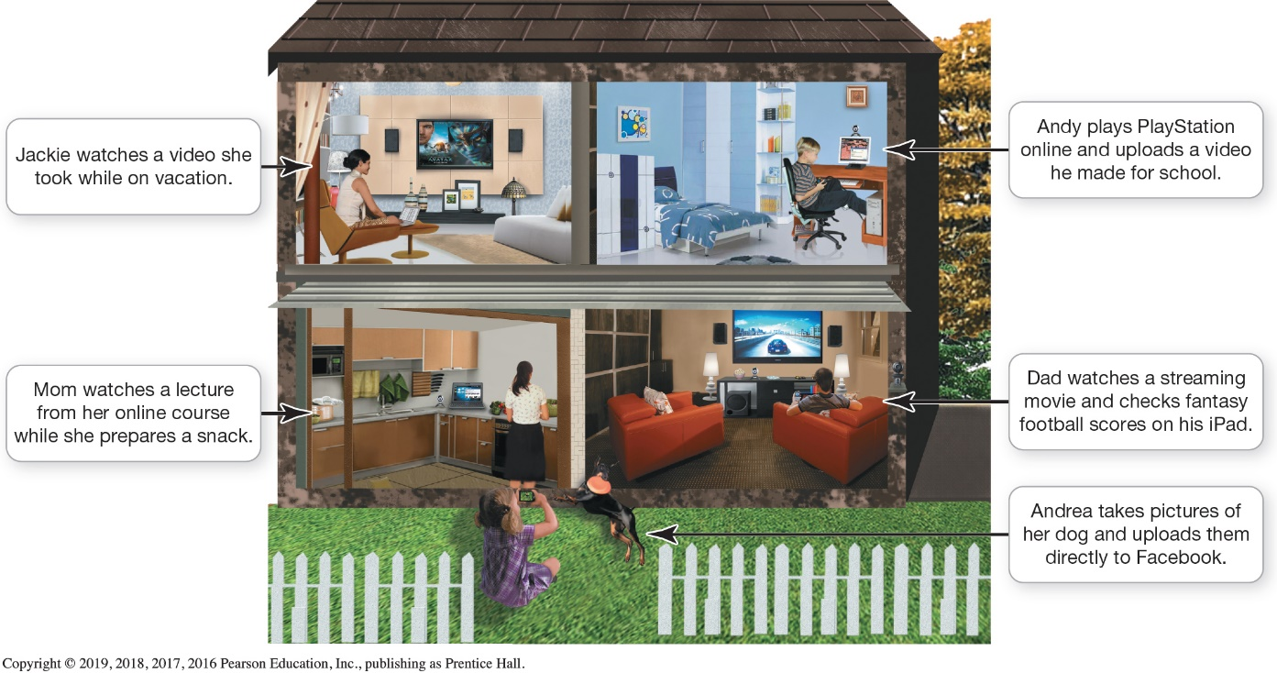
Networking Fundamentals
Understanding Networks (1 of 3)
(Objective 7.1)
Computer network
Node
  Computer
  Peripheral
  Network device
Notes:
A computer network is simply two or more computers that are connected via software and hardware so that they can communicate with each other.
Each device connected to a network is referred to as a node.
A node can be a computer, a peripheral such as a printer or game console, or a network device such as a router.

Slide 5
Networking Fundamentals
Understanding Networks (2 of 3)
(Objective 7.1)
Benefits of networks
  Sharing a high-speed Internet connection
  Sharing printers and peripheral devices
  Sharing files
  Common communications
Disadvantage of networks
  Setup and administration
Notes:
There are several benefits to having computers networked:
Sharing an Internet connection: A network lets you share the high-speed Internet connection coming into your home.
Sharing printers and other peripherals: Networks let you share printers and other peripheral devices.
Sharing files: You can share files between networked computers without having to use portable storage devices to transfer the files.
Common communications: Computers running different operating systems can communicate on the same network.
The major disadvantage of networks is the setup time.

Slide 6
Networking Fundamentals
Understanding Networks (3 of 3)
(Objective 7.1)
How data moves through networks
  Data transfer rate (bandwidth) is the maximum speed data can be transmitted
  Throughput is the actual speed data is transferred
  Measured in megabits per second (Mbps) or gigabits per second (Gbps)
Notes:
The following terms help us understand how data moves through networks.
Data transfer rate (bandwidth) is the maximum speed data can be transmitted.
Throughput is the actual speed data is transferred.
Data transfer rate and throughput are usually measured in megabits per second (Mbps) and gigabits per second (Gbps).

Slide 7
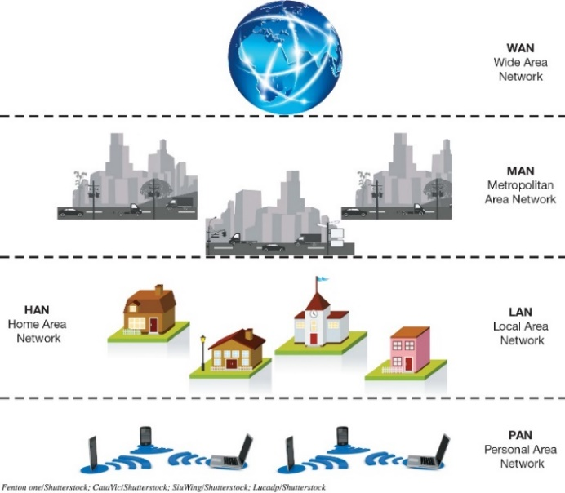
Network Architectures
Network Designs (1 of 3)
(Objective 7.2)
Networks can be classified by distance
  Personal area network (PAN)
  Local area network (LAN)
  Home area network (HAN)
  Metropolitan area network (MAN)
  Wide area network (WAN)
Notes:
Networks can be classified by distance.
A personal area network (PAN) is used for communication among devices close to one person.
A local area network (LAN) is a network in which the nodes are located within a small geographical area.
A home area network (HAN) is a specific type of LAN located in a home.
A metropolitan area network (MAN) is a large network designed to provide access to a specific geographical area, such as an entire city.
A wide area network (WAN) spans a large physical distance.

Slide 8
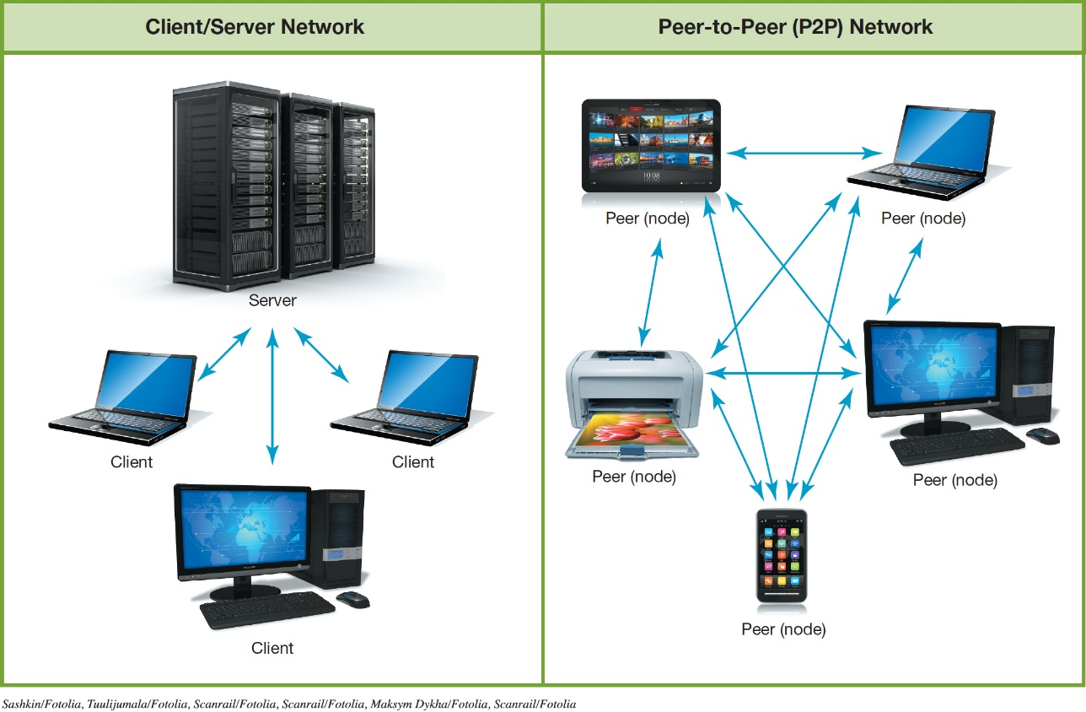
Network Architectures
Network Designs (2 of 3)
(Objective 7.2)
Networks can be classified by levels of administration
  Client/server
  network
  Peer-to-peer
  network
Notes:
Networks can be classified by levels of administration.
In a client/server network, a client is a computer on which users accomplish tasks and make requests, whereas the server is the computer that provides information or resources to the client computers.
In a peer-to-peer (P2P) network, each node connected on the network can communicate directly with every other node on the network.

Slide 9
Network Architectures
Network Designs (3 of 3)
(Objective 7.2)
Classifying networks by protocols
  Ethernet
    Developed by the Institute of Electrical and Electronics Engineers
    Wireless networks (Wi-Fi)
    Wired networks (gigabit Ethernet [GbE])
  Backward compatibility
Notes:
Networks can be classified by the protocols used.
Ethernet
Developed by the Institute of Electrical and Electronics Engineers (IEEE).
This applies to wireless and wired networks.
The ability of current devices to use earlier standards in addition to the current standard is known as backward compatibility.

Slide 10
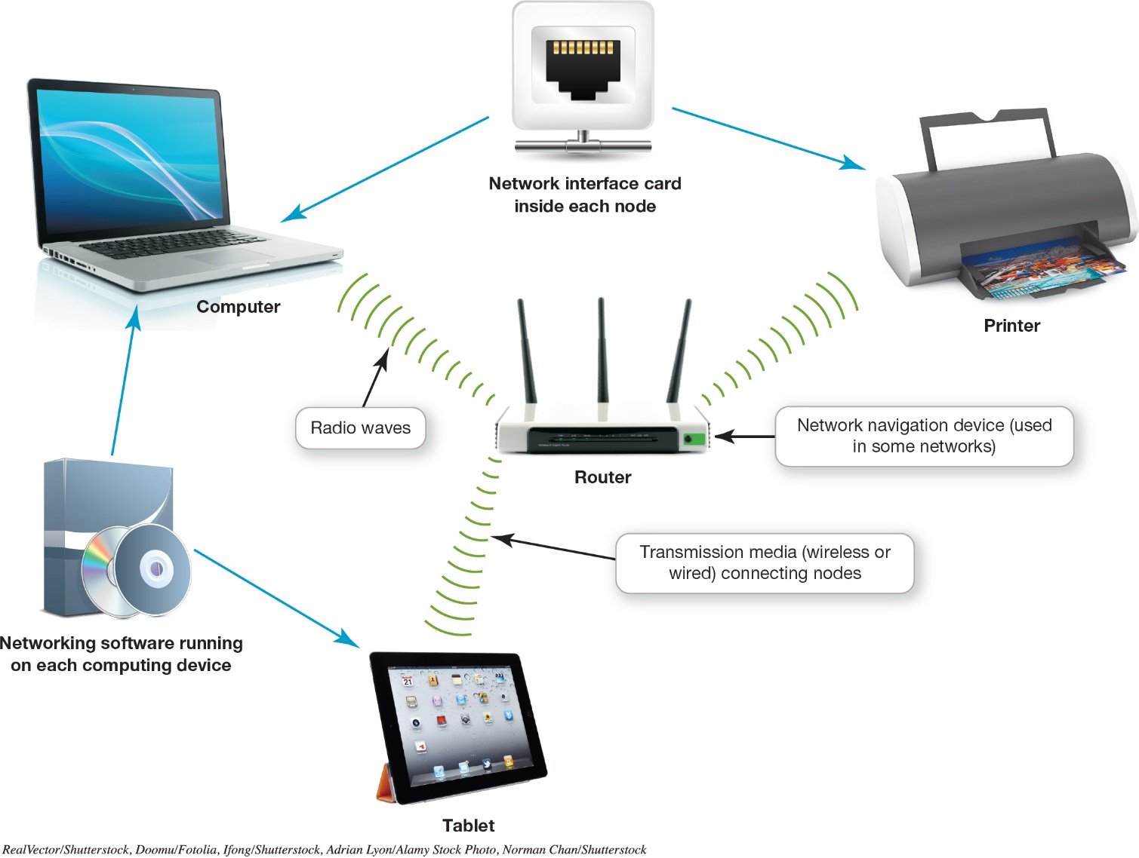
Network Components
(Objective 7.3)
Notes:
In order to function, all networks must include:
A means of connecting the nodes on the network—cables or wireless technology.
Special hardware devices that allow the nodes to communicate with each other and to send data.
Software that allows the network to run.

Slide 11
Network Components
Transmission Media (1 of 2)
(Objective 7.3)
Transmission media establish a communications channel between the nodes on a network
  Wireless networks
  Wired networks
Notes:
Transmission media establish a communications channel between the nodes on a network.
They can be either wireless or wired.

Slide 12
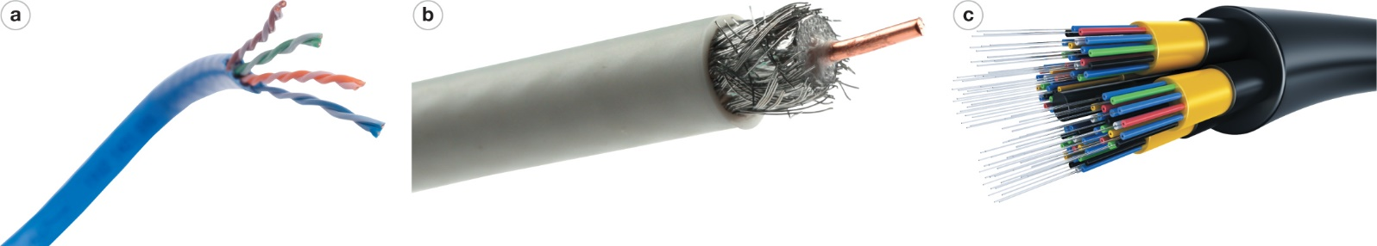
Network Components
Transmission Media (2 of 2)
(Objective 7.3)
Wired
  UTP cable: twisted copper wires surrounded by a plastic jacket
  Coaxial cable: single copper wire surrounded by layers of plastic
  Fiber-optic cable: plastic or glass fibers
Notes:
Wired networks can use the following media:
UTP cable: twisted copper wires surrounded by a plastic jacket.
Coaxial cable: single copper wire surrounded by layers of plastic.
Fiber-optic cable: plastic or glass fibers.

Slide 13
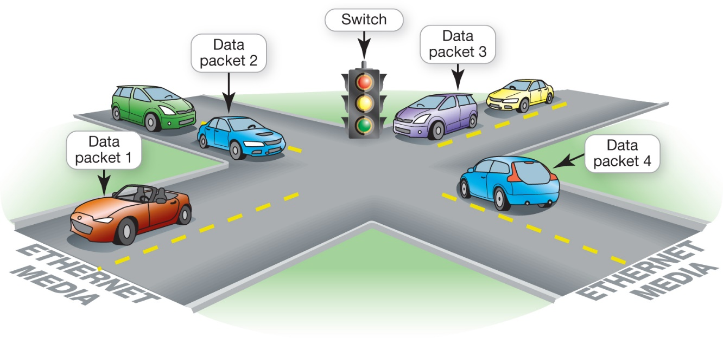
Network Components
Basic Network Hardware
(Objective 7.4)
Network adapter
Network interface
card (NIC)
Modem
Router
Switch
Notes:
Each node needs a network adapter. An integrated network adapter is referred to as a network interface card.
A broadband connection requires a modem, which translates the signal into digital and back again.
Data is sent in bundles called packets.
Network navigation devices facilitate and control the flow of data.
A router transfers packets of data between two or more networks.
A switch acts like a traffic signal on a network.

Slide 14
Network Components
Network Software
(Objective 7.5)
Operating system for P2P networking
Client/server network
  Communicate through centralized server
  Specialized network operating system(NOS) software
Notes:
Because home networks are P2P networks, they need operating system software that supports P2P networking.
As opposed to P2P networks, the nodes on a client/sever network don’t communicate directly with each other; rather, they communicate through a centralized server. Communicating through a server is more efficient in a network with a large number of nodes, but it requires more complex software. Therefore, servers on client/server networks have specialized network operating system (NOS) software installed.

Slide 15
Connecting to the Internet
Broadband Internet Connections (1 of 2)
(Objective 7.6)
Home network
  Share an Internet connection
Must purchase Internet access from ISP
  Specialized providers
  Companies that provide other services
Broadband
Cellular or dial-up
Notes:
One of the main reasons for setting up a network is to share an Internet connection. Some businesses and large organizations have a dedicated connection to the Internet, but other businesses and homeowners purchase Internet access from Internet service providers (ISPs). ISPs might be specialized providers.
Broadband is the preferred way to access the Internet, but in some situations cellular or dial-up access might be necessary.

Slide 16
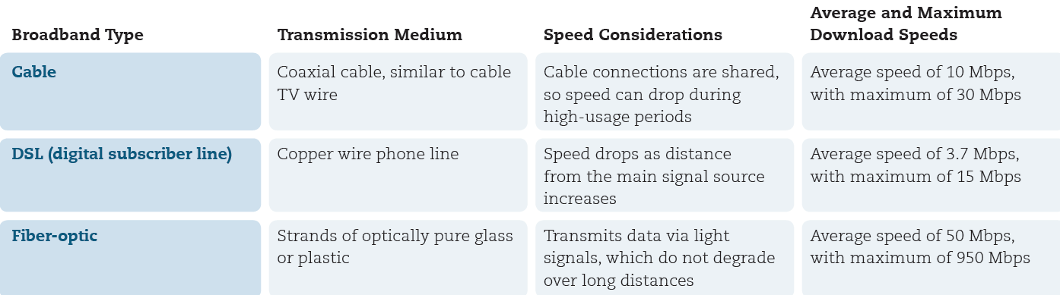
Connecting to the Internet
Broadband Internet Connections (2 of 2)
(Objective 7.6)
Broadband
  Cable Internet
  DSL (digital subscriber line)
  Fiber-optic service
  Satellite Internet
Notes:
Broadband is often referred to as high-speed Internet. This high rate of access is in contrast to dial-up Internet access.
The standard wired broadband technologies in most areas are cable, DSL, and fiber-optic service.
Satellite Internet is used mostly in rural or mountain areas.

Slide 17
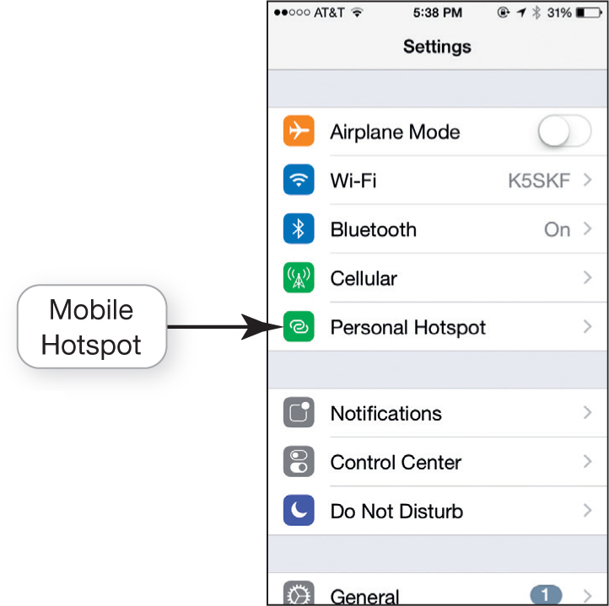
Connecting to the Internet
Wireless Internet Access
(Objective 7.7)
Mobile broadband
  Wireless Internet
  at home
  Mobile hotspot
  Wireless ISP
  Data plan
Notes:
To access the Internet wirelessly at home, you need to establish WiFi on your home network by using a router.
When away from home, you can find a mobile hotspot.
Mobile broadband connects you to the Internet through 4G or 5G access.
You must have a wireless Internet service provider.
An Internet connectivity plan is known as a data plan.

Slide 18
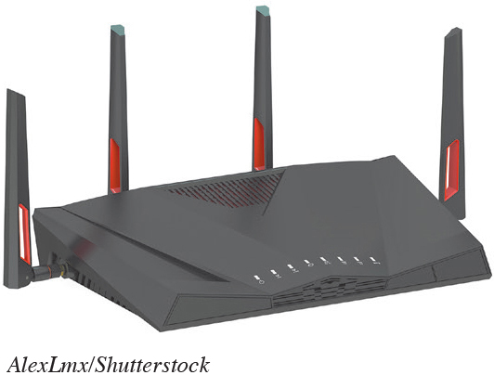
Installing and Configuring Home Networks
Planning Your Home Network
(Objective 7.8)
List all the devices you are using
Use the latest standard
Use the newest equipment
Notes:
One of the first things you should do to evaluate your network is list all the devices you’re using.
For a home network to run most efficiently and to provide the fastest experience, it’s best that all network nodes use the latest Ethernet standard.
If your router is provided by your ISP and it’s an older standard, you should consider having your ISP provide you with a new router.

Slide 19
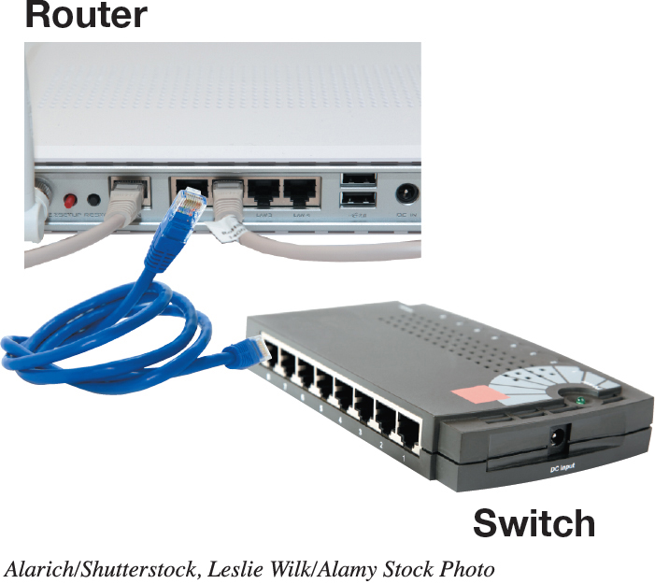
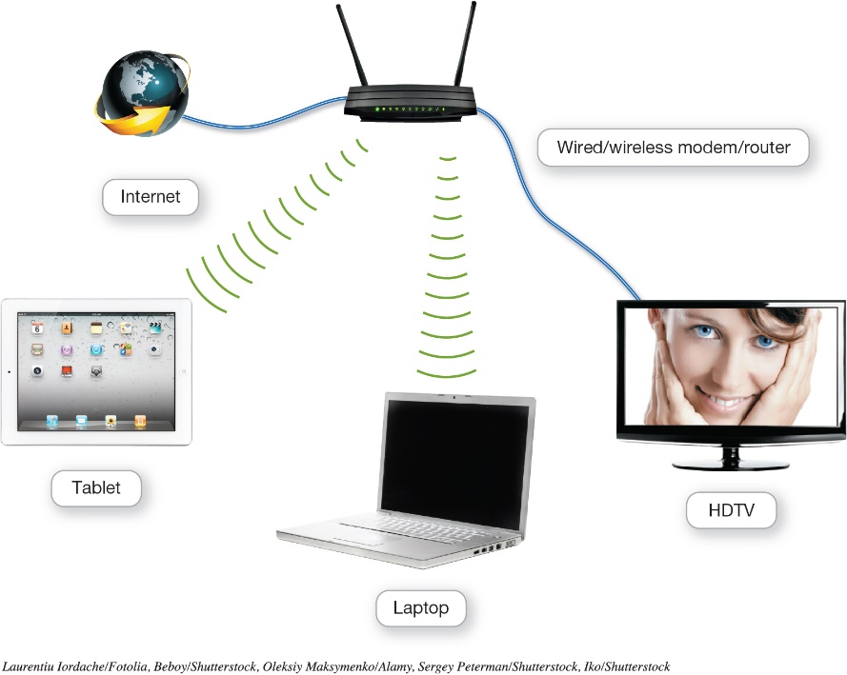
Installing and Configuring Home Networks
Connecting Devices to a Network (1 of 2)
(Objective 7.9)
Routers
Switches
Notes:
Apple has designed routers that are optimized for working with Apple computers.
Windows machines can also connect to an AirPort router, so it’s a great choice for households with both Apples and PCs.
The AirPort Express router can be used for home networks to support devices running iOS, macOS, and Windows.
A switch acts like a traffic signal on a network.

Slide 20
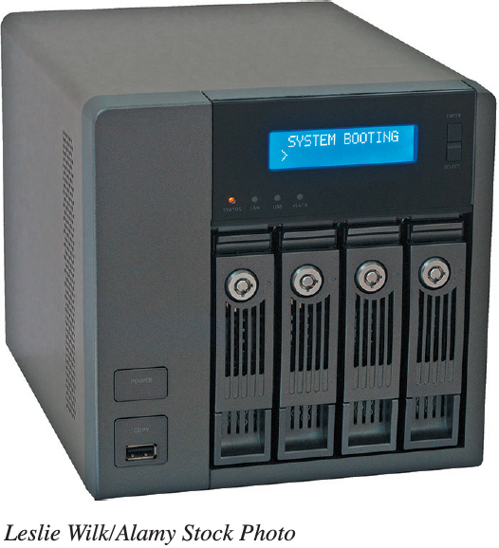
Installing and Configuring Home Networks
Connecting Devices to a Network (2 of 2)
(Objective 7.9)
Specialized home networking devices
  NAS devices
  Home network servers
  Network-ready device
Notes:
There are specialized home networking devices.
Network-attached storage (NAS) devices are specialized devices designed to store and manage network data. NAS devices provide centralized data storage and access.
Home network servers are specialized devices designed to store and share files across the network.
A network-ready device (or Internet-ready device) can be connected directly to a network through either a wired or wireless connection.

Slide 21
Installing and Configuring Home Networks
Troubleshooting Wireless Network Problems (Objective 7.10)
Maximum Wi-Fi range is about 350 feet
Walls, floors, and large metal objects are sources of interference with wireless signals
Place an access point where the Wi-Fi signal becomes weaker
A wireless range extender repeats or amplifies wireless router signal
Notes:
The maximum range of Wi-Fi 4 or Wi-Fi 5 wireless devices is about 350 feet. As you go farther away from your router, the speed (throughput) decreases.
Walls, floors, and large metal objects (such as refrigerators) are the most common sources of interference with wireless signals.
Place an access point in the location where the original Wi-Fi signal becomes weaker.
Use a wireless range extender to repeat or amplify the wireless router signal.

Slide 22
Managing and Securing Wireless Networks
Securing Wireless Networks (1 of 3)
(Objective 7.11)
Use encryption and security protocols
Change network name (SSID)
Disable SSID broadcast
Change the default password
Create a passphrase
Notes:
There are various issues and methods for securing your wireless network:
Use encryption and security protocols.
Change network name service set identifier (SSID).
Disable SSID broadcast.
Change the default password.
Create a passphrase.

Slide 23
Managing and Securing Wireless Networks
Securing Wireless Networks (2 of 3)
(Objective 7.11)
Implement media access control
Limit signal range
Keep router firmware up to date
Disable remote access
Notes:
Additional methods for securing your wireless network:
Implement media access control.
Limit signal range.
Keep router firmware up to date.
Disable remote access.

Slide 24
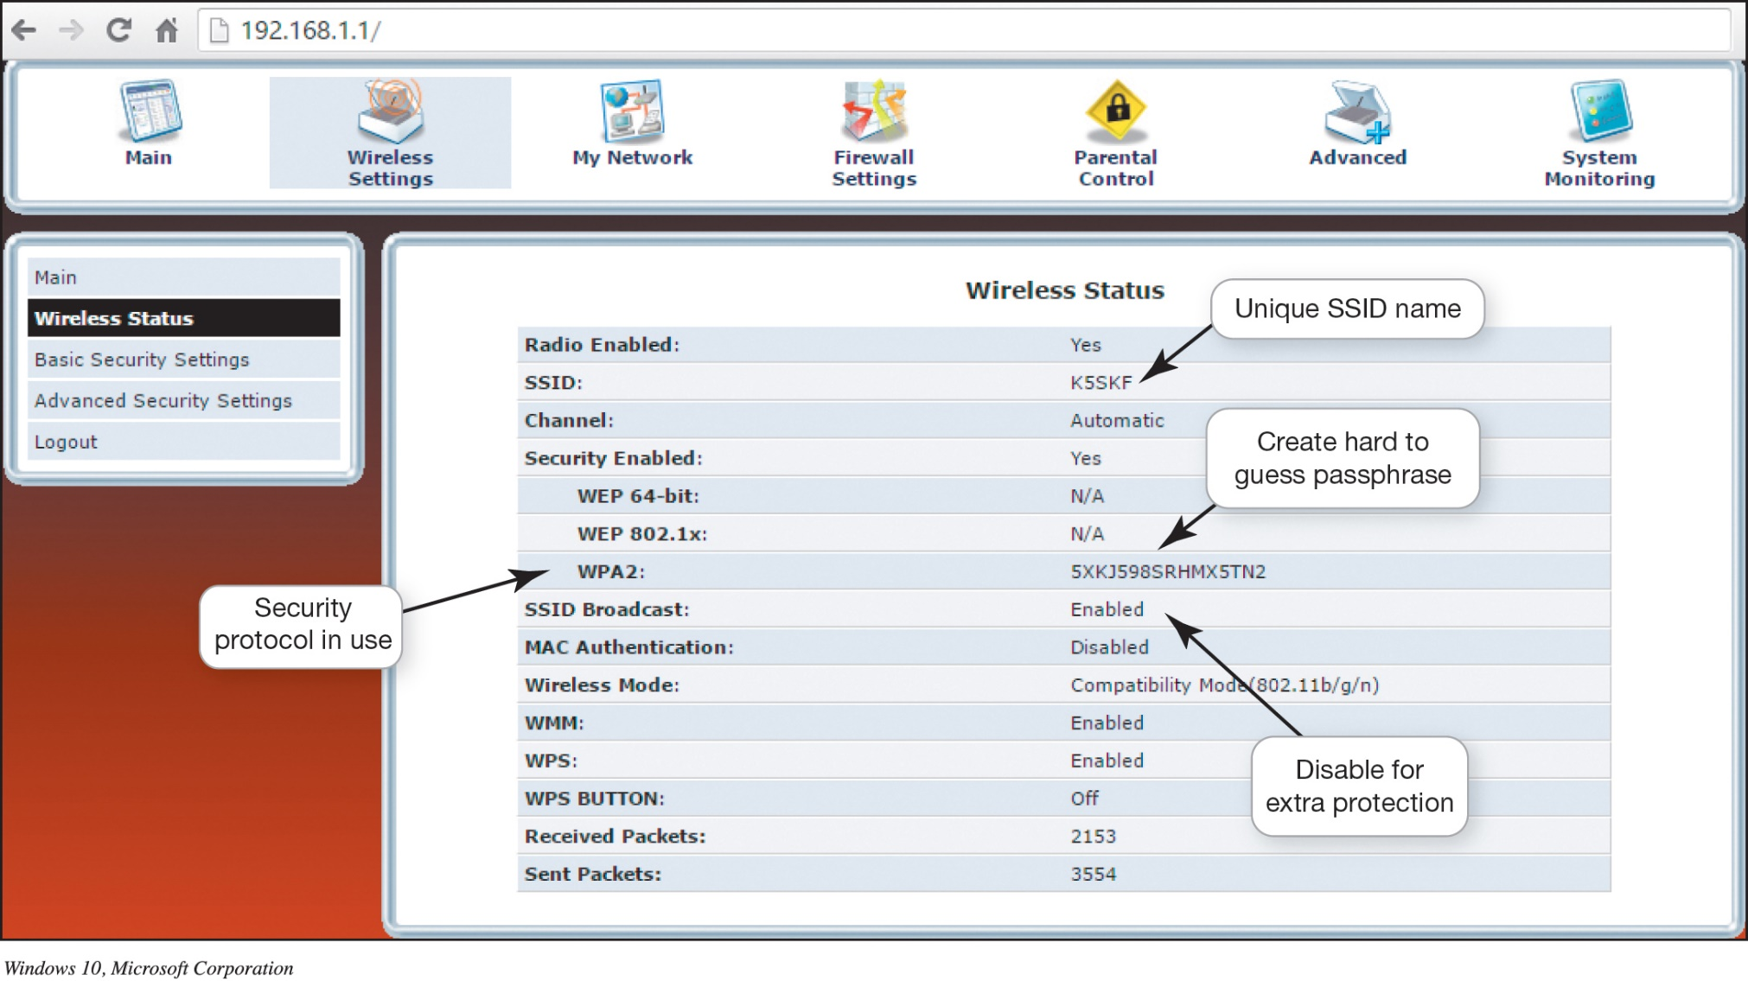
Managing and Securing Wireless Networks
Securing Wireless Networks (3 of 3)
(Objective 7.12)
Notes:
By accessing your router, you can configure the security protocols available on your router and change the SSID.

Slide 25

Copyright
All rights reserved. No part of this publication may be reproduced, stored in a retrieval system, or transmitted, in any form or by any means, electronic, mechanical, photocopying, recording, or otherwise, without the prior written permission of the publisher. Printed in the United States of America.

