Slide 1
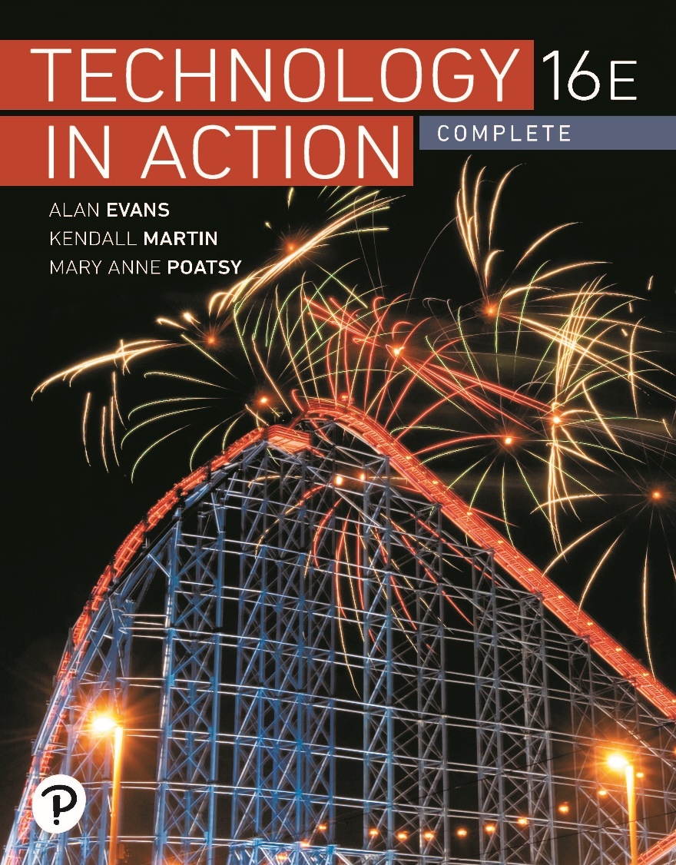
Technology in Action
16th Edition
Chapter 8
Managing a Digital Lifestyle: Challenges and Ethics

Slide 2
Learning Objectives (1 of 3)
8.1 Describe how digital convergence and the Internet of Things have evolved.
8.2 Explain the differences between digital and analog signals.
8.3 Describe the different types of e-readers.
8.4 Explain how to purchase, borrow, and publish e-texts.
8.5 Describe how digital music is created and stored.
8.6 Summarize how to listen to and publish digital music.
8.7 Explain how best to create, print, and share digital photos.
Notes:
The learning objectives are:
8.1 Describe how digital convergence and the Internet of Things have evolved.
8.2 Explain the differences between digital and analog signals.
8.3 Describe the different types of e-readers.
8.4 Explain how to purchase, borrow, and publish e-texts.
8.5 Describe how digital music is created and stored.
8.6 Summarize how to listen to and publish digital music.
8.7 Explain how best to create, print, and share digital photos.

Slide 3
Learning Objectives (2 of 3)
8.8 Describe how to create, edit, and distribute digital video.
8.9 Discuss the challenges in managing an active digital lifestyle.
8.10 Describe the various types of intellectual property.
8.11 Explain how copyright is obtained and the rights granted to the owners.
8.12 Explain copyright infringement, summarize the potential consequences, and describe situations in which you can legally use copyrighted material.
Notes:
Additional learning objectives are:
8.8 Describe how to create, edit, and distribute digital video.
8.9 Discuss the challenges in managing an active digital lifestyle.
8.10 Describe the various types of intellectual property.
8.11 Explain how copyright is obtained and the rights granted to the owners.
8.12 Explain copyright infringement, summarize the potential consequences, and describe situations in which you can legally use copyrighted material.

Slide 4
Learning Objectives (3 of 3)
8.13 Explain plagiarism and strategies for avoiding it.
8.14 Describe hoaxes and digital manipulation.
8.15 Describe what comprises your online reputation and how to protect it.
Notes:
Additional learning objectives are:
8.13 Explain plagiarism and strategies for avoiding it.
8.14 Describe hoaxes and digital manipulation.
8.15 Describe what comprises your online reputation and how to protect it.

Slide 5
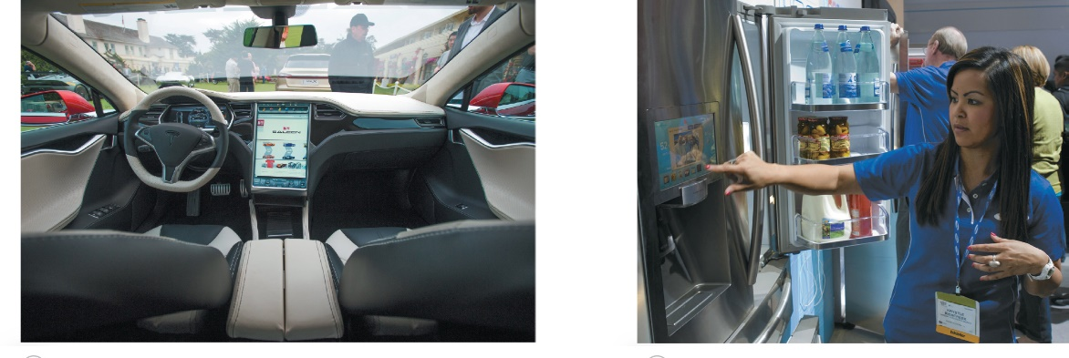
Digital Basics
Digital Convergence and the Internet of Things
(Objective 8.1)
Digital convergence
  Single unifying device to meet our digital needs
  Media, Internet, entertainment, and telephone needs
Internet of Things
(IoT)
Digital Living Network Alliance (DLNA)
Notes:
Digital convergence, the use of a single unifying device to handle media, Internet, entertainment, and telephone needs, is exemplified in the range of devices now on the market. You see digital convergence in the evolution of smartphones, which now let you do just about anything a computer can do.
The Internet of Things (IoT) includes networking common household items, like refrigerators.
The Digital Living Network Alliance is an organization working to standardize different kinds of appliances and network devices used in our homes.

Slide 6
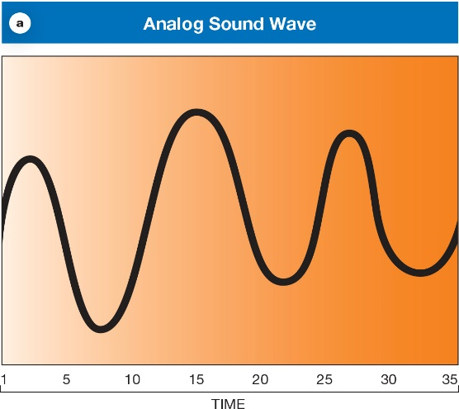
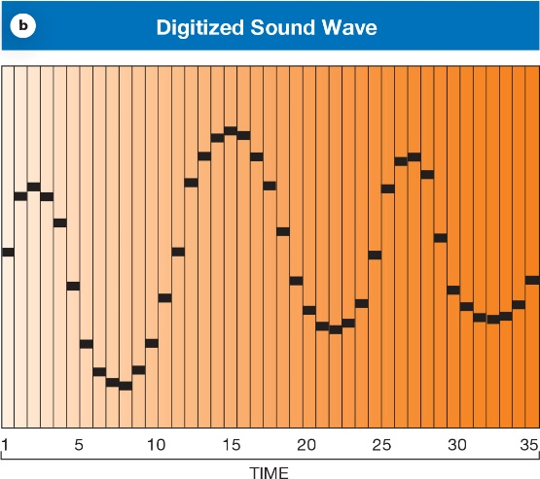
Digital Basics
Digital vs. Analog
(Objective 8.2)
Any kind of information can be digitized
Digital
  Long strings of numbers
Analog
  Continuous waves
Analog-to-digital
conversion
Notes:
Any kind of information can be digitized.
Digital formats describe signals as long strings of numbers. This gives us a way to describe sound and light waves so that sounds and images can be reproduced perfectly.
A sequence of numbers can express complicated analog shapes with analog-to-digital conversion. The incoming analog signal is measured many times each second. The series of numbers produced by the analog-to-digital conversion process gives the digital form of the wave.

Slide 7
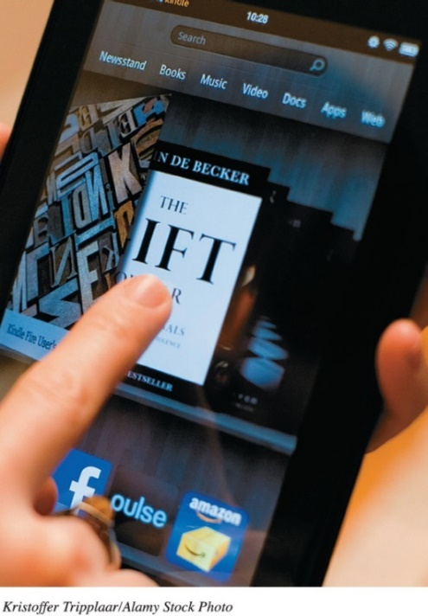
Digital Publishing
E-Readers
(Objective 8.3)
Electronic text (e-text)
  Textual information captured digitally
E-readers
  Devices that display e-text
  and have supporting tools
Allure of digital publishing
  Distribution
Electronic Ink (E Ink)
  Sharp grayscale representation of text
Notes:
Electronic text is textual information that has been captured digitally.
E-readers are devices that display e-text and have supporting tools.
The allure of digital publishing is the ease of distribution.
Electronic Ink (E Ink) is a sharp grayscale representation of text.

Slide 8
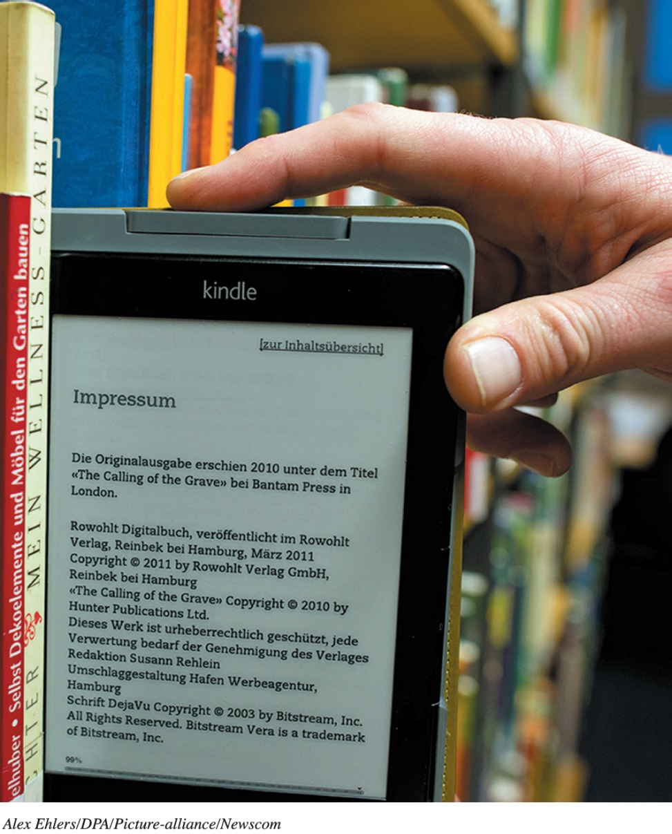
Digital Publishing
Using e-Texts
(Objective 8.4)
Using e-Texts
  Amazon Kindle
  Barnes & Noble
  Nook
  Library
  Project Gutenberg
  Self-publish
Notes:
There are free software versions of the Kindle and the NOOK that run on either PC or Apple computers. You can download texts and read them as a PDF file or by using browser add-ons.
Digital formats for publishing vary.
Amazon sells the Kindle.
Barnes & Noble sells the NOOK.
Project Gutenberg is a repository site with a collection of 57,000 free books.
Self-publishing is much easier in the age of digital texts.

Slide 9
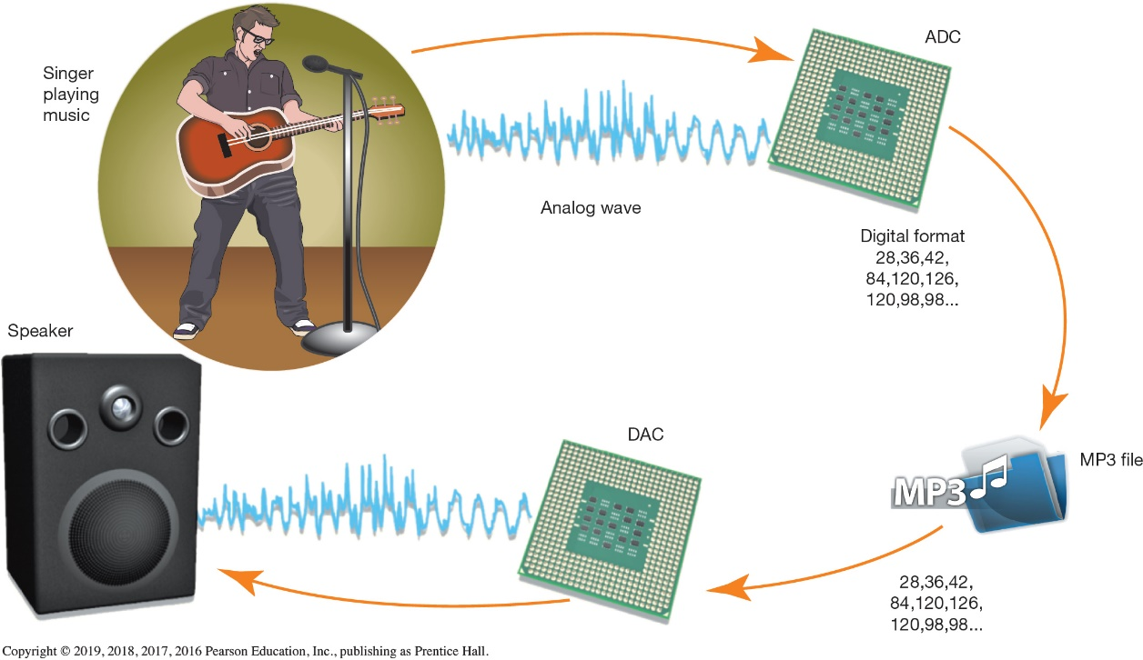
Digital Music
Creating and Storing Digital Music
(Objective 8.5)
Analog-to-digital converter (ADC)
Sampling rate
File types
Ripping
Storage options
  USB devices
  Cloud services
Notes:
To record digital music, the sound waves need to be turned into a string of digital information through an analog-to-digital converter.
The sampling rate specifies the number of times the analog wave is measured each second.
There are several file formats used to store digital music and video, including MP3, AAC, WMA, DivX, MPEG-4, WMV, and XviD. All file formats compete on sound and video quality and compression, which relates to how small the file can be and still provide high-quality playback.
Ripping is the process of converting a song from a CD to a digital MP3 file.
To move large volumes of data between your computer and music device, you can connect the devices using a USB port. Cloud services automatically push music to your mobile device.

Slide 10
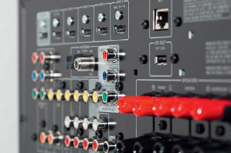
Digital Music
Distributing Digital Music
(Objective 8.6)
Options for listening to digital music
  Port or dock on an audio receiver
  Networked audio/video receivers
  New cars equipped with an auxiliary input
  Systems like Sonos that mate wirelessly with a mobile device
Digital rights management (DRM)
  System of access that allows only limited use of material that’s been legally purchased
Notes:
Options for listening to digital music include:
A port or dock on an audio receiver.
Networked audio/video receivers.
New cars equipped with an auxiliary input.
Systems like Sonos that mate wirelessly with a mobile device.
Digital rights management (DRM) is a system of access that allows only limited use of material that’s been legally purchased.

Slide 11
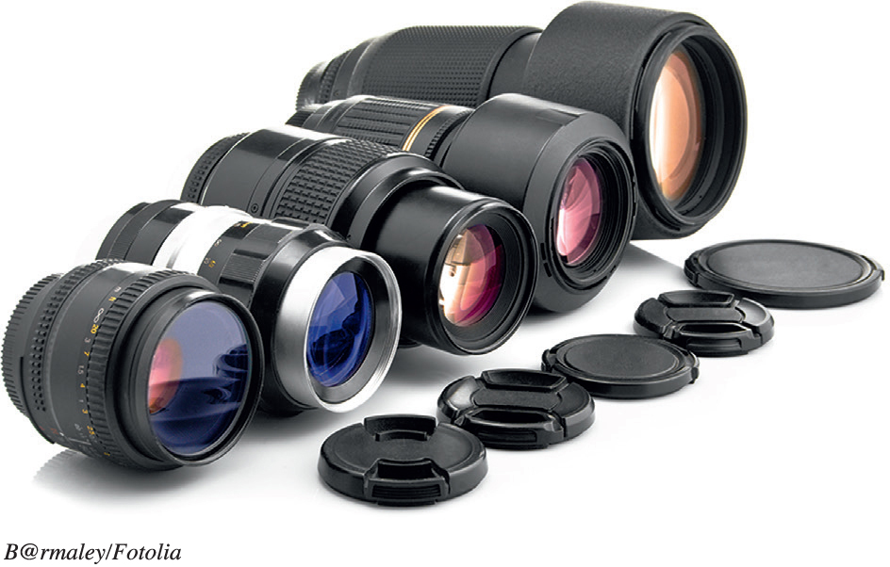
Digital Media
Digital Photography (1 of 3)
(Objective 8.7)
Digital cameras
  Capture images and video
  Convert to digital data
Factors that determine
image quality
  Quality of lenses
  Image sensor size
  File format and compression used
  Color management software
  Camera's resolution
Notes:
Digital cameras do not use film. Instead, they capture images on electronic sensors and then convert those images to digital data.
When choosing a camera, the first question to answer is whether you want a compact “point-and-shoot” model camera or a more serious digital SLR.
The overall image quality is determined by many factors:
Quality of lenses
Image sensor size
The file format and compression used
Color management software
The camera's resolution

Slide 12
Digital Media
Digital Photography (2 of 3)
(Objective 8.7)
Resolution
  Number of data points captured for each image
Pixel
  Picture element is a single dot in a digital image
File formats
  RAW files record all the original image information
  JPEG files can be compressed to varying degrees
Notes:
A picture’s resolution is the number of data points captured for each image.
A pixel is a picture element, namely, a single dot in a digital image.
File formats for pictures include:
RAW files, which record all the original image information.
JPEG files, which can be compressed to varying degrees.

Slide 13
Digital Media
Digital Photography (3 of 3)
(Objective 8.7)
Printing digital photos
  Photo printer—inkjet printers
  Photo-printing service
    Flickr
Notes:
The most popular and inexpensive printers for printing photos are inkjet printers.
Most photo-printing labs, including film-processing departments at stores such as Target, offer digital printing services. Online services, such as Flickr and Shutterfly, store your images and allow you to create hard-copy prints, greeting cards, photo books, calendars, and gifts.

Slide 14
Digital Media
Digital Video (1 of 2)
(Objective 8.8)
Sources of digital video content
  Television
  Internet (Vimeo)
  Pay services (iTunes, Netflix, Hulu, Amazon)
Digital camcorders, smartphones, or webcams allow recording of digital video
Video-editing software allows editing of digital video
Notes:
Sources of digital video content include:
Television
the Internet (Vimeo)
Pay services (iTunes, Netflix, Hulu, and Amazon)
Digital camcorders, smartphones, or webcams allow recording of digital video.
Video-editing software allows editing of digital video.

Slide 15
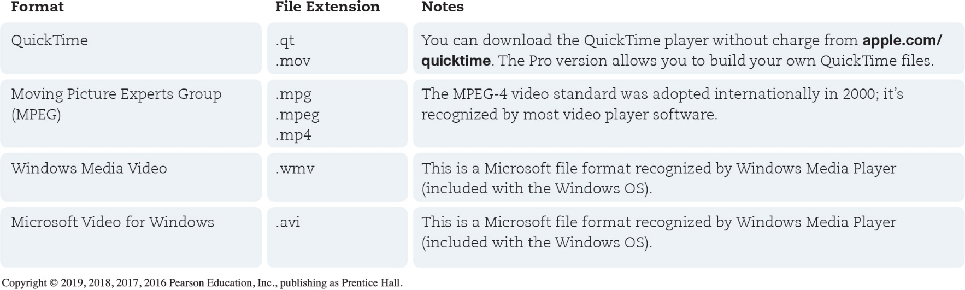
Digital Media
Digital Video (2 of 2)
(Objective 8.8)
Codecs are rules for compressing audio and video
High definition is a standard that guarantees a specific resolution and aspect ratio
Notes:
Codecs are rules for compressing audio and video.
High definition is a standard that guarantees a specific resolution and aspect ratio.
This table shows some of the popular video file formats in use, along with their file extensions.

Slide 16
Managing Your Digital Lifestyle
Digital Challenges and Dilemmas (1 of 2)
(Objective 8.9)
Deep Web—part of the Internet that cannot be found using a search engine
Dark Web—part of the Deep Web that cannot be accessed with a regular web browser
  Consists of anonymously hosted websites mostly used
    For illegal activities
    By people concerned about privacy
Notes:
The Deep Web is part of the Internet that cannot be found using a search engine.
The Dark Web is part of the Deep Web that cannot be accessed with a regular web browser. It consists of anonymously hosted websites that are mostly used for illegal activities or by people who are very concerned about privacy.

Slide 17
Managing Your Digital Lifestyle
Digital Challenges and Dilemmas (2 of 2)
(Objective 8.9)
Cryptocurrency—enables direct anonymous transactions between users
Cryptocurrency transactions are kept in a blockchain
Digital wallet stores cryptocurrency transaction information
Notes:
Cryptocurrency enables direct anonymous transactions between users. Payments are sent peer-to-peer from the payee to the recipient without the need to supply personal information. Bitcoin is the most well-know cryptocurrency.
Cryptocurrency tractions are kept in a blockchain, which is on a massive public online ledger.
A digital wallet stores the information needed to complete cryptocurrency transactions.

Slide 18
Protection of Digital Property
Intellectual Property
(Objective 8.10)
Intellectual property—product of a person’s mind
Categories of intellectual property
  Copyright
  Patents
  Trademarks
  Service marks
  Trade dress
Notes:
Intellectual property (IP) is a product of a person’s mind.
Categories of intellectual property are:
Copyright protection can be granted to creators of “original works of authorship.”
Patents grant inventors the right to stop others from manufacturing, using, or selling their inventions.
Trademarks are a word, phrase, symbol, or design or a combination of these that uniquely identify and differentiate the goods of one party from those of another.
Service marks are the same as a trademark, but apply to a service as opposed to a product.
Trade dress applies to the visual appearance of a product or its packaging.

Slide 19
Protection of Digital Property
Copyright Basics
(Objective 8.11)
Copyright—begins when a work is created and fixed into a digital or physical form
Public domain—works without copyright protection
Copyleft—enables copyright holders to grant certain rights to the work
Notes:
Copyrights begin when works are created and fixed into a digital or physical form.
Works are considered in the public domain if they have no copyright protection.
Copyleft are plans that enable copyright holders to grant certain rights to the work.

Slide 20
Protection of Digital Property
Copyright Infringement (1 of 2)
(Objective 8.12)
Copyright infringement—violations of the holder’s rights
Music and video violations cause a significant loss of revenue
Software piracy is illegally using copyrighted software
Notes:
Copyright infringement happens when violations of the holder’s rights occur.
Music and video violations cause a significant loss of revenue.
Software piracy is illegally using copyrighted software.

Slide 21
Protection of Digital Property
Copyright Infringement (2 of 2)
(Objective 8.12)
Photos should be considered copyrighted
Model release grants the photographer the right to use an image
Fair use provides a way for people to use portions of a copyrighted work
Notes:
Photos should be considered copyrighted.
Model release grants the photographer the right to use an image of the model (or subject of the photo) commercially.
Fair use provides a way for people to use portions of a copyrighted work.

Slide 22
Living Ethically in the Digital Era
Plagiarism
(Objective 8.13)
Copying text or ideas from someone else and claiming them as your own
Usually considered an academic offense and isn’t punishable under civil law
Cite the source if there is any doubt
Notes:
Plagiarism is the act of copying text or ideas from someone else and claiming them as your own.
Plagiarism is usually considered an academic offense of dishonesty and isn’t punishable under U.S. civil law.
Cite the source if there is any doubt.

Slide 23
Living Ethically in the Digital Era
Hoaxes and Digital Manipulation
(Objective 8.14)
Hoax—is anything designed to deceive another person
Fake news—stories that are invented and are intended to spread misinformation
Urban legends—incorporated into society as true events even though they are false
Digital manipulation—altering media from the way they were originally seen
Notes:
A hoax is anything designed to deceive another person.
Fake news refers to stories that are invented and are intended to spread misinformation rather than being factual.
Urban legends are incorporated into society as true events even though they are false.
Digital manipulation involves altering media from the way they were originally seen.

Slide 24
Living Ethically in the Digital Era
Protecting Your Online Reputation
(Objective 8.15)
Online reputation—the information available about you in cyberspace
Persistence of information—facts about you might never disappear
Protecting your online reputation
  Improve and update your personal profiles
  Create content on relevant sites
  Post frequently
  Be vigilant
Notes:
Your online reputation is the information available about you in cyberspace that can influence people’s opinions of you in the real world.
Persistence of information means that facts about you might never disappear from the Internet.
Ways to protect your online reputation include:
Improve and update your personal profiles.
Create content on relevant sites.
Post frequently.
Be vigilant.

Slide 25

Copyright
All rights reserved. No part of this publication may be reproduced, stored in a retrieval system, or transmitted, in any form or by any means, electronic, mechanical, photocopying, recording, or otherwise, without the prior written permission of the publisher. Printed in the United States of America.

