Slide 1

Technology in Action
16th Edition
Chapter 9
Securing Your System: Protecting Your Digital Data and Devices

Slide 2
Learning Objectives (1 of 3)
9.1 Describe how identity theft is committed and the types of scams identity thieves perpetrate.
9.2 Describe the different types of hackers and the tools they use.
9.3 Explain what a computer virus is, why it is a threat to your security, how a computing device catches a virus, and the symptoms it may display.
9.4 List the different categories of computer viruses, and describe their behaviors.
9.5 Explain what malware, spam, and cookies are and how they impact your security.
Notes:
The learning objectives are:
9.1 Describe how identity theft is committed and the types of scams identity thieves perpetrate.
9.2 Describe the different types of hackers and the tools they use.
9.3 Explain what a computer virus is, why it is a threat to your security, how a computing device catches a virus, and the symptoms it may display.
9.4 List the different categories of computer viruses, and describe their behaviors.
9.5 Explain what malware, spam, and cookies are and how they impact your security.

Slide 3
Learning Objectives (2 of 3)
9.6 Describe social engineering techniques, and explain strategies to avoid falling prey to them.
9.7 Explain what a firewall is and how a firewall protects your computer from hackers.
9.8 Explain how to protect your computer from virus infection.
9.9 Describe how passwords and biometric characteristics can be used for user authentication.
9.10 Describe ways to surf the Web anonymously.
Notes:
Additional learning objectives are:
9.6 Describe social engineering techniques, and explain strategies to avoid falling prey to them.
9.7 Explain what a firewall is and how a firewall protects your computer from hackers.
9.8 Explain how to protect your computer from virus infection.
9.9 Describe how passwords and biometric characteristics can be used for user authentication.
9.10 Describe ways to surf the Web anonymously.

Slide 4
Learning Objectives (3 of 3)
9.11 Describe the types of information you should never share online.
9.12 List the various types of backups you can perform on your computing devices, and explain the various places you can store backup files.
9.13 Explain the negative effects environment and power surges can have on computing devices.
9.14 Describe the major concerns when a device is stolen and strategies for solving the problems.
Notes:
Additional learning objectives are:
9.11 Describe the types of information you should never share online.
9.12 List the various types of backups you can perform on your computing devices, and explain the various places you can store backup files.
9.13 Explain the negative effects environment and power surges can have on computing devices.
9.14 Describe the major concerns when a device is stolen and strategies for solving the problems.

Slide 5
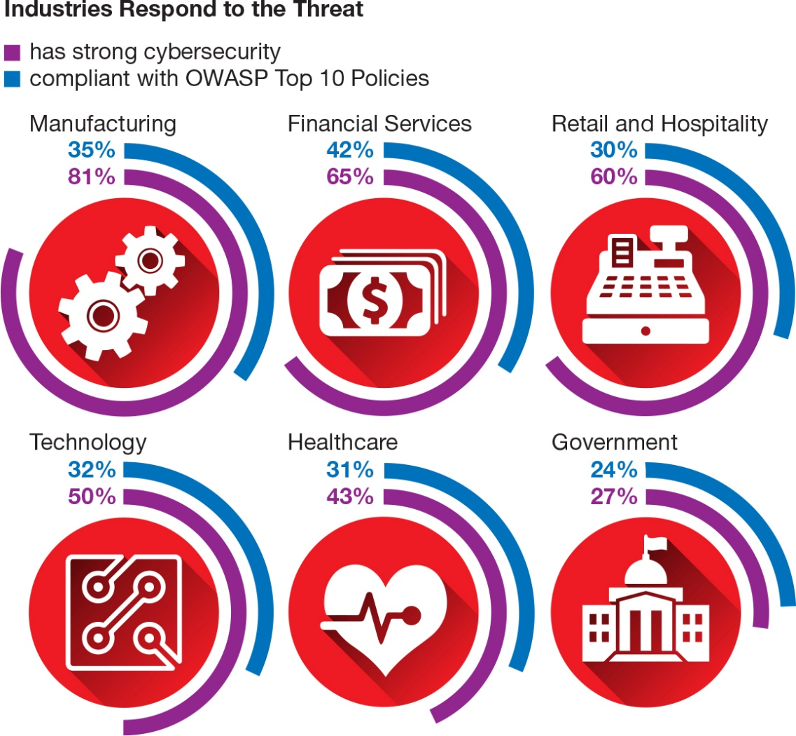
Identity Theft and Hackers
Cybercrime
Cybercriminals
Common types of cybercrimes
Notes:
Cybercrime is any criminal action perpetrated primarily through the use of a computer.
Cybercriminals are individuals who use computers, networks, and the Internet to perpetrate crime.
Four common categories of complaints received were FBI-related scams, identity theft, nonauction/non-delivery of merchandise, and advance fee fraud.
Although the top four complaints all relate to some type of fraud, other complaints received involved equally serious matters such as computer intrusions—hacking—child pornography, and blackmail.

Slide 6
Identity Theft and Hackers
Identity Theft
(Objective 9.1)
Occurs when a thief steals personal information and poses as you
  Most financially damaging cybercrime for individuals
Types of scams
  Counterfeiting credit and debit cards
  Requesting changes of address
  Opening new credit cards
  Obtaining medical services
  Buying a home
Notes:
Identity theft occurs when a thief steals personal information and poses as you.
It is the most financially damaging cybercrime for individuals.
Types of scams include:
Counterfeiting credit and debit cards
Requesting changes of address
Opening new credit cards
Obtaining medical services
Buying a home in your name and then reselling the house

Slide 7
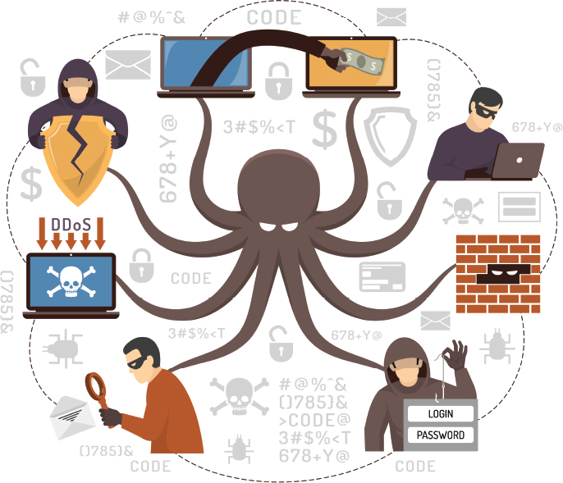
Identity Theft and Hackers
Hacking (1 of 4)
(Objective 9.2)
Hacker—anyone who unlawfully breaks into a computer system
Types of hackers
  White-hat (ethical hackers)
  Black-hat hackers
  Grey-hat hackers
Packet analyzer (sniffer)
Keylogger
Notes:
A hacker is most commonly defined as anyone who unlawfully breaks into a computer system.
There are numerous types of hackers:
White-hat hackers break into systems for nonmalicious reasons such as to test system security vulnerabilities or to expose undisclosed weaknesses.
Black-hat hackers break into systems to destroy information or for illegal gain.
Grey-hat hackers illegally break into systems to flaunt their expertise or to attempt to sell their services in repairing security breaches.
A packet analyzer (sniffer) is a program deployed by hackers that looks at (or sniffs) each packet as it travels on the Internet.
A keylogger is a program that captures all keystrokes made on a computer.

Slide 8
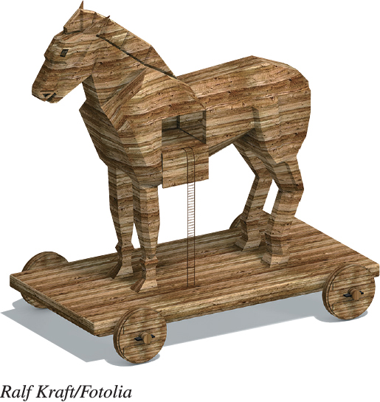
Identity Theft and Hackers
Hacking (2 of 4)
(Objective 9.2)
Trojan horses—appear to be useful but run malicious code
Backdoor programs and
rootkits allow hackers to
gain access to a computer
Notes:
A Trojan horse is a program that appears to be something useful or desirable but does something malicious in the background without your knowledge.
Backdoor programs and rootkits are programs that allow hackers to gain access to your computer and take almost complete control of it without your knowledge.

Slide 9
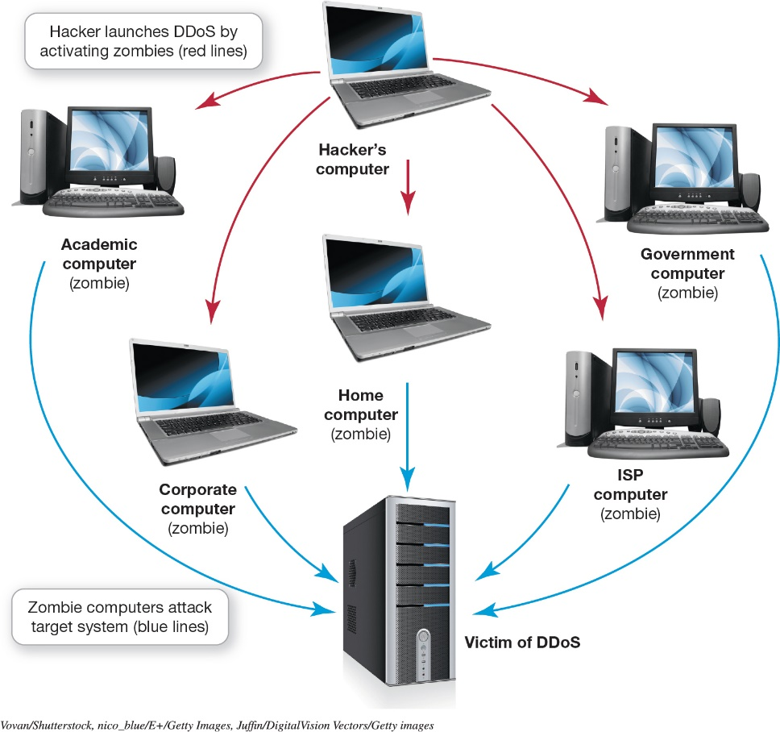
Identity Theft and Hackers
Hacking (3 of 4)
(Objective 9.2)
Zombies—computers
that a hacker controls
Denial-of-service
  Legitimate users are
  denied access to a
  computer system
  System shuts down
DDoS
Botnet—large group of software running on zombie computers
Notes:
A computer that a hacker controls is referred to as a zombie. Zombies are often used to launch denial-of-service attacks on other computers.
In a denial-of-service attack, legitimate users are denied access to a system because a hacker is repeatedly making requests of that system through a computer the hacker has taken over as a zombie. A computer can handle only a certain number of requests for information at one time. When it is flooded with requests, it shuts down and refuses to answer any requests for information, even if the requests are from a legitimate user.
A distributed denial-of-service (DDoS) attack launches DoS attacks from more than one zombie at the same time.
A botnet is a large group of software running on zombie computers.

Slide 10
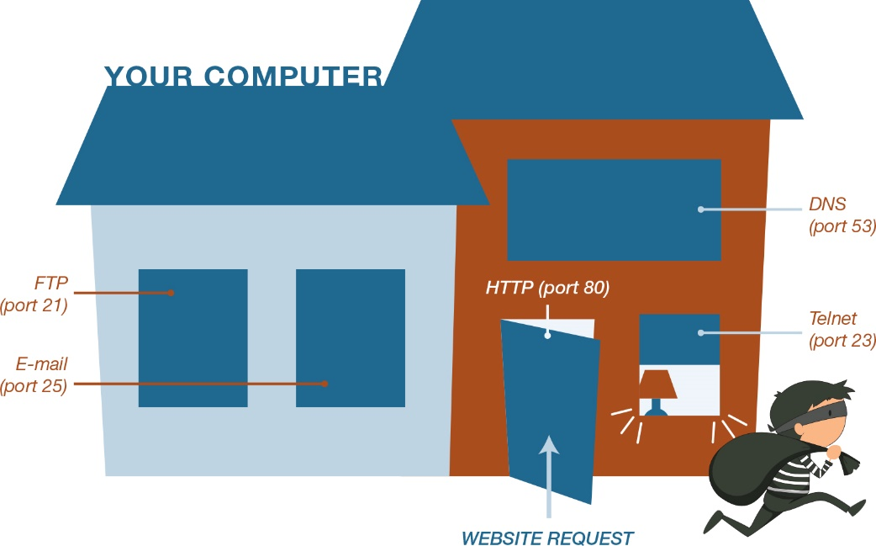
Identity Theft and Hackers
Hacking (4 of 4)
(Objective 9.2)
Exploit kits—software that runs on servers searching for vulnerabilities
Logical ports are virtual, not physical, communications paths
Notes:
Exploit kits are software programs that run on servers searching for vulnerabilities.
Logical ports are virtual, not physical, communications paths.

Slide 11
Computer Viruses
Virus Basics
(Objective 9.3)
Virus—program that attaches to a computer program to spread to other computers
Main purpose—replicate itself and copy its code into as many other host files as possible
Secondary objectives can be destructive
Smartphones and tablets can be infected with viruses
Notes:
A virus is a program that attaches to a computer program to spread to other computers.
Its main purpose is to replicate itself and copy its code into as many other host files as possible.
Secondary objectives range from displaying annoying messages on the computer screen to destroying files or the contents of entire hard drives. Viruses can be destructive.
Smartphones and tablets can be infected with viruses.

Slide 12
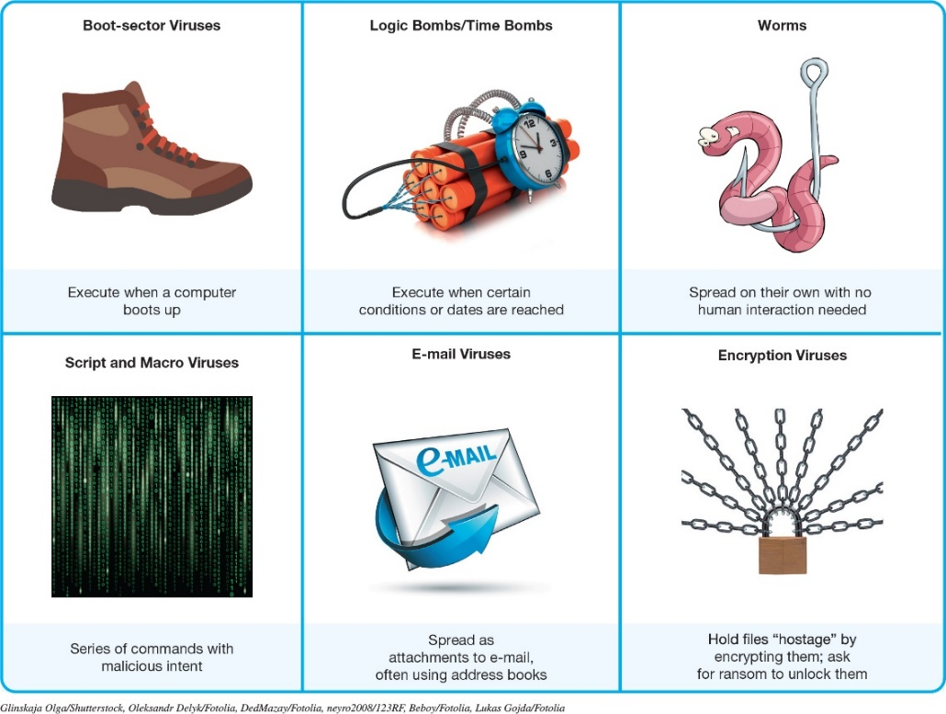
Computer Viruses
Types of Viruses (1 of 2)
(Objective 9.4)
Boot-sector viruses
Logic bombs and time bombs
Worms
Script and macro viruses
E-mail viruses
Encryption viruses
Notes:
Viruses can come in many types:
Boot-sector viruses replicates themselves onto a hard drive’s master boot record.
A logic bomb is a virus that is triggered when certain logical conditions are met, such as opening a file or starting a program a certain number of times. A time bomb is a virus that is triggered by the passage of time or on a certain date.
Worms work independently of host file execution and are much more active in spreading themselves.
Script and macro viruses are a series of commands that are executed without one’s knowledge.
E-mail viruses use the address book in the victim’s e-mail system to distribute themselves.
When encryption or ransomware viruses infect a computer, they run a program that searches for types of data files and compresses them. You then receive a message that asks you to send payment to an account if you want to receive the program to decrypt your files.

Slide 13
Computer Viruses
Types of Viruses (2 of 2)
(Objective 9.4)
Classified by methods used to avoid detection
  Polymorphic viruses change their code or periodically rewrite themselves to avoid detection
  Multi-partite viruses are designed to infect multiple file types
  Stealth viruses temporarily erase their code from the files where they reside and hide in active memory
Notes:
Viruses can be classified by the methods they take to avoid detection:
A polymorphic virus changes its code to avoid detection. Most polymorphic viruses infect a particular type of file.
A multipartite virus is designed to infect multiple file types in an effort to fool the antivirus software that is looking for it.
Stealth viruses temporarily erase their code from the files where they reside and hide in the active memory of the computer.

Slide 14
Online Annoyances and Social Engineering
Online Annoyances (1 of 3)
(Objective 9.5)
Malware—software that has malicious intent
  Adware—software that displays sponsored advertisements
  Spyware—unwanted piggyback software
    Transmits information
    Uses tracking cookies
    Keystroke logger
Notes:
Malware is software that has a malicious intent.
Adware displays unsponsored advertisements.
Spyware is an unwanted program that downloads with other software from the Internet and runs in the background.
Spyware transmits information about you.
Many spyware programs use tracking cookies.
A keystroke logger program monitors keystrokes.

Slide 15
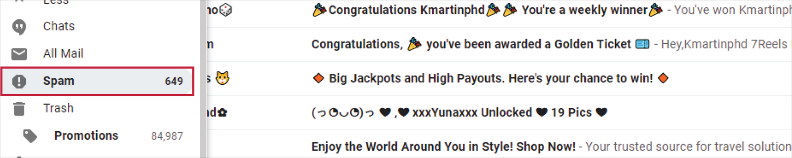
Online Annoyances and Social Engineering
Online Annoyances (2 of 3)
(Objective 9.5)
Spam—unwanted software or junk e-mail
Tactics to minimize spam (spam filter)
Notes:
Spam is unwanted or junk e-mail.
A spam filter is an option you can select in your e-mail account that places known or suspected spam messages into a special folder.

Slide 16
Online Annoyances and Social Engineering
Online Annoyances (3 of 3)
(Objective 9.5)
Cookies—small text files received when you visit a website
Help companies determine the effectiveness of their marketing
They do not search your hard drive for personal information
May invade your privacy
Pose no security threat
Notes:
Cookies are small text files that some websites automatically store on your hard drive when you visit them.
Companies use this information to determine the traffic flowing through their website and the effectiveness of their marketing strategy.
Cookies do not go through your hard drive in search of personal information.
The main concern is that advertisers will use this information indiscriminately, thus invading your privacy.
Cookies pose no security threat because it is virtually impossible to hide a virus or malicious software program in a cookie.

Slide 17
Online Annoyances and Social Engineering
Social Engineering (1 of 3)
(Objective 9.6)
Social engineering—any technique using social skills to generate human interaction
  Lures individuals to reveal sensitive information
Pretexting involves creating a scenario that sounds legitimate
Notes:
Social engineering is any technique using social skills to generate human interaction with the purpose of luring individuals to reveal sensitive information.
Pretexting involves creating a scenario that sounds legitimate.

Slide 18
Online Annoyances and Social Engineering
Social Engineering (2 of 3)
(Objective 9.6)
Phishing—luring people into revealing information
Pharming—malicious code planted on a computer to gather information
Guidelines to avoid schemes
Notes:
Phishing lures Internet users to reveal personal information.
Pharming occurs when malicious code is planted on your computer.
These guidelines help to avoid such schemes:
Never reply directly to any e-mail asking for personal information.
Don’t click on a link in an e-mail.
Check with the company asking for information.
Never give personal information over the Internet unless you know the site is secure.
Use phishing filters.
Use Internet security software that’s constantly being updated.

Slide 19
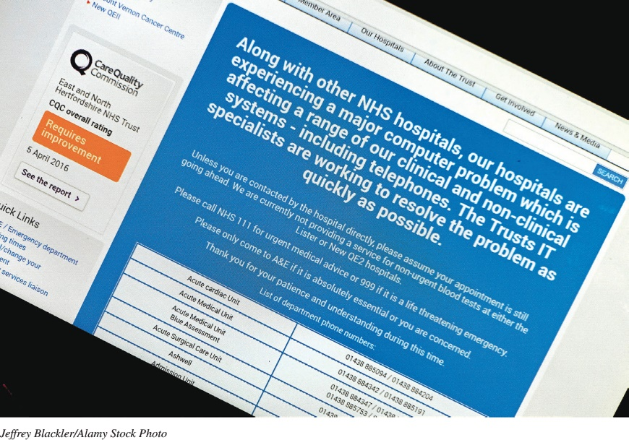
Online Annoyances and Social Engineering
Social Engineering (3 of 3)
(Objective 9.6)
Scareware—malware that attempts to convince you something is wrong … and to pay money to fix it
Notes:
Scareware is a type of malware that downloads onto your computer and tries to convince you that your computer is infected with a virus or other type of malware.
You’re then directed to a website where you can buy fake removal or antivirus tools that provide little or no value.
Scareware is a social engineering technique because it uses people’s fear of computer viruses to convince them to part with their money.

Slide 20
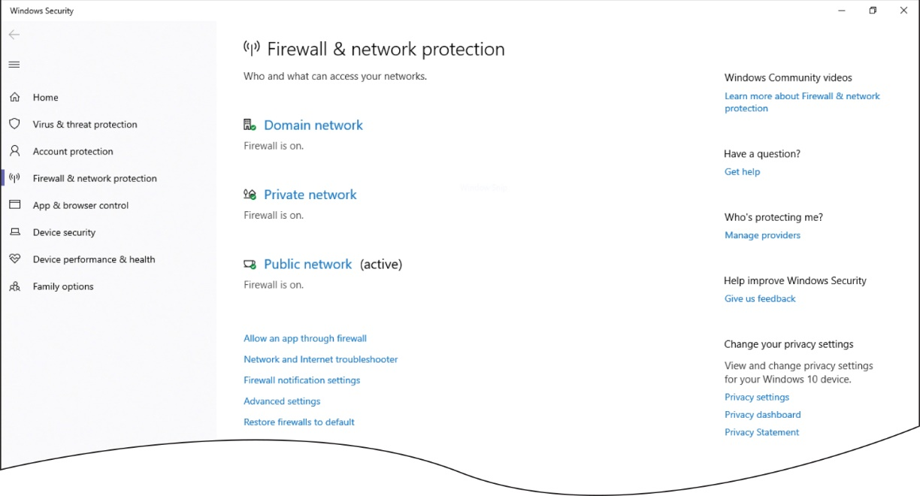
Restricting Access to Your Digital Assets
Firewalls (1 of 3)
(Objective 9.7)
Firewall—software or hardware designed to protect computers from hackers
Windows and macOS include firewalls
Notes:
A firewall is a software program or hardware device designed to protect computers from hackers.
Both Windows and macOS include reliable firewalls. Windows Firewall displays the status of a firewall.

Slide 21
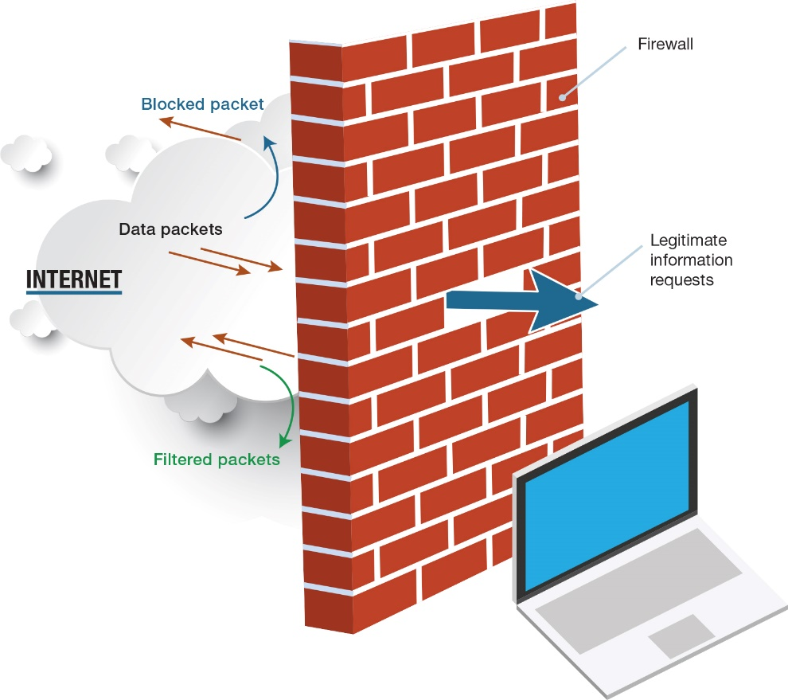
Restricting Access to Your Digital Assets
Firewalls (2 of 3)
(Objective 9.7)
Security suites include firewall software
Notes:
Antivirus protection is included in comprehensive Internet security packages such as Norton Security Suite or Trend Micro Internet Security.

Slide 22
Restricting Access to Your Digital Assets
Firewalls (3 of 3)
(Objective 9.7)
Packet filtering
  Filter out packets sent to logical ports
Logical port blocking
  Completely refuses requests from the Internet asking for access to specific ports
Network address translation
  Assign IP addresses on a network
Notes:
Firewalls can be configured so that they filter out packets sent to specific logical ports in a process known as packet filtering.
Firewalls can also be configured to completely refuse requests from the Internet asking for access to specific ports in a process known as logical port blocking.
Firewalls use a process called network address translation to assign internal IP addresses on a network.

Slide 23
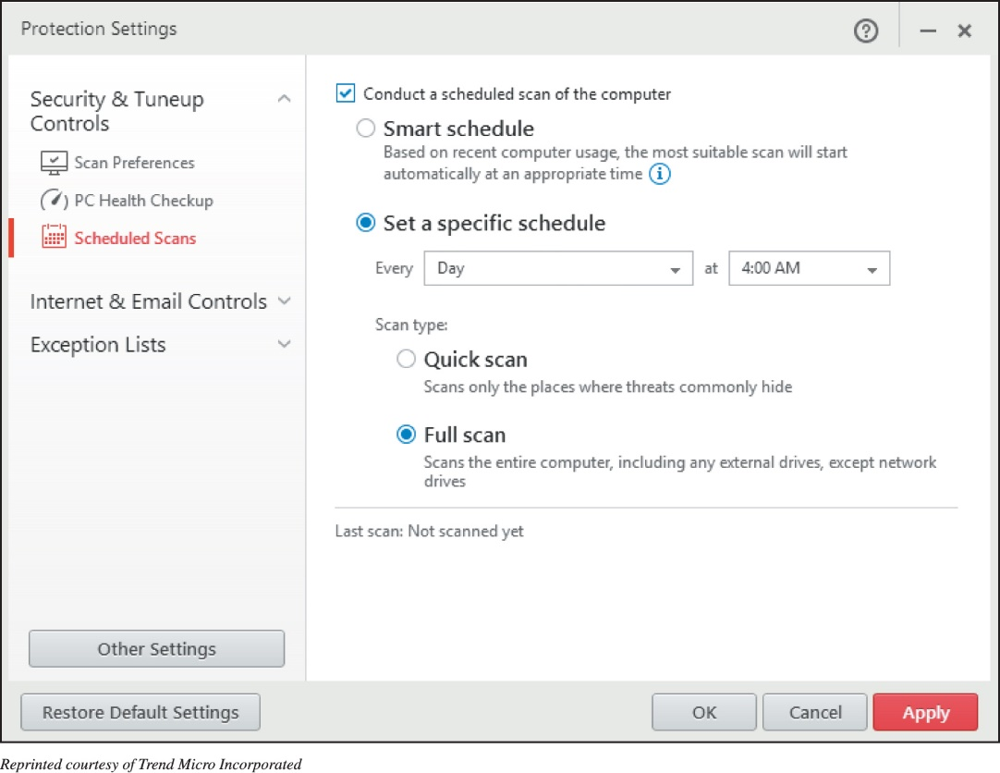
Restricting Access to Your Digital Assets
Preventing Virus Infections (1 of 3)
(Objective 9.8)
Antivirus software
  Detects viruses and
  protects your computer
Popular programs
  Symantec
  Trend Micro
  Avast
Notes:
Antivirus software is specifically designed to detect viruses and protect your computer and files from harm.
Symantec, Trend Micro, and Avast are among the companies that offer highly rated antivirus software packages.

Slide 24
Restricting Access to Your Digital Assets
Preventing Virus Infections (2 of 3)
(Objective 9.8)
Virus signature
  Portion of the virus code that’s unique to a particular computer virus
Quarantining
  Placing virus in a secure area so it won’t spread to other files
Inoculation
  Records key attributes about your computer files and keep stats in secure place
Notes:
A virus signature is a portion of the virus code that’s unique to a particular computer virus.
Quarantining involves placing virus in a secure area so it won’t spread to other files.
During inoculation, key attributes about your computer files are recorded and keep stats in secure place.

Slide 25
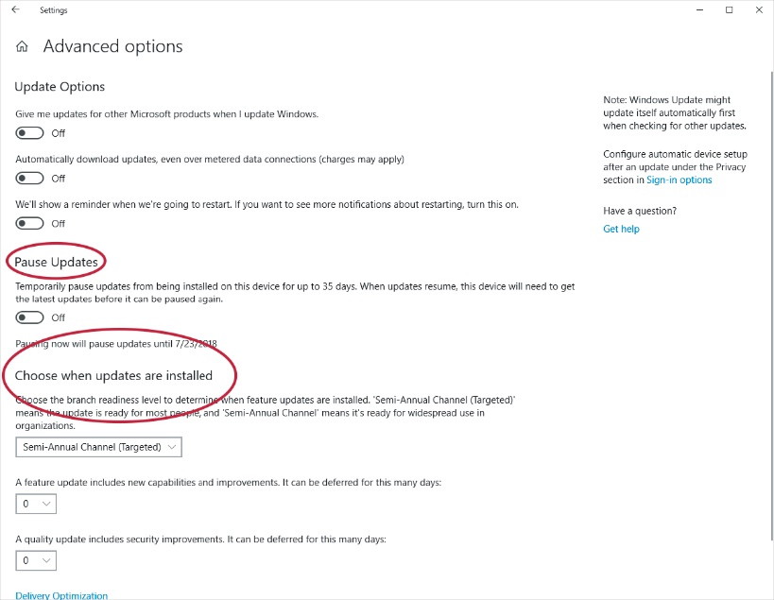
Restricting Access to Your Digital Assets
Preventing Virus Infections (3 of 3)
(Objective 9.8)
Drive-by download
  Exploits weaknesses in operating systems
  Combat by keeping OS up to date
Notes:
Many viruses exploit weaknesses in operating systems. This type of attack, known as a drive-by download, affects almost 1 in 1,000 web pages.
To combat these threats, make sure your OS is up to date and contains the latest security patches.

Slide 26
Restricting Access to Your Digital Assets
Authentication: Passwords and Biometrics (1 of 2)
(Objective 9.9)
Strong passwords—at least eight characters and use:
  Uppercase
  Lowercase
  Numeric
  Symbols
Notes:
You should create strong passwords—ones that are difficult for hackers to guess.
Typically they should be at least eight characters and use uppercase, lowercase, numeric, and symbol characters.

Slide 27
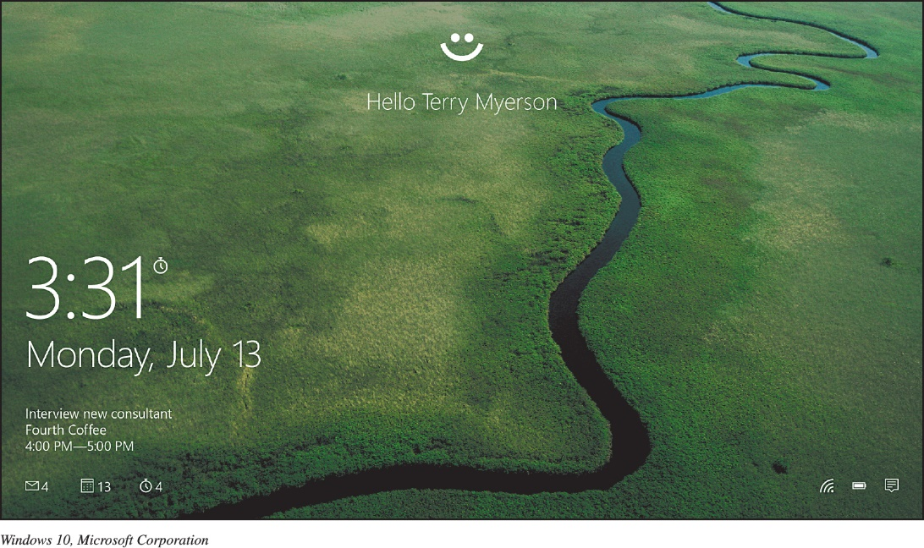
Restricting Access to Your Digital Assets
Authentication: Passwords and Biometrics (2 of 2)
(Objective 9.9)
Biometric Authentication Devices
  Fingerprint
  Iris pattern in eye
  Voice authentication
  Face pattern
  recognition
  Provide a high
  level of security
Notes:
A biometric authentication device is a device that reads a unique personal characteristic such as a fingerprint or the iris pattern in your eye and converts it to a digital code.
Because no two people have the same biometric characteristics, these devices provide a high level of security.
Other biometric devices, including voice authentication and facial recognition systems, are now widely offered in notebook computers, tablets, and smartphones.
This figure shows Windows Hello, which brings facial recognition for login to laptops and mobile devices that have an integrated camera.

Slide 28
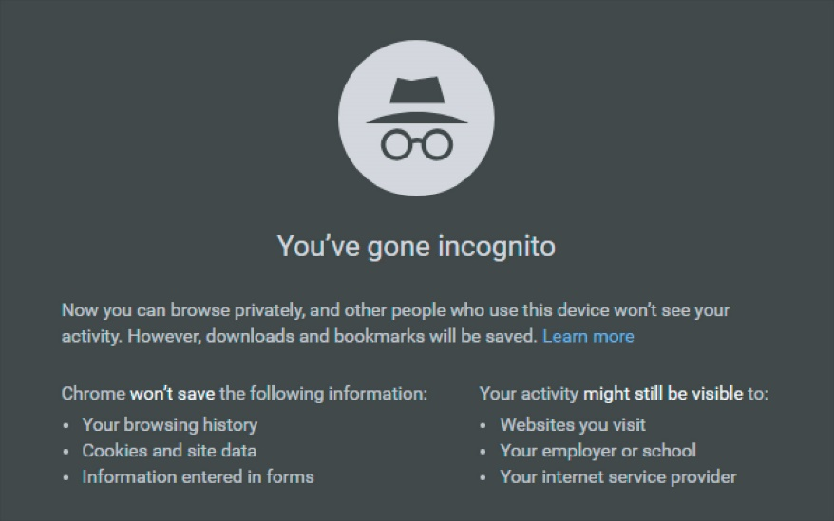
Restricting Access to Your Digital Assets
Anonymous Web Surfing: Hiding from Prying Eyes
(Objective 9.10)
Privacy tools
  Private Browsing
  InPrivate
  Incognito
Portable privacy devices
  Kingston Personal Flash Drives
Virtual private networks (VPNs)
  Secure networks that are established using the public Internet infrastructure
Notes:
Privacy tools connected with web browsers include:
Private Browsing,
InPrivate, and
Incognito.
Portable privacy devices, such as Kingston Personal Flash Drives, are available.
Virtual private networks (VPNs) are secure networks that are established using the public Internet infrastructure.

Slide 29
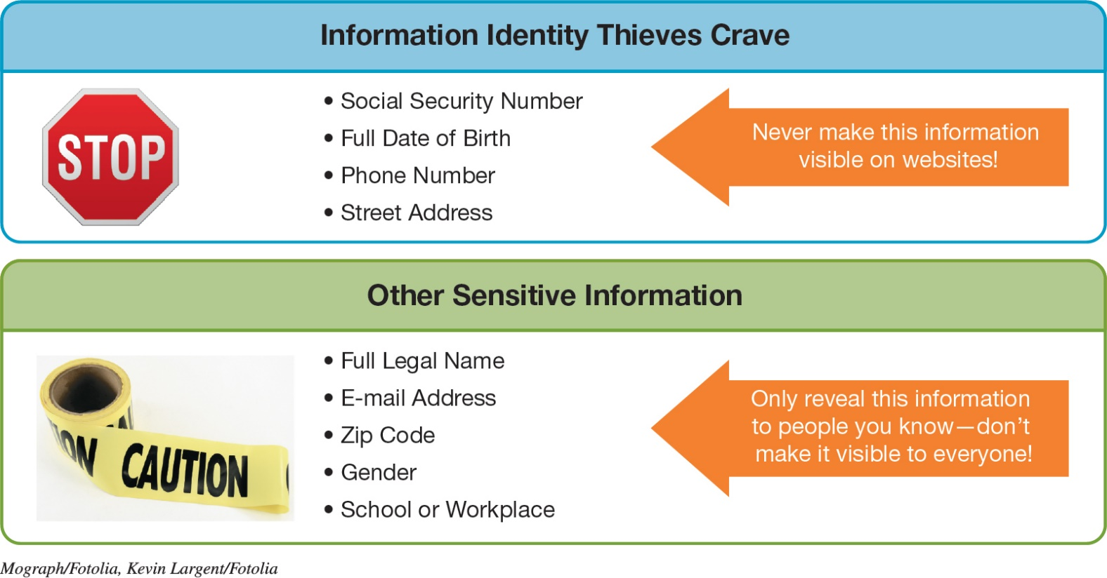
Keeping Your Data Safe
Protecting Your Personal Information
(Objective 9.11)
Reveal as little information as possible
In Facebook, change your privacy settings
Notes:
What information should not be shared on websites?
Reveal as little information as possible in social media.
In Facebook, change your privacy settings.

Slide 30
Keeping Your Data Safe
Backing Up Your Data (1 of 2)
(Objective 9.12)
Backups—copies of files used to replace lost or damaged originals
Files to backup
  Data files
  Program files
Types of backups
  Full
  Incremental
  Image
Notes:
Backups are copies of files used to replace the originals if they’re lost or damaged.
Files to backup include data files and program files.
Types of backups include full, incremental, and image.

Slide 31
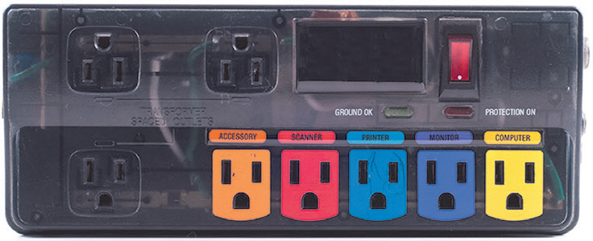
Protecting Your Physical Computing Assets
Environmental Factors and Power Surges
(Objective 9.13)
Power surges
  Old or faulty wiring
  Downed power lines
  Lightning strikes
  Malfunctions at electric company substations
Surge protector / Whole-house surge protector
  Replace every 2–3 years
  Use with all devices that have solid-state components
Notes:
Power surges occur when an electrical current is supplied in excess of normal voltage. Old or faulty wiring, downed power lines, malfunctions at electric company substations, and lightning strikes can all cause power surges.
A surge protector protects your computer.
Replace surge protectors every 2–3 years or after a major surge.
All electronic devices that have solid-state components, such as TVs, stereos, printers, and cell phones, should be connected to a surge protector.

Slide 32
Protecting Your Physical Computing Assets
Preventing and Handling Theft
(Objective 9.14)
Three main security concerns with mobile devices:
  Keeping them from being stolen
  Keeping data secure in case they are stolen
  Finding a device if it is stolen
Notes:
You have three main security concerns with mobile devices:
Keeping them from being stolen.
Keeping data secure in case they are stolen.
Finding a device if it is stolen.

Slide 33

Copyright
All rights reserved. No part of this publication may be reproduced, stored in a retrieval system, or transmitted, in any form or by any means, electronic, mechanical, photocopying, recording, or otherwise, without the prior written permission of the publisher. Printed in the United States of America.

