Slide 1

Technology in Action
16th Edition
Chapter 10
Behind the Scenes: Software Programming

Slide 2
Learning Objectives (1 of 3)
10.1 Describe the importance of programing to both software developers and users.
10.2 Summarize the stages of the system development life cycle.
10.3 Define programming and list the steps in the program development life cycle.
10.4 Describe how programmers construct a problem statement from a description of a task.
10.5 Explain how programmers use flow control and design methodologies when developing algorithms.
Notes:
The learning objectives are:
10.1 Describe the importance of programing to both software developers and users.
10.2 Summarize the stages of the system development life cycle.
10.3 Define programming and list the steps in the program development life cycle.
10.4 Describe how programmers construct a problem statement from a description of a task.
10.5 Explain how programmers use flow control and design methodologies when developing algorithms.

Slide 3
Learning Objectives (2 of 3)
10.6 Discuss the categories of programming languages and the roles of the compiler and the integrated development environment in coding.
10.7 Identify the role of debugging in program development.
10.8 Explain the importance of testing and documentation in program development.
10.9 Discuss the driving factors behind the popularity of various programming languages.
Notes:
Additional learning objectives are:
10.6 Discuss the categories of programming languages and the roles of the compiler and the integrated development environment in coding.
10.7 Identify the role of debugging in program development.
10.8 Explain the importance of testing and documentation in program development.
10.9 Discuss the driving factors behind the popularity of various programming languages.

Slide 4
Learning Objectives (3 of 3)
10.10 Summarize the considerations in identifying an appropriate programming language for a specific setting.
10.11 Compare and contrast modern programming languages.
10.12 State key principles in the development of future programming languages.
Notes:
Additional learning objectives are:
10.10 Summarize the considerations in identifying an appropriate programming language for a specific setting.
10.11 Compare and contrast modern programming languages.
10.12 State key principles in the development of future programming languages.

Slide 5
Understanding Programming
Some tasks are complex
  Require creative thought
  Require human touch
Some tasks are candidates for automation
  Repetitive
  Work with electronic information
  Follow a series of clear steps
Notes:
Every day we face a wide array of tasks. Some tasks are complex. These tasks require creative thought and human touch.
But some tasks are candidates for automation with computers—automation achieved through programming. This includes:
Tasks that are repetitive.
Those that work with electronic information.
Those that follow a series of clear steps.

Slide 6

Life Cycle of an Information System
The Importance of Programming
(Objective 10.1)
A career in programming offers:
  Plentiful jobs
  Strong salaries
  Telecommuting is often
  easy to arrange
Programming is necessary when there is no existing software for the task
Macros can execute a complicated sequence of steps with a single command
Notes:
A career in programming offers many advantages:
Jobs are plentiful.
Salaries are strong.
Telecommuting is often easy to arrange.
If you can’t find an existing software product to accomplish a task, programming is mandatory.
Macros can execute a complicated sequence of steps with a single command.

Slide 7
Life Cycle of an Information System
System Development Life Cycle (1 of 2)
(Objective 10.2)
Information system—collection of pieces working to achieve a common goal
An information system includes
  Data
  People
  Procedures
  Hardware
  Software
Notes:
Generally speaking, a system is a collection of pieces working together to achieve a common goal. Your body, for example, is a system of muscles, organs, and other groups of cells working together.
An information system includes data, people, procedures, hardware, and software that help in planning and decision making. Information systems help run an office and coordinate online-purchasing systems and are behind database-driven applications used by Amazon and Netflix.

Slide 8
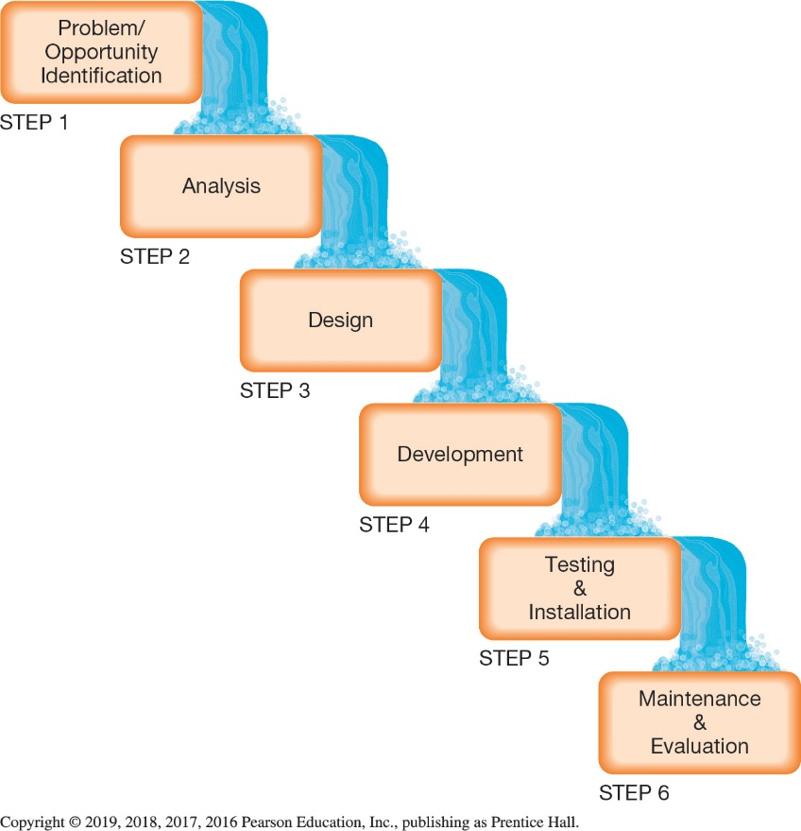
Life Cycle of an Information System
System Development Life Cycle (2 of 2)
(Objective 10.2)
Steps of the SDLC
  Problem and opportunity
  Identification
  Analysis by developing the
  program specification
  Design using data flow diagrams
  Development of the actual program
  Testing and installation to insure it works
  Maintenance and evaluation to maintain usefulness
Notes:
There are six steps in a system development life cycle (SDLC) model.
Corporations form a development committee to evaluate proposals.
Analysts explore the problem, develop a program specification, define user requirements, and recommend a plan of action.
A plan using flowcharts and data-flow diagrams helps programmers.
Program development begins next.
Testing and installing the program ensure it works properly.
Program performance is monitored to determine whether the program is meeting the needs of end users.

Slide 9
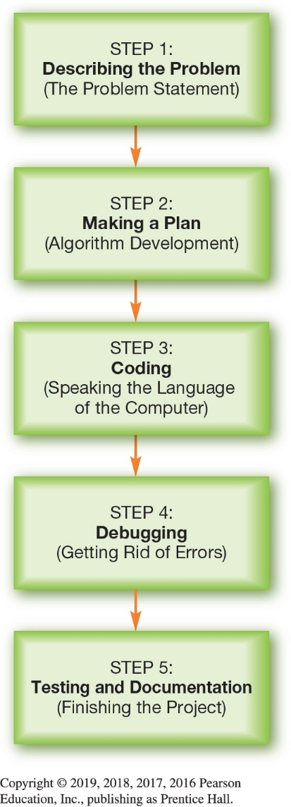
Life Cycle of a Program
The Program Development Life Cycle
(Objective 10.3)
Programming—translates a task into commands that a computer uses to perform a task
Program development life cycle (PDLC)
  Stages a project goes through from development to deployment
Notes:
Programming is the process of translating a task into commands that a computer uses to perform a task.
Program development life cycle (PDLC) is the process of moving through the stages a project goes through from development to deployment.

Slide 10
Life Cycle of a Program
The Problem Statement (1 of 2)
(Objective 10.4)
  Problem statement
  Clear description of tasks to be performed
  Understand goals of programming
Interact with users
  Data is raw input
  Information is the result
  Method is the process of converting inputs into proper outputs
Notes:
The problem statement is the starting point of programming.
It provides a clear description of tasks to be performed.
It helps the programmer understand goals of programming.
The goal of a good problem statement is to have programmers interact with users in these three areas:
Data is the raw input that users have at the start of the job.
Information is the result needed at the end of the problem.
Method is the process of converting inputs into proper outputs.

Slide 11
Life Cycle of a Program
The Problem Statement (2 of 2)
(Objective 10.4)
  Error handling—what a program does when errors happen
  Testing plan
    Lists specific input numbers expected to be entered by users
    Lists output values that a program would return for those input values
Notes:
Error handling describes what the program should do if the input is invalid.
A testing plan lists specific input numbers expected to be entered by users and lists output values that a program would return for those input values.

Slide 12
Life Cycle of a Program
Algorithm Development (1 of 5)
(Objective 10.5)
Algorithm—set of steps that describe what a program must do to complete its task
Algorithms represented through flowcharts
  Provide visual representations of patterns
Pseudocode is a text-based approach to documenting an algorithm
Notes:
An algorithm is a set of steps that describe what a program must do to complete its task.
Algorithms can be represented through flowcharts.
They provide visual representations of patterns.
Pseudocode is a text-based approach to documenting an algorithm.

Slide 13
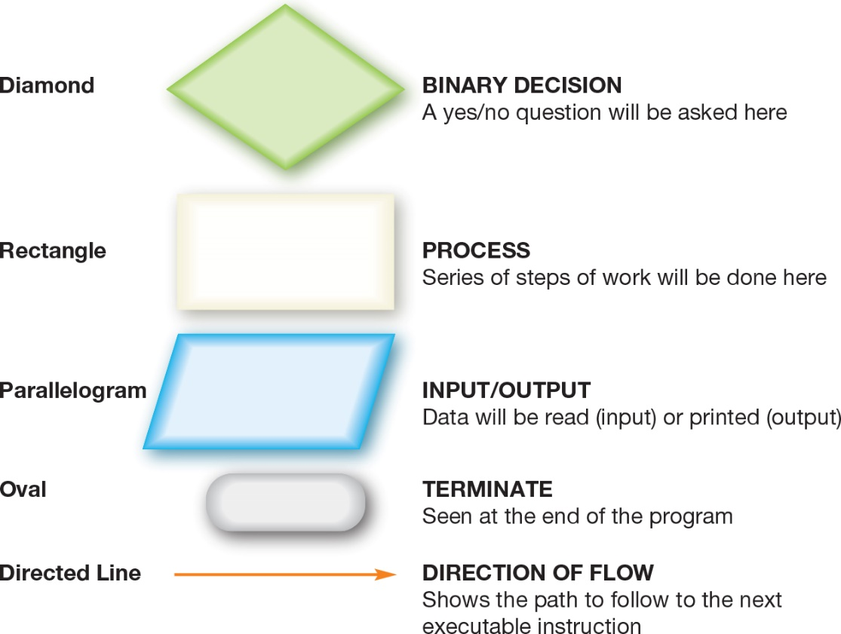
Life Cycle of a Program
Algorithm Development (2 of 5)
(Objective 10.5)
Flowcharts use symbols to provide a visual representation of an algorithm
Notes:
Flowcharts use symbols to provide a visual representation of the patterns the algorithm. This figure shows the flowcharting symbols.

Slide 14
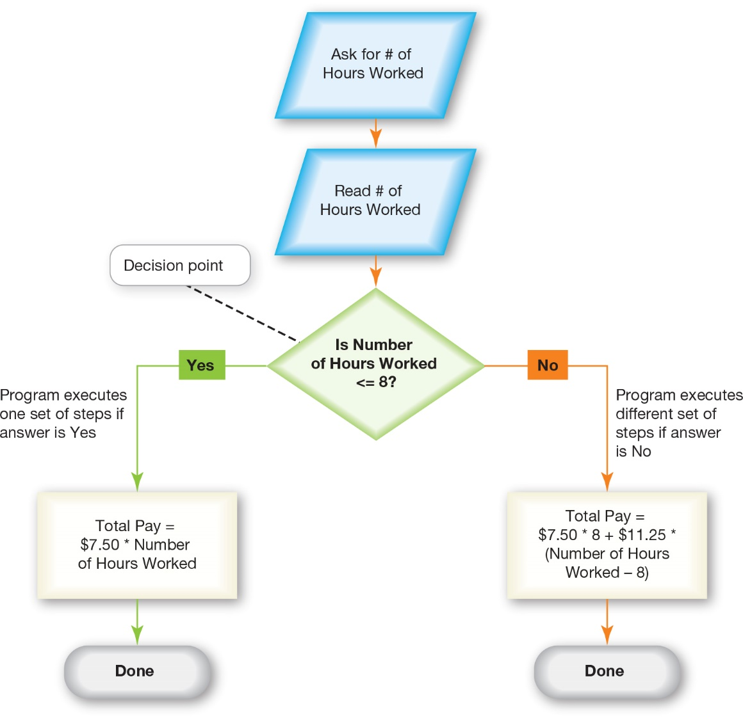
Life Cycle of a Program
Algorithm Development (3 of 5)
(Objective 10.5)
Flow Control
  Decision points
    Binary decisions
    Loops
Notes:
Algorithms include decision points, which are places where the program must choose from a list of actions based on the value of a certain input.
Binary decisions are questions that can be answered with either yes (true) or no (false).
With loops, when a question is asked, i the answer is yes, actions are performed. Once the actions have finished, the question is asked again, creating a loop. When the answer is no, the algorithm moves to the first step that follows the loop.

Slide 15
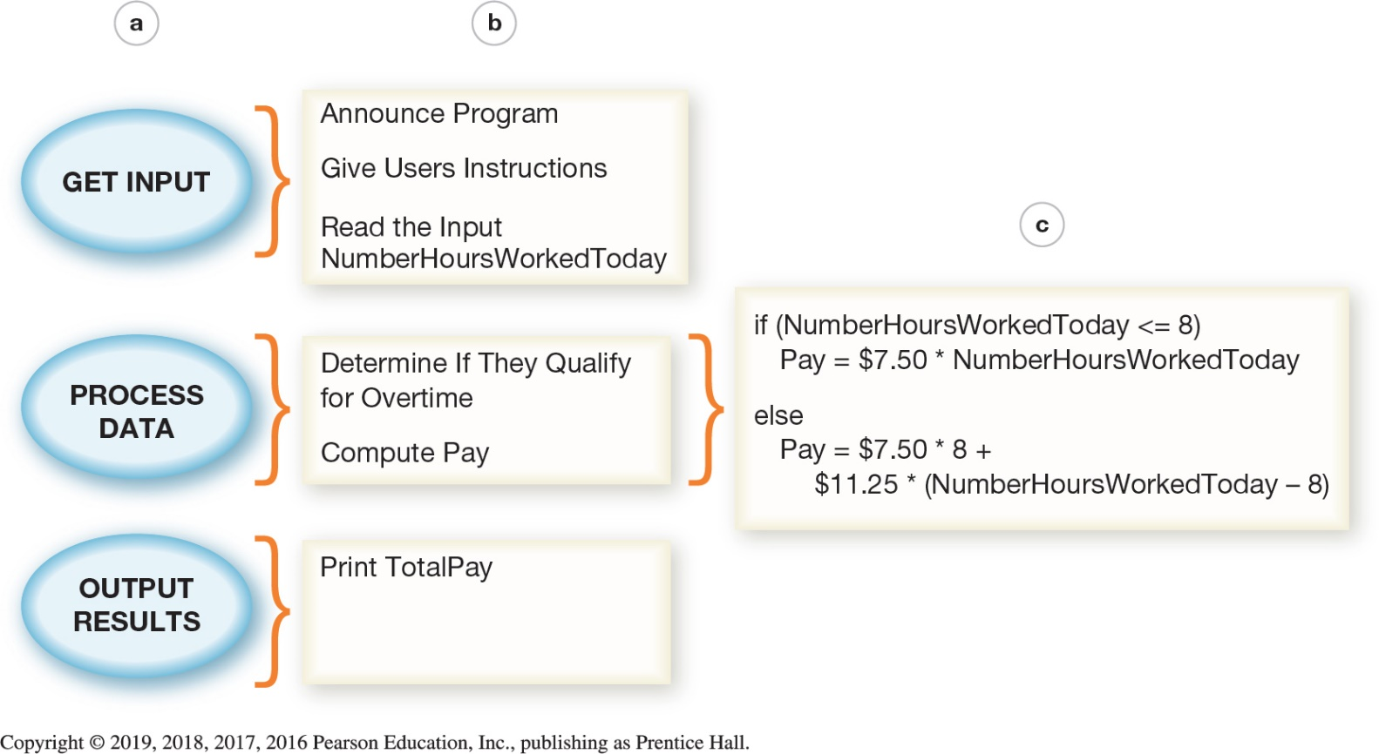
Life Cycle of a Program
Algorithm Development (4 of 5)
(Objective 10.5)
Top-down design—approach in which a problem is broken into a series of high-level tasks
Notes:
Top-down design is an approach in which a problem is broken into a series of high-level tasks.
In this figure:
The top-down design is applied to the highest level of tasks in our parking garage example,
The tasks are further refined into subtasks, and
Subtasks are refined into a sequence of instructions—an algorithm.

Slide 16
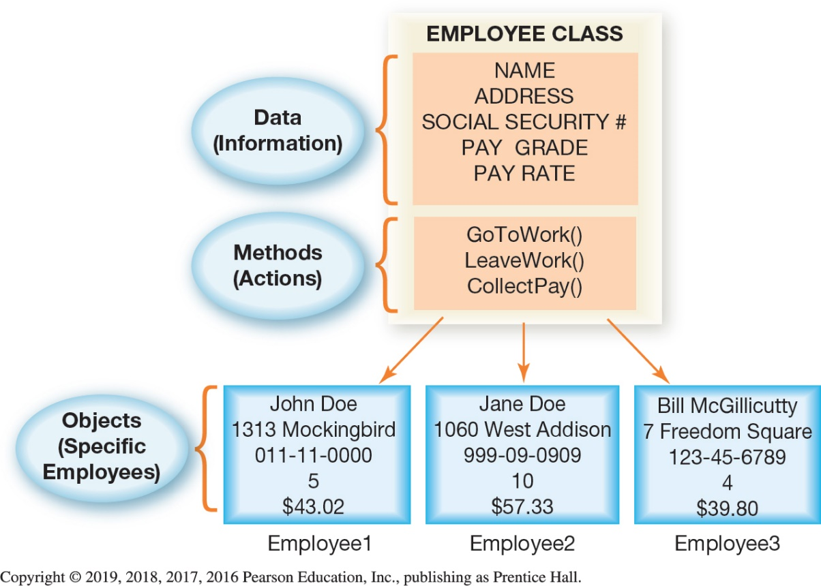
Life Cycle of a Program
Algorithm Development (5 of 5)
(Objective 10.5)
Object-oriented analysis—programmers identify model classes to solve a problem
Reusability
Inheritance
  Classes
  Base class
  Derived class
Notes:
In object-oriented analysis, programmers first identify all the categories of inputs the program is meant to solve. These categories are called classes.
An important aspect of object-oriented design is that it leads to reusability.
Inheritance means that a new class can automatically pick up all the data and methods of an existing class and then can extend and customize those to fit its own specific needs.
The original class is called the base class, and the new, modified class is called the derived class.
Programmers may need to create several different examples of a class. Each of these examples is an object. As seen in the figure, John Doe, Jane Doe, and Bill McGillicutty are Employee objects (specific examples of the Employee class).

Slide 17
Life Cycle of a Program
Coding (1 of 5)
(Objective 10.6)
  Coding—translating an algorithm into CPU instructions
Programmers move from algorithm to code by
  Identifying key pieces of information
  Identifying the flow of each step
  Converting the algorithm into specific programming language
Notes:
Translating an algorithm into a programming language is called coding.
Once programmers create an algorithm, they select the best programming language for the problem and then translate the algorithm into that language. Translating an algorithm into a programming language is the act of coding.
Once programmers have an algorithm, they identify the key pieces of information the algorithm uses to make decisions. Then they convert the algorithm into computer code in a specific programming language.

Slide 18
Life Cycle of a Program
Coding (2 of 5)
(Objective 10.6)
Programming language
  A “code” for instructions CPU can perform
  Languages use special words and strict rules
  Allows control of CPU without knowing hardware details
  Five generations of languages
Notes:
A programming language is a kind of “code” for the set of instructions the CPU knows how to perform. Computer programming languages use special words and strict rules so that programmers can control the CPU without having to know all of its hardware details. There are five generations of languages.

Slide 19
Life Cycle of a Program
Coding (3 of 5)
(Objective 10.6)
Portability—capability to move a solution from one type of computer to another
Variables are the input and output a program manipulates
  Variable declarations tell the system to allocate space in RAM
Comments are added to explain the purpose of a section of code
Notes:
Portability is the capability to move a solution from one type of computer to another.
Variables are the input and output a program manipulates.
Variable declarations tell the system to allocate space in RAM.
Comments are added to explain the purpose of a section of code.

Slide 20
Life Cycle of a Program
Coding (4 of 5)
(Objective 10.6)
Compilation—process of converting code into machine language
Compiler understands syntax of programming language and structure of CPU
  Reads source code
  Creates an executable program
Some languages use an interpreter
  Translates into an intermediate form
Notes:
Compilation is the process by which code is converted into machine language—the language the CPU can understand (1s and 0s).
A compiler is a program that understands both the syntax of the programming language and the exact structure of the CPU.
An interpreter translates the source code into an intermediate form, line by line. Each line is executed as it’s translated. The finished program runs faster than an interpreter.

Slide 21
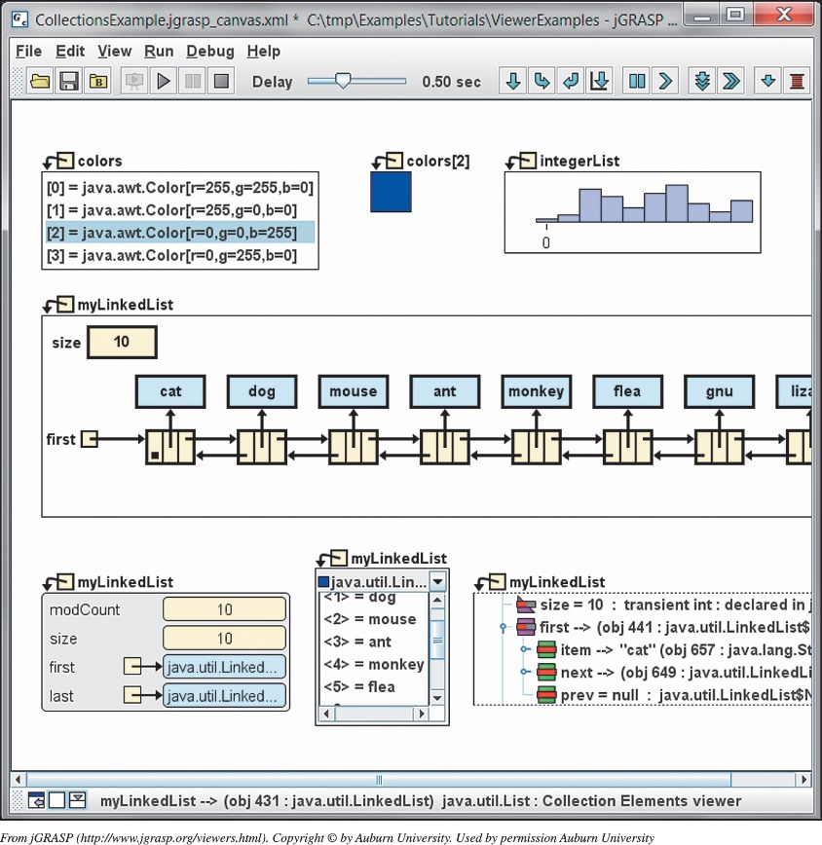
Life Cycle of a Program
Coding (5 of 5)
(Objective 10.6)
IDE—helps programmers write and test their programs
Notes:
An integrated development environment (IDE) is a developmental tool that helps programmers write and test their programs.

Slide 22
Life Cycle of a Program
Debugging
(Objective 10.7)
Debugging—finding and correcting errors
Testing plan helps programmers know program has solved the problem
Logical errors
  Program runs but executes incorrectly
Runtime errors
  Dividing by zero
Notes:
Debugging is the process of running the program over and over to find and repair errors and to make sure the program behaves in the way it should.
A complete testing plan includes sample inputs that exercise all the error handling required as well as all the processing paths.
Logical errors in the problem are caught when the program executes.
Runtime errors include issues like dividing by zero.

Slide 23
Life Cycle of a Program
Testing and Documentation
(Objective 10.8)
Internal testing
External testing
Solving problems after beta testing
Finishing the project
Release to manufacturers (RTM)
Documentation
General availability (GA)
Notes:
In internal testing, a group uses the program in every possible way.
In external testing, people like those who will use the software work with it.
Before commercial release, software is often provided in a beta version to test sites or to interested users.
Releasing to other manufacturers is called release to manufacturers (or RTM).
Documentation is created.
Finally, the product is in general availability (or GA) and can be purchased by the public.

Slide 24
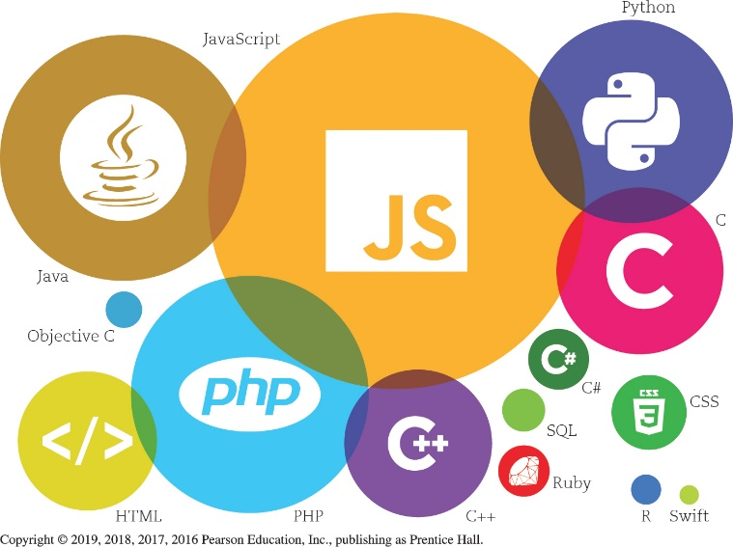
Many Programming Languages
Need for Diverse Languages
(Objective 10.9)
Examine job postings for programmers
Certain languages dominate in specific industries
Introductory programming course includes:
  Design
  Algorithm development
  Debugging techniques
  Project management
Notes:
One quick way to determine which languages are popular is to examine job postings for programmers. As of this presentation, the languages most in demand include C/C++ and Java.
In specific industries, certain languages tend to dominate the work.
A good introductory programming course will emphasize many skills and techniques. You should find a course that emphasizes design, algorithm development, debugging techniques, and project management.

Slide 25
Many Programming Languages
Selecting the Right Language
(Objective 10.10)
Need to consider:
  Space available
  Speed required
  Organizational resources available
  Type of target application
Visual programming language
  Scratch
  App Inventor
Notes:
A programming team considers several factors before selecting the language it will use for a specific project:
Space available,
Speed required,
Organizational resources available, and
Type of target application.
Visual programming languages, like Scratch and App Inventor, use graphical blocks to represent control elements and variables. Programming consists of clicking together these blocks to define program behavior.

Slide 26
Exploring Programming Languages
Tour of Modern Languages (1 of 4)
(Objective 10.11)
Visual Basic
  Prototype
  Rapid application development
  Used to build wide range of applications
  .Net Framework
  Application Programming Interface
C++
  Executes difficult, repetitive numerical calculations
Notes:
Programmers often like to build a prototype, or small model, of their program at the beginning of a large project. Prototyping is a form of rapid application development (RAD).
Microsoft Visual Basic (VB) is a powerful programming language used to build a wide range of Windows applications.
The Microsoft .NET (pronounced “dot net”) Framework is a software development environment designed to let websites “talk” to each other.
The rules are documented in an Application Programming Interface (API).
A Windows application that demands raw processing power to execute difficult, repetitive numerical calculations is most often a candidate for C/C++.

Slide 27
Exploring Programming Languages
Tour of Modern Languages (2 of 4)
(Objective 10.11)
Java and C#
  Collect information from networked computers
  Architecture neutral
  C# competes with Java
Objective C and Swift
  Used to program applications in macOS
  Object-oriented
  Swift introduced by Apple for iOS
Notes:
Java and C# were developed to collect information from networked computers. They are architecture neutral. C# competes with Java.
Objective C is the language most often used to program applications to run under macOS. It’s an object-oriented style of language. Swift is a new programming language introduced by Apple for developing for iOS and macOS.

Slide 28
Exploring Programming Languages
Tour of Modern Languages (3 of 4)
(Objective 10.11)
Hypertext Markup Language (HTML)
  Basic formatting language for web applications
Scripting languages
  Limited to performing a set of specialized tasks
  Examples: JavaScript, PHP, and VBScript
ASP, JSP, and PHP
  Used to build interactive web pages
Notes:
Hypertext Markup Language (HTML) is the basic formatting language for web applications.
Scripting languages are limited to performing a set of specialized tasks. Some examples include JavaScript, PHP, and VBScript.
ASP, JSP, and PHP are used to build interactive web pages.

Slide 29
Exploring Programming Languages
Tour of Modern Languages (4 of 4)
(Objective 10.11)
AJAX, XML, and JSON
  Create web applications that update and communicate with other computers
Mobile application development
  Speed the development of applications for mobile devices
Notes:
AJAX, XML, and JSON are languages used to create web applications that update and communicate with other computers.
Mobile application development speeds the development of applications for mobile devices for both the iPhone and Android platforms.

Slide 30
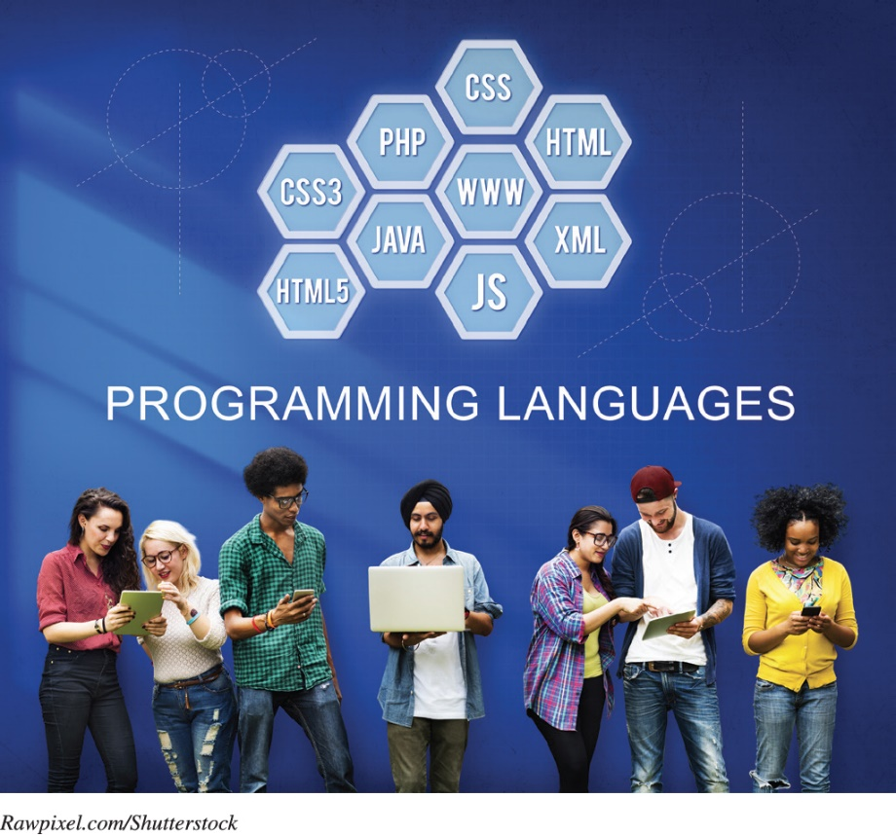
Exploring Programming Languages
Future of Programming Languages
(Objective 10.12)
Not easy to predict
Visual programming languages
Will always need
a variety
Notes:
It is never easy to predict which language will become the next “great” language.
The future may bring a push for the elegance of visual programming. Visual programming languages (VPLs) use visual modeling, creating the code using images to represent each statement, which helps programmers understand complex designs.
There will always be a variety of languages, each with its own personality.

Slide 31

Copyright
All rights reserved. No part of this publication may be reproduced, stored in a retrieval system, or transmitted, in any form or by any means, electronic, mechanical, photocopying, recording, or otherwise, without the prior written permission of the publisher. Printed in the United States of America.

