Slide 1

Technology in Action
16th Edition
Chapter 11
Behind the Scenes: Databases and Information Systems

Slide 2
Learning Objectives (1 of 2)
11.1 Explain what a database is and why databases are useful.
11.2 Describe features of flat databases.
11.3 Describe features of relational databases.
11.4 Describe features of object-oriented databases.
11.5 Describe features of multidimensional databases.
11.6 Explain how Web 2.0 data is managed in a database.
11.7 Describe how relational databases organize and define data.
Notes:
The learning objectives are:
11.1 Explain what a database is and why databases are useful.
11.2 Discuss the benefits of using a database.
11.3 Describe features of relational databases.
11.4 Describe features of object-oriented databases.
11.5 Describe features of multidimensional databases.
11.6 Explain how Web 2.0 data is managed in a database.
11.7 Describe how relational databases organize and define data.

Slide 3
Learning Objectives (2 of 2)
11.8 Describe how data is inputted and managed in a database.
11.9 Explain what data warehouses and data marts are and how they are used.
11.10 Describe data mining and how it works.
11.11 Describe the main types of business information systems and how they are used by business managers.
Notes:
Additional learning objectives are:
11.8 Describe how data is inputted and managed in a database.
11.9 Explain what data warehouses and data marts are and how they are used.
11.10 Describe data mining and how it works.
11.11 Describe the main types of business information systems and how they are used by business managers.

Slide 4
The Need for Databases
Database Basics
(Objective 11.1)
Database—collection of related data that can be stored, sorted, organized, and queried
Database advantages
  Manage large amounts of data efficiently
  Enable information sharing
  Promote data integrity
Data integrity—ensures database data is accurate and reliable
Notes:
A database is a collection of related data that can be stored, sorted, organized, and queried.
Database advantages include that
• they manage large amounts of data efficiently,
• they enable information sharing, and
• they promote data integrity.
Data integrity ensures that the data contained in the database is accurate and reliable.

Slide 5
Database Types
Flat Databases (1 of 2)
(Objective 11.2)
Flat databases—represented as a list or simple table
Flat database problems
  Data redundancy
  Data inconsistency
  Inappropriate data
  Incomplete data
Notes:
Flat databases are often represented as a list or simple table.
Flat databases can lead to several problems:
Duplicate data or data redundancy
Data inconsistency
Inappropriate data
Incomplete data

Slide 6
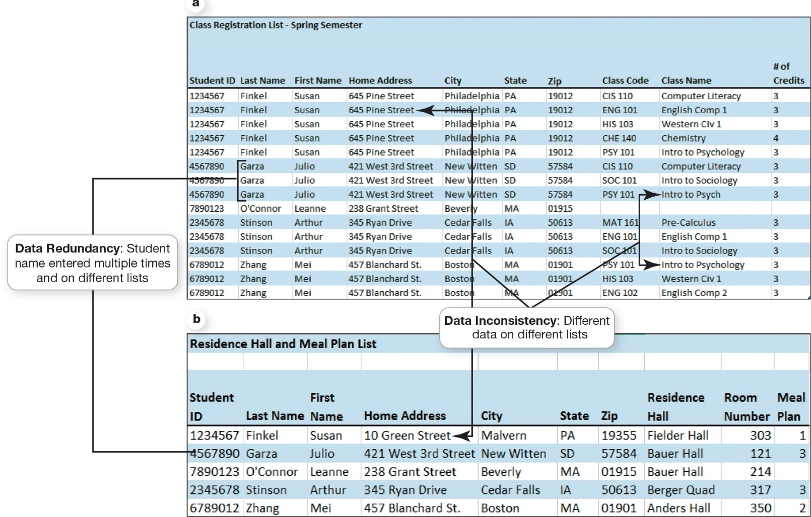
Database Types
Flat Databases (2 of 2)
(Objective 11.2)
Notes:
This figure shows examples of data redundancy and data inconsistency.

Slide 7
Database Types
Relational Databases (1 of 2)
(Objective 11.3)
Relational databases
  Organize data in table format
  Logically group similar data into a relationship
  Common field in one table linked to common field in second table
Types of relationships
  One-to-many
  One-to-one
  Many-to-many
Notes:
Relational databases operate by organizing data into various tables based on logical groupings. In relational databases, a link between tables that defines how the data is related is referred to as a relationship.
The common field in one table is linked to the common field in another table.
There are three types of relationships that can be created:
One-to-many
One-to-one
Many-to-many

Slide 8
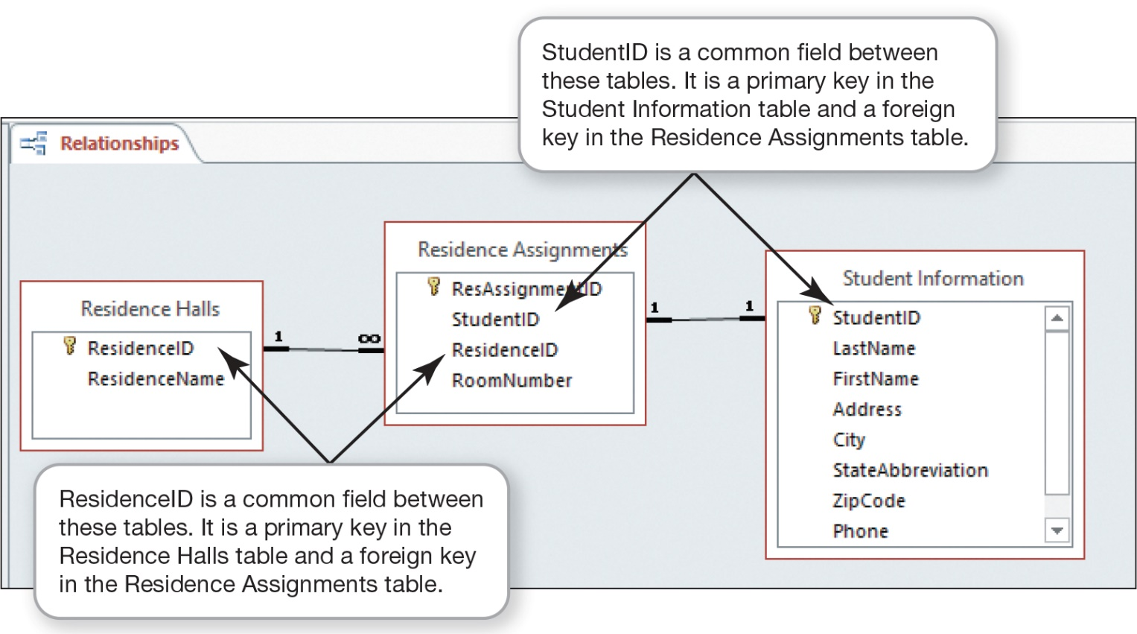
Database Types
Relational Databases (2 of 2)
(Objective 11.3)
Notes:
This figure shows tables linked to each other using a one-to-many relationship and a one-to-one relationship.

Slide 9
Database Types
Object-Oriented Databases
(Objective 11.4)
Object-oriented databases
  Store data in objects rather than tables
  Contain methods for processing or manipulating data
  Can store more types of data
  Can access data faster
  Better at handling unstructured data
  Data known as a binary large object (BLOB)
  Query language is designed to manipulate or extract data
Notes:
Object-oriented databases store data in objects rather than in tables.
Objects contain not only data but also methods for processing or manipulating that data.
This allows object-oriented databases to store more types of data than relational databases and to access that data faster.
They are also better at handling unstructured data.
Data of this type is known as a binary large object (BLOB) because it’s encoded in binary form.
A query language is designed to manipulate or extract data from a database.

Slide 10
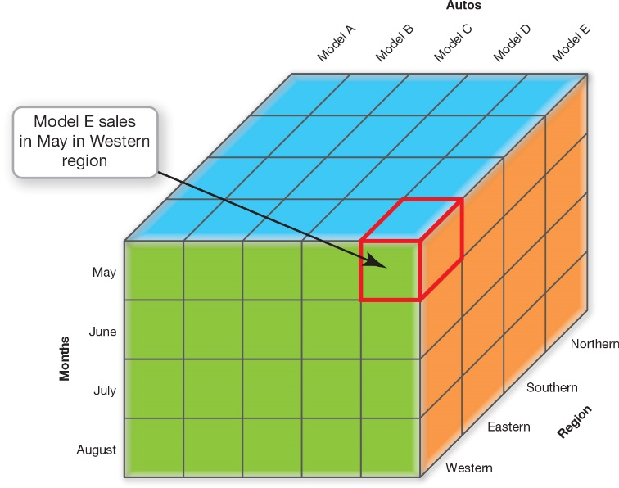
Database Types
Multidimensional Databases (1 of 2)
(Objective 11.5)
Multidimensional databases
  Stored data can be analyzed from different dimensions
  Relational database has only two dimensions (fields and records)
  Organized in cube format
    Measure attribute
    Feature attribute
Notes:
Multidimensional databases store data that can be analyzed from different perspectives, called dimensions.
This distinguishes it from a relational database, which stores data in tables that have only two dimensions—fields and records.
Multidimensional databases organize data in a cube format.
Each data cube has a measure attribute, which is the main type of data that the cube is tracking.
Other elements of the cube are known as feature attributes, which describe the measure attribute in some meaningful way.

Slide 11
Database Types
Multidimensional Databases (2 of 2)
(Objective 11.5)
Advantages
  Customized to provide information to a variety of users based on their needs
  Process data much faster than pure relational databases
Notes:
The two main advantages of multidimensional databases are as follows:
They can be customized to provide information to a variety of users based on their needs.
They can process data much faster than pure relational databases can.

Slide 12
Database Types
NoSQL Databases
(Objective 11.6)
NoSQL databases
  Have been developed to handle newer types of unstructured data
  Store and manage data so that the data can be accessed quickly
  Do not provide the same level of data consistency as SQL databases
Notes:
Because of the increasing use of Web 2.0 applications and the generation of big data, a different database solution was necessary to handle newer types of unstructured data. NoSQL (nonrelational or not only SQL) databases have been developed to meet those needs. NoSQL systems store and manage data so that the data can be accessed quickly and enable the database design and structure greater flexibility. Although NoSQL systems generally do not provide the same level of data consistency as SQL databases, they offer speedier access and greater sizing capabilities.

Slide 13
Using Databases
Relational Database Components and Functions
(1 of 6) (Objective 11.7)
DBMS—software that allows a computer to perform database functions
Main operations
  Storing and defining data
  Viewing, adding, deleting, and modifying data
  Querying data
  Outputting data
Notes:
A database management system (DBMS) is the software that allows a computer to perform database functions.
The four main operations are:
Storing and defining data
Viewing (or browsing), adding, deleting, and modifying data
Querying (extracting) data
Outputting data

Slide 14
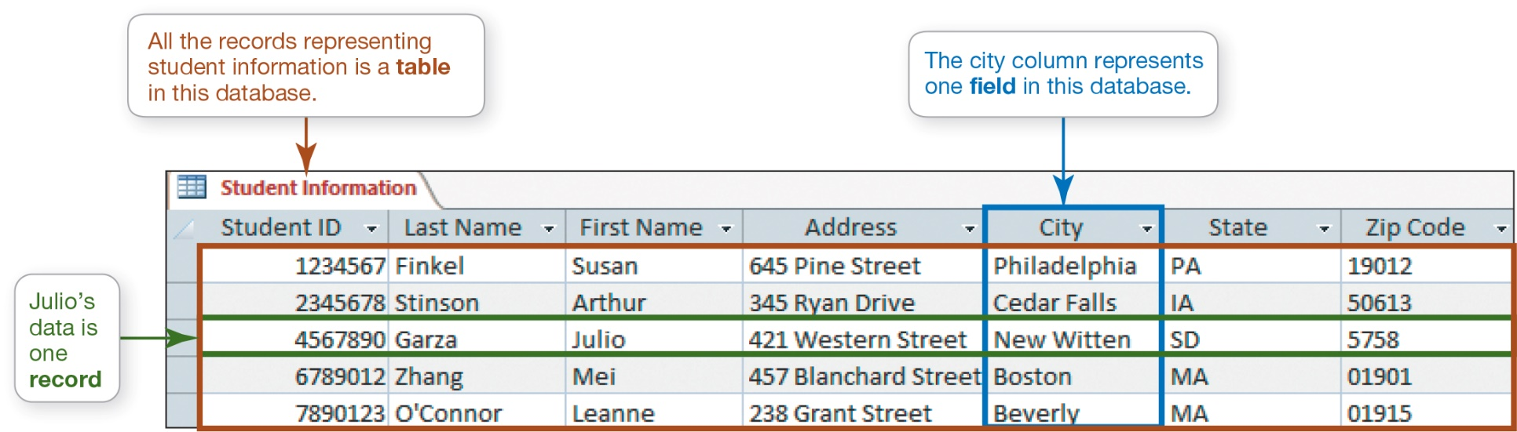
Using Databases
Relational Database Components and Functions
(2 of 6) (Objective 11.7)
Storing and defining data
  Fields are categories of data
  Records are groups of related fields
  Tables are groups of records
Notes:
Data is stored in a database in:
Fields: categories into which a database organizes data.
Records: a group of related fields.
Tables: a group of related records.

Slide 15
Using Databases
Relational Database Components and Functions
(3 of 6) (Objective 11.7)
Data (field) types indicate what kind of data is stored in the field
  Short Text and Long Text
  Number, Large Number, and Currency
  Date/Time
  Yes/No
  Calculated
  OLE Object
  Hyperlink
Notes:
Data (field) types indicate what kind of data is stored in the field. The following are the available field types:
Short Text
Long Text
Number, Large Number, and Currency
Date/Time
Yes/No
Calculated
OLE Object
Hyperlink

Slide 16
Using Databases
Relational Database Components and Functions
(4 of 6) (Objective 11.7)
Field properties help to define field data
  Field size defines the maximum number of characters a field can hold
  Default value is what is used unless the user enters another value
  Caption enables the display of the field name in a more meaningful or readable manner
Notes:
Field properties help to define field data. Three common field properties are:
Field size, which defines the maximum number of characters a field can hold.
The default value is what is used unless the user enters another value.
A caption enables you to display the field name in a more meaningful or readable manner.

Slide 17
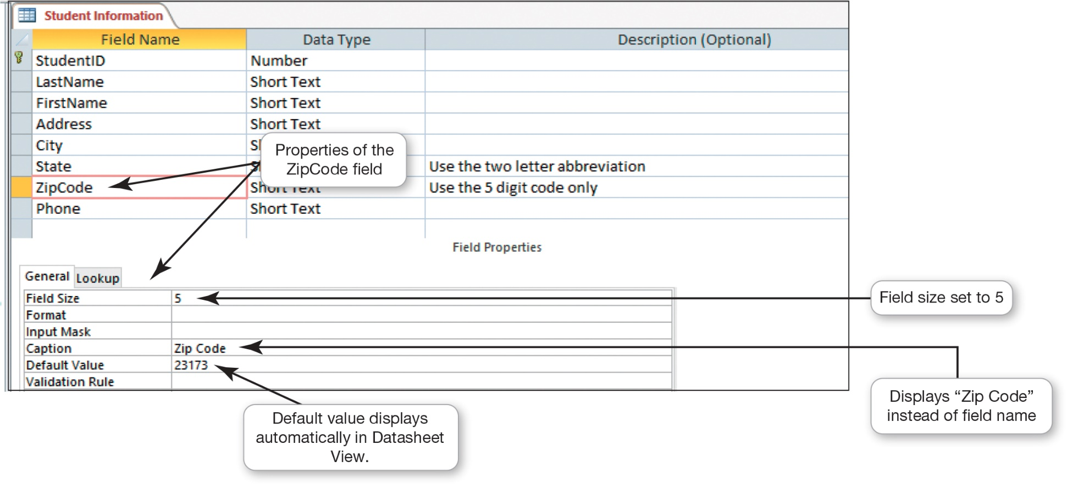
Using Databases
Relational Database Components and Functions
(5 of 6) (Objective 11.7)
Notes:
The figure shows some of the data types and field properties.

Slide 18
Using Databases
Relational Database Components and Functions
(6 of 6) (Objective 11.7)
Using keys
  Primary key field
  Foreign key
  Referential integrity
Data dictionary
Metadata
  Describes other data
Notes:
When creating a table, the use of primary keys is very important.
A primary key is a field in the table that uniquely identifies a record.
In related tables, the common field that is linked to a primary key in one table is called the foreign key in the linked table.
Referential integrity ensures that relationships between tables remain constant and guarantees the quality of the data in the database.
It’s useful, especially for large databases, to access the data dictionary (or the database schema).
The attributes that define the data in the data dictionary are metadata: data that describes other data.

Slide 19
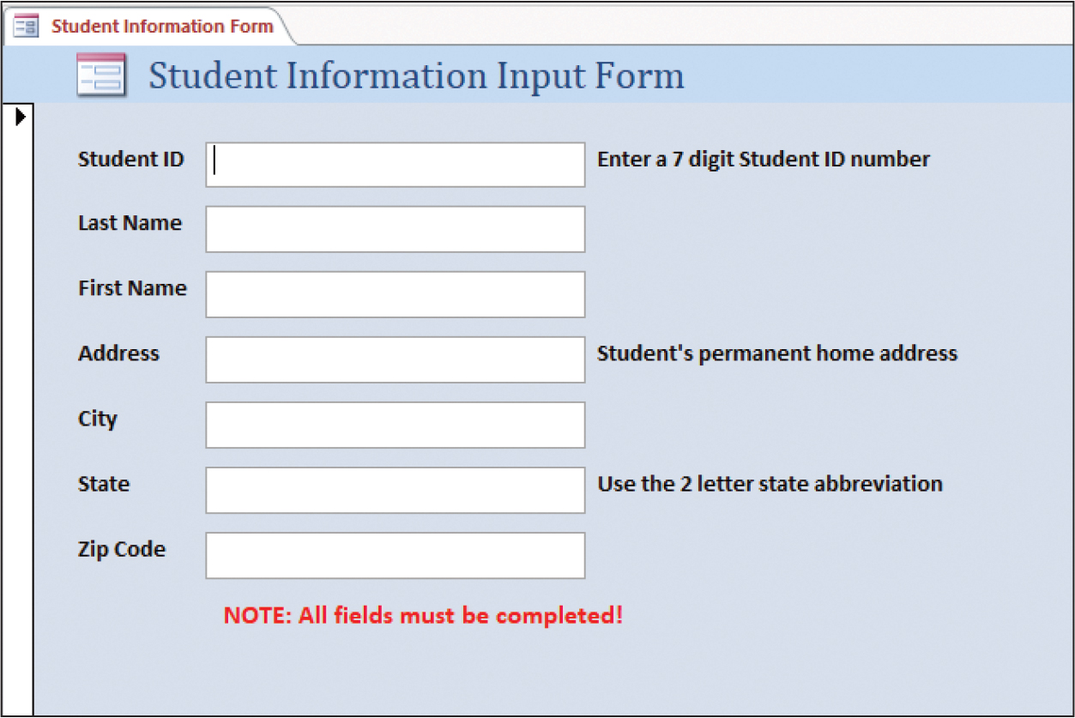
Using Databases
Inputting and Managing Data (1 of 2)
(Objective 11.8)
Input forms control how new data is entered
Notes:
Input forms are used to control how new data is entered into a database.

Slide 20
Using Databases
Inputting and Managing Data (2 of 2)
(Objective 11.8)
Data validation ensures that only valid data is entered in a field
  Range check
  Field constraint
  Completeness check
  Consistency check
  Alphabetic/numeric checks
Notes:
Data validation is the process of ensuring that data entered into a field meets specified guidelines.
A range check ensures that the data entered into the field falls within a certain range of values.
A field constraint is a property that must be satisfied for an entry to be accepted into the field.
A completeness check ensures that all required fields have been completed.
A consistency check compares the values of data in two or more fields to see if those values are reasonable.
An alphabetic check confirms that only textual characters are entered in a field. A numeric check confirms that only numbers are entered in the field.

Slide 21
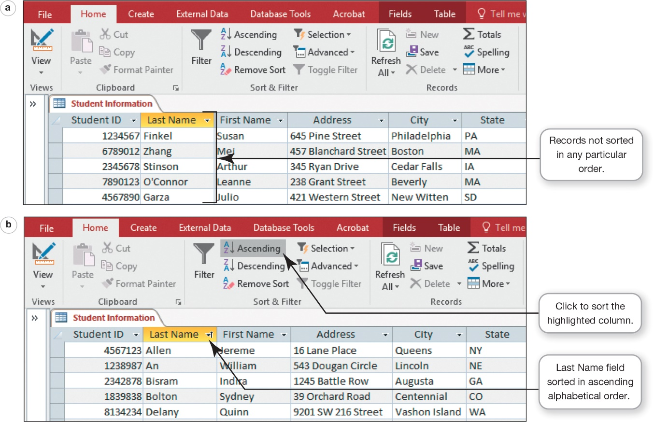
Using Databases
Viewing and Sorting Data
(Objective 11.8)
Viewing and sorting data allows you to display and reorder data
Notes:
Displaying the tables on-screen and browsing through all the data is an option with most databases. You can easily sort data into ascending or descending order.

Slide 22
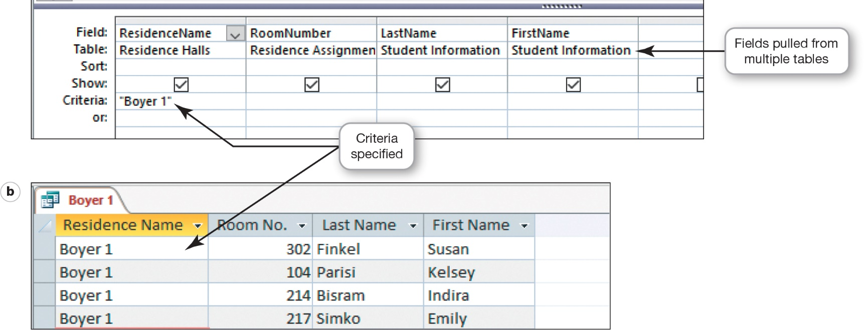
Using Databases
Extracting or Querying Data
(Objective 11.8)
Extracting or querying data
  Use a filter
  Use a query
Notes:
There are two ways to display only those records that match particular criteria:
Use a filter.
Use a query.
The figure shows the results of a query.

Slide 23
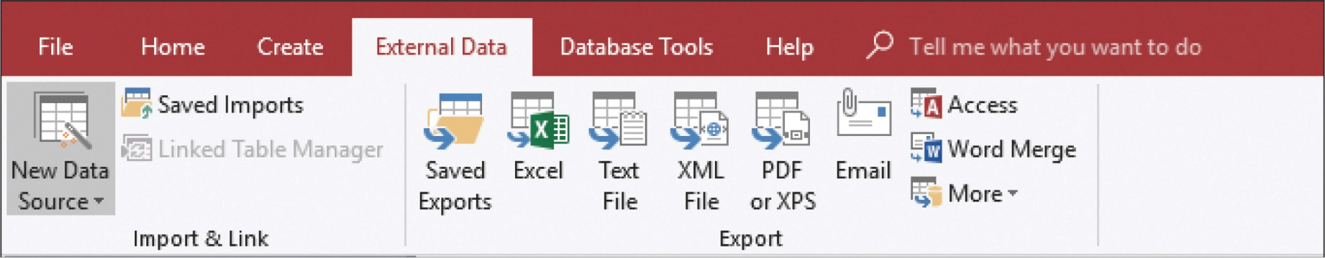
Using Databases
Outputting Data
(Objective 11.8)
Outputting data
  Displaying/printing a report
  Exporting to another application
Notes:
How is data output?
The most common form of output for any database is a viewable (or printable) electronic report.
The data in a database can be transferred to another software application.

Slide 24
Data Warehousing and Storage
Data Warehouses and Data Marts (1 of 2)
(Objective 11.9)
Data warehouse
  Large-scale collection of data
  Contains and organizes data in one place
  Data comes from multiple databases
  Consolidates information from various systems
  Presents enterprise-wide view of operations
  Organized by subject
Notes:
A data warehouse is a large-scale collection of data that contains and organizes all the data from an organization’s multiple databases in one place.
Individual databases contain a wealth of information, but each database’s information usually pertains to one area in the organization.
Data warehouses consolidate information from various operational systems to present an enterprise-wide view of business operations.
Data in the data warehouse is organized by subject.

Slide 25
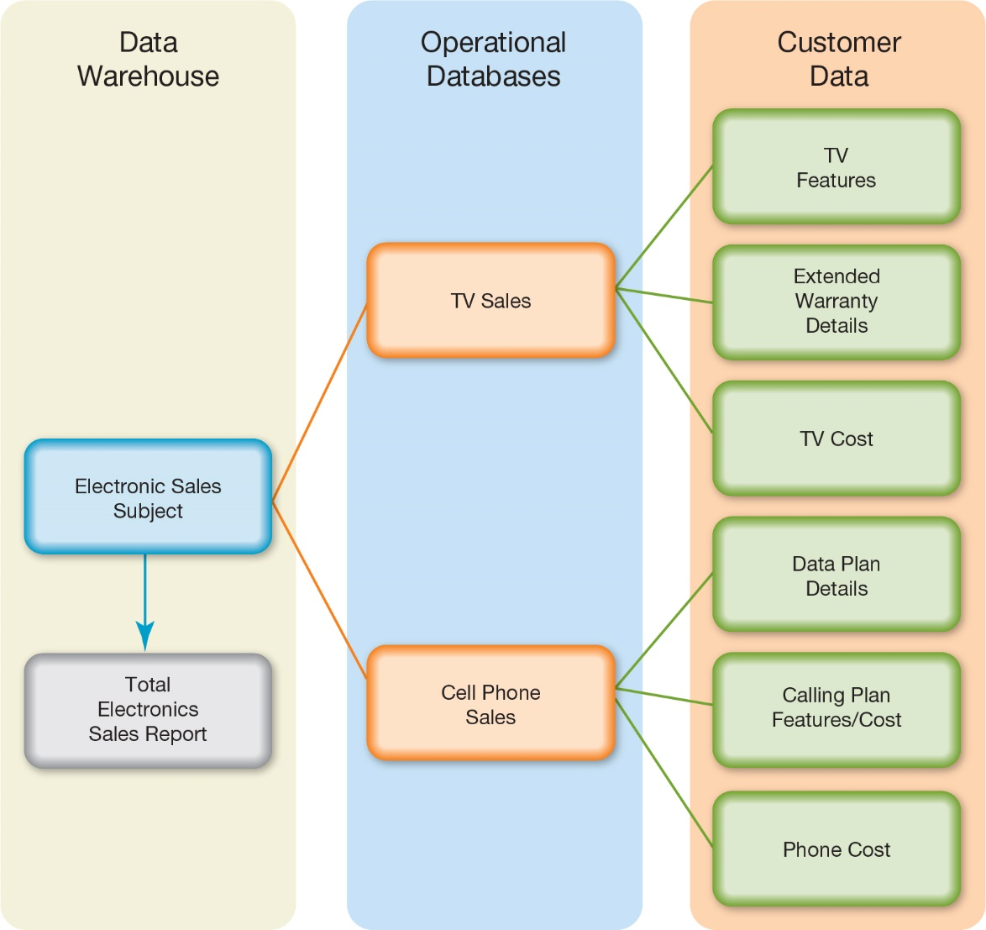
Data Warehousing and Storage
Data Warehouses and Data Marts (2 of 2)
(Objective 11.9)
Notes:
Data from individual databases are drawn together in a data warehouse. Managers can use online analytical processing (OLAP) software to view and manipulate data in a data warehouse.

Slide 26
Data Warehousing and Storage
Data Marts (1 of 2)
(Objective 11.9)
Data mart—small slices of a data warehouse
  Used to analyze a related set of data grouped together and separated out from the main body of data
  Compared to a data warehouse, data mart information pertains to a single business component
Notes:
Small slices of the data warehouse, each called a data mart, are often created so that companies can analyze a related set of data that is grouped together and separated out from the main body of data in the data warehouse. Whereas a data warehouse has an enterprise-wide depth, the information in a data mart pertains to a single component of the business. Data can be extracted using powerful OLAP query tools, or it can be stored in specialized data marts for use by specific employee groups.

Slide 27
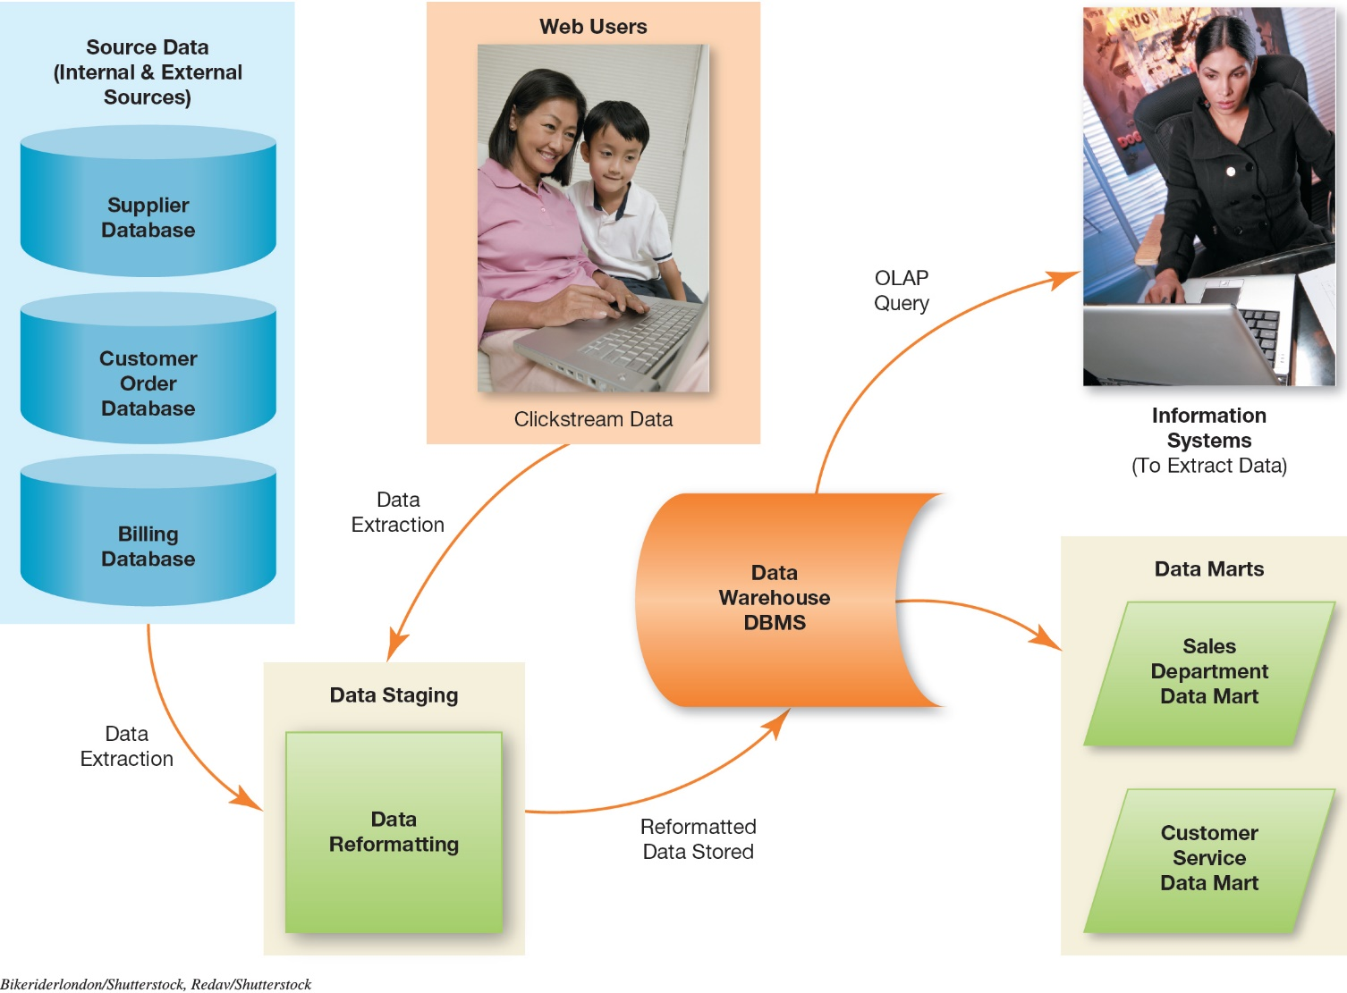
Data Warehousing and Storage
Data Marts (2 of 2)
(Objective 11.9)
Notes:
An overview of the data-warehousing process.

Slide 28
Data Warehousing and Storage
Data Mining (1 of 2)
(Objective 11.10)
Data mining
  Process by which data are analyzed and investigated to spot patterns and trends
  Businesses mine data to better understand their customers
Notes:
Data mining is the process by which data are analyzed and investigated, trying to spot patterns and trends.
The main reason businesses mine data is to understand their customers better.

Slide 29
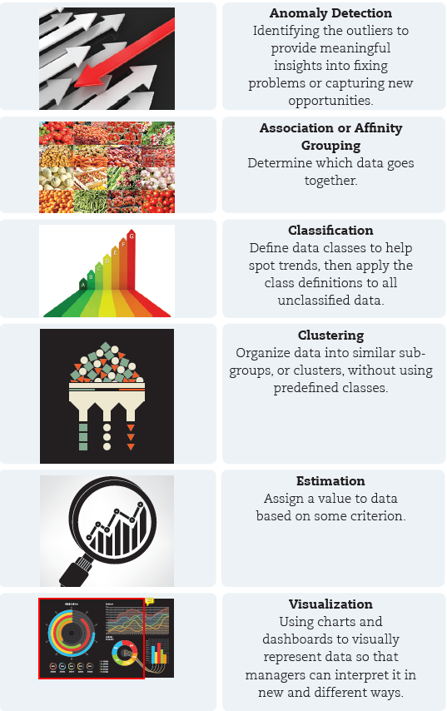
Data Warehousing and Storage
Data Mining (2 of 2)
(Objective 11.10)
Techniques
  Anomaly detection
  Association or affinity grouping
  Classification
  Clustering
  Estimation
  Visualization
Notes:
Data mining techniques include:
Anomaly detection
Association or affinity grouping
Classification
Clustering
Estimation
Visualization

Slide 30
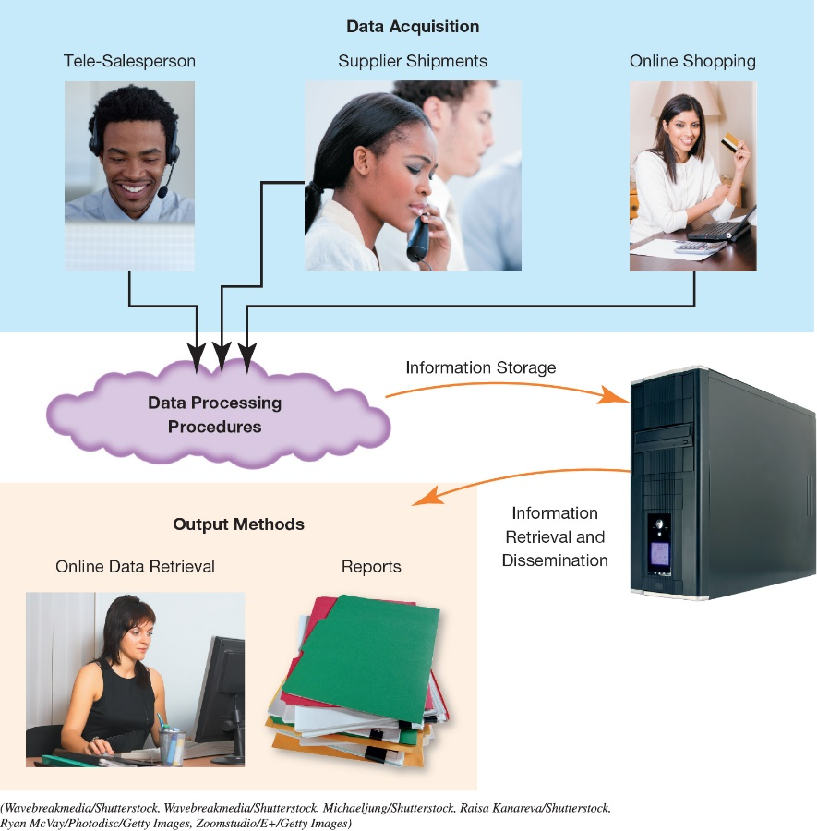
Using Databases to Make Business Decisions
Business Information Systems (1 of 7)
(Objective 11.11)
Information system—software-based solution to gather and analyze information
  Acquire data
  Process data into
  information
  Store the data
  Provide output
Notes:
An information system is a software-based solution used to gather and analyze information.
All information systems perform similar functions, including acquiring data, processing that data into information, storing the data, and providing the user with a number of output options with which to make the information meaningful and useful.

Slide 31
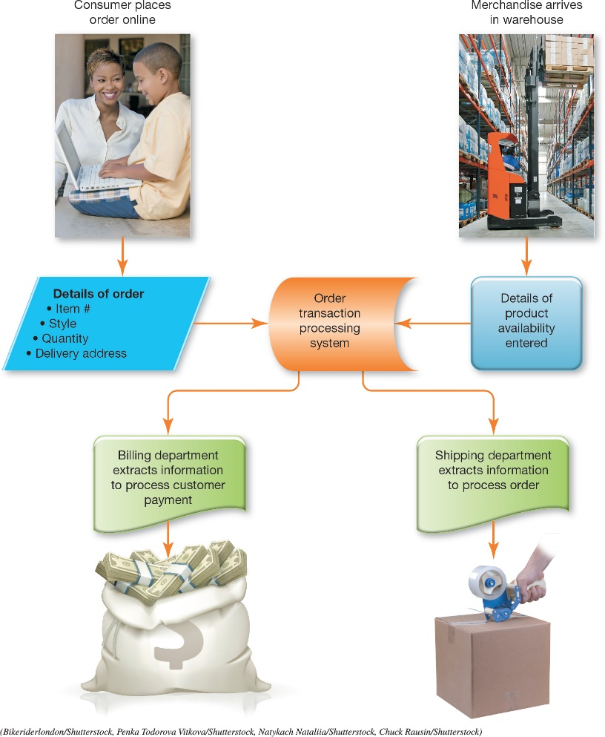
Using Databases to Make Business Decisions
Business Information Systems (2 of 7)
(Objective 11.11)
Transaction-processing system
  Tracks everyday business transactions
  Real-time processing ensures that the data is current
  Batch processing is appropriate for activities that aren’t time sensitive
Notes:
A transaction-processing system (TPS) is an operational-level system that tracks everyday business transactions.
Real-time processing ensures that the data is current by processing and recording transactions as they occur.
Batch processing accumulates data until a certain point is reached and then several transactions are processed at once; it is appropriate for activities that aren’t time sensitive.

Slide 32
Using Databases to Make Business Decisions
Business Information Systems (3 of 7)
(Objective 11.11)
Management information system
  Provides timely and accurate information
  Enables managers to make critical decisions
Generates reports
  Detail
  Summary
  Exception
Notes:
A management information system (MIS) provides timely and accurate information that enables managers to make critical business decisions. MISs were a direct outgrowth of TPSs.
MISs generate three types of reports:
A detail report provides a list of the transactions that occurred during a certain time period.
A summary report provides a consolidated picture of detailed data.
An exception report shows conditions that are unusual or that need attention by system users.

Slide 33
Using Databases to Make Business Decisions
Business Information Systems (4 of 7)
(Objective 11.11)
Decision support system—business intelligence system that helps managers develop problem solutions
  Uses information from databases and data warehouses
  Users can add their own insights and experiences to the solution
Notes:
A decision support system (DSS) is another type of business intelligence system designed to help managers develop solutions for specific problems.
A DSS not only uses data from databases and data warehouses, it also enables users to add their own insights and experiences and apply them to the solution.

Slide 34
Using Databases to Make Business Decisions
Business Information Systems (5 of 7)
(Objective 11.11)
Model management system
  Assists in building management models in DSS
Business intelligence—the ability to improve business decision making
  Used to analyze and interpret large sets of data
  Enables executives and senior managers to make informed decisions
Notes:
A model management system assists in building management models in DSS.
Business intelligence (BI) is the ability to improve business decision making with databases.
It is used to analyze and interpret large sets of data (big data).
It enables executives and senior managers to make informed decisions on how best to run a business.

Slide 35
Using Databases to Make Business Decisions
Business Information Systems (6 of 7)
(Objective 11.11)
Enterprise resource planning (ERP) system
  Accumulates information relevant to running a business
  Makes information available to decision makers
Notes:
An enterprise resource planning (ERP) system accumulates all information relevant to running a business and makes it readily available to whoever needs it to make decisions.

Slide 36
Using Databases to Make Business Decisions
Business Information Systems (7 of 7)
(Objective 11.11)
Knowledge-based system
  Provides intelligence that supplements user’s intellect
  Natural language processing systems
  Artificial intelligence
  Fuzzy logic
Notes:
A knowledge-based system provides intelligence that supplements the user’s own intellect.
Natural language processing (NLP) systems enable users to communicate with computer systems using a natural spoken or written language.
Artificial intelligence is the branch of computer science that deals with the attempt to create computers that think like humans.
Fuzzy logic enables the interjection of experiential learning into the equation by considering probabilities.

Slide 37

Copyright
All rights reserved. No part of this publication may be reproduced, stored in a retrieval system, or transmitted, in any form or by any means, electronic, mechanical, photocopying, recording, or otherwise, without the prior written permission of the publisher. Printed in the United States of America.

