Slide 1

Technology in Action
16th Edition
Chapter 12
Behind the Scenes: Networking and Security in the Business World

Slide 2
Learning Objectives (1 of 3)
12.1 List the advantages for businesses of installing a network.
12.2 Explain the differences between a client/server network and a peer-to-peer network.
12.3 Describe the common types of client/server networks as well as other networks businesses use.
12.4 List the common types of servers found on client/server networks.
12.5 Describe the common types of network topologies and the advantages and disadvantages of each one.
Notes:
The learning objectives are:
12.1 List the advantages for businesses of installing a network.
12.2 Explain the differences between a client/server network and a peer-to-peer network.
12.3 Describe the common types of client/server networks as well as other networks businesses use.
12.4 List the common types of servers found on client/server networks.
12.5 Describe the common types of network topologies and the advantages and disadvantages of each one.

Slide 3
Learning Objectives (2 of 3)
12.6 Describe the types of wired and wireless transmission media used in networks.
12.7 Describe how network adapters help data move around a network.
12.8 Define MAC addresses, and explain how they are used to move data around a network.
12.9 List the various network navigation devices, and explain how they help route data through networks.
Notes:
Additional learning objectives are:
12.6 Describe the types of wired and wireless transmission media used in networks.
12.7 Describe how network adapters help data move around a network.
12.8 Define MAC addresses, and explain how they are used to move data around a network.
12.9 List the various network navigation devices, and explain how they help route data through networks.

Slide 4
Learning Objectives (3 of 3)
12.10 Explain why network operating systems are necessary for networks to function.
12.11 List major security threats to networks, and explain how network administrators mitigate these threats.
Notes:
Additional learning objectives are:
12.10 Explain why network operating systems are necessary for networks to function.
12.11 List major security threats to networks, and explain how network administrators mitigate these threats.

Slide 5
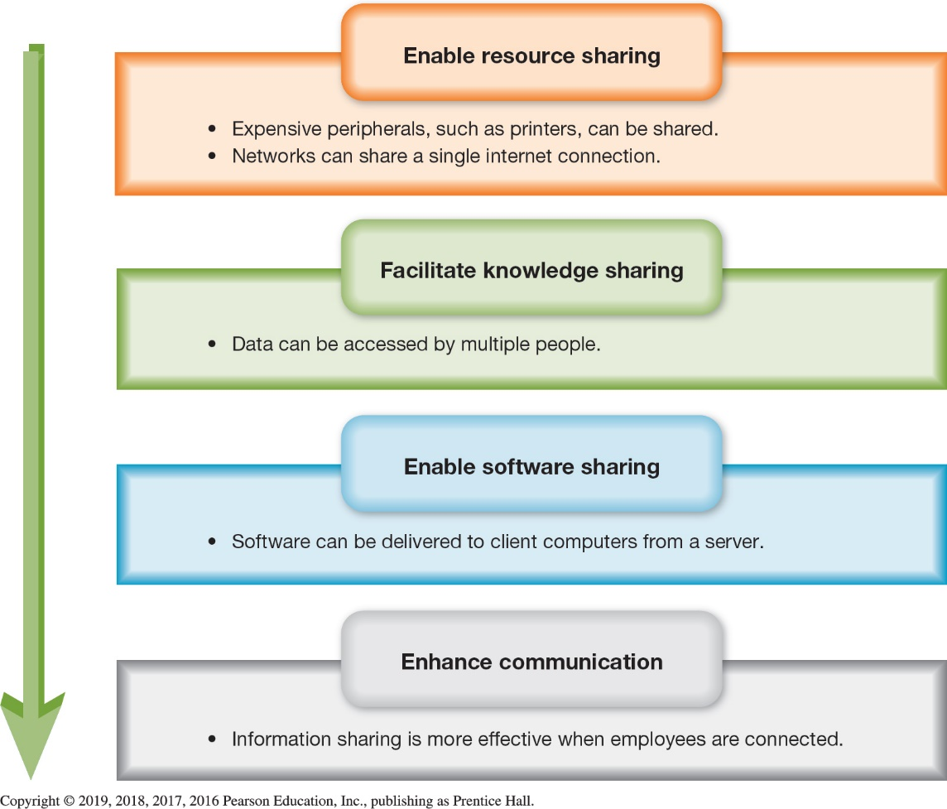
Client/Server Network Basics
Networking Advantages (1 of 2)
(Objective 12.1)
Advantages
  Enable sharing of
    Peripherals
    Resources
    Date
    Software
  Enhance
  communication
Notes:
Recall that a network is a group of two or more computing devices—or nodes—that are configured to share information and resources such as printers, files, and databases.
Networked computers have many advantages over individual computers:
Networks enable people to share peripherals such as printers or share resources.
Networked databases can serve the needs of many people at one time and can increase the availability of data.
Installing a new version of software on everyone’s desktop in a business with many employees can be time-consuming.
Social networking tools, e-mail, and instant messaging are powerful applications when deployed on a network.

Slide 6
Client/Server Network Basics
Networking Advantages (2 of 2)
(Objective 12.1)
Disadvantages
  May require additional personnel
  Require special equipment and software
Notes:
The disadvantages of a network are:
They may require additional personnel—network administrators.
They require special equipment and software.

Slide 7
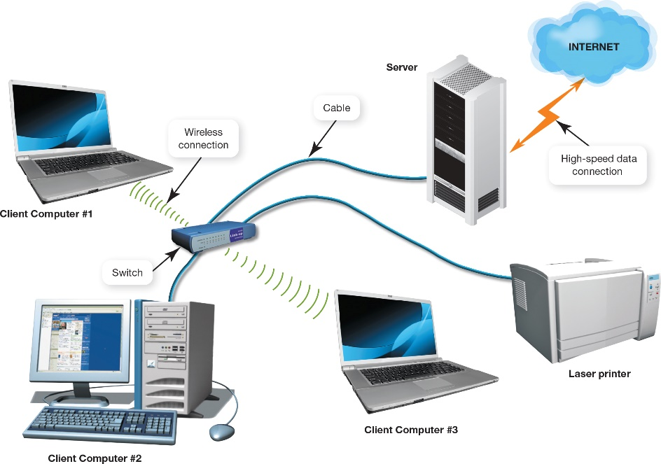
Client/Server Network Basics
Comparing Client/Server and Peer-to-Peer Networks (Objective 12.2)
Client/server network
  Centralized
Peer-to-peer (P2P)
  Decentralized
Advantages of client/server networks
  Efficient data flow
  Scalability—more users can be added without affecting the performance of the network
Notes:
The majority of computer networks are based on the client/server model of computing.
Client/server networks are said to be centralized.
The smallest networks, such as peer-to-peer (P2P) networks, are typically used in homes and small businesses.
Peer-to-peer networks are decentralized.
There are at least two main advantages to a client/server network:
The main advantage of a client/server relationship is that it makes data flow more efficiently than in P2P networks.
Client/server networks also have increased scalability, which means that more users can be added easily without affecting the performance of the other network nodes.

Slide 8
Client/Server Network Basics
Types of Client/Server Networks (1 of 3)
(Objective 12.3)
Local area network
  Few users over small geographic area
Wide area network
  Many users over wide physical area
Intranet—private network set up by a business
Extranet—area of an intranet used by certain people on the intranet
  Electronic data interchange
Notes:
A local area network (LAN) is a small group of computers linked over a small geographic area.
A wide area network (WAN) comprises large numbers of users over a wider physical area.
An intranet is a private network set up by a business or an organization.
An area of an intranet that only certain corporations or individuals can access is an extranet.
Electronic data interchange (EDI) allows the exchange of large amounts of business data.

Slide 9
Client/Server Network Basics
Types of Client/Server Networks (2 of 3)
(Objective 12.3)
Virtual private networks use the public Internet to build a secure, private network
  Tunneling
Client/server network key components
  Servers
  Network topologies
  Transmission media
  Network adapters
  Network navigation devices
  A network operating system
Notes:
A virtual private network (VPN) uses the public Internet communications infrastructure to build a secure, private network among various locations.
The main technology for achieving a VPN is called tunneling.
The key components of a client/server network are:
Servers
Network topologies (the layout of the components)
Transmission media
Network adapters
Network navigation devices
A network operating system

Slide 10
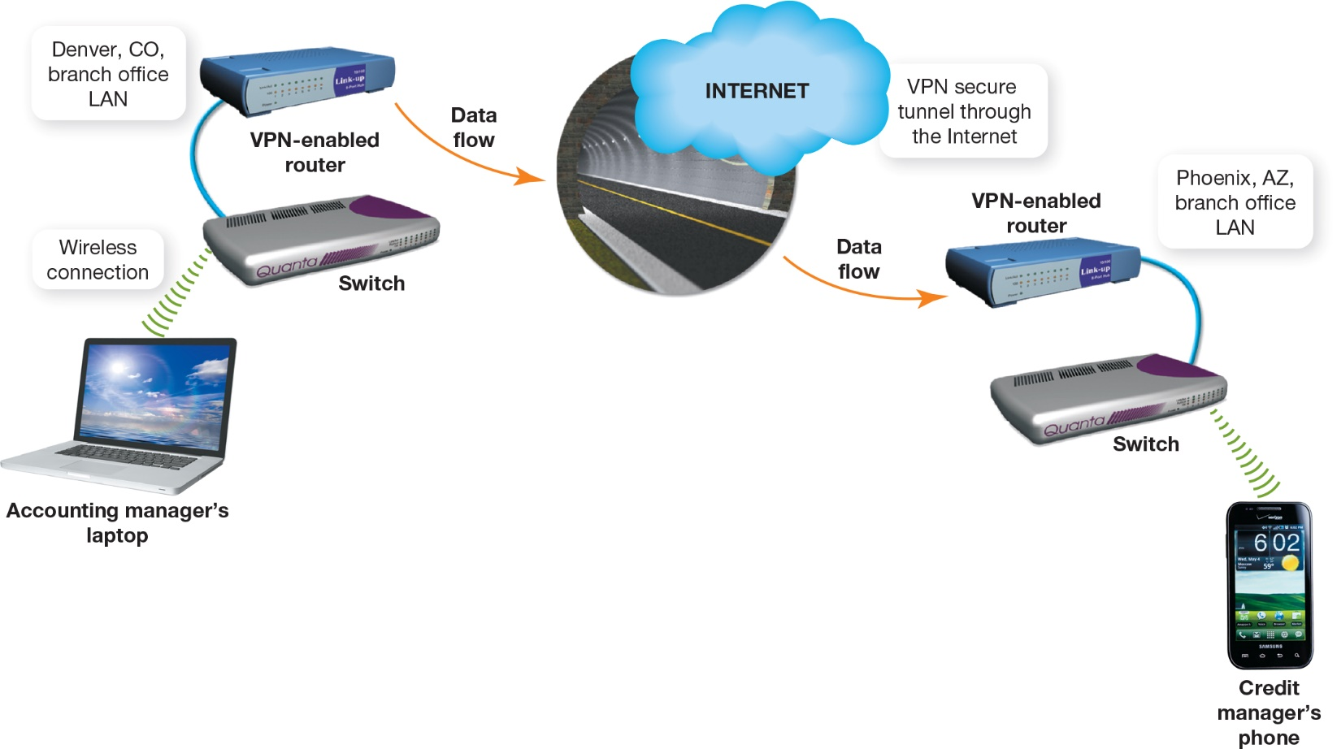
Client/Server Network Basics
Types of Client/Server Networks (3 of 3)
(Objective 12.3)
Notes:
The figure shows how local area networks in different cities can communicate securely over the Internet using VPN technology.

Slide 11
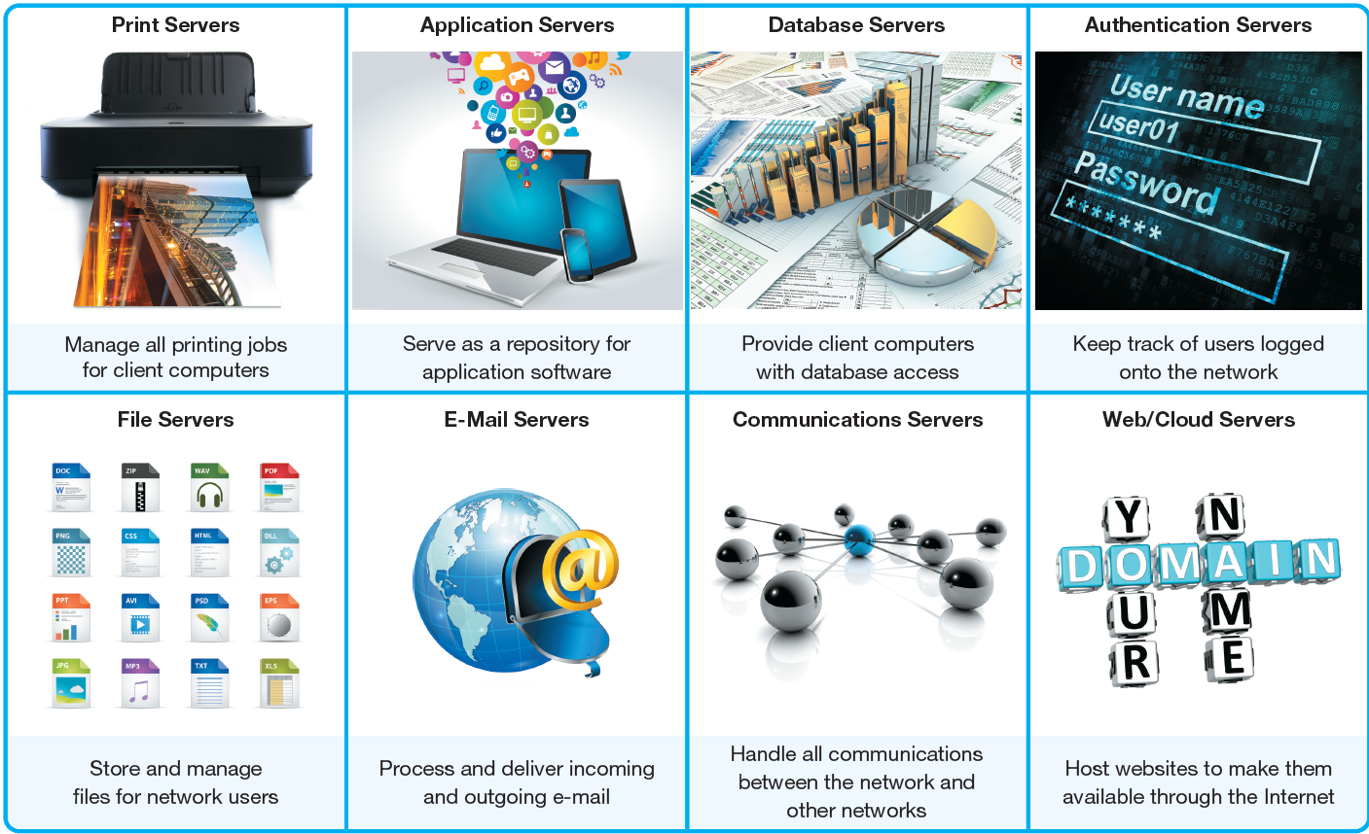
Servers and Network Topologies
Servers
(Objectives 12.4)
Dedicated server fulfills a specific function
Common types
  Print
  Application
  Database
  Authentication
  File
  E-mail
  Communications
  Web and Cloud
Notes:
A dedicated server is a server used to fulfill one specific function. Common types are:
Authentication servers
File servers
Print servers
Application servers
Database servers
E-mail servers
Communications servers
Web/cloud servers

Slide 12
Servers and Network Topologies
Network Topologies (1 of 7)
(Objective 12.5)
Bus topology—computers connected in sequence on a single cable
  Data collisions—data from two computers collide
  Packets—data broken into small segments
  Passive technology—nodes do nothing to move data
  Terminators absorbs signal
Advantages
  Simple and low cost
Notes:
In a bus—or linear bus—topology, all computers are connected in sequence on a single cable.
Data collisions occur when data from two computers collide in the connection media.
Data is broken into small segments, called packets.
Since the nodes do nothing to move data, this is considered passive technology.
Terminators absorb signals and do not reflect them back to the network.
The advantages of the bus topology include the simplicity and low cost of the network.

Slide 13
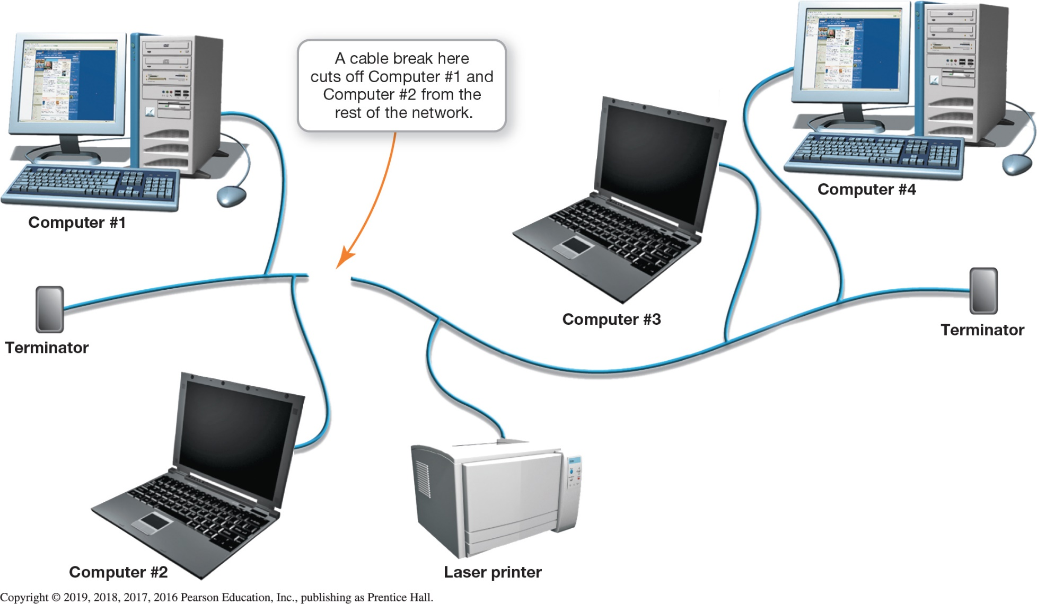
Servers and Network Topologies
Network Topologies (2 of 7)
(Objective 12.5)
Notes:
This figure depicts a linear bus topology in which all computers are connected in a sequence.

Slide 14
Servers and Network Topologies
Network Topologies (3 of 7)
(Objective 12.5)
Ring topology—resembles a circle
  Token—special data packet
  Passed from computer to computer
  Active topology—the nodes participate in the transmission of data
Advantages
  Provides a fairer allocation of resources
  Performance remains acceptable
Disadvantages
  One computer failure can bring network down
Notes:
The computers and peripherals in a ring—or loop—topology are laid out in a configuration resembling a circle. Data flows around the circle from device to device in one direction only. Because data is passed using a special data packet called a token, this type of topology was once commonly called a token-ring topology.
The ring topology has a number of advantages:
It provides a fair allocation of resources.
Performance remains acceptable even with large numbers of users.
The ring topology has one major disadvantage:
If one computer fails, the entire network can come to a halt because the failed computer is unavailable to retransmit tokens and data.

Slide 15
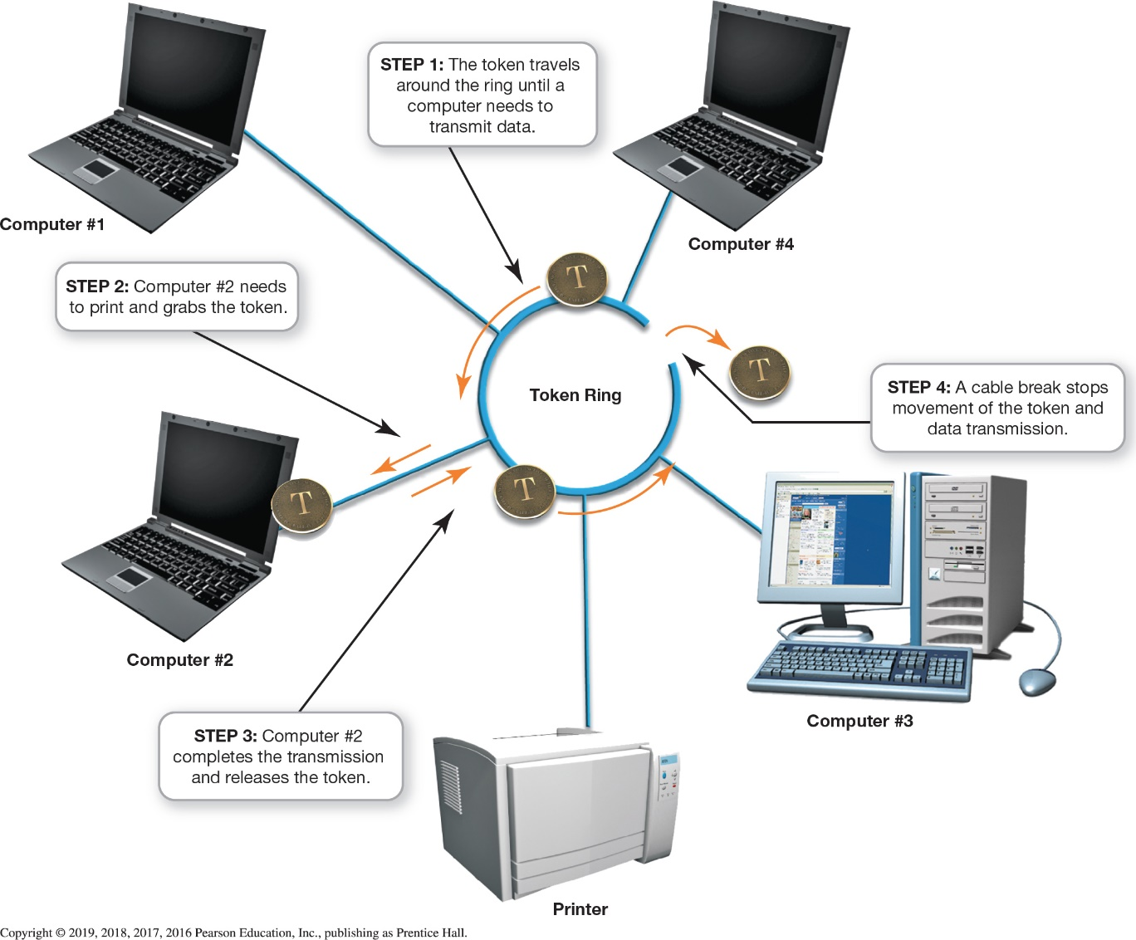
Servers and Network Topologies
Network Topologies (4 of 7)
(Objective 12.5)
Notes:
This figure illustrates how a ring topology provides a fair allocation of resources.

Slide 16
Servers and Network Topologies
Network Topologies (5 of 7)
(Objective 12.5)
Star topology—nodes connect to a central communications device
  Most widely deployed client/server topology
  Offers the most flexibility for a low price
  Uses carrier sense multiple access with collision detection (CSMA/CD)
  Jam signal aids in addressing data collisions
Notes:
A star topology is the most widely deployed client/server network topology because it offers the most flexibility. In a star topology, the nodes connect to a central communications device called a switch in a pattern resembling a star. It uses carrier sense multiple access with collision detection (CSMA/CD). A jam signal aids in addressing data collisions.

Slide 17
Servers and Network Topologies
Network Topologies (6 of 7)
(Objective 12.5)
Advantages
  Failure of one computer doesn’t affect the rest of the network
  Easy to add nodes
  Performance remains acceptable with growth
  Troubleshooting and repairs are easier
Disadvantage
  Used to be cost—not as relevant now
Notes:
The advantages of star networks include:
The failure of one computer doesn’t affect the rest of the network.
It is easy to add nodes.
Performance remains acceptable with growth.
Troubleshooting and repairs are easier.
The disadvantage of star networks used to be cost, but that is not as relevant now.

Slide 18
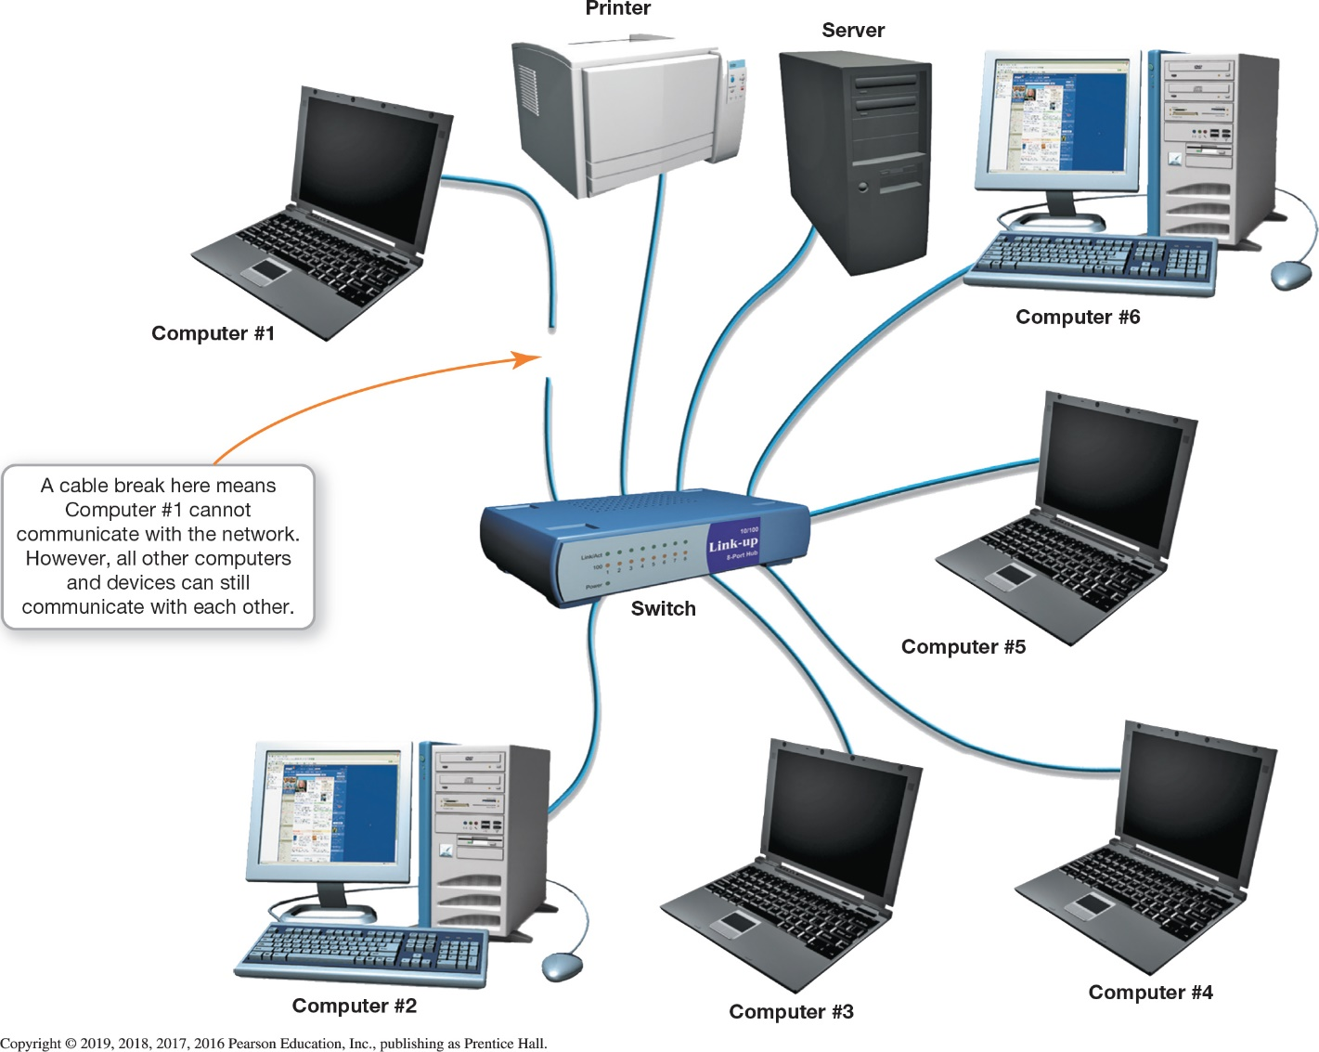
Servers and Network Topologies
Network Topologies (7 of 7)
(Objective 12.5)
Notes:
This figure illustrates a star topology, in which network nodes are connected through a central switch.

Slide 19
Transmission Media
Wired and Wireless Transmission Media (1 of 7)
(Objective 12.6)
Transmission media through which data flows
  Wired
  Wireless
  Corporate networks use both
Notes:
Transmission media, whether for wired or wireless communications technology, make up the system that data takes to flow between devices on the network.
Most corporate networks contain a combination of wired and wireless media.

Slide 20
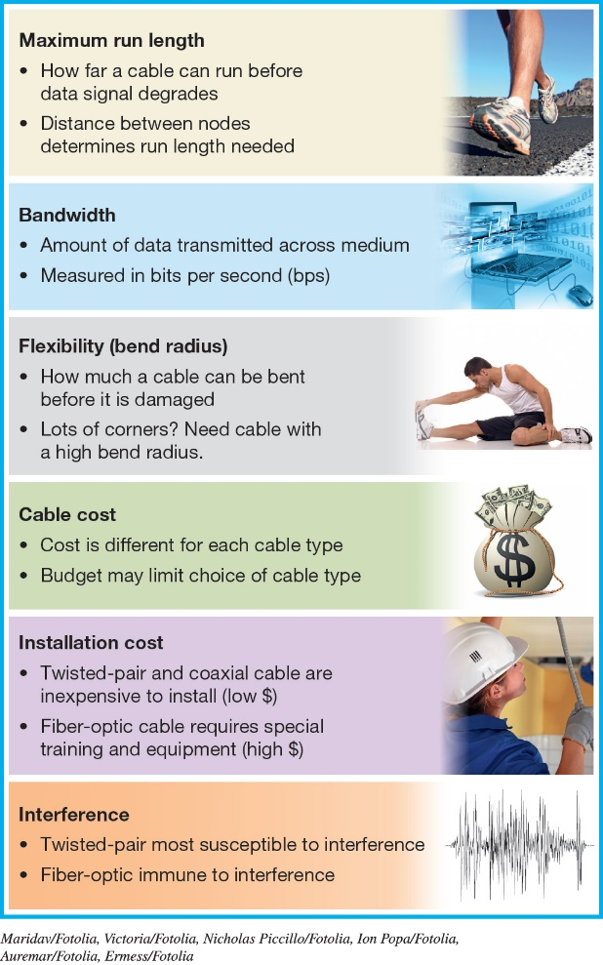
Transmission Media
Wired and Wireless Transmission Media (2 of 7)
(Objective 12.6)
Factors when choosing cable type
  Maximum run length
  Bandwidth
  Bend radius
  Cable cost
  Installation cost
  Interference
Sources of interference
  Electromagnetic
  Radio frequency
Notes:
Although each cable type is different, the same six factors always need to be considered when choosing a cable type: maximum run length, bandwidth, bend radius (flexibility), cable cost, installation cost, and interference.
Sources of interference include electromagnetic interference and radio frequency interference.

Slide 21
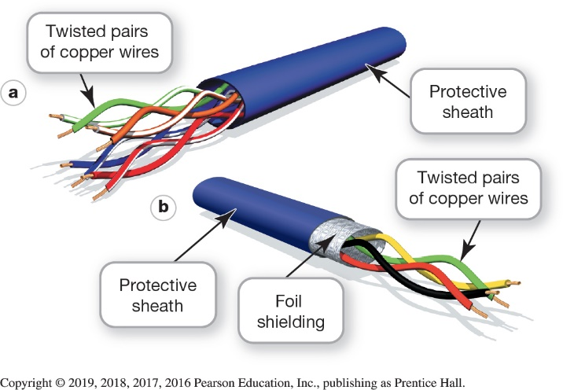
Transmission Media
Wired and Wireless Transmission Media (3 of 7)
(Objective 12.6)
Twisted-pair cable
  Pairs of copper wires twisted around each other
    Reduces interference
    Reduces crosstalk
  Covered by protective sheath
  Unshielded has no foil shielding
  Shielded has foil shielding
Notes:
Twisted-pair cable consists of pairs of copper wires twisted around each other and covered by a protective sheath (jacket). The twists are important because they cause the magnetic fields that form around the wires to intermingle, making them less susceptible to outside interference.
If the twisted-pair cable contains a layer of foil shielding to reduce interference, it’s called shielded twisted-pair (STP) cable.

Slide 22
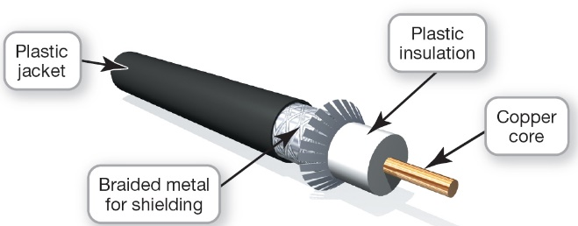
Transmission Media
Wired and Wireless Transmission Media (4 of 7)
(Objective 12.6)
Coaxial cable
  Not as popular, still used when there is heavy electrical interference
  Four components
    Core is used for transmitting the signal
    Solid layer of nonconductive insulating material
    Layer of braided metal shielding
    External jacket of lightweight plastic
Notes:
Not as popular as it once was, coaxial cable is still used in manufacturing facilities with heavy electrical interference.
Coaxial cable has four components:
A core is in the very center and is used for transmitting the signal.
A solid layer of nonconductive insulating material surrounds the core.
A layer of braided metal shielding covers the insulation to reduce interference.
An external jacket of lightweight plastic covers the internal cable components.

Slide 23
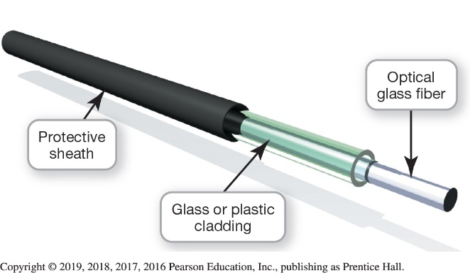
Transmission Media
Wired and Wireless Transmission Media (5 of 7)
(Objective 12.6)
Fiber-optic cable
  Composed of
    Glass fiber through which data are transmitted
    Protective layer of glass or plastic to protect it
    Outer jacket (sheath) for additional protection
  Transmission is only in one direction
Notes:
Fiber-optic cable is composed of the following:
A glass (or plastic) fiber through which data are transmitted.
A protective layer of glass or plastic cladding wrapped around the core to protect it.
An outer jacket, which is made of a durable material.
Data transmissions can pass through fiber-optic cable in only one direction. Therefore, at least two fibers (or cores) are contained in most fiber-optic cables to enable transmission of data in both directions.

Slide 24
Transmission Media
Wired and Wireless Transmission Media (6 of 7)
(Objective 12.6)
Business wireless networks
  Very similar to home networks
  Wireless access points installed to provide additional coverage
  Most businesses use a combination of wired and wireless media
Notes:
Wireless networks in business are very similar to what is available to home networks.
Wireless access points are installed to provide additional coverage.
Most businesses use a combination of wired and wireless media.

Slide 25
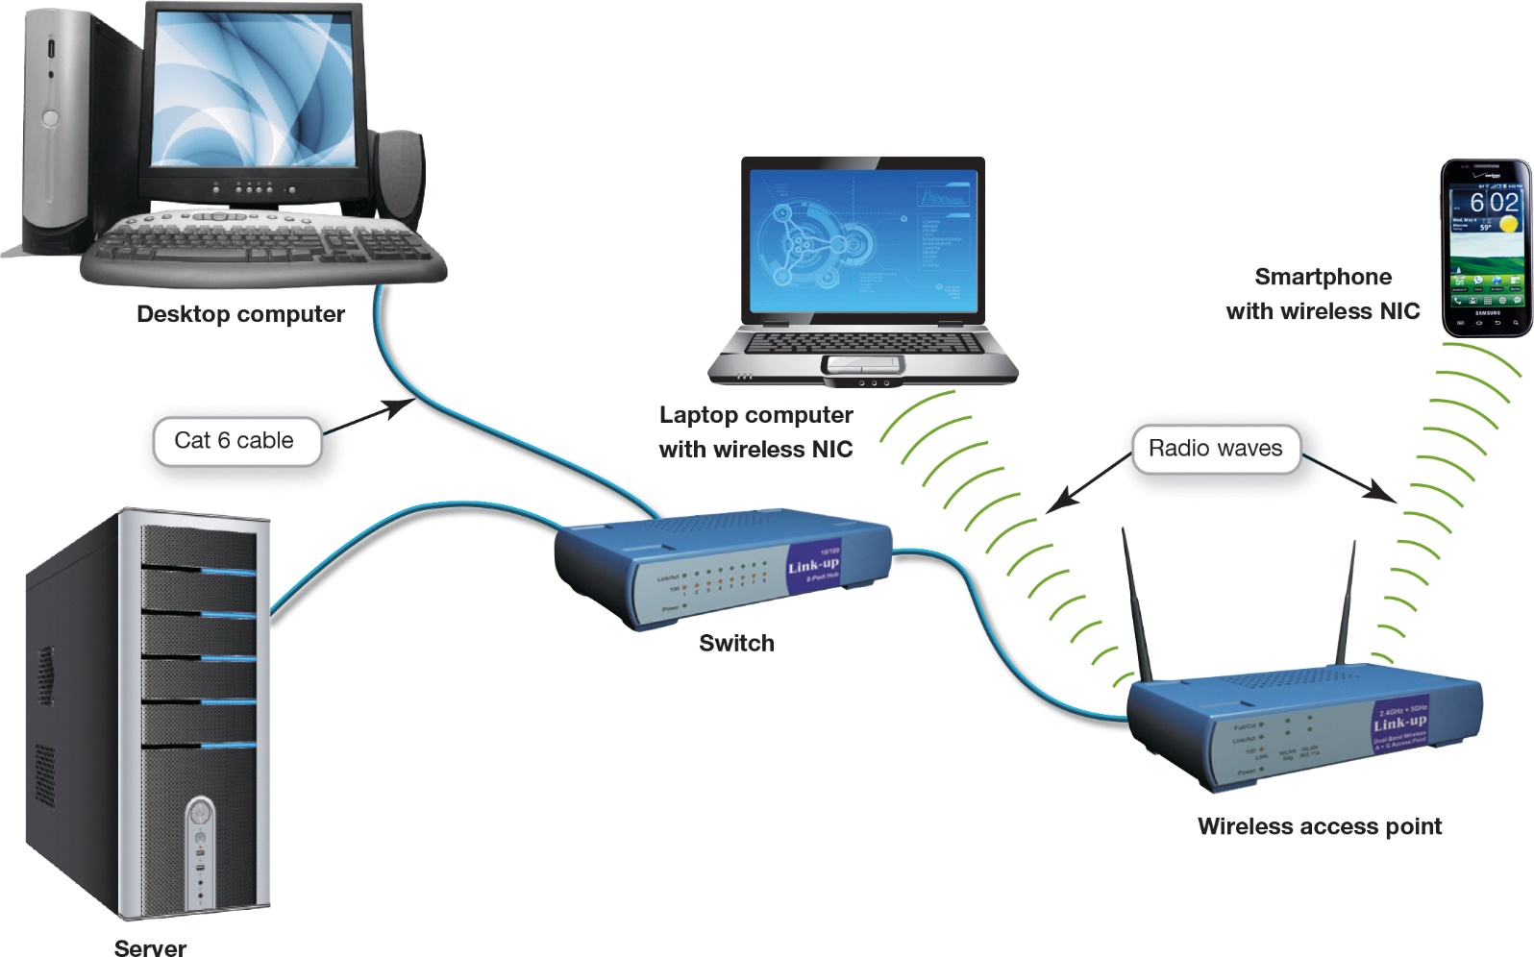
Transmission Media
Wired and Wireless Transmission Media (7 of 7)
(Objective 12.6)
Notes:
This figure shows a small business network with a wireless access point.

Slide 26
Network Adapters and Navigation Devices
Network Adapters
(Objective 12.7)
Network adapters—devices that perform specific tasks enabling nodes to communicate on a network
Three critical functions
  Generate high-power signals
  Break data into packets
  Act as gatekeepers for information
Notes:
Network adapters are devices that perform specific tasks to enable nodes to communicate on a network.
Network adapters perform three critical functions:
They generate high-powered signals to enable network transmissions.
They’re responsible for breaking the data into packets and transmitting and receiving data. They also are responsible for receiving incoming data packets and, in accordance with networking protocols, reconstructing them.
They act as gatekeepers for information flowing to and from the client computer.

Slide 27
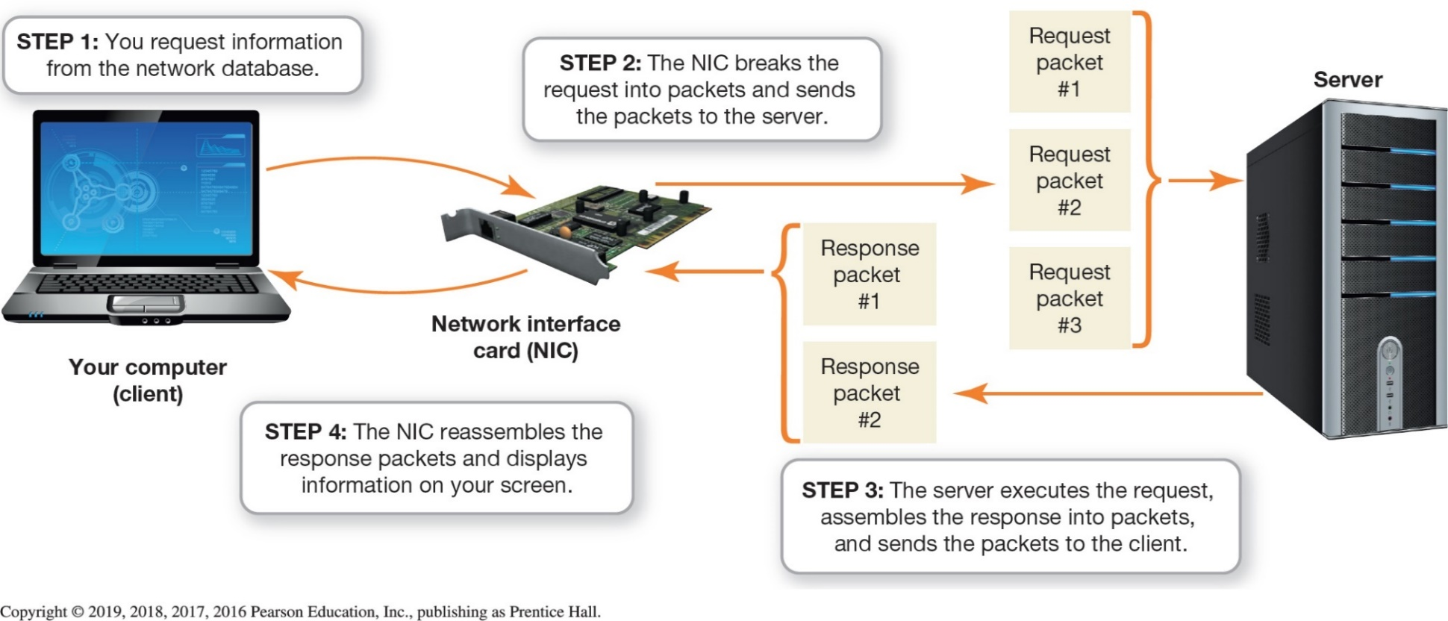
Network Adapters and Navigation Devices
Network Adapters
(Objective 12.7)
Notes:
As shown in the figure, a network interface card (NIC) is responsible for breaking down data into packets, preparing packets for transmission, receiving incoming data packets, and reconstructing them.

Slide 28
Network Adapters and Navigation Devices
MAC Addresses
(Objective 12.8)
Media access control (MAC) address
  6 two-position characters
    First three sets specify the manufacturer
    Second set makes up a unique address
  Institute of Electrical and Electronics Engineers (IEEE) allocate blocks of numbers
  Not the same as an IP address
Notes:
A media access control (MAC) address is 6 two-position sets of characters.
The first three sets specify the manufacturer of the network device.
The second set makes up a unique address for that device.
The Institute of Electrical and Electronics Engineers (IEEE) is responsible for allocating blocks of numbers.
A MAC address is not the same as an IP address.

Slide 29
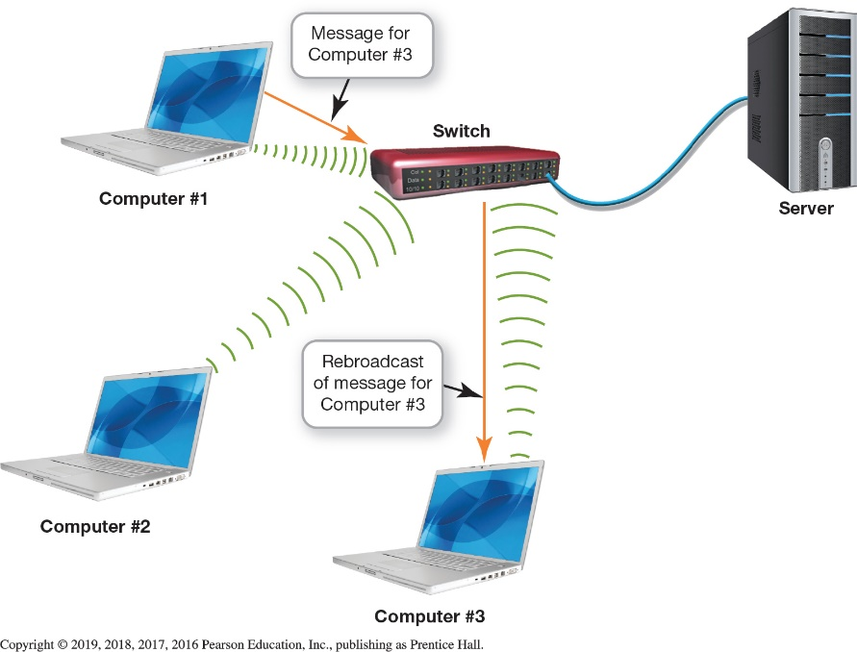
Network Adapters and Navigation Devices
Switches, Bridges, and Routers
(Objective 12.9)
Switch—rebroadcasts data to appropriate network node
Bridge—sends data between different collision domains
Router—sends information between two networks
Notes:
A switch makes decisions, based on the MAC address of the data, as to where the data is to be sent and rebroadcasts it to the appropriate network node.
A bridge is a device that’s used to send data between different collision domains, depending on where the recipient device is located.
A router is designed to send information between two networks.

Slide 30
Network Operating Systems and Network Security
Network Operating Systems
(Objective 12.10)
Network operating system
  Needs to be installed on each client and server computer
  Designed to facilitate communication
  Peer-to-peer software built into Windows
  TCP/IP is the standard networking protocol
Notes:
Special software known as a network operating system (NOS) needs to be installed on each client computer and server that’s connected to the network to provide the services necessary for them to communicate.
NOS software is designed to facilitate communication between the software and hardware components of your computer.
The software that P2P networks require is built into the Windows, Linux, and Macintosh operating systems.
Most corporate networks use TCP/IP as their standard networking protocol regardless of the manufacturer of their NOS.

Slide 31
Network Operating Systems and Network Security
Client/Server Network Security (1 of 5)
(Objective 12.11)
Sources of security threats
  Human errors and mistakes
  Malicious human activity
  Natural events and disasters
Authentication is used to screen users
  Possessed object
Brute force attack
Notes:
Sources of threats to client/server networks can be classified into three main groups:
Human errors and mistakes
Malicious human activity perpetrated by current employees, former employees, or third parties
Natural events and disasters such as floods and fires
Authentication is the process whereby users prove they have authorization to use a computer network.
A possessed object is any object that users carry to identify themselves.
Attempting to access an account by repeatedly trying different passwords is known as a brute force attack.

Slide 32
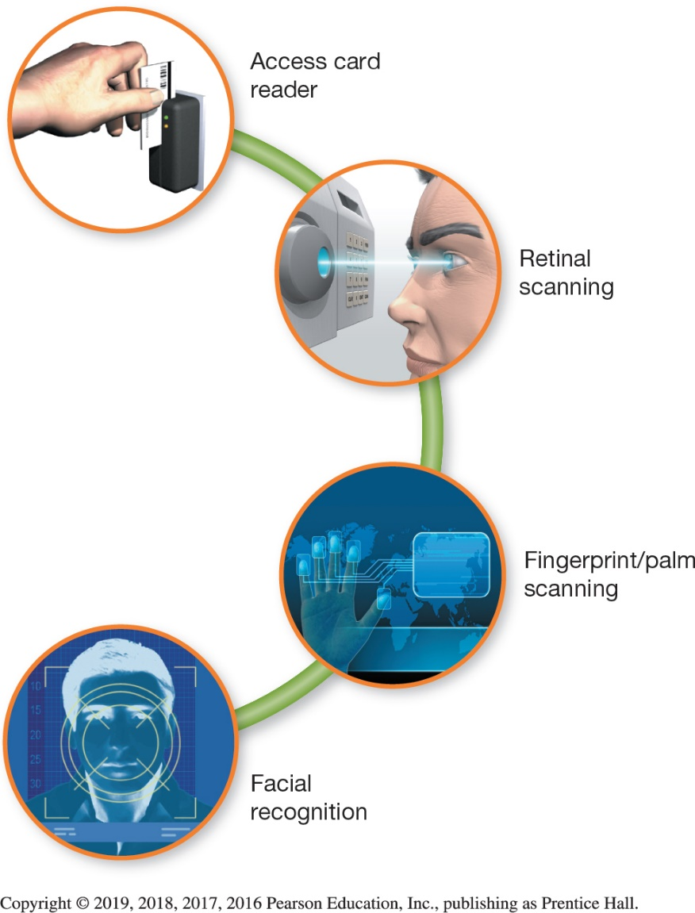
Network Operating Systems and Network Security
Client/Server Network Security (2 of 5)
(Objective 12.11)
Access privileges restrict access to network assets
Physical protection measures
  Access card reader
  Biometric authentication device
Notes:
When an account is set up on a network, certain access privileges are granted to indicate which systems the user is allowed to use.
Access card readers provide a relatively inexpensive solution to security for areas needing low-level security.
Biometric authentication devices, such as fingerprint/palm, retinal, and facial-recognition scanners, are used to protect high-security areas such as server rooms.

Slide 33
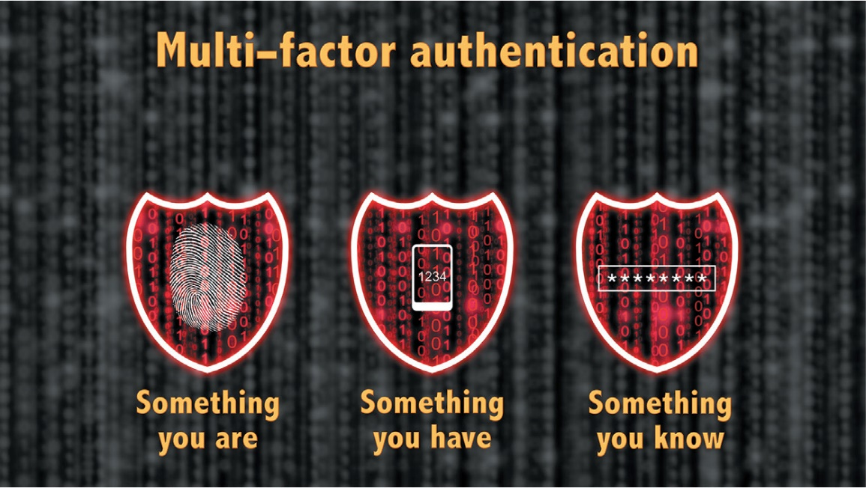
Network Operating Systems and Network Security
Client/Server Network Security (3 of 5)
(Objective 12.11)
Multi-factor authentication requires two of these three factors be demonstrated before authorization is granted
Notes:
Multi-factor authentication requires two of these three factors be demonstrated before authorization is granted:
Something you are
Something you have
Something you know

Slide 34
Network Operating Systems and Network Security
Client/Server Network Security (4 of 5)
(Objective 12.11)
Firewalls can be composed of software or hardware
  Packet screening—external screening router examines incoming data packets
  Bastion host—heavily secured server
  Honey pot—computer to attract unauthorized users
  Proxy server acts as a go-between
Notes:
Firewalls can be composed of software or hardware or both.
Packet screening involves having an external screening router examining incoming data packets.
A bastion host is a heavily secured server located on a special perimeter network.
A honey pot is a computer set up to attract unauthorized users.
A proxy server acts as a go-between, connecting computers on the internal network with those on the external network (the Internet).

Slide 35
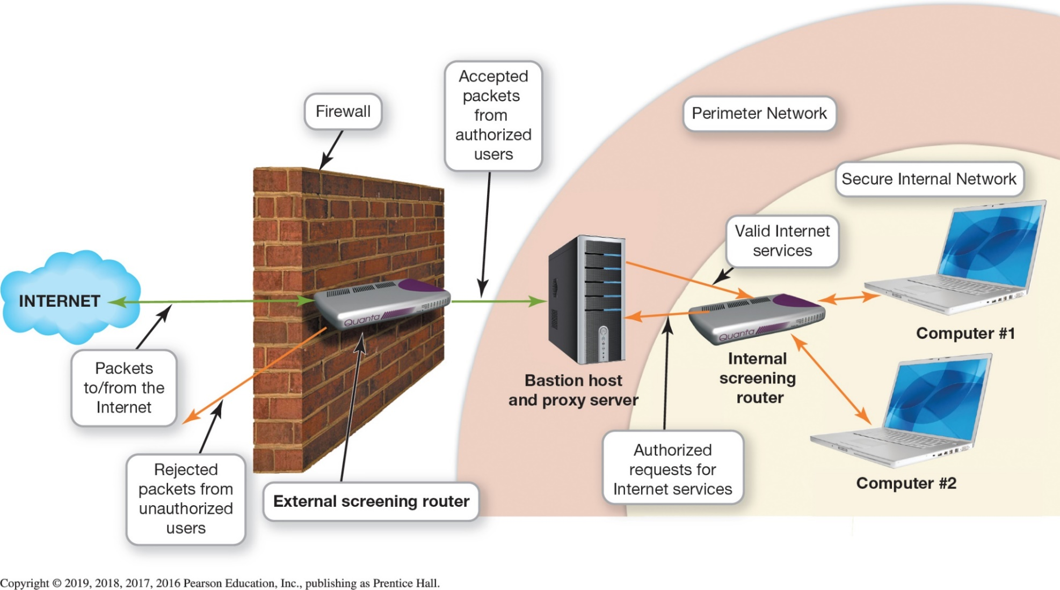
Network Operating Systems and Network Security
Client/Server Network Security (5 of 5)
(Objective 12.11)
Notes:
This figure illustrates how business firewalls provide sophisticated protection from hackers.

Slide 36

Copyright
All rights reserved. No part of this publication may be reproduced, stored in a retrieval system, or transmitted, in any form or by any means, electronic, mechanical, photocopying, recording, or otherwise, without the prior written permission of the publisher. Printed in the United States of America.

