Slide 1

Technology in Action
16th Edition
Chapter 13
Behind the Scenes: How the Internet Works

Slide 2
Learning Objectives (1 of 2)
13.1 Describe the management of the Internet.
13.2 Explain how the Internet’s networking components interact.
13.3 List and describe the Internet protocols used for data transmission.
13.4 Explain how each device connected to the Internet is assigned a unique address.
13.5 Discuss how a numeric IP address is changed into a readable name.
Notes:
The learning objectives are:
13.1 Describe the management of the Internet.
13.2 Explain how the Internet’s networking components interact.
13.3 List and describe the Internet protocols used for data transmission.
13.4 Explain how each device connected to the Internet is assigned a unique address.
13.5 Discuss how a numeric IP address is changed into a readable name.

Slide 3
Learning Objectives (2 of 2)
13.6 Compare and contrast a variety of web development languages.
13.7 Compare and contrast server-side and client-side application software.
13.8 Discuss the mechanisms for communicating via e-mail and instant messaging.
13.9 Explain how data encryption improves security.
Notes:
Additional learning objectives are:
13.6 Compare and contrast a variety of web development languages.
13.7 Compare and contrast server-side and client-side application software.
13.8 Discuss the mechanisms for communicating via e-mail and instant messaging.
13.9 Explain how data encryption improves security.

Slide 4
Internet Management and Networking
Management (1 of 2)
(Objective 13.1)
Internet Society
  Provides leadership for orderly growth and development of the Internet
Internet Engineering Task Force
  Researches new Internet technologies
  Internet Architecture Board
  Provides direction for the maintenance and development of Internet protocols
Notes:
Some of the organizations that play a part in Internet governance and development include:
The Internet Society, which provides leadership for orderly growth and development of the Internet.
The Internet Engineering Task Force (IETF), which researches new Internet technologies.
The Internet Architecture Board (IAB), which provides direction for the maintenance and development of Internet protocols.

Slide 5
Internet Management and Networking
Management (2 of 2)
(Objective 13.1)
Internet Corporation for Assigned Names and Numbers
  Responsible for managing the Internet’s domain name system and the allocation of IP addresses
World Wide Web Consortium
  Sets standards and develops protocols for the web
Notes:
Other organizations that play a part in Internet governance and development include:
The Internet Corporation for Assigned Names and Numbers (ICANN), which is responsible for managing the Internet’s domain name system and the allocation of IP addresses.
The World Wide Web Consortium (W3C), which sets standards and develops protocols for the web.

Slide 6
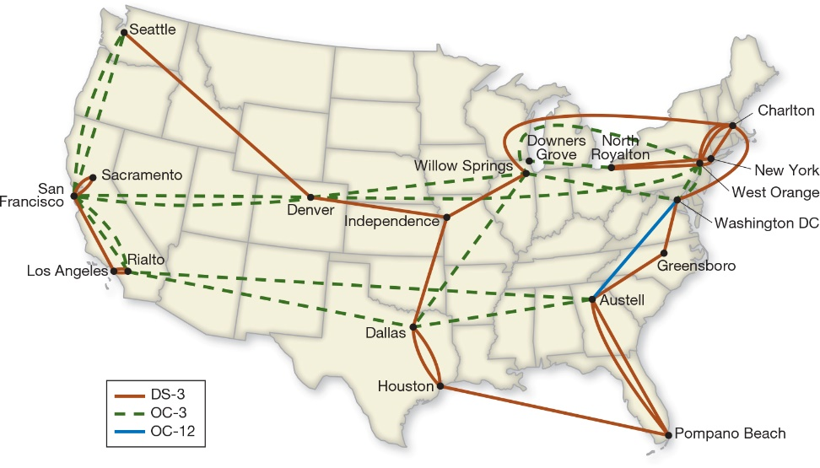
Internet Management and Networking
Networking Components (1 of 3)
(Objective 13.2)
Internet—network of networks
Backbone
  Main paths of the Internet
  Data travels the fastest
  Collection of large national and international networks
  Optical carrier line
    Fiber-optic
Notes:
As a “network of networks,” the Internet is similar to the U.S. highway system, where smaller roads feed into larger, faster highways.
The main paths of the Internet are known collectively as the Internet backbone.
The Internet backbone is a collection of large national and international networks, most of which are owned by commercial, educational, or government organizations.
These backbone providers, which are required to connect to other backbone providers, have the fastest high-speed connections.
A backbone is typically a high-speed fiber-optic line, designated as an optical carrier (OC) line.

Slide 7
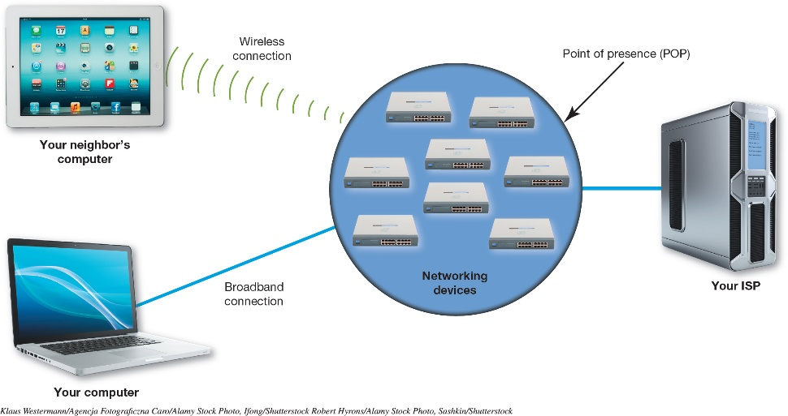
Internet Management and Networking
Networking Components (2 of 3)
(Objective 13.2)
Internet exchange point (IXP)
  Used for connecting Internet service providers
  One or more network switches
Point of presence
  Used for individuals
  Bank of modems,
  servers, routers,
  and switches
Notes:
Internet service providers (ISPs) like Verizon and Comcast are connected together through an Internet exchange point (IXP).
A typical IXP is made up of one or more network switches to which ISPs connect.
Individual Internet users enter an ISP through a point of presence (POP).
This is a bank of modems, servers, routers, and switches.
This figure shows how home users connect to their ISPs through a single point of presence that can handle many simultaneous connections.

Slide 8
Internet Management and Networking
Networking Components (3 of 3)
(Objective 13.2)
Client/server model is used for Internet
Common Internet servers
  Web servers
  Commerce servers
  File servers
Notes:
The majority of Internet communications follow the client/server model of network communications.
Common Internet servers include:
Web servers, which host web pages and provide information to clients.
Commerce servers, which enable users to buy goods and services.
File servers, which provide remote storage space.

Slide 9
Internet Management and Networking
Data Transmission (1 of 4)
(Objective 13.3)
Network follows standard protocols to send information
Protocol—a set of rules for exchanging electronic information
  They are the “rules of the road”
  Open as opposed to proprietary
Notes:
Just like any other network, the Internet follows standard protocols to send information between computers.
A computer protocol is a set of rules for exchanging electronic information.
If the Internet is the information superhighway, then protocols are the rules of the road.
Each protocol had to be an open system, meaning its design would be made public for access by any interested party. This was in direct opposition to the proprietary system (private system) model that was the norm at the time.

Slide 10
Internet Management and Networking
Data Transmission (2 of 4)
(Objective 13.3)
Circuit switching—dedicated connection formed between two points
  Inefficient when applied to computers
  Computers transmit data in a group, or burst
  Processor works on the next task and ceases to communicate until ready to transmit next burst
  Circuit would have to remain open
Notes:
Circuit switching is a dedicated connection formed between two points.
Circuit switching is inefficient. As a computer processor performs the operations necessary to complete a task, it transmits data in a group, or burst.
The processor begins on its next task and ceases to communicate with output devices or other networks until it’s ready to transmit in the next burst.
Circuit switching is inefficient because either the circuit would have to remain open or it would have to be reestablished for each burst.

Slide 11
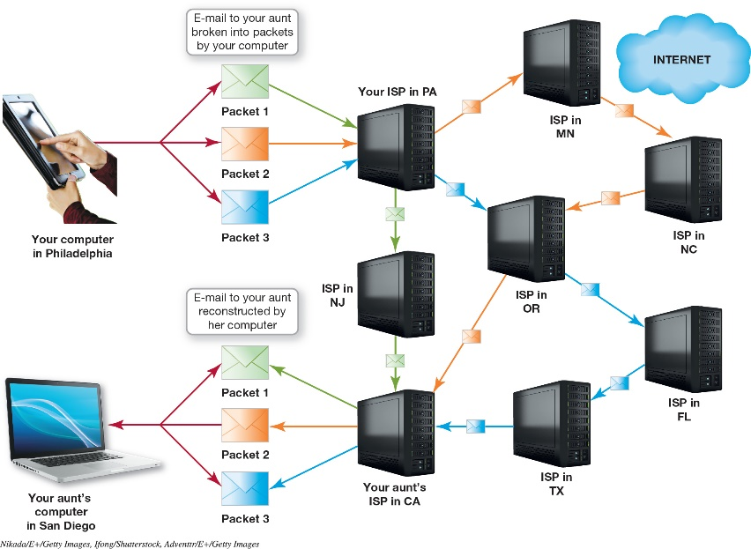
Internet Management and Networking
Data Transmission (3 of 4)
(Objective 13.3)
Packet switching—breaks data into chunks called packets and simultaneously sends them over various routes to a destination
Packets contain
  Address to which the
  packet is being sent
  Address from where
  the packet originates
  Reassembly instructions
  Data that is being transmitted
Notes:
Packet switching breaks data is into smaller chunks called packets (or data packets), which are sent over various routes at the same time to a destination.
Packets contain:
The address to which the packet is being sent
The address from where the packet originates
Reassembly instructions, if the original data is split between packets
The data that’s being transmitted

Slide 12
Internet Management and Networking
Data Transmission (4 of 4)
(Objective 13.3)
TCP/IP—main suite of Internet protocols
  Consists of many interrelated protocols
  Transmission Control Protocol
  Internet protocol is responsible for sending the information from one computer to another
Notes:
Although many protocols are available on the Internet, the main suite of protocols used is TCP/IP.
The suite is named after the original two protocols that were developed for the Internet: the Transmission Control Protocol (TCP) and the Internet Protocol (IP).
Although most people think that the TCP/IP suite consists of only two protocols, it actually includes many interrelated protocols.

Slide 13
Internet Identity
IP Addresses (1 of 3)
(Objective 13.4)
Each Internet device is required to have an IP address
Internet Corporation for Assigned Names and Numbers (ICANN) ensures IP addresses are unique
IP address forms
  Dotted decimal
  Dotted quad
  Octet
Notes:
Recall that an IP address is a unique identification number that defines each computer, service, or other device connected to the Internet.
Each computer, server, or device connected to the Internet is required to have a unique identification number or IP address.
The Internet Corporation for Assigned Names and Numbers (ICANN) ensures that IP addresses are unique and haven’t been assigned to other users. ICANN is responsible for allocating IP addresses to network administrators.
An IP address in this form is called a dotted decimal number (or a dotted quad). Each of the four numbers in a dotted decimal number is referred to as an octet.

Slide 14
Internet Identity
IP Addresses (2 of 3)
(Objective 13.4)
Internet Protocol version 4 (IPv4)
  Created in 1981
  Over 4 billion possible values
Internet of Things (IoT)—explosive growth of Internet-enabled devices
Internet Protocol version 6 (IPv6)
  Provides more IP addresses
Notes:
Internet Protocol version 4 (IPv4) was created in 1981. Four billion values for an address field seemed like enough to last forever. However, as the Internet grew, we are running out of IP addresses.
The Internet of Things (IoT) is a term for the explosive growth of Internet-enabled devices.
Internet Protocol version 6 (IPv6) is an IP addressing scheme that makes IP addresses longer, thereby providing more available IP addresses.

Slide 15
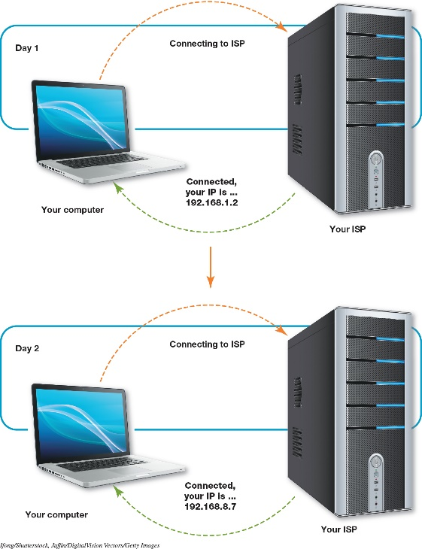
Internet Identity
IP Addresses (3 of 3)
(Objective 13.4)
How a computer gets an IP address
  Static
  IP address never changes
  Assigned by network
  administrator or ISP
  Dynamic
  IP address is temporary
  Assigned from pool of addresses
  More common
  DCHP shares IP addresses as needed
Notes:
IP addresses are assigned either statically or dynamically.
Static addressing means that the IP address never changes.
Dynamic addressing, in which your computer is assigned a temporary address from an available pool of IP addresses, is more common.
Dynamic Host Configuration Protocol (DHCP) takes a pool of IP addresses and shares them with hosts on the network on an as-needed basis.

Slide 16
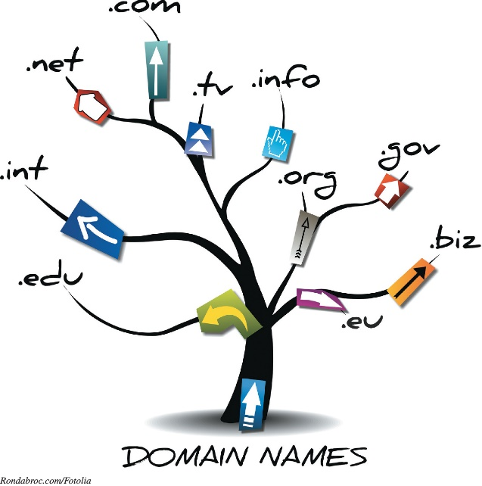
Internet Identity
Domain Names (1 of 2)
(Objective 13.5)
Top-level domain (TLD)
  Standardized pools such as
  .com and .org
  Established by ICANN
Second-level domain
  Directly below the top-level domain
  Unique within its own TLD
  Not necessarily unique to all top-level domains
Notes:
Domains are organized by level. The portion of the domain name after the dot is the top-level domain (TLD). The TLDs are standardized pools such as .com and .org established by ICANN.
A second-level domain is a domain that’s directly below a top-level domain, and needs to be unique within its own TLD but not necessarily unique to all top-level domains.

Slide 17
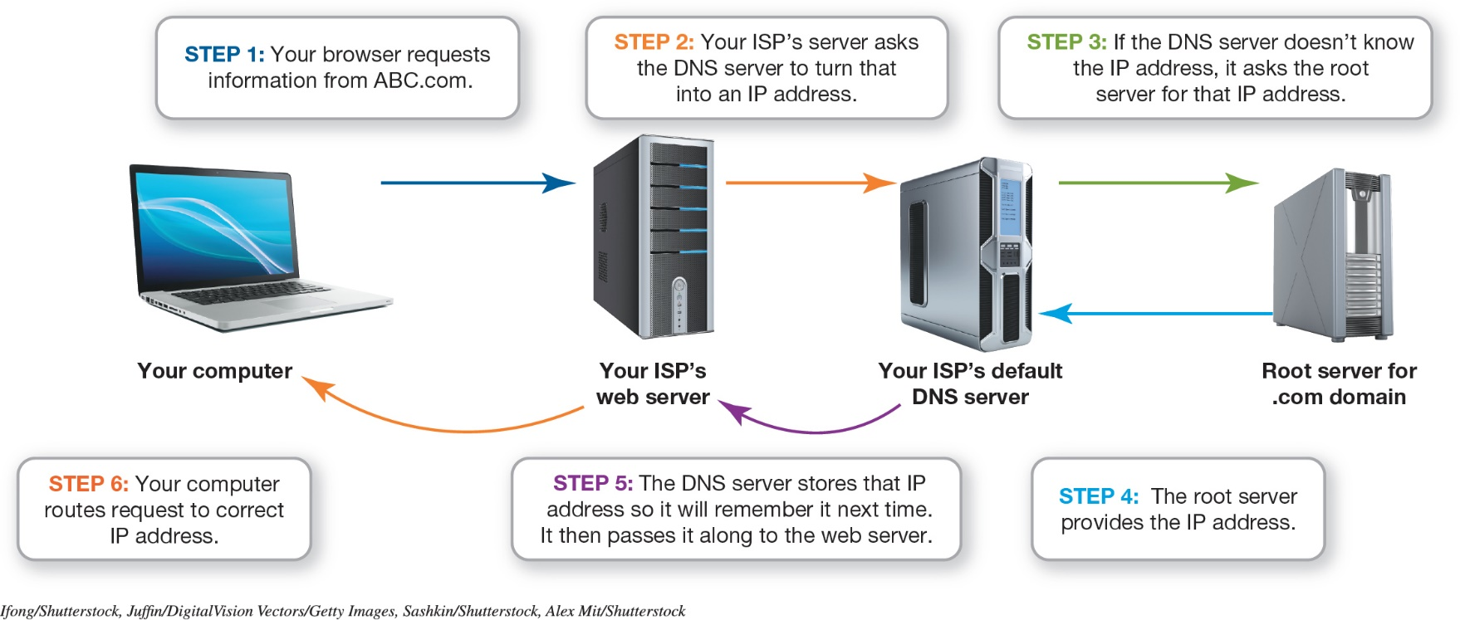
Internet Identity
Domain Names (2 of 2)
(Objective 13.5)
Computer converts URL to an IP address
Domain name system server functions like an Internet phone book
Notes:
When you enter a URL in your browser, your computer converts the URL to an IP address.
To do this, your computer consults a database maintained on a domain name system (DNS) server that functions like a phone book for the Internet.
This figure shows the DNS servers in action.

Slide 18
Web Technologies
Web Development (1 of 4)
(Objective 13.6)
  HTML
  Not a programming language
  Set of rules for marking blocks of text
  Browser knows how to display text
  Surrounded by pairs of HTML tags
  Tags and text referred to as an element
      <b><i>This should be bolded and italicized.</i></b>
Notes:
Hypertext Markup Language (HTML) isn’t a programming language; it’s a set of rules for marking up blocks of text so that a browser knows how to display them.
Blocks of text are surrounded by pairs of HTML tags. HTML tags surround and define HTML content. Each pair of tags and the text between them are referred to as an element.
This example provides multiple tags combined in a single element: <b><i>This should be bolded and italicized.</i></b>.

Slide 19
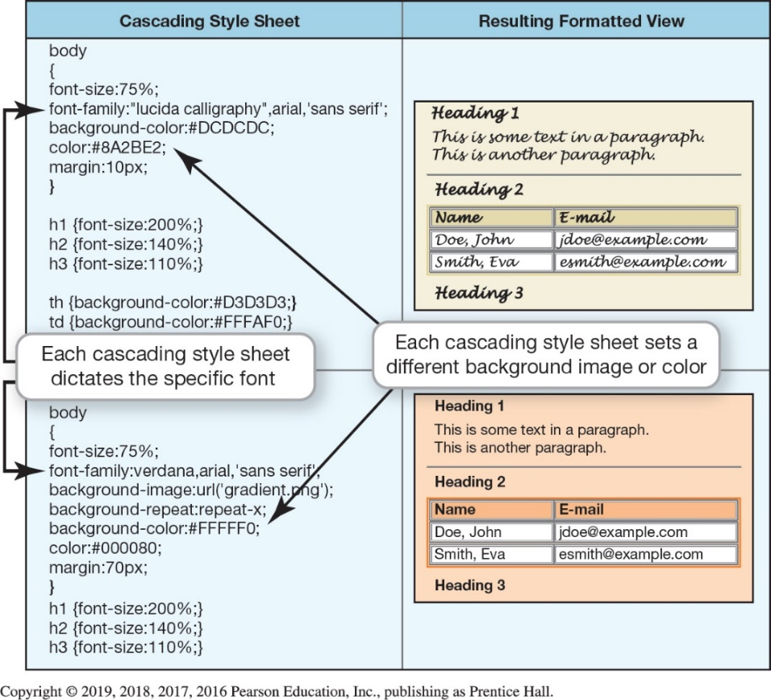
Web Technologies
Web Development (2 of 4)
(Objective 13.6)
Cascade style sheet—list of rules defining how to display HTML elements
Notes:
A cascading style sheet (CSS) is a list of rules that defines in one single location how to display HTML elements.

Slide 20
Web Technologies
Web Development (3 of 4)
(Objective 13.6)
XML—different from HTML
  eXtensible Markup Language—describes what data is, not how it’s to be displayed
      Provides a method of data validation through XML schema diagrams (XSD)
JSON—JavaScript Object Notation
  Data interchange that is easy for humans to read and write
Notes:
The eXtensible Markup Language (XML) describes what data is being described rather than how it’s to be displayed.
XML schema diagrams (XSD) allow you to specify all kinds of data validation for a specific XML tag.
Another popular format, JSON, stands for JavaScript Object Notation and is a data interchange standard that is easy for humans to read and write.

Slide 21
Web Technologies
Web Development (4 of 4)
(Objective 13.6)
Hypertext Transfer Protocol—transfers hypertext documents across the Internet
Hypertext Transfer Protocol Secure—used to securely send data over the web
  SSL
  TLS
Notes:
The Hypertext Transfer Protocol (HTTP) was created especially for the transfer of hypertext documents across the Internet.
Hypertext Transfer Protocol Secure (HTTPS) ensures that data is sent securely over the web.
HTTPS is actually an acronym that’s the combination of HTTP and Secure Sockets Layer (SSL), a network security protocol.
Transport Layer Security (TLS) is an updated extension of SSL.

Slide 22
Web Technologies
Application Architecture (1 of 3)
(Objective 13.7)
Server-side applications
  The web is a client/server network
  Program on server is considered server-side
  Can require many communication sessions between client and server
  Can perform very complex operations
Notes:
As you’ll recall, the web is a client/server network.
The type of program that runs on a web server rather than on your computer is referred to as a server-side program.
Server-side program execution can require many communication sessions between the client and the server to achieve the goal, but server-side programs can perform very complex operations.

Slide 23
Web Technologies
Application Architecture (2 of 3)
(Objective 13.7)
Client-side applications
  Programs that run on client computer
  Require no interaction with web server
  New data is only sent in response to a request
  Exchange of data can make interactivity inefficient and slow
  More efficient on local computer
Notes:
A client-side program runs on the client computer and requires no interaction with a web server.
The receiving computer can’t get new data from the server unless a new request is made.
If interactivity is required on a web page, this exchange of data between the client and server can make the interactivity inefficient and slow.
Often, it’s more efficient to run programs on your computer. Therefore, client-side programs are created.

Slide 24
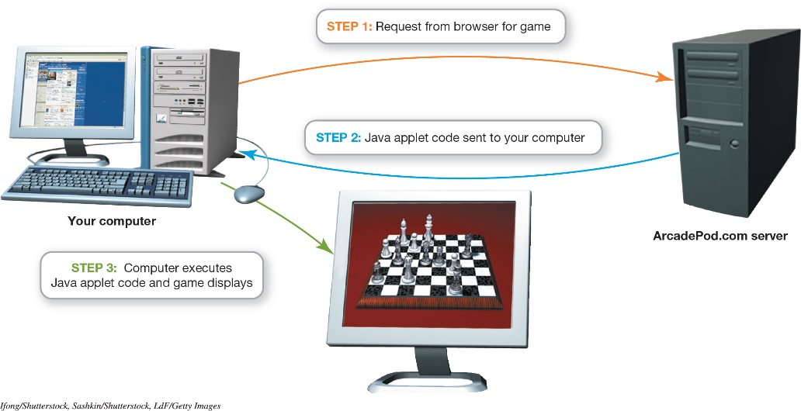
Web Technologies
Application Architecture (3 of 3)
(Objective 13.7)
JavaScript—commonly used scripting language
Applet—small application located on the server
Notes:
JavaScript is a commonly used scripting language embedded within a web page.
An applet is a small application located on the server.

Slide 25
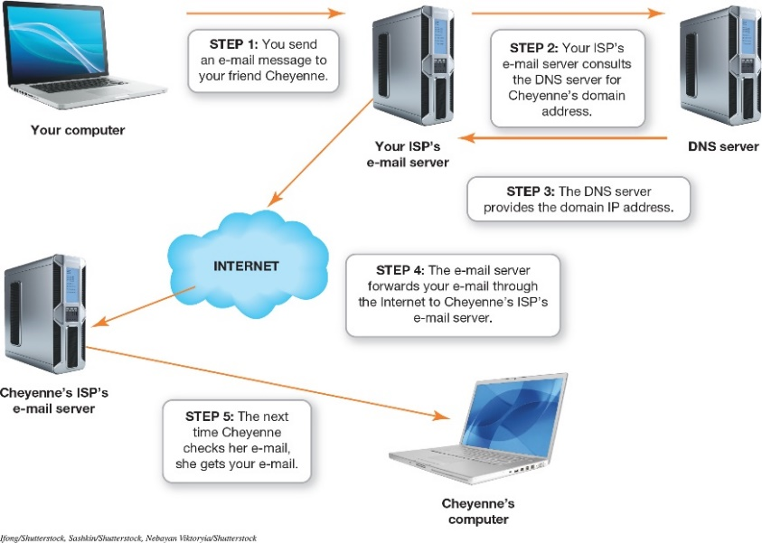
Communications Over the Internet
Types of Internet Communication (1 of 2)
(Objective 13.8)
E-mail—one of the most common communication methods
  Created in 1971
  Simple Mail Transfer
  Protocol (SMTP) is
  responsible
  for sending e-mail
  Multipurpose Internet Mail
  Extensions (MIME) allows sending of files
Notes:
E-mail is one of the most common communication methods on the Internet.
In 1971, Ray Tomlinson created e-mail from a simple program he wrote to enable users to leave text messages for each other on a single machine.
The Simple Mail Transfer Protocol (SMTP) is responsible for sending e-mail along the Internet to its destination.
When the need arose to send files by e-mail, the Multipurpose Internet Mail Extensions (MIME) specification was introduced.
This figure shows a sample route an e-mail takes on the Internet.

Slide 26
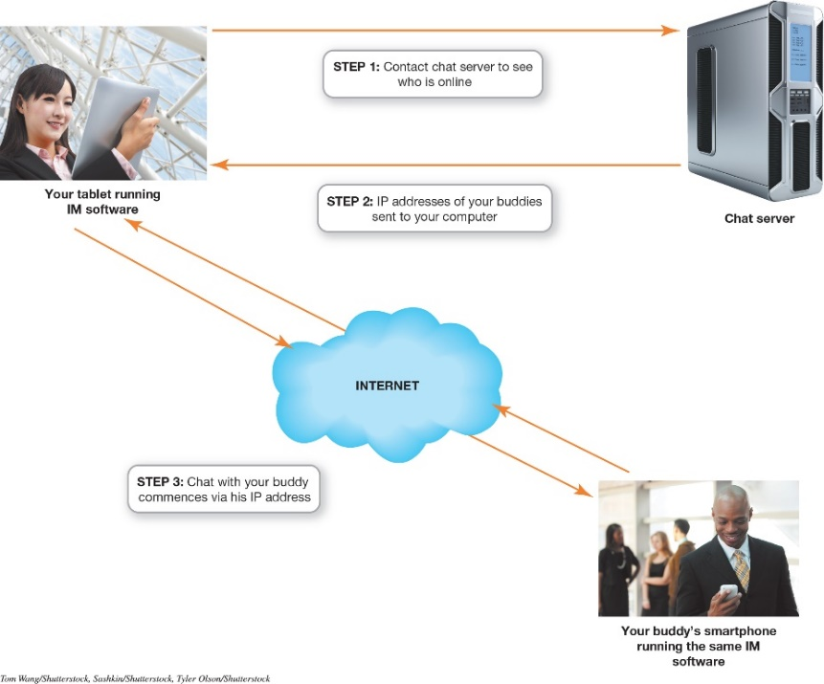
Communications Over the Internet
Types of Internet Communication (2 of 2)
(Objective 13.8)
Instant messaging (IM)
  Another common communication method
  Uses a client program
  Makes connection with chat server
  Chatting takes place between two devices
Notes:
Instant messaging (IM) requires the use of a client program that connects to an IM service.
The client software running on your device makes a connection with the chat server and provides it with connection information.
Because your device and your friend’s device have the connection information for each other, the server isn’t involved in the session.
Chatting takes place directly between the two devices.
This figure shows how an instant messaging program works.

Slide 27
Communications Over the Internet
Encryption (1 of 3)
(Objective 13.9)
Encryption
  E-mail is susceptible to being read by unintended parties
  Might remain on servers
  Process of coding e-mail so that only the person with the key can decode the message
Notes:
Encryption is necessary for e-mail because e-mail is susceptible to being read by unintended parties.
It might also remain on servers either permanently or temporarily.
Encryption is the process of coding e-mail so that only the person with the key can decode the message.

Slide 28
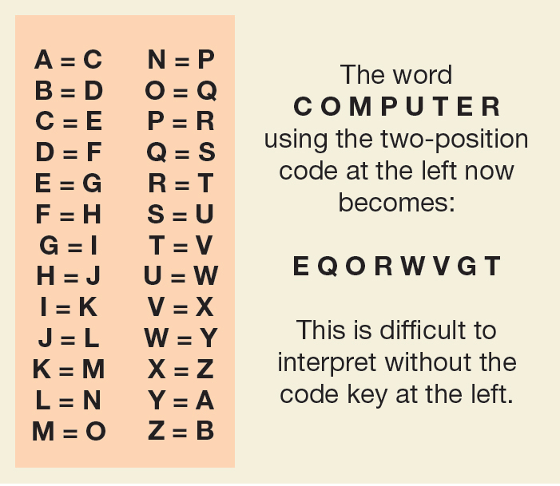
Communications Over the Internet
Encryption (2 of 3)
(Objective 13.9)
Private-key encryption
  Only the two parties have the code
  Could be a shift code
  Could be more complex substitution code
  Main problem is key
  security
Notes:
In private-key encryption, only the two parties involved in sending the message have the code. This could be a simple shift code where letters of the alphabet are shifted to a new position or a substitution code where, a = h, b = r, c = g, etc.
The main problem with private-key encryption is key security. If someone steals a copy of the code or is savvy about decoding, the code is broken.

Slide 29
Communications Over the Internet
Encryption (3 of 3)
(Objective 13.9)
Public-key encryption
  Two keys (key pair) are created
    One for coding and one for decoding
  Coding key is distributed as public key
    Message being sent is coded using public key
  Decode using private key
    Only receiver knows private key
  Public key is generated using a complex mathematical formula
Notes:
In public-key encryption, two keys, known as a key pair, are created. You use one key for coding and the other for decoding.
The public key is used for coding. You can place this key on your website. Anyone wishing to send you a message can download your public key and code the message using your public key.
The private key is generated first. The public key is then generated using a complex mathematical formula.

Slide 30

Copyright
All rights reserved. No part of this publication may be reproduced, stored in a retrieval system, or transmitted, in any form or by any means, electronic, mechanical, photocopying, recording, or otherwise, without the prior written permission of the publisher. Printed in the United States of America.

