Slide 1
Religious Practices in Oceania
Student’s Name
Institutional Affiliations

Slide 2
Sacred Items, Areas , and Practices
 | Contrast | Comparison
Sacred Items | Christianity uses sacred items such as crosses to symbolize the death of Jesus on the cross. Ocean cults have sacred items such as weapons that symbolize power. | The two have sacred items that have meanings, and used to strengthen faith.
Oceanic areas | Christian uses specific areas such as churches to worship while oceanic cults have private areas and neighborhood where they carry out their activities. | The two also have designated places of worship.
Practices | Christians offer tithe as a form of appreciation to God which Oceanic cult members while oceanic cult member large walls to be isolated from the external world. | The two also have practices that are differentiate them from other religions.

Slide 3
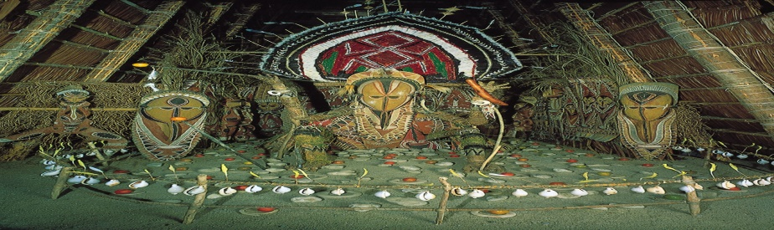
New Beliefs and Topics
Divisions can be due to the adoption of technology that were not used in the past.
Also, new interpretation of religious books can cause division.
Besides, issue on polygamy and monogamy can be a dividing factor.
Celibacy is another divisive factor, especially the Catholics.
Issues of gene editing is another contentious issue in most religions (Lipka, 2016).
The issue of changing God’s creation through practices such as face surgeries and implants is also a bone of contention.
The issue of suicide bombing has caused divisions among Muslims.

Slide 4
Oceanic Cult
Political intervention is a key divisive factor in oceanic cults.
Also, the issue of privacy has also caused divisions among cult members.
Besides, sacrifices is another factor that make members of cult groups disagree.
Dealership in illegal business also divides cult members.
The possession of gothic items also cause disagreements in Oceanic cults.
Wealth acquisition also cause divisions among members affiliated to Oceanic cults.

Slide 5
Cults’ Practices and Values
Cult members live in private communities and neighborhoods.
They build large walls around their houses.
They deal in illegal businesses such as weapon manufacture.
They make sacrifices that mostly involve the spillage of blood.
Most of them value material wealth such as money, cars, and other luxuries.
They also value loyalty among its members.

Slide 6
Cont.
Cult members worship under the guidance of the leaders.
They continuously their ideals to distract their members from the truth.
They value being denigrated with outsiders including family members.
Cults arouse the emotions of their followers to prevent them to think objectively.
They use techniques such hypnosis, love bombing, peer group pressure to control their members (Human Givens Institute, 2020).
Lastly, they have dress codes that should observed during their meetings.

Slide 7
References
Human Gives Institute, (2020). Exploring the cult in culture. Retrieved from
https://www.hgi.org.uk/resources/delve-our-extensive-library/society-
and-culture/exploring-cult-culture
Lipka, M. (2016). The religious divide on views of technologies that would enhance human beings. Pew Research Center. Retrieved from
https://www.pewresearch.org/fact-tank/2016/07/29/the-religious-divide-on-views-of-technologies-that-would-enhance-human-beings/

