Slide 1
Name
Institution course
Netflix

Slide 2
Introduction
This presentation is meant to analyze and interpret the strategic optimism culture adopted, and grown by Reed Hastings
He is Netflix’s current and founding CEO.
We are scrutinizing the competitive advantage model that paved the way for the rise of Netflix
Notes:
We start our presentation by analysing, interpreting the strategic optimism culture adopted and grown by Reed Hastings, Netflix’s current and founding CEO. We are scrutinizing the competitive advantage model that paved the way for the rise of Netflix

Slide 3
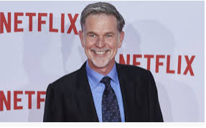
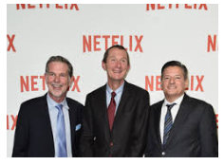
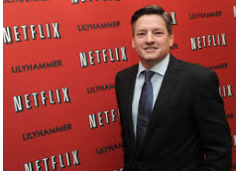

Protagonist
Reed Hastings
Ted Sarandos
Neil Hunt
Source:https://www.google.com/search?q=reed+hastings&rlz=1C1CHBD_enKE886KE886&sxsrf=ALeKk00nu_h3cd088rLzyHQwu0G62R6NgQ:1585776141674&source=lnms&tbm=isch&sa=X&ved=2ahUKEwj_l_i8lMjoAhWAQkEAHbp0CoAQ_AUoAXoECBsQAw&biw=1366&bih=695
Reed Hastings: Founder and current CEO.
Ted Sarandos: Chief Content Officer.
Neil Hunt: Chief Product Officer:
Notes:
This slides gives a summary of Netflix's Protagonist such as Reed Hastings, Ted Sarandos and Neil Hunt who Positively impacts its growth

Slide 4
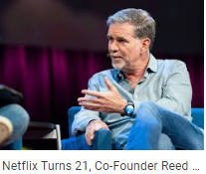
Summary
A Netflix refers to subscription done online through rental services of DVD
Netflix was conceived for the fast time by Hastings in 1997 who is a very one of the most entrepreneur
Recently, from all commercial dimension it has been growing persistently.
Its competitors reports to have been managed through its effort in delivering repackaging.
The company started as a mail delivery service for DVDs,
Currently it has adopted internet based mechanisms
The internet based mechanisms to facilitate client convenience and fully immersed into online-based movie subscriptions.
It model of delivery has changed. However, it is retaining the primary service output like films.
It is currently the biggest online-based subscription enterprise in the world and delivers DVD globally
Founder of Netfix Reed Hastings
Source: https://www.google.com/search?q=reed+hastings&rlz=1C1CHBD_enKE886KE886&sxsrf=ALeKk00nu_h3cd088rLzyHQwu0G62R6NgQ:1585776141674&source=lnms&tbm=isch&sa=X&ved=2ahUKEwj_l_i8lMjoAhWAQkEAHbp0CoAQ_AUoAXoECBsQAw&biw=1366&bih=695
Notes:
This slide describes a summary of since its Since its inception in 1997 up to date. It also pinpoints how it has been growing persistently under the leadership of its founder and CEO Hastings

Slide 5
Issues:
Rental prices charging besides its competitors
Slow delivery provision
A challenge of customer base and online viewing feature
Strategy of staff retention
Issue of primary culture retention
Agreements of sharing revenues
Flexibility and innovation in the pricing system
increase in prices for films and tv
Huge appetite for risk based capital investments
Other streaming services pose competition
Notes:
This slides discuses possible issues that can affect net fix

Slide 6
SWOT analysis
Strengths-
DVD rental function retentions
Relates well with USPS
High growth rate
Adaptability and flexibility with price/cost
Benefit form strategies of Competitive pricing
ability to focus on customer service
Notes:
This slides highlight key potential strengths of Netflix in services provision such as DVD rental function retentions
Relates well with USPS
High growth rate
Adaptability and flexibility with price/cost
Benefit form strategies of Competitive pricing
ability to focus on customer service

Slide 7
Weaknesses
Competition from aggressive content producers like Blockbuster
The rise of piracy within the industry
Lack of demand for VOD delivery
Shipping delay
Burden of subscription costs
Notes:
This slide is focusing on weaknesses of Netflix. Some of these include ; Competition from aggressive content producers like Blockbuster
The rise of piracy within the in industry
Lack of demand for VOD delivery
Shipping delay
Burden of subscription costs

Slide 8
Continued- SWOT Analysis
Opportunities-
Rise in internet use
Alliances with production studios
Application of niche marketing and retention of primary objective
Customer retention
Notes:
This slides highlights the Rise in internet use, Alliances with production studios,
Application of niche marketing and retention of primary objective as well as Customer retention as big opportunities for Netflix

Slide 9


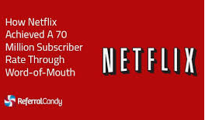

Opportunities-
Increased rate in internet usage
Alliances with production studios
Niche marketing and retention
The retention of customers
Source of photos: https://www.google.com/search?q=netflix+niche+marketing&rlz=1C1CH BD_enKE886KE886&tbm=isch&sxsrf=ALeKk03kPcLJIeBkhNrxSCae93B5u3dLOg:1585775070566&source=lnms&sa=X&ved=0ahUKEwjdgpm-kMjoAhXCiVwKHbkTC7sQ_AUIDygC&biw=1366&bih=695&dpr=1
Notes:
This slides highlights some of Netflix's opportunities like :Increased rate in internet usage
Alliances with production studios
Niche marketing and retention
The retention of customers

Slide 10
Threats
Increased cases of piracy
Inadequate demand for VOD delivery
Competition from aggressive content producers like Blockbuster
Notes:
This slides discuses Blockbuster, piracy and low demand of VOD delivery as threats that can affect its operation

Slide 11

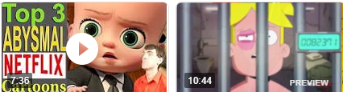
Position statement
Netflix is an online service platform
It offers streaming services like movies, cartoons and television shows
a monthly fee is needed for a customer to enjoy all the services
Its target market is based on ages stemming from young, to elderly populations
Click the link: https://www.youtube.com/watch?v=3t3qJZi6bc8
Netflix cartoons
Notes:
The slide explains positioning statement for netflix

Slide 12
Netflix action plan
Goals | Objectives | Responsibility | timeline | Evaluation
To provide best online services | Effective delivery of repackaging | retain DVD rental function | 2020-2025 | Assessing customers feedback
Widening the markets for its products | Dominating all commercial dimensions | Enforcing good relations with USPS | 2020-2025 | Assess the extent at which target market access the services
Maximizing profit and minimizing losses | staff retention Competing favourably | Adapting with cost flexibility | 2020-2025 | Assessment of how retained employees perform
Retention of customers | Advancing online reviewing features | Focusing on customer services | 2020-2025 | Assessing customers feedback
Notes:
This slide focuses on the action plan starting with Goals , Objectives , Responsibility, timeline and Evaluation

