Slide 1
Political Disclosure
By Kerri Zloch, Dayna Bowers, Gwendolyn Braccialarghe, Madelyn Fradkin, and Yairo Rincon

Slide 2
Contents
Abortions
Politicians or important leaders that have in one way or another promoted a culture of misogyny and patriarchal standards
Public institutions change to create legitimacy for the present discourse
Reproduction of political power
Power abuse or domination
Forms of resistance or counter-power against such forms of discursive dominance
Consequences of social and political inequality that results from such domination

Slide 3
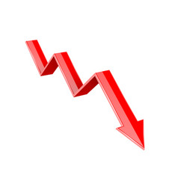
Abortion Statics
623..
14
43%
186
How many?
Deaths
There were 623,471 abortions in the year 2000.
How many women have died during an abortin in 1998 and 1999.
To birth ratio
Undergrad parents
There were 11.6 abortions to 1000 births.
Are single mothers

Slide 4

Why are abortions such a hot topic?
Women have been shunned for getting abortions
Those who are anti-abortions make it very religious
Many campaigns for “My Body My Choice”
Have been banned and then legal back and forth in various countries
Men have been making the decision for this topic

Slide 5
The Debate
The Pro-Choice
The Pro-life
It is a clump of cells
It is your choice to have the child or not
Shouldn't be judged as we are sinners
“The government is already trying to control us enough it's our bodies.”
There is a heartbeat at week 6 of pregnancy.
It was your choice to have sex.
It was your choice to have sex, that is the outcome
“Aboration takes away human life”

Slide 6
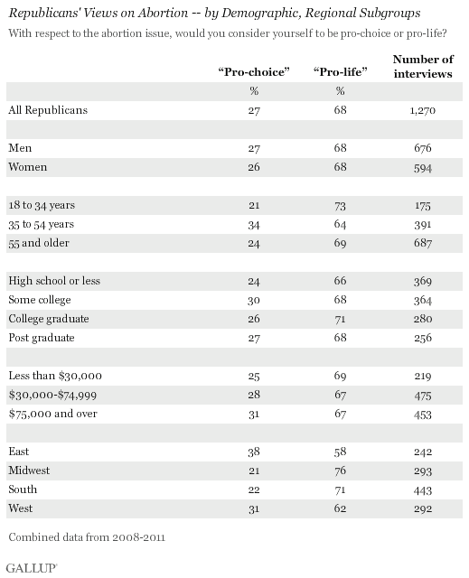
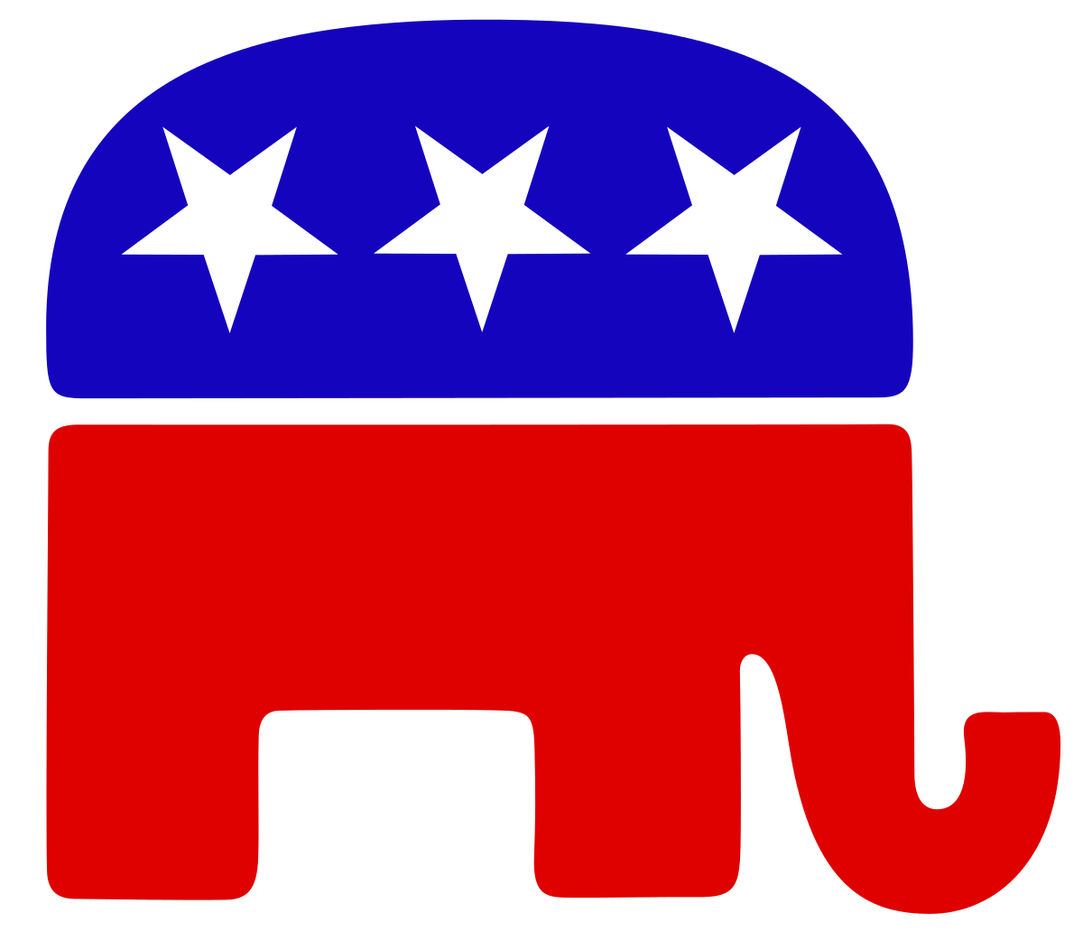
Republicans View

Slide 7
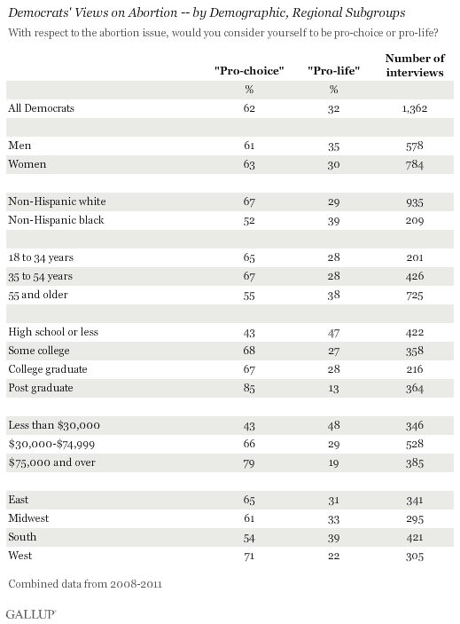
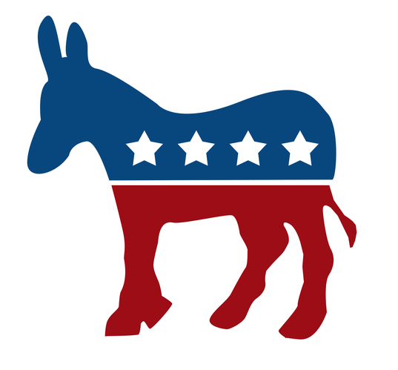
Democrats View

Slide 8
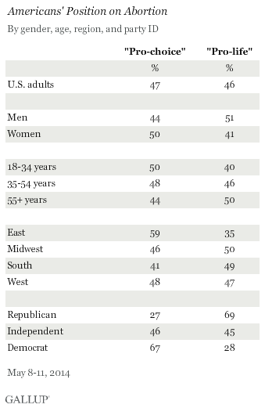
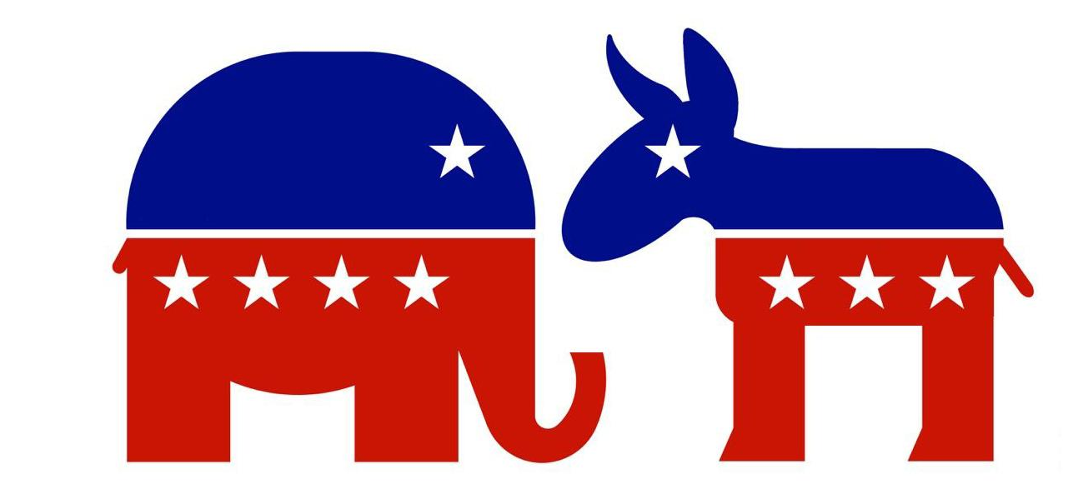
Mixed together

Slide 9


Abortion Hostility
•Abortion is a hot topic, and it has been for the past 20 years. This is since many people claim that the rights of women’s body are beyond the life of a fetus.
•This ethical dilemma undermines women who have been victims of rape, sexual assault or psychological problems. Most of the time if there is a reason for a women to want to abort, it is because she cannot provide the life the baby deserves.
•By 2016, more than half of all states had at least four of the 10 major types of abortion restrictions* and so are considered hostile to abortion rights.

Slide 10
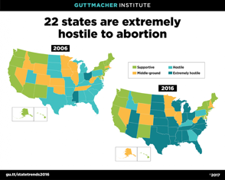

Slide 11
ROLE OF THE PRESIDENT
According to Elizabeth Nash, “the election of Donald J. Trump raised the specter that the Supreme Court—if dramatically reshaped by the new administration—could place abortion rights for women across the country very much in jeopardy.” (2017)
This idea can be supported with the fact that Donald Trump has repeatedly stated that he is pro-life and takes a position that is considered hostile for women who need abortion clinics to provide the necessary services safely and under the law.
A President who does not support women’s health rights can greatly influence the overall population and polarize people in two different groups; those who believe in abortion rights and those who condemn it.

Slide 12
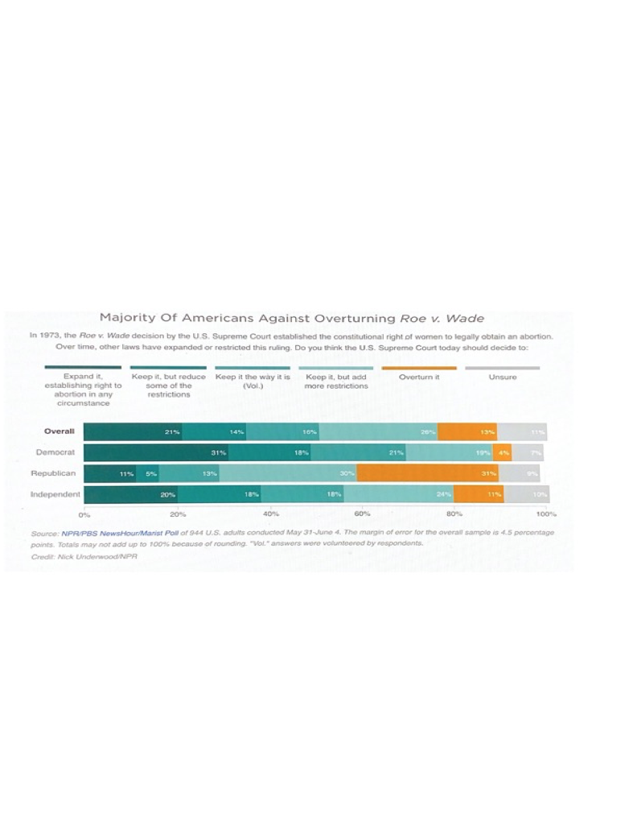

Slide 13
Cultural factors part 2
When it comes to the morals of a society, we have to understand the background of their religion and ideology. It is important to note that we are a product of our environment and our previous experiences and that is why the DISCOURSE is evident when it comes to arguing against the women’s health rights.
Moreover, many of us do not understand that these laws are controlling the lives of women and very much go together with the fictional novels that we were reading previously such as the Unnamed Midwife.

Slide 14
Cultural factors part 2
v “As the conservative justices of the Supreme Court lay the groundwork to undermine abortion rights, and as President Donald Trump and Senate Majority Leader Mitch McConnell stack the courts with political ideologues,¹¹ anti-abortion legislators at the state level continue to advance dangerous, medically unnecessary abortion restrictions.” (Ellman, 2020)
v It is our duty to defend what we believe is right and it is through education that we can win this fight
v Moreover, there are still many ethical dilemmas that might nudge us to think about the greater good of our society vs the life of a fetus but given the fact that many of these women are raped or physically impaired it is our duty to provide them with proper health care and planning to assure they do not go to clandestine clinics with no licenses nor approved medical supervision.

Slide 15
Continued
v Moreover, there are still many ethical dilemmas that might nudge us to think about the greater good of our society vs the life of a fetus but given the fact that many of these women are raped or physically impaired it is our duty to provide them with proper health care and planning to assure they do not go to clandestine clinics with no licenses nor approved medical supervision.

Slide 16
Work Cited Slide
“Didyouknow-4.” Pregnant on Campus, 28 Sept. 2016, pregnantoncampus.org/didyouknow-4/.
“Abortion Surveillance --- United States, 2000.” Centers for Disease Control and Prevention, Centers for Disease Control and Prevention, www.cdc.gov/mmwr/preview/mmwrhtml/ss5212a1.htm.
“Data & Statistics - Reproductive Health.” Centers for Disease Control and Prevention, Centers for Disease Control and Prevention, 18 Nov. 2019, www.cdc.gov/reproductivehealth/data_stats/index.htm.
Saad, Lydia. “U.S. Still Split on Abortion: 47% Pro-Choice, 46% Pro-Life.” Gallup.com, Gallup, 25 Sept. 2020, news.gallup.com/poll/170249/split-abortion-pro-choice-pro-life.aspx.

Slide 17
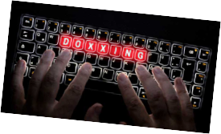
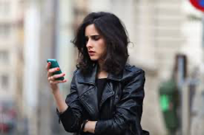
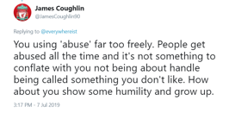
Misogyny Online
By Gwendolyn Braccialarghe
Social media is a platform where we all can participate freely. However, with free participation there is also the freedom of expression
Amnesty International tasked MORI to conduct a study with an online poll with women between ages 18 to 55 from the UK, USA, Spain Denmark, Italy, Spain, Poland and New Zealand.
60% of women from the eight countries claimed they experienced online abuse/harassment from strangers
Around two-thirds of women reported they experienced low self-esteem, stress, anxiety or panic attacks as a result of the abuse
76% of women from the eight countries experienced abuse/harassment on social media while trying to made changes to the way they used social media as a result
64% of women believed that online abuse/harassment is a normality
Women who use social media have also reported privacy violations through “doxxing” (the sharing of sexual/private images without ones consent

Slide 18
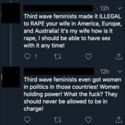
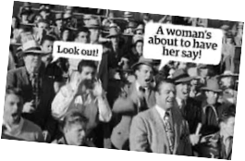
Patriarchal Discourse Through Social Media
Patriarchal discourse: determines the social, economical, political and physical being of women
A study conducted with Twitter found that in Turkey, there was a trend of tweets with the hashtag: #BirKadinaMutlaka (translated: #AWomanHasToBe) This trend was a result of women in Turkey requesting for more rights. The meaning behind the hashtag is that a woman has to be loyal, a woman must take care of her husband, a woman must respect her husband, and so on.
In 2015, a female organization created a movement to reclaim their bodies from patriarchal oppression and expectations from ideals/views emplaced through shame and pornographic films.
An under the radar movement known as The Red Pill, is comprised of a group of men with common ideals against women, immigrants, and people of color. This organization believes:
Women have too many rights
Women want to be dominated
Men are being cheated out of their rights and MORE

Slide 19
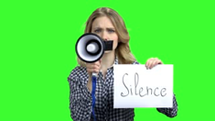
The Psychological Impact and Silencing
Most women who believe that online abuse/harassment is normalized suggest ignoring it is the best solution
In the UK, Denmark and USA, about 60% of women in these countries disagree that online abuse can be stopped by ignoring it.
The poll also found that women who experienced online abuse/harassment claimed that there was an impact on their self esteem and self confidence.
Two-thirds of women from all the eight countries stated that they felt a sense of powerlessness.
About 80% had an impact on their freedom of expression.
Women increased their security and privacy settings
Some made changes to the content they posted
About a third changed how they expressed themselves in response to abuse or harassment

Slide 20
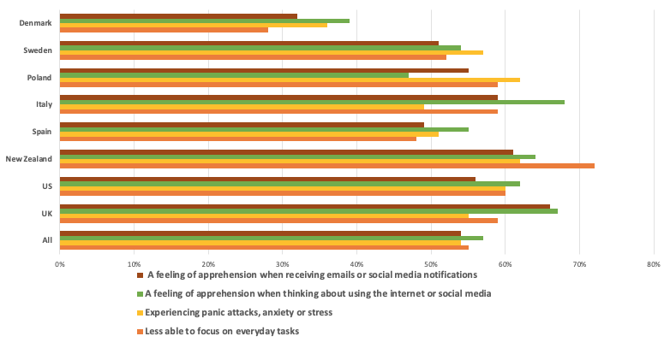
The Psychological Impact And Silencing

Slide 21
Political Oppression
There is a set-in-place view of gender in politics. It is said that men have it easier when pursuing that career path, whereas women have to “prove themselves.”
About 7 in 10 women agree that there are too few women in political roles. 6 in 10 women say that gender discrimination is a major obstacle towards female leadership.
Women underrepresented in politics:
57% say voters are not ready to elect more female leaders (41% in 2014).
64% of women in the Republican Party vs. 28% of GOP men have stated that women having more to prove than men is a reason as to why there are fewer women in political offices
The next slide provides a chart that includes the ideal traits voters find would be helpful to a candidate.

Slide 22
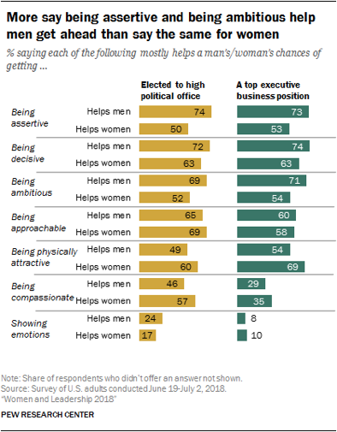
The Psychological Impact and Silencing
Based on the graph, women are considered less assertive, ambitious, or motivated than men.
It is more helpful for women to receive a position if they more attractive, approachable and compassionate than men.
About 52% say that showing emotions hurts women in politics

Slide 23
Works Cited
Azmina Dhrodia !function(d, et al. Social Media and the Silencing Effect: Why Misogyny Online Is a Human Rights Issue, 23 Nov. 2017, www.newstatesman.com/2017/11/social-media-and-silencing-effect-why-misogyny-online-human-rights-issue.
Annadís G Rúdólfsdóttir, Ásta Jóhannsdóttir. “Fuck Patriarchy! An Analysis of Digital Mainstream Media Discussion of the #Freethenipple Activities in Iceland in March 2015 - Annadís G Rúdólfsdóttir, Ásta Jóhannsdóttir, 2018.” SAGE Journals, journals.sagepub.com/doi/abs/10.1177/0959353517715876?journalCode=fapa.
Molly Nesselrodt, et al. “The Red Pill: a Men's Rights Movement - BUnow - Bloomsburg.” BUnow, 8 Aug. 2019, bunow.com/the-red-pill-a-mens-rights-movement/.
Reid, Rebecca. “Welcome to the Red Pill: The Angry Men's Rights Group That 'Knows What Women Want'.” The Telegraph, Telegraph Media Group, 13 Nov. 2015, www.telegraph.co.uk/women/life/red-pill-mens-rights-anti-feminist-group-who-know-what-women-want/.
Juliana Menasce Horowitz, Ruth Igielnik and Kim Parker. “How Americans View Women Leaders in Politics and Business.” Pew Research Center's Social & Demographic Trends Project, 7 Aug. 2020, www.pewsocialtrends.org/2018/09/20/women-and-leadership-2018/.
Azmina Dhrodia !function(d, et al. Social Media and the Silencing Effect: Why Misogyny Online Is a Human Rights Issue, 23 Nov. 2017, www.newstatesman.com/2017/11/social-media-and-silencing-effect-why-misogyny-online-human-rights-issue.

Slide 24
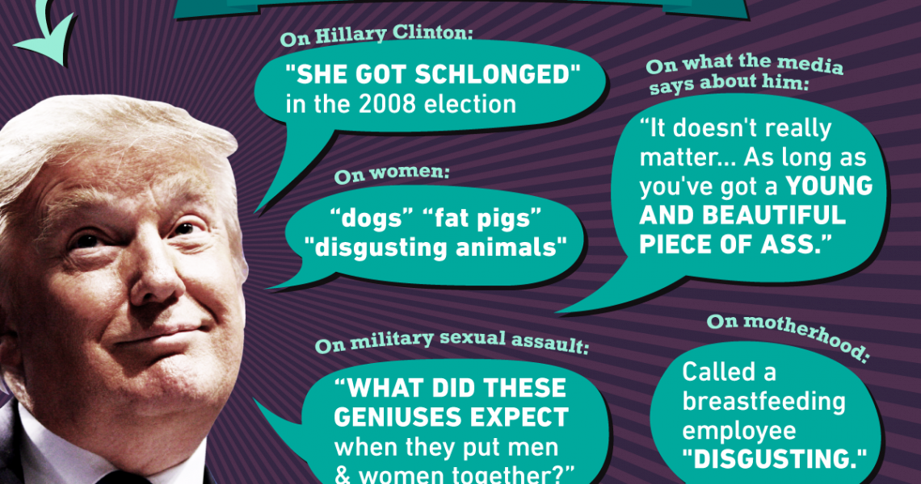
Politicians or Important Leaders That Have in One Way or Another Promoted a Culture of Misogyny and Patriarchal Standards
By Madelyn Fradkin

Slide 25
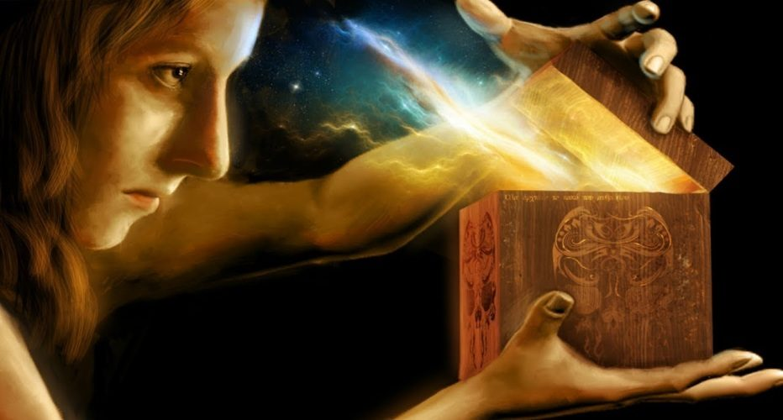
Misogyny
The term “misogyny” is derived from the Ancient Greek word “mīsoguníā” which means hatred towards women. Misogyny has taken shape in multiple forms such as male privilege, patriarchy, gender discrimination, sexual harassment, belittling of women, violence against women, and sexual objectification.[1,2] The roots of misogyny can be traced back to ancient Greek mythology. According to Hesiod before women came into existence, men were coexisting peacefully as companions to Gods until Prometheus decided to steal the secret of fire from the God which angered Zeus. Zeus punished mankind with an evil thing for their delight called Pandora, the first woman who carried a box which unleashed all evils such as labor, sickness, old age, and death. (Srivastava, Chaudhury, Bhat, & Sahu, 2017)

Slide 26
Are Women “Qualified” ???
“Harvard researchers found in 2010 that voters regarded ‘power-seeking’ women with contempt and anger,” Astor wrote, but saw power-seeking men as strong and competent.” (Sullivan, 2019).
Women are less likely than men to be willing to endure the rigors of a political campaign. They are less likely than men to be recruited to run for office. They are less likely than men to have the freedom to reconcile work and family obligations with a political career. They are less likely than men to think they are “qualified” to run for office. And they are less likely than men to perceive a fair political environment. (Lawless & Fox, 2008).

Slide 27
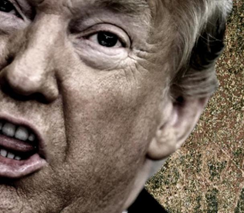
When it comes to Misogyny…
From unwanted sexual advances, sexual misconduct, and hundreds of thousands of dollars paid as “hush money” to quiet his mistresses, there is no better example of a politician who has in one way or another promoted a culture of misogyny and patriarchal standards than the 45th President of the United States, Donald J. Trump.

Slide 28
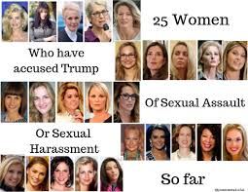
Patriarchal President
“Donald Trump has struck deals with women in his life, or formerly in his life, exchanging money for silence.” (Graham, 2018)
Republican presidential nominee Donald Trump once told an interviewer that he advises his friends to "be rougher" with their wives, and that he sometimes goes "through the roof" when he comes home and dinner isn't ready. (Crockett, 2016)
Trump told the women in the crowd of thousands in Lansing: “We’re getting your husbands back to work, and everybody wants it and the cure can never be worse than the problem itself.” (Press, 2020)

Slide 29
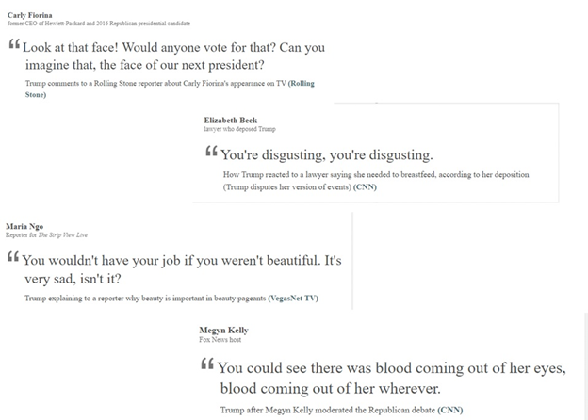
From the mouth of the 45th President...

Slide 30
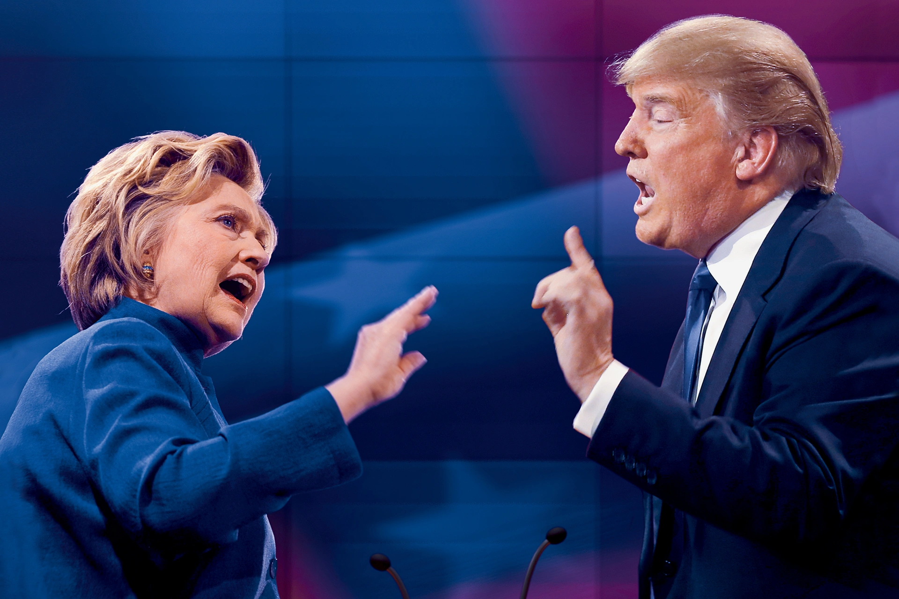
A female politician to attract male voters she must “Man Up!”
“In many elections,” Professor Sperling said, “candidates frame their appeals in gendered ways — they compete, for instance, over who is more ‘masculine.’ This is the case for male and female candidates alike.”
Professor Boatright added, “In 2016, the stark choice between the first major-party female candidate and a man who exhibited a persistent pattern of misogyny made the use of gender more prominent than in any previous election in the United States.”
Clark University

Slide 31
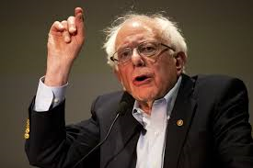
Don’t judge a book by it’s cover!
Male politicians, Senator Bernie Sanders for instance, is totally accepted with his crazy hair and excitable temperament. But women politicians “get bashed far more than their male counterparts for personality quirks, vulnerabilities and actions of all sorts. Not to mention their appearance and speaking voices.” (Sullivan, 2019)
“While men get to be flawed and human and complex, women are mostly allowed to audition only for pedestals, for sainthood, for absolute purity” writes Heidi Moore, a former Wall Street Journal reporter.

Slide 32
Works Cited
Clark political scientists examine masculinity, misogyny, and the 2016 presidential race: Clark Now: Clark University. (2020, January 22). Retrieved November 07, 2020, from https://www.washingtonpost.com/lifestyle/style/how-sexist-will-the-medias-treatment-of-female-candidates-be-rule-out-not-at-all/2019/02/15/117158e4-2fcb-11e9-8ad3-9a5b113ecd3c_story.html
Crockett, E. (2016, June 02). Donald Trump in 1994: I tell my friends to "be rougher" with their wives. Retrieved November 07, 2020, from https://www.vox.com/2016/6/2/11833912/donald-trump-1994-women-buildings-misogyny
Frostenson, S. (2016, October 09). 28 years of Trump insulting women. Retrieved November 07, 2020, from https://apps.voxmedia.com/graphics/vox-trump-misogny-timeline/
Graham, D. (2018, January 18). Donald Trump's Long History With Hush Money. Retrieved November 07, 2020, from https://www.theatlantic.com/politics/archive/2018/01/donald-trumps-long-history-with-hush-money/550745/
Lange, J. (2018, October 16). 61 things Donald Trump has said about women. Retrieved November 07, 2020, from https://theweek.com/articles/655770/61-things-donald-trump-said-about-women
Lawless, J. L., & Fox, R. L. (2008, May). Why Are Women Still Not Running for Public Office? Issues in Governance Studies, 16, 1.
https://clarknow.clarku.edu/2019/12/23/clark-political-scientists-examine-masculinity-misogyny-and-the-2016-presidential-race/
Press, A. (2020, October 27). Trump to women: 'We're getting your husbands back to work'. Retrieved November 07, 2020, from https://www.marketwatch.com/story/trump-to-women-were-getting-your-husbands-back-to-work-01603838100
Srivastava, K., Chaudhury, S., Bhat, P., & Sahu, S. (2017). Misogyny, feminism, and sexual harassment. Retrieved November 07, 2020, from https://www.ncbi.nlm.nih.gov/pmc/articles/PMC6058438/
Sullivan, M. (2019, February 20). Perspective | How sexist will the media's treatment of female candidates be? Rule out 'not at all.' Retrieved November 07, 2020, from https://www.washingtonpost.com/lifestyle/style/how-sexist-will-the-medias-treatment-of-female-candidates-be-rule-out-not-at-all/2019/02/15/117158e4-2fcb-11e9-8ad3-9a5b113ecd3c_story.html

Slide 33

Violence Against Women
By Yairo Rincon
Abortion –
and its ethical dilemma

Slide 34

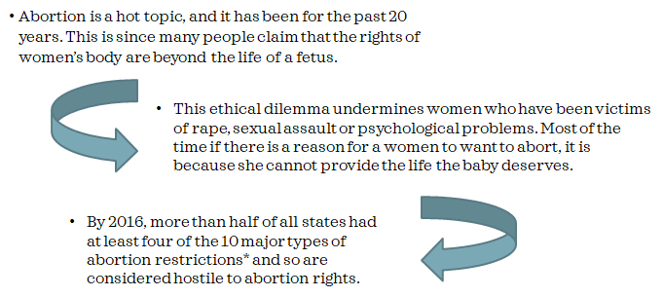
Abortion Hostility

Slide 35
Role of the President
According to Elizabeth Nash, “the election of Donald J. Trump raised the specter that the Supreme Court—if dramatically reshaped by the new administration—could place abortion rights for women across the country very much in jeopardy.” (2017)
This idea can be supported with the fact that Donald Trump has repeatedly stated that he is pro-life and takes a position that is considered hostile for women who need abortion clinics to provide the necessary services safely and under the law.
A President who does not support women’s health rights can greatly influence the overall population and polarize people in two different groups; those who believe in abortion rights and those who condemn it.

Slide 36
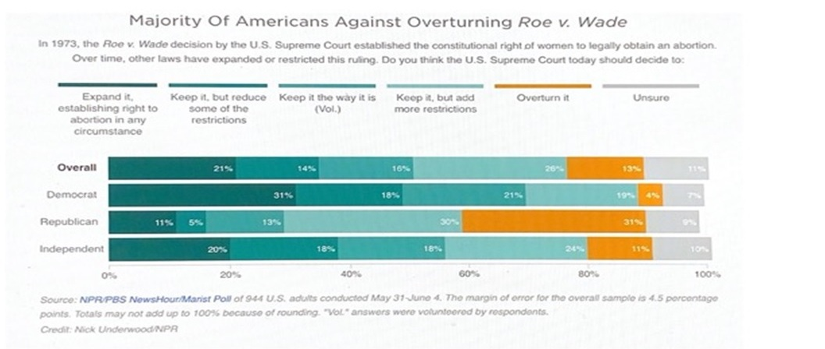
Roe v. Wade

Slide 37
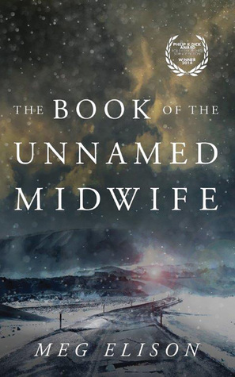
Cultural Factors Part 2
When it comes to the morals of a society, we have to understand the background of their religion and ideology. It is important to note that we are a product of our environment and our previous experiences and that is why the DISCOURSE is evident when it comes to arguing against the women’s health rights.
Moreover, many of us do not understand that these laws are controlling the lives of women and very much go together with the fictional novels that we were reading previously such as the Unnamed Midwife.

Slide 38
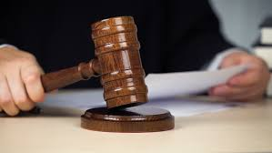
Final Argument
“As the conservative justices of the Supreme Court lay the groundwork to undermine abortion rights, and as President Donald Trump and Senate Majority Leader Mitch McConnell stack the courts with political ideologues,anti-abortion legislators at the state level continue to advance dangerous, medically unnecessary abortion restrictions.” (Ellman, 2020)
It is our duty to defend what we believe is right and it is through education that we can win this fight.
Moreover, there are still many ethical dilemmas that might nudge us to think about the greater good of our society vs the life of a fetus but given the fact that many of these women are raped or physically impaired it is our duty to provide them with proper health care and planning to assure they do not go to clandestine clinics with no licenses nor approved medical supervision.

Slide 39
Works Cited
Ellmann, N. (n.d.). State Actions Undermining Abortion Rights in 2020. Retrieved November 07, 2020, from https://www.americanprogress.org/issues/women/reports/2020/08/27/489786/state-actions-undermining-abortion-rights-2020/
Montanaro, D. (2019, June 07). Poll: Majority Want To Keep Abortion Legal, But They Also Want Restrictions. Retrieved November 07, 2020, from https://www.npr.org/2019/06/07/730183531/poll-majority-want-to-keep-abortion-legal-but-they-also-want-restrictions
Nash, E., Guttmacher Institute, Gold, R., Ansari-Thomas, Z., Cappello, O., & Mohammed, L. (2017, July 13). Policy Trends in the States: 2016. Retrieved November 07, 2020, from https://www.guttmacher.org/article/2017/01/policy-trends-states-2016

Slide 40
Forms of resistance or counter-power against such forms of discursive dominance
By William Robbins
“As the conservative justices of the Supreme Court lay the groundwork to undermine abortion rights, and as President Donald Trump and Senate Majority Leader Mitch McConnell stack the courts with political ideologues,anti-abortion legislators at the state level continue to advance dangerous, medically unnecessary abortion restrictions.” (Ellman, 2020)
Political discourse is the formal exchange of reasoned views as to which of several alternative courses of action should be taken to solve a societal problem.
Large majorities say the tone and nature of political debate in the United States has become more negative in recent years – as well as less respectful, less fact-based and less substantive.
sizable majorities say Trump’s comments often or sometimes make them feel concerned (76%), confused (70%), embarrassed (69%) and exhausted (67%). By contrast, fewer have positive reactions to Trump’s rhetoric, though 54% say they at least sometimes feel entertained by what he says.

Slide 41
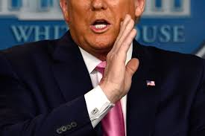
Trump
"Look at that face. Would anybody vote for that? Can you imagine that, the face of our next president? I mean, she's a woman, and I'm not supposed to say bad things, but really, folks, come on. Are we serious?"
"If Hillary Clinton can't satisfy her husband, what makes her think she can satisfy America?”
"Does she have a good body? No. Does she have a fat ass? Absolutely."

Slide 42
Media sources aggravate the stereotypization in politics through accentuation on indigenously women’s characteristics and roles, for examples, a mother, a wife, a guardian of the hearth, a teacher, and a seller. Listed roles are proven true by public opinion that such political posts as a Minister of Health; a Minister of Social Services, of Citizenship and Immigration, a Minister of Public Relations, a Minister of Maternity and Child Welfare Service and a Minister of Education are associated with women (Shvedova, 2002).
Men’s cause is keeping influence, status and making an arrangement. Women, by contrast, use language for establishment of communication, for relationship maintaining and “to be liked.”

Slide 43
Women's Political Discourse profiles women in the most highly visible political offices today
We analyzed these and many other articles about Hillary Clinton and noticed the tendency of a prevailing masculine features in the image construction. The majority of journalists pointed out on the male features of the character, which Clinton shows in political struggle. At the same time we analyzed articles, where Hillary was half represented or represented as a woman. Half representation means either Hillary’s male and female features were just listed or that features were countered. The majority of articles with “just a woman” representation were devoted to scandals or events, where Hillary makes herself inaccurate.

